Slide 1
Old Spec Q’s
Probability
Practice G (i)
Practice G (ii)
Practice H
Practice I (i)
Practice I (ii)
Specimen
SAM
2018*
*discrete uniform distribution

Slide 2
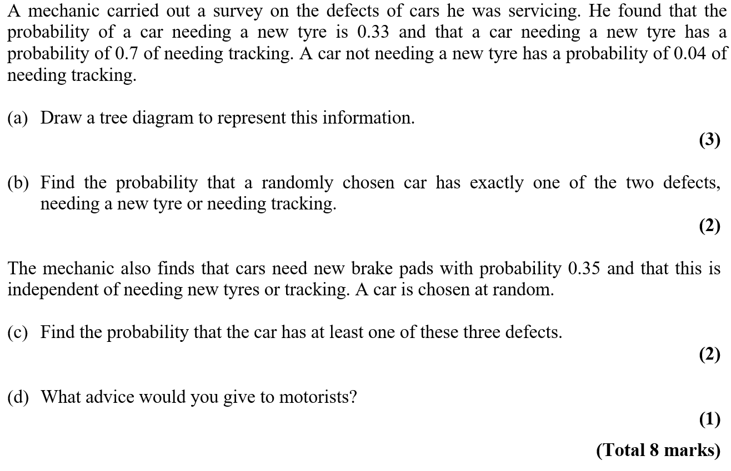


Practice Paper G

Slide 3
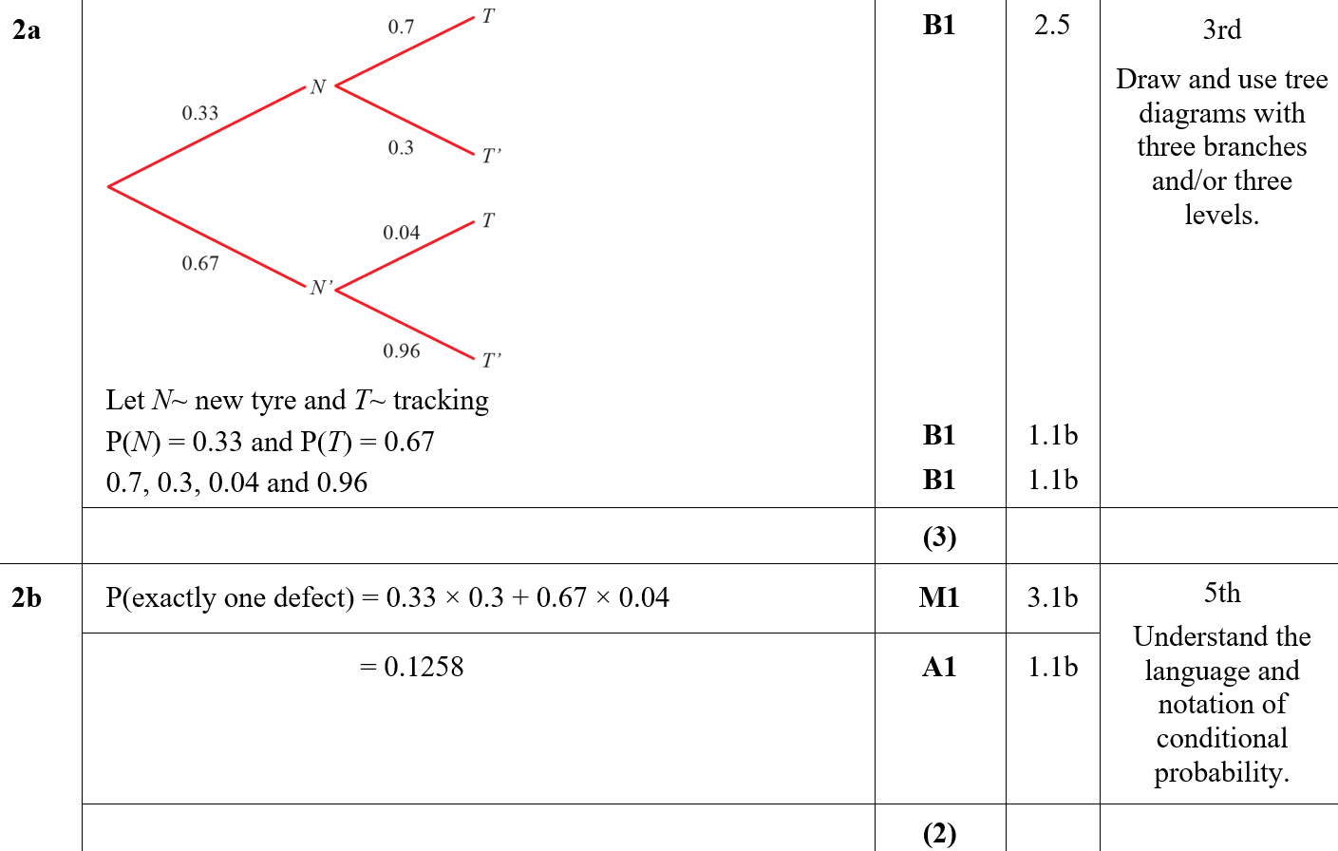

Practice Paper G
A
B

Slide 4
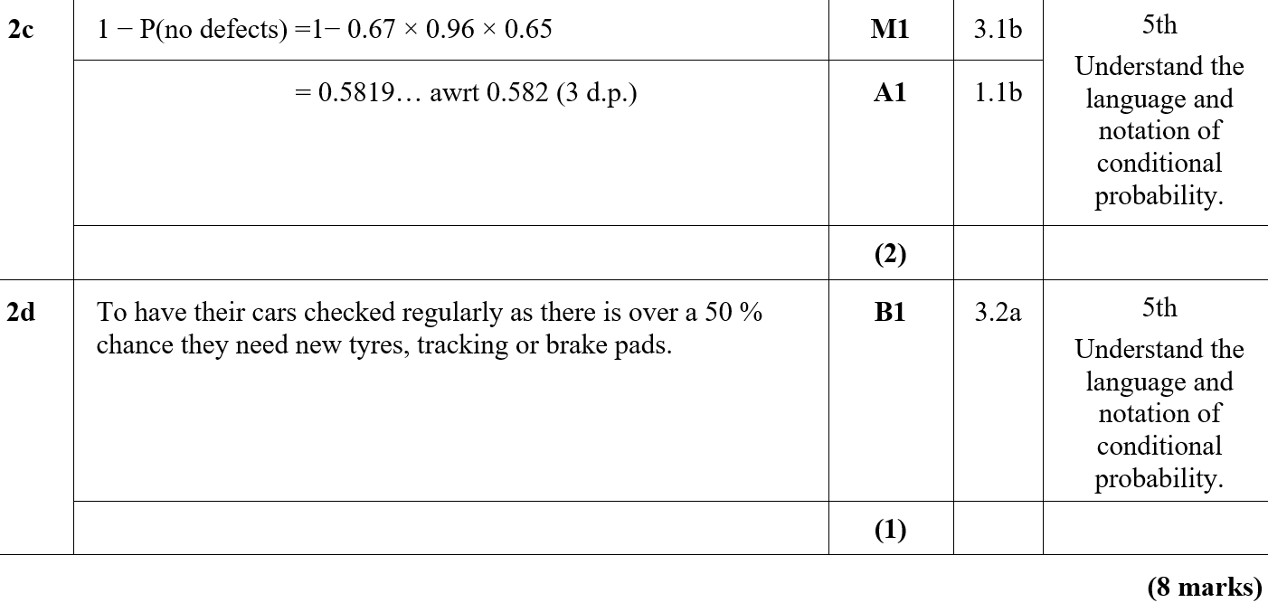
Practice Paper G
C
D

Slide 5
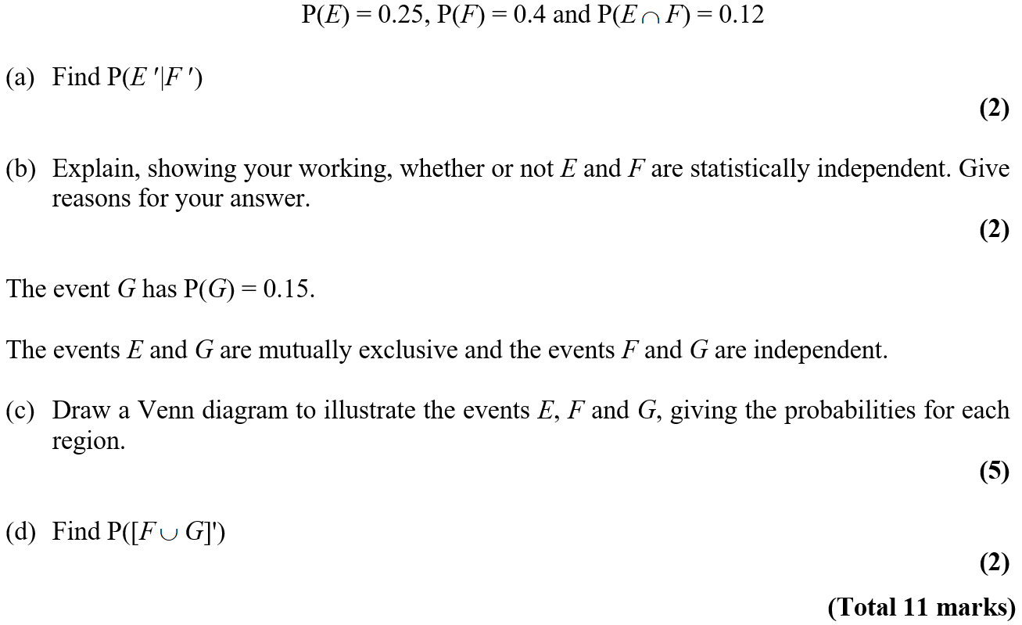
Practice Paper G

Slide 6
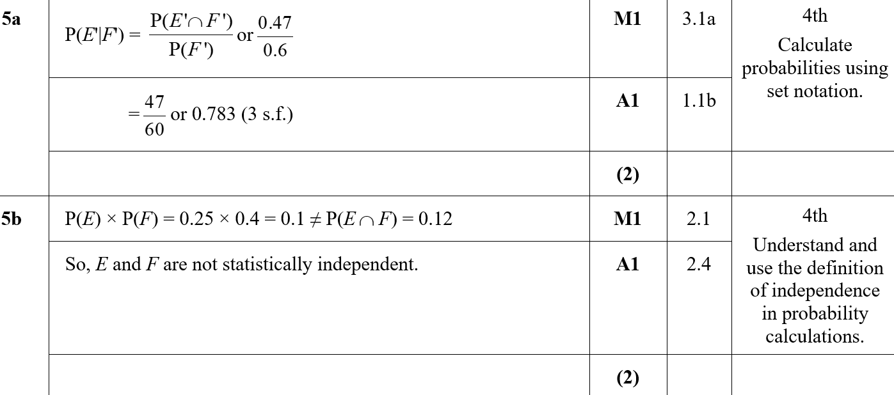
Practice Paper G
A
B

Slide 7
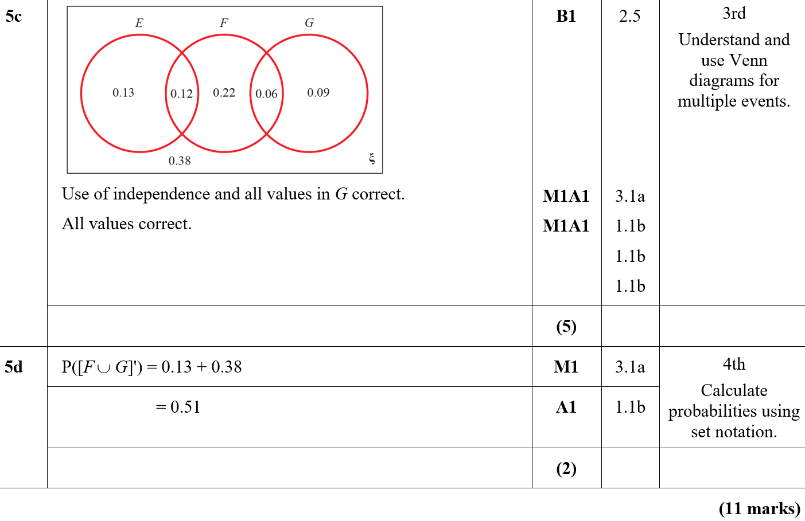
Practice Paper G
C
D

Slide 8
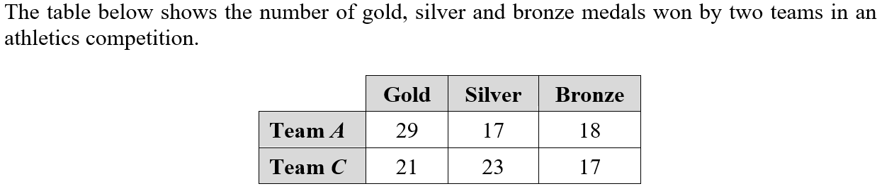
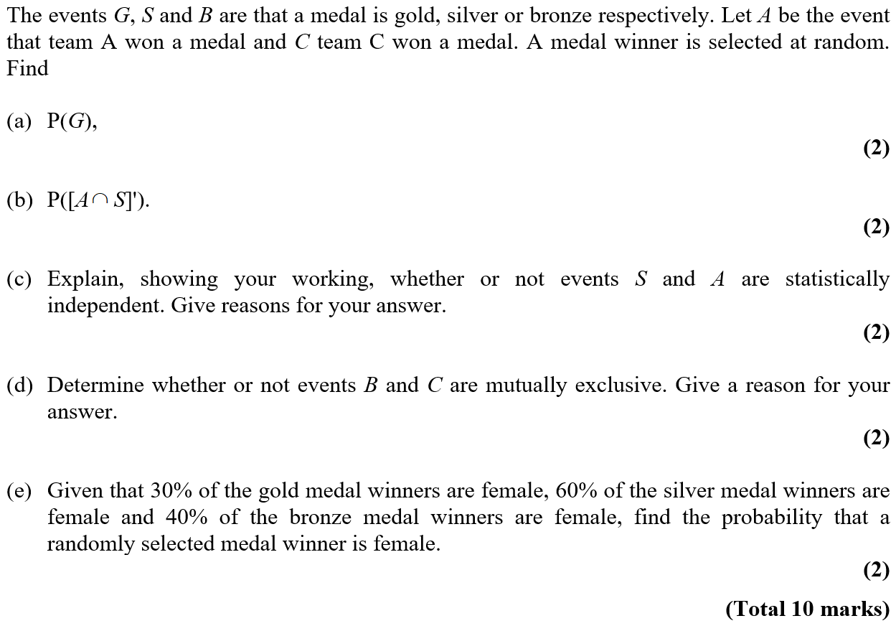
Practice Paper H

Slide 9
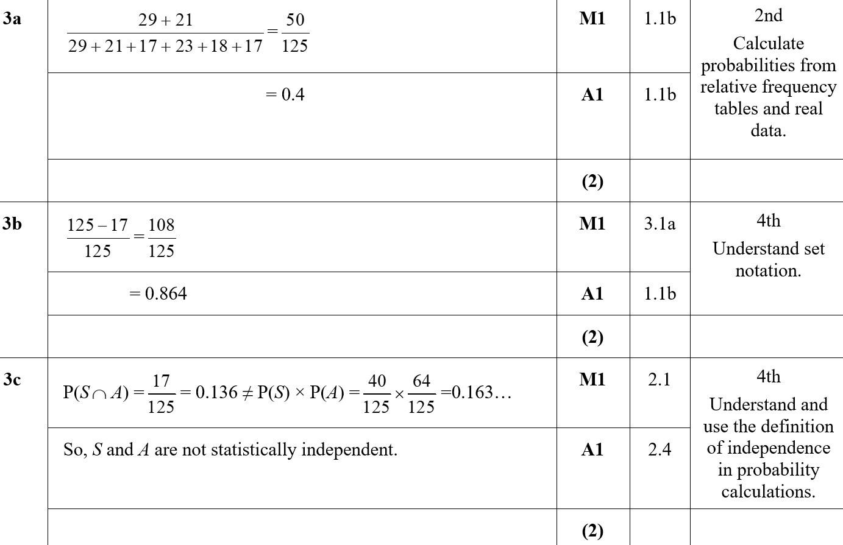
Practice Paper H
A
B
C

Slide 10
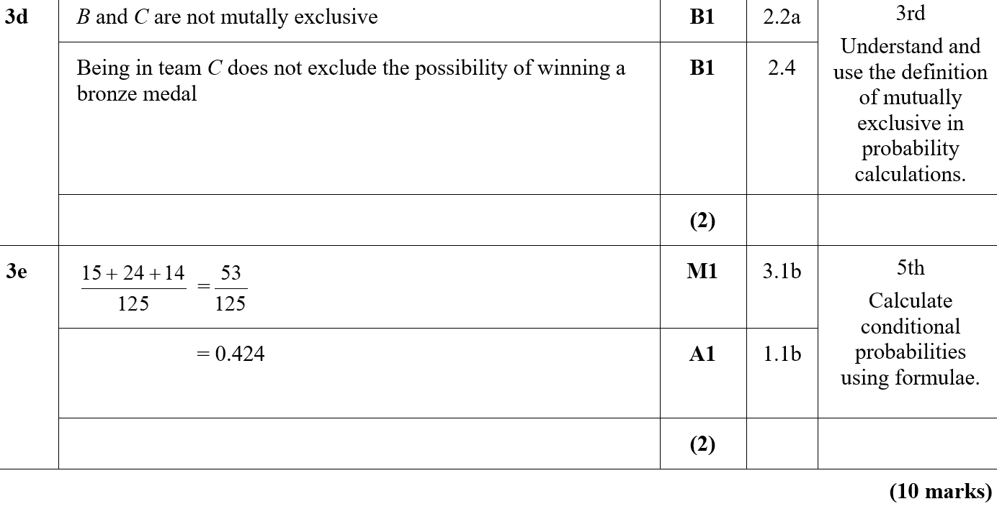
Practice Paper H
D
E

Slide 11
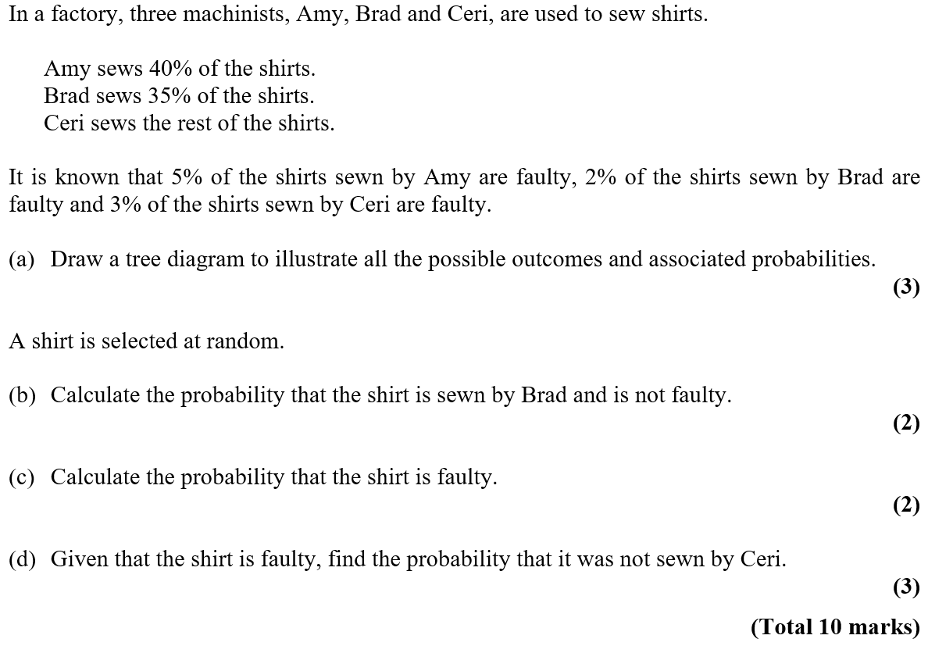
Practice Paper I

Slide 12
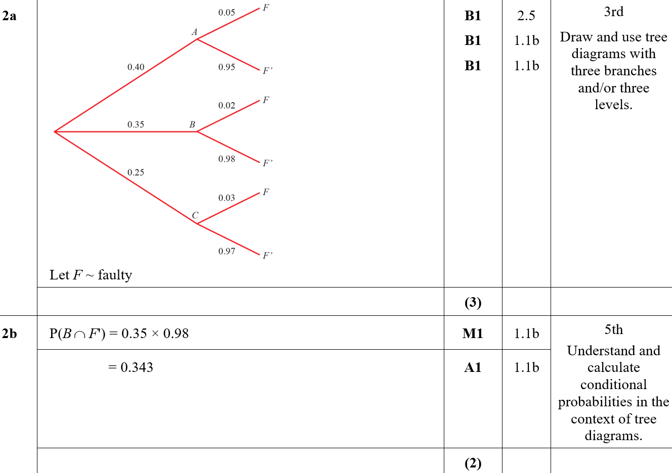
Practice Paper
Practice Paper I
A
B

Slide 13
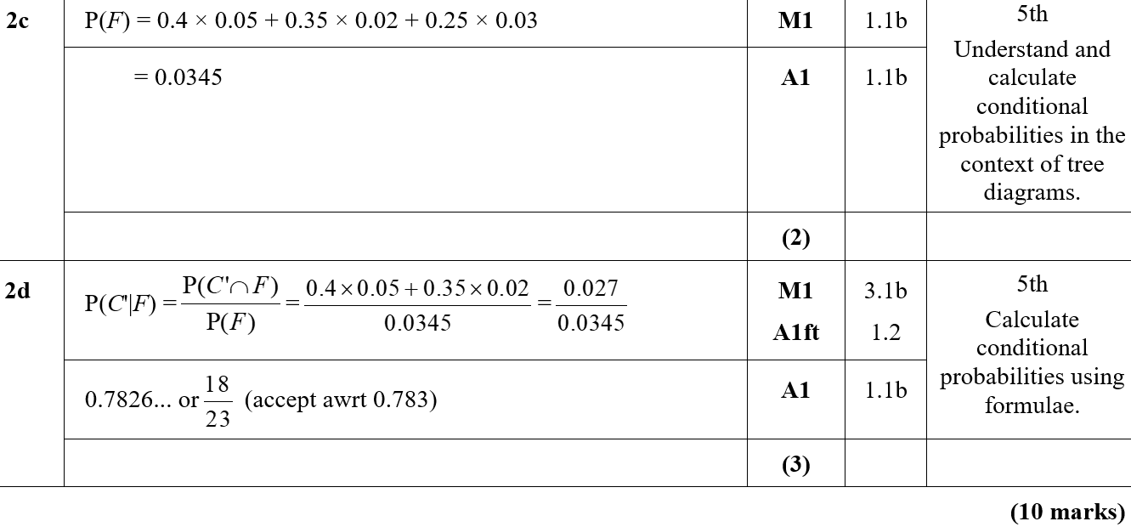
Practice Paper
Practice Paper I
C
D

Slide 14
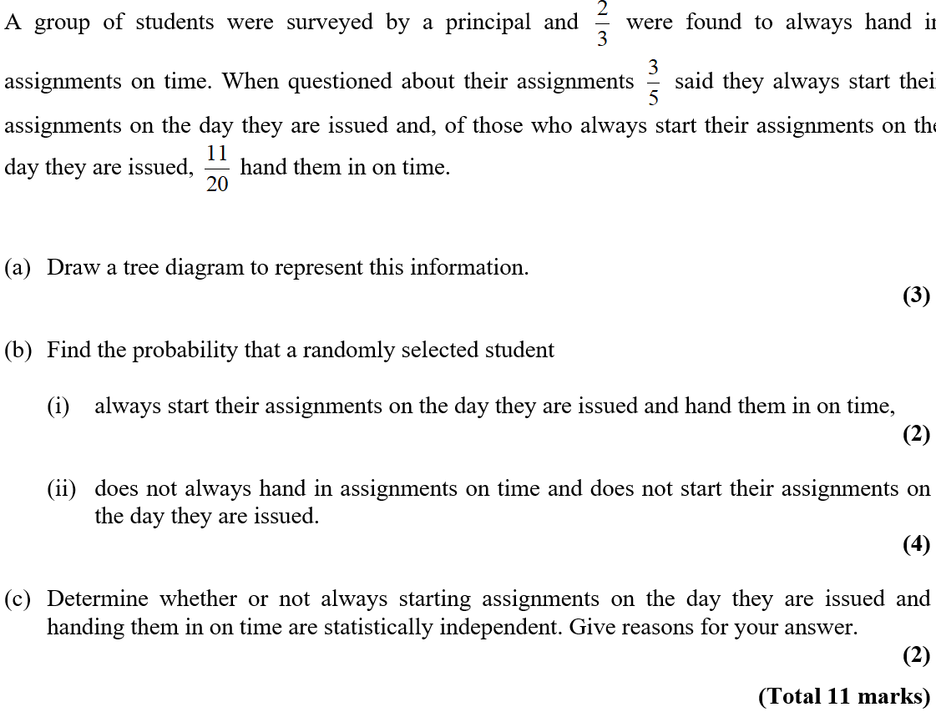
Practice Paper I

Slide 15
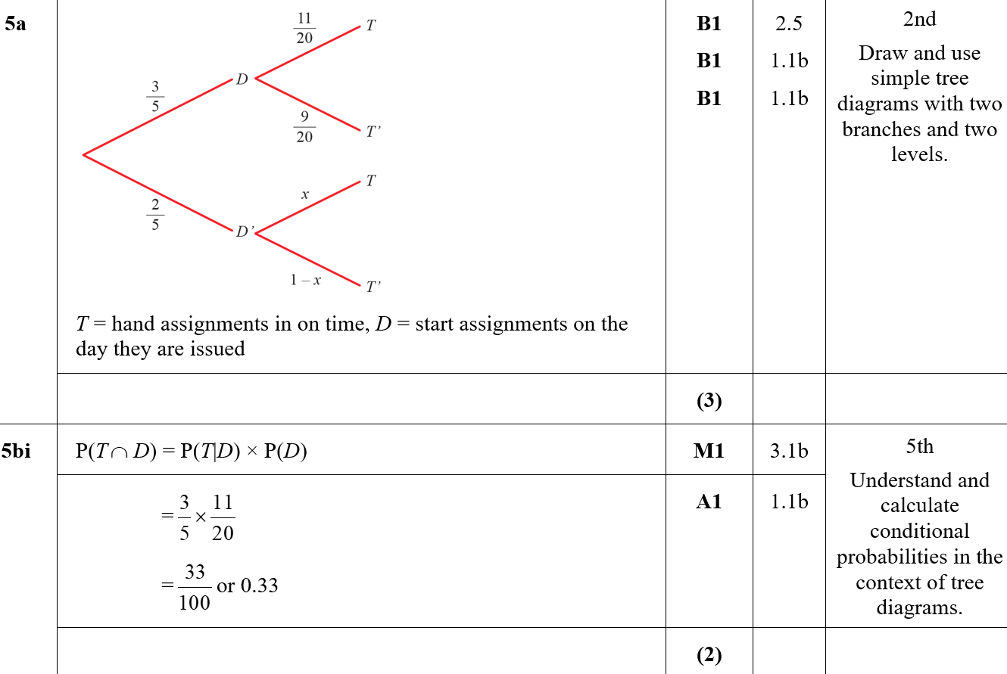
Practice Paper I
A
B (i)

Slide 16
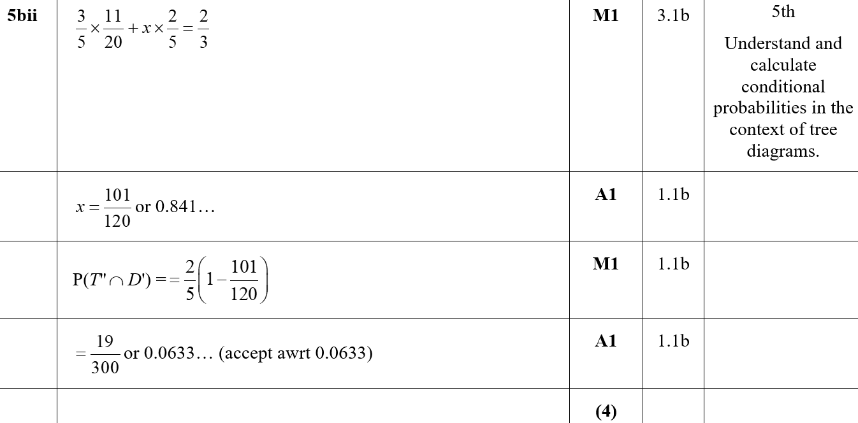
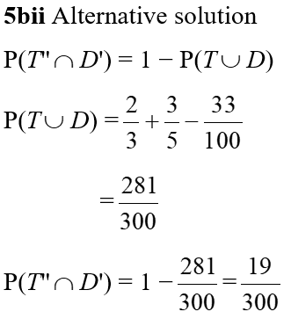
Practice Paper I
B (ii)
B (ii) (Alternative)

Slide 17
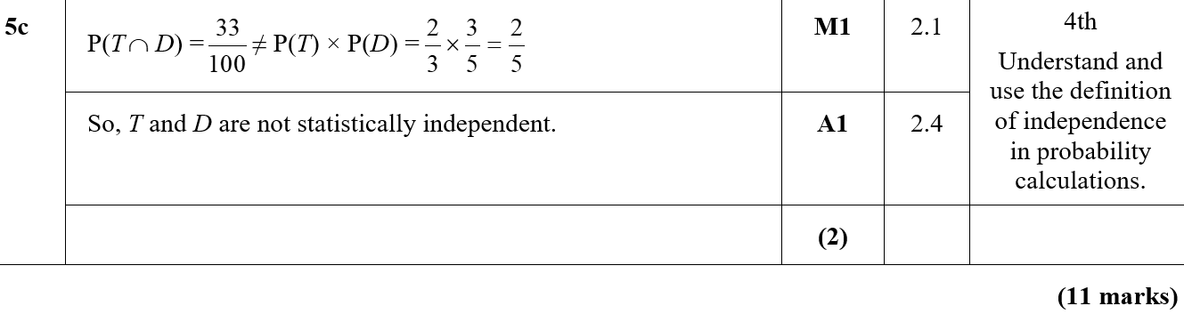
Practice Paper I
C

Slide 18
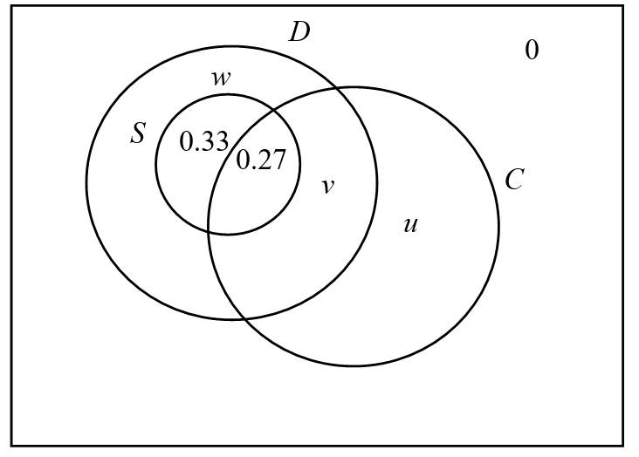
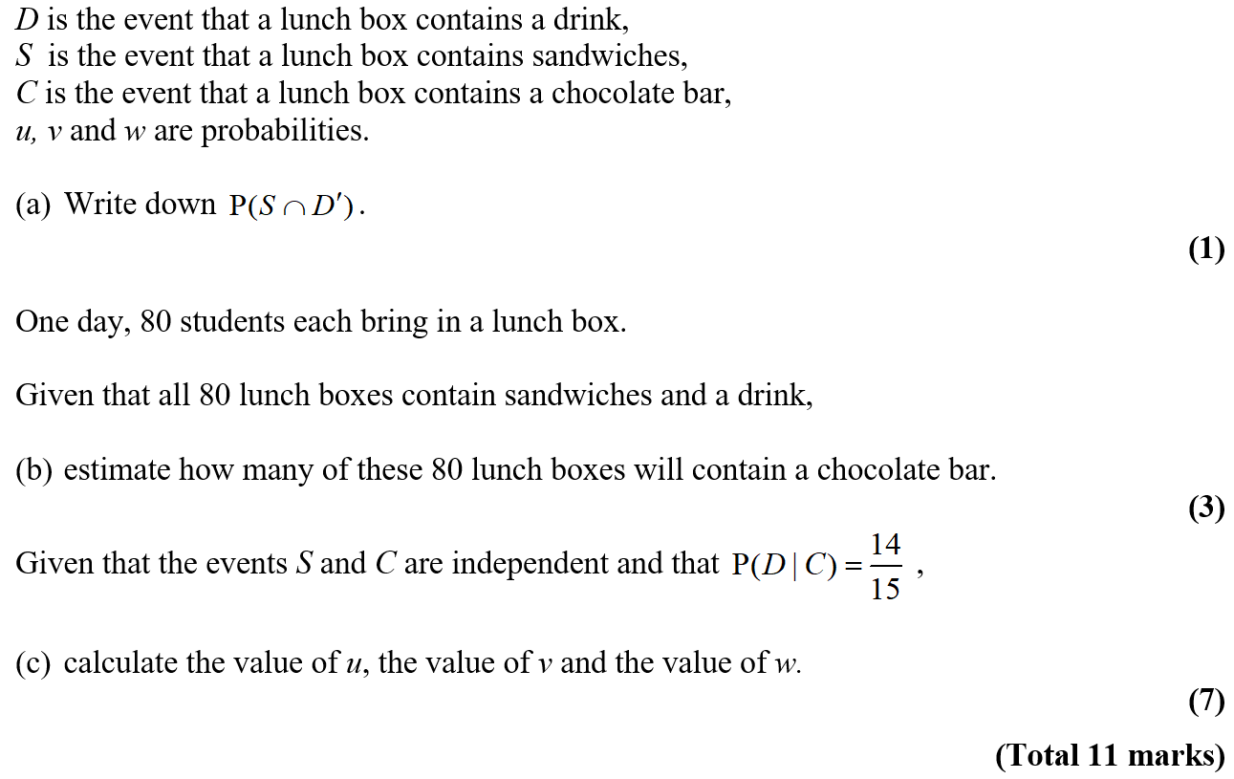
Specimen

Slide 19
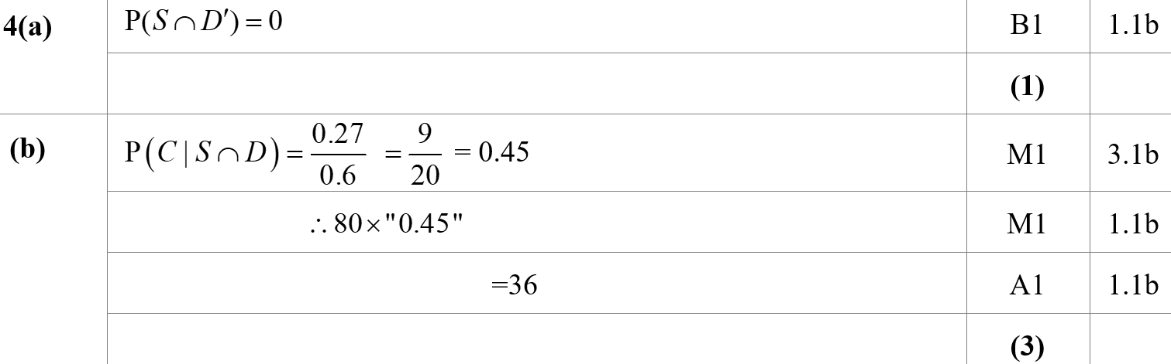
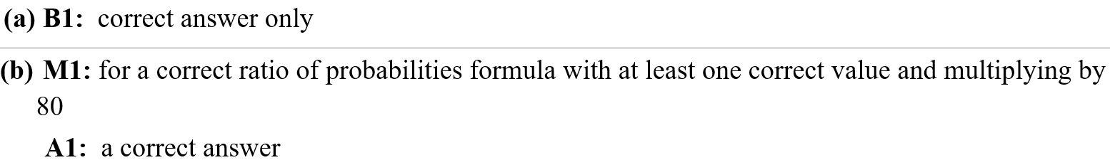
Specimen
A
B
A notes
B notes

Slide 20
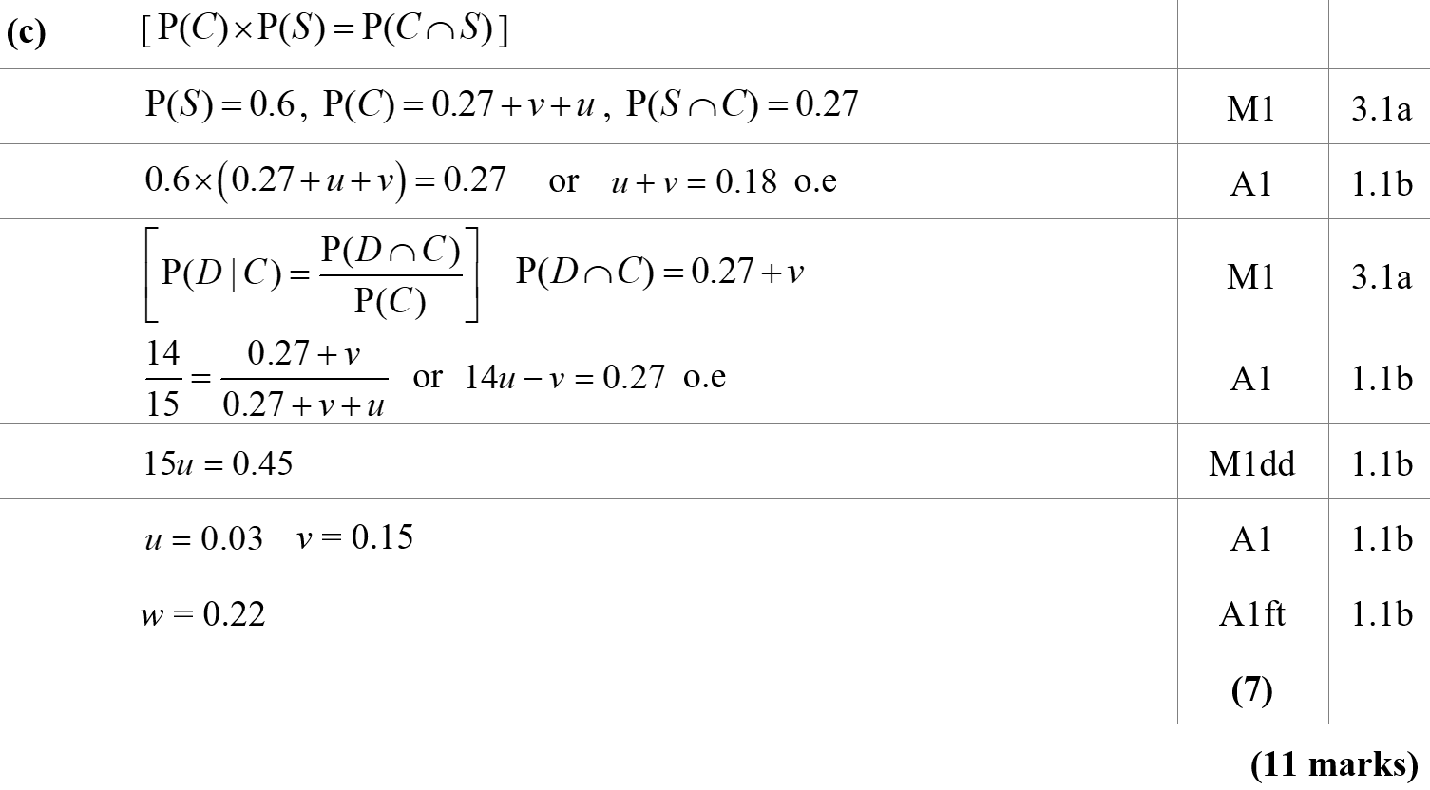
Specimen
C

Slide 21
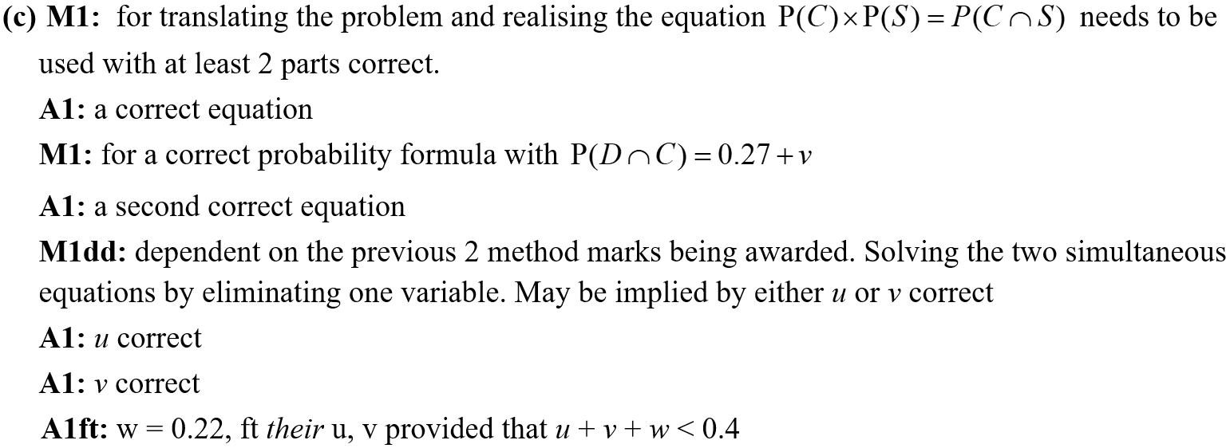
Specimen
C notes

Slide 22
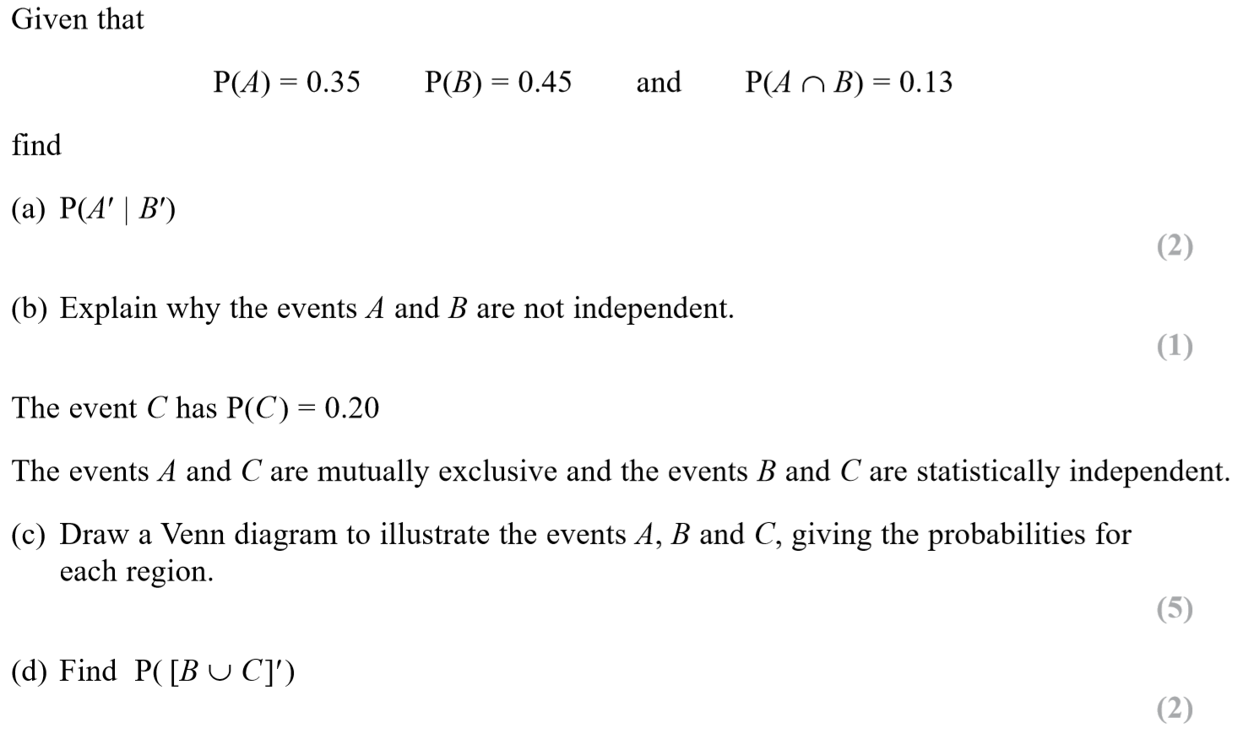
SAM

Slide 23
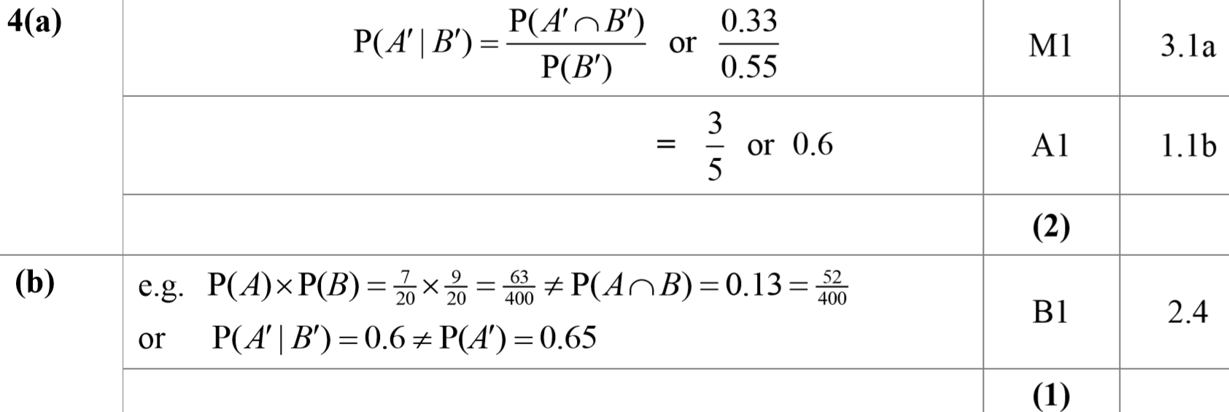
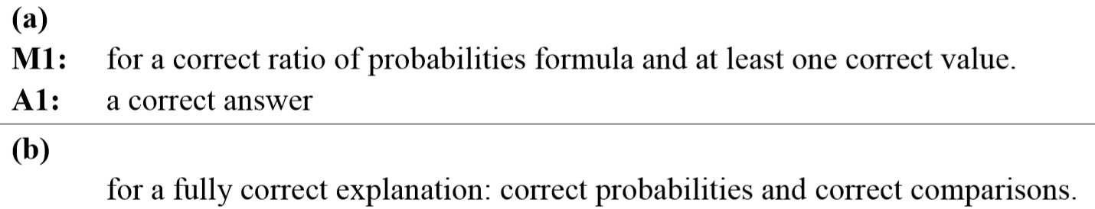
SAM
A
B
A notes
B notes

Slide 24
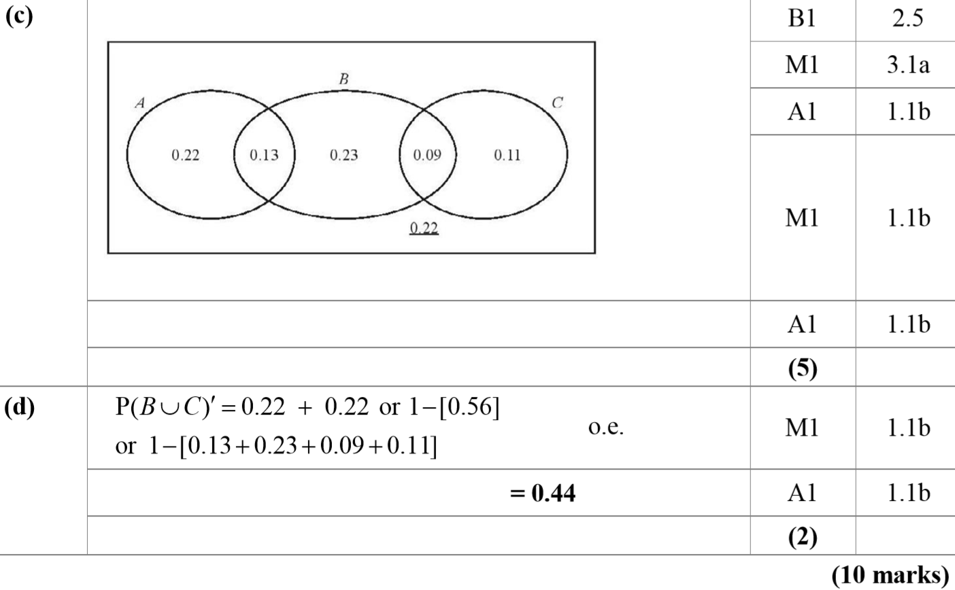
SAM
C
D

Slide 25
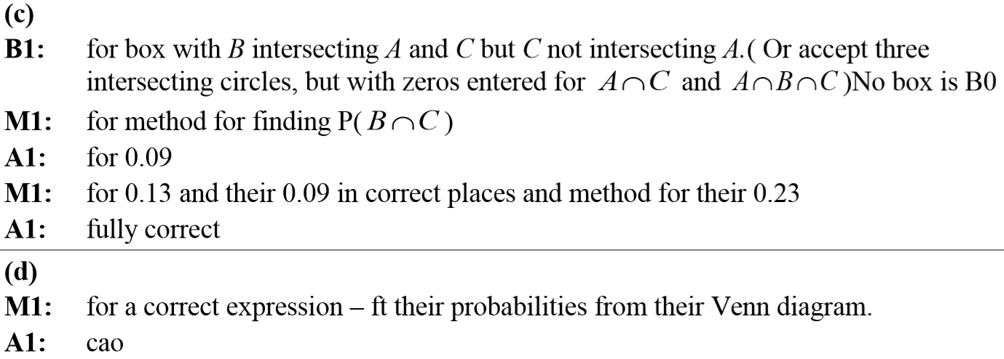
SAM
C notes
D notes

Slide 26
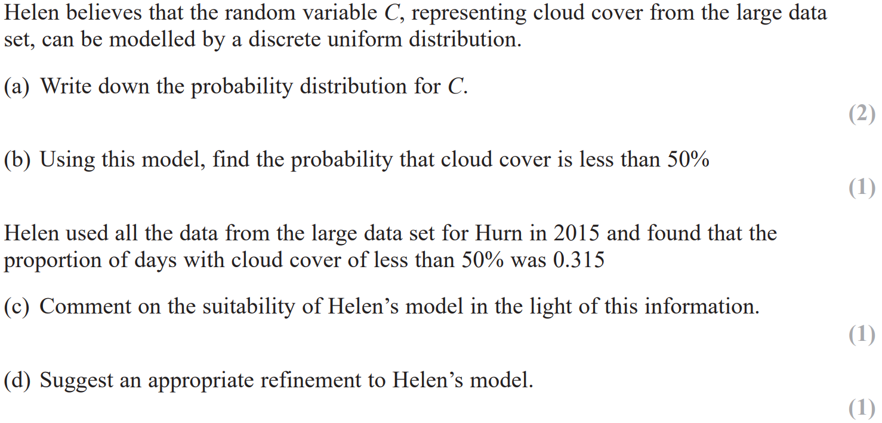
2018

Slide 27
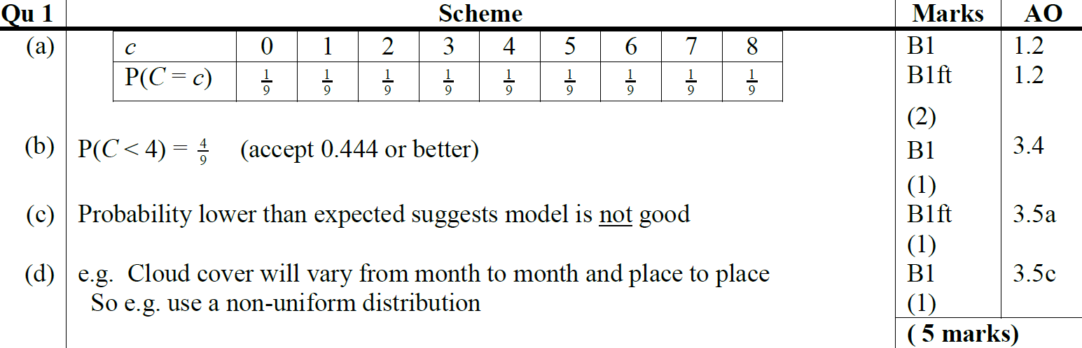
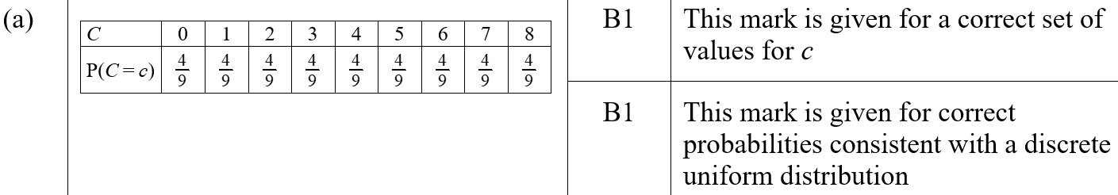
2018
A
B
C
D
A (SF)
B (SF)

Slide 28
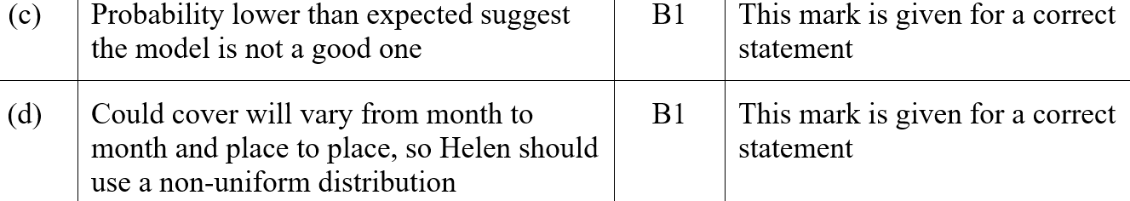
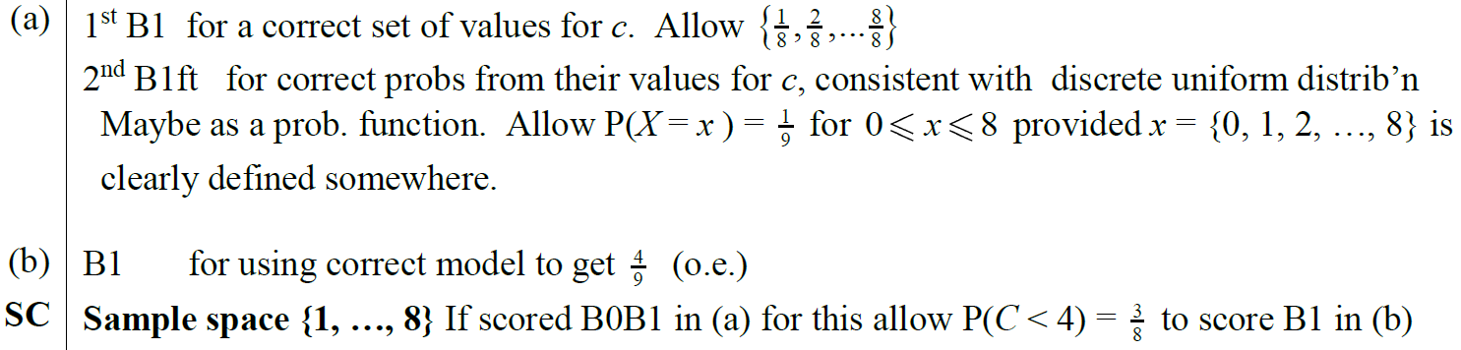
2018
C (SF)
D (SF)
A notes
B notes

Slide 29
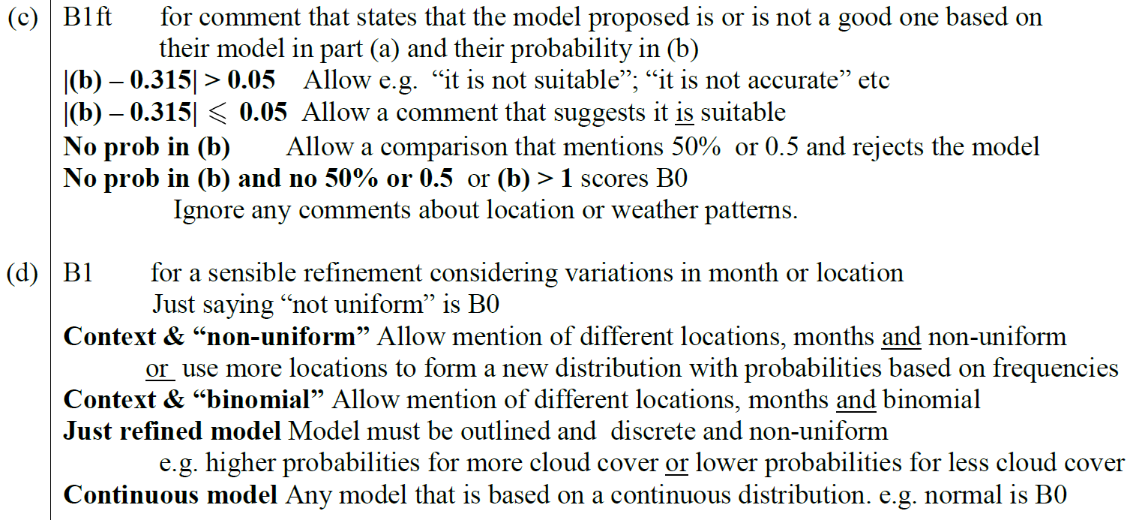
2018
C notes
D notes

Slide 30
New Spec Q’s
Old Spec Probability
Jan 2006 (i)
May 2008 (ii)
Jan 2011
May 2014 (i)
Jan 2006 (ii)*
Jan 2009
May 2011
May 2014 (ii)
Jan 2006 (iii)
May 2009 (i)
Jan 2012 (i)
June 2015
May 2006
May 2009 (ii)
Jan 2012 (ii)
June 2016
Jan 2007
Jan 2010 (i)
May 2012 (i)
June 2017
June 2007
Jan 2010 (ii)
May 2012 (ii)
June 2018
Jan 2008
May 2010 (i)
Jan 2013
May 2008 (i)
May 2010 (ii)
May 2013
*discrete uniform distribution

Slide 31
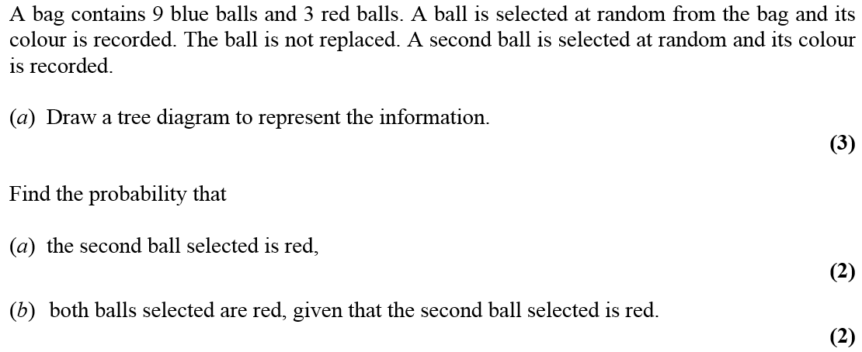
Jan 2006

Slide 32
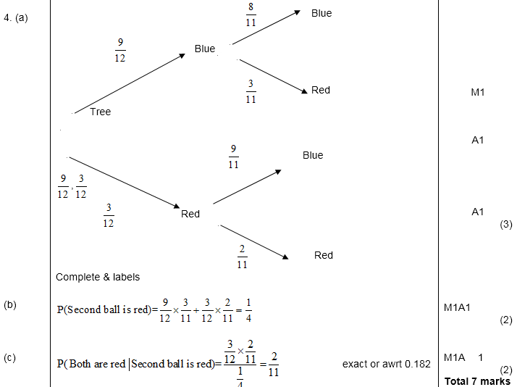
A
Jan 2006
B
C

Slide 33
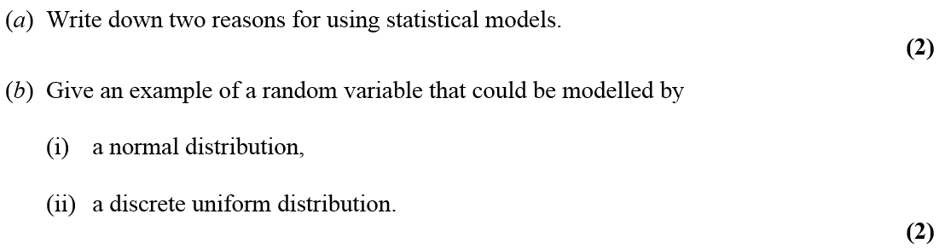
Jan 2006

Slide 34
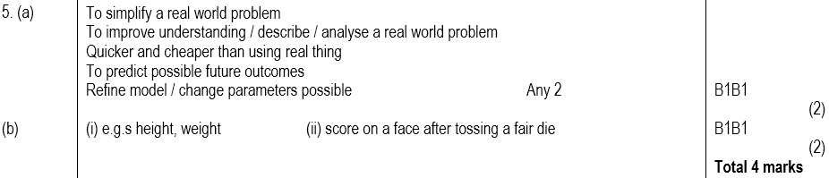
Jan 2006
A
B(i)
B(ii)

Slide 35
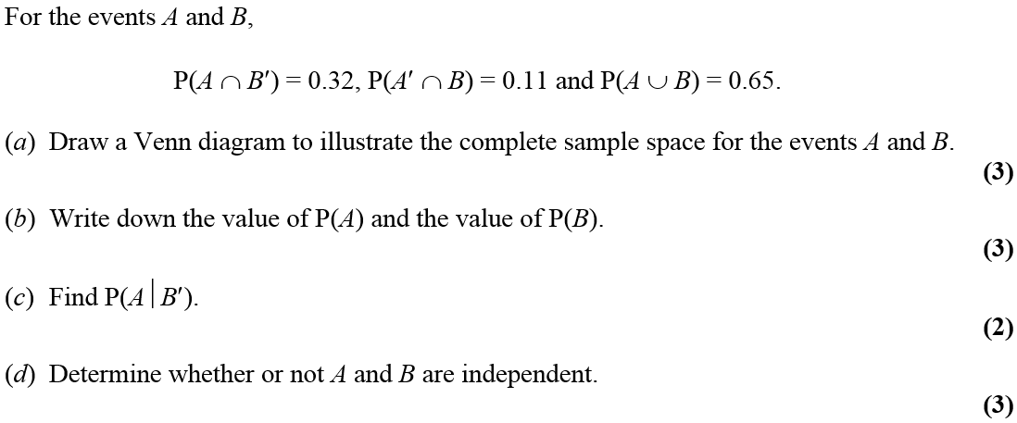
Jan 2006

Slide 36
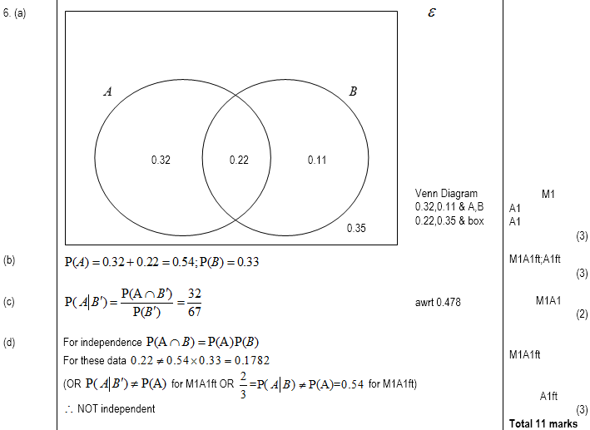
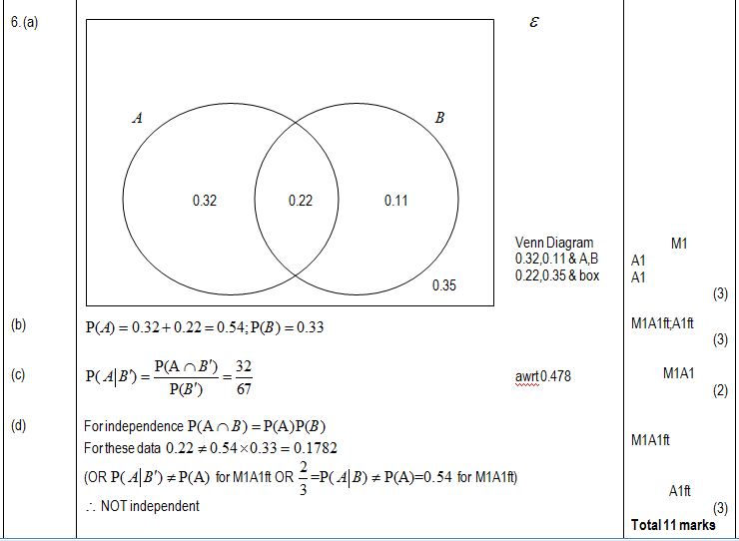
Jan 2006
A
B
C
D

Slide 37
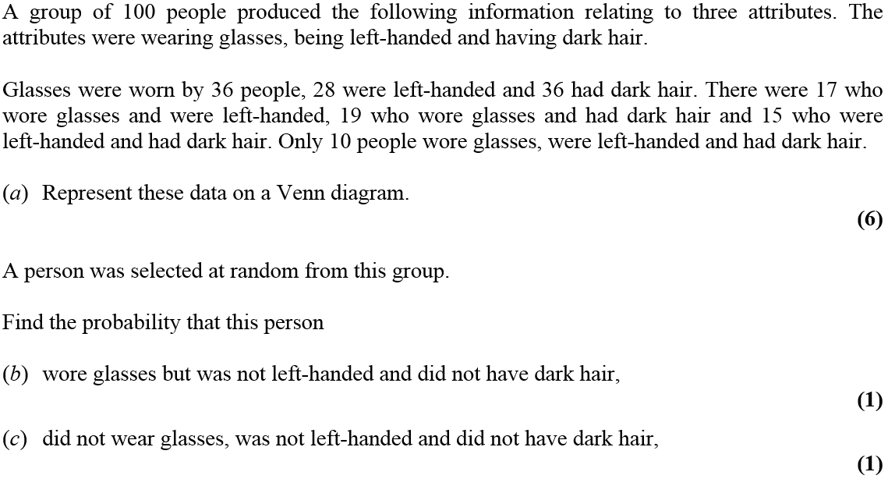
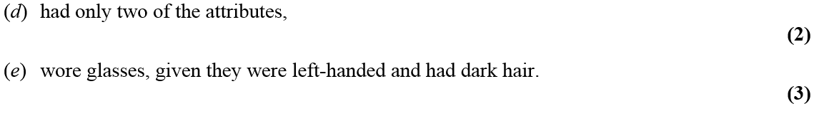
May 2006

Slide 38
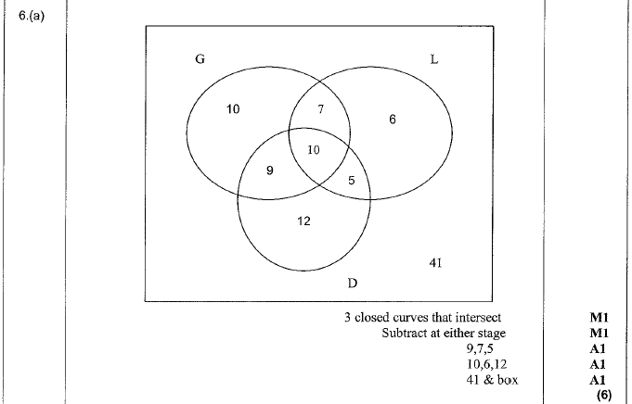
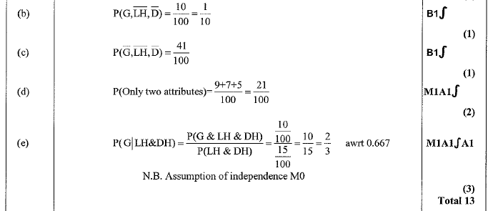
May 2006
A
B
C
D
E

Slide 39
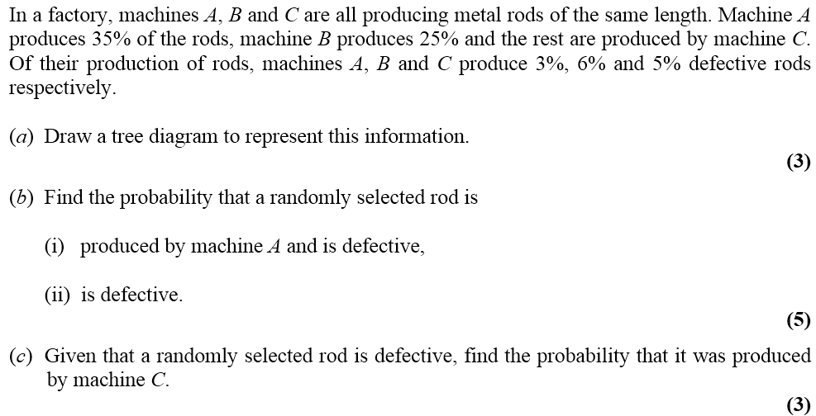
Jan 2007

Slide 40
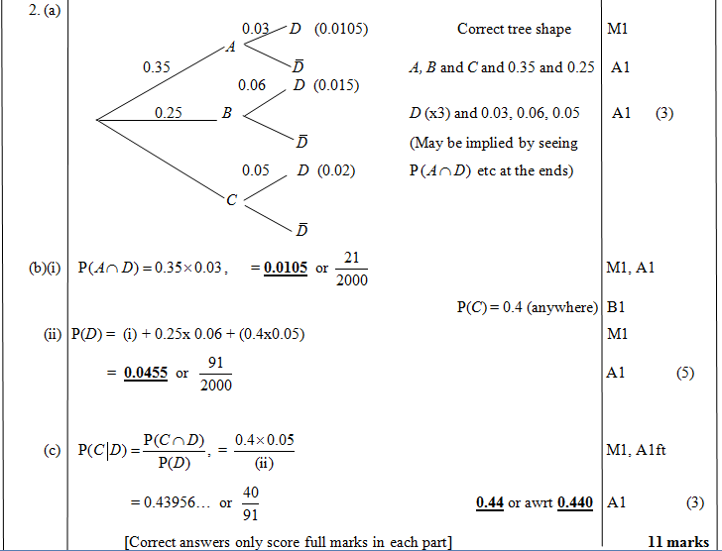
Jan 2007
A
B (i)
B (ii)
C

Slide 41
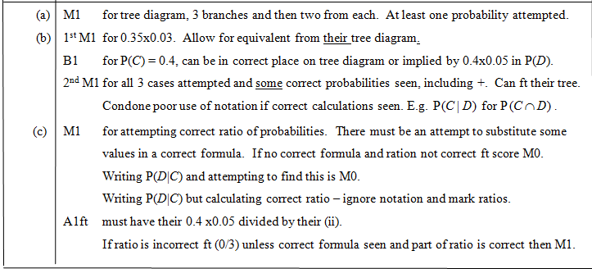
Jan 2007
A
B
C

Slide 42
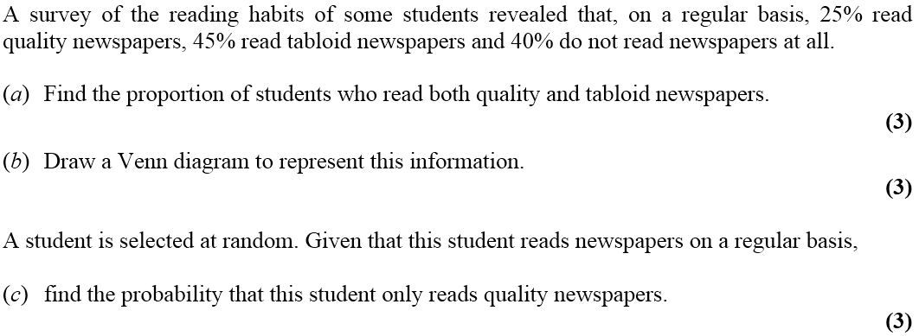
June 2007

Slide 43

June 2007
A
B
C

Slide 44

June 2007
A
B
C

Slide 45


Jan 2008

Slide 46


Jan 2008
A
B
C
D
E
F

Slide 47

Jan 2008
A
B
C,D,E
C
D
E
F

Slide 48

May 2008

Slide 49


A
May 2008
B
C
D

Slide 50


May 2008

Slide 51


May 2008
A
B
C
D

Slide 52

Jan 2009

Slide 53

Jan 2009
A
B
C

Slide 54

Jan 2009
A
B
C
Diagrams
A errors
B errors

Slide 55

May 2009

Slide 56


May 2009
A
B (i)
B (ii)
C

Slide 57

May 2009
A
B (i)
B (ii)
C

Slide 58

May 2009

Slide 59

A (i)
May 2009
A (ii)
B
C
D
A

Slide 60

Jan 2010

Slide 61

Jan 2010
A
B

Slide 62

Jan 2010
A
B
A
B

Slide 63


Jan 2010

Slide 64

A
Jan 2010
B
C
D

Slide 65

Jan 2010
A
B
C
D

Slide 66




May 2010

Slide 67

May 2010
A
B
C
D

Slide 68


May 2010

Slide 69

May 2010
A
B
C
D
E

Slide 70



Jan 2011

Slide 71

Jan 2011
A

Slide 72


Jan 2011
B
C
D
E
F

Slide 73

Jan 2011
B
C
E
F

Slide 74


May 2011

Slide 75

May 2011
A
B
C
D
E

Slide 76

May 2011
B
C
D
E

Slide 77

Jan 2012

Slide 78

Jan 2012
A
B
C
D

Slide 79


Jan 2012

Slide 80

Jan 2012
A
B
C
D
E

Slide 81



May 2012

Slide 82

May 2012
A
B
C
D
E

Slide 83


May 2012

Slide 84

May 2012
A
B
C
D

Slide 85


Jan 2013

Slide 86

Jan 2013
A
B
C
D
E

Slide 87



May 2013

Slide 88

May 2013
A
B
C
D
E

Slide 89

May 2014

Slide 90


May 2014
A
B
C
D

Slide 91

May 2014

Slide 92


May 2014
A
B
C
D

Slide 93

June 2015

Slide 94

June 2015
A
B
C
D

Slide 95

June 2015
E
A notes
C notes
D notes
E notes

Slide 96


June 2016

Slide 97

June 2016
A
B
C
D (i)
D (ii)
E

Slide 98

June 2016
B notes
C notes
D (i) notes
D (ii) notes
E notes

Slide 99

June 2017

Slide 100

June 2017
A
B
C
D
E

Slide 101

June 2017
A, B & C notes
D notes
E notes

Slide 102

June 2018

Slide 103

June 2018
A
B
C
D

Slide 104

June 2018
A notes
B notes
C notes
D notes

