Slide 1
Old Spec Q’s
Numerical Methods
Practice A
2018 1
Practice B
2018 2
Practice C
Practice D
Practice E
Practice F
SAM 1

Slide 2
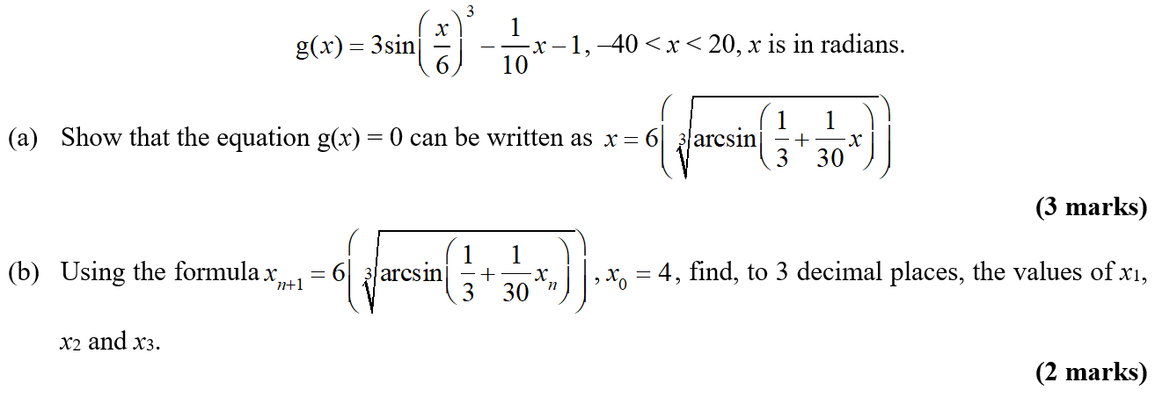
Practice A

Slide 3
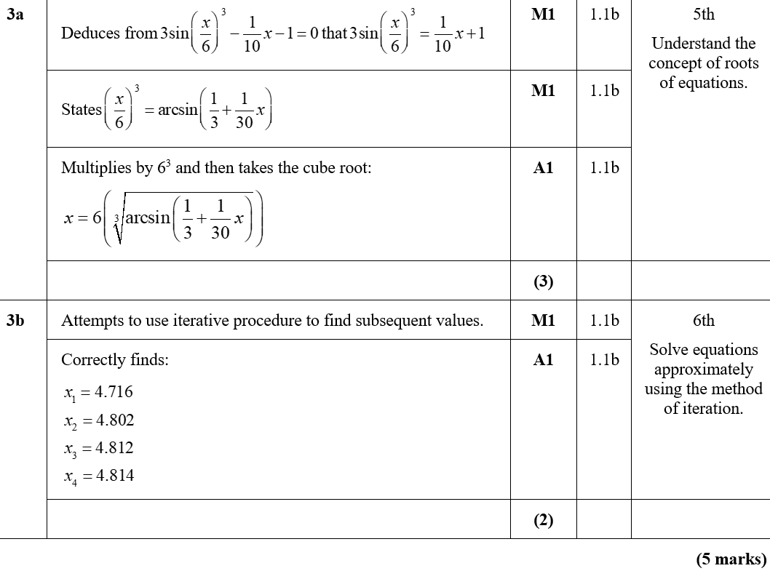
Practice A
A
B
B notes

Slide 4
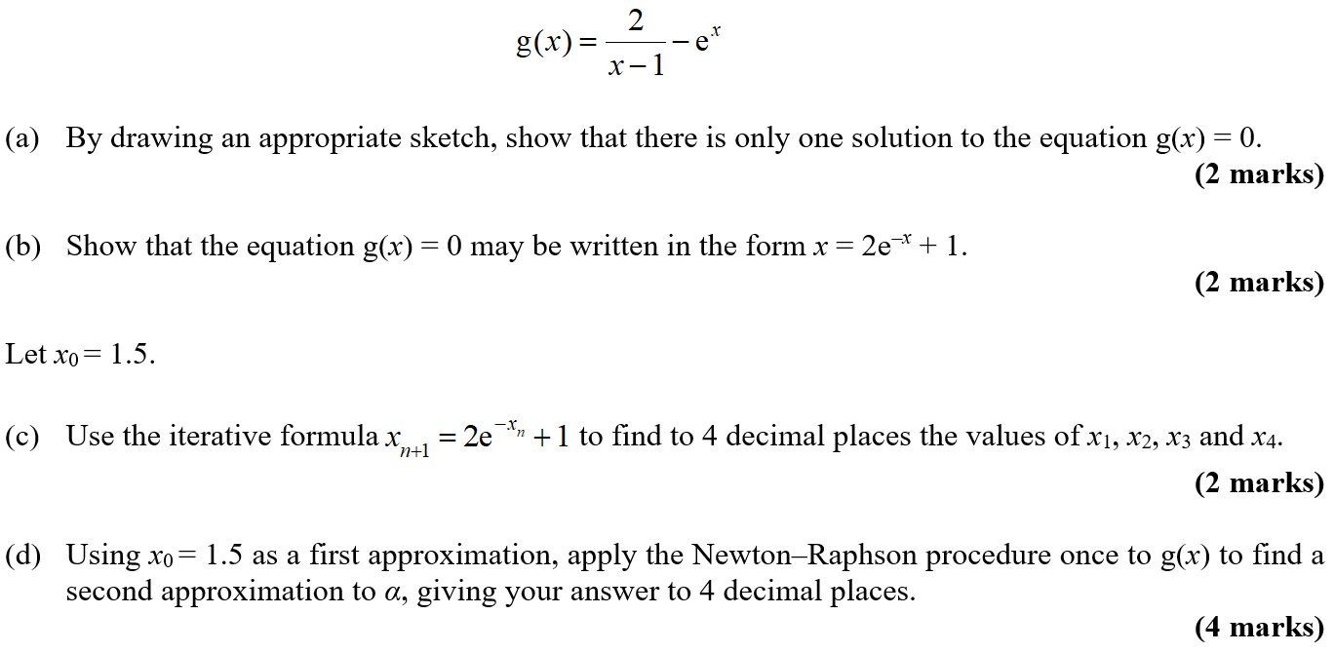
Practice B

Slide 5
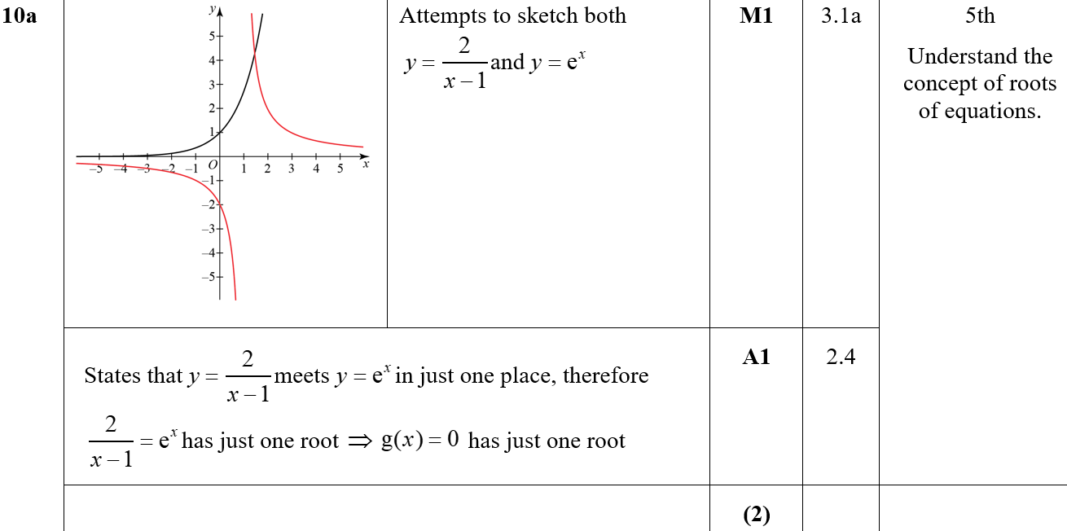
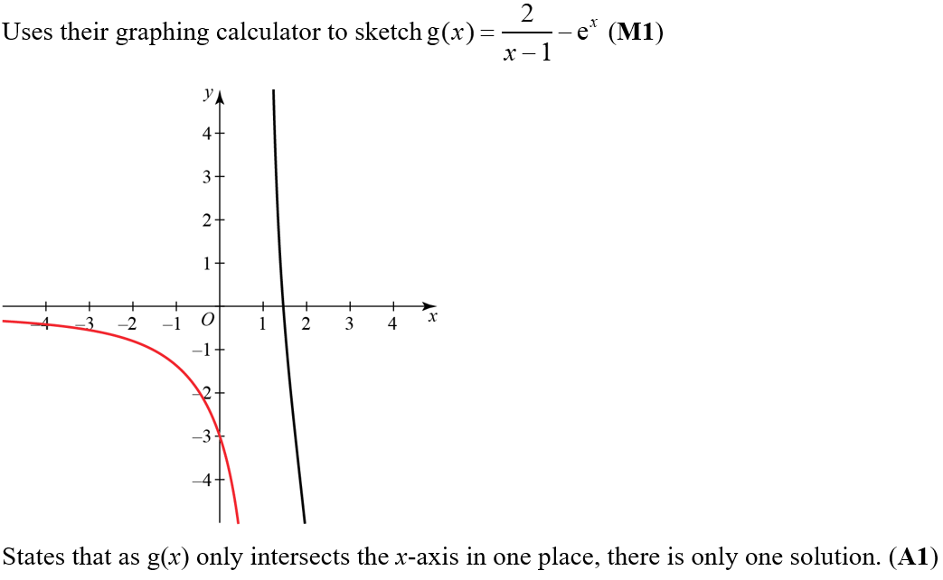
Practice B
A
A notes

Slide 6
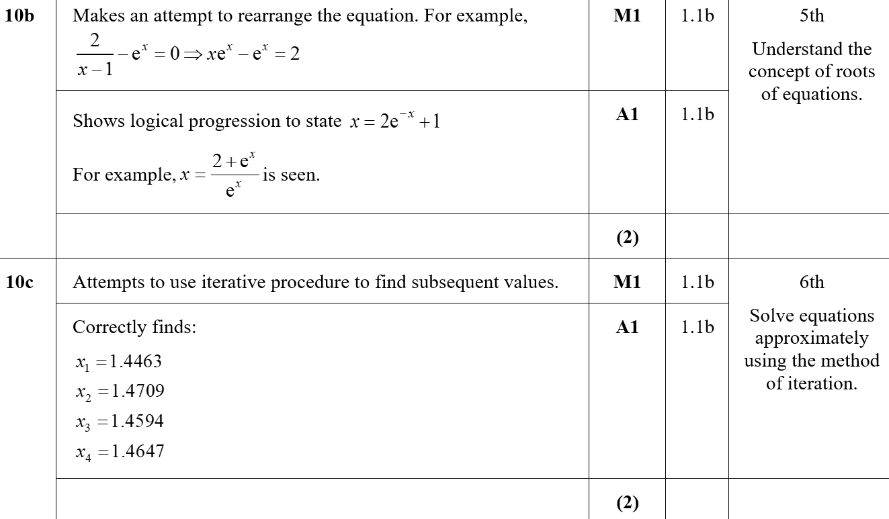
Practice B
B
C
C notes

Slide 7
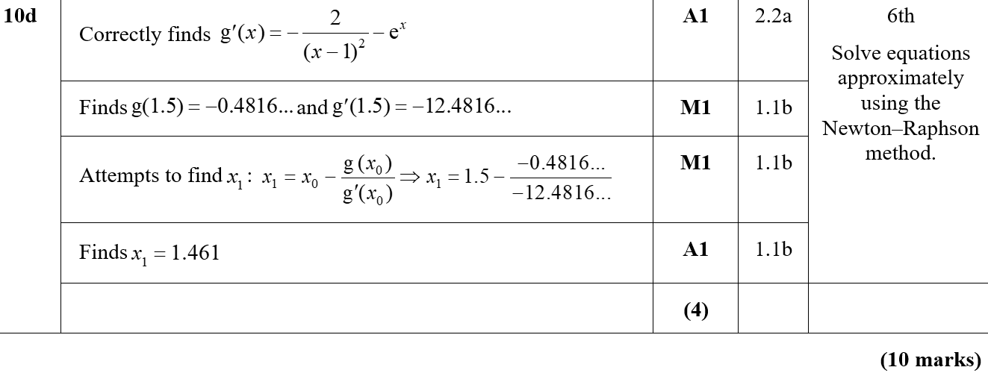
Practice B
D

Slide 8
Practice C

Slide 9
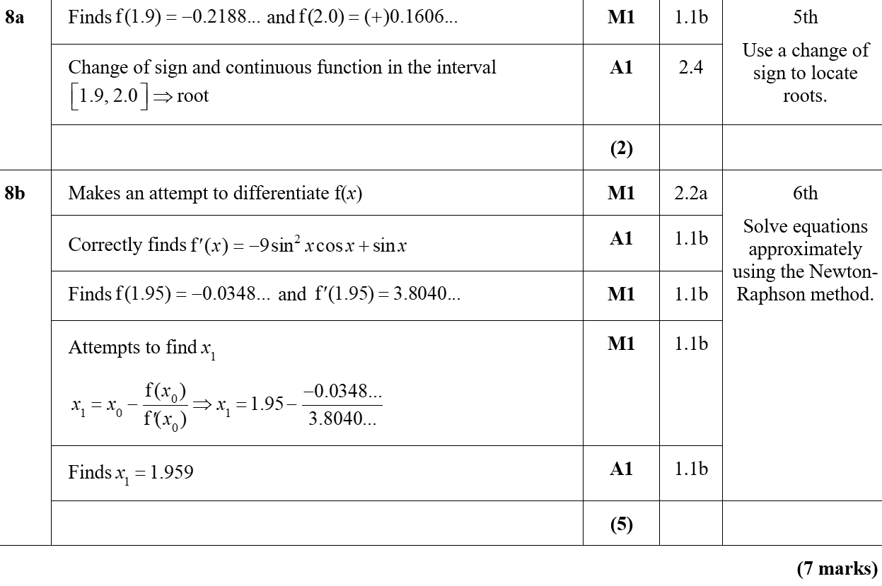
Practice C
A
B
A notes

Slide 10
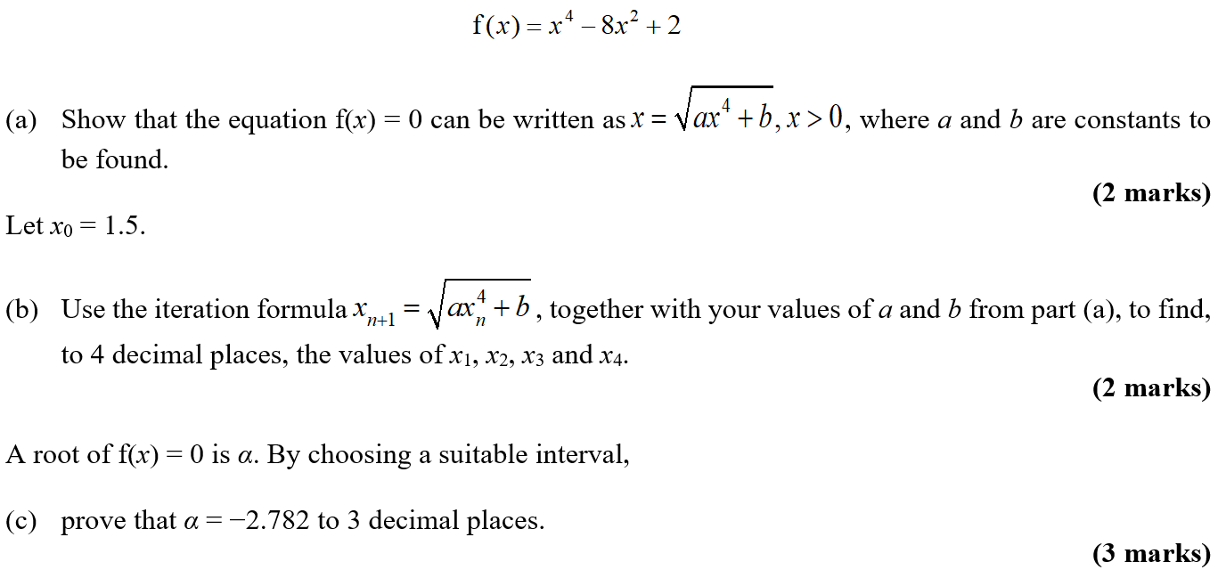
Practice D

Slide 11
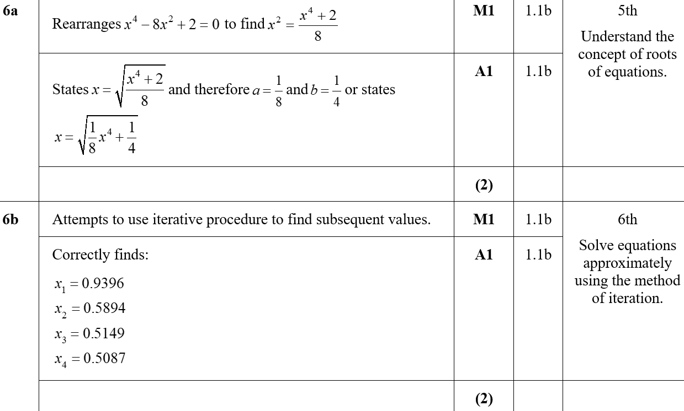
Practice D
A
B
B notes

Slide 12
Practice D
C
C notes

Slide 13
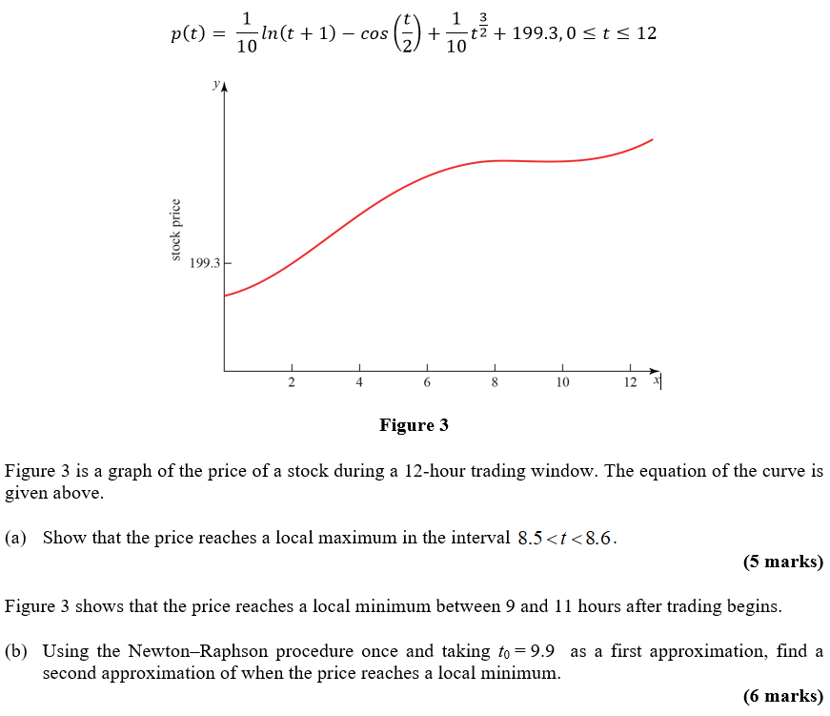
Practice E

Slide 14
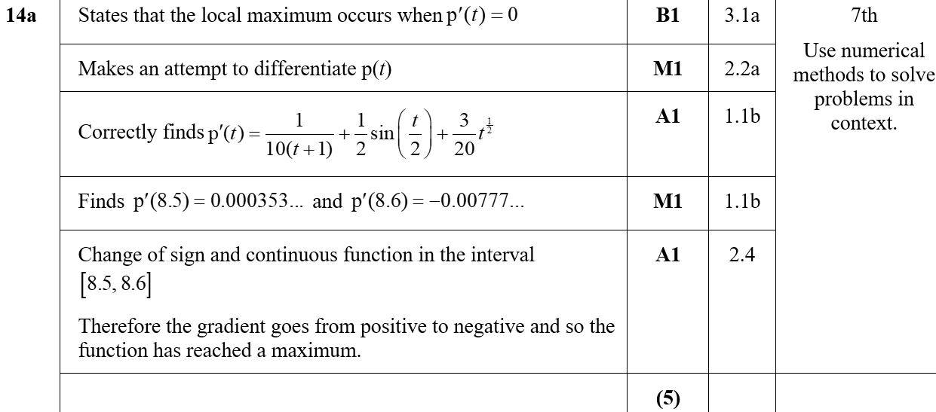
Practice E
A
A notes

Slide 15
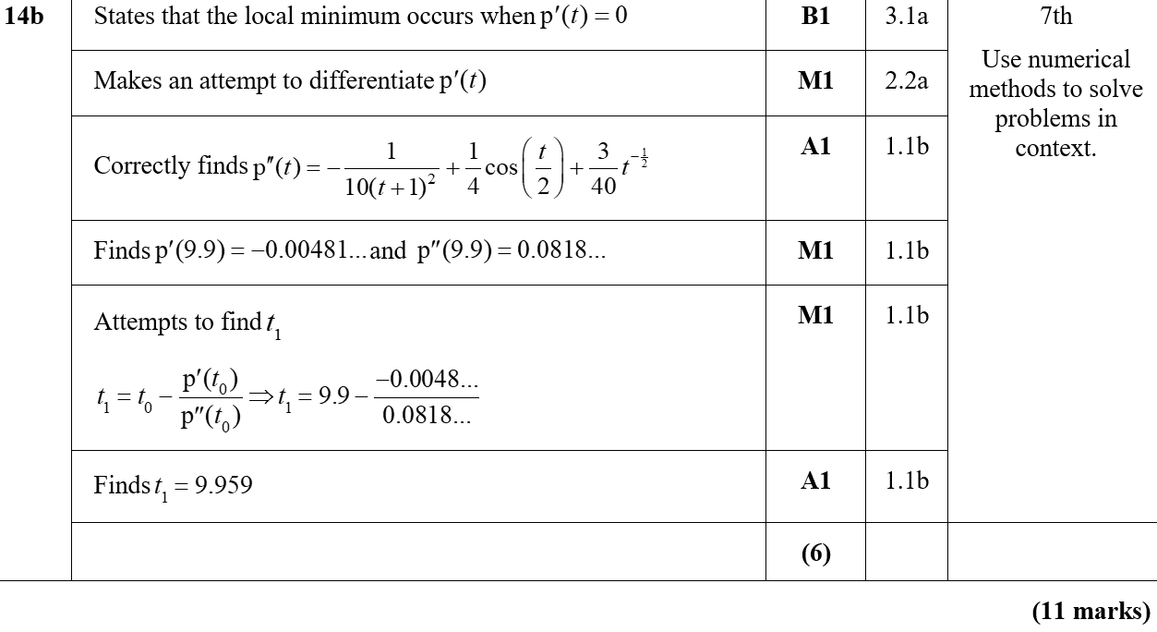
Practice E
B

Slide 16
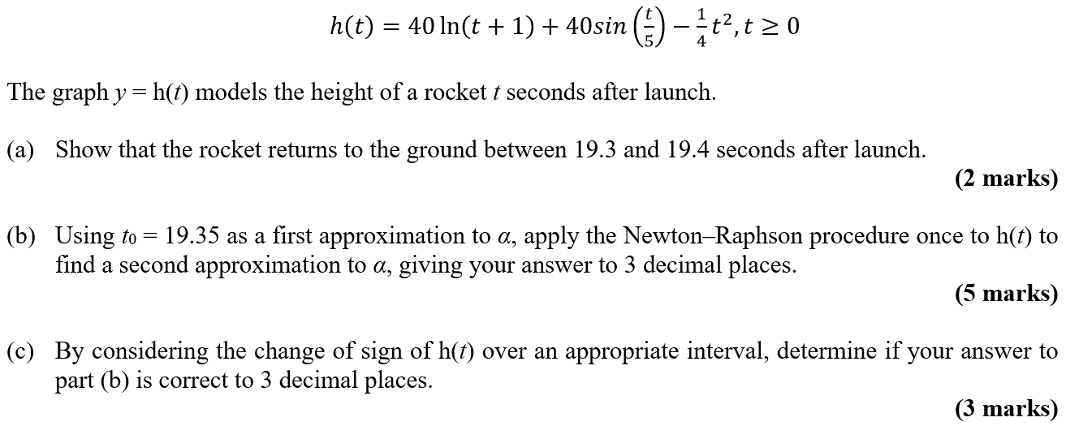
Practice F

Slide 17
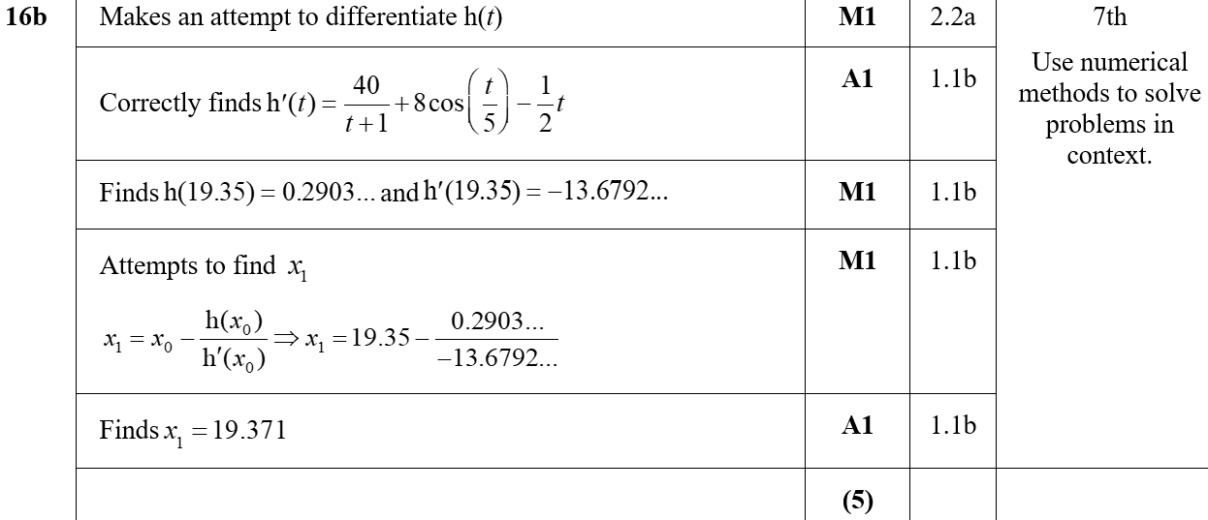
Practice F
A
B
A notes on following slide

Slide 18
Practice F
C
A notes

Slide 19
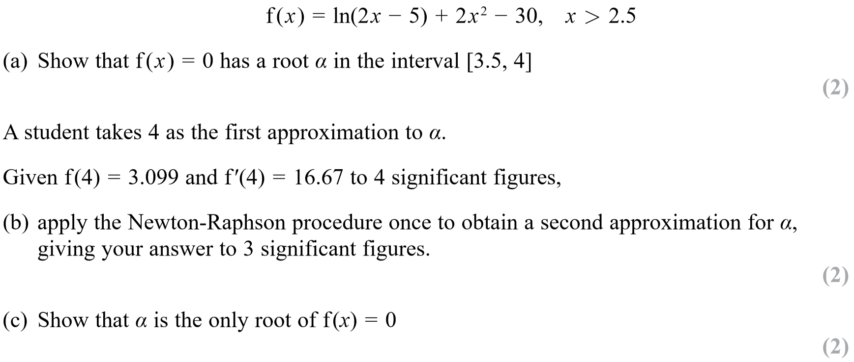
SAM Paper 1

Slide 20
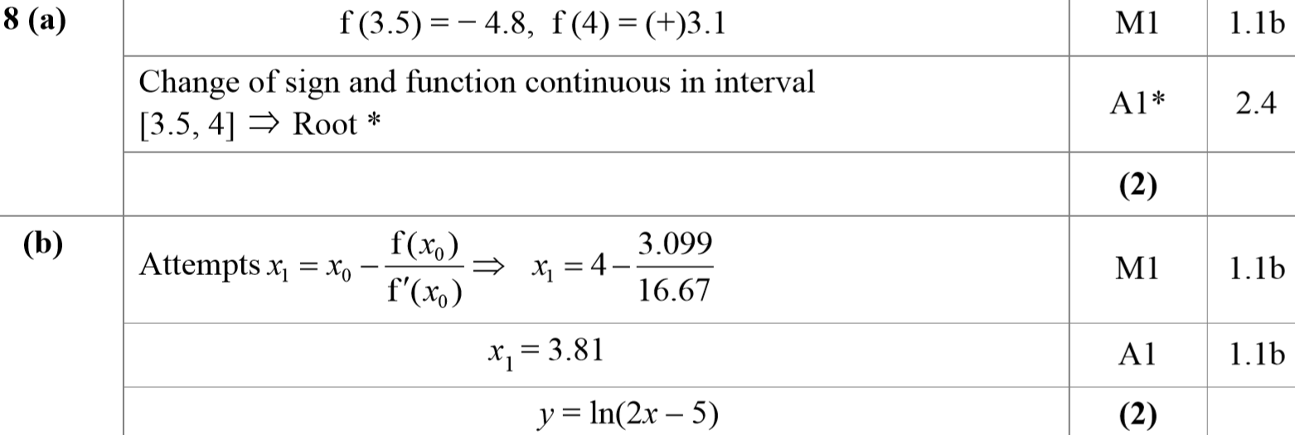
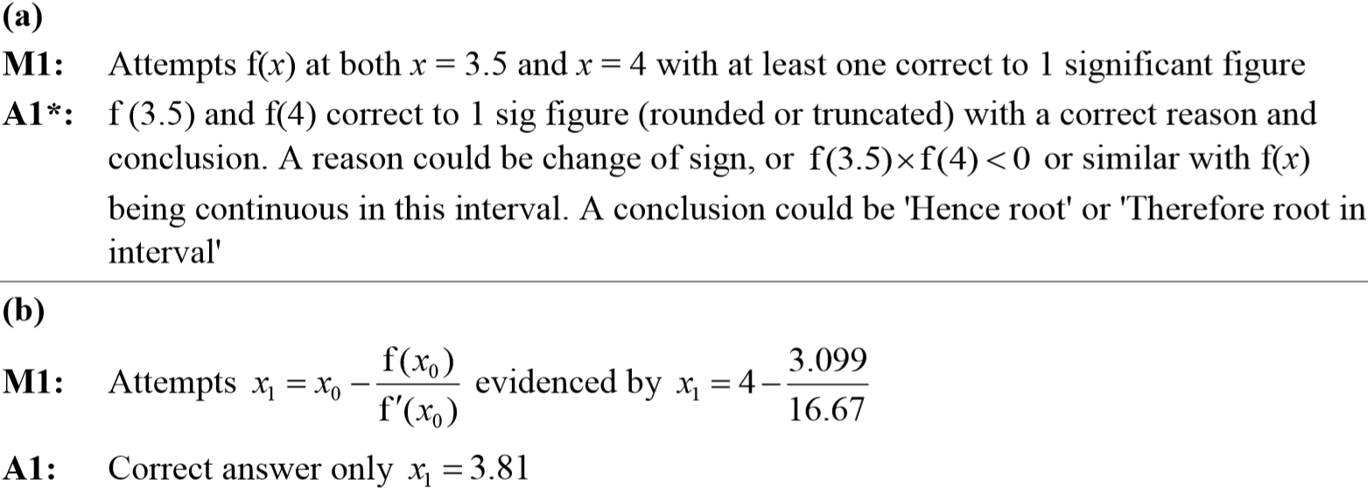
SAM Paper 1
A
B
A notes
B notes

Slide 21
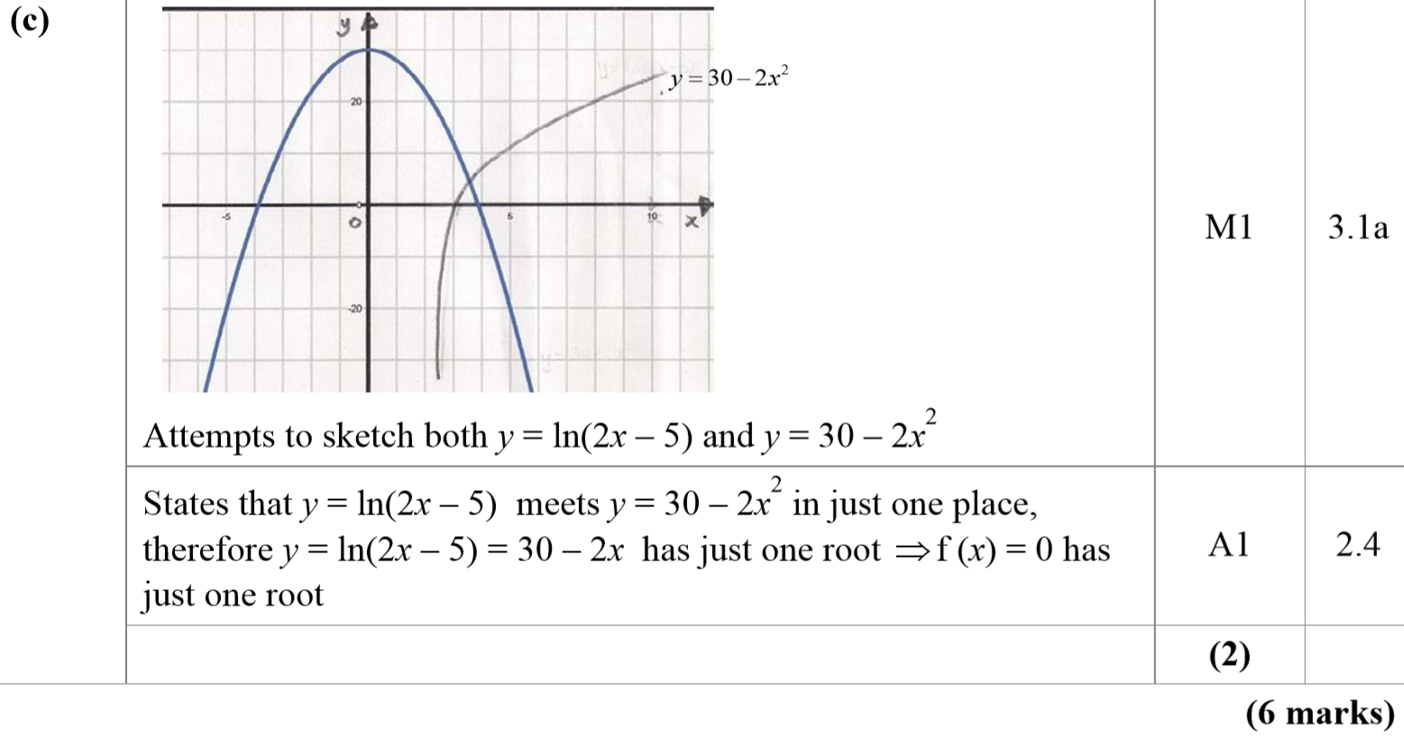
SAM Paper 1
C
C notes

Slide 22
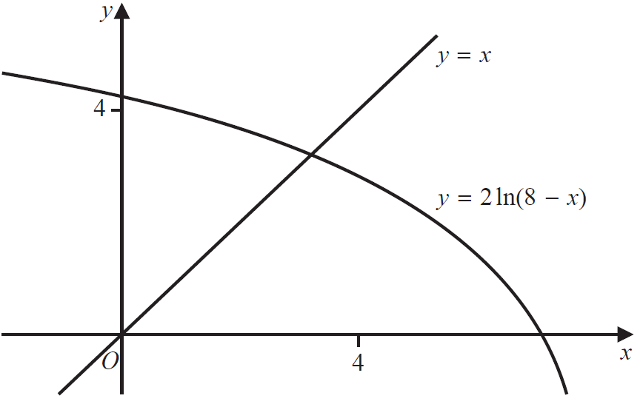
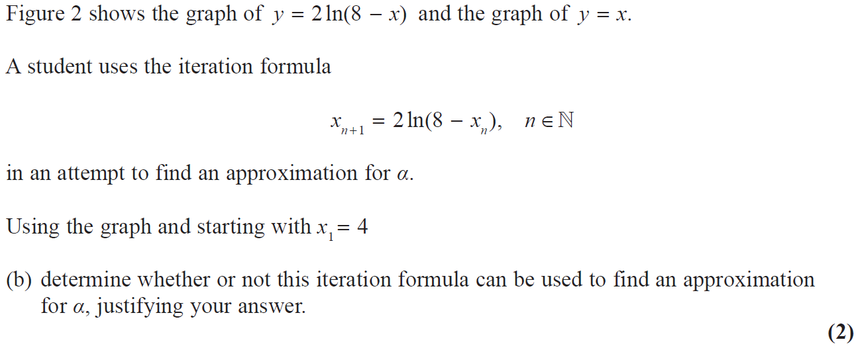
2018 Paper 1

Slide 23
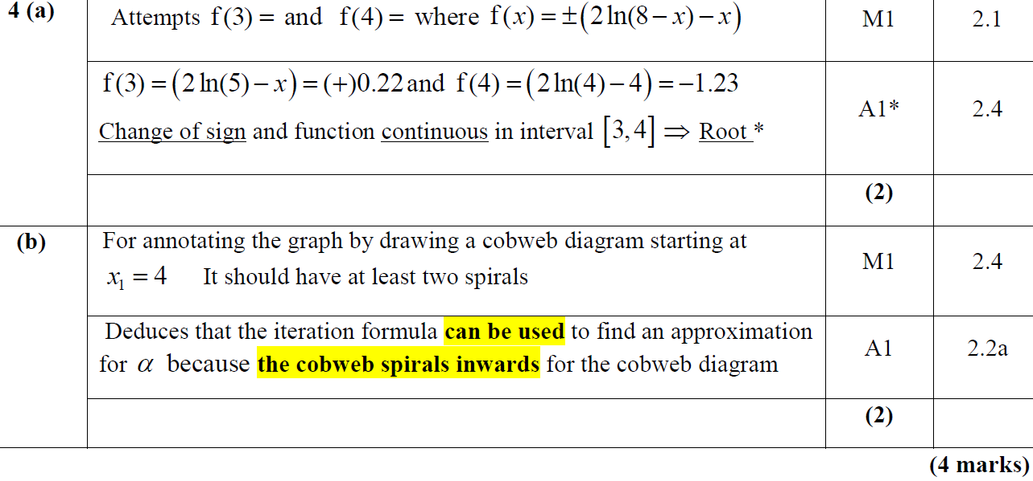
2018 Paper 1
A
B
A (SF)

Slide 24
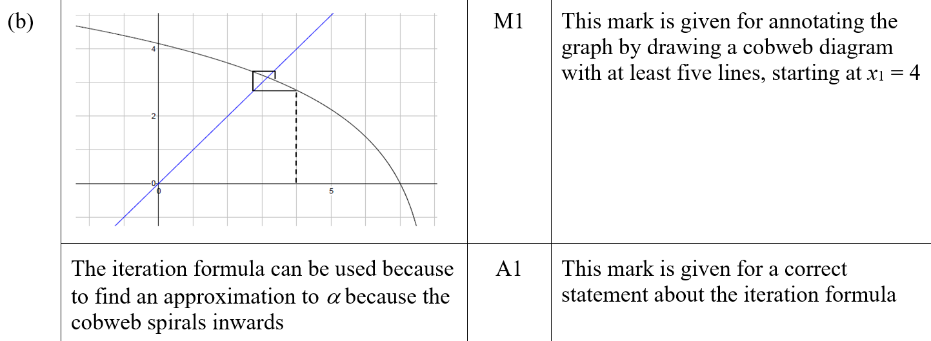
2018 Paper 1
B (SF)
A notes

Slide 25
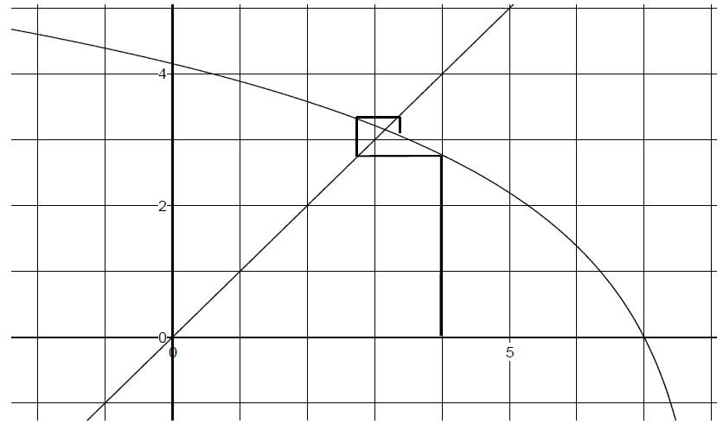
2018 Paper 1
B notes

Slide 26
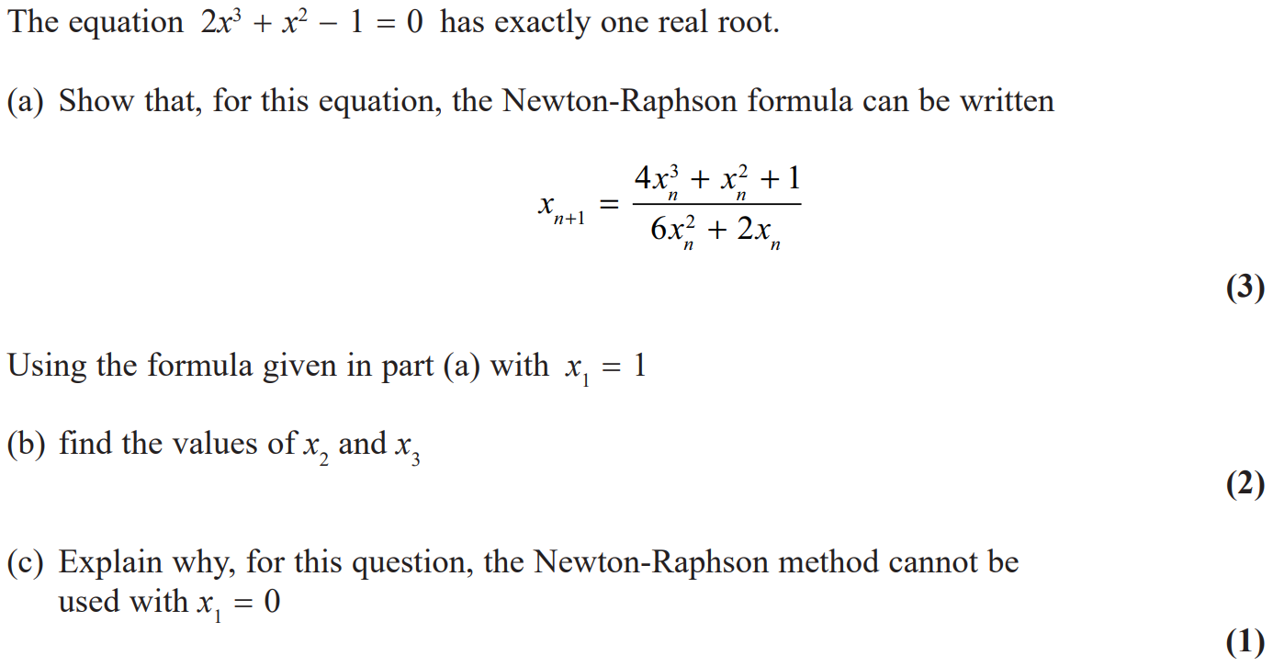
2018 Paper 2

Slide 27
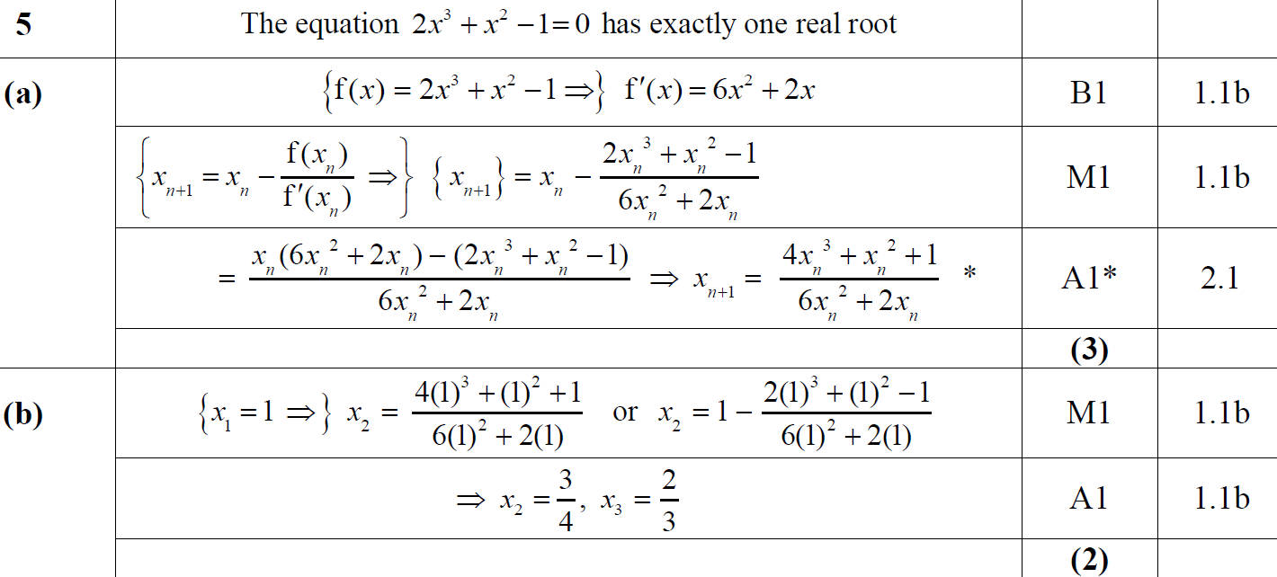
2018 Paper 2
A
B

Slide 28
2018 Paper 2
C

Slide 29
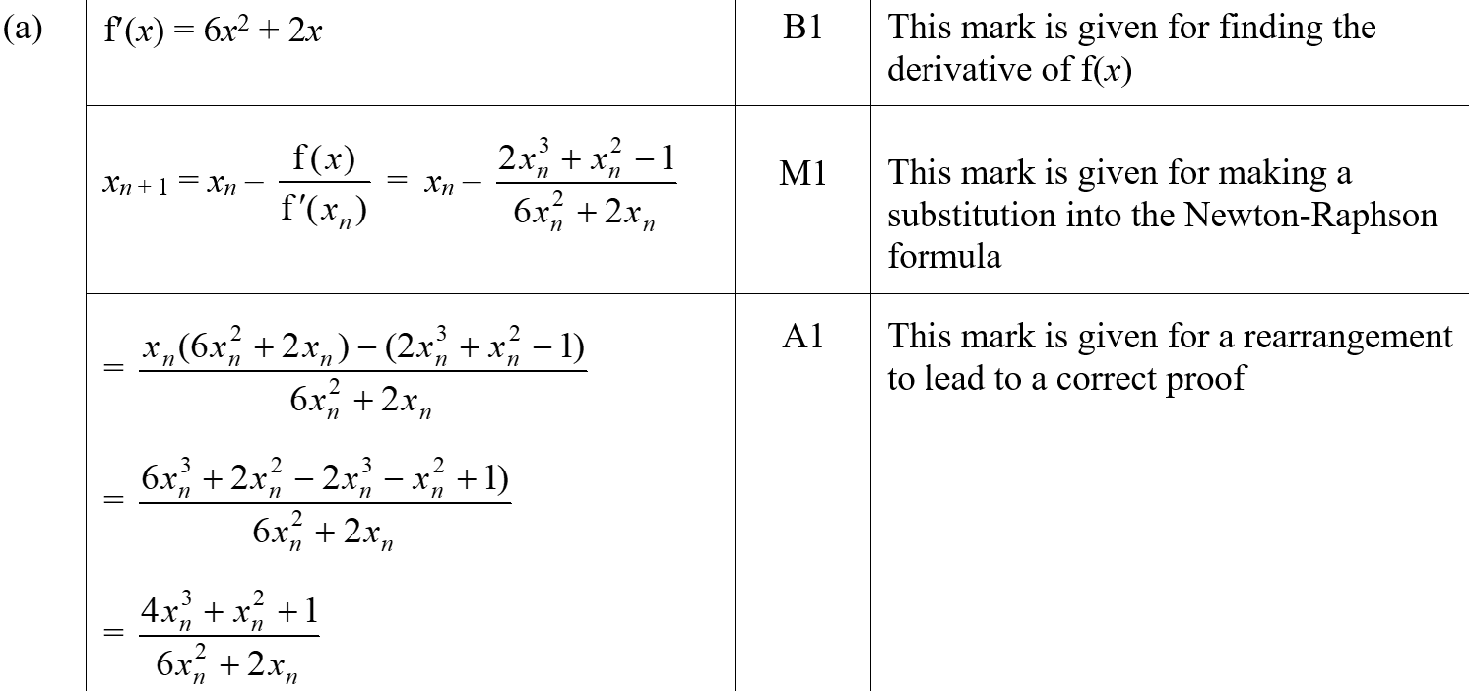
2018 Paper 2
A (SF)

Slide 30
2018 Paper 2
B (SF)
C (SF)

Slide 31
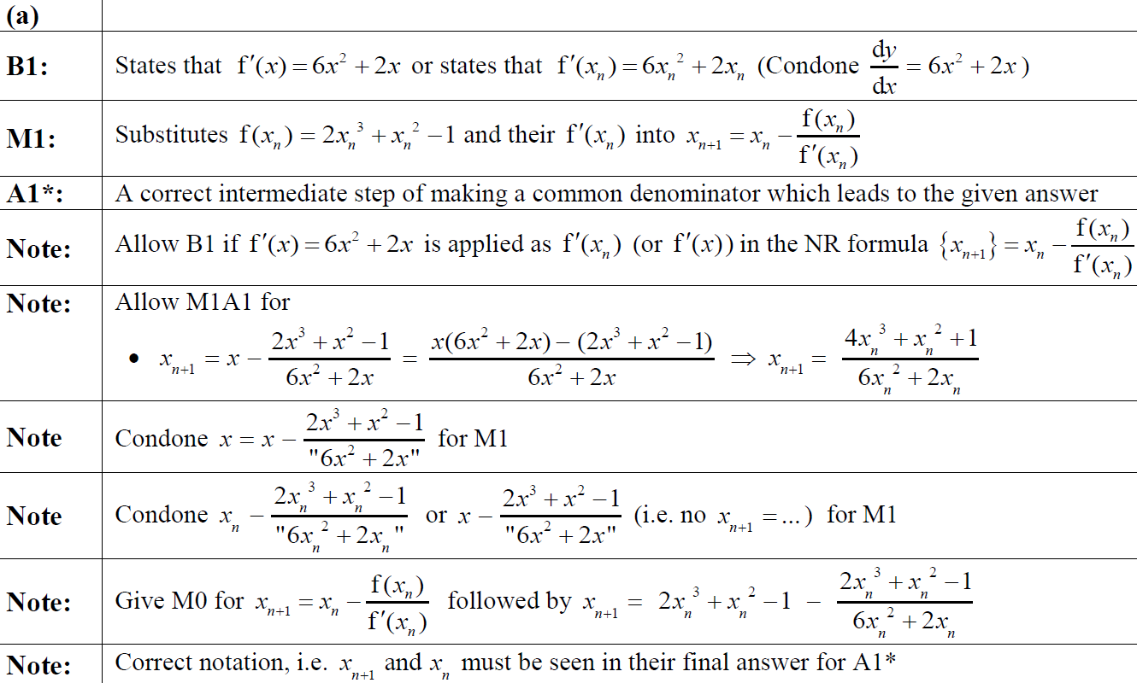
2018 Paper 2
A notes

Slide 32
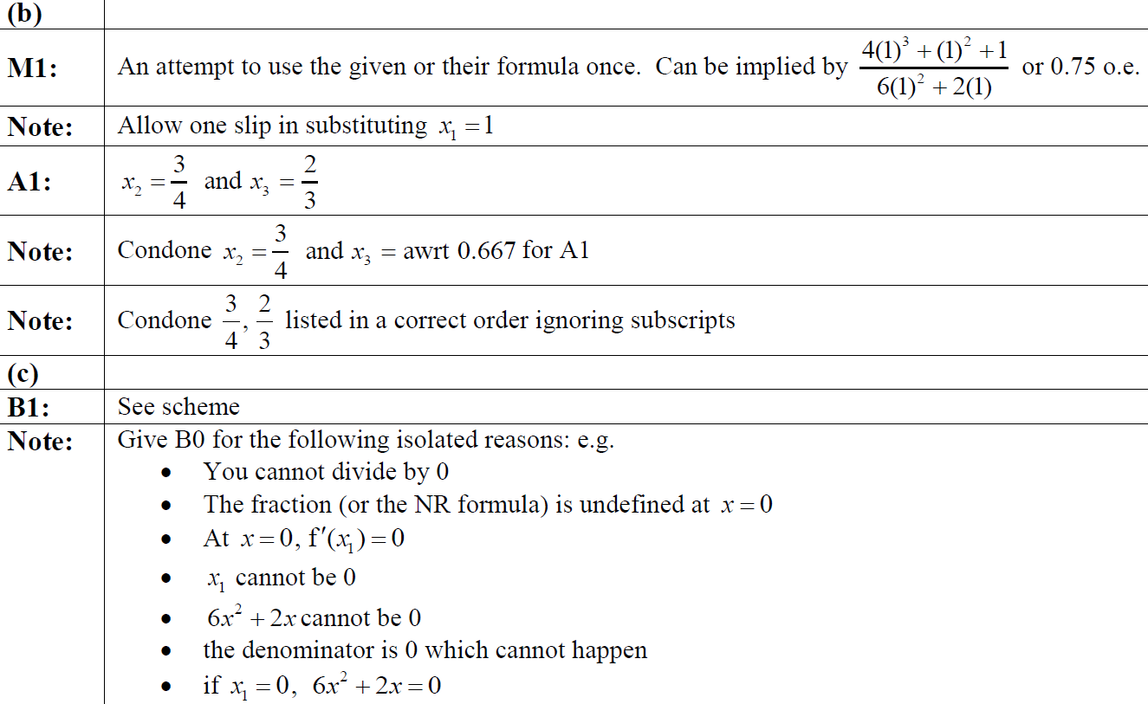
2018 Paper 2
B notes
C notes

Slide 33
New Spec Q’s
Old Spec Numerical Methods
P4 /FP1 Newton Raphson
FP1 Newton Raphson
C3 Iterations
Jan 2006
Jan 2013
Jan 2006
Jan 2010
June 2014
Jan 2002
June 2006
Jan 2009
June 2014
June 2006
June 2010
June 2015
June 2002
Jan 2007
June 2009
June 2016
Jan 2007
Jan 2011
June 2016
Jan 2003
June 2007
Jan 2010
June 2017
June 2007
June 2011
June 2017
June 2003
Jan 2008
June 2010
Jan 2008
Jan 2012
June 2018
Jan 2004
June 2008
Jan 2011
June 2008
June 2012
June 2004
Jan 2009
June 2011
Jan 2009
Jan 2013
Jan 2005
June 2009
Jan 2012
June 2009
June 2013
June 2005
Jan 2010
June 2012

Slide 34
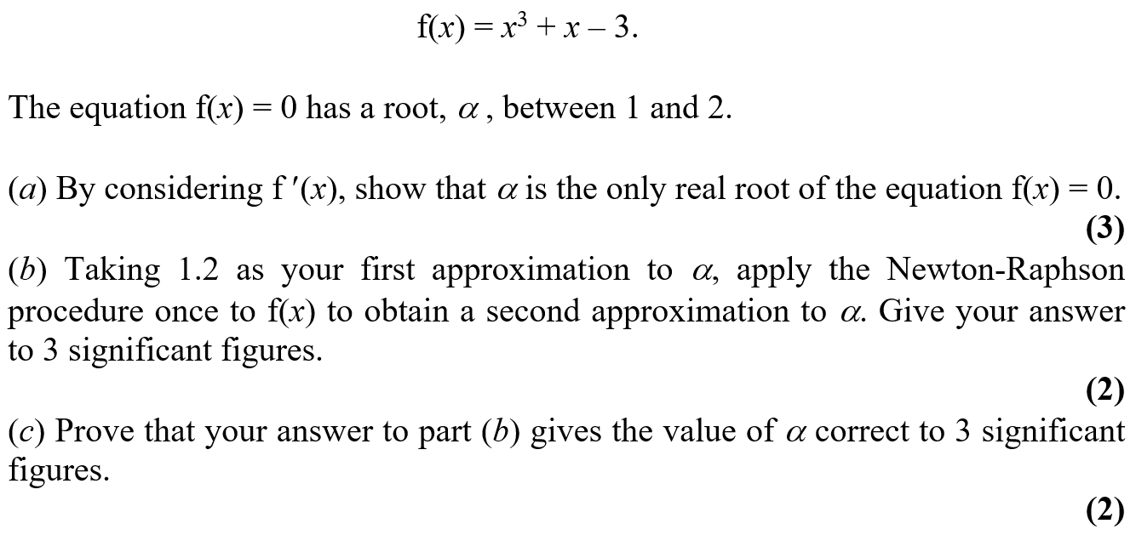
Jan 2002

Slide 35
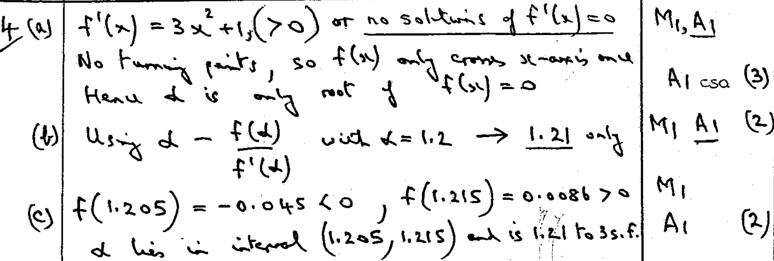
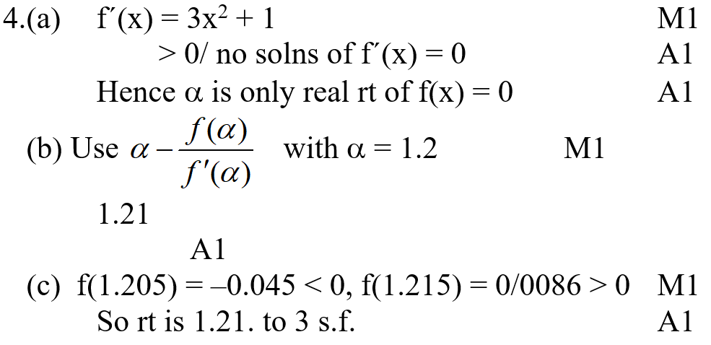
Jan 2002
A
B
C
A
B
C

Slide 36
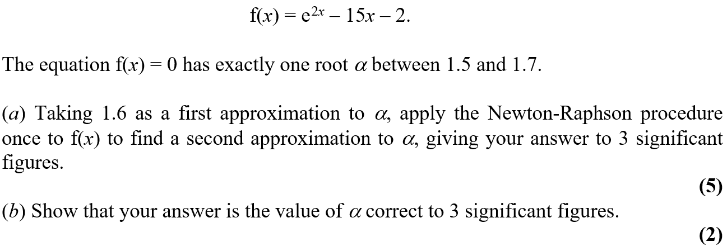
June 2002

Slide 37
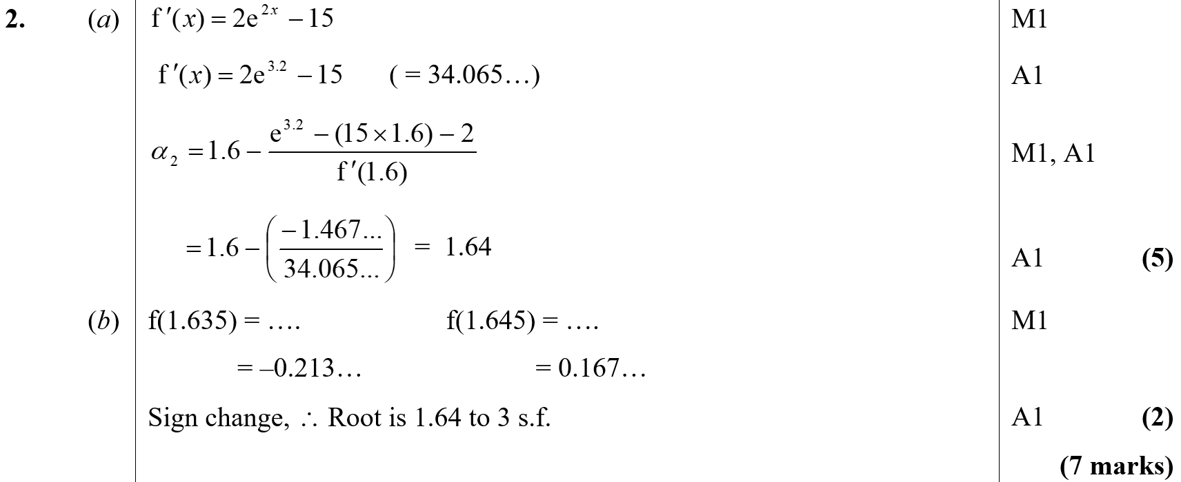
June 2002
A
B

Slide 38
Jan 2003

Slide 39
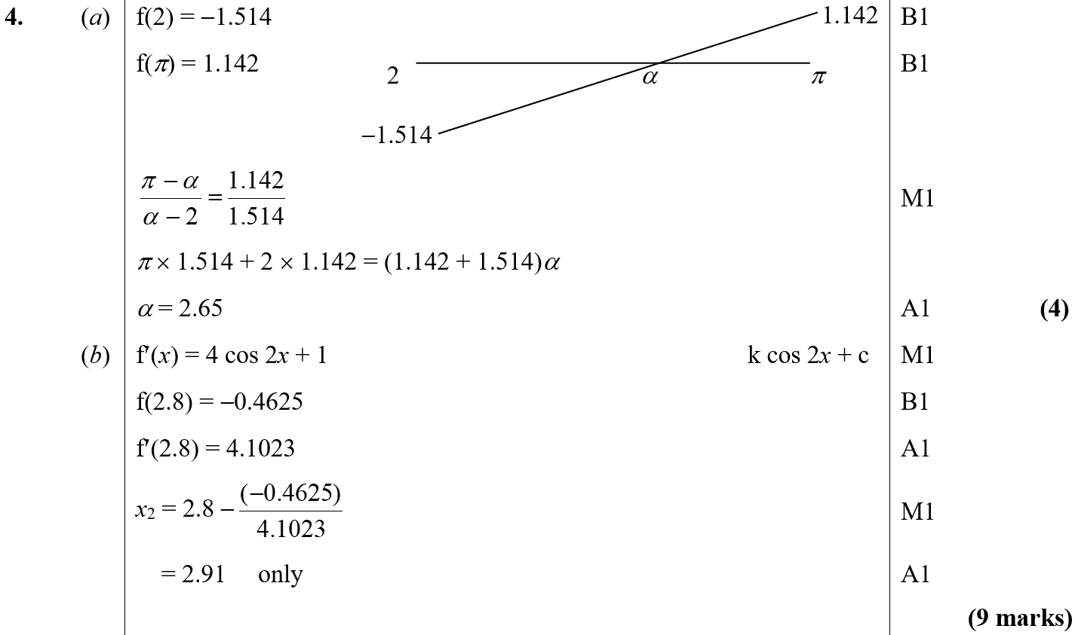
Jan 2003
A
B

Slide 40
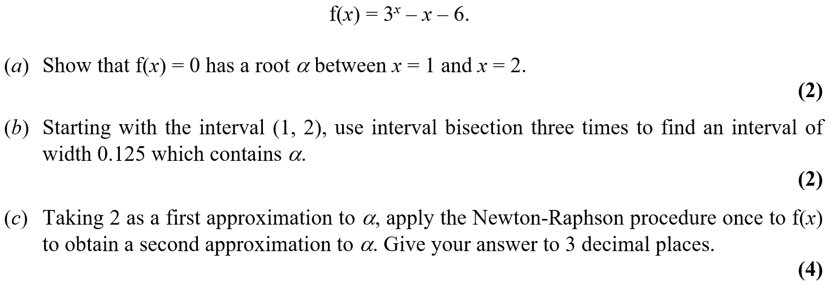
June 2003

Slide 41
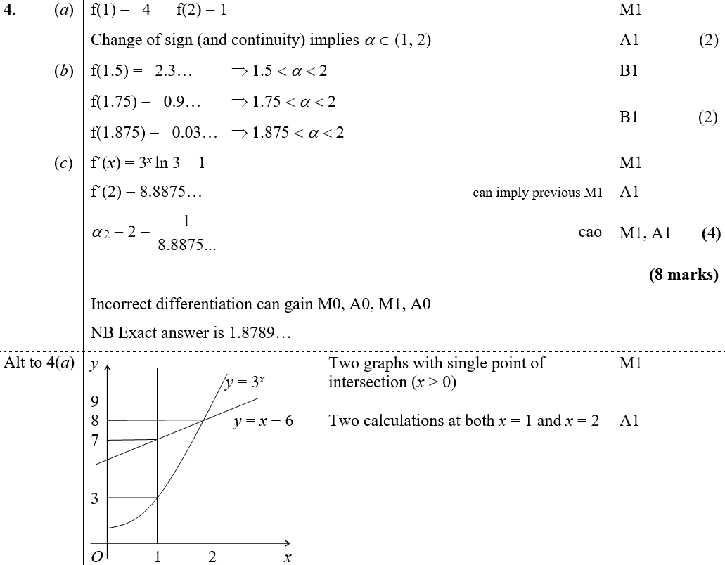
June 2003
A
B
C
A Alternative

Slide 42
Jan 2004

Slide 43
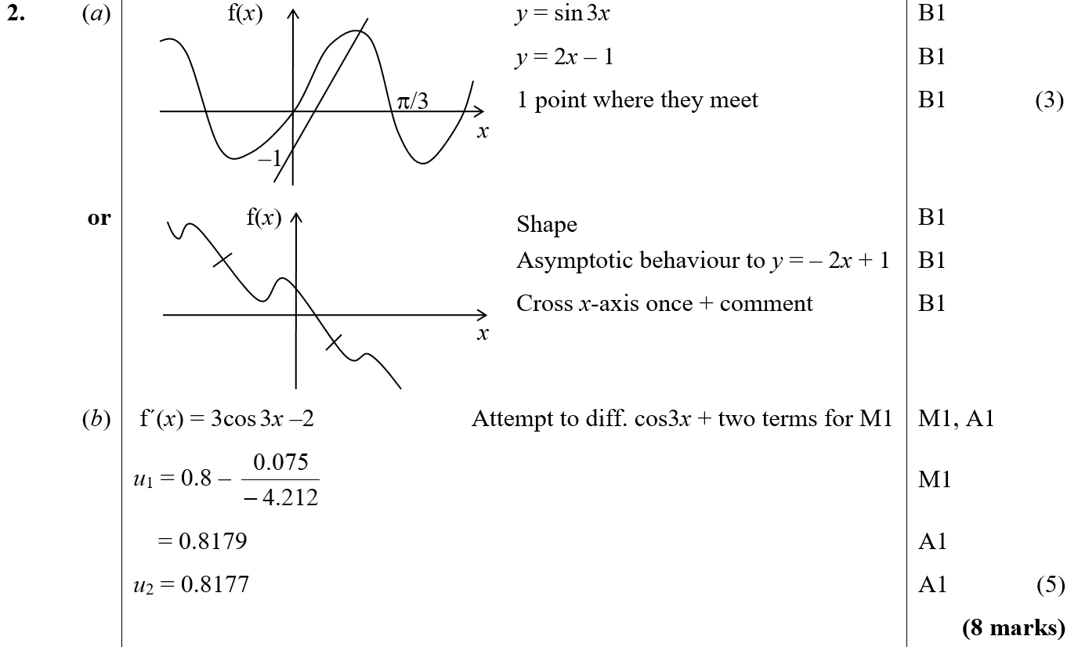
Jan 2004
A
B

Slide 44
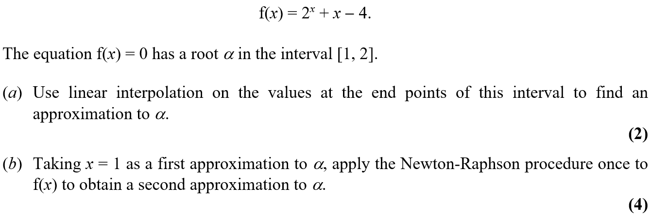
June 2004

Slide 45
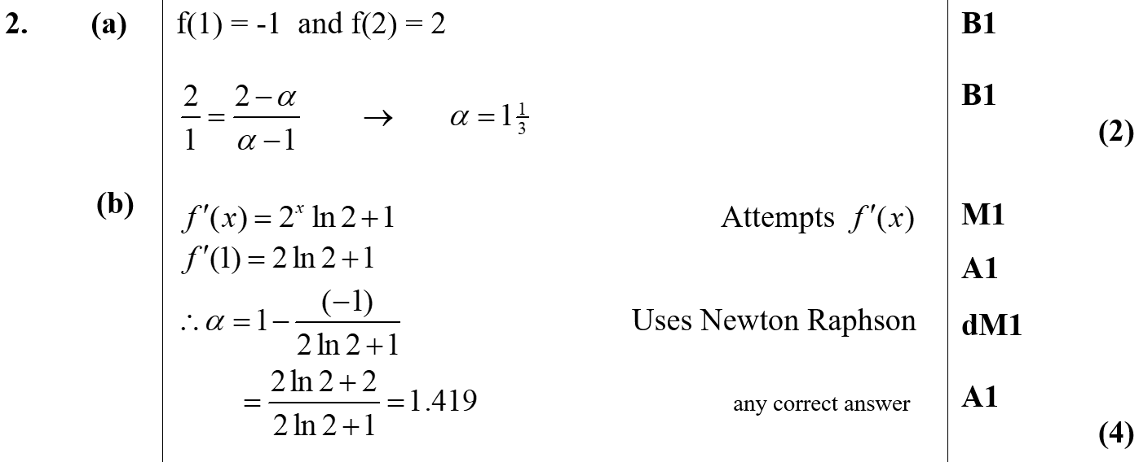
June 2004
A
B

Slide 46
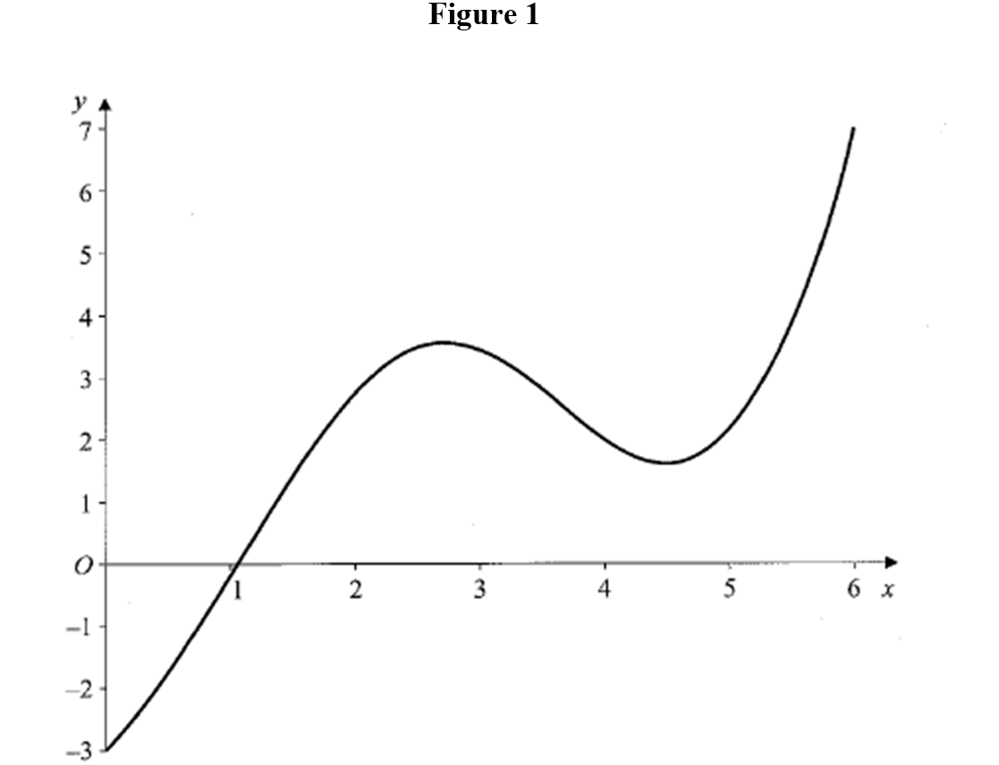
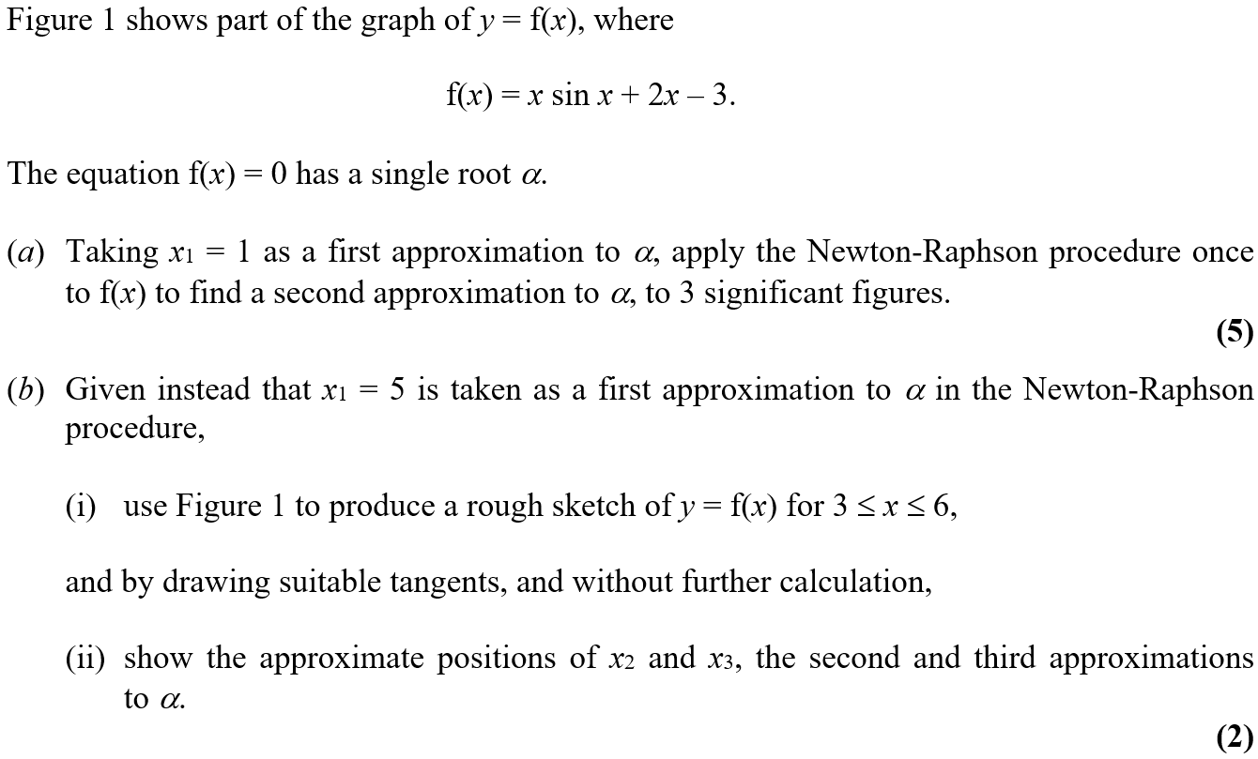
Jan 2005

Slide 47
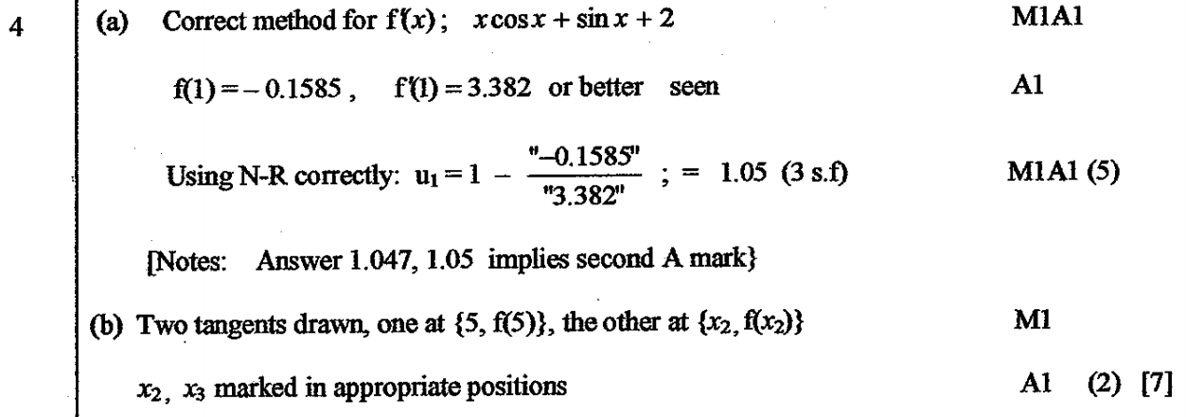
Jan 2005
A
B

Slide 48
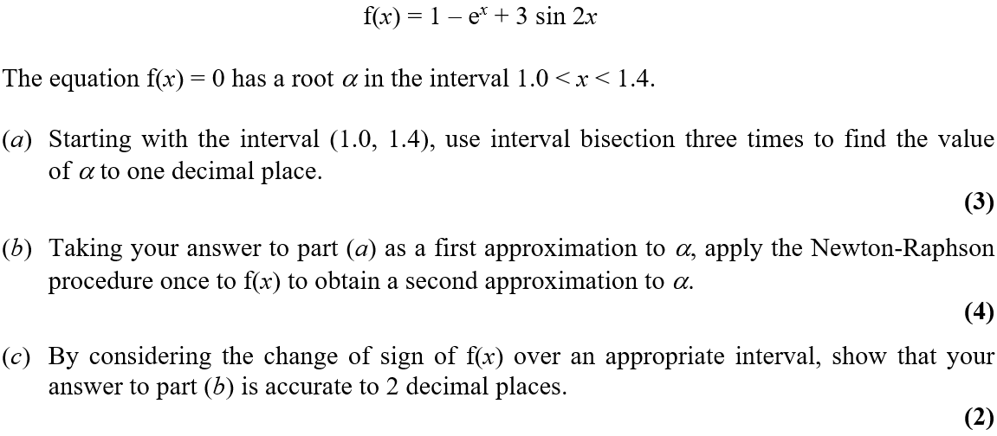
June 2005

Slide 49
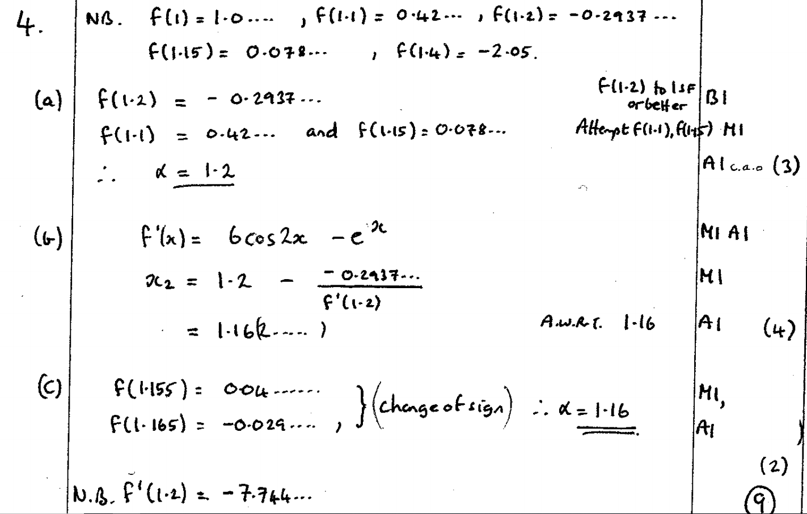
June 2005
A
B
C

Slide 50
Jan 2006

Slide 51
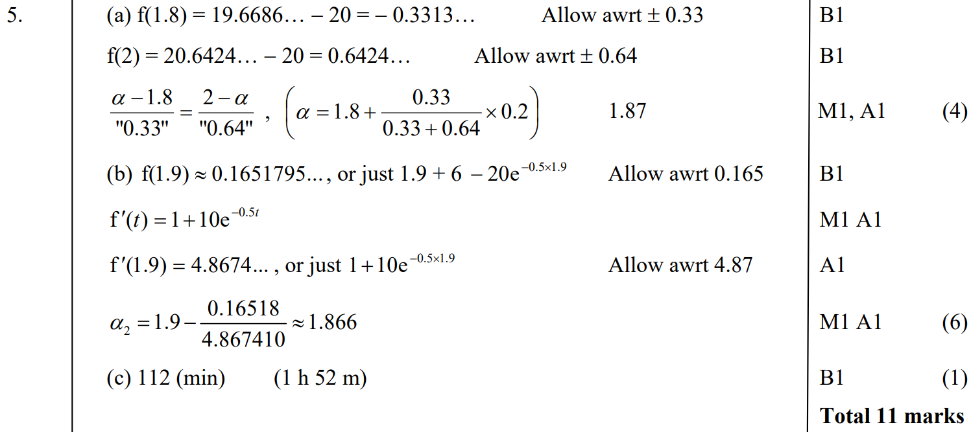
Jan 2006
A
B
C

Slide 52
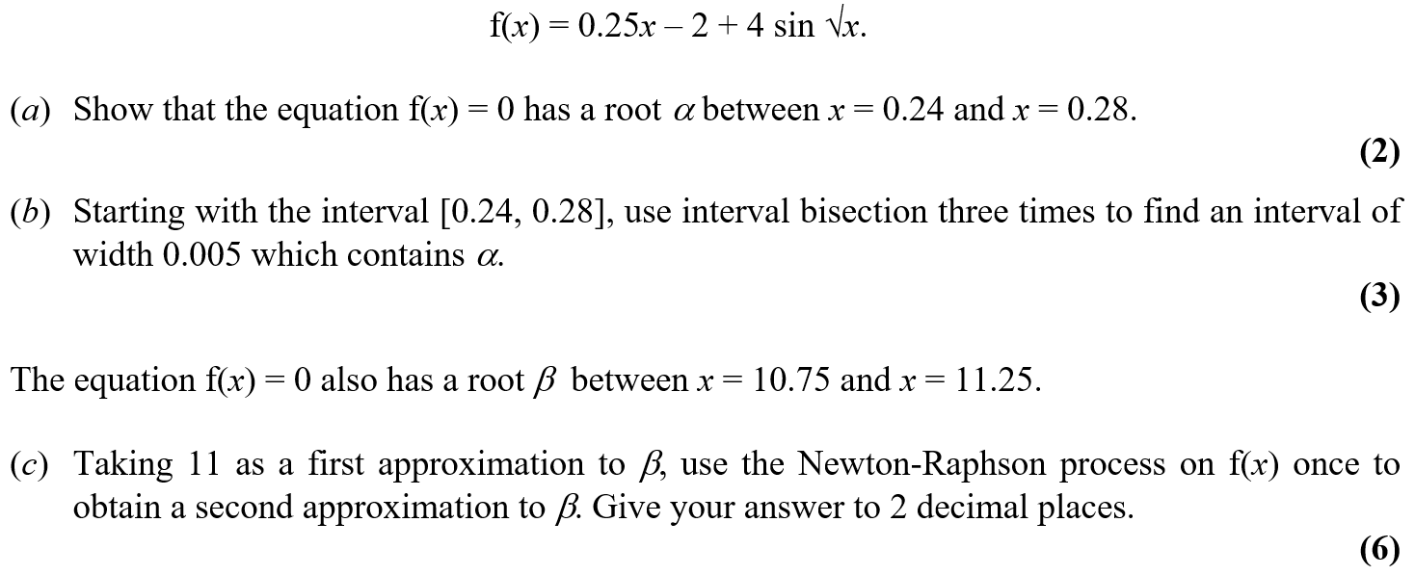
June 2006

Slide 53
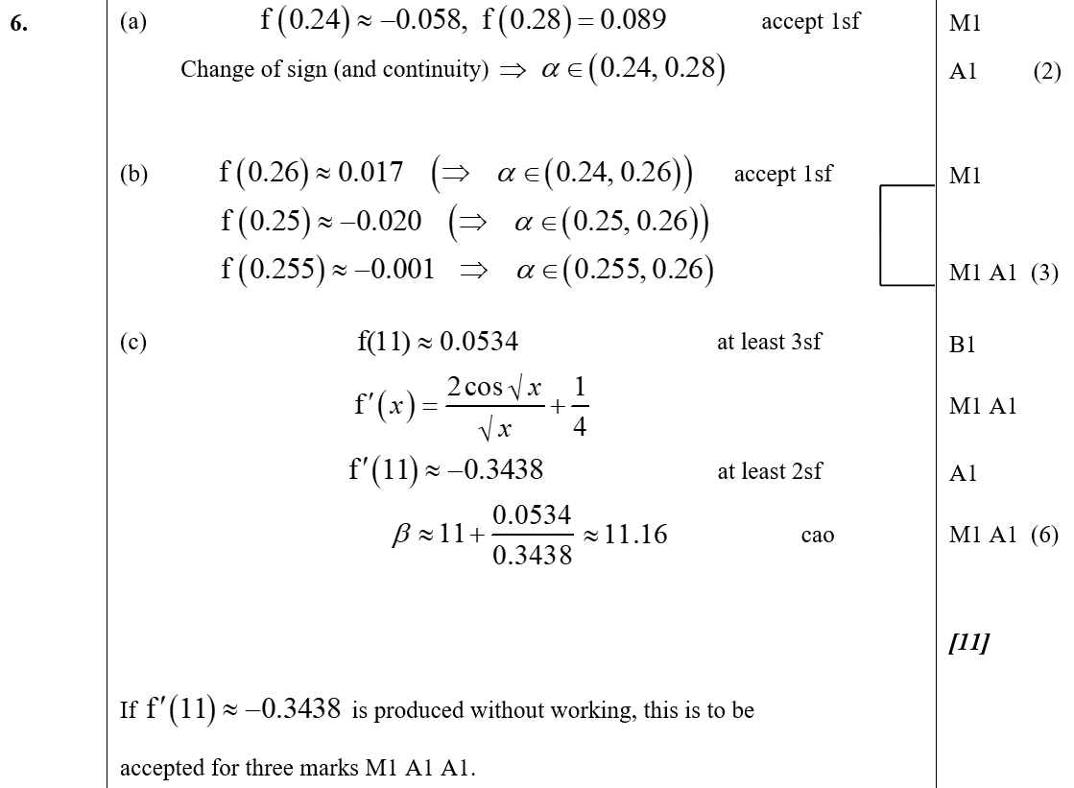
June 2006
A
B
C

Slide 54
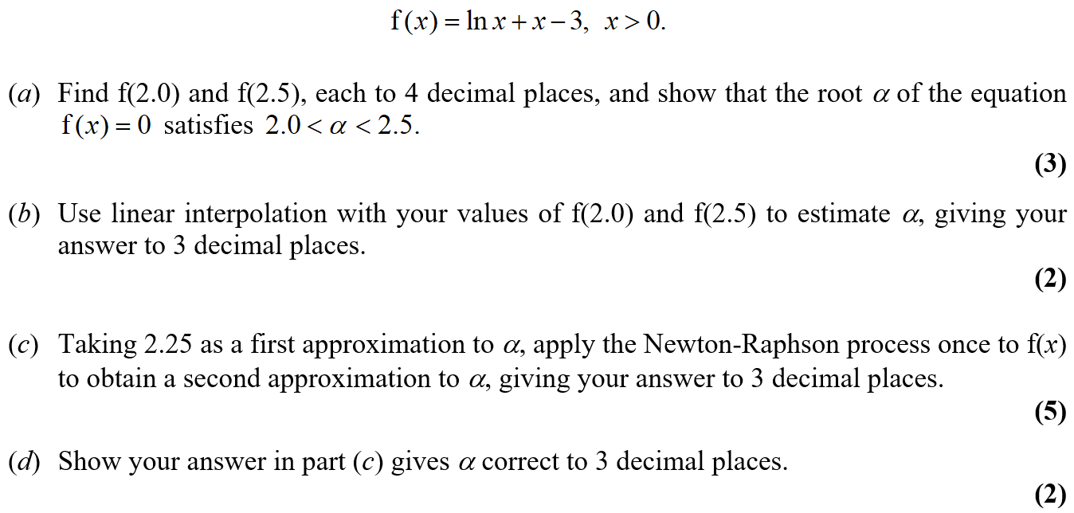
Jan 2007

Slide 55
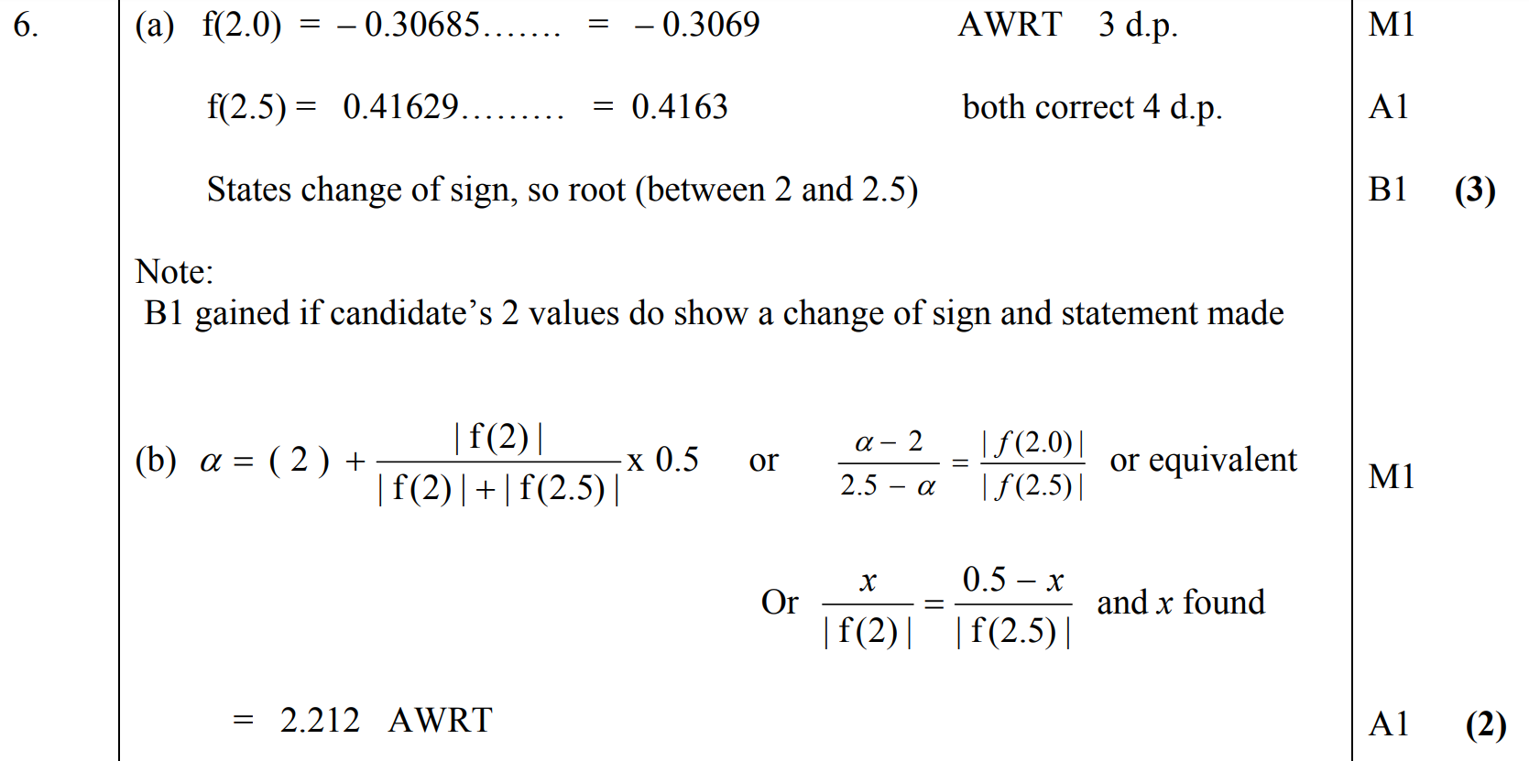
Jan 2007
A
B

Slide 56
Jan 2007
C
D

Slide 57
Jan 2007
C notes
D notes

Slide 58
June 2007

Slide 59
June 2007
A
B
C
D

Slide 60
June 2007
A notes
C notes
D notes

Slide 61
Jan 2008

Slide 62
Jan 2008
A
B
A notes
B notes

Slide 63
June 2008

Slide 64
June 2008
A
B

Slide 65
Jan 2009

Slide 66
Jan 2009
A
B
C

Slide 67
Jan 2009
B notes
C notes

Slide 68
June 2009

Slide 69
June 2009
A
B
C

Slide 70
June 2009
C Alternative
A notes
B notes
C notes

Slide 71
Jan 2010

Slide 72
Jan 2010
A
B
C

Slide 73
Jan 2009

Slide 74
Jan 2009
A
B
C
A notes
B notes
C notes

Slide 75
June 2009

Slide 76
June 2009
A
B
B notes

Slide 77
Jan 2010

Slide 78
Jan 2010
A
B
C
A notes
B notes
C notes

Slide 79
June 2010

Slide 80
June 2010
A
B
C

Slide 81
June 2010
A notes
B notes
C notes

Slide 82
Jan 2011

Slide 83
Jan 2011
A
B

Slide 84
Jan 2011
C

Slide 85
June 2011

Slide 86
June 2011
A
B

Slide 87
Jan 2012

Slide 88
Jan 2012
A
B

Slide 89
Jan 2012
C

Slide 90
June 2012

Slide 91
June 2012
A

Slide 92
Jan 2013

Slide 93
Jan 2013
A
B
A notes
B notes

Slide 94
June 2014

Slide 95
June 2014
A
B
C

Slide 96
June 2016

Slide 97
June 2016
A
B
A notes
B notes

Slide 98
June 2017

Slide 99
June 2017
A
B

Slide 100
June 2017
A notes
B notes

Slide 101
Jan 2006

Slide 102
Jan 2006
A
B
C

Slide 103
June 2006

Slide 104
June 2006
A
B
C

Slide 105
Jan 2007

Slide 106
Jan 2007
A
B
C

Slide 107
Jan 2007
D
E

Slide 108
June 2007

Slide 109
June 2007
A
B
C

Slide 110
Jan 2008

Slide 111
Jan 2008
A
B
C

Slide 112
June 2008

Slide 113
June 2008
A
B
C
D

Slide 114
Jan 2009

Slide 115
Jan 2009
A
B
C

Slide 116
June 2009

Slide 117
June 2009
A
B

Slide 118
Jan 2010

Slide 119
Jan 2010
A
B

Slide 120
Jan 2010
C

Slide 121
June 2010

Slide 122
June 2010
A
B
C
D

Slide 123
Jan 2011

Slide 124
Jan 2011
A
B
C

Slide 125
Jan 2011
D
E

Slide 126
June 2011

Slide 127
June 2011
A
B
C

Slide 128
Jan 2012

Slide 129
Jan 2012
A
B
C
D

Slide 130
Jan 2012
A Notes
B Notes
C Notes
D Notes

Slide 131
June 2012

Slide 132
June 2012
A
B
C

Slide 133
Jan 2013

Slide 134
Jan 2013
A
B
C

Slide 135
June 2013

Slide 136
June 2013
A
B
C
D

Slide 137
June 2013
A Notes

Slide 138
June 2013
B Notes
C Notes

Slide 139
June 2013
D Notes

Slide 140
June 2014

Slide 141
June 2014
A
B
C

Slide 142
June 2015

Slide 143
June 2015
A
B
C

Slide 144
June 2015
A Alternative 1
A Alternative 2

Slide 145
June 2015
A notes

Slide 146
June 2015
B notes
C notes

Slide 147
June 2016

Slide 148
June 2016
A (i)
A (ii)
A (iii)
B
C
D

Slide 149
June 2016
A (i) notes
A (ii) notes
A (iii) notes

Slide 150
June 2016
B notes

Slide 151
June 2016
C notes

Slide 152
June 2016
D notes

Slide 153
June 2017

Slide 154
June 2017
A
B

Slide 155
June 2017
C

Slide 156
June 2017
A notes

Slide 157
June 2017
B notes
C notes

Slide 158
June 2018

Slide 159
June 2018
A
B
C

Slide 160
June 2018
A notes

Slide 161
June 2018
B notes
C notes

