Slide 1
Old Spec Q’s
Functions
Graphical transformations
Practice A
SAM 1
Practice B
SAM 2
(i)
Practice C
SAM 2
(ii)
Practice D
2018 2
(i)
Practice E
2018 2
(ii)
Practice F

Slide 2
Practice A

Slide 3
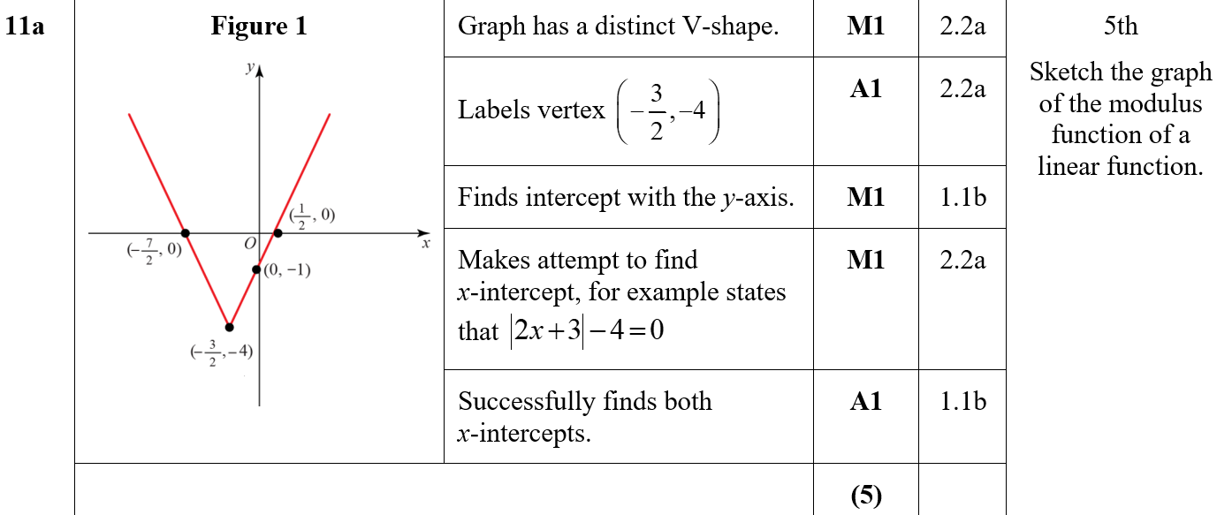
Practice A
A

Slide 4
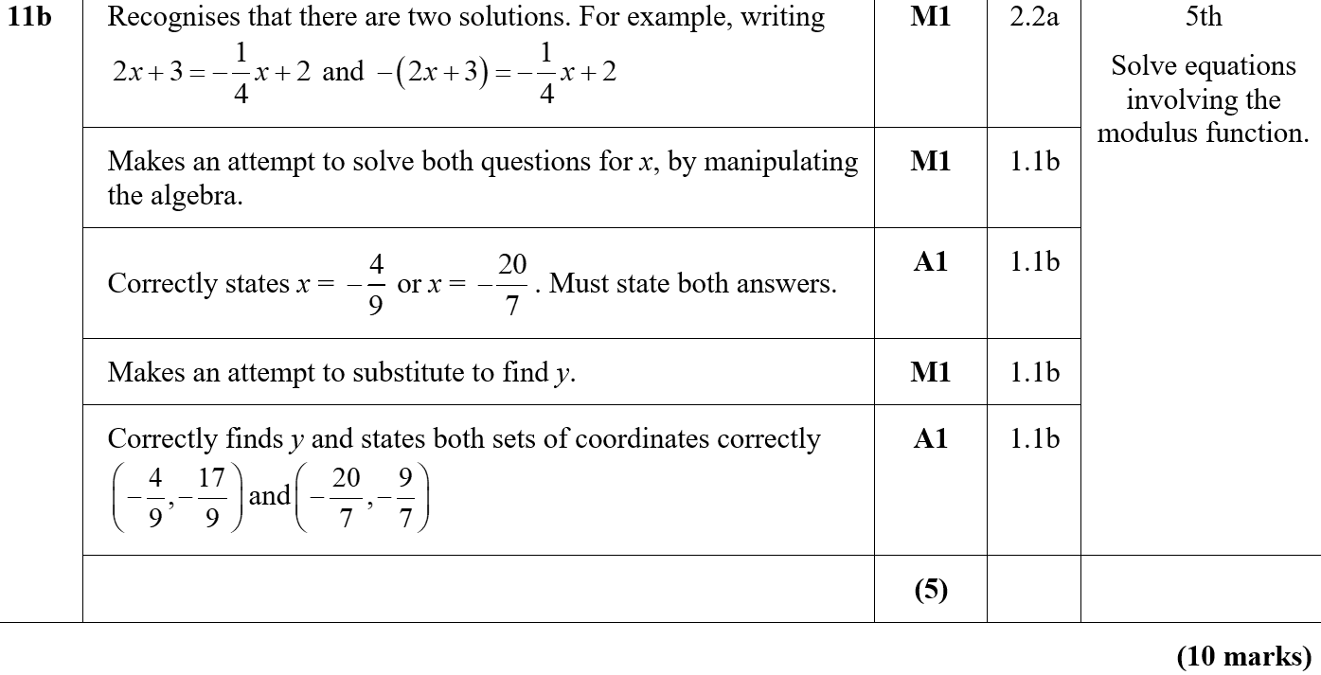
Practice A
B

Slide 5
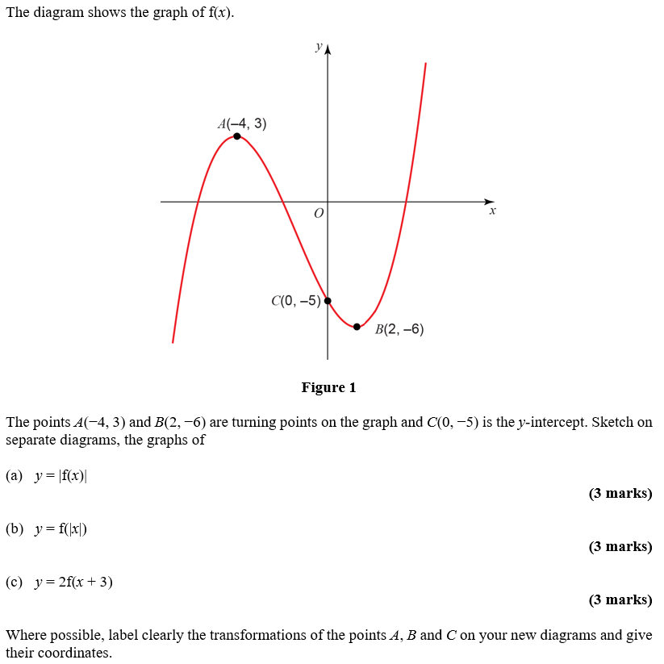
Practice B

Slide 6
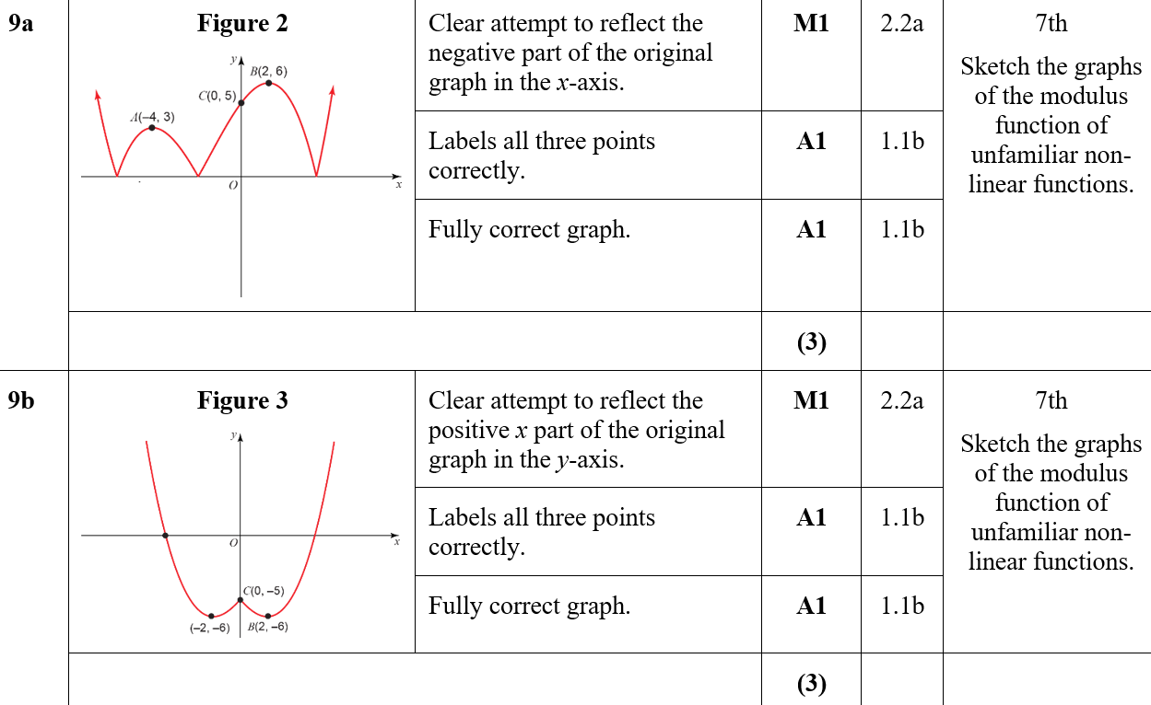
Practice B
A
B

Slide 7
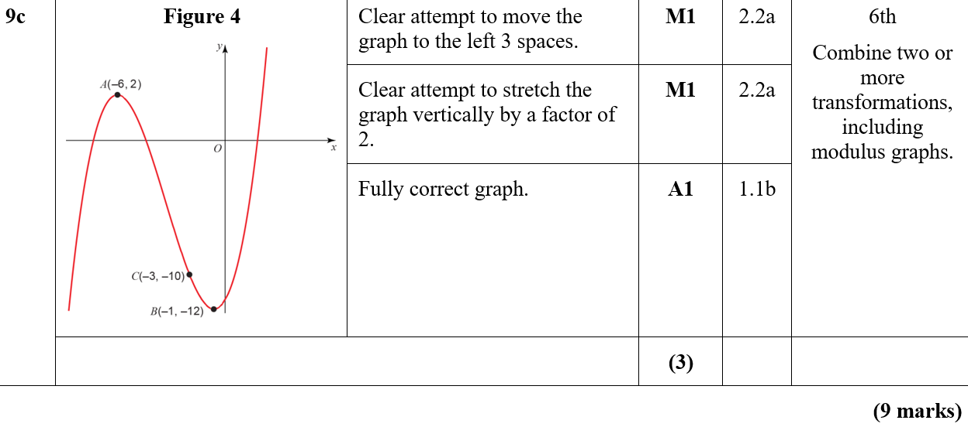
Practice B
C

Slide 8
Practice C

Slide 9
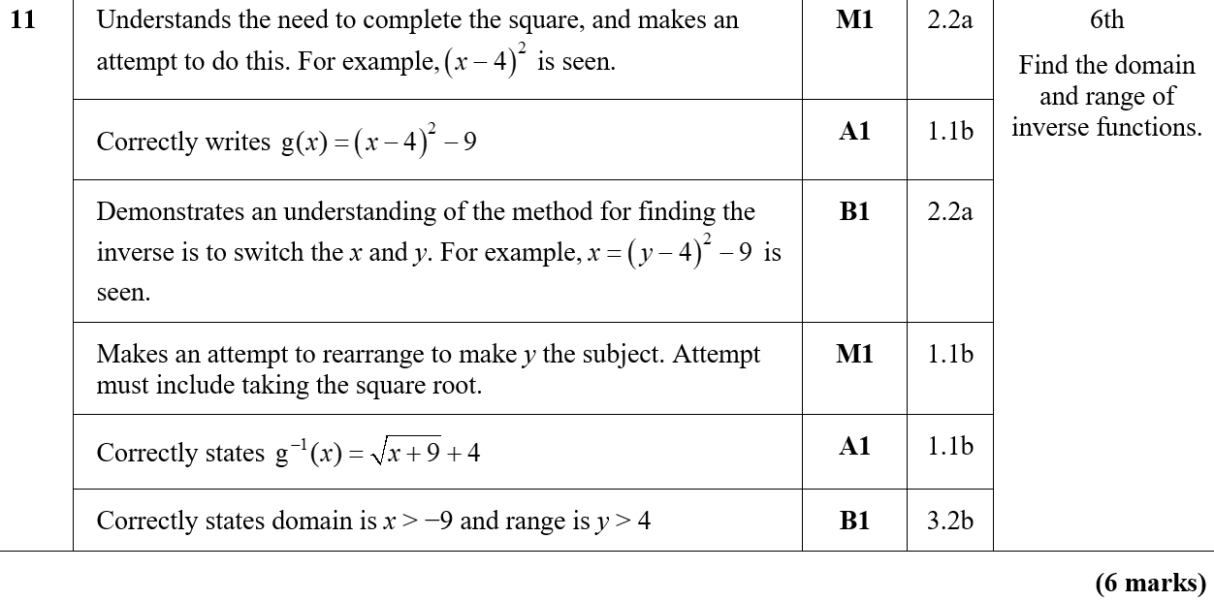
Practice C
A

Slide 10
Practice D

Slide 11
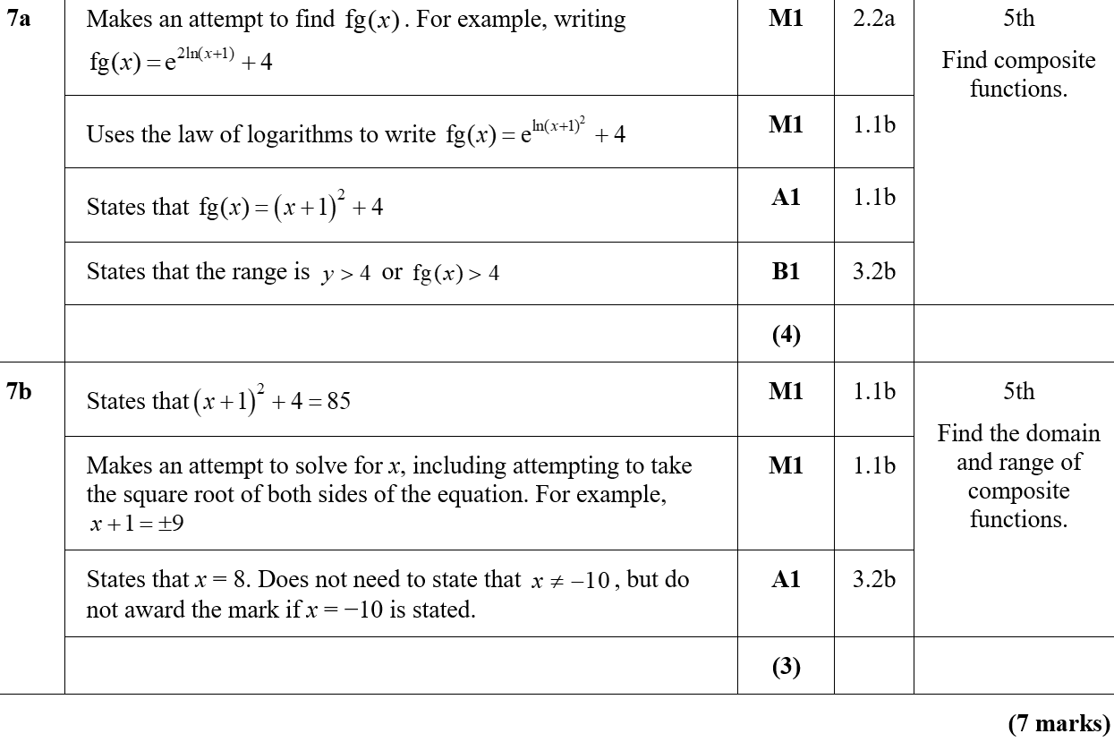
Practice D
A
B

Slide 12
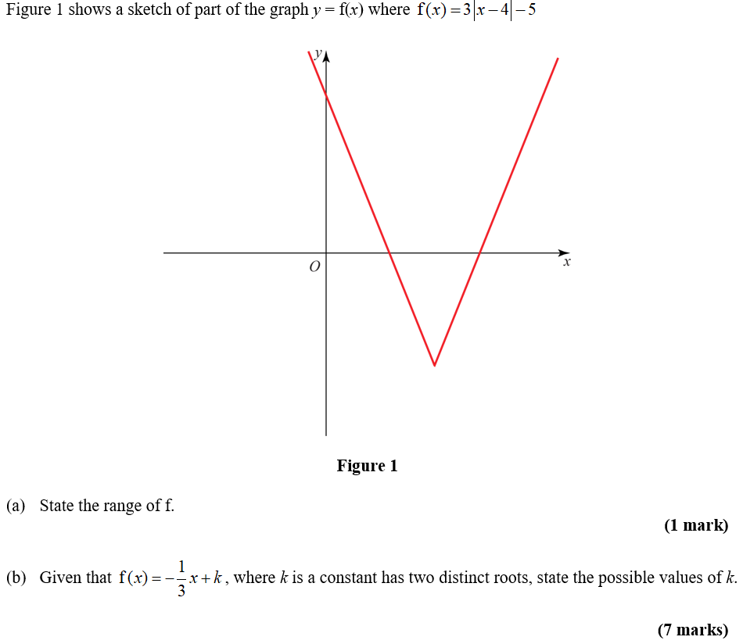
Practice E

Slide 13
Practice E
A

Slide 14
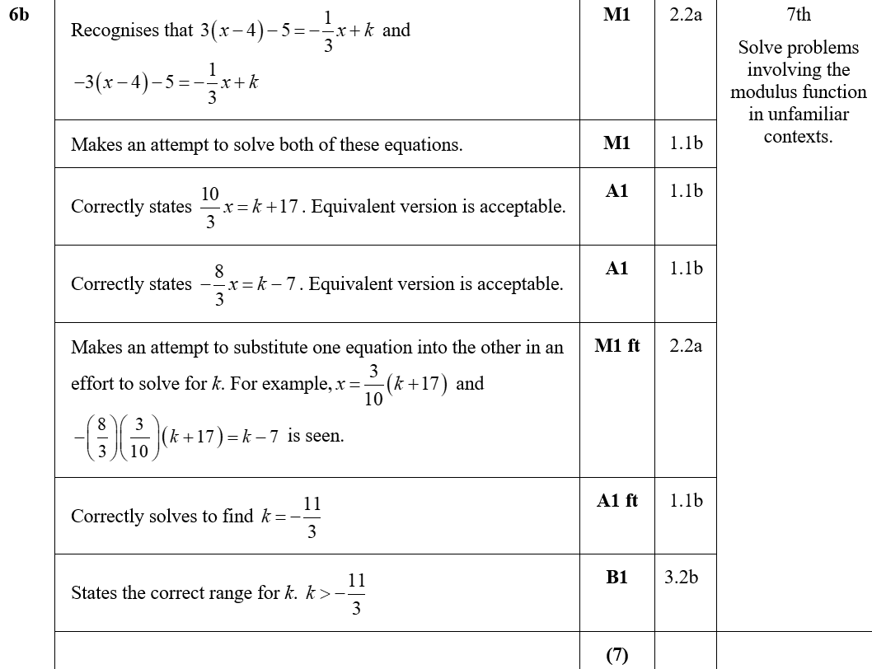
Practice E
B

Slide 15
Practice F

Slide 16
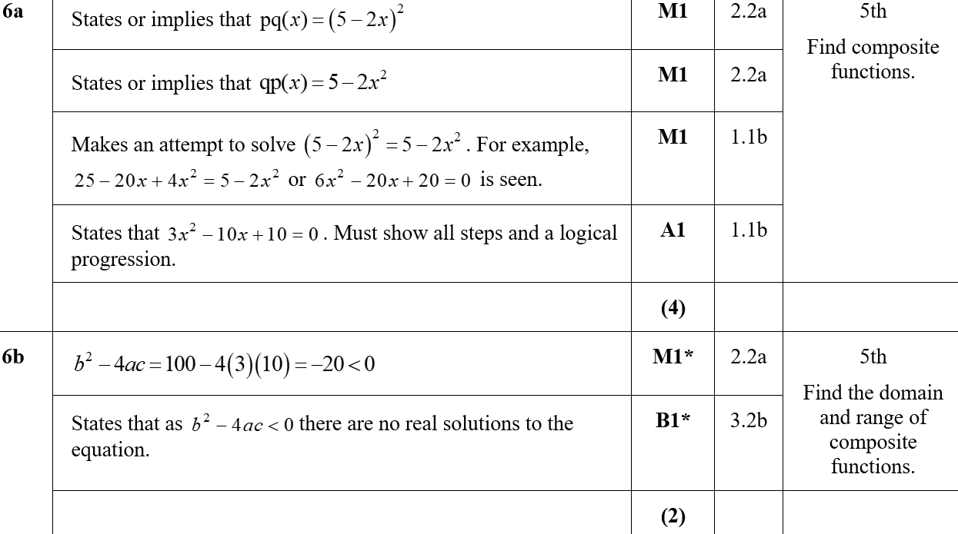
Practice F
A
B

Slide 17
Practice F
Alternative B

Slide 18
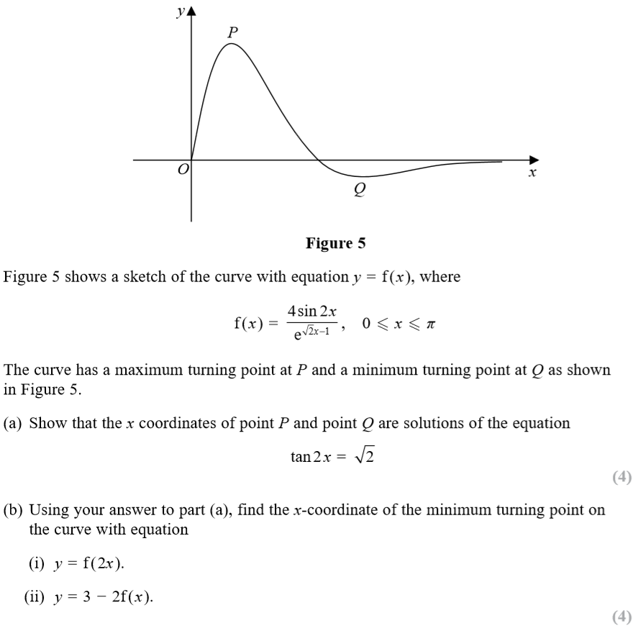
SAM Paper 1

Slide 19
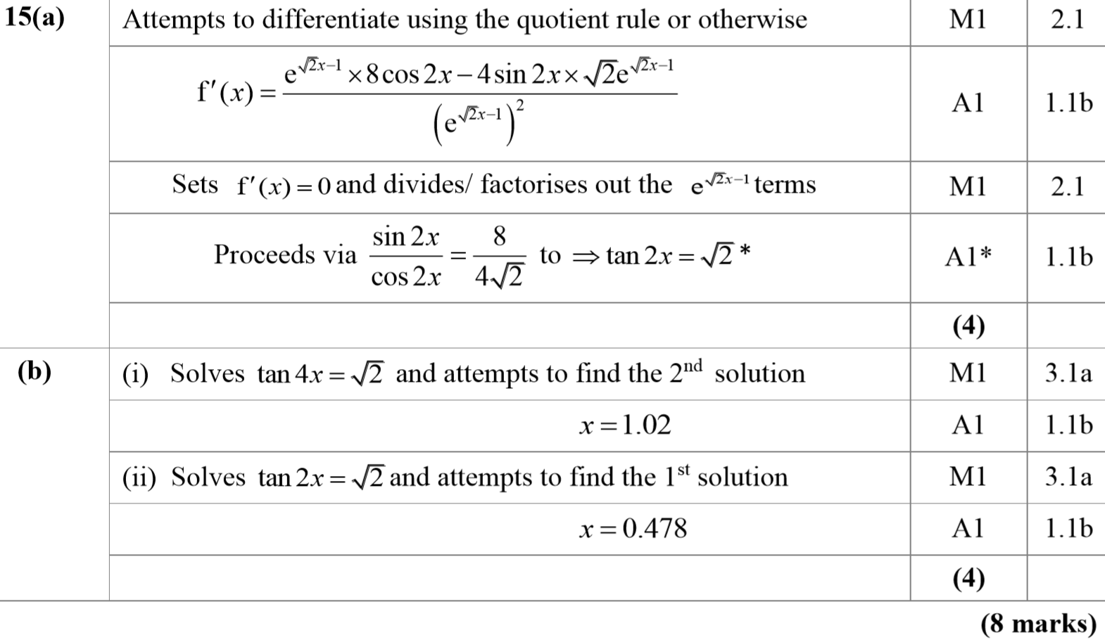
SAM Paper 1
A
B

Slide 20
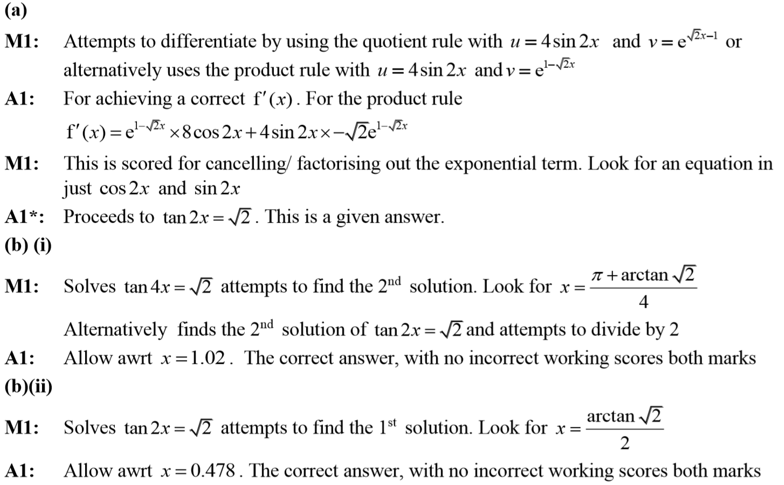
SAM Paper 1
A notes
B (i) notes
B (ii) notes

Slide 21
SAM Paper 2

Slide 22
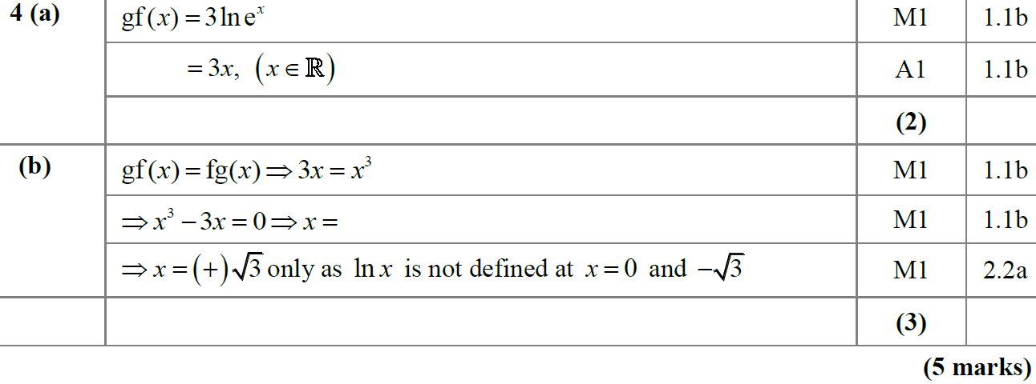
SAM Paper 2
A
B

Slide 23
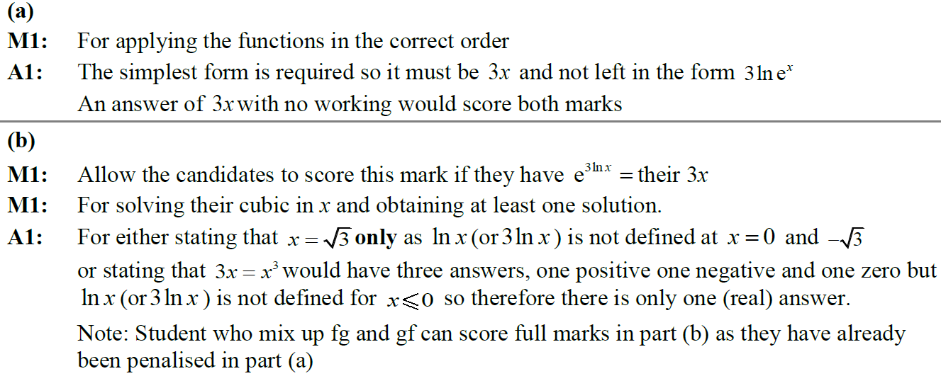
SAM Paper 2
A notes
B (i) notes

Slide 24
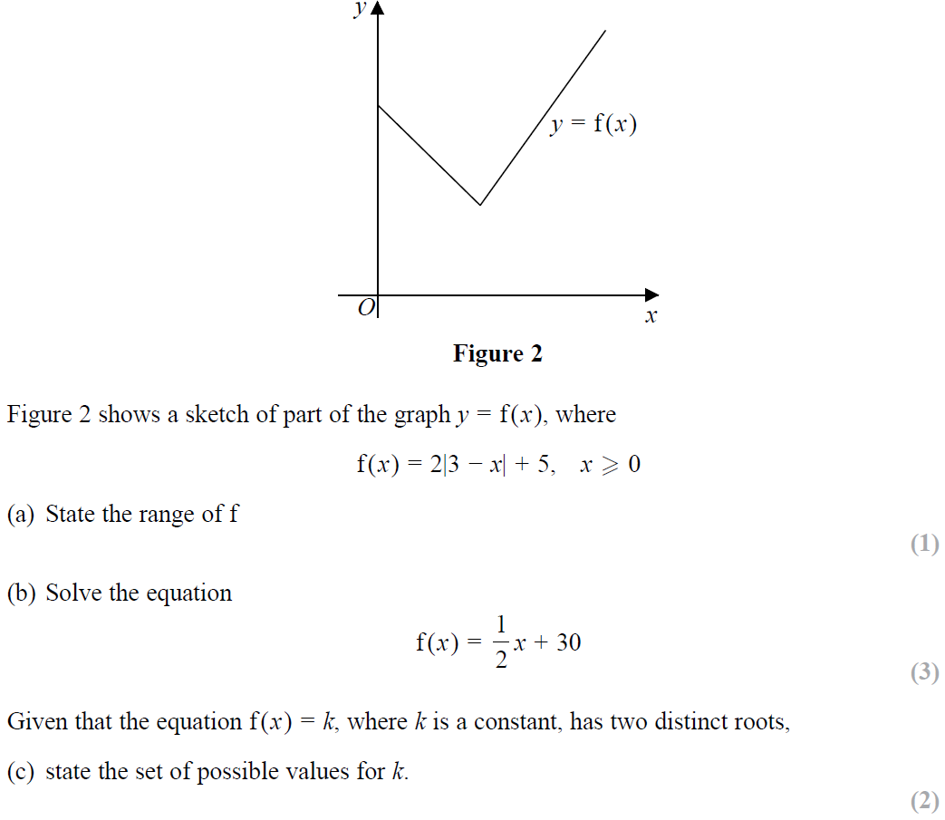
SAM Paper 2

Slide 25
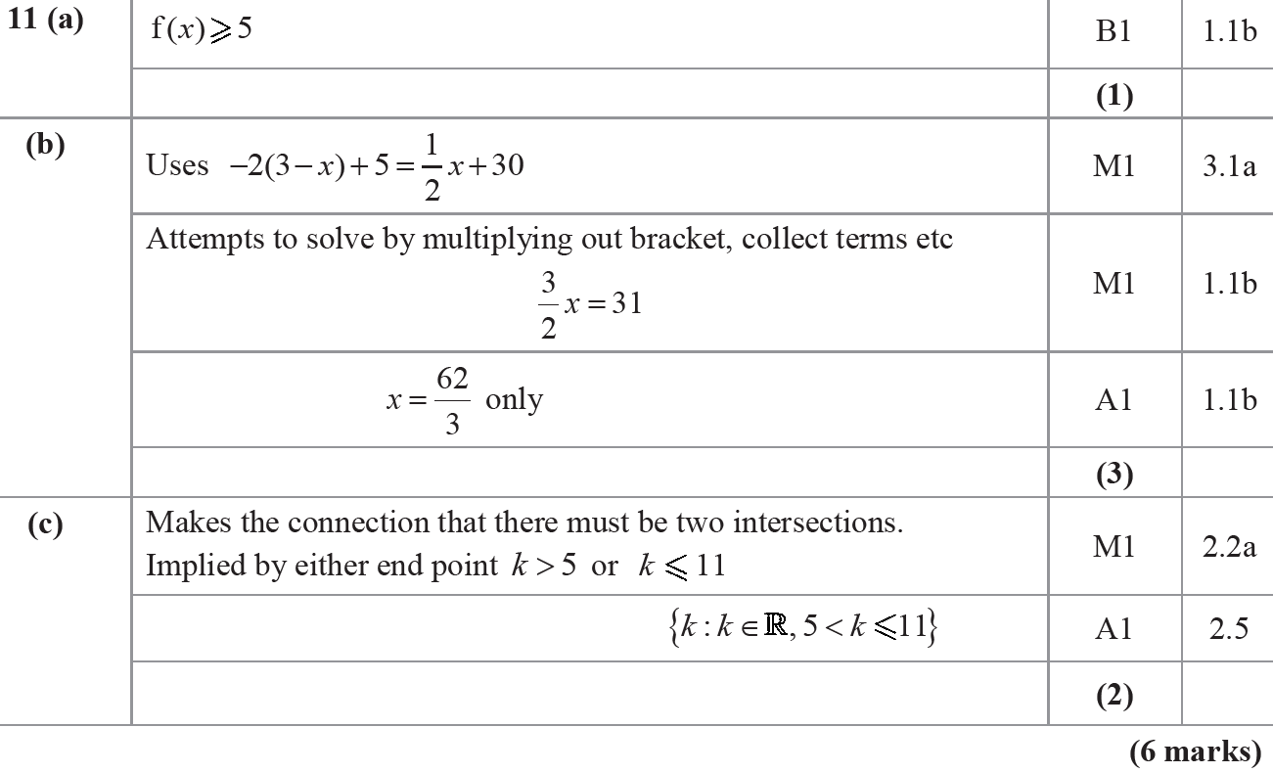
SAM Paper 2
A
B
C

Slide 26
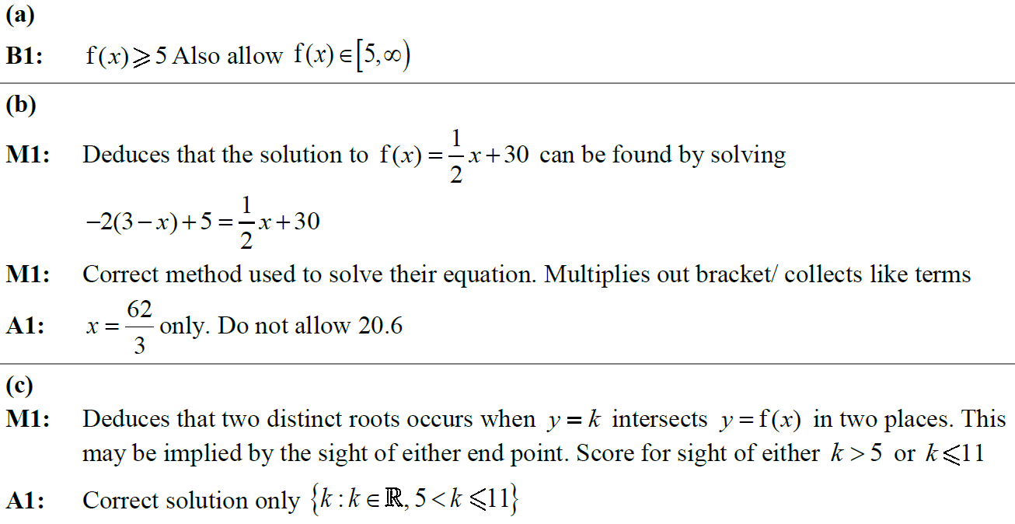
SAM Paper 2
A notes
B notes
C notes

Slide 27
2018 Paper 2

Slide 28
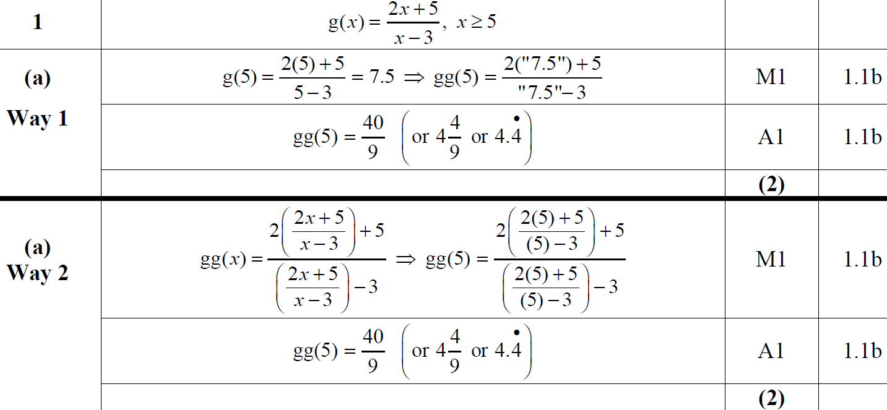
2018 Paper 2
A
A Alternative

Slide 29
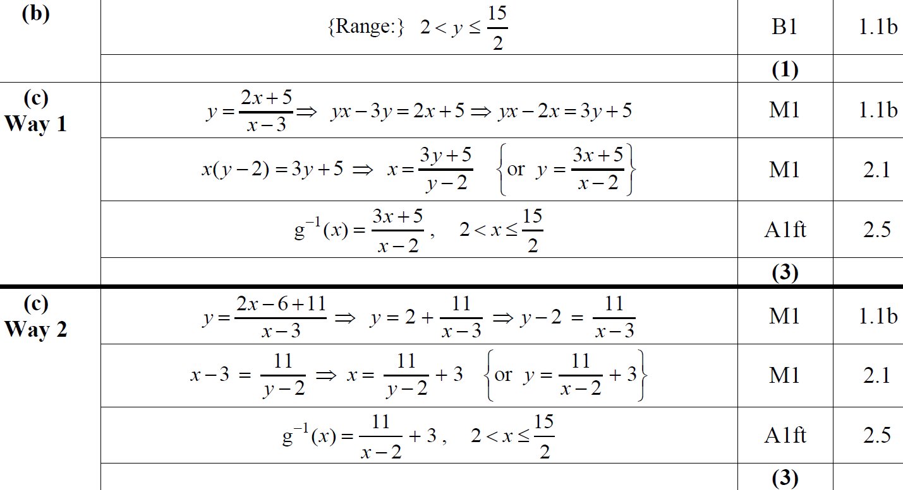
2018 Paper 2
B
C
C Alternative

Slide 30
2018 Paper 2
A (SF)
B (SF)

Slide 31
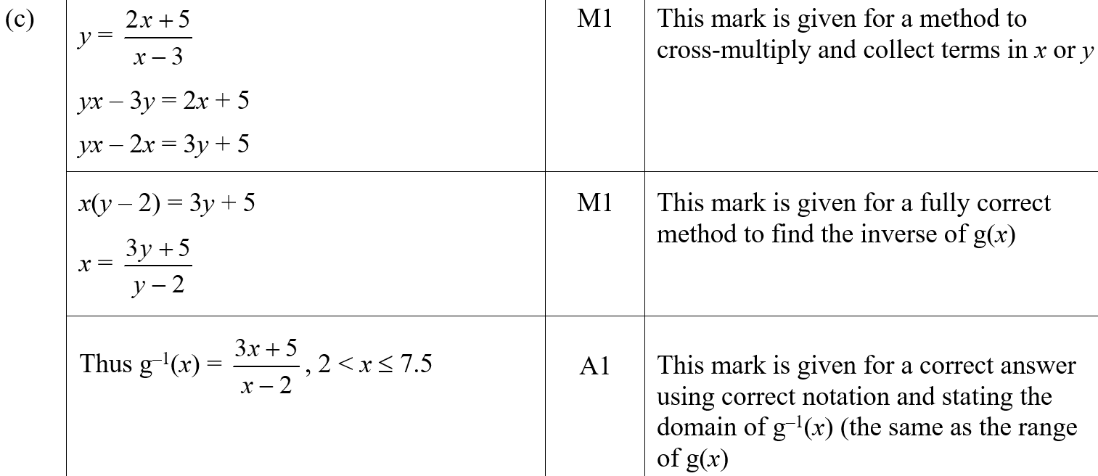
2018 Paper 2
C (SF)

Slide 32
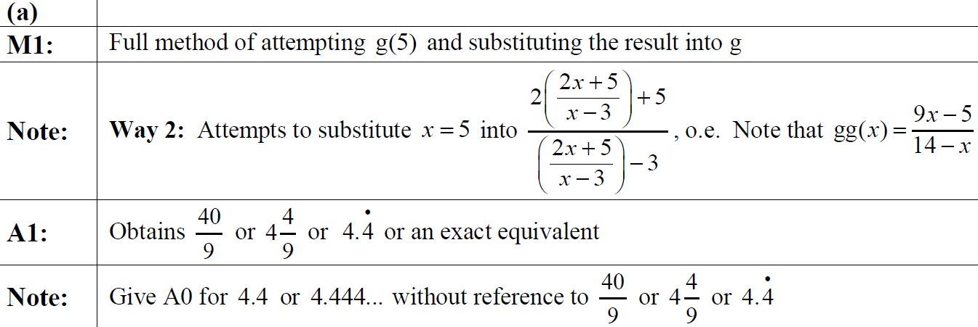
2018 Paper 2
A notes
B notes

Slide 33
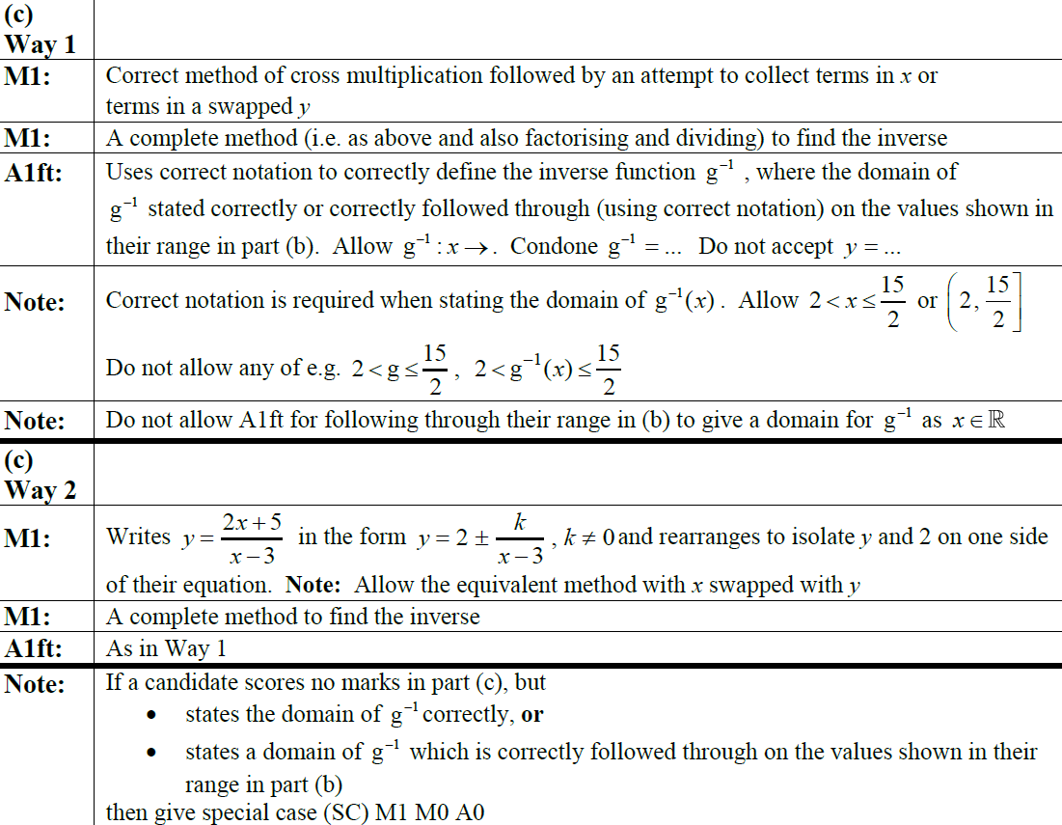
2018 Paper 2
C notes

Slide 34
2018 Paper 2

Slide 35
2018 Paper 2
A
A (SF)

Slide 36
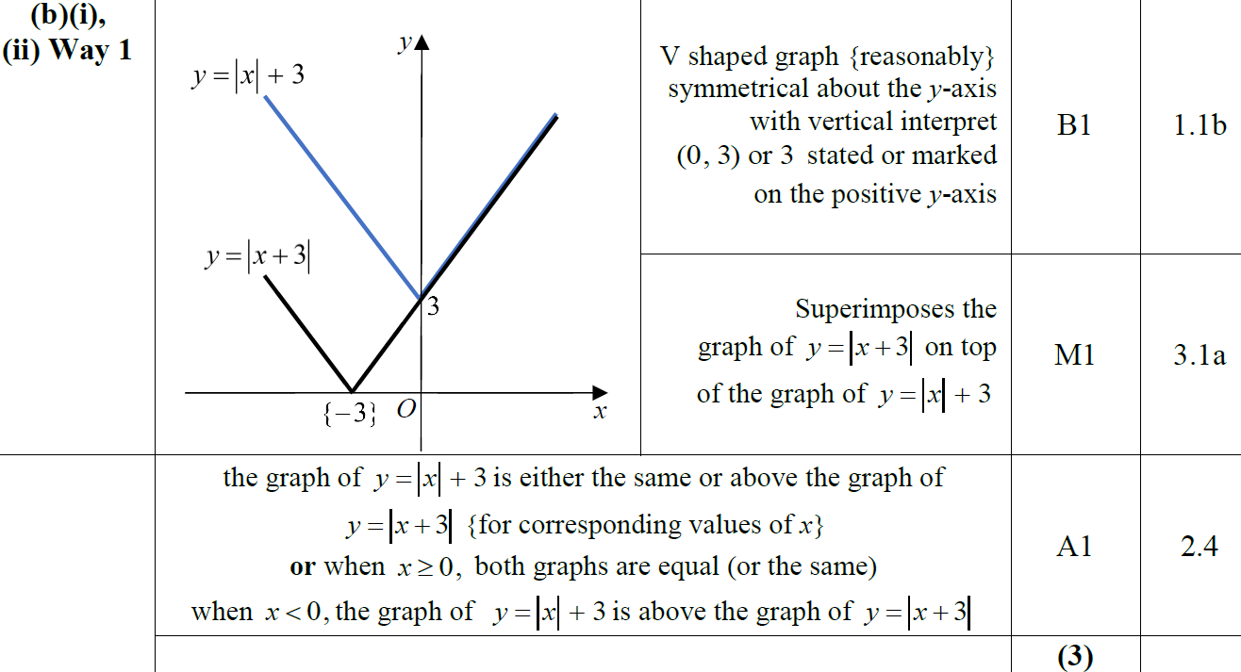
2018 Paper 2
B
B (ii) Alternatives

Slide 37
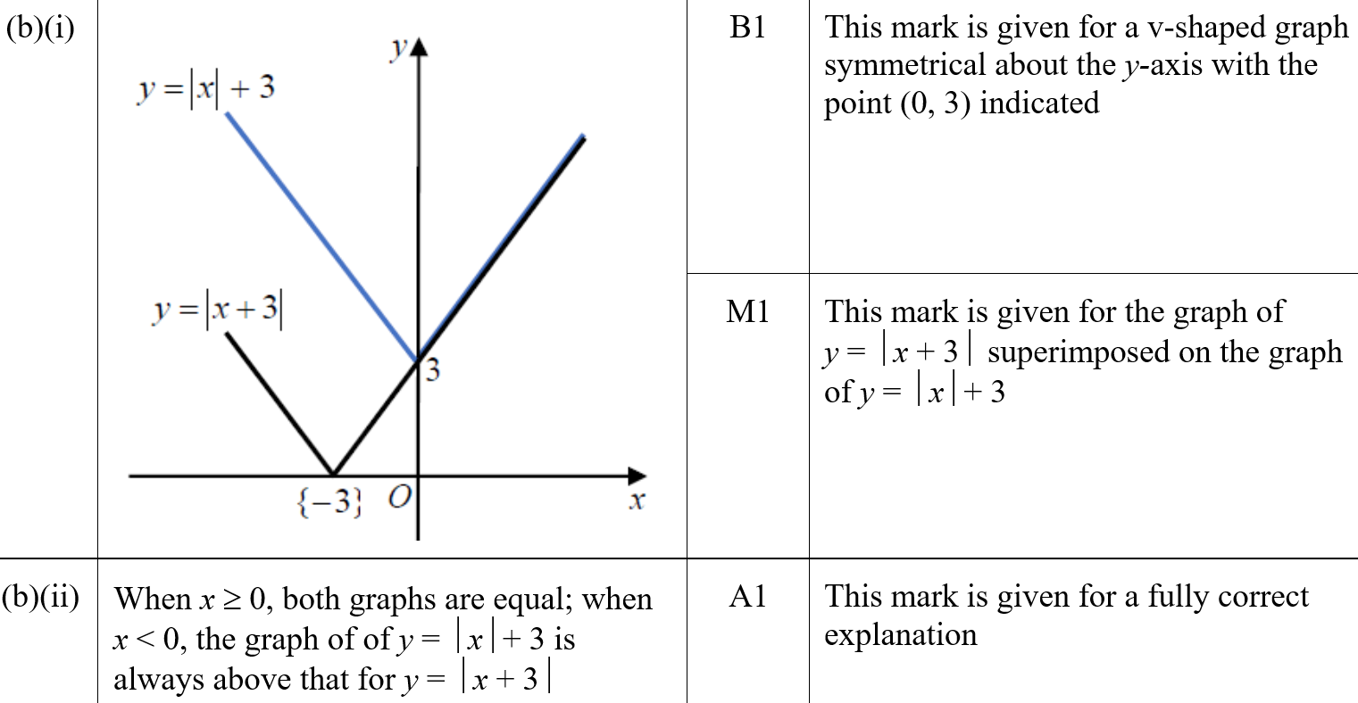
2018 Paper 2
B (i) (SF)
B (ii) (SF)

Slide 38
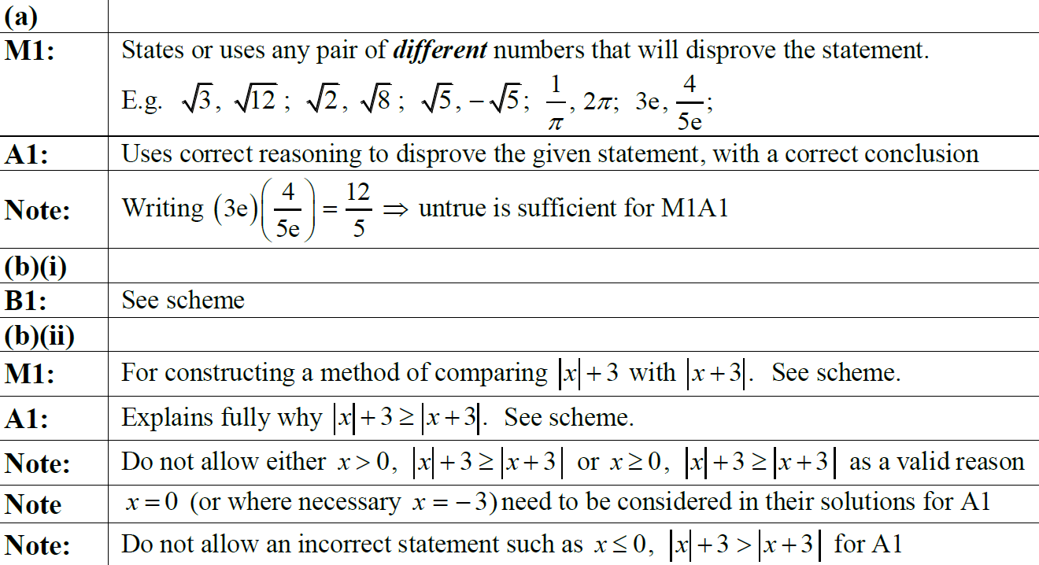
2018 Paper 2
A notes
B (i) notes
B (ii) notes

Slide 39
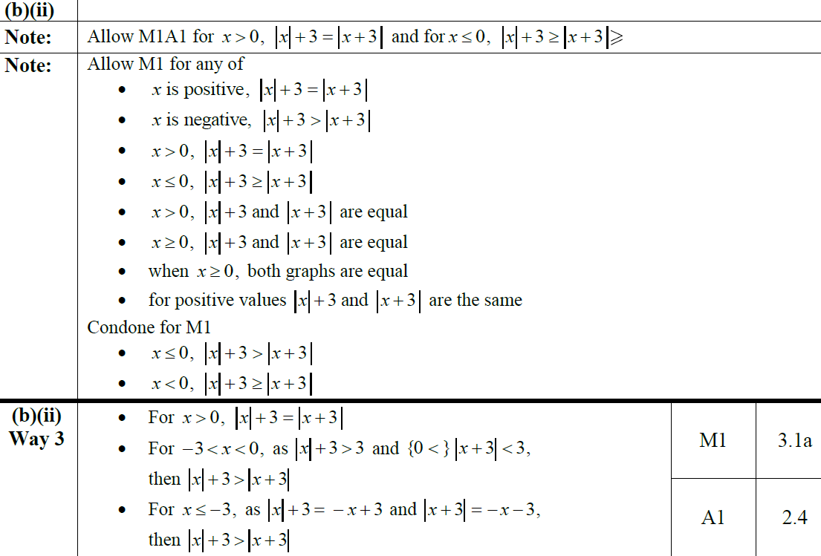
2018 Paper 2
B (ii) Alternatives notes

Slide 40
New Spec Q’s
Old Spec Functions
C3 Transforming Graphs
C3 Functions
Jan 2006
Jan 2011
June 2018
Jan 2009
Jan 2013
June 2006
June 2011
June 2009
June 2013
Jan 2007
Jan 2012
Jan 2006 (i)
Jan 2010 (i)
June 2014
June 2007
June 2012
Jan 2006 (ii)
Jan 2010 (ii)
June 2015
Jan 2008
Jan 2013
June 2006 (i)
June 2010
June 2016
June 2008
June 2013
June 2006 (ii)
Jan 2011
June 2017
Jan 2009
June 2014
Jan 2007
June 2011
June 2018
June 2009
June 2015
June 2007
Jan 2012
Jan 2010
June 2016
Jan 2008
June 2012 (i)
June 2010
June 2017
June 2008
June 2012 (ii)

Slide 41
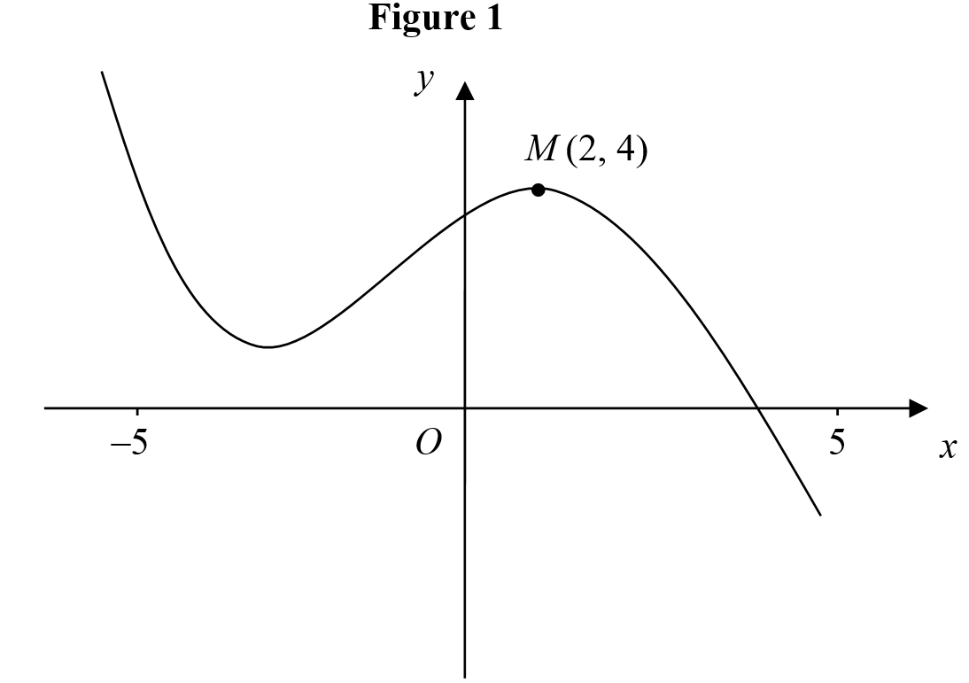
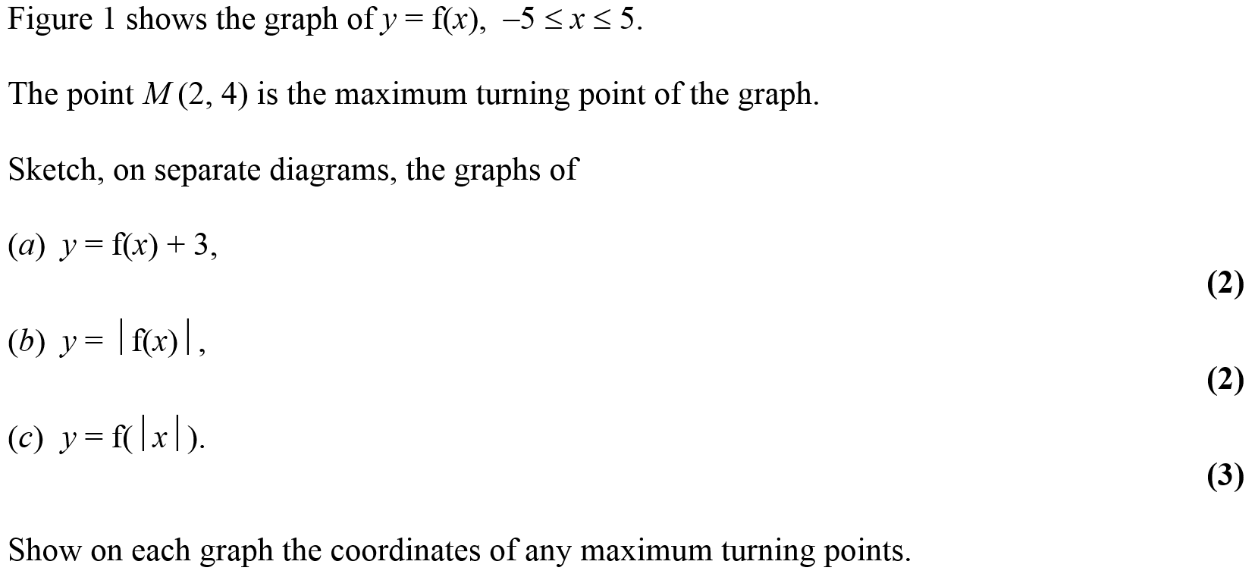
Jan 2006

Slide 42
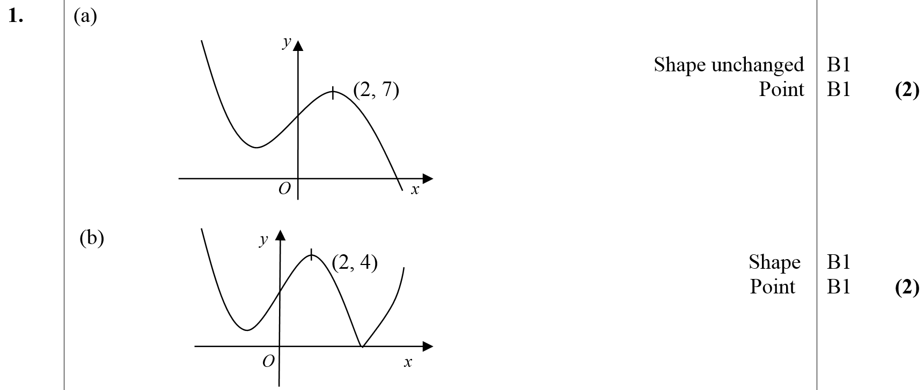
Jan 2006
A
B
C

Slide 43
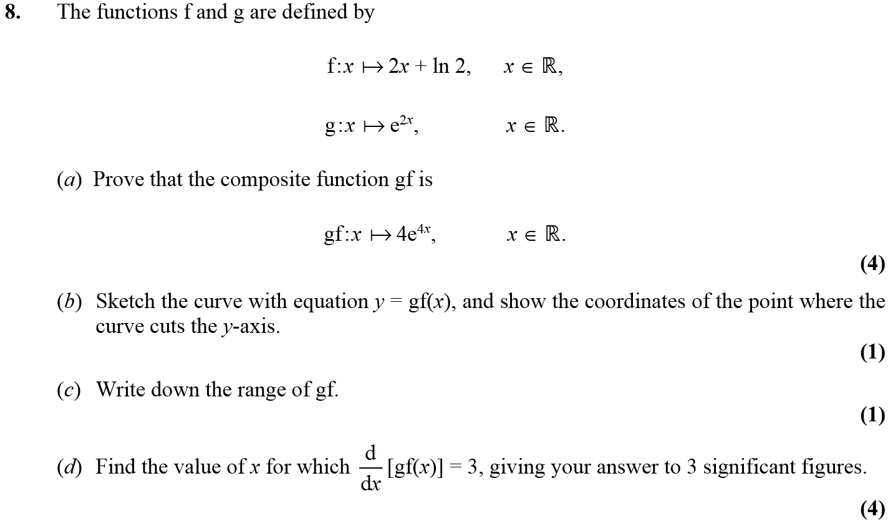
Jan 2006

Slide 44
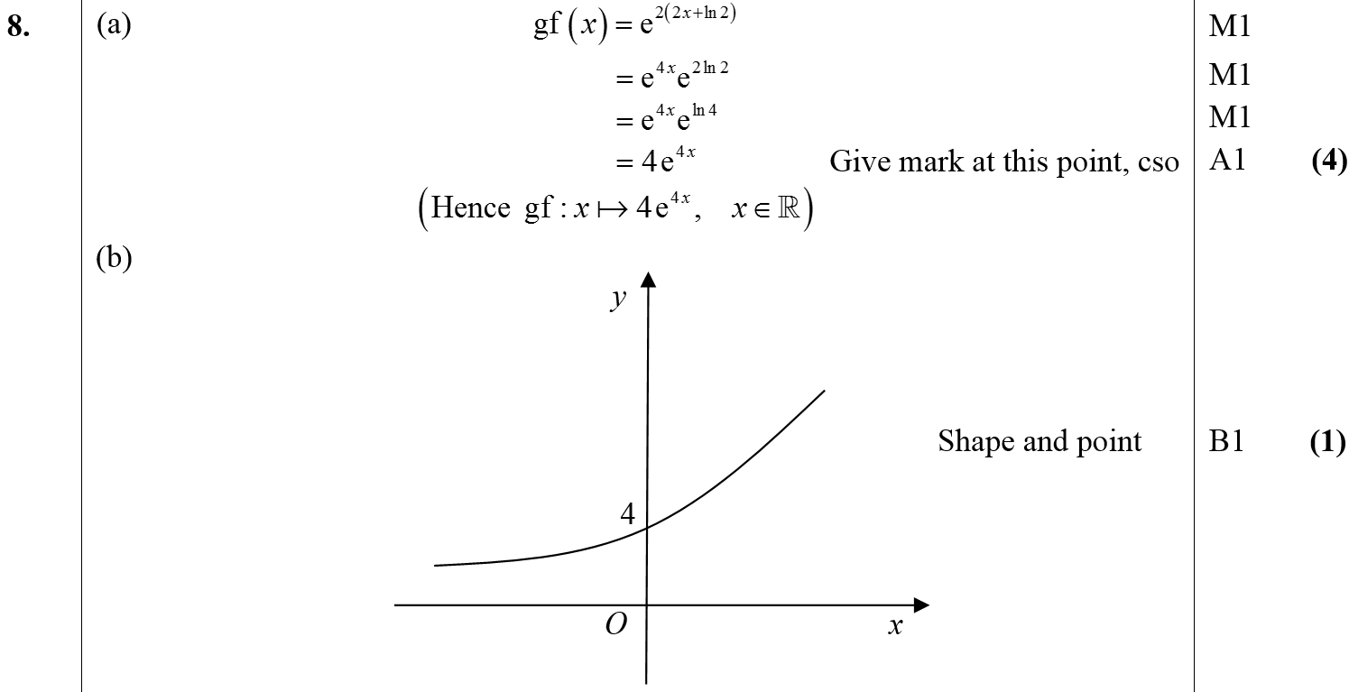
Jan 2006
A
B
C
D

Slide 45
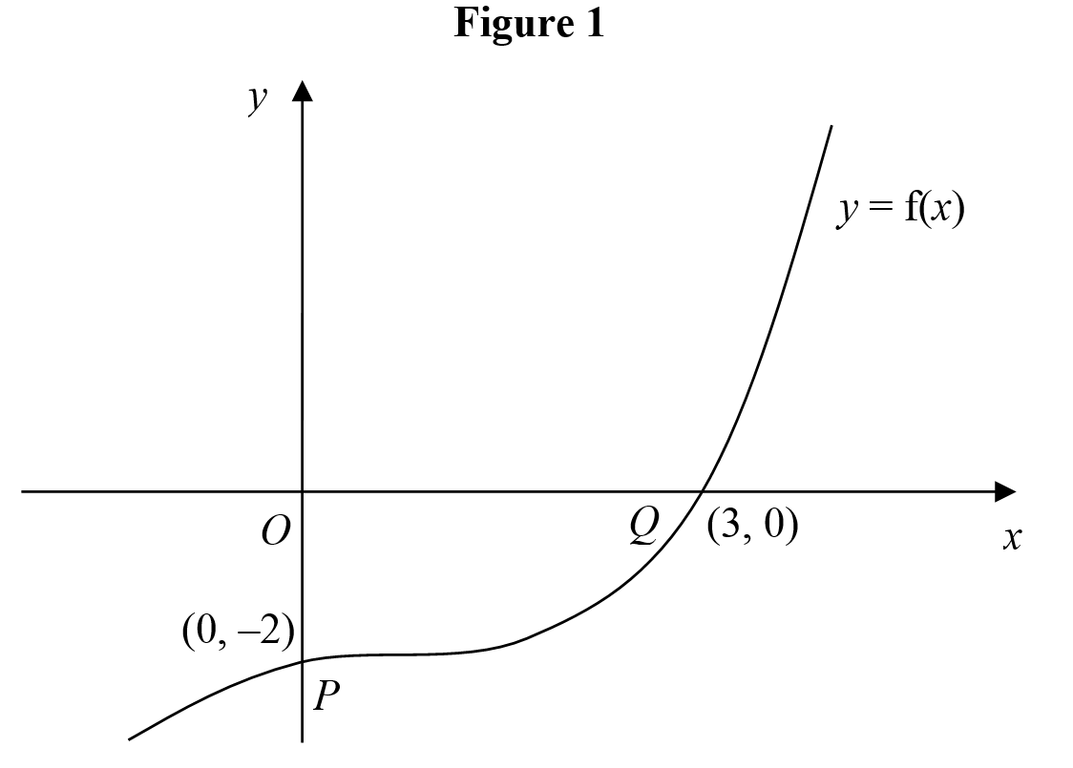
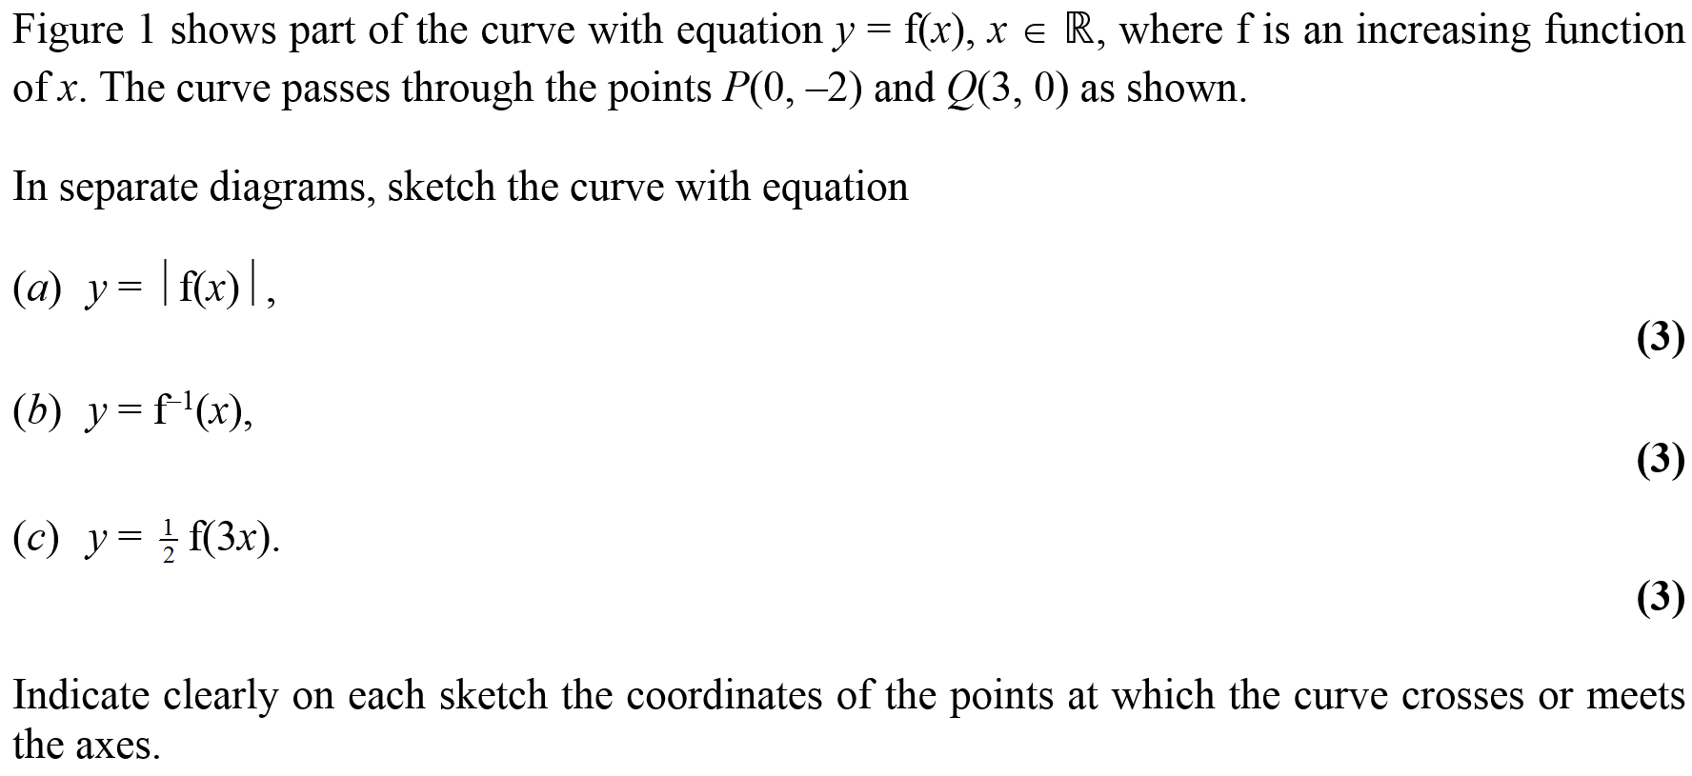
June 2006

Slide 46
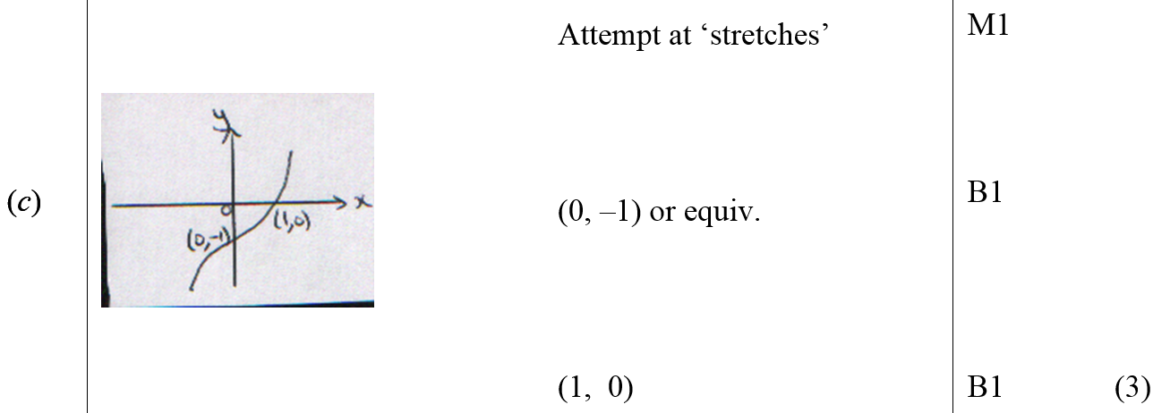
June 2006
A
B
C

Slide 47
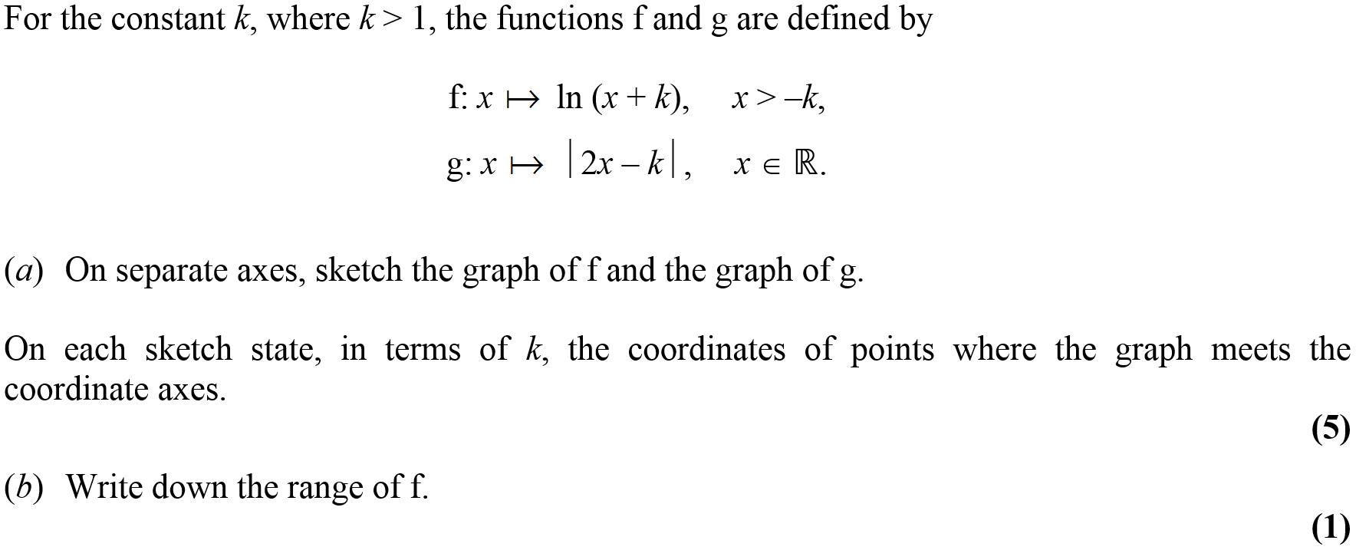
June 2006

Slide 48
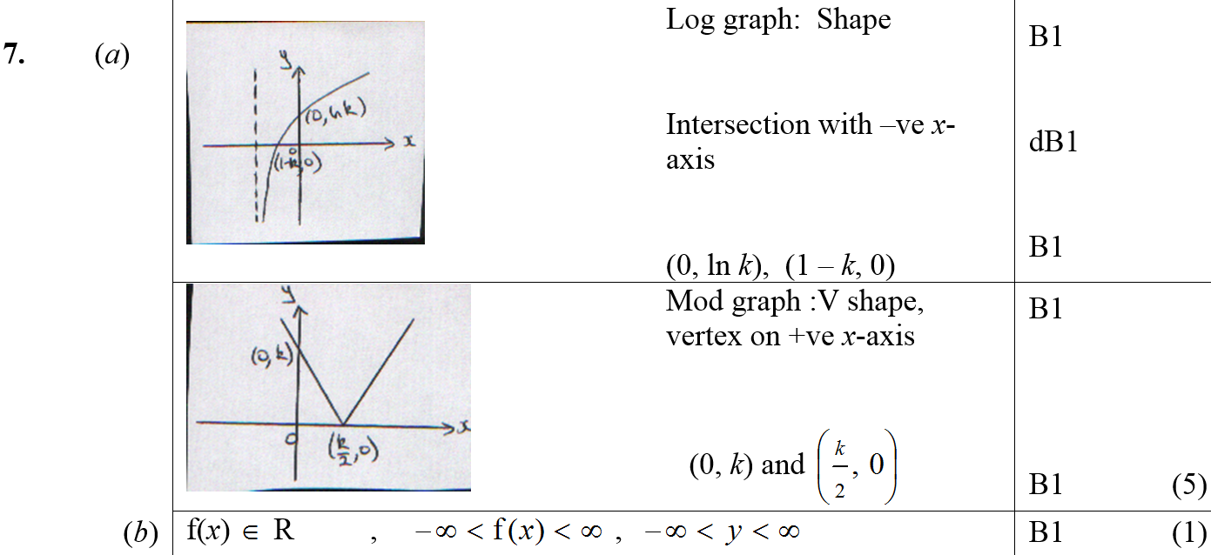
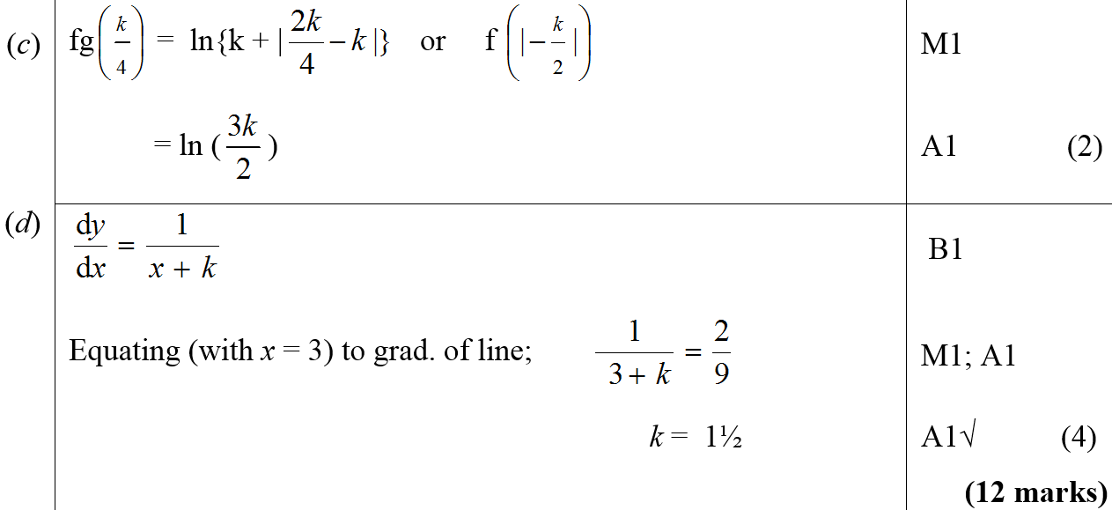
June 2006
A
B
C
D

Slide 49
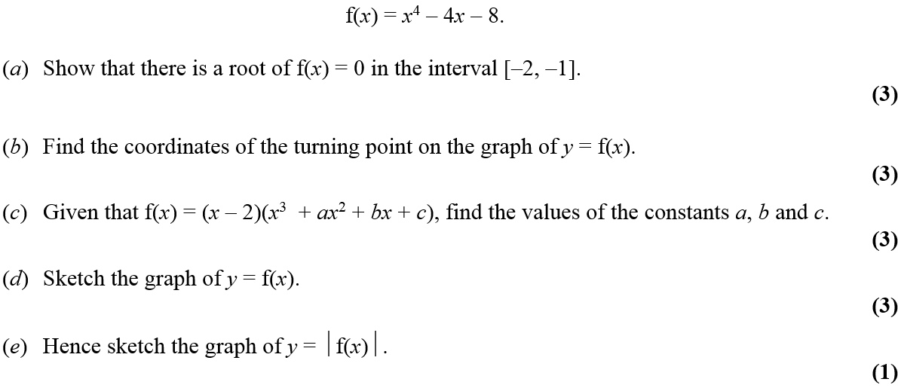
Jan 2007

Slide 50
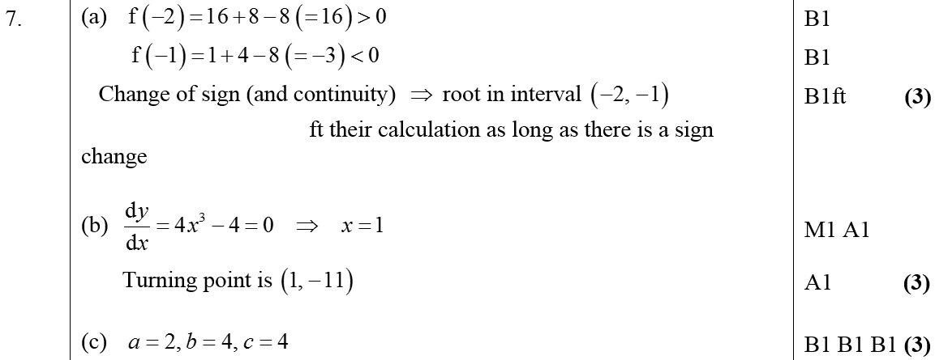
Jan 2007
A
B
C

Slide 51
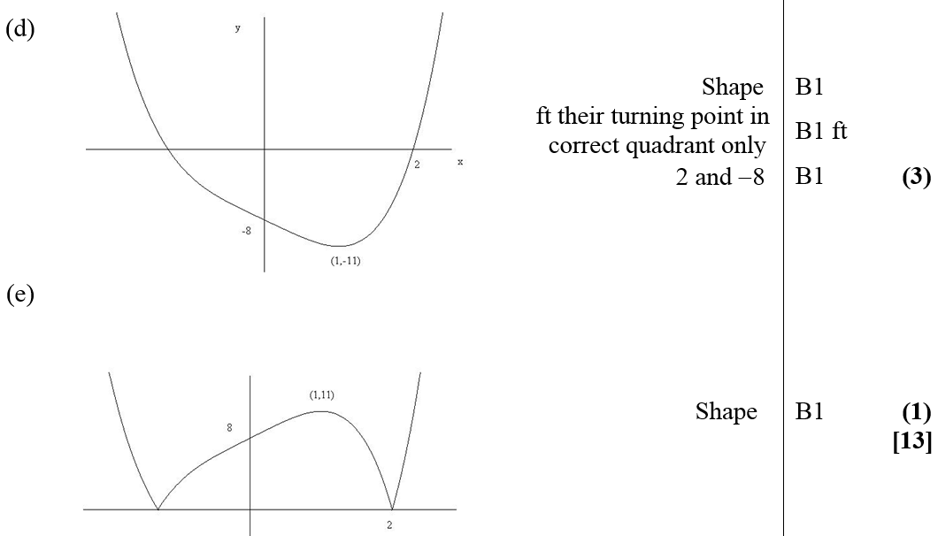
Jan 2007
D
E

Slide 52
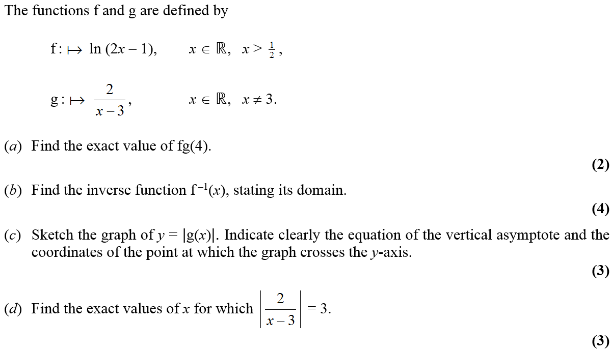
June 2007

Slide 53
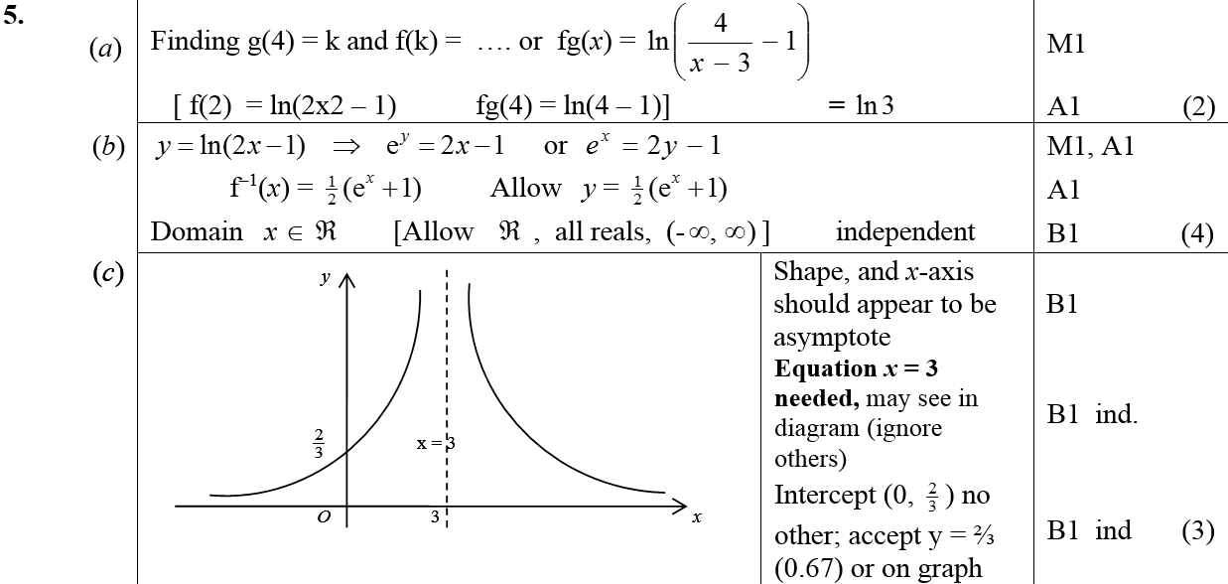
June 2007
A
B
C
D

Slide 54
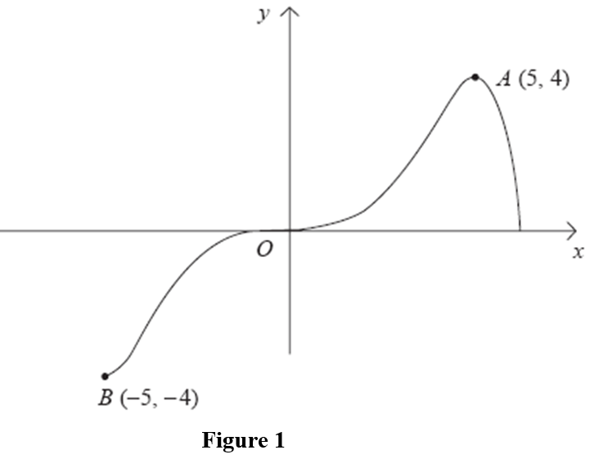
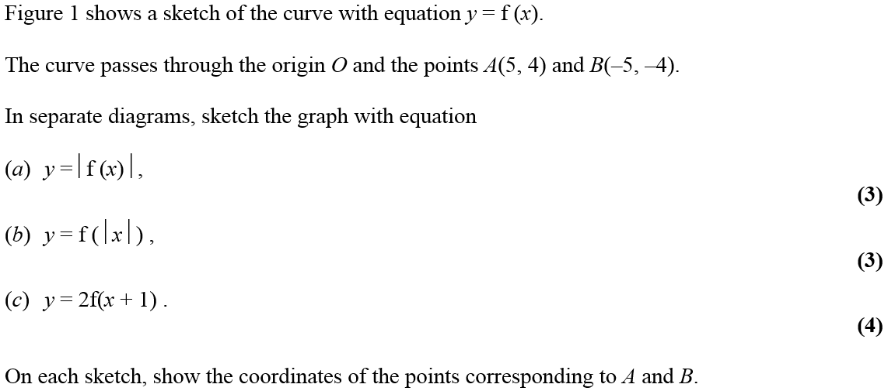
Jan 2008

Slide 55
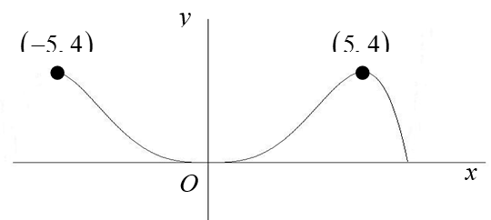
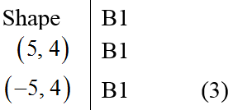
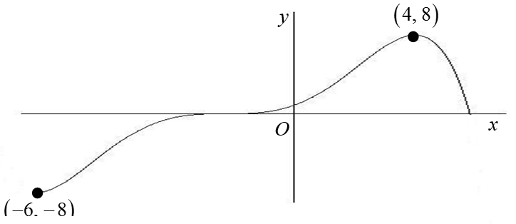
Jan 2008
A
B
C
General notes

Slide 56
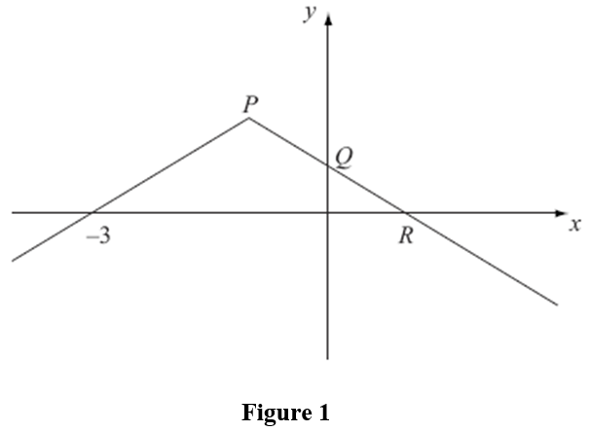
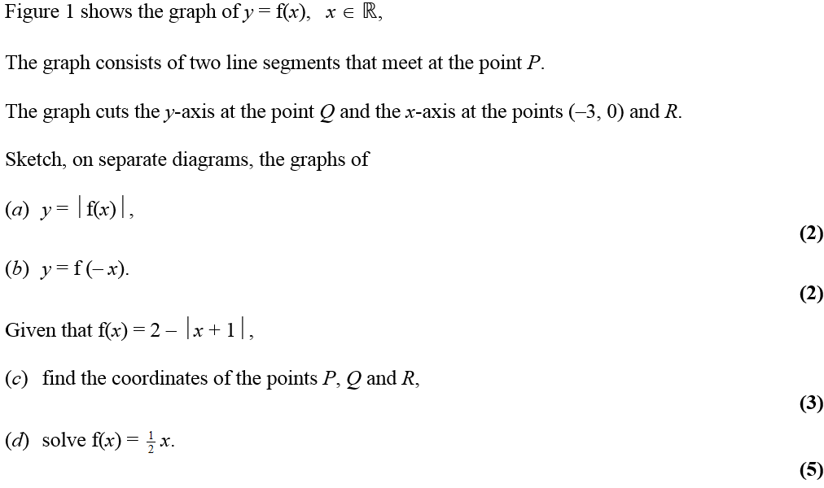
June 2008

Slide 57
June 2008
A
B
C
D

Slide 58
Jan 2009

Slide 59
Jan 2009
A
B

Slide 60
June 2009

Slide 61
June 2009
A
B

Slide 62
June 2009
C
D
E

Slide 63
Jan 2010

Slide 64
Jan 2010
A

Slide 65
Jan 2010

Slide 66
i
Jan 2010
ii

Slide 67
Jan 2010
iii

Slide 68
June 2010

Slide 69
June 2010
A (i)
A (ii)
B
C
D

Slide 70
Jan 2011

Slide 71
Jan 2011
A
B
C
D

Slide 72
Jan 2011
E (i)
E (ii)
F

Slide 73
June 2011

Slide 74
June 2011
A
B

Slide 75
June 2011
A
B

Slide 76
June 2011
Alternative B

Slide 77
June 2011
Notes on Alternative B

Slide 78
June 2011
2 more methods for B

Slide 79
Jan 2012

Slide 80
Jan 2012
A
B

Slide 81
Jan 2012
A Notes
B Notes

Slide 82
June 2012

Slide 83
June 2012
A
B
C

Slide 84
June 2012

Slide 85
June 2012
A
B
C
D
E

Slide 86
Jan 2013

Slide 87
Jan 2013
A
B
C
D

Slide 88
June 2013

Slide 89
June 2013
(i)
(i) Notes

Slide 90
June 2013
(ii)
(ii) Notes

Slide 91
June 2013
(iii)
(iii) Notes

Slide 92
June 2013
(i) Examples
(ii) Examples
Example of follow through in part (ii) and (iii)

Slide 93
June 2014
$$ℝ$$

Slide 94
June 2014
A
B
C

Slide 95
June 2015

Slide 96
June 2015
A (i)
A (i) notes

Slide 97
June 2015
A (ii)
A (ii) notes

Slide 98
June 2015
B
C
B notes
C notes

Slide 99
June 2016

Slide 100
June 2016
A
B

Slide 101
June 2016
A notes

Slide 102
June 2016
B notes

Slide 103
June 2017

Slide 104
June 2017
A (i)
A (ii)
B

Slide 105
June 2017
A (i) notes
A (ii) notes

Slide 106
June 2017
B notes

Slide 107
June 2018

Slide 108
June 2018
A
B
C
A notes

Slide 109
June 2018
B notes

Slide 110
June 2018
B Alternative
C notes

Slide 111
Jan 2006

Slide 112
Jan 2006
A
B
C
D

Slide 113
June 2006

Slide 114
June 2006
A
B
C
D

Slide 115
Jan 2007

Slide 116
Jan 2007
A
B
C
D

Slide 117
Jan 2007
E

Slide 118
June 2007

Slide 119
June 2007
A
B
C
D

Slide 120
Jan 2008

Slide 121
Jan 2008
A
B
C

Slide 122
Jan 2008
D

Slide 123
June 2008

Slide 124
June 2008
A
B
C
D

Slide 125
Jan 2009

Slide 126
Jan 2009
A
B
C
D

Slide 127
June 2009

Slide 128
June 2009
A
B

Slide 129
June 2009
C
D
E

Slide 130
Jan 2010

Slide 131
Jan 2010
i (A)
i (B)

Slide 132
Jan 2010
ii (A)
ii (B)

Slide 133
June 2010

Slide 134
June 2010
A
B
C
D

Slide 135
Jan 2011

Slide 136
Jan 2011
A
B
C
D

Slide 137
Jan 2011
E (i)
E (ii)
F

Slide 138
June 2011

Slide 139
June 2011
A
B
C
D

Slide 140
Jan 2012

Slide 141
Jan 2012
A
B
C
D

Slide 142
Jan 2012
A Notes

Slide 143
Jan 2012
B Notes
C Notes
D Notes

Slide 144
June 2012

Slide 145
June 2012
A
B
C
D
E

Slide 146
Jan 2013

Slide 147
Jan 2013
A
B
C
D

Slide 148
June 2013

Slide 149
June 2013
A
B
C
D

Slide 150
June 2013
A Notes
B Notes
C Notes
D Notes

Slide 151
June 2013
D Alternative
D Alternative Notes

Slide 152
June 2014

Slide 153
June 2014
A
B
C

Slide 154
June 2015

Slide 155
June 2015
A
B
C

Slide 156
June 2015
A notes

Slide 157
June 2015
B notes

Slide 158
June 2015
C notes

Slide 159
June 2016

Slide 160
June 2016
A
B
A Alternative

Slide 161
June 2016
A Special Cases

Slide 162
June 2016
A notes
B notes

Slide 163
June 2017

Slide 164
June 2017
A
B
C

Slide 165
June 2017
D
C Alternative
A notes

Slide 166
June 2017
B notes

Slide 167
June 2017
C notes

Slide 168
June 2017
D notes

Slide 169
June 2018

Slide 170
June 2018
A
B

Slide 171
June 2018
A Alternative 1
A Alternative 2

Slide 172
June 2018
A notes

Slide 173
June 2018
B notes

