Slide 1
Old Spec Q’s
Data Processing
Specimen
SAM
2018

Slide 2
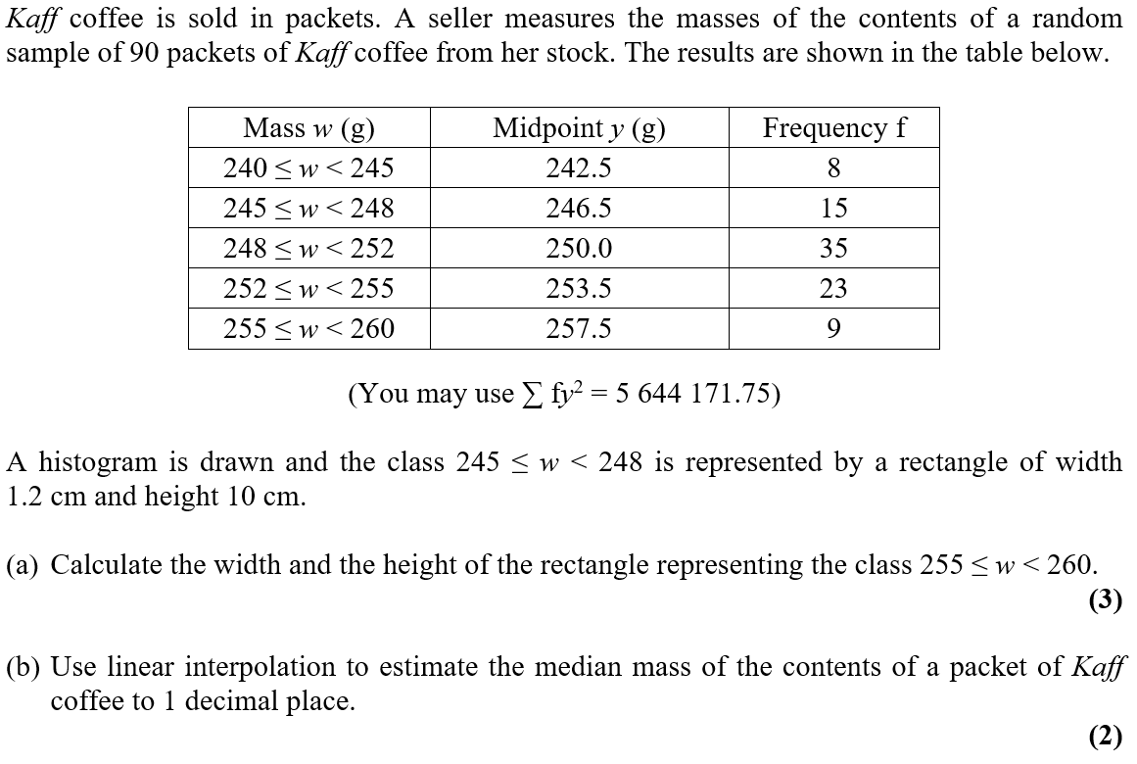
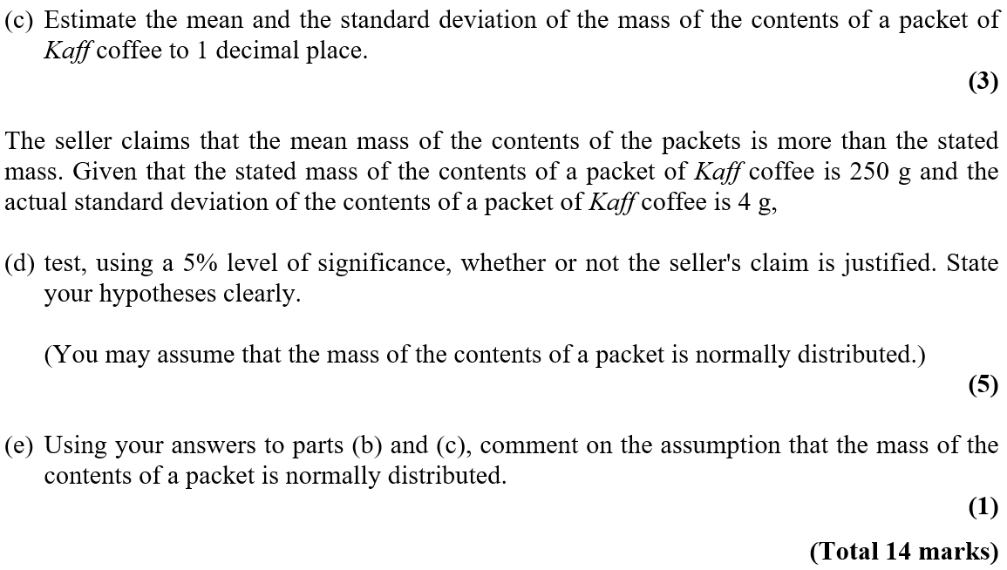


Specimen

Slide 3
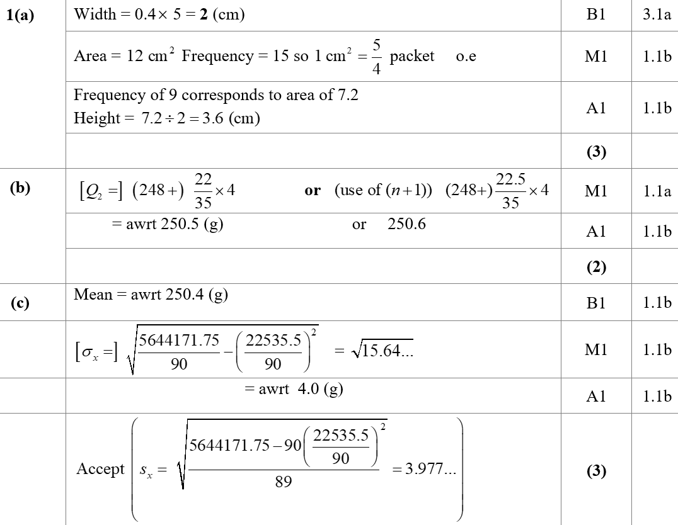

Specimen
A
B
C

Slide 4
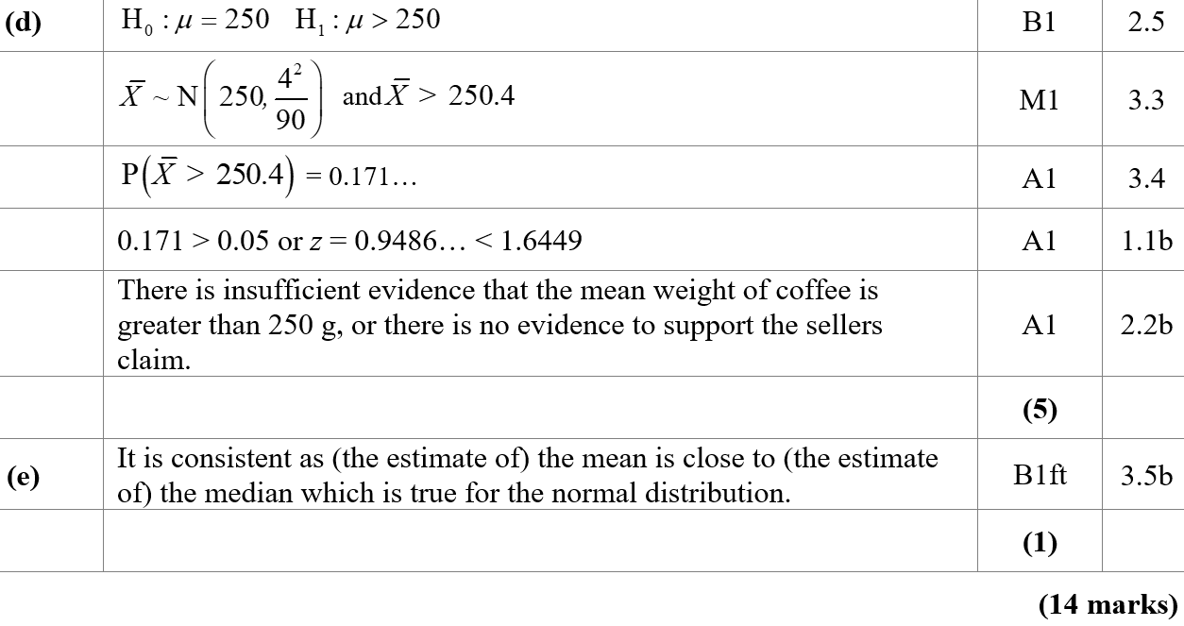
Specimen
D
E

Slide 5
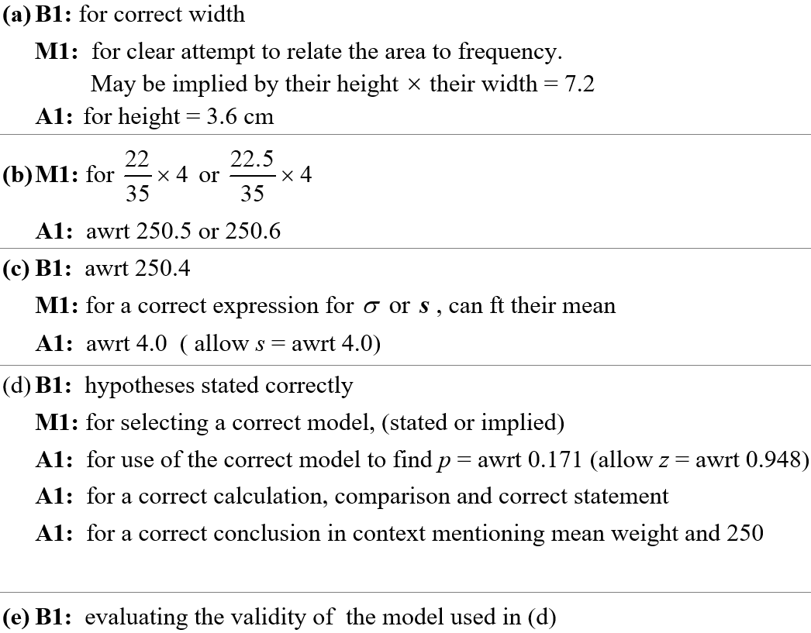
Specimen
A notes
B notes
C notes
D notes
E notes

Slide 6
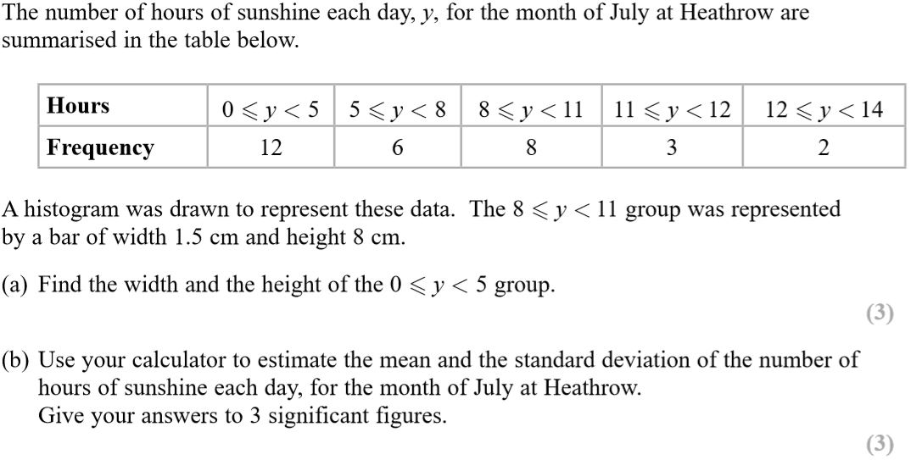
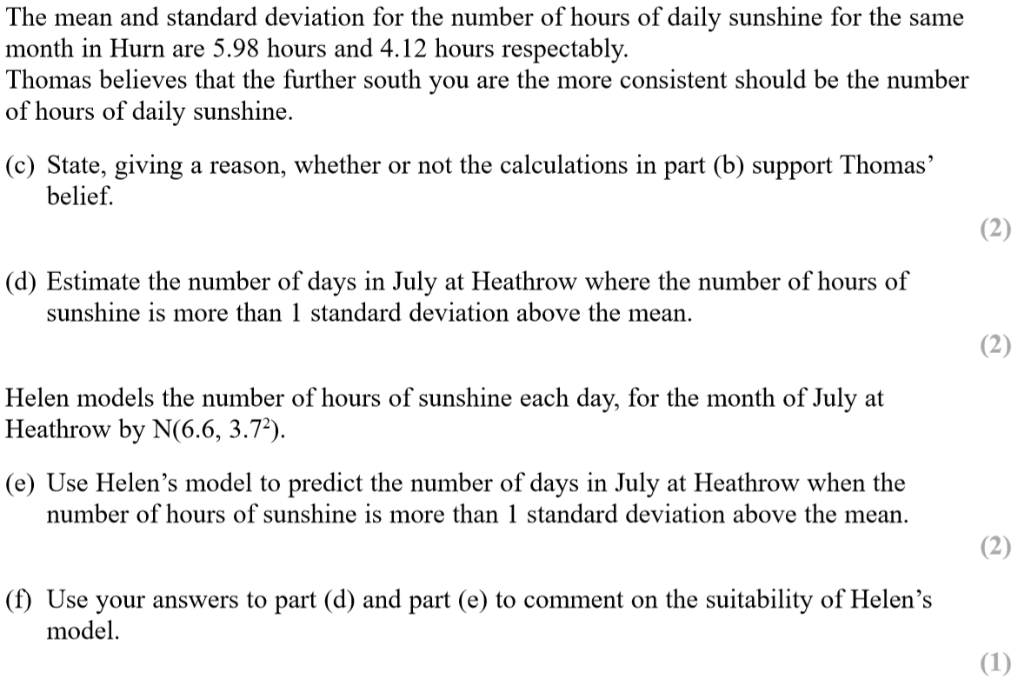
SAM

Slide 7
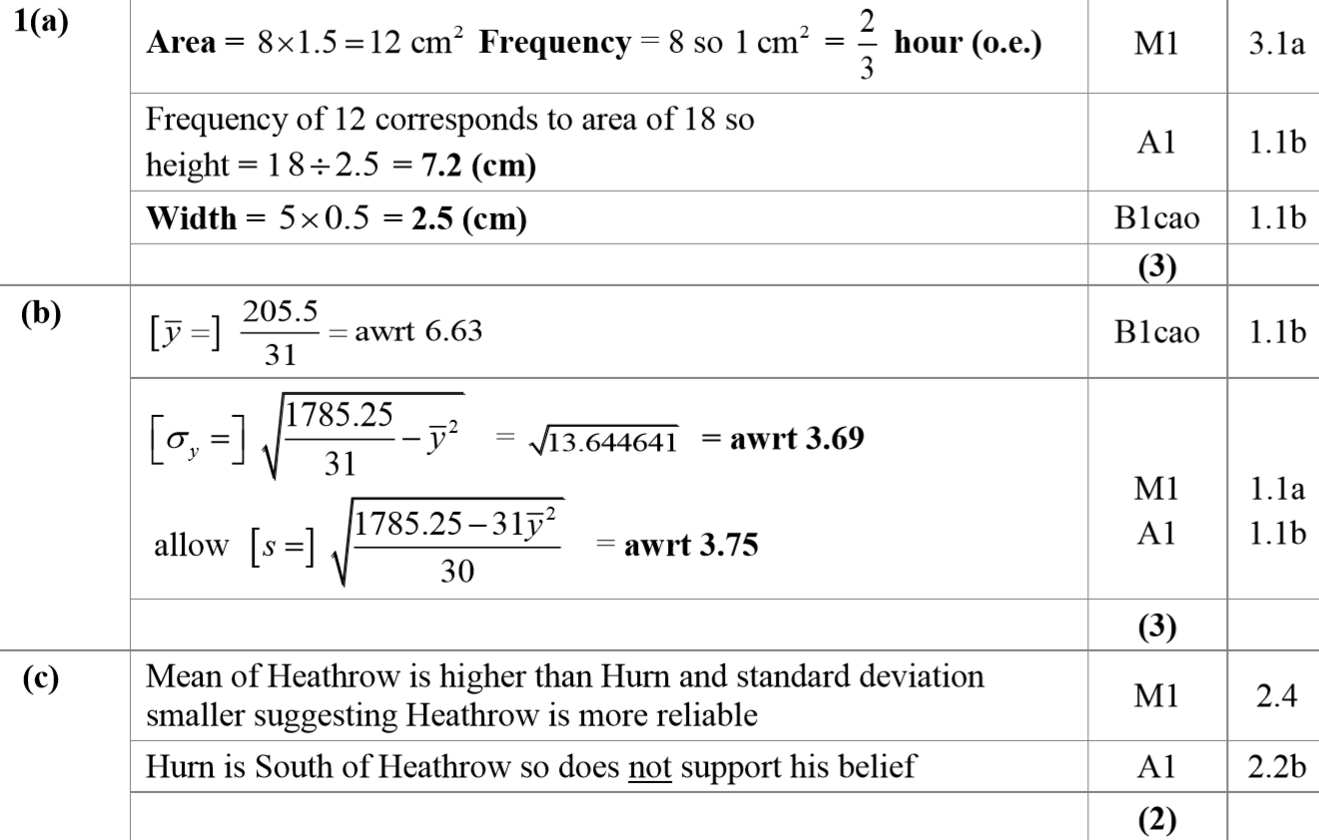
SAM
A
B
C

Slide 8
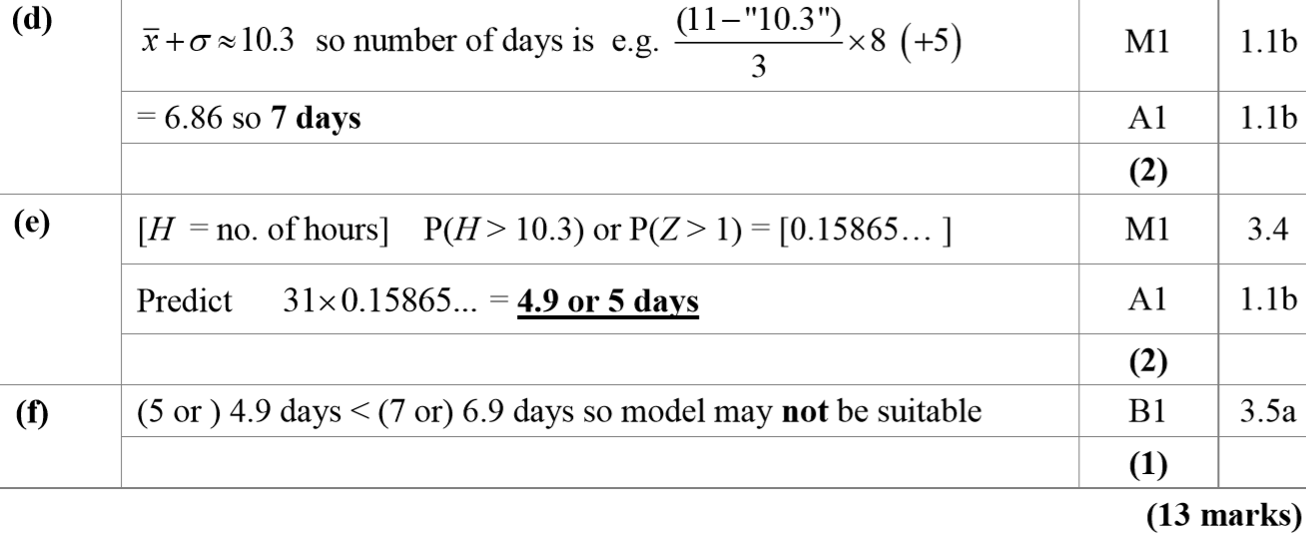
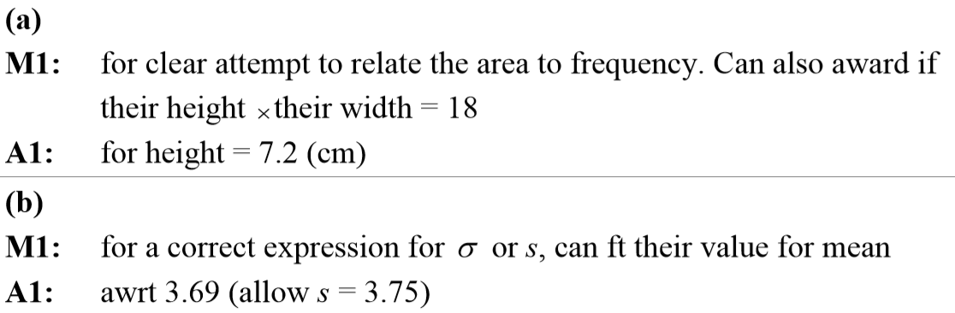
SAM
D
E
F
A notes
B notes

Slide 9
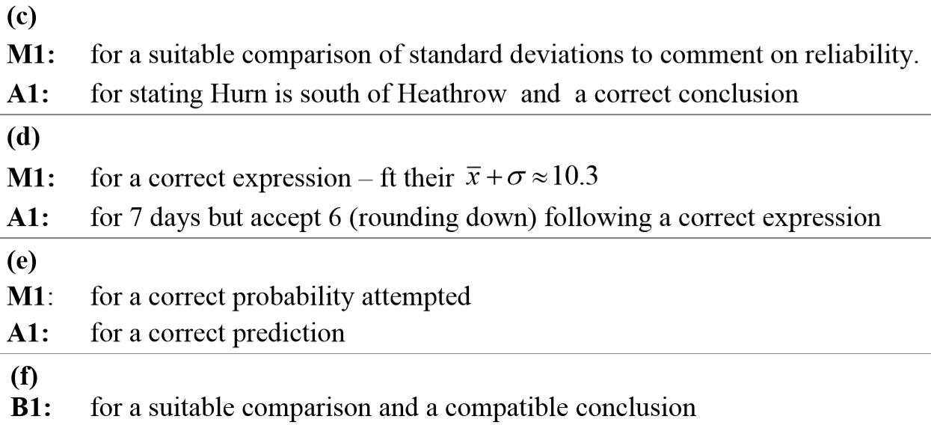
SAM
C notes
D notes
E notes
F notes

Slide 10
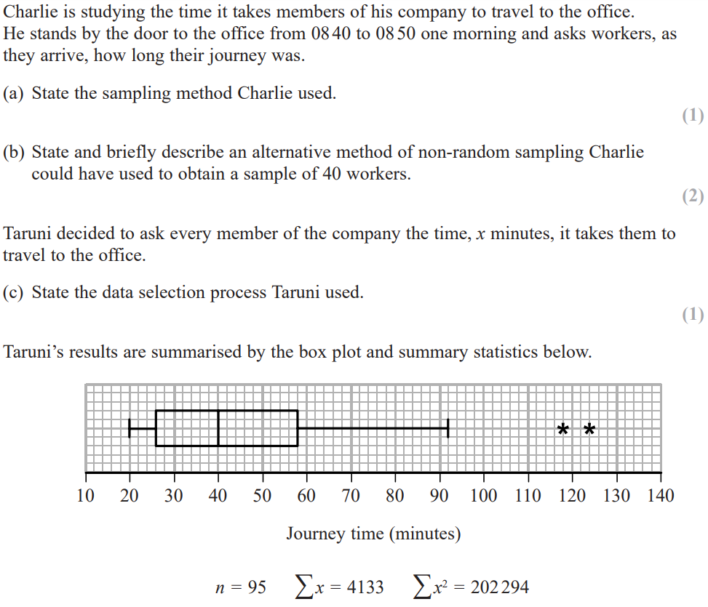
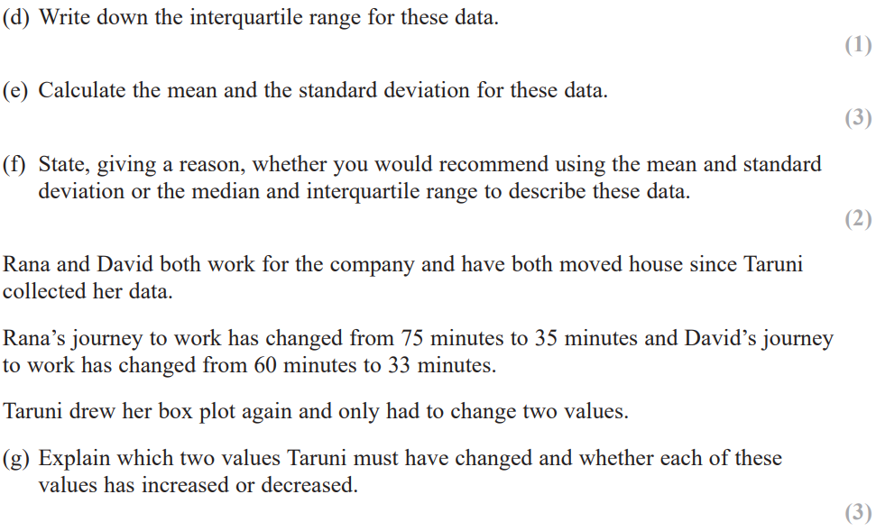
2018

Slide 11
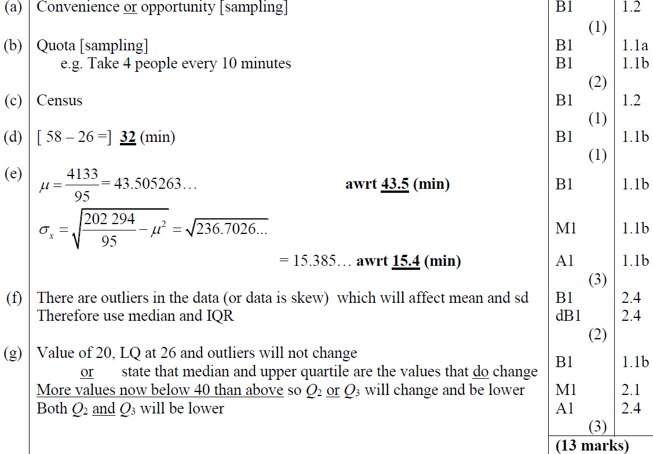
2018
A
B
C
D
E
F
G

Slide 12
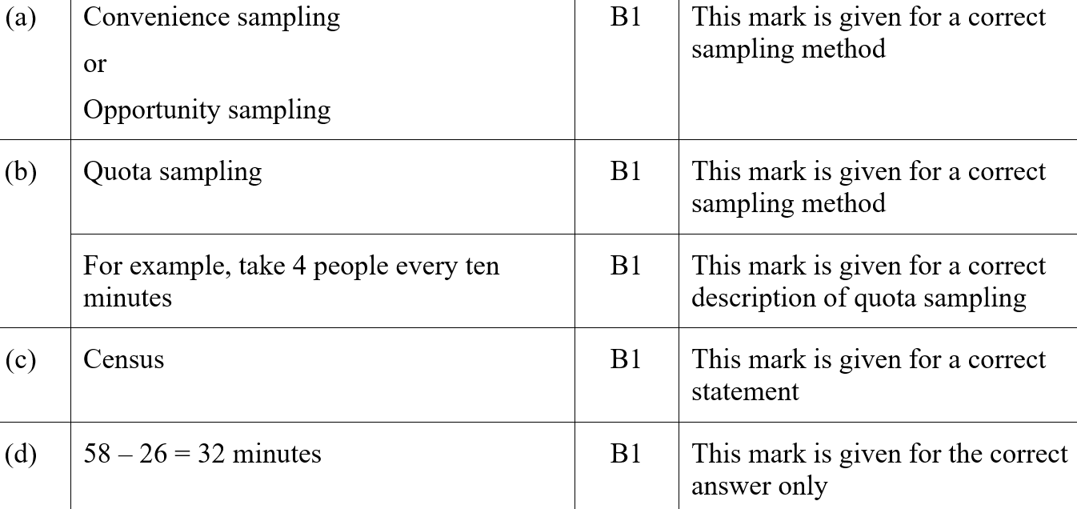
2018
A (SF)
B (SF)
C (SF)
D (SF)

Slide 13
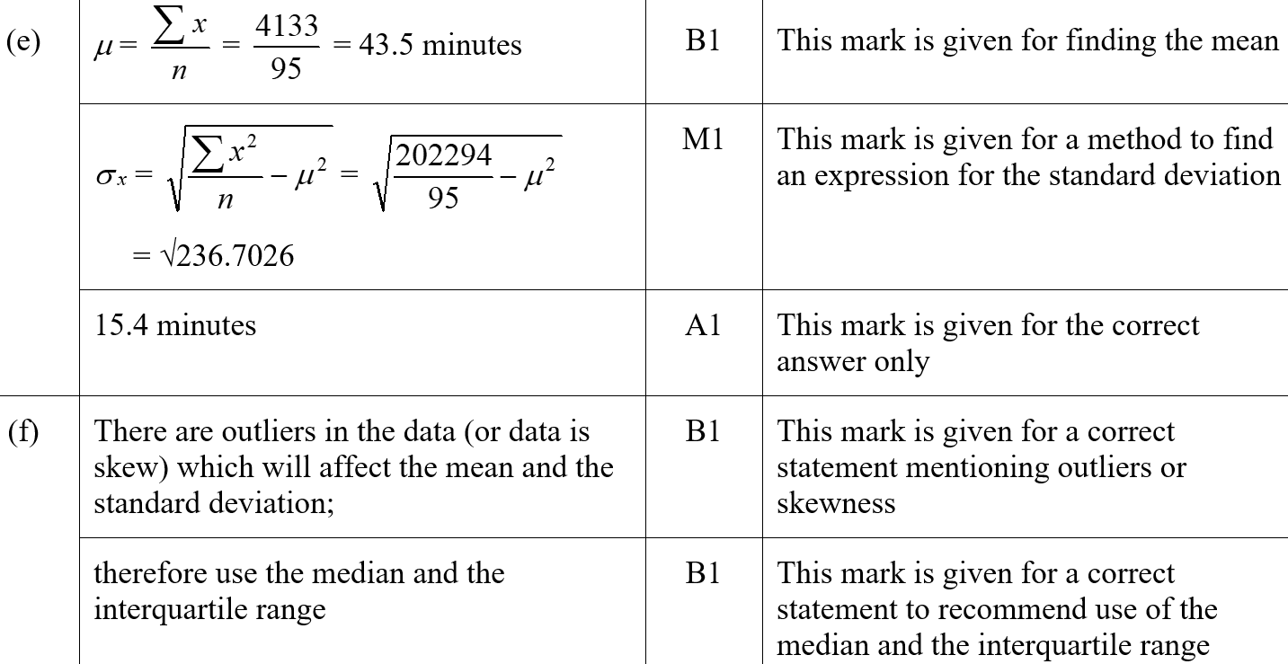
2018
E (SF)
F (SF)

Slide 14
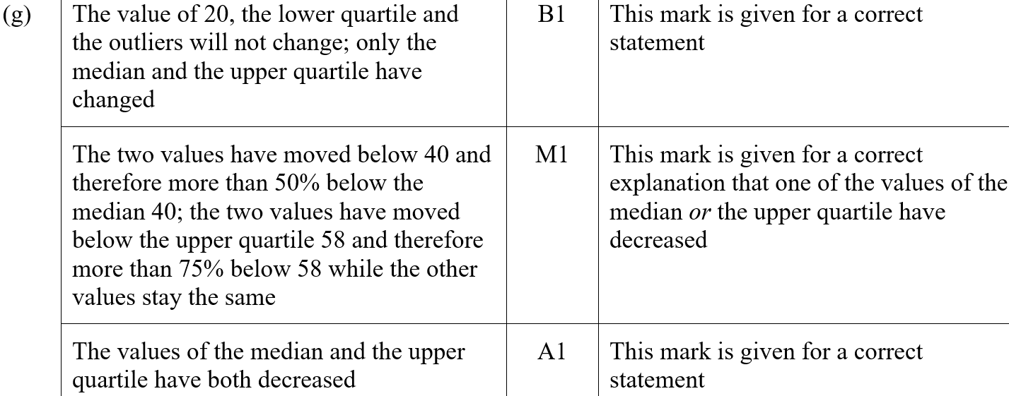
2018
G (SF)

Slide 15
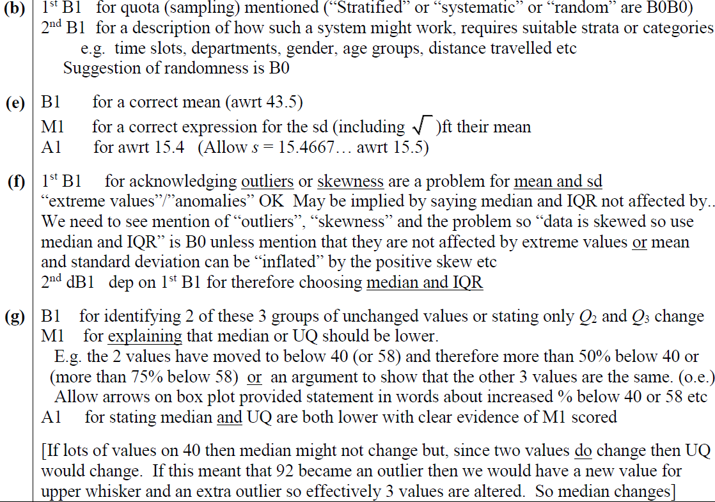
2018
B notes
E notes
F notes
G notes

Slide 16
New Spec Q’s
*Skew and Stem & Leaf not on new spec
Old Spec Data Processing
Jan 2006
S&L*
Jan 2008 (ii)
histogram
Jan 2011 (ii)
Box plot*
May 2013 (ii)
S2 & S3 sampling
May 2006 (i)
Box plot
May 2008
S&L*
Jan 2011 (iii)*
May 2014 (i) S&L, Box Plot*
May 2006
Jan 2006
Jan 2007
May 2006
May 2006 (ii)
Jan 2009
histogram*
May 2011
Some normal distribution*
May 2014 (ii)
Jan 2008
June 2009
Jan 2007 (i)*
May 2009 (i) histogram
May 2009
June 2010
Jan 2012 (i)
histogram
May 2014 (iii) histogram*
Jan 2007 (ii)
histogram
May 2010
June 2012
May 2009 (ii)
Some Normal distribution*
Jan 2012 (ii)
S&L*
June 2013
Jan 2007 (iii)
General
June 2015
Box plot
May 2011
May 2012
histogram
June 2015
June 2007 (i)
Some normal distribution*
June 2016 (i)
Jan 2010 (i)
S&L*
June 2016
Jan 2013
histogram*
June 2016 (ii) Histogram
Jan 2010 (ii)*
June 2017
June 2007 (ii)
histogram*
May 2013 (i)
Box and S&L*
June 2017 Histogram*
Jan 2008 (i)*
May 2010*
Jan 2011 (i)
June 2018 Histogram*

Slide 17
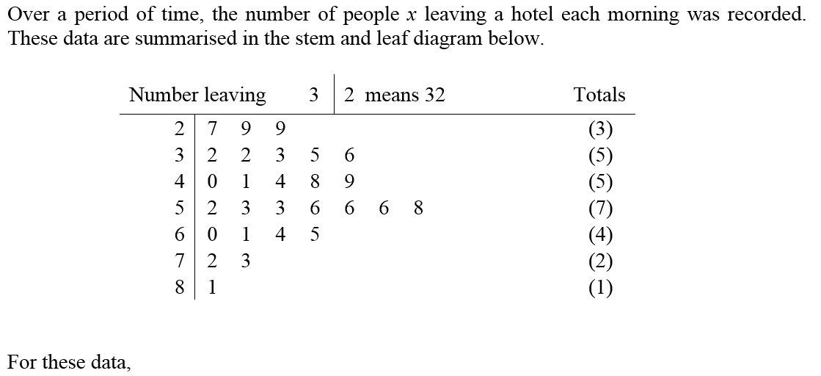
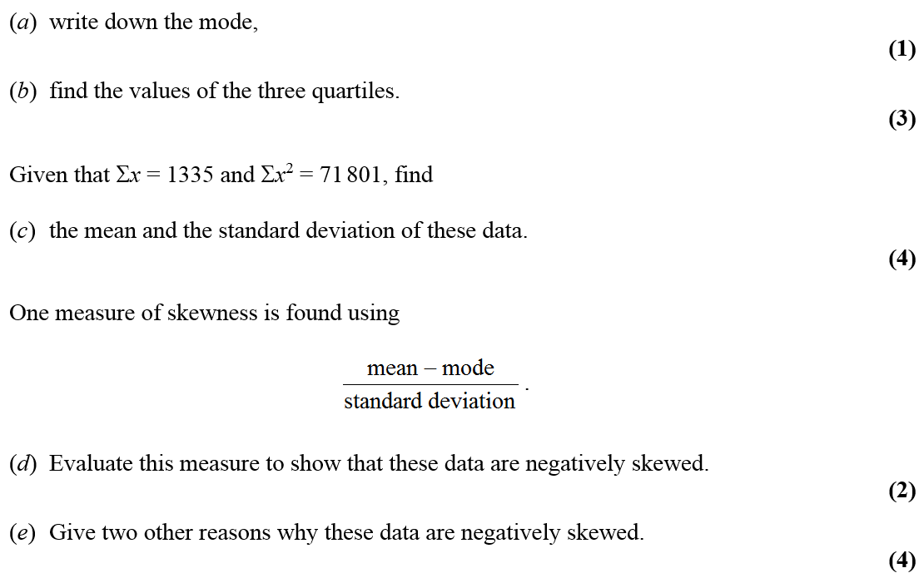
Jan 2006

Slide 18
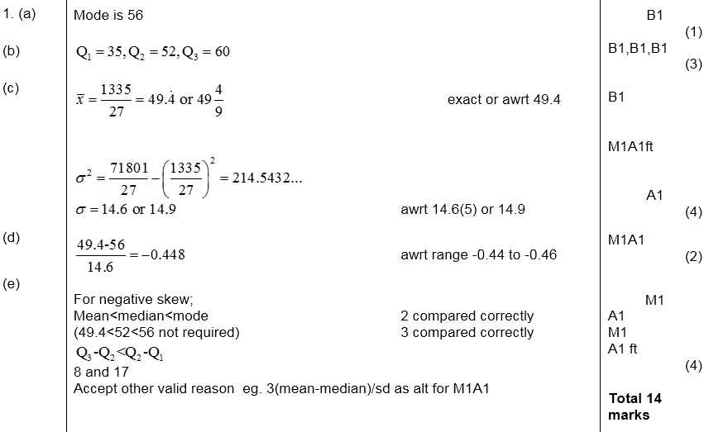
Jan 2006
A
B
C
D
E

Slide 19
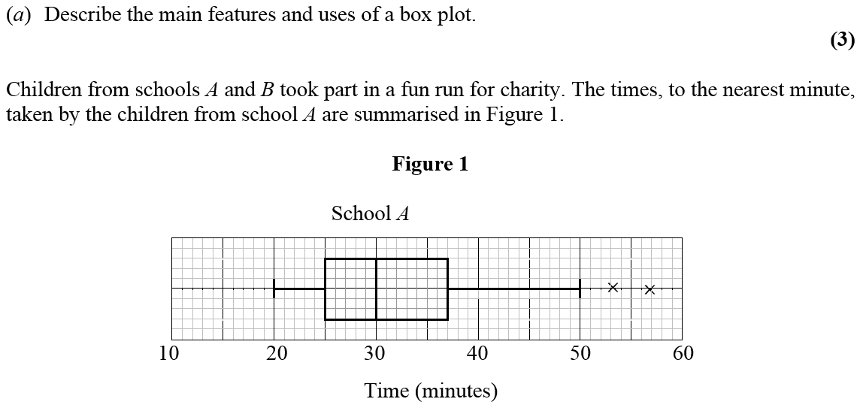
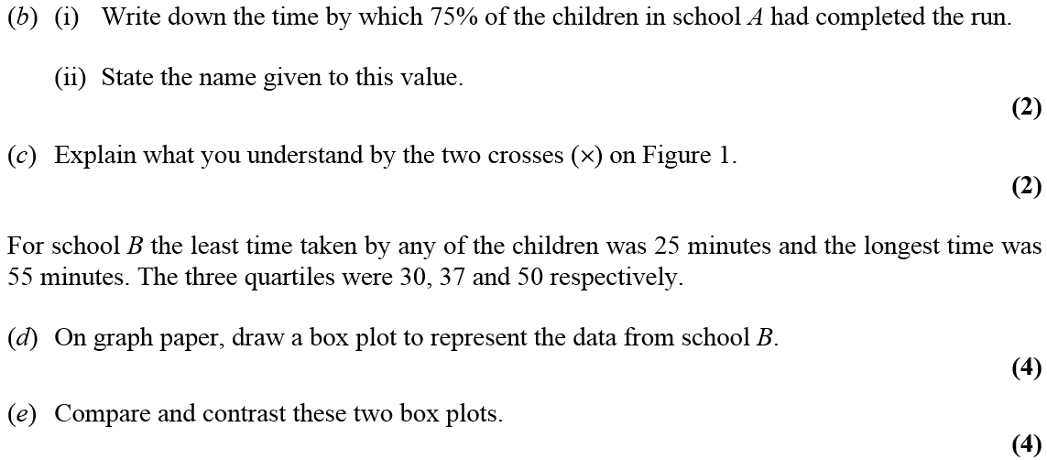
May 2006

Slide 20
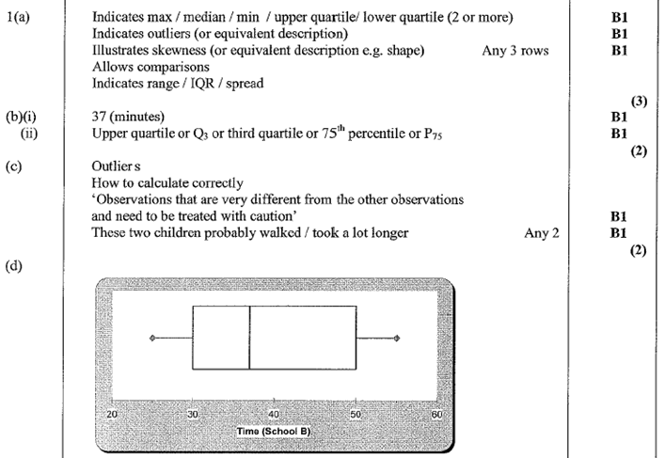
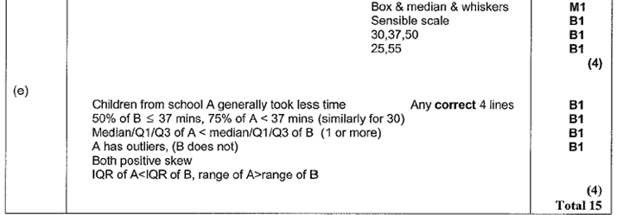
May 2006
A
B
C
D
E

Slide 21
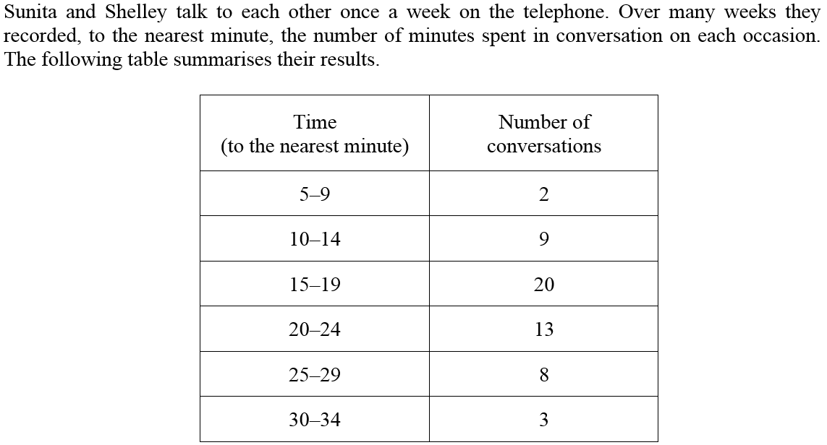
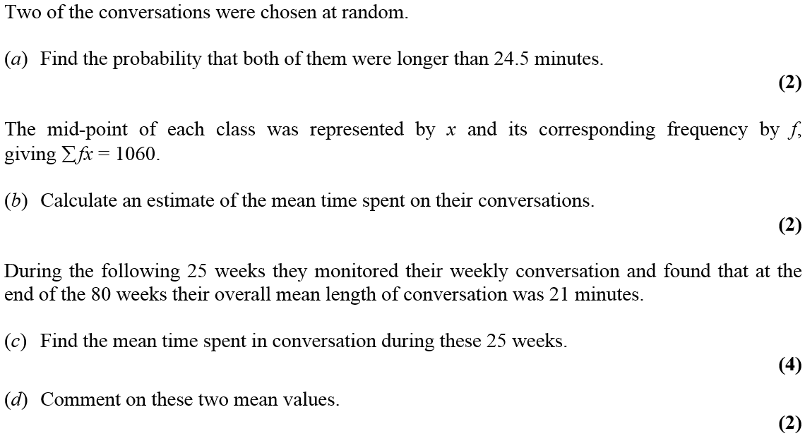
May 2006

Slide 22
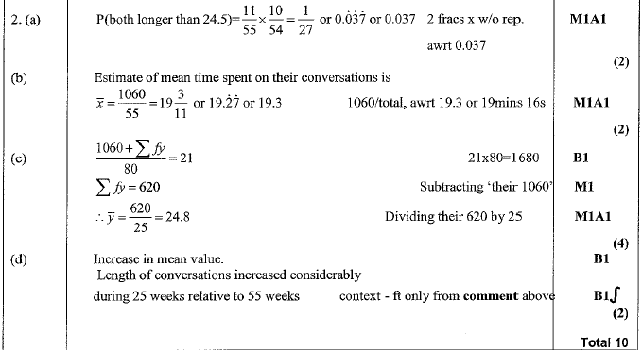
May 2006
A
B
C
D

Slide 23
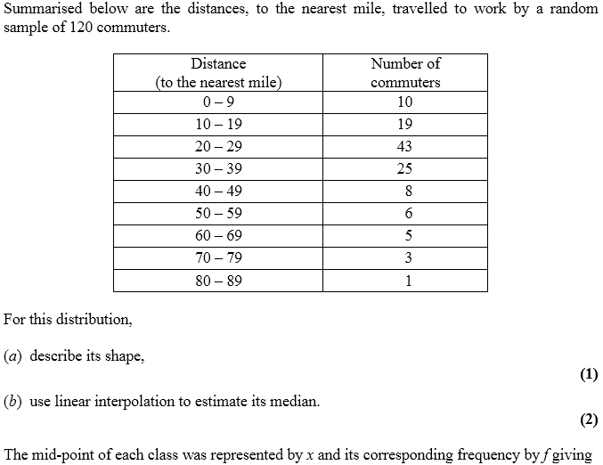
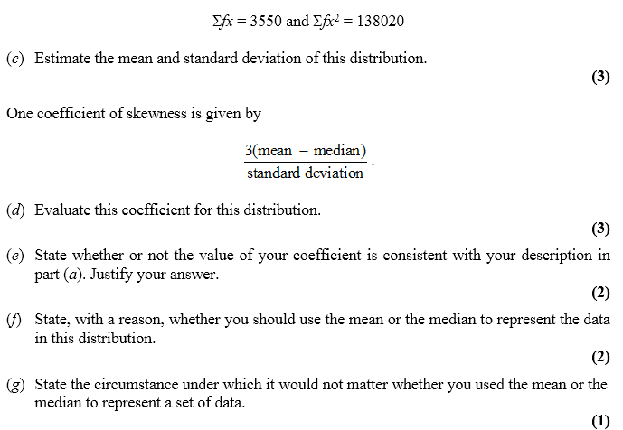
Jan 2007

Slide 24
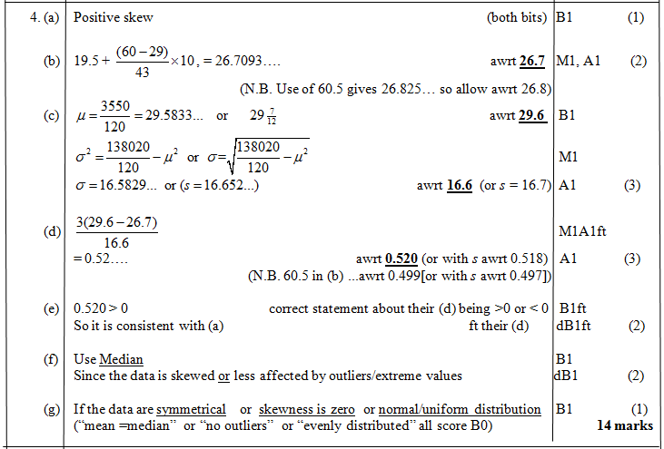
Jan 2007
A
B
C
D
E
F
G

Slide 25
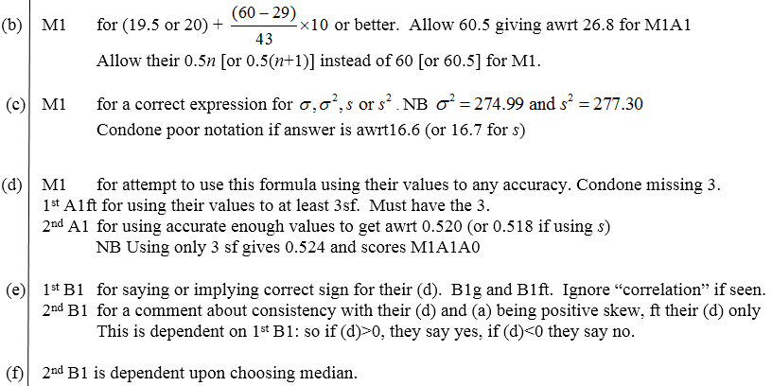
Jan 2007
B
C
D
E
F

Slide 26
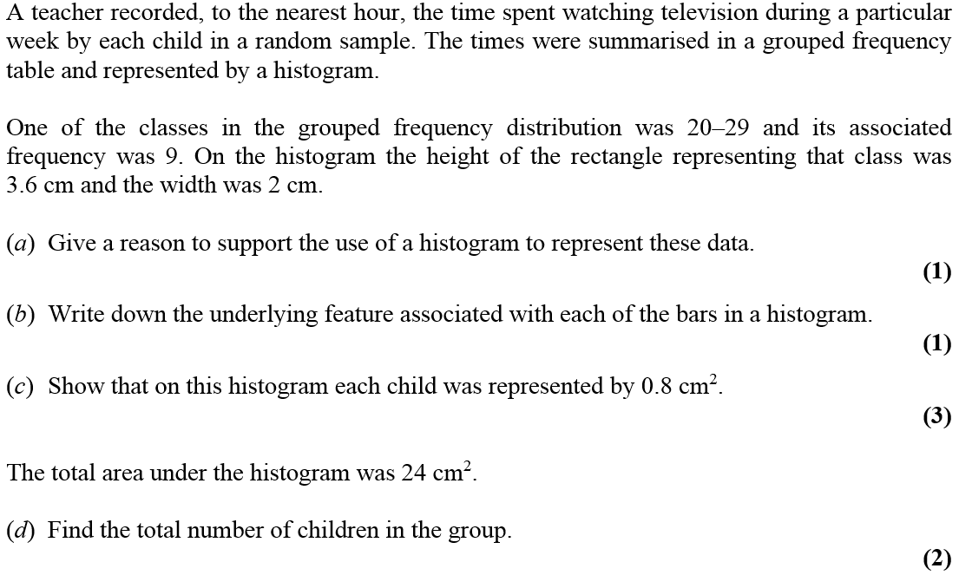
Jan 2007

Slide 27
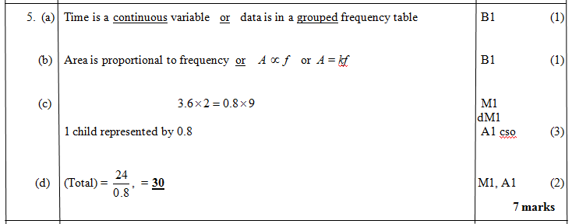
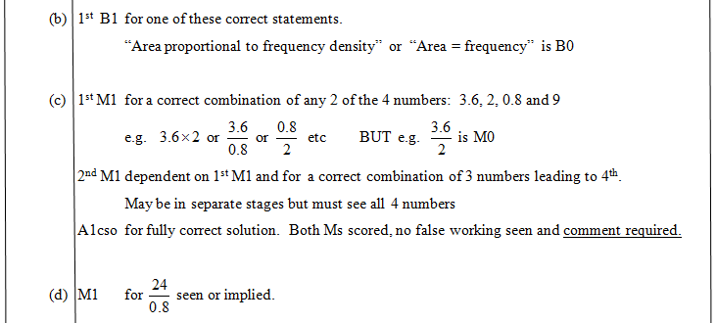
Jan 2007
A
B
C
D
B
C
D

Slide 28
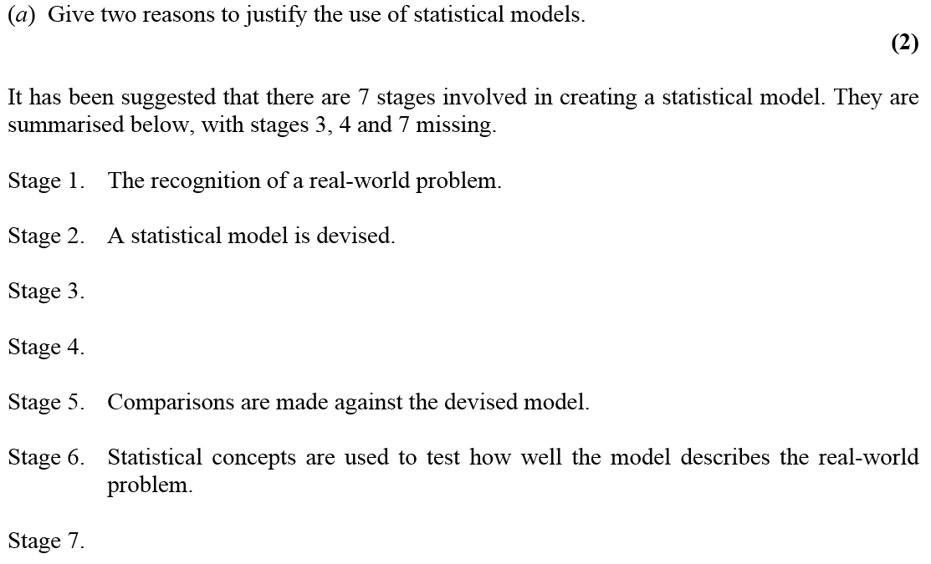
Jan 2007

Slide 29
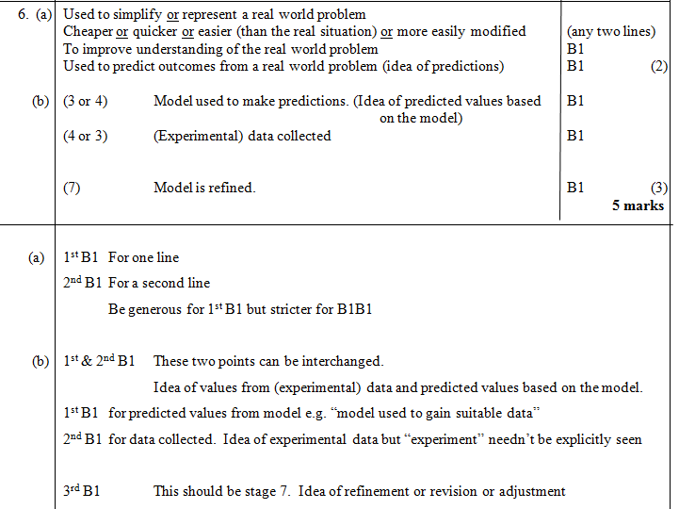
Jan 2007
A
B
A
B

Slide 30
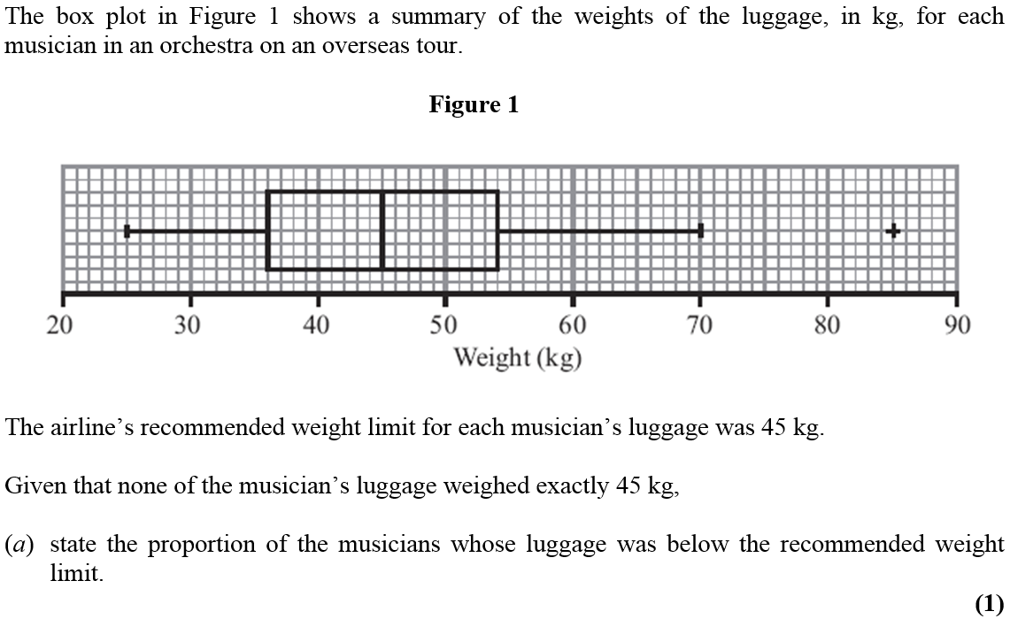
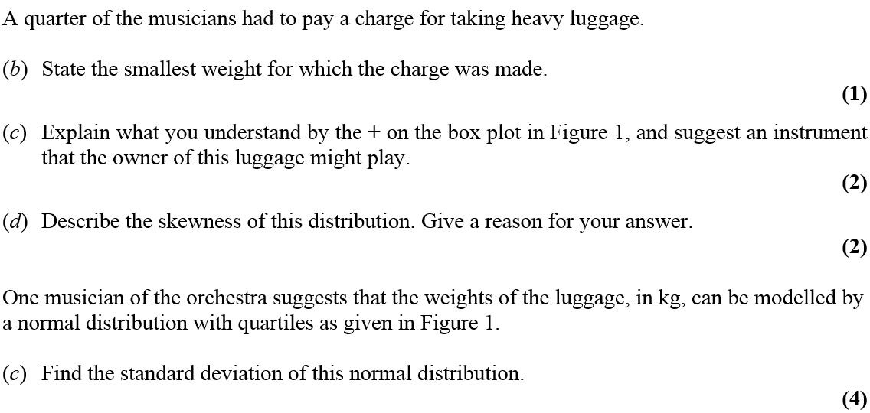
June 2007

Slide 31
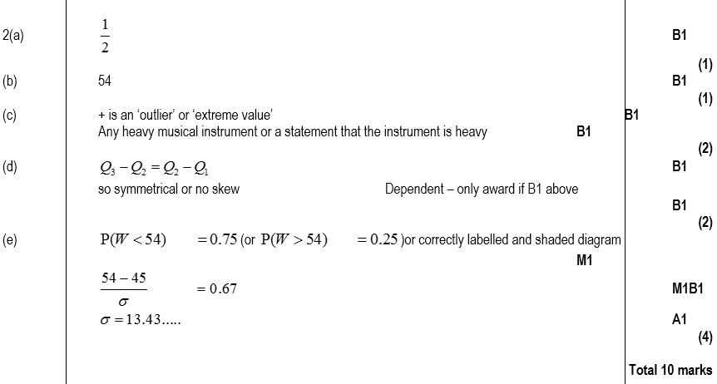
June 2007
A
B
C
D
E

Slide 32
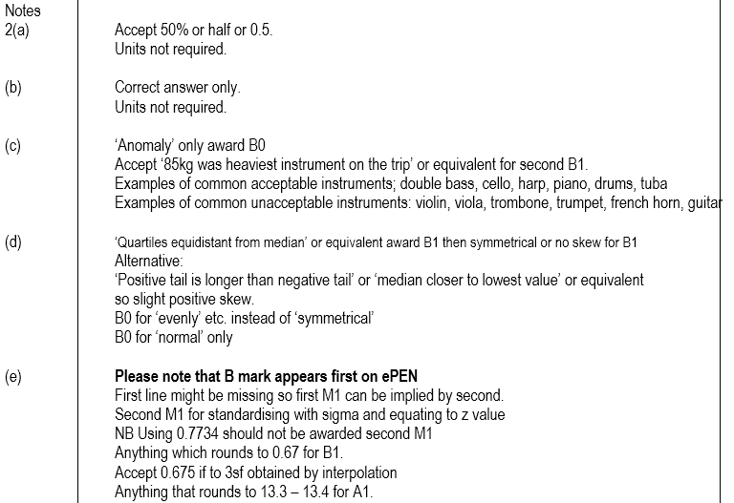
June 2007
A
B
C
D
E

Slide 33
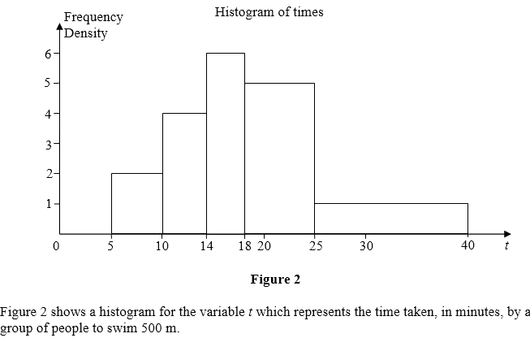
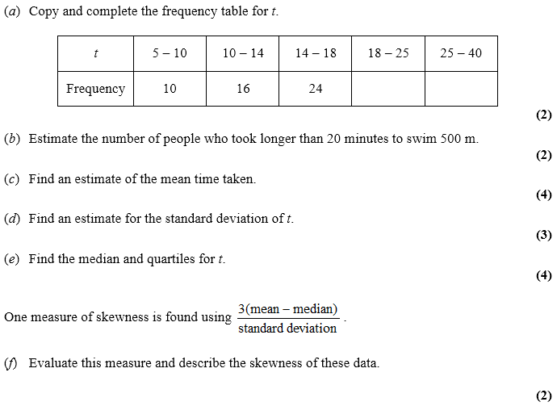
June 2007

Slide 34
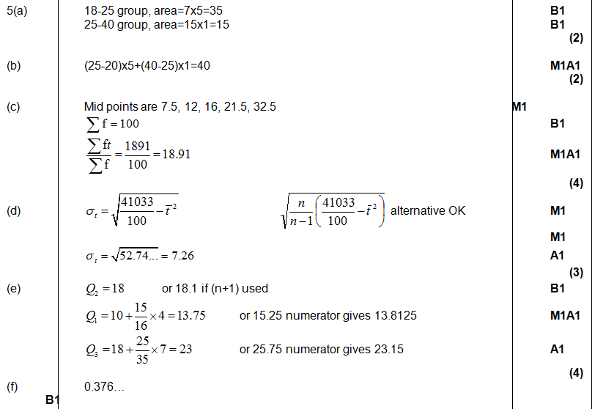
June 2007
A
B
C
D
E
F

Slide 35
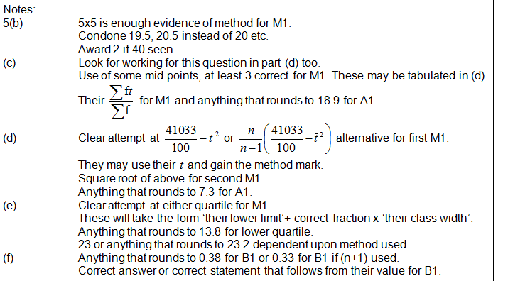
June 2007
B
C
D
E
F

Slide 36
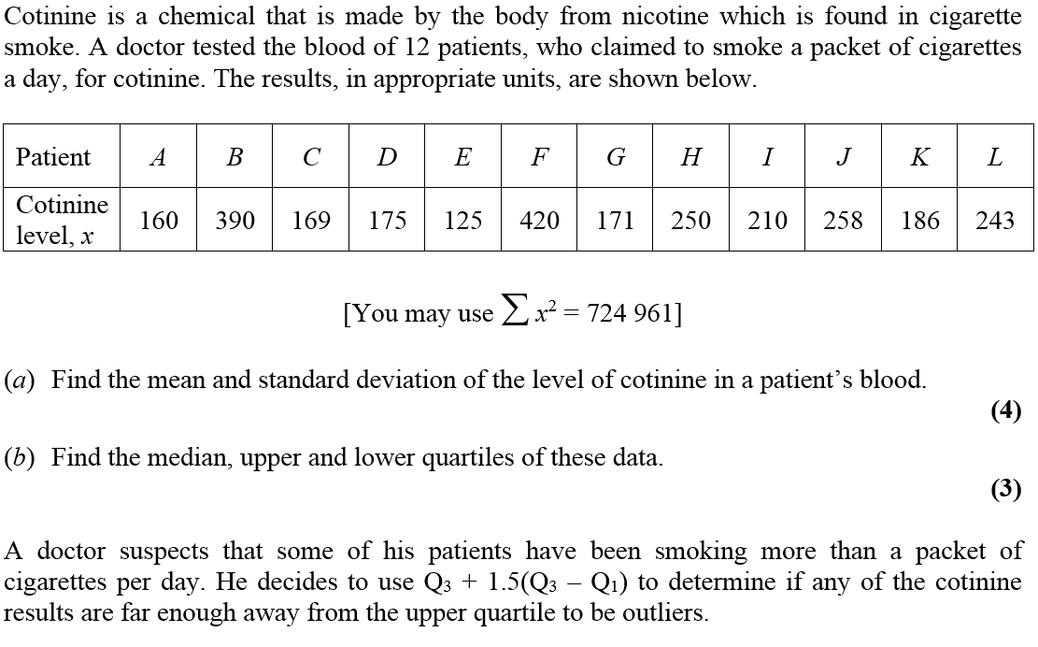
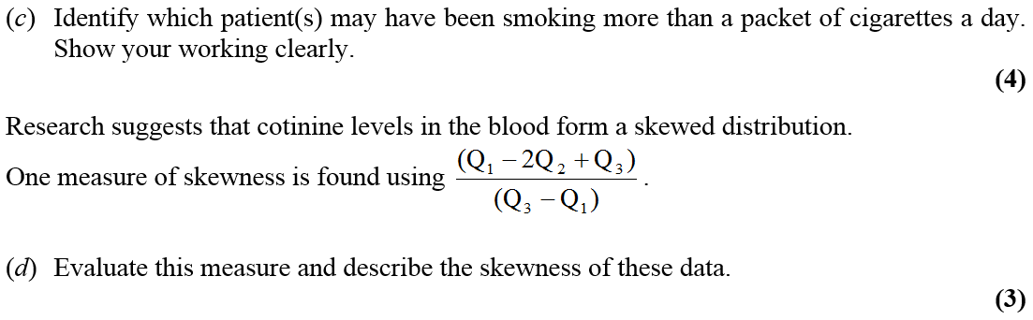
Jan 2008

Slide 37
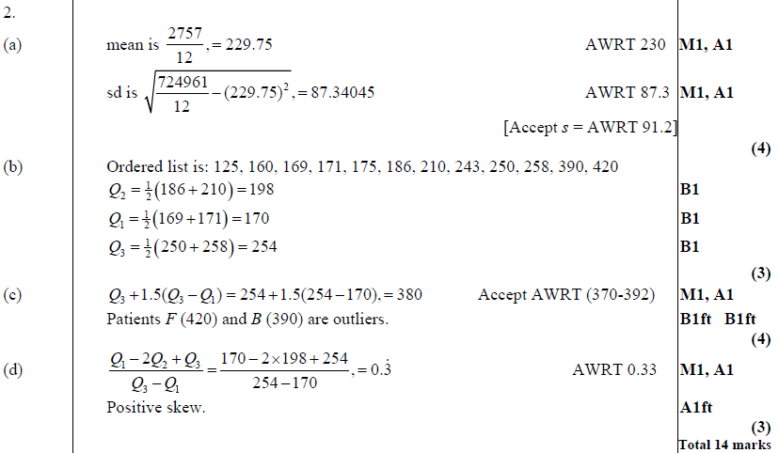
Jan 2008
A
B
C
D

Slide 38
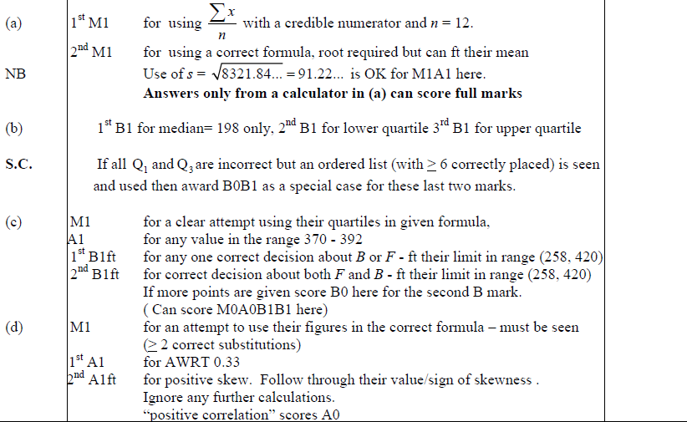
Jan 2008
A
B
C
D

Slide 39
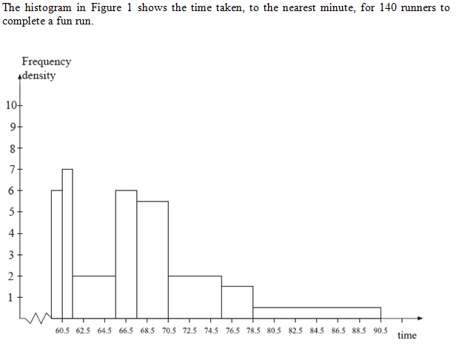

Jan 2008

Slide 40

Jan 2008
A

Slide 41



May 2008

Slide 42


A
May 2008
B
C (i)
C (ii)
D
E

Slide 43


Jan 2009

Slide 44

Jan 2009
A
B
C
D
E

Slide 45

Jan 2009
A
B
C
D
E

Slide 46

May 2009

Slide 47

May 2009
A
B

Slide 48


May 2009

Slide 49

May 2009
A
B
C
D

Slide 50

May 2009
A
B
C
D

Slide 51


Jan 2010

Slide 52

Jan 2010
A
B
C
D

Slide 53

Jan 2010
B
C
D

Slide 54


Jan 2010

Slide 55

Jan 2010
A
B
C
D
E

Slide 56

Jan 2010
B
C
D
E

Slide 57


May 2010

Slide 58

May 2010
A
B
C
D
E

Slide 59

Jan 2011

Slide 60

Jan 2011
A
B
A
B

Slide 61



Jan 2011

Slide 62

Jan 2011
A
B
C

Slide 63

Jan 2011
A
B
C

Slide 64


Jan 2011

Slide 65

Jan 2011
A
B
C

Slide 66

Jan 2011
A
B
C

Slide 67


May 2011

Slide 68

May 2011
A
B
C
D
E

Slide 69


May 2011
A
B
C
D
E

Slide 70

Jan 2012

Slide 71


Jan 2012
A
B
A
B

Slide 72



Jan 2012

Slide 73

Jan 2012
A
B
C
D
E

Slide 74


May 2012

Slide 75

May 2012
A
B
C
D
E

Slide 76




Jan 2013

Slide 77

A
Jan 2013
B
C
D
E
F

Slide 78




May 2013

Slide 79

May 2013
A
B
C
D

Slide 80



May 2013

Slide 81

May 2013
A
B
C
D
E
F

Slide 82



May 2014

Slide 83

May 2014
A
B
C

Slide 84

May 2014

Slide 85

May 2014
A

Slide 86


May 2014

Slide 87


May 2014
A
B
C
D

Slide 88



June 2015

Slide 89

June 2015
A
B
C
D
E
F

Slide 90

June 2015
C notes
D notes
E notes
F notes

Slide 91


June 2016

Slide 92

June 2016
A
B
C
D
E

Slide 93

June 2016
A notes
B notes
C notes
D notes
E notes

Slide 94


June 2016

Slide 95

June 2016
A
B
C (i)
C (ii)
D
E
F (i)
F (ii)

Slide 96

June 2016
A notes
B notes
C (i) notes
C (ii) notes
D notes
E notes
F (i) notes
F (ii) notes

Slide 97


June 2017

Slide 98

June 2017
A
B
C
D
E
F
G

Slide 99

June 2017
A notes
B notes
C (i) notes
D notes
E notes
F notes
G notes

Slide 100


June 2018

Slide 101

June 2018
A
B
C
D
E
F

Slide 102

June 2018
A notes
B notes
C notes
D notes
E notes
F notes

Slide 103

Jan 2006

Slide 104

Jan 2006
A

Slide 105

May 2006

Slide 106

May 2006
A
B
C

Slide 107

May 2006

Slide 108

May 2006
A
B

Slide 109

Jan 2007

Slide 110

Jan 2007
A
B (i)
B (ii)

Slide 111

Jan 2008

Slide 112

Jan 2008
A
B
C
D
A notes

Slide 113

Jan 2008
B notes
C notes
D notes

Slide 114

May 2009

Slide 115

May 2009
A
B
C

Slide 116

June 2009

Slide 117

June 2009
A
B (i)
B (ii)

Slide 118

June 2009
A notes
B (i) notes
B (ii) notes

Slide 119

June 2010

Slide 120

June 2010
A
B
A notes

Slide 121

May 2010

Slide 122

May 2010
A
B
C
D
A notes

Slide 123

May 2010
B notes
C notes
D notes

Slide 124

May 2011

Slide 125

May 2011
A
B

Slide 126

June 2012

Slide 127

June 2012
A
B
C
D

Slide 128

June 2012
A notes
C notes
D notes

Slide 129

June 2013

Slide 130


June 2013
A (i)
A (ii)
A notes

Slide 131

June 2014

Slide 132
June 2014
A
B
C

Slide 133

June 2015

Slide 134
June 2015
A

Slide 135

June 2016

Slide 136

June 2016
A

Slide 137

June 2016
B
notes

Slide 138

June 2017

Slide 139

June 2017
A
B
C

