Slide 1
Old Spec Q’s
Data Processing
sampling techniques
correlation and regression
Practice E (i)
Practice I (i)
SAM (iii)
Practice E (ii)
Practice I (ii)
2018 (i)
large data set
Practice F (i)
Practice I (iii)
2018 (ii)
Practice F (ii)
Practice J (i)
measures of central tendency and variation
Practice G (i)
Practice J (ii)
Practice G (ii)
Practice J (iii)
Practice H (i)
SAM (i)
Practice H (ii)
SAM (ii)

Slide 2
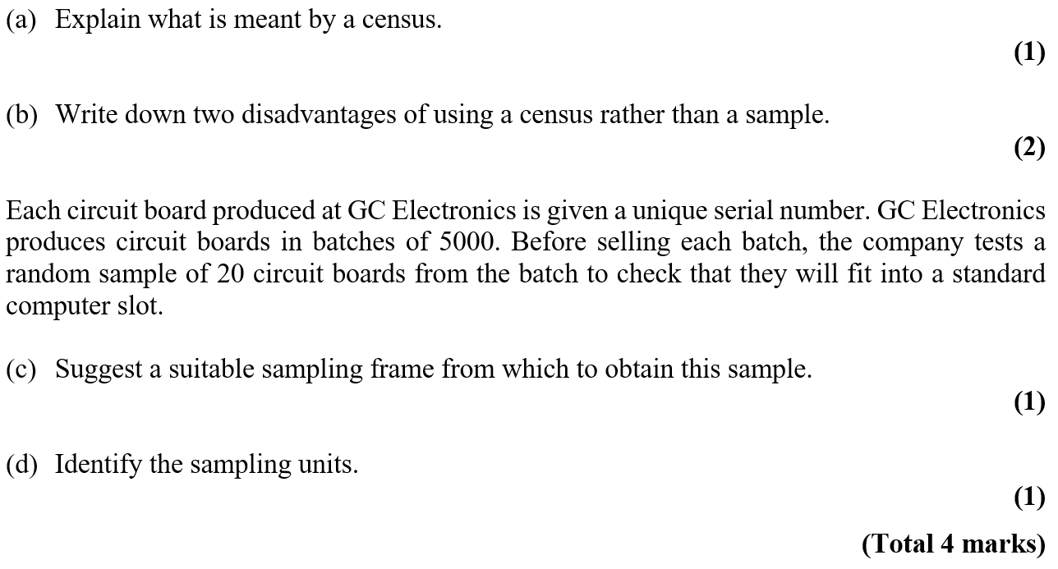


Practice E

Slide 3
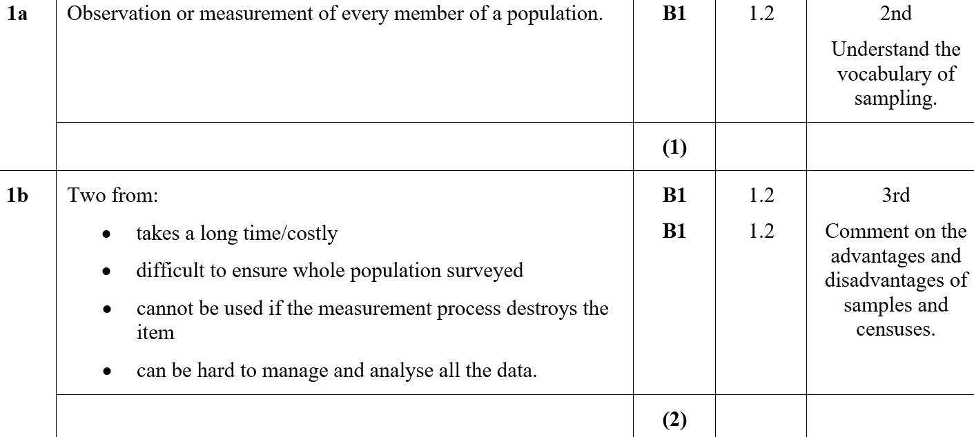

Practice E
A
B

Slide 4
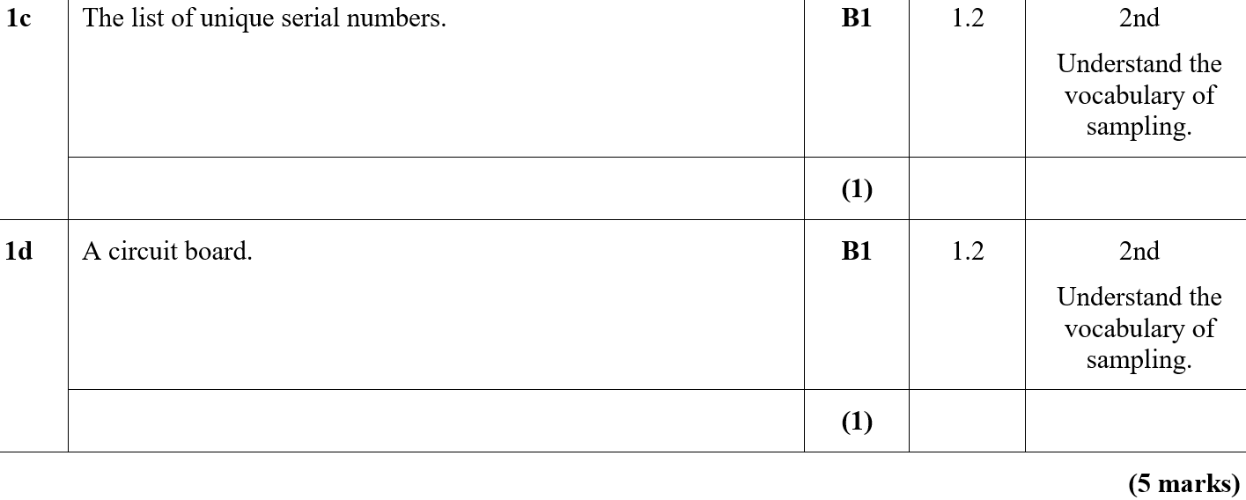
Practice E
C
D

Slide 5
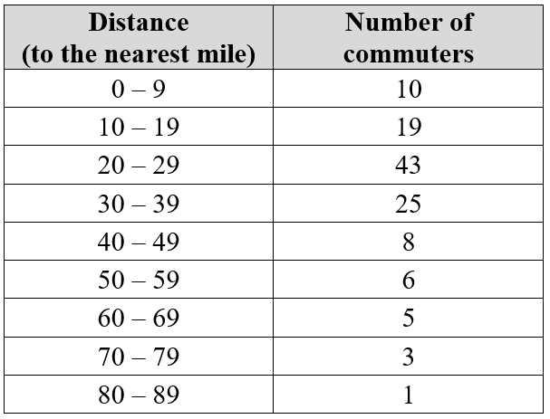
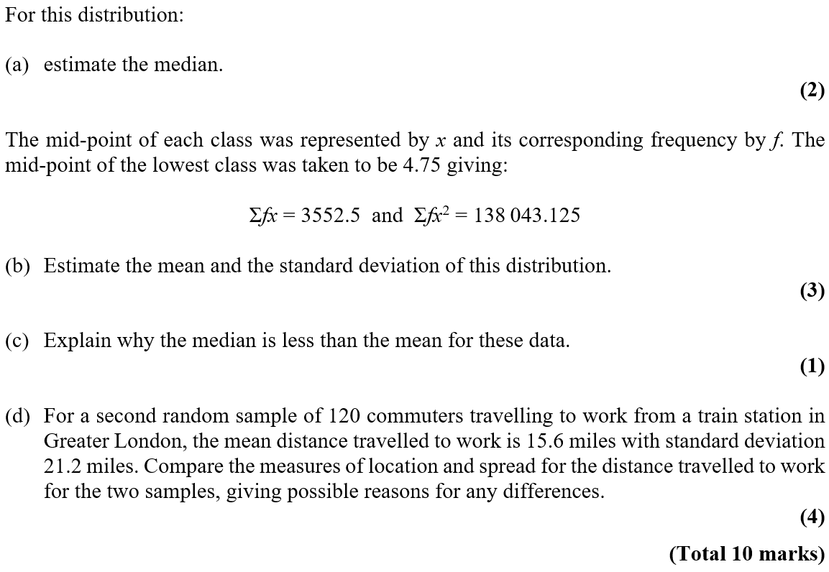
Practice E

Slide 6
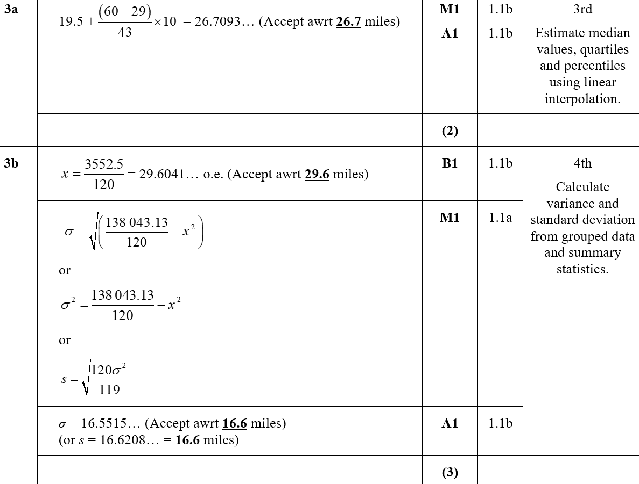
Practice E
A
B

Slide 7
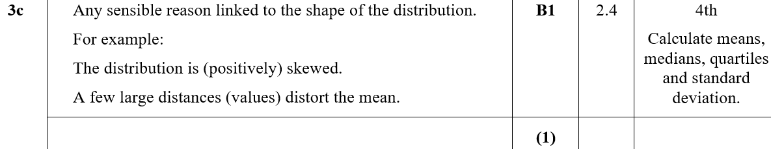
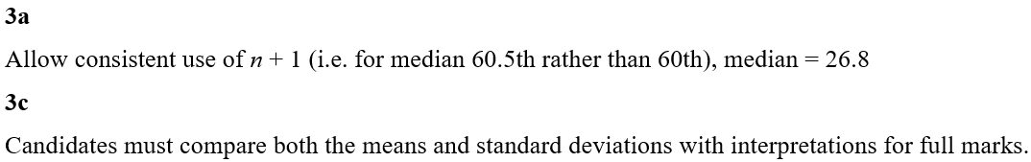
Practice E
C
A notes
C notes

Slide 8
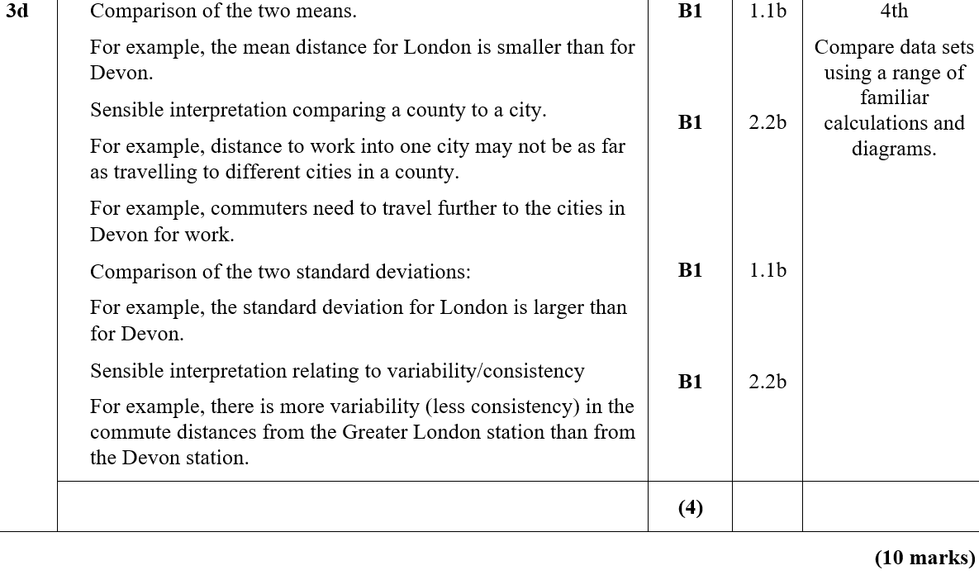
Practice E
D

Slide 9
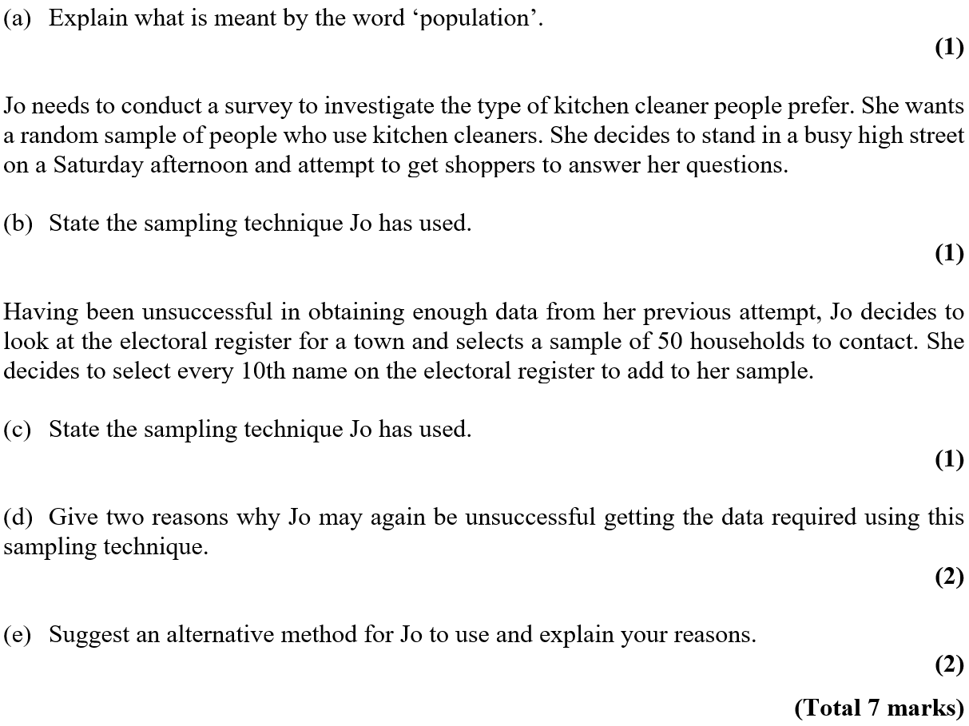
Practice F

Slide 10
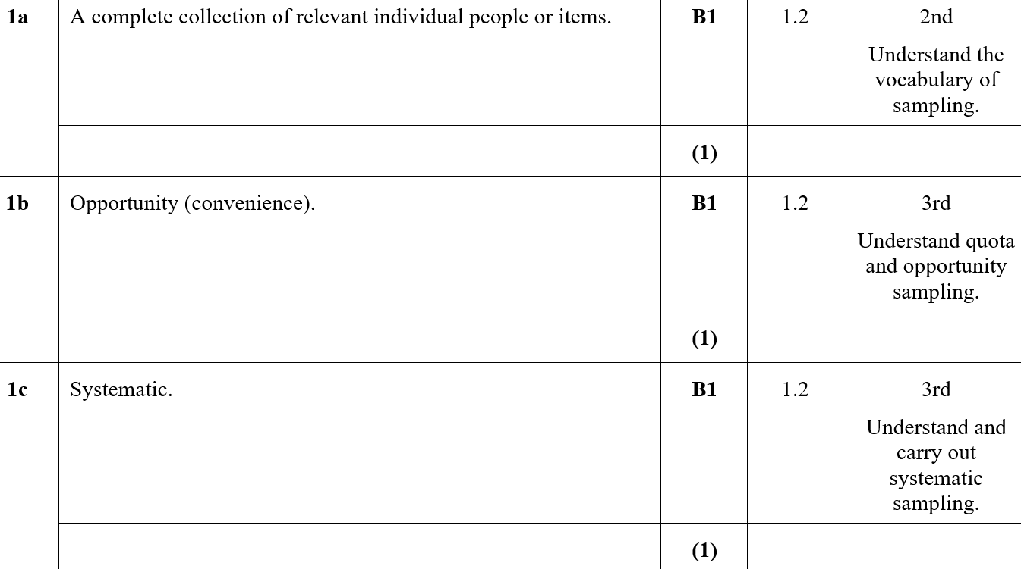
Practice F
A
B
C

Slide 11
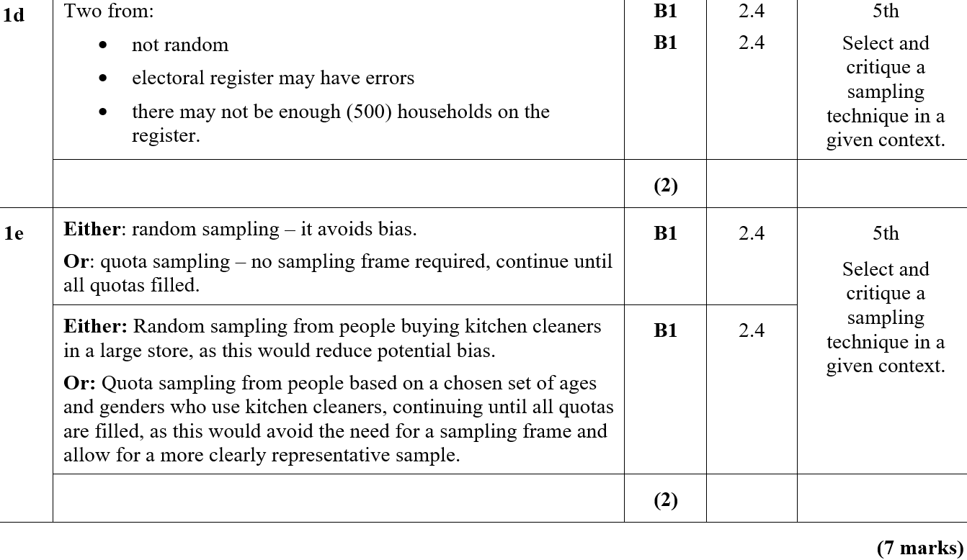
Practice F
D
E

Slide 12
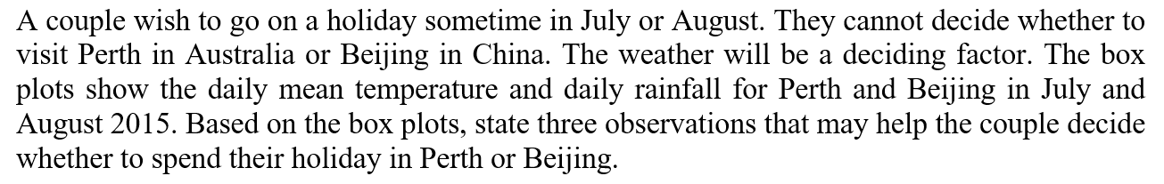
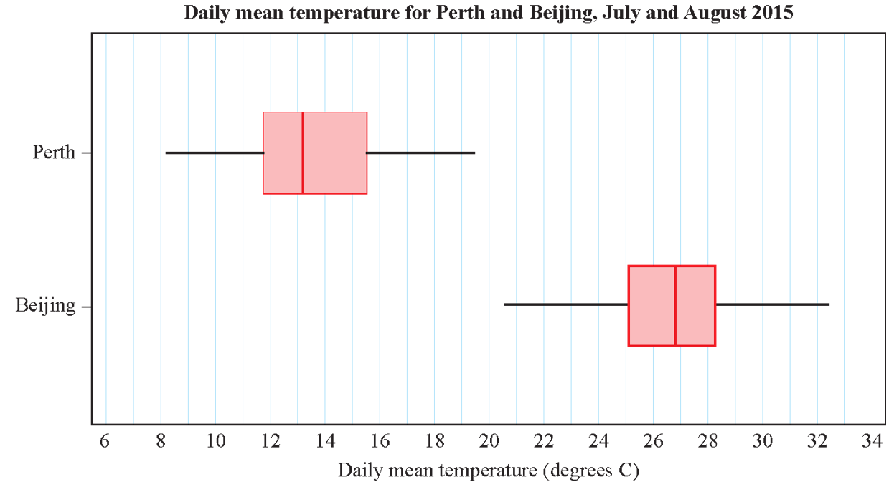

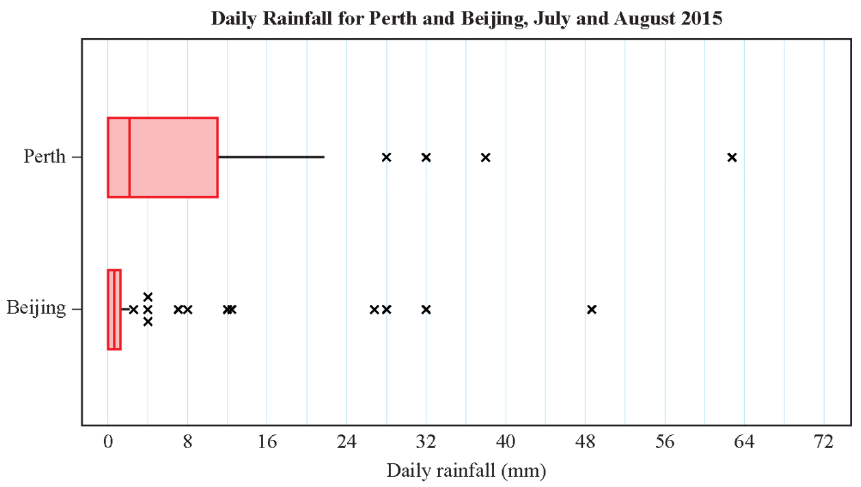

Practice F

Slide 13
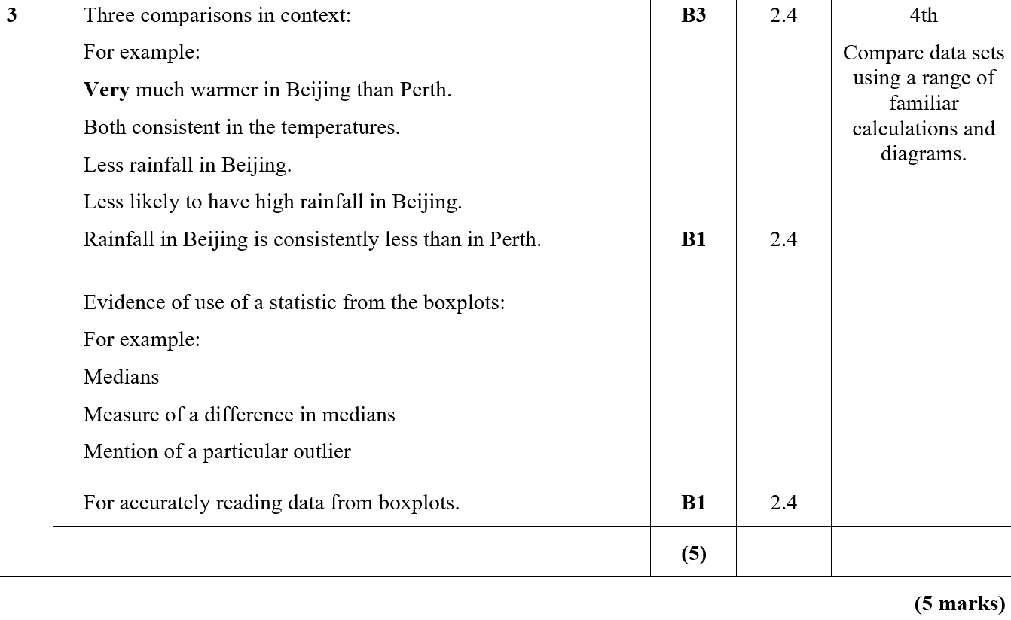
Practice F
A

Slide 14
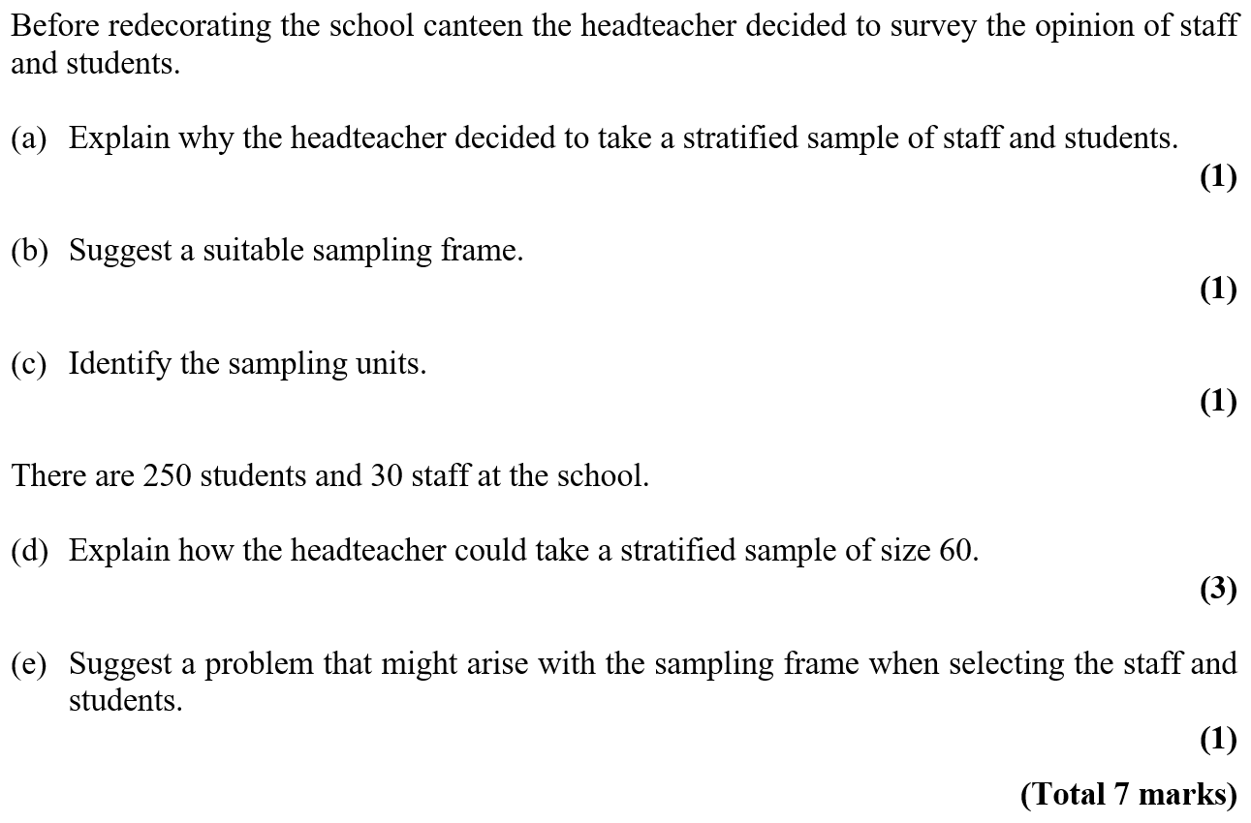
Practice G

Slide 15
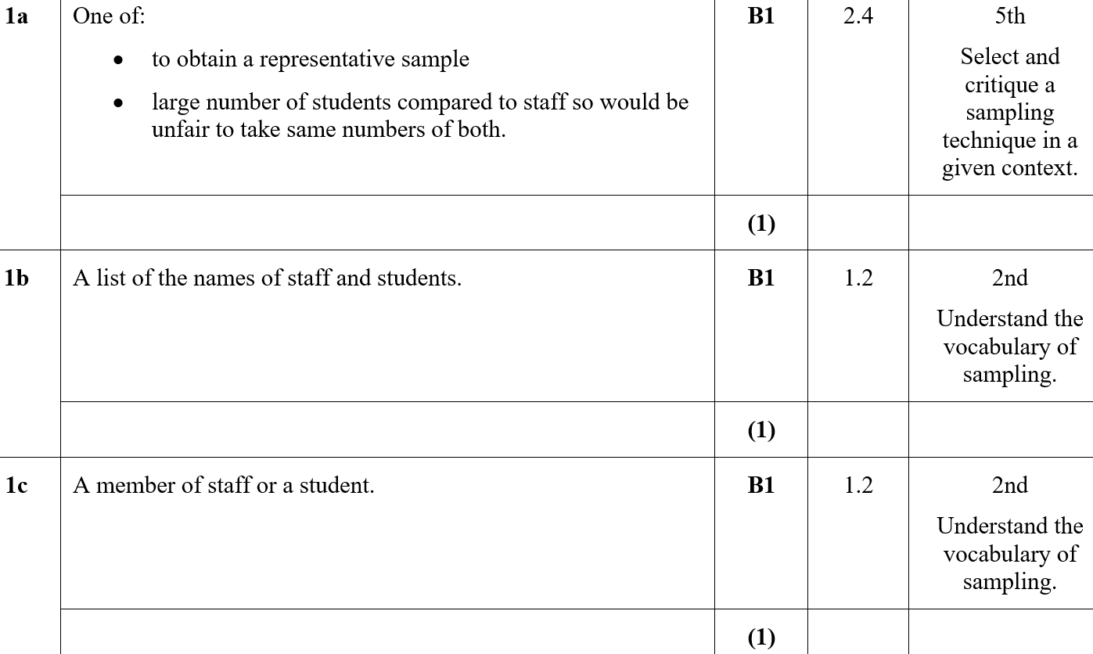
Practice G
A
B
C

Slide 16
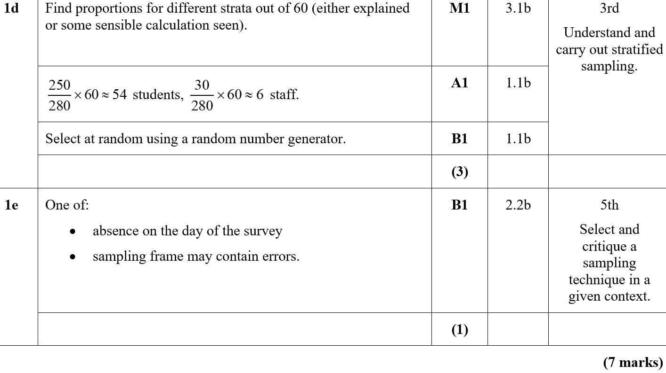
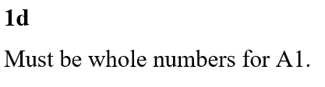
Practice G
D
E
D notes

Slide 17
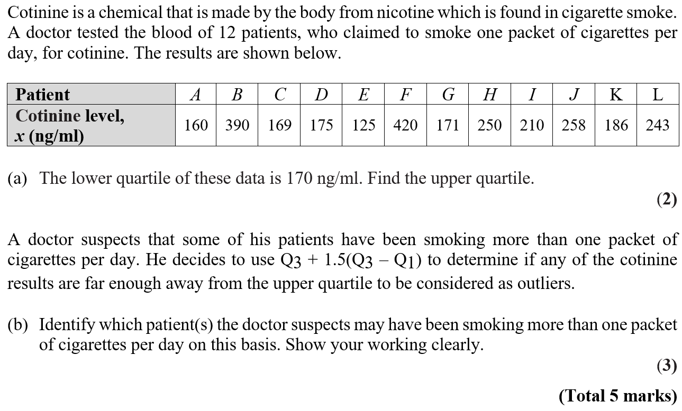
Practice G

Slide 18
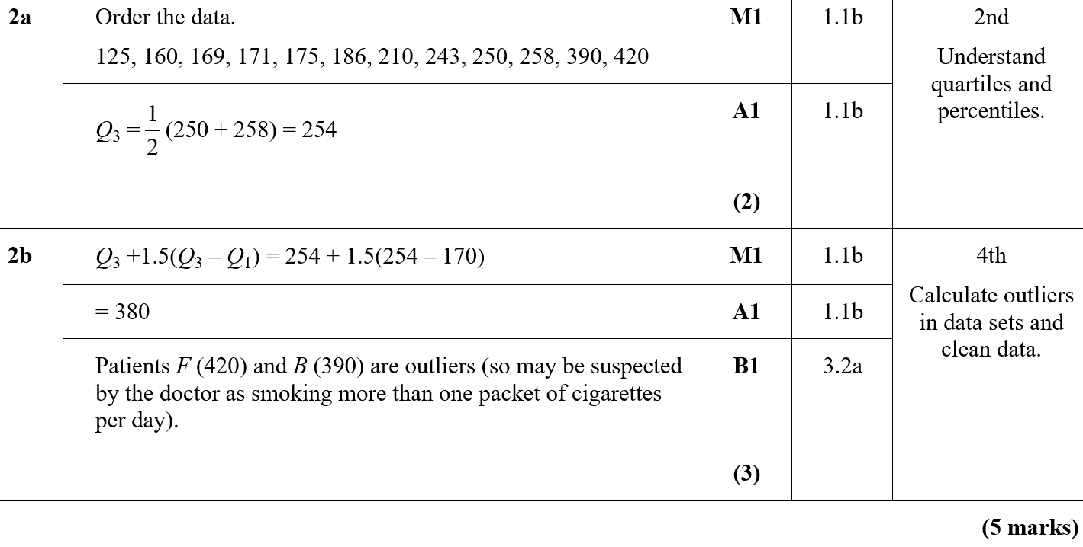
Practice G
A
B

Slide 19
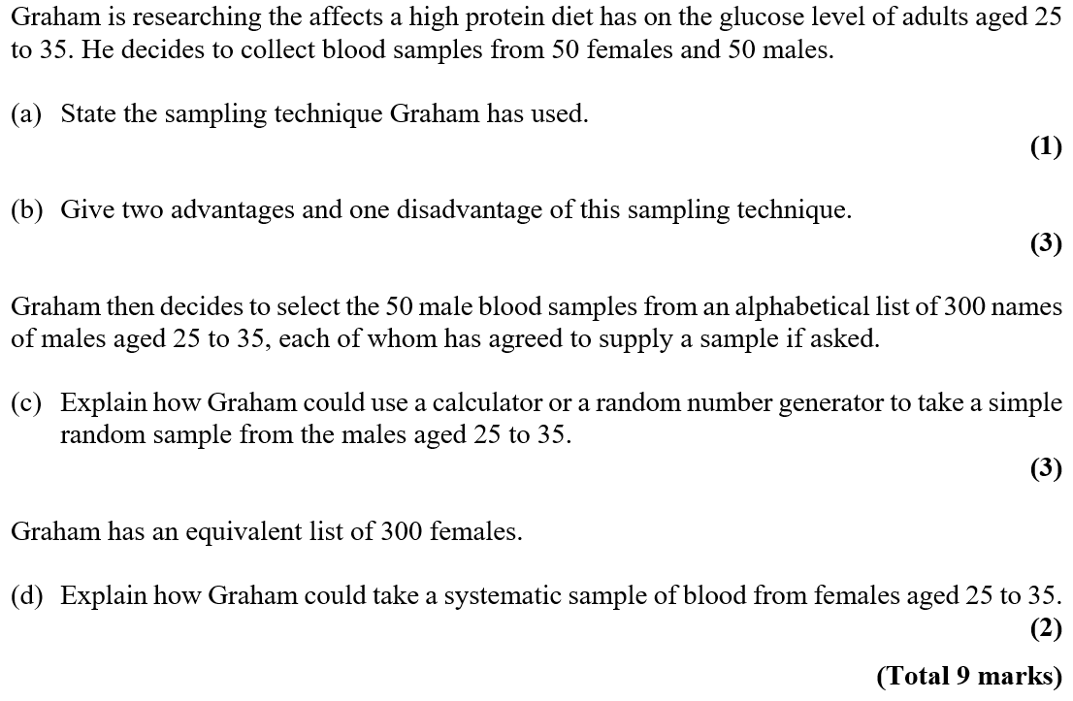
Practice H

Slide 20
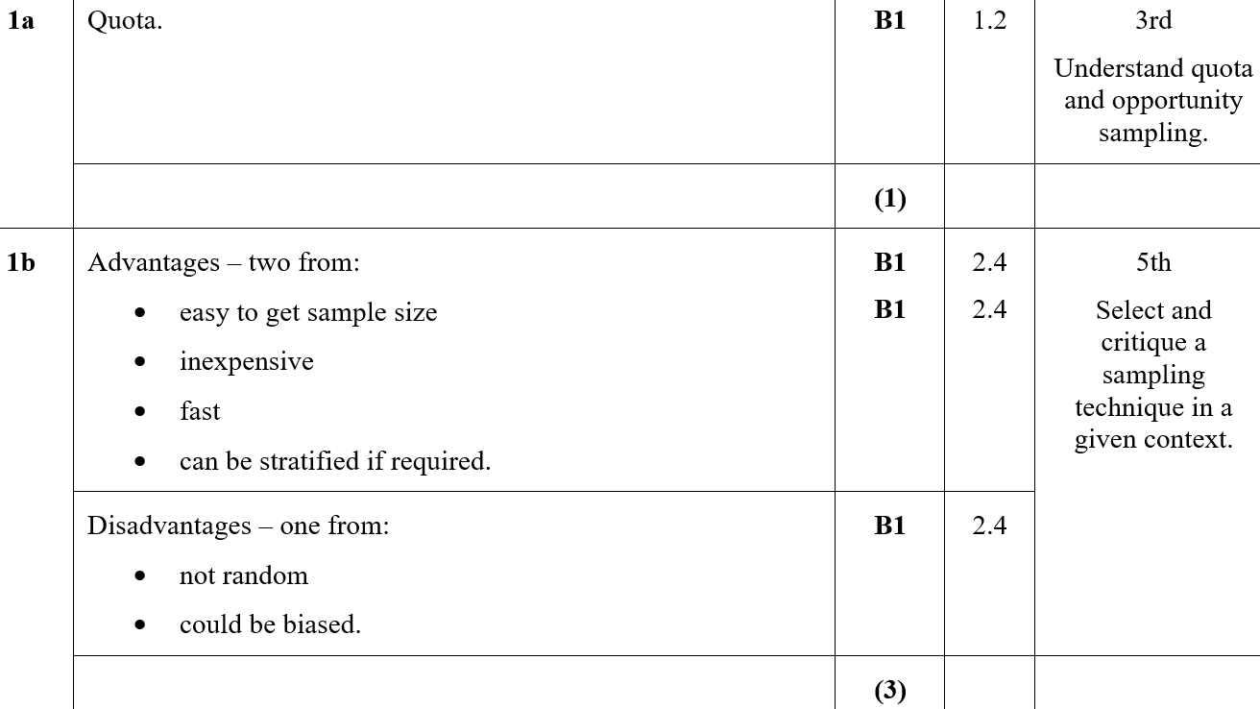
Practice H
A
B

Slide 21
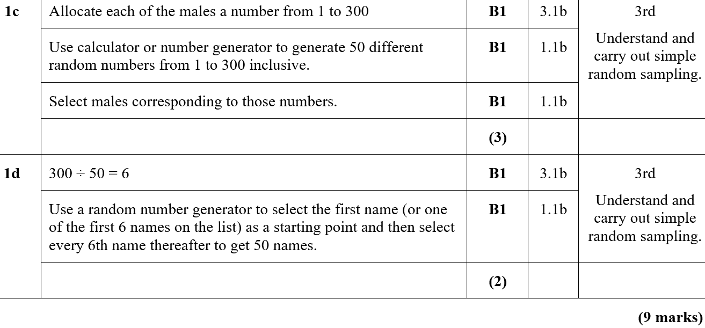
Practice H
C
D

Slide 22
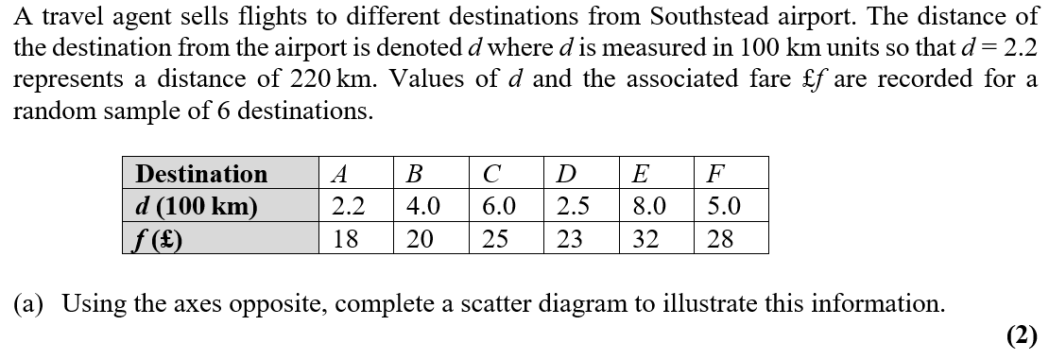
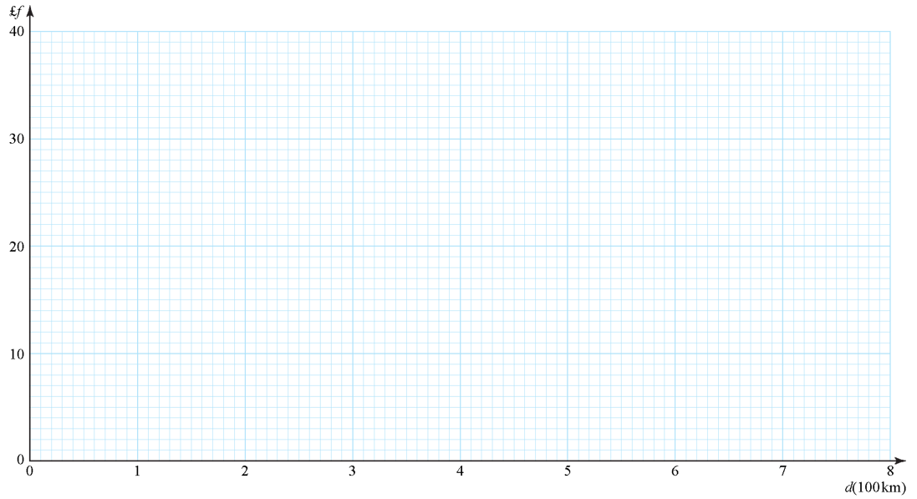

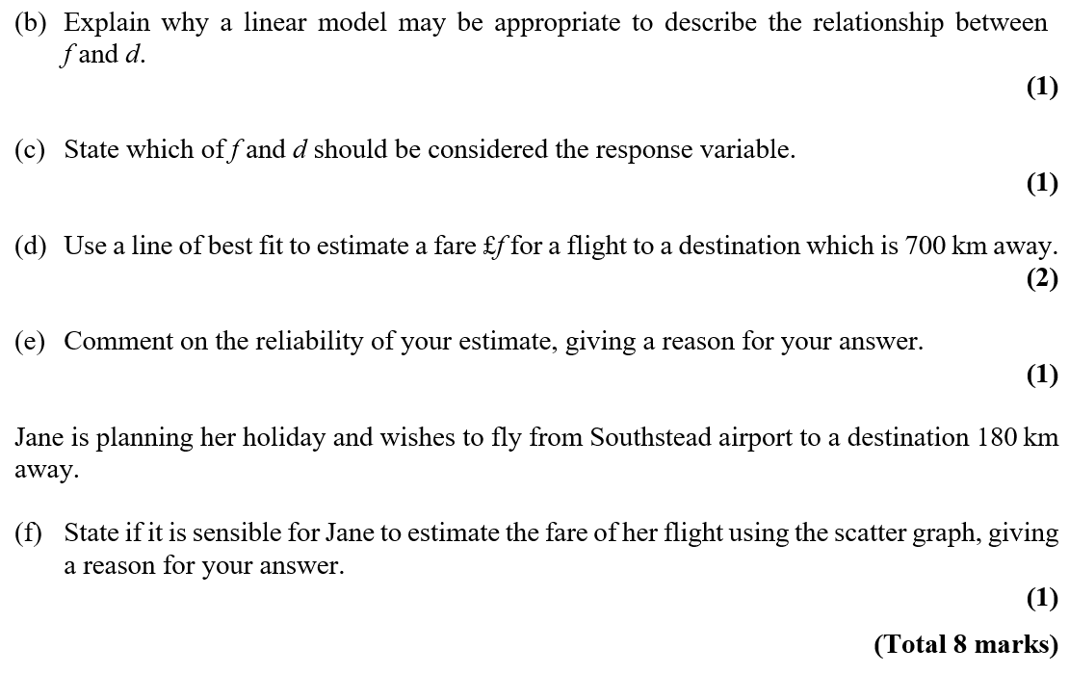
Practice H

Slide 23
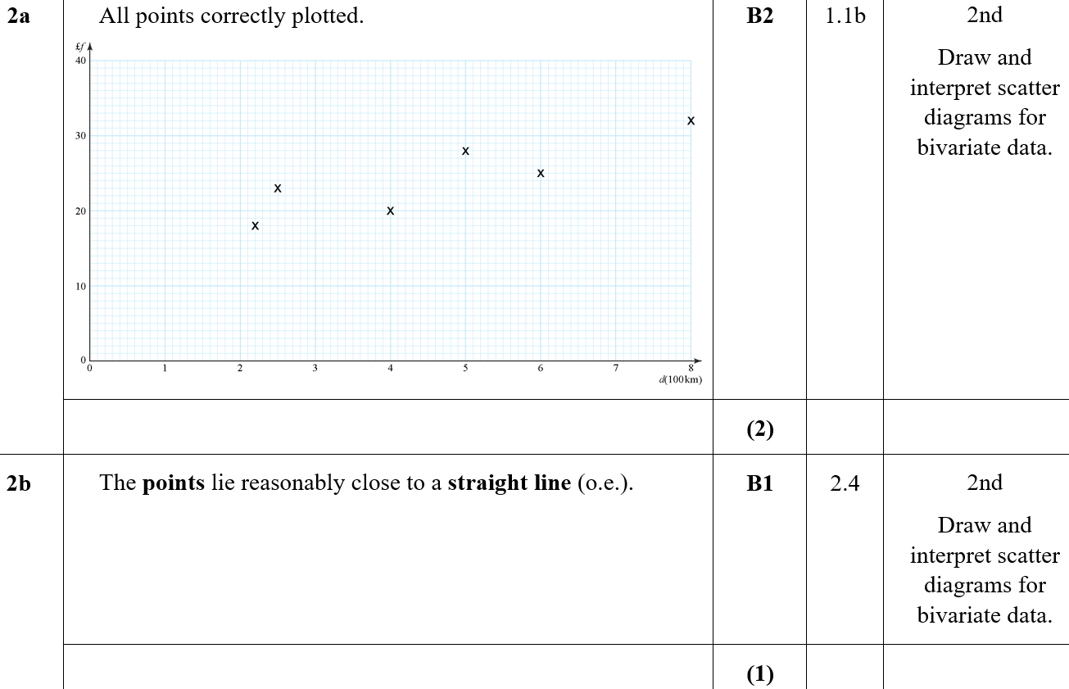
Practice H
A
B

Slide 24
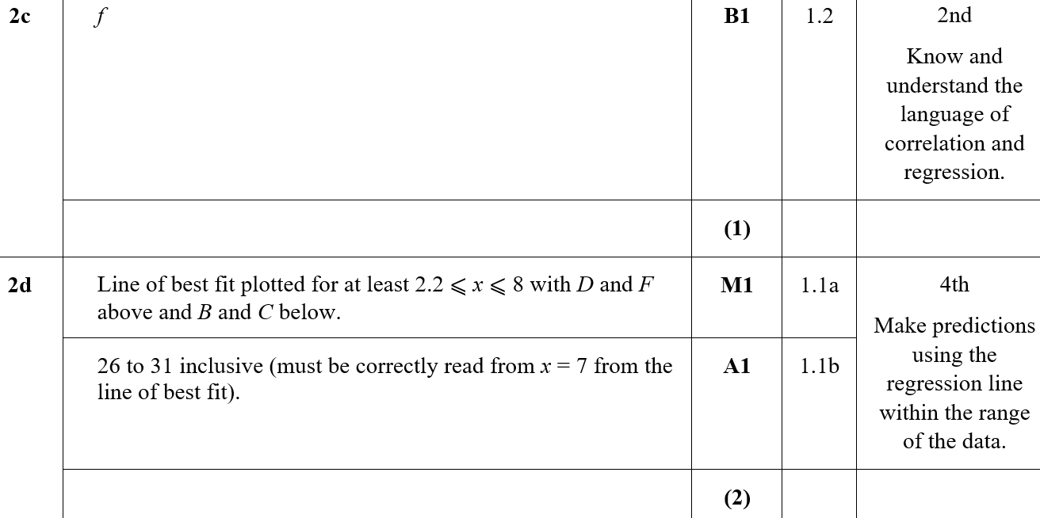
Practice H
C
D

Slide 25
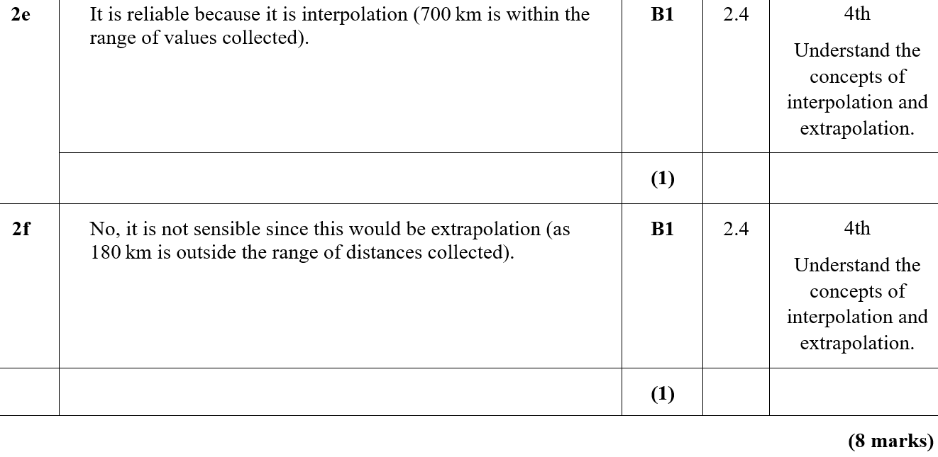
Practice H
E
F

Slide 26
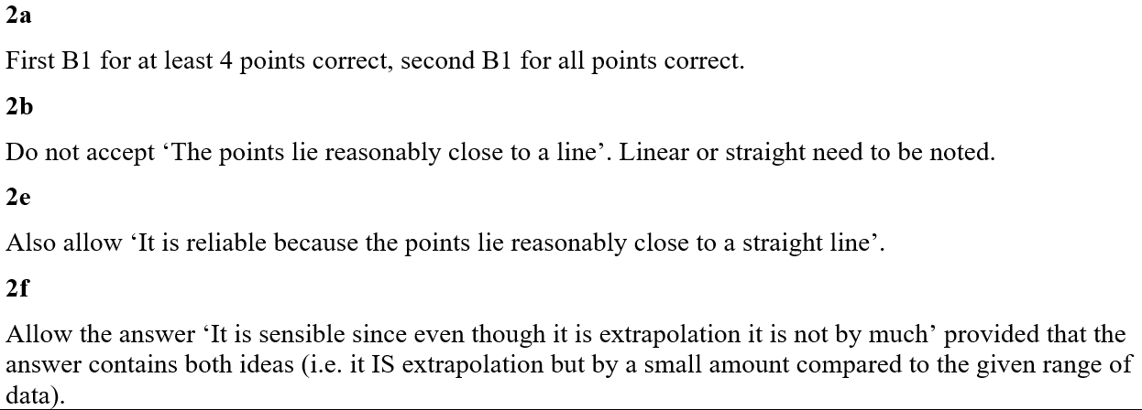
Practice H
A notes
B notes
E notes
F notes

Slide 27
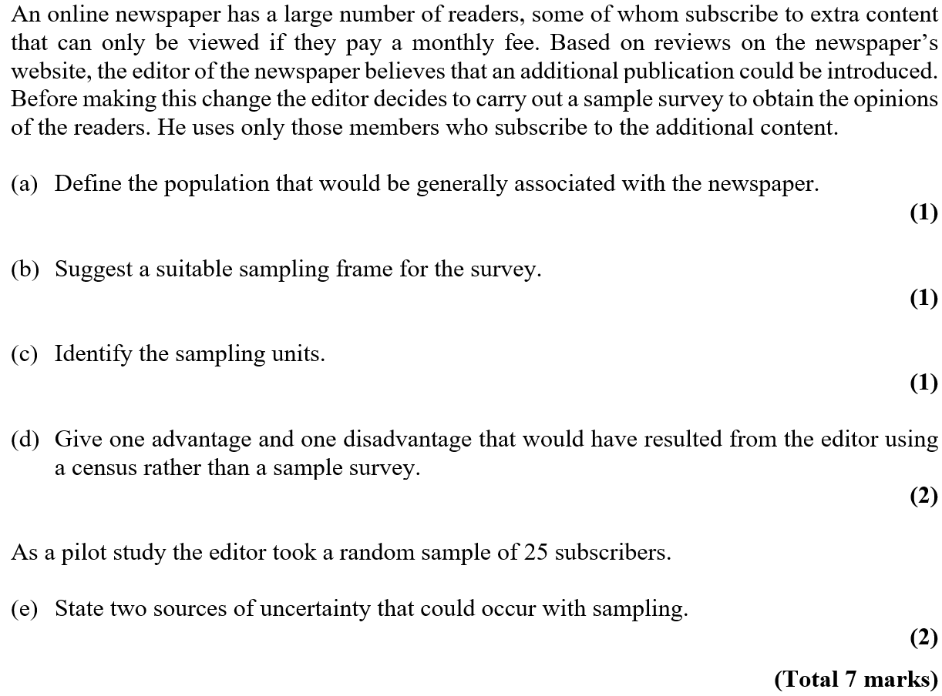
Practice I

Slide 28
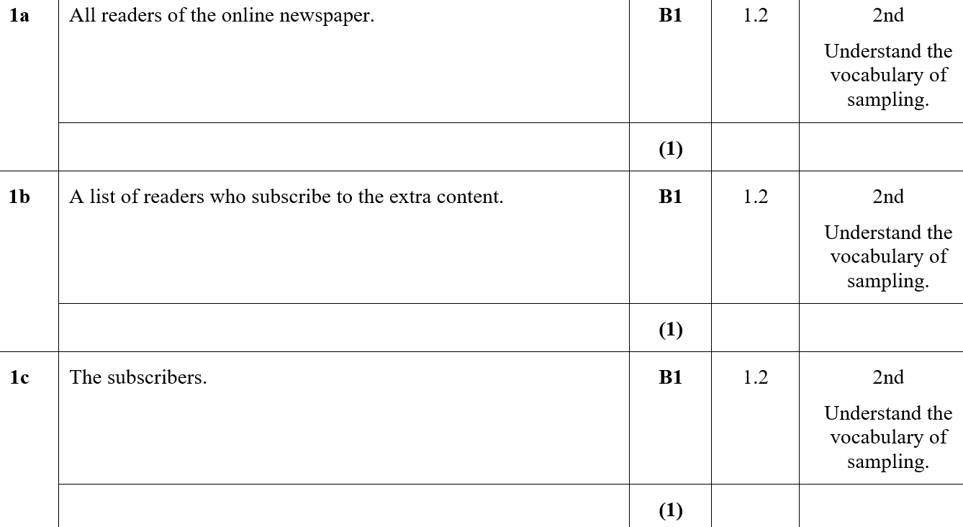
Practice I
A
B
C

Slide 29
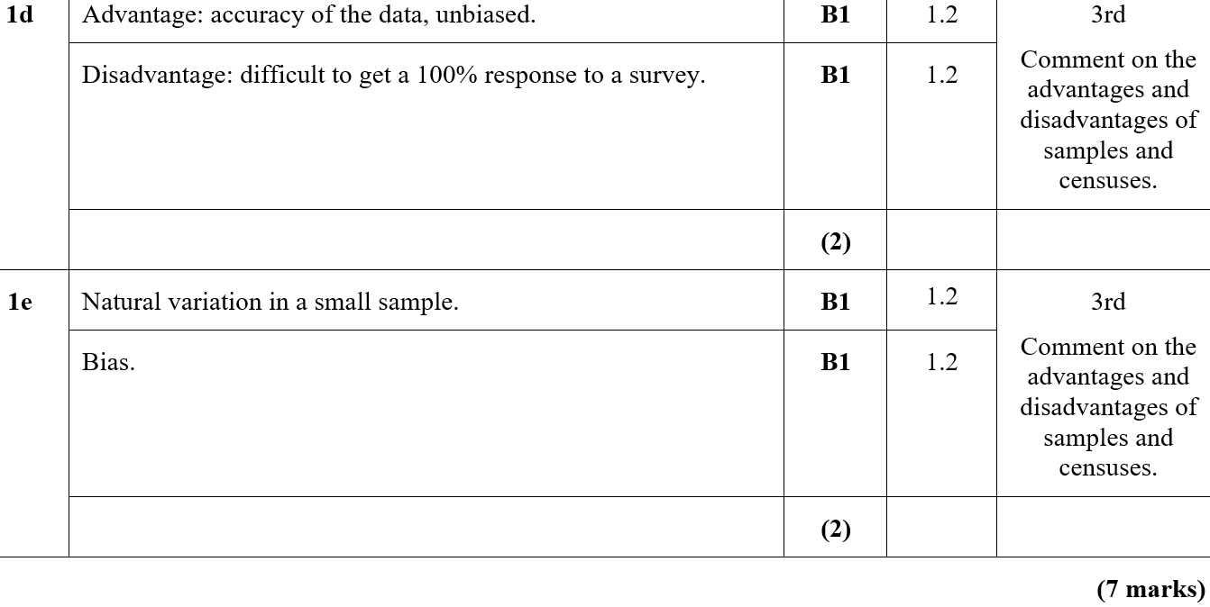
Practice I
D
E

Slide 30
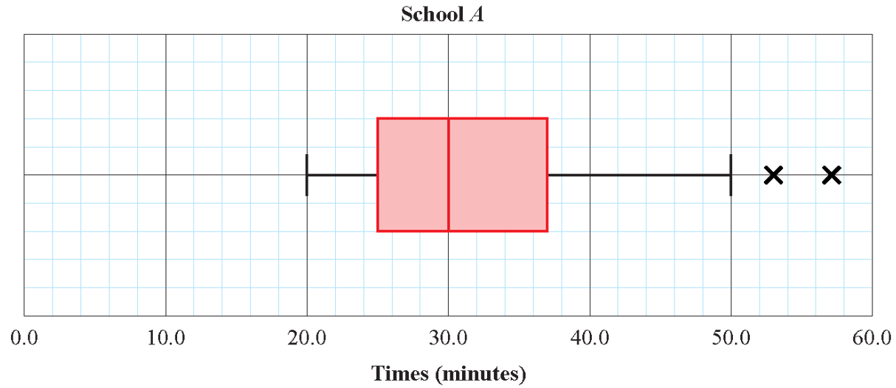

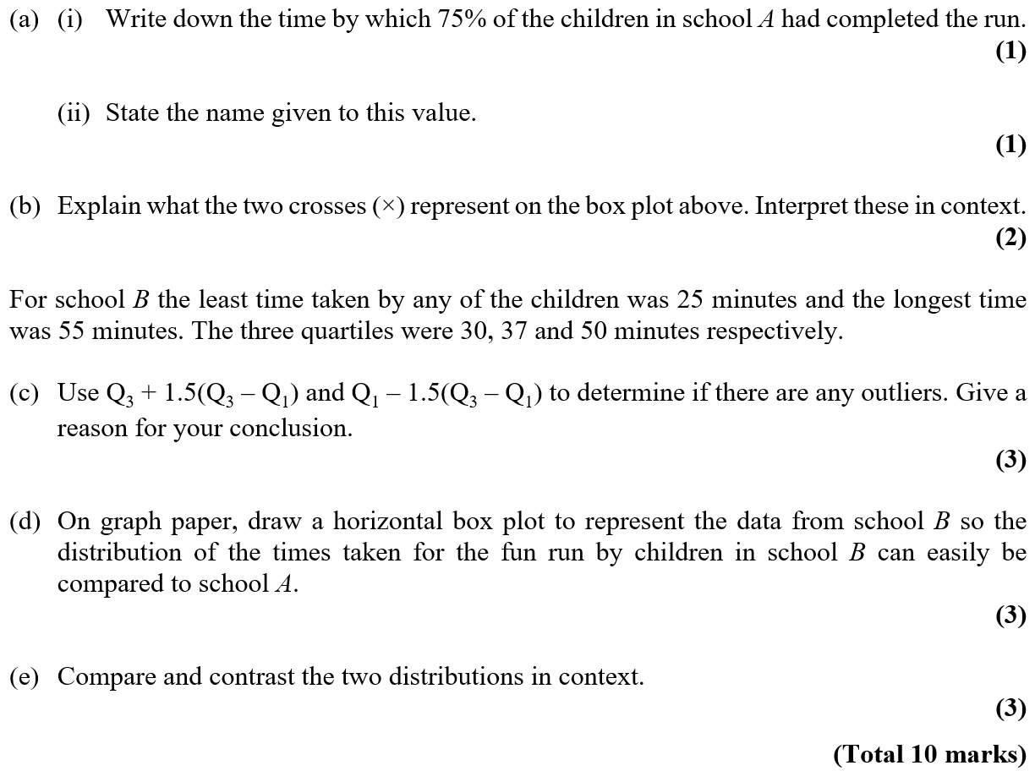
Practice I

Slide 31
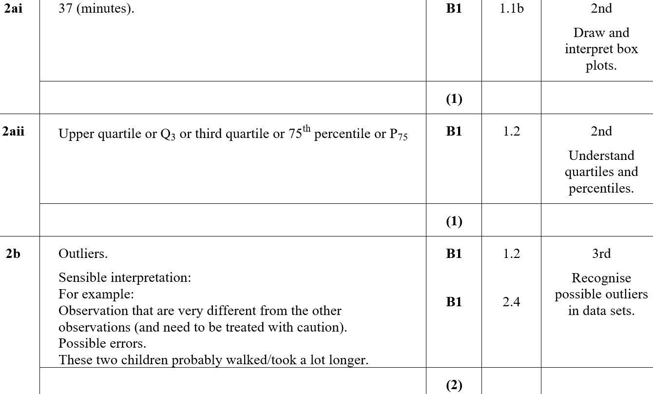
Practice I
A (i)
A (ii)
B

Slide 32
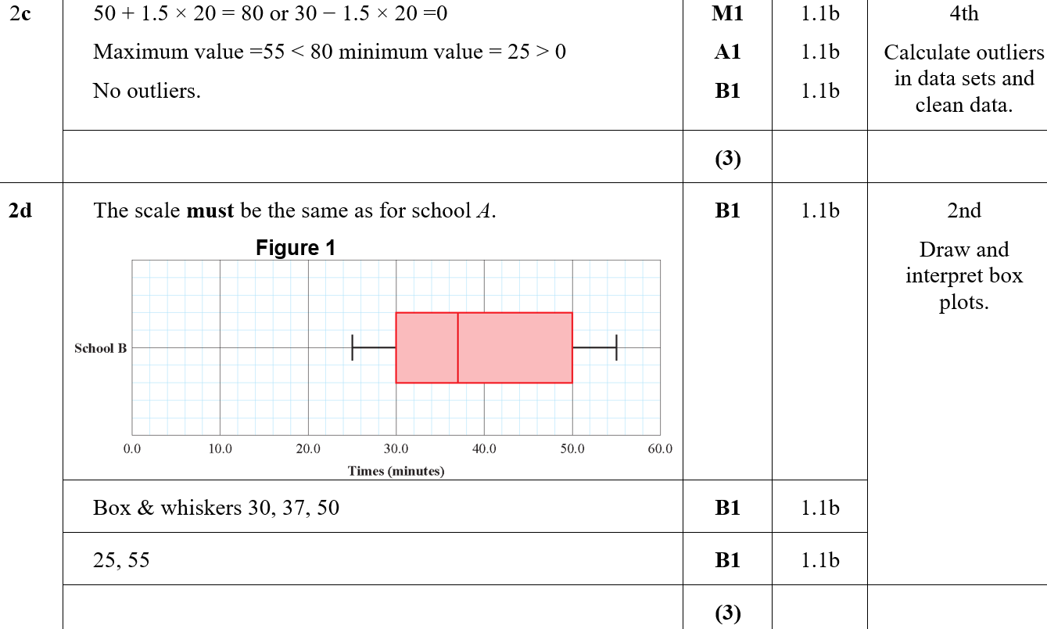

Practice I
C
D
C notes

Slide 33
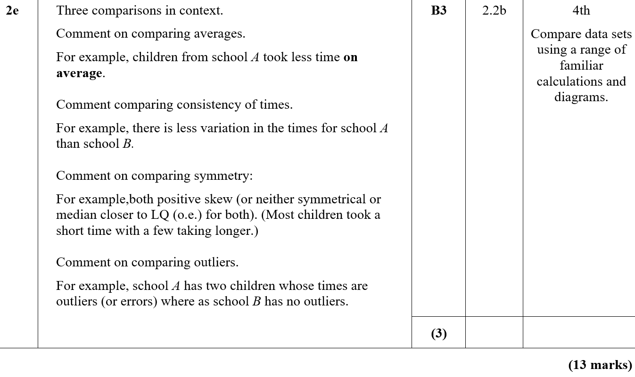
Practice I
E

Slide 34
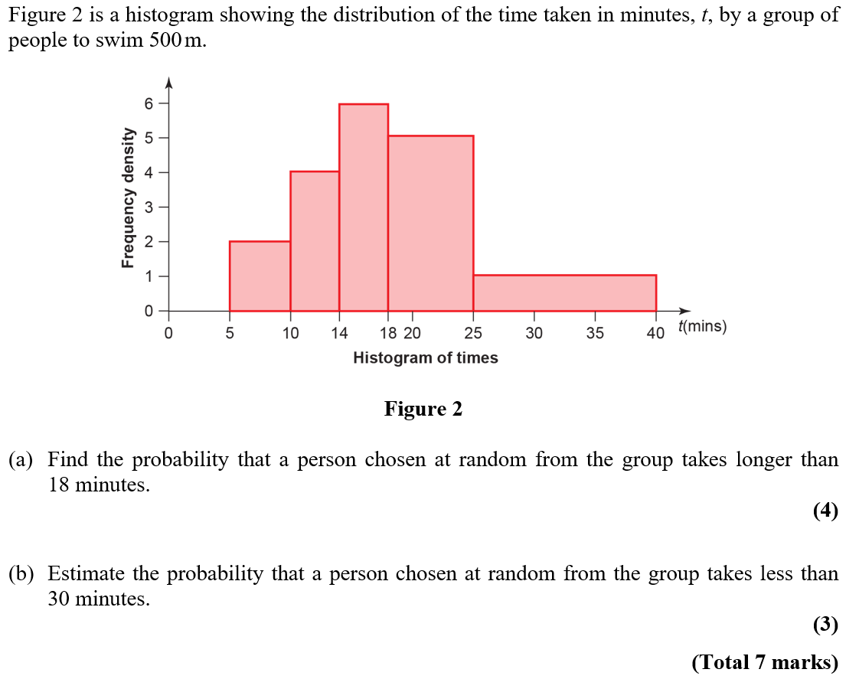
Practice I

Slide 35
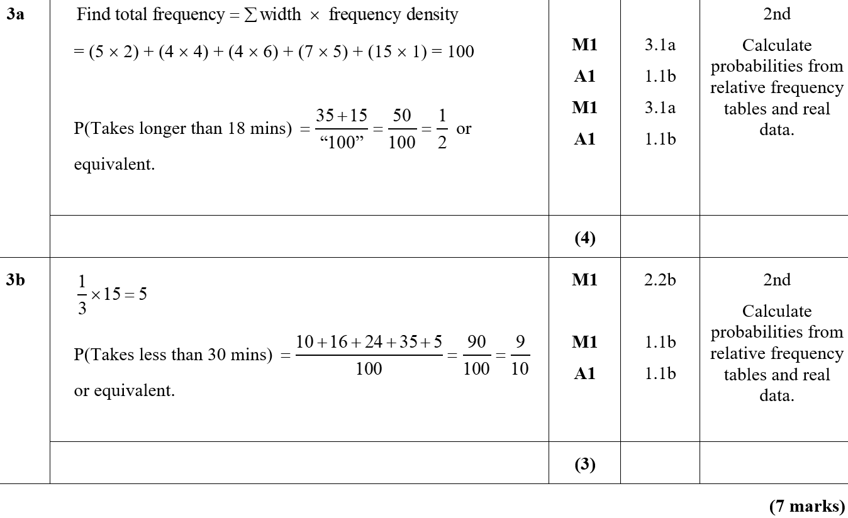
Practice I
A
B

Slide 36
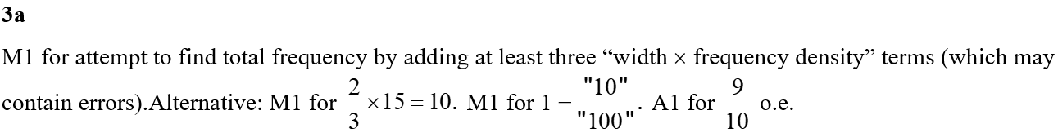
Practice I
A notes

Slide 37
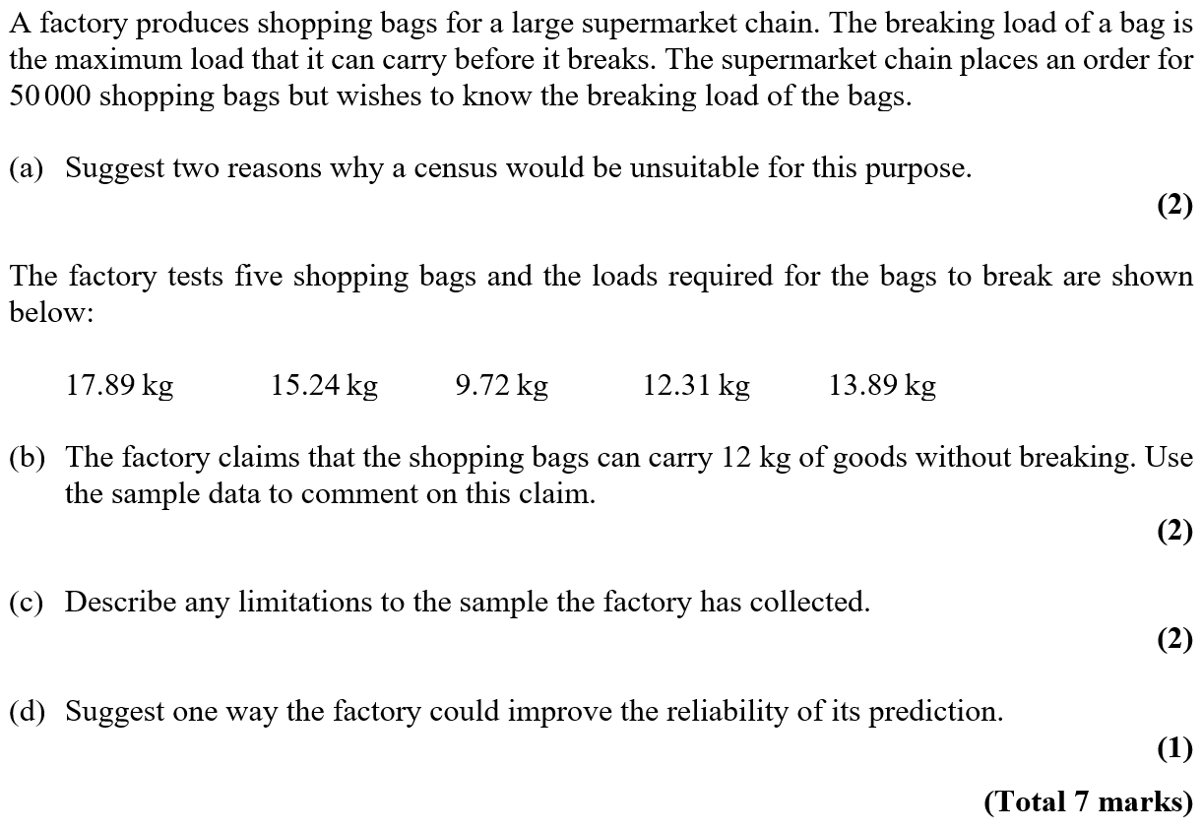
Practice J

Slide 38
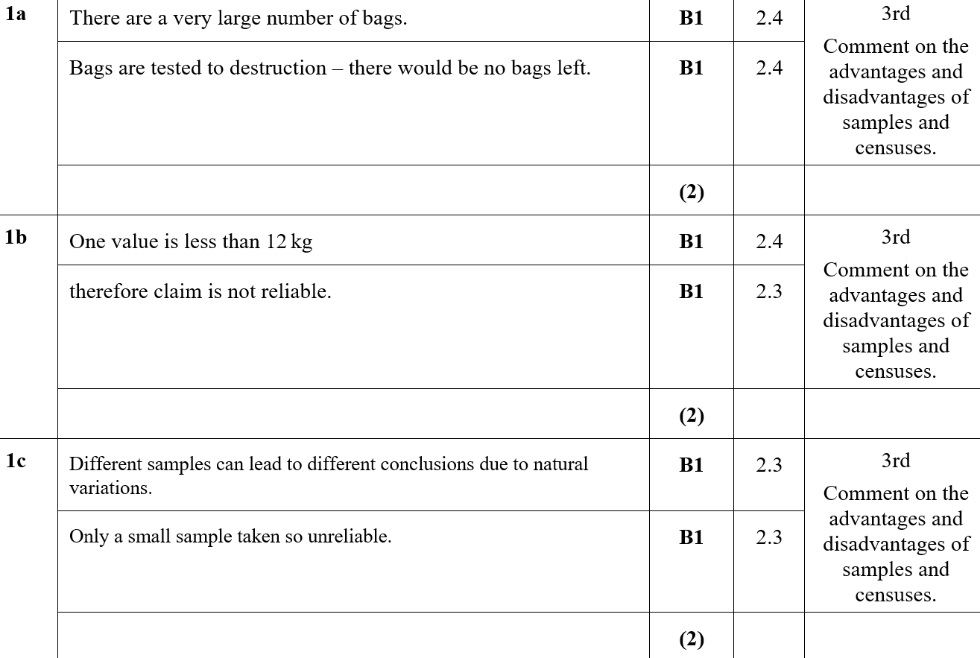
Practice J
A
B
C

Slide 39
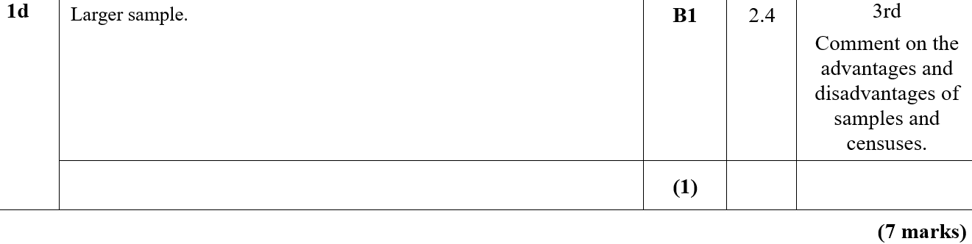
Practice J
D

Slide 40
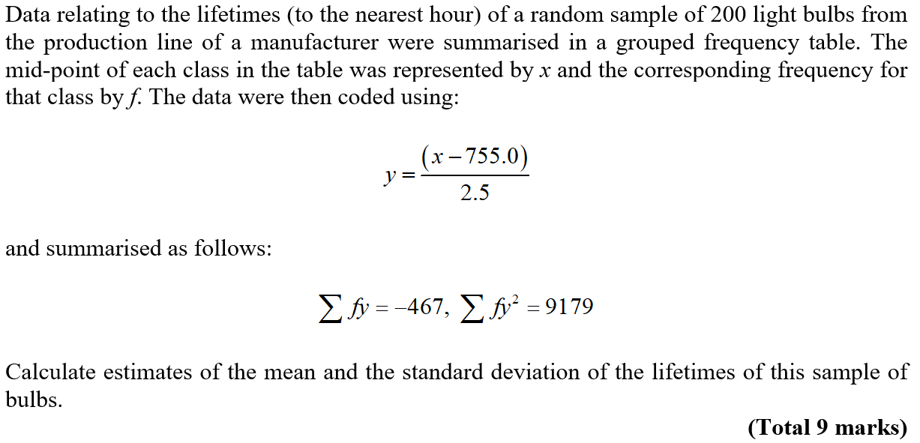
Practice J

Slide 41
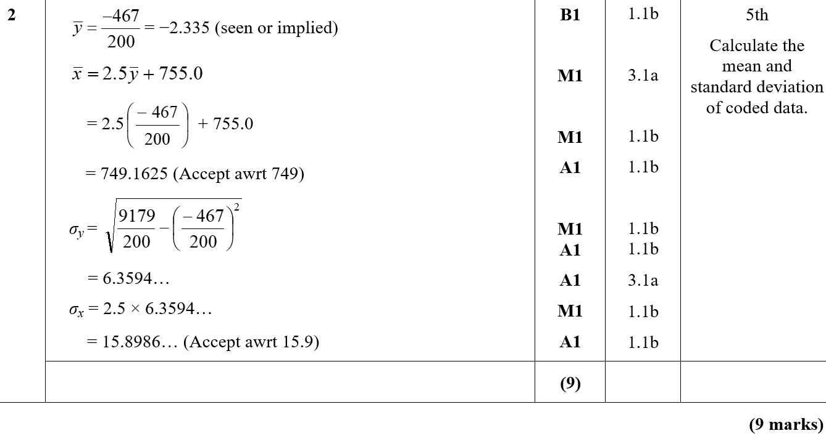
Practice J
A

Slide 42
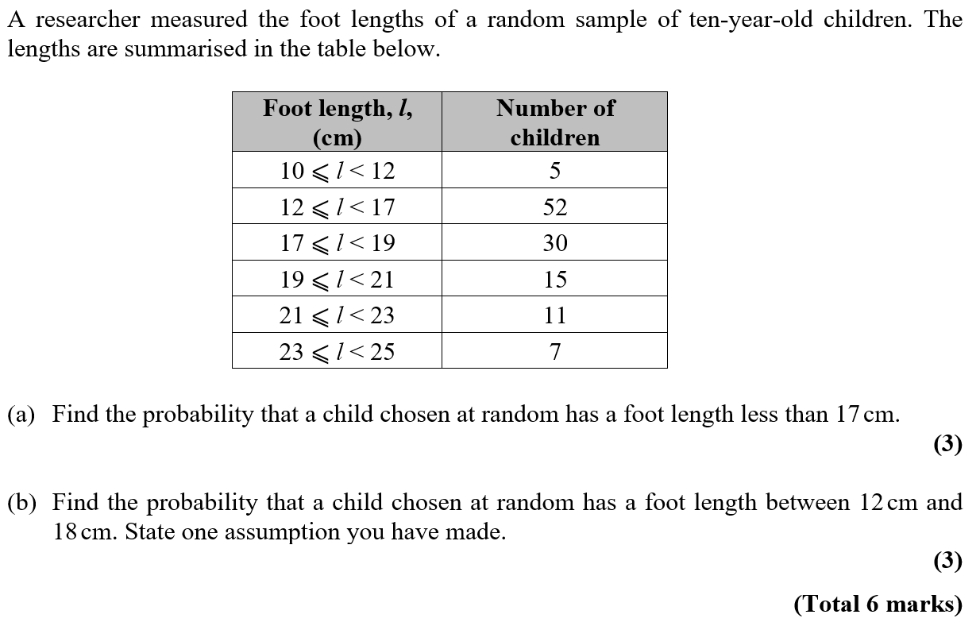
Practice J

Slide 43
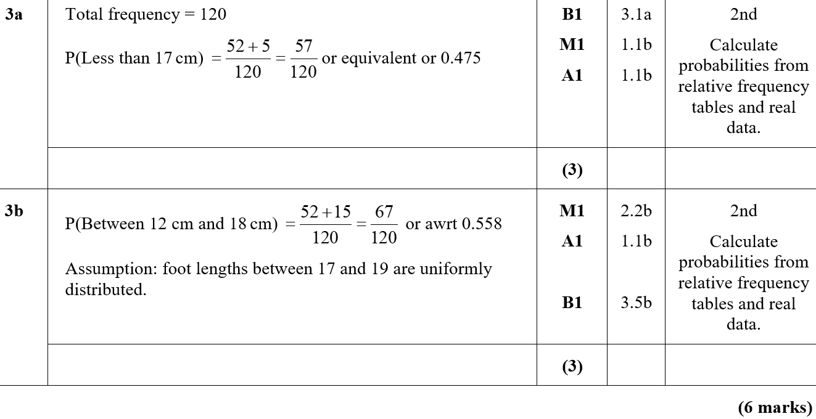
Practice J
A
B

Slide 44

SAM

Slide 45


SAM
A
B
C
B notes
C notes

Slide 46



SAM

Slide 47

SAM
A
A notes

Slide 48



SAM

Slide 49

SAM
A
B (i)
B (ii)
C
D

Slide 50


SAM
E (i)
E (ii)
A notes
B (i) notes
B (ii) notes
C notes

Slide 51

SAM
D notes
E (i) notes
E (ii) notes

Slide 52

2018

Slide 53


2018
A
B
C
A (SF)
B (SF)
C (SF)

Slide 54

2018
A notes
B notes
C notes

Slide 55



2018

Slide 56

2018
A
B
C
D (i)
D (ii)

Slide 57

2018
A (SF)
B (SF)
C (SF)

Slide 58

2018
D (i) (SF)
D (ii) (SF)
A notes

Slide 59


2018
B notes
C notes
D (i) notes
D (ii) notes
D Alternative notes

Slide 60
New Spec Q’s
*Skew and Stem & Leaf not on new spec
Old Spec Data Processing
Jan 2006
S&L*
Jan 2008 (ii)
histogram
Jan 2011 (ii)
Box plot*
May 2013 (ii)
S2 & S3 sampling
May 2006 (i)
Box plot
May 2008
S&L*
Jan 2011 (iii)*
May 2014 (i) S&L, Box Plot*
May 2006
Jan 2006
Jan 2007
May 2006
May 2006 (ii)
Jan 2009
histogram*
May 2011
Some normal distribution*
May 2014 (ii)
Jan 2008
June 2009
Jan 2007 (i)*
May 2009 (i) histogram
May 2009
June 2010
Jan 2012 (i)
histogram
May 2014 (iii) histogram*
Jan 2007 (ii)
histogram
May 2010
June 2012
May 2009 (ii)
Some Normal distribution*
Jan 2012 (ii)
S&L*
June 2013
Jan 2007 (iii)
General
June 2015
Box plot
May 2011
May 2012
histogram
June 2015
June 2007 (i)
Some normal distribution*
June 2016 (i)
Jan 2010 (i)
S&L*
June 2016
Jan 2013
histogram*
June 2016 (ii) Histogram
Jan 2010 (ii)*
June 2017
June 2007 (ii)
histogram*
May 2013 (i)
Box and S&L*
June 2017 Histogram*
Jan 2008 (i)*
May 2010*
Jan 2011 (i)
June 2018 Histogram*

Slide 61


Jan 2006

Slide 62

Jan 2006
A
B
C
D
E

Slide 63


May 2006

Slide 64


May 2006
A
B
C
D
E

Slide 65


May 2006

Slide 66

May 2006
A
B
C
D

Slide 67


Jan 2007

Slide 68

Jan 2007
A
B
C
D
E
F
G

Slide 69

Jan 2007
B
C
D
E
F

Slide 70

Jan 2007

Slide 71


Jan 2007
A
B
C
D
B
C
D

Slide 72

Jan 2007

Slide 73

Jan 2007
A
B
A
B

Slide 74


June 2007

Slide 75

June 2007
A
B
C
D
E

Slide 76

June 2007
A
B
C
D
E

Slide 77


June 2007

Slide 78

June 2007
A
B
C
D
E
F

Slide 79

June 2007
B
C
D
E
F

Slide 80


Jan 2008

Slide 81

Jan 2008
A
B
C
D

Slide 82

Jan 2008
A
B
C
D

Slide 83


Jan 2008

Slide 84

Jan 2008
A

Slide 85



May 2008

Slide 86


A
May 2008
B
C (i)
C (ii)
D
E

Slide 87


Jan 2009

Slide 88

Jan 2009
A
B
C
D
E

Slide 89

Jan 2009
A
B
C
D
E

Slide 90

May 2009

Slide 91

May 2009
A
B

Slide 92


May 2009

Slide 93

May 2009
A
B
C
D

Slide 94

May 2009
A
B
C
D

Slide 95


Jan 2010

Slide 96

Jan 2010
A
B
C
D

Slide 97

Jan 2010
B
C
D

Slide 98


Jan 2010

Slide 99

Jan 2010
A
B
C
D
E

Slide 100

Jan 2010
B
C
D
E

Slide 101


May 2010

Slide 102

May 2010
A
B
C
D
E

Slide 103

Jan 2011

Slide 104

Jan 2011
A
B
A
B

Slide 105



Jan 2011

Slide 106

Jan 2011
A
B
C

Slide 107

Jan 2011
A
B
C

Slide 108


Jan 2011

Slide 109

Jan 2011
A
B
C

Slide 110

Jan 2011
A
B
C

Slide 111


May 2011

Slide 112

May 2011
A
B
C
D
E

Slide 113


May 2011
A
B
C
D
E

Slide 114

Jan 2012

Slide 115


Jan 2012
A
B
A
B

Slide 116



Jan 2012

Slide 117

Jan 2012
A
B
C
D
E

Slide 118


May 2012

Slide 119

May 2012
A
B
C
D
E

Slide 120




Jan 2013

Slide 121

A
Jan 2013
B
C
D
E
F

Slide 122




May 2013

Slide 123

May 2013
A
B
C
D

Slide 124



May 2013

Slide 125

May 2013
A
B
C
D
E
F

Slide 126



May 2014

Slide 127

May 2014
A
B
C

Slide 128

May 2014

Slide 129

May 2014
A

Slide 130


May 2014

Slide 131


May 2014
A
B
C
D

Slide 132



June 2015

Slide 133

June 2015
A
B
C
D
E
F

Slide 134

June 2015
C notes
D notes
E notes
F notes

Slide 135


June 2016

Slide 136

June 2016
A
B
C
D
E

Slide 137

June 2016
A notes
B notes
C notes
D notes
E notes

Slide 138


June 2016

Slide 139

June 2016
A
B
C (i)
C (ii)
D
E
F (i)
F (ii)

Slide 140

June 2016
A notes
B notes
C (i) notes
C (ii) notes
D notes
E notes
F (i) notes
F (ii) notes

Slide 141


June 2017

Slide 142

June 2017
A
B
C
D
E
F
G

Slide 143

June 2017
A notes
B notes
C (i) notes
D notes
E notes
F notes
G notes

Slide 144


June 2018

Slide 145

June 2018
A
B
C
D
E
F

Slide 146

June 2018
A notes
B notes
C notes
D notes
E notes
F notes

Slide 147

Jan 2006

Slide 148

Jan 2006
A

Slide 149

May 2006

Slide 150

May 2006
A
B
C

Slide 151

May 2006

Slide 152

May 2006
A
B

Slide 153

Jan 2007

Slide 154

Jan 2007
A
B (i)
B (ii)

Slide 155

Jan 2008

Slide 156

Jan 2008
A
B
C
D
A notes

Slide 157

Jan 2008
B notes
C notes
D notes

Slide 158

May 2009

Slide 159

May 2009
A
B
C

Slide 160

June 2009

Slide 161

June 2009
A
B (i)
B (ii)

Slide 162

June 2009
A notes
B (i) notes
B (ii) notes

Slide 163

June 2010

Slide 164

June 2010
A
B
A notes

Slide 165

May 2010

Slide 166

May 2010
A
B
C
D
A notes

Slide 167

May 2010
B notes
C notes
D notes

Slide 168

May 2011

Slide 169

May 2011
A
B

Slide 170

June 2012

Slide 171

June 2012
A
B
C
D

Slide 172

June 2012
A notes
C notes
D notes

Slide 173

June 2013

Slide 174


June 2013
A (i)
A (ii)
A notes

Slide 175

June 2014

Slide 176
June 2014
A
B
C

Slide 177

June 2015

Slide 178
June 2015
A

Slide 179

June 2016

Slide 180

June 2016
A

Slide 181

June 2016
B
notes

Slide 182

June 2017

Slide 183

June 2017
A
B
C

