Slide 1
Old Spec Q’s
Correlation and Regression
Practice G (i)
Specimen
Practice G (ii)
SAM
Practice H (i)
2018
Practice H (ii)
Practice H (iii)
Practice I (i)
Practice I (ii)
Practice I (iii)

Slide 2
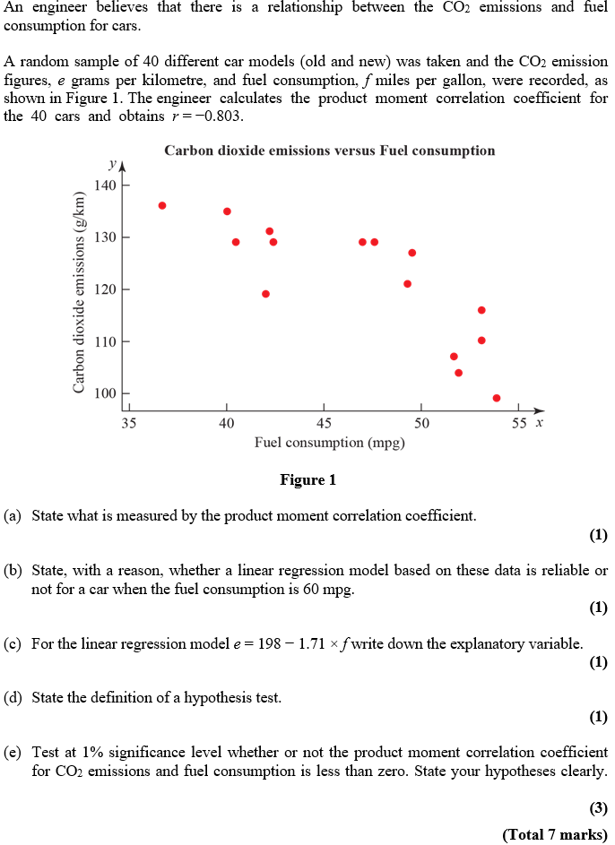
Practice Paper G

Slide 3
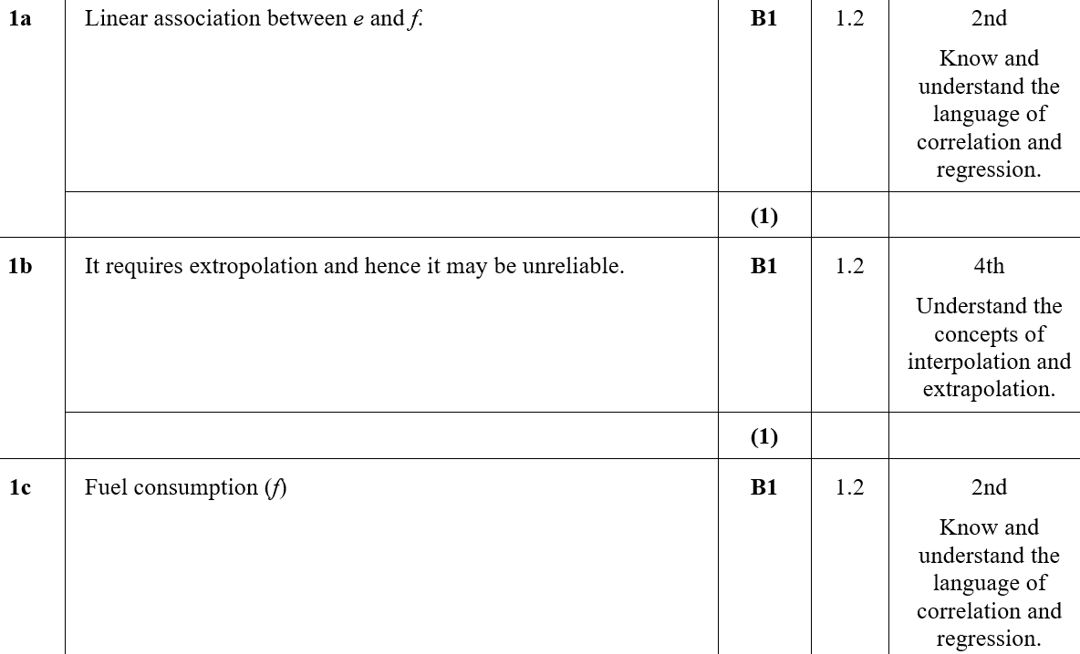
Practice Paper G
A
B
C

Slide 4
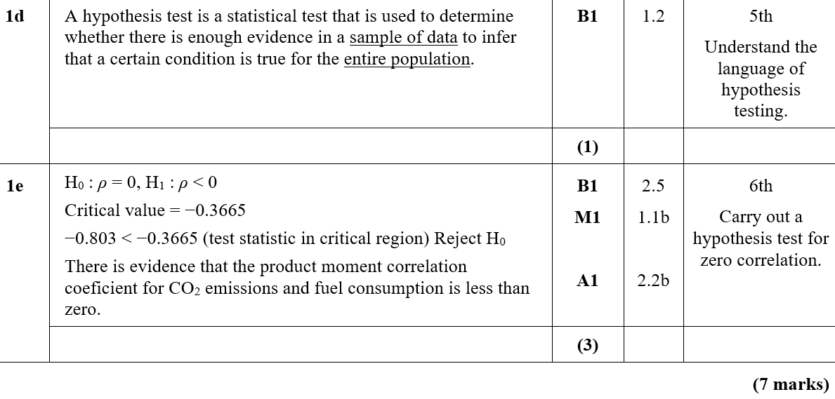
Practice Paper G
D
E

Slide 5
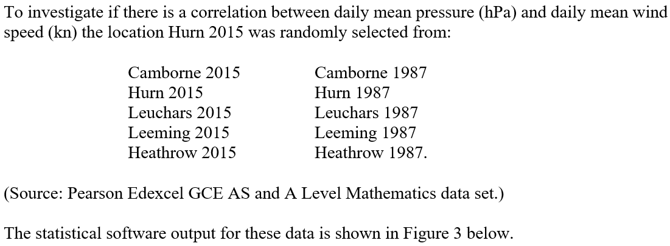
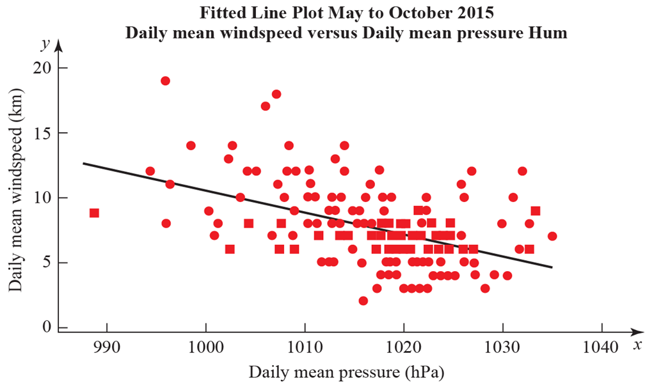
Practice Paper G

Slide 6
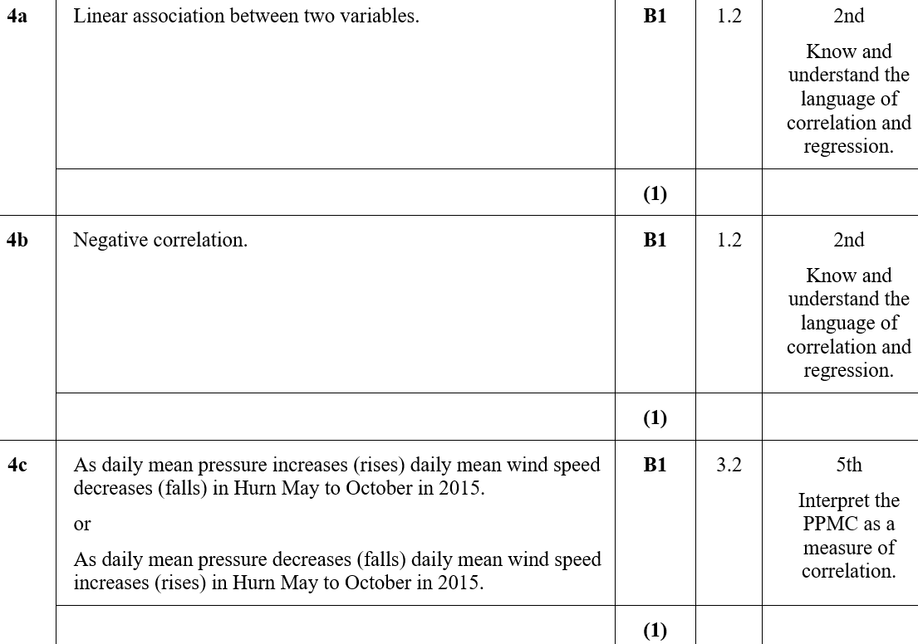
Practice Paper G
A
B
C

Slide 7
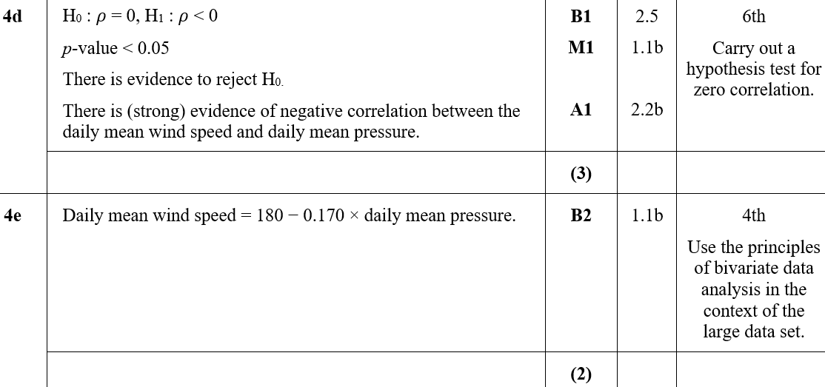
Practice Paper G
D
E
E notes

Slide 8
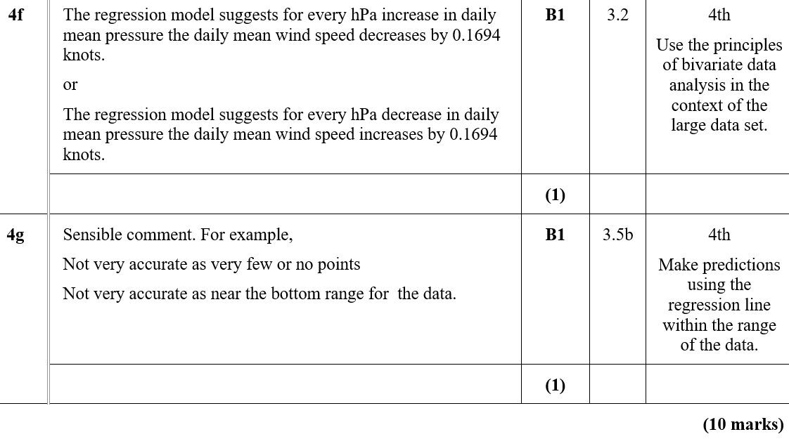
Practice Paper G
F
G

Slide 9
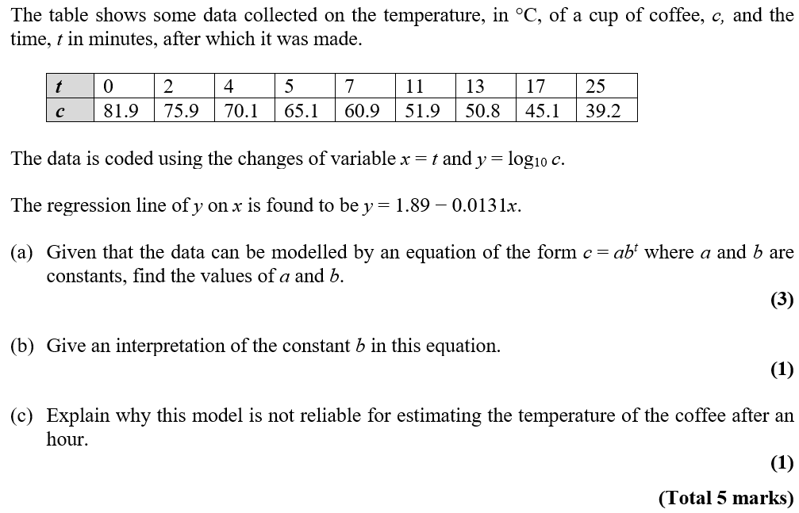
Practice Paper H

Slide 10
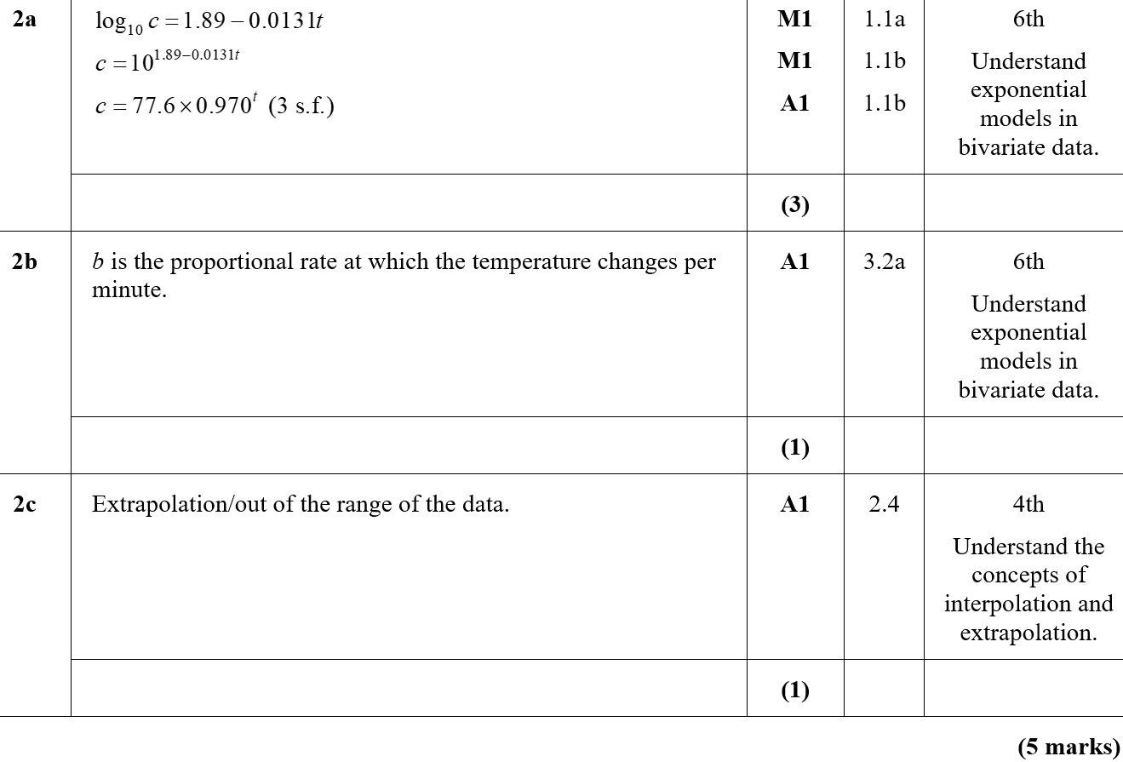
Practice Paper H
A
B
C

Slide 11
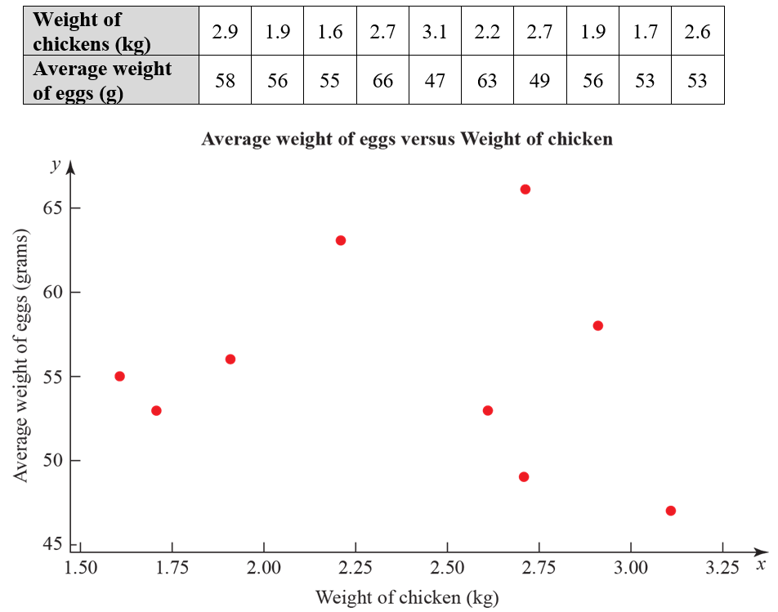
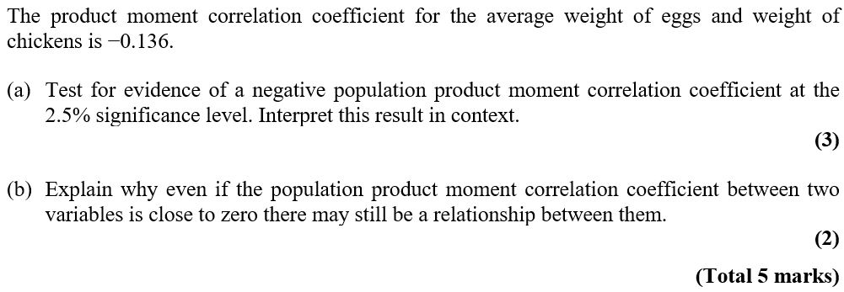
Practice Paper H

Slide 12
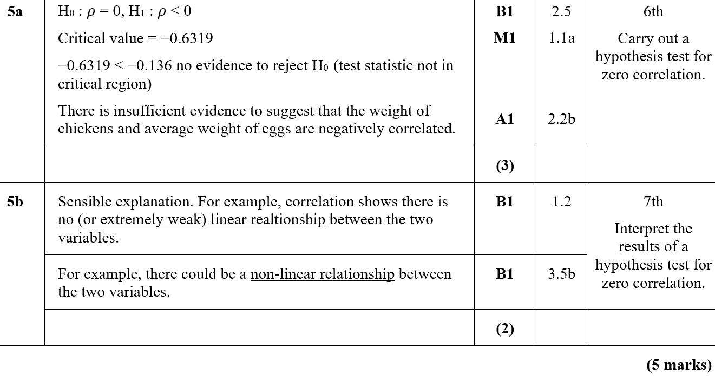
Practice Paper H
A
B

Slide 13
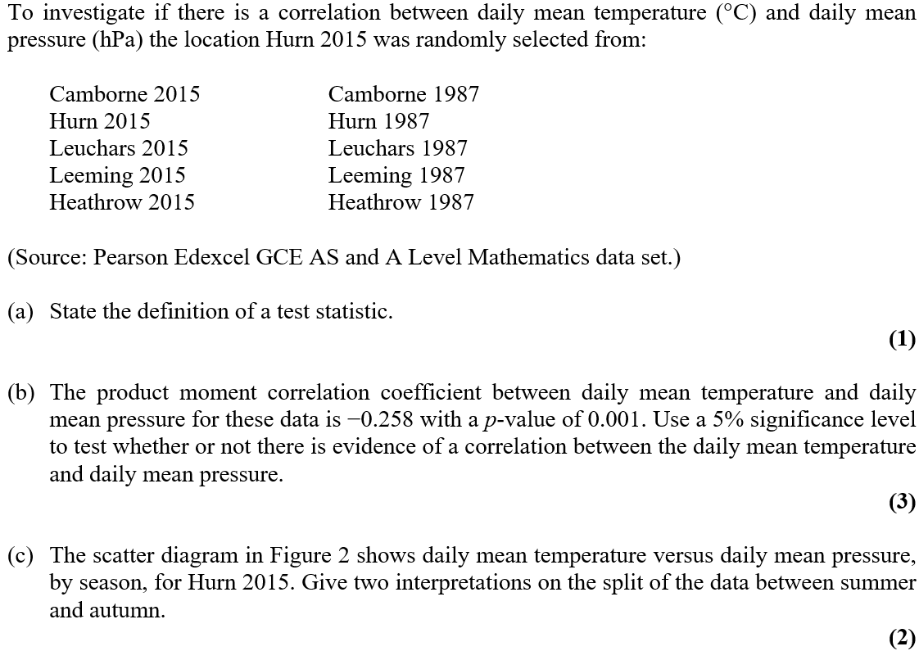
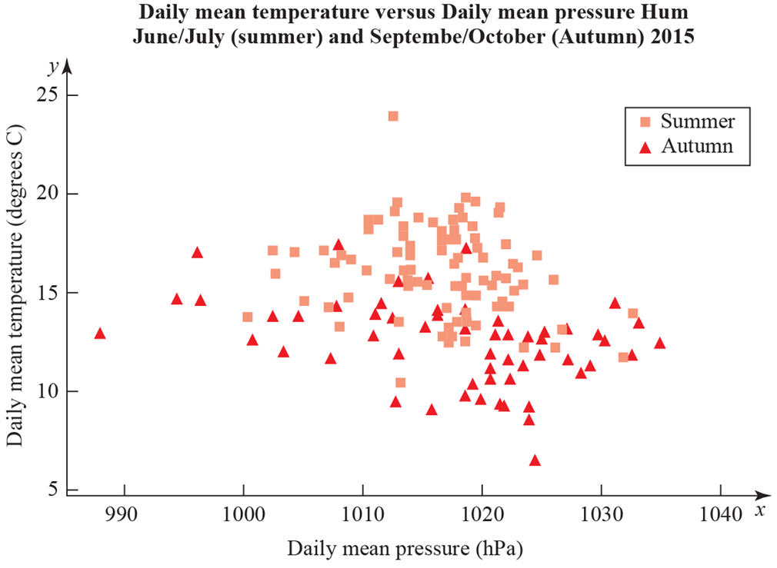
Practice Paper H

Slide 14
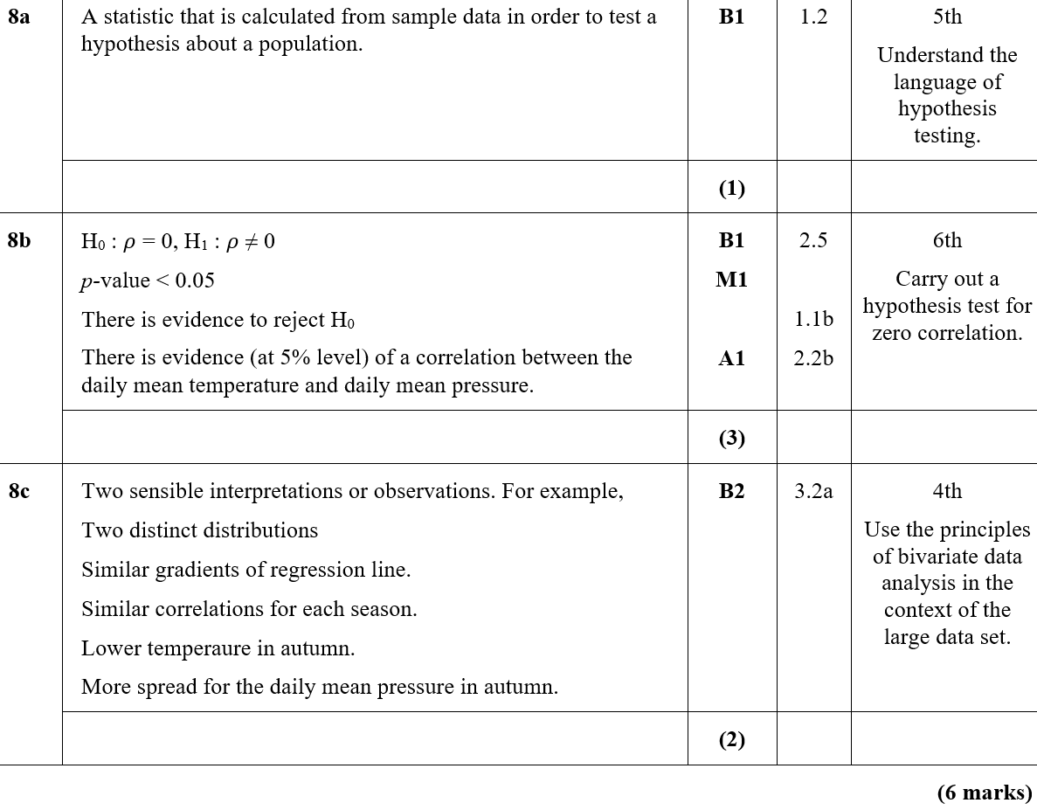
Practice Paper H
A
B
C

Slide 15
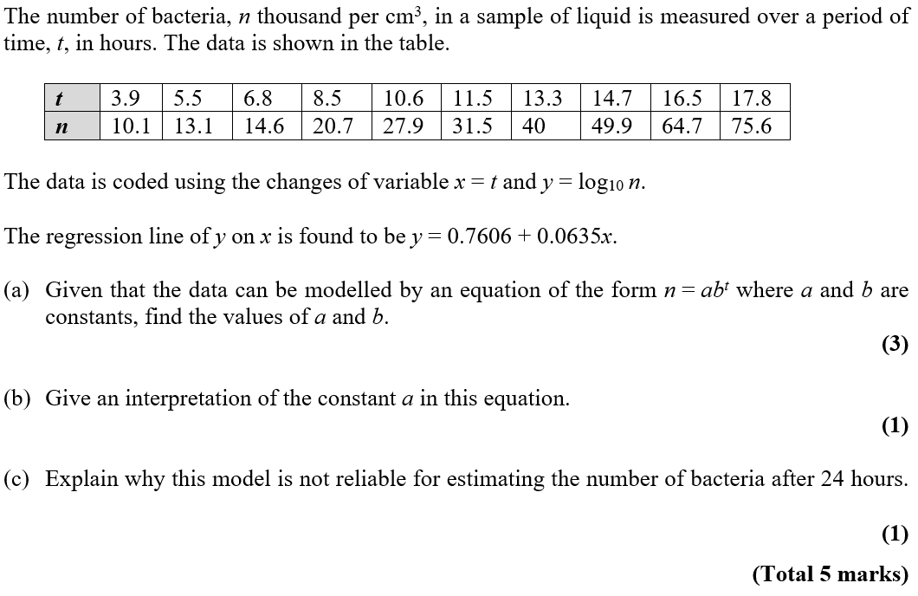
Practice Paper I

Slide 16
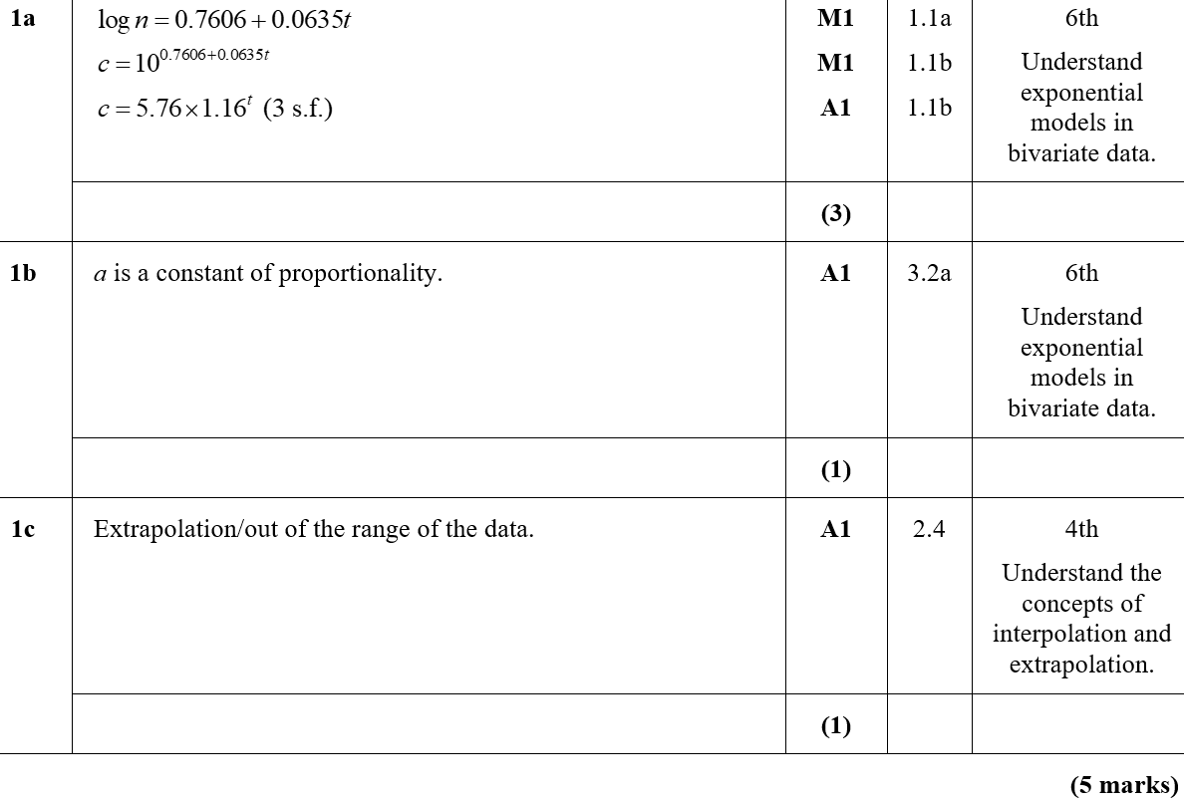
Practice Paper I
A
B
C

Slide 17
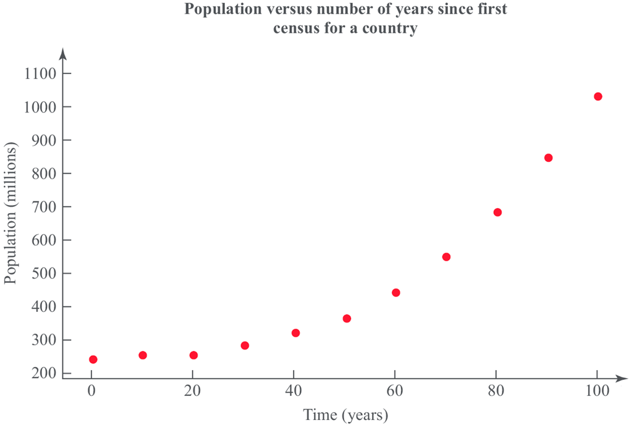
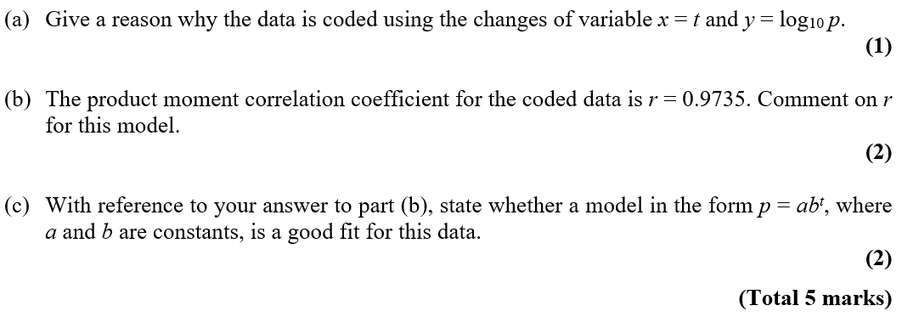
Practice Paper I

Slide 18
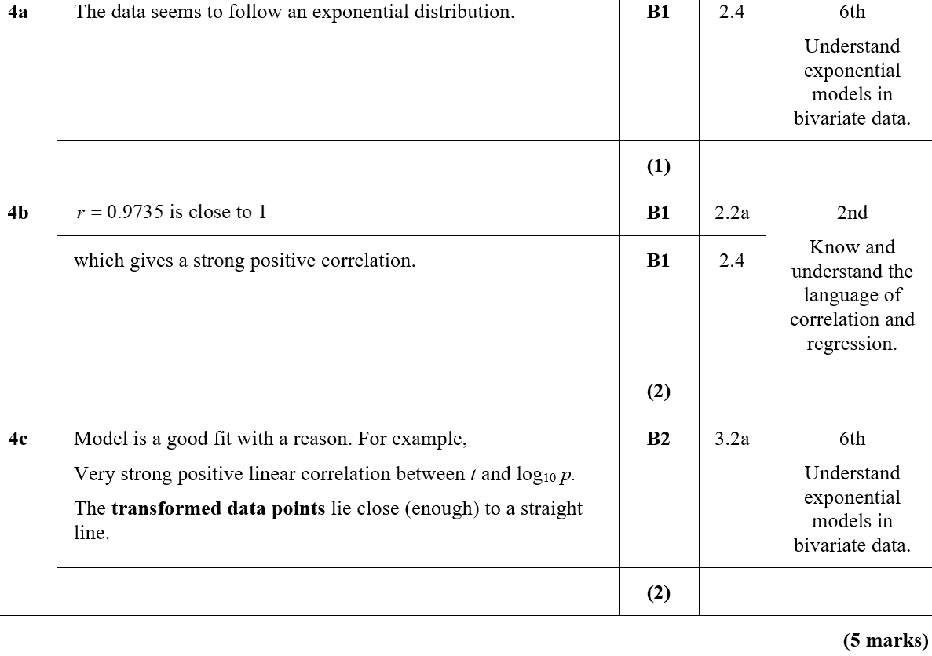
Practice Paper I
A
B
C
C notes

Slide 19
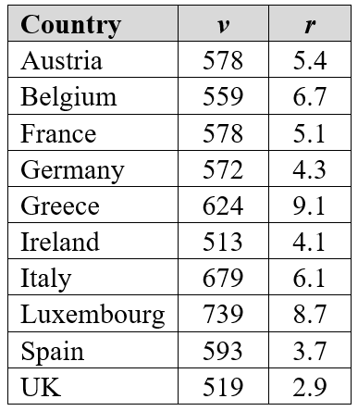
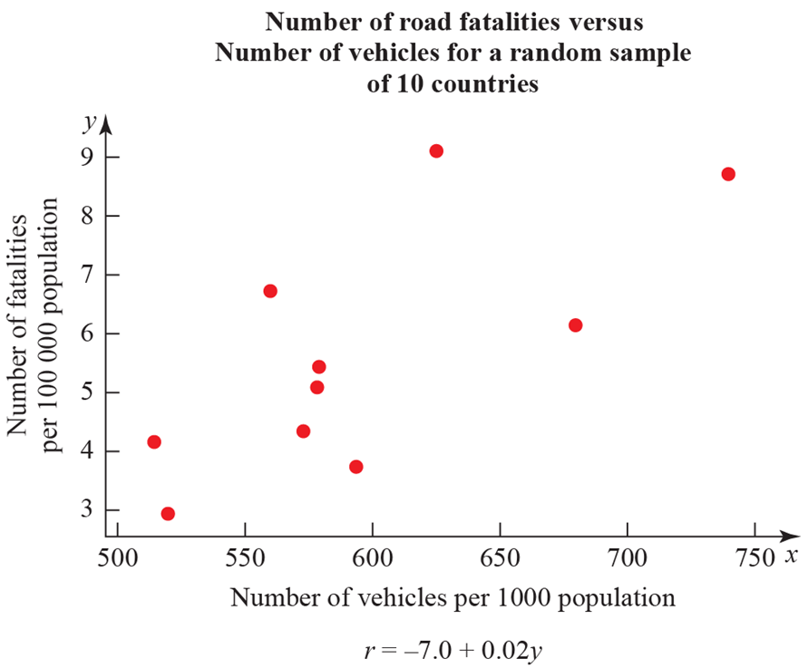
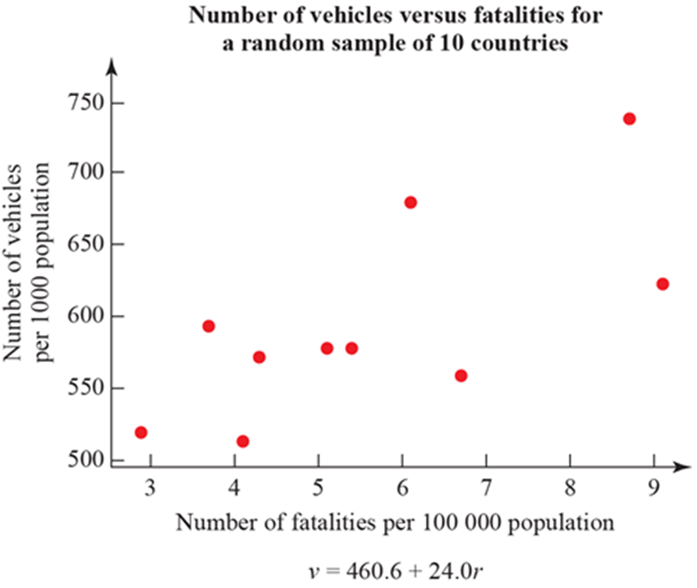
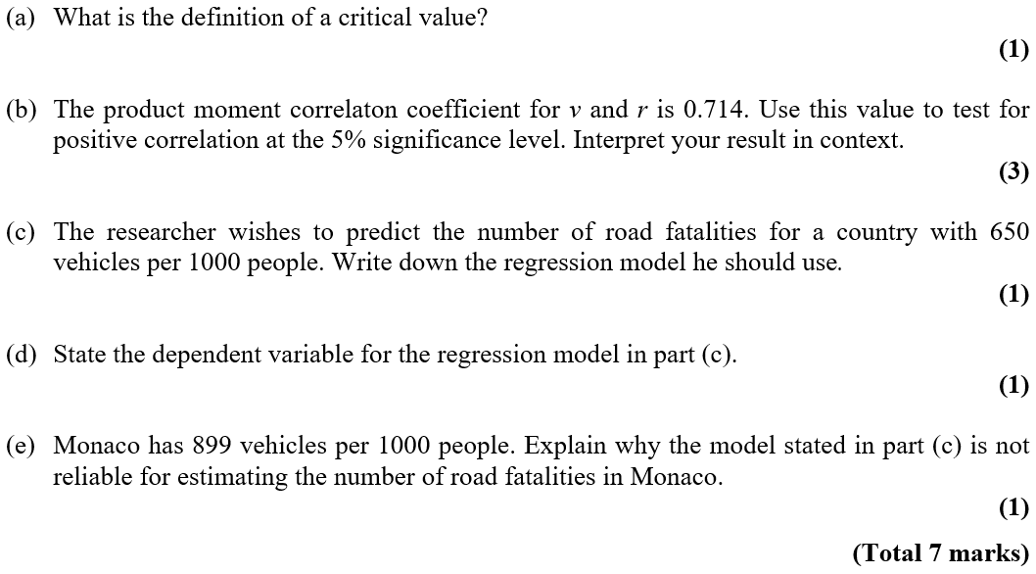
Practice Paper I

Slide 20
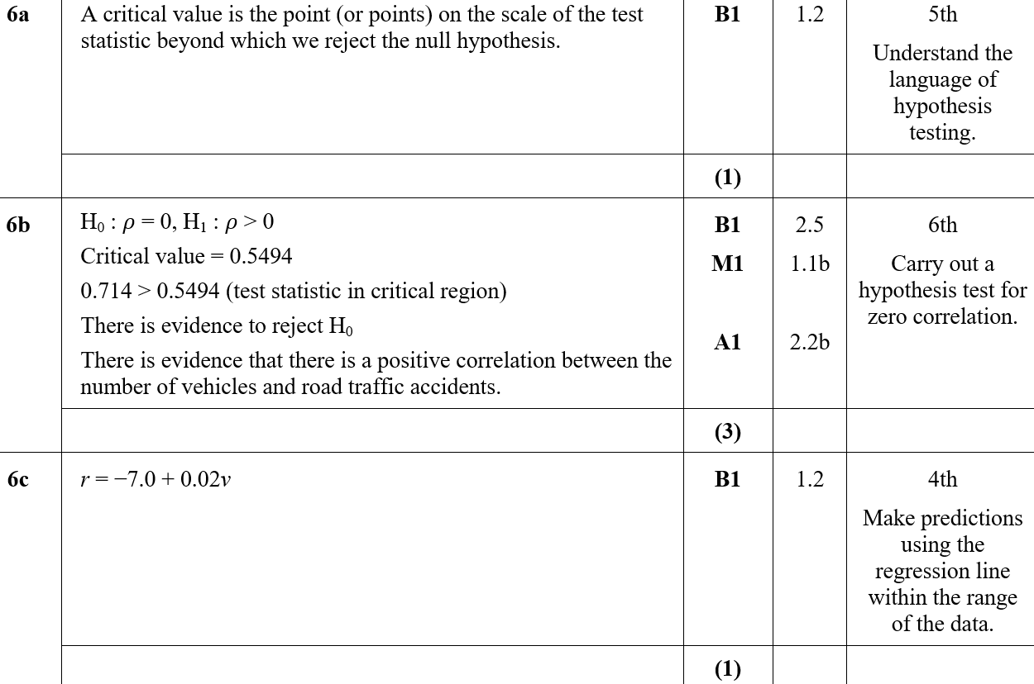
Practice Paper I
A
B
C

Slide 21
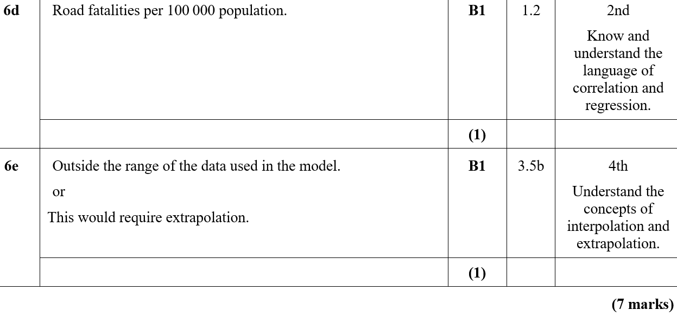
Practice Paper I
D
E

Slide 22
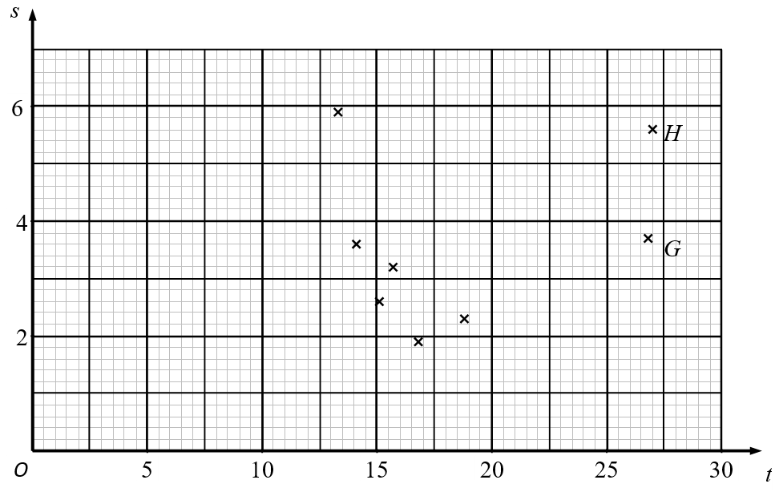
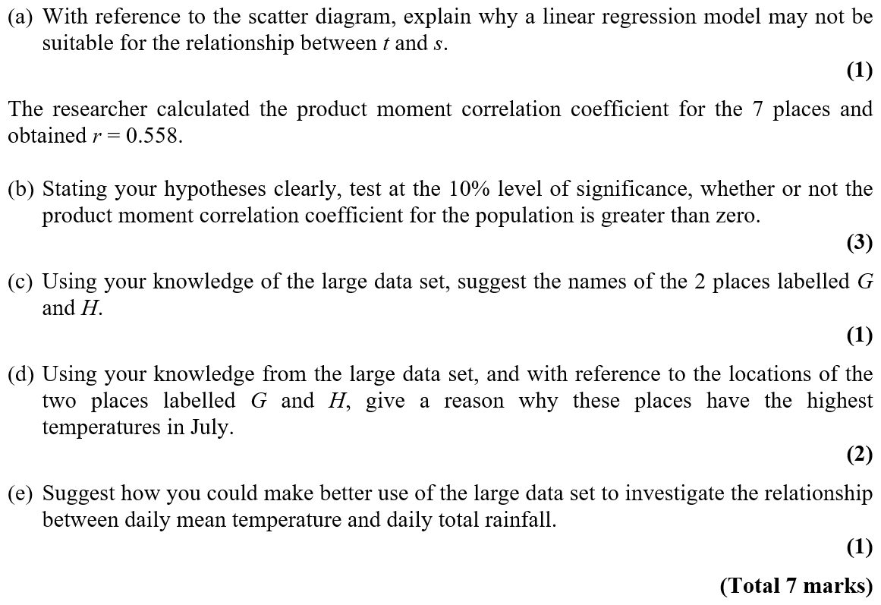
Specimen

Slide 23
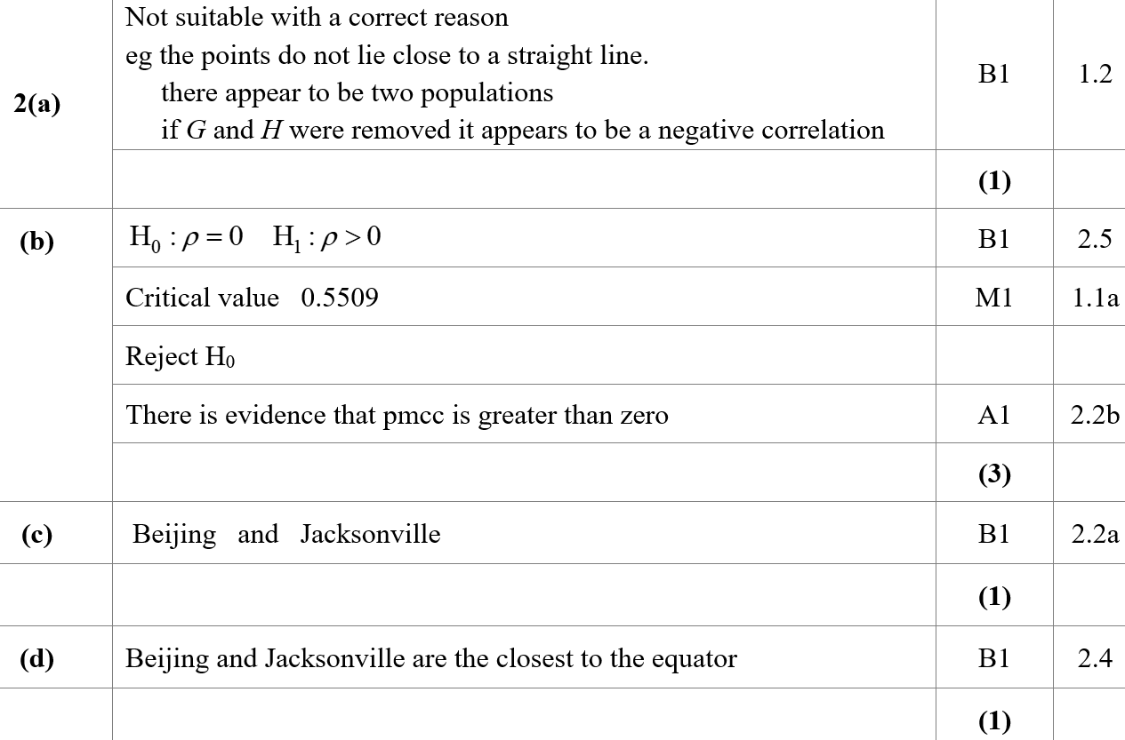
Specimen
A
B
C
D
E

Slide 24
Specimen
A notes
B notes
C notes
D notes

Slide 25
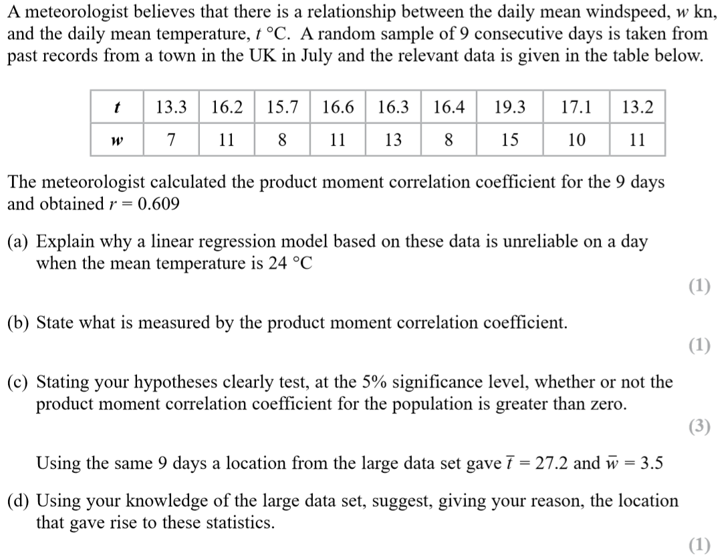
SAM

Slide 26
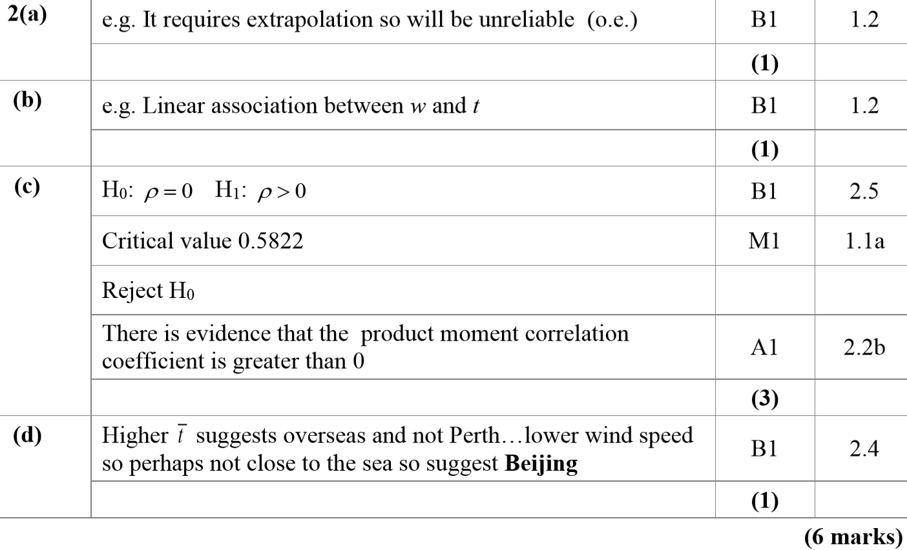
SAM
A
B
C
D

Slide 27
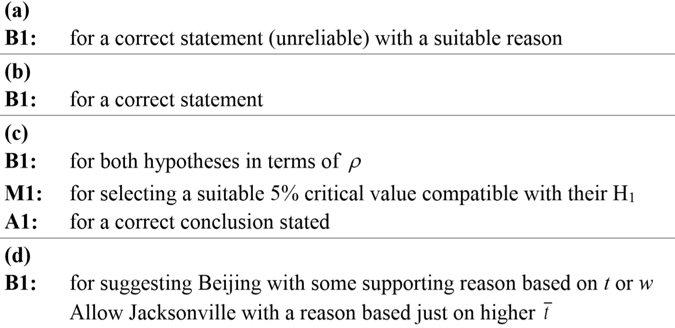
SAM
A notes
B notes
C notes
D notes

Slide 28
2018

Slide 29
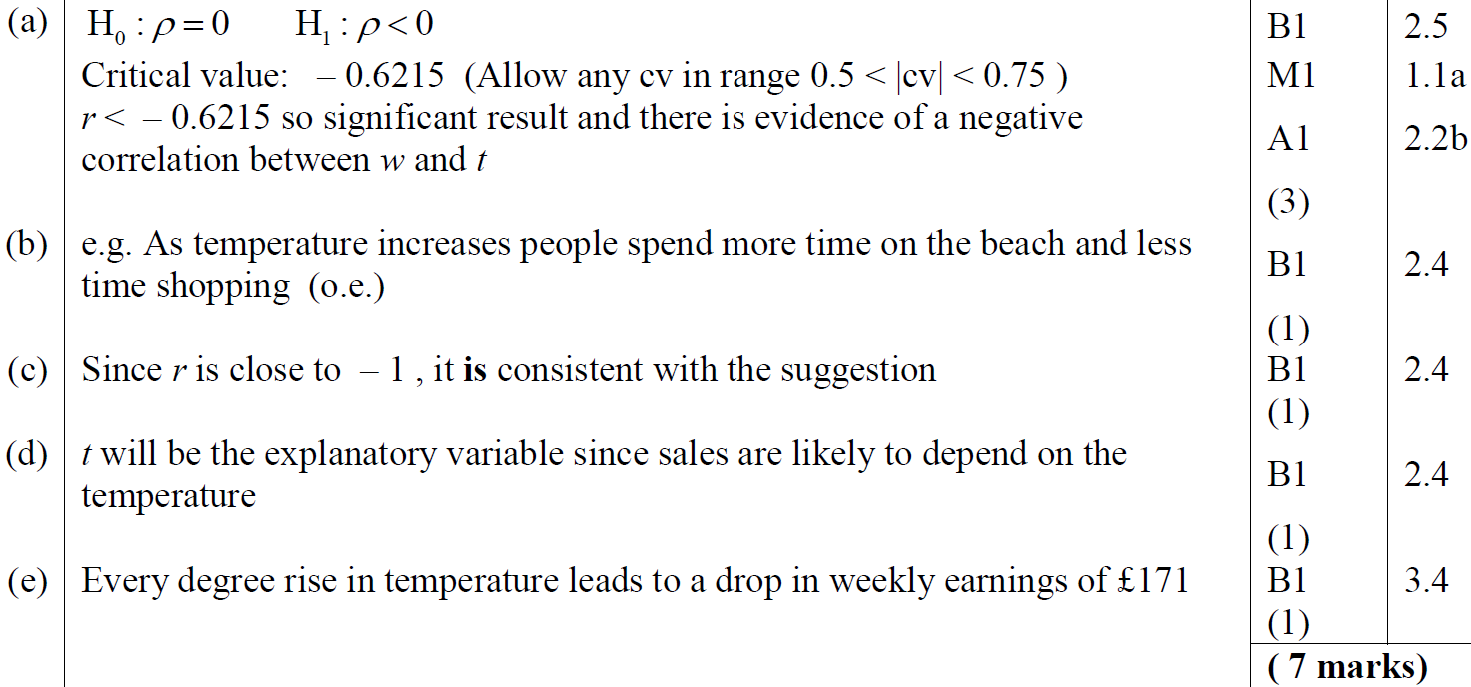
2018
A
B
C
D
E

Slide 30
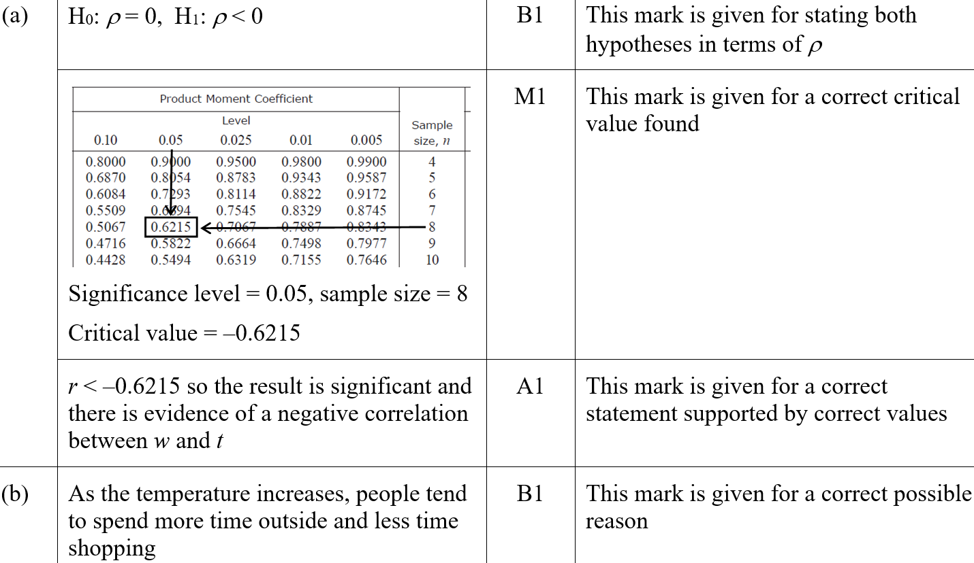
2018
A (SF)
B (SF)

Slide 31
2018
C (SF)
D (SF)
E (SF)
A notes

Slide 32
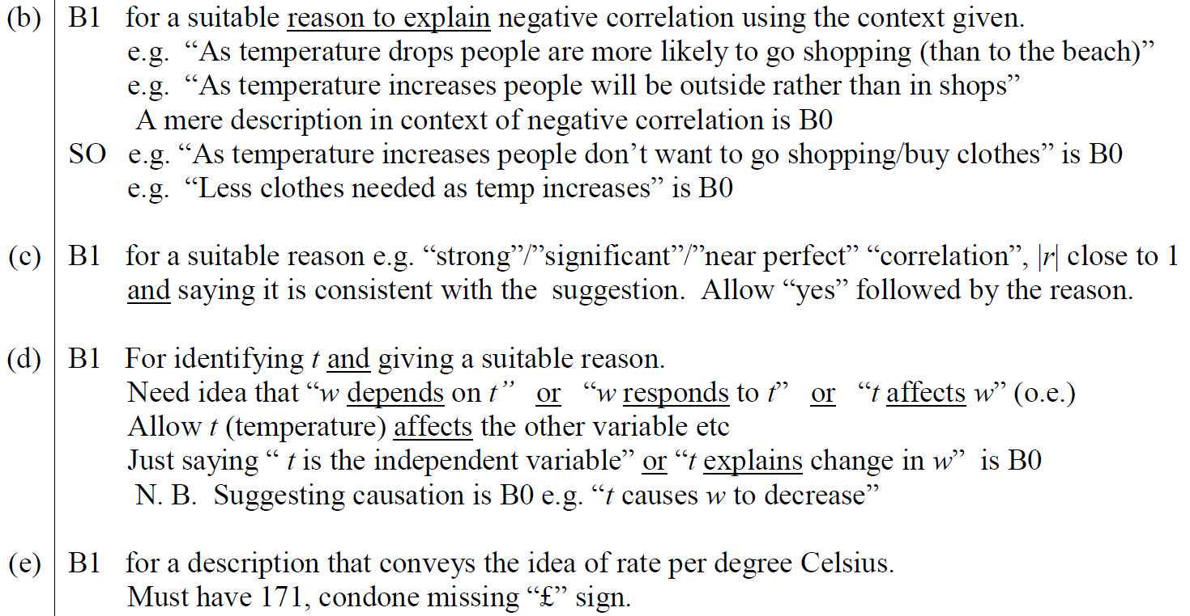
2018
B notes
C notes
D notes
E notes

Slide 33
New Spec Q’s
Old Spec Correlation and Regression
Jan 2006
Jan 2009 (i)
Jan 2011 (ii)
May 2013
May 2006
Jan 2009 (ii)
May 2011 (i)
May 2014
Jan 2007
May 2009 (i)
May 2011 (ii)
June 2015 (i)
June 2007 (i)
May 2009 (ii)
Jan 2012
June 2015 (ii)
June 2007 (ii)
Jan 2010
May 2012 (i)
June 2016 (i)
Jan 2008(i)
May 2010 (i)
May 2012 (ii)
June 2016 (ii)
Jan 2008 (ii)
May 2010 (ii)
Jan 2013 (i)
June 2017
May 2008
Jan 2011 (i)
Jan 2013 (ii)
June 2018

Slide 34
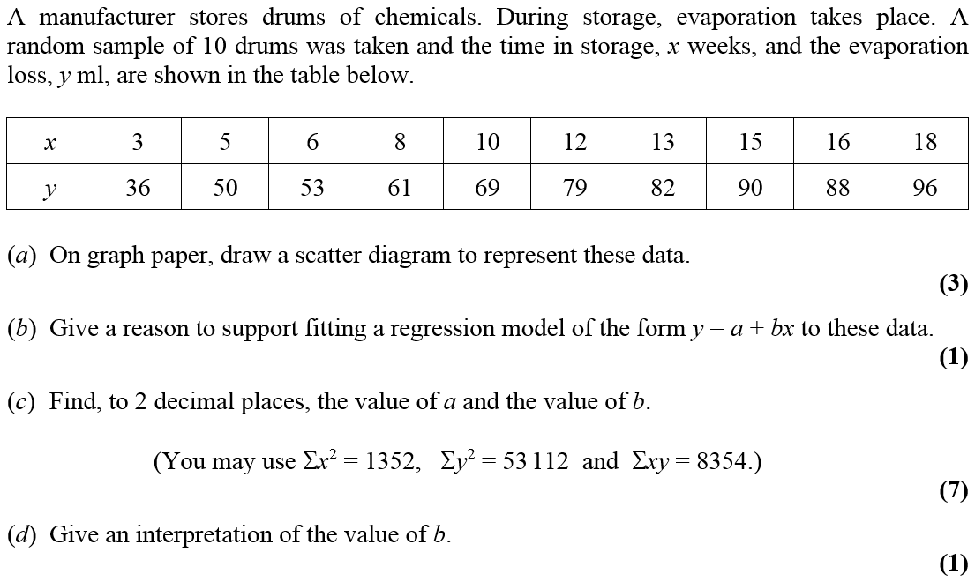
Jan 2006

Slide 35
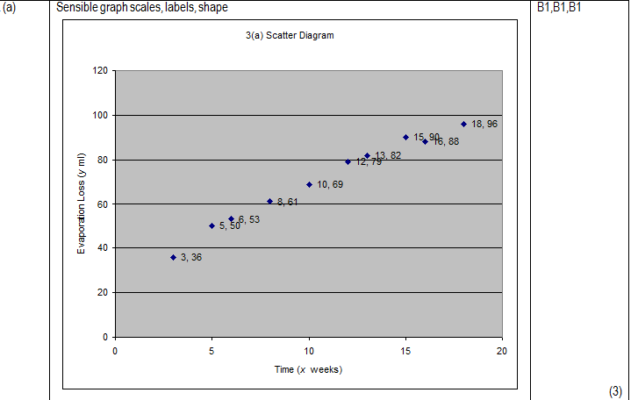
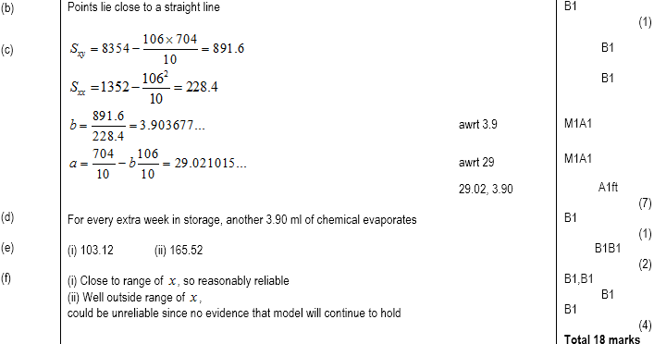
Jan 2006
A
B
C
D
E
F

Slide 36
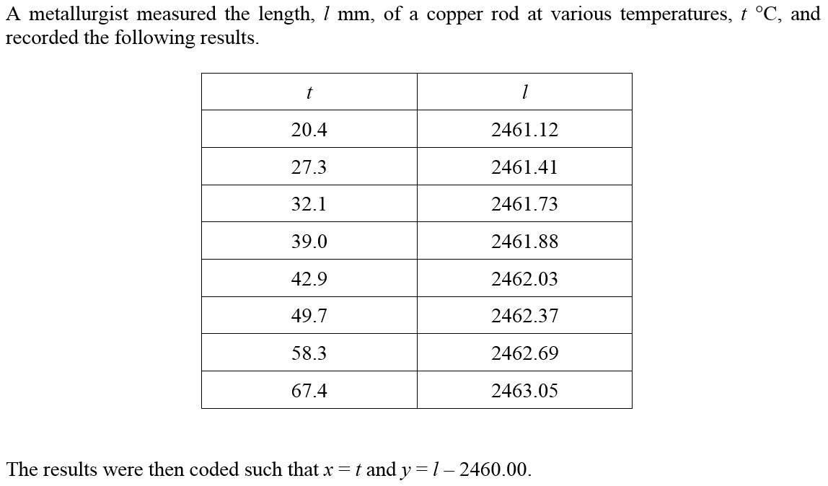
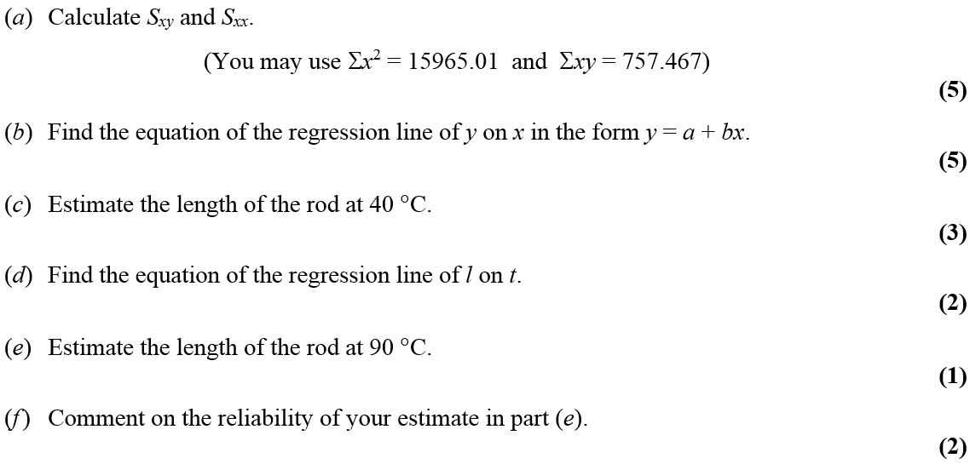
May 2006

Slide 37
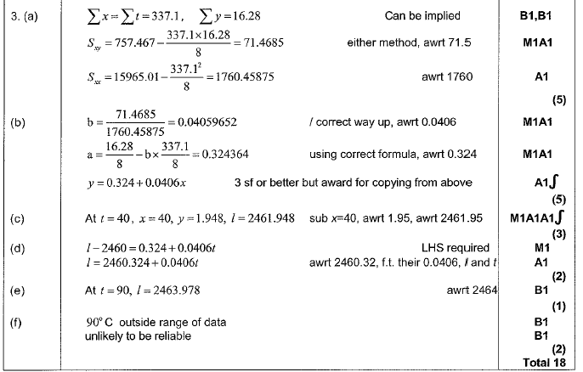
May 2006
A
B
C
D
E
F

Slide 38
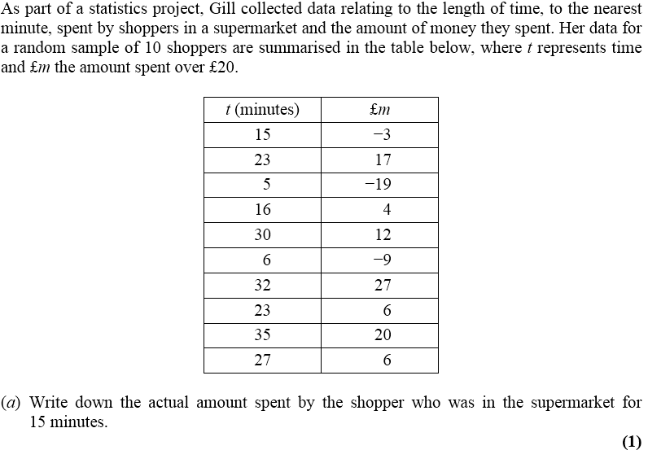
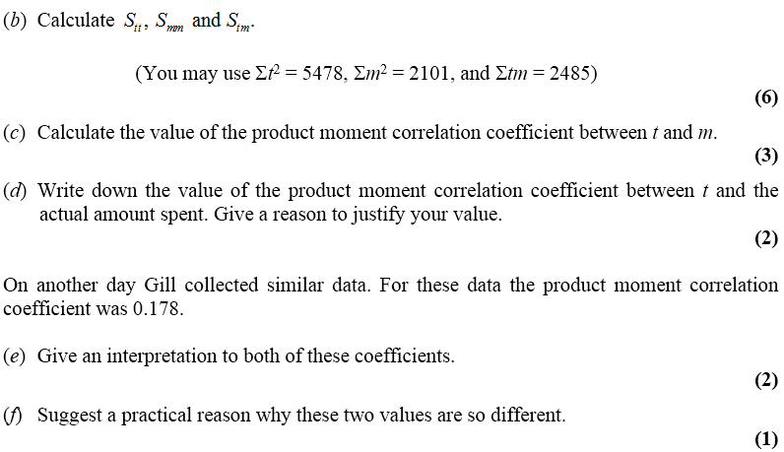
Jan 2007

Slide 39
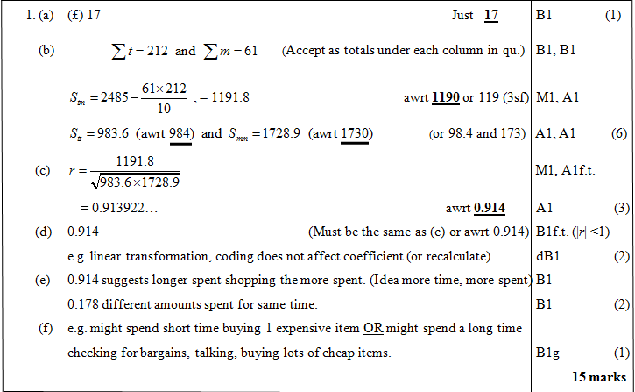
Jan 2007
A
B
C
D
E
F

Slide 40
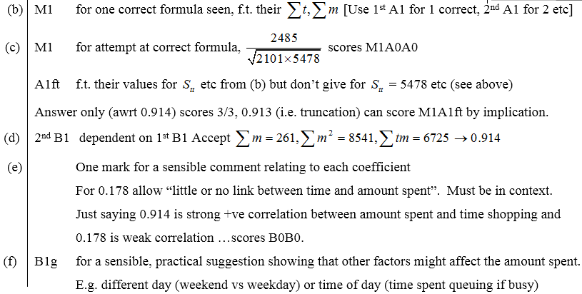
Jan 2007
B
C
D
E
F

Slide 41
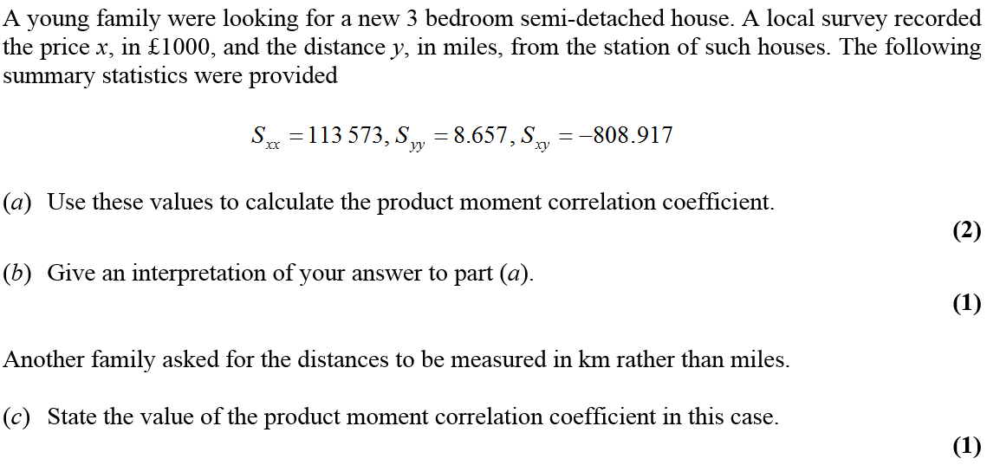
June 2007

Slide 42
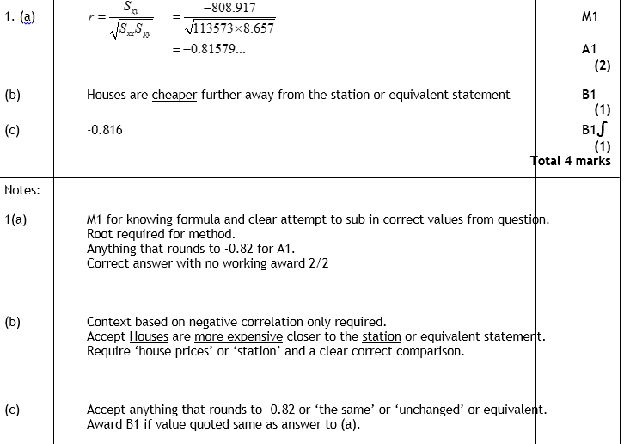
June 2007
A
B
C
A
B
C

Slide 43
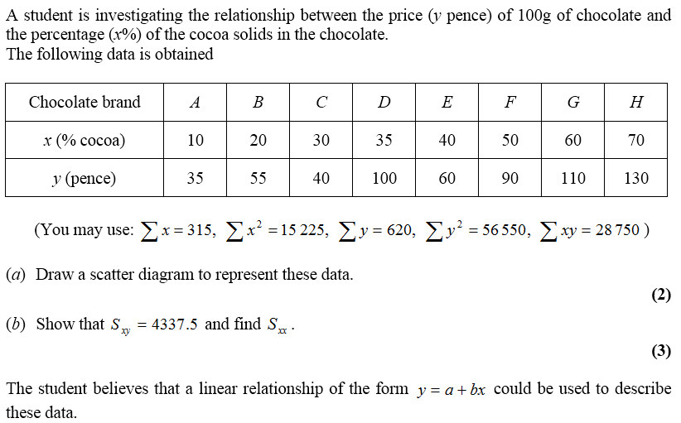
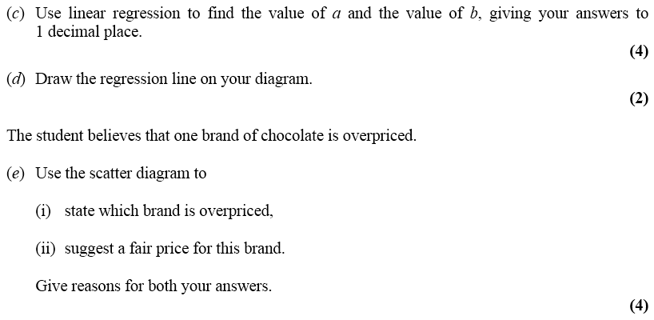
June 2007

Slide 44
June 2007
A
B
C
D
E

Slide 45
June 2007
A
B
C
D
E

Slide 46
Jan 2008

Slide 47
Jan 2008
A
B

Slide 48
Jan 2008
A
B

Slide 49
Jan 2008

Slide 50
Jan 2008
A
B
C
D

Slide 51
Jan 2008
A
B
C
D

Slide 52
May 2008

Slide 53
A
May 2008
B
C
D
E
F

Slide 54
Jan 2009

Slide 55
Jan 2009
A
B
C
D
E

Slide 56
Jan 2009
A
B
C
D
E

Slide 57
Jan 2009

Slide 58
Jan 2009
A
B
C
D
E
F

Slide 59
Jan 2009
A
B
C
D
E
F

Slide 60
May 2009

Slide 61
A
May 2009
B
C
A
B
C

Slide 62
May 2009

Slide 63
A
May 2009
B
C
A
B
C

Slide 64
Jan 2010

Slide 65
A
Jan 2010
B
C
D
E
F
G

Slide 66
Jan 2010
A
B
C
D
E
F
G

Slide 67
Jan 2010
D&F

Slide 68
May 2010

Slide 69
May 2010
A
B
C

Slide 70
May 2010

Slide 71
A
May 2010
B
C
D
E
F

Slide 72
May 2010
A

Slide 73
Jan 2011

Slide 74
Jan 2011
A
B
C

Slide 75
Jan 2011
A
B
C

Slide 76
Jan 2011

Slide 77
A
Jan 2011
B
A
B

Slide 78
May 2011

Slide 79
May 2011
A
B
C
D
E

Slide 80
May 2011
A
B
C
D
E

Slide 81
May 2011

Slide 82
May 2011
A
B
C
D
E

Slide 83
May 2011
A
B
C
D
E

Slide 84
Jan 2012

Slide 85
A
Jan 2012
B
C
D
E (i)
E (ii)
F

Slide 86
May 2012

Slide 87
May 2012
A
B
C

Slide 88
May 2012

Slide 89
A
May 2012
B
C
D

Slide 90
May 2012
E
F

Slide 91
Jan 2013

Slide 92
Jan 2013
A
B
C

Slide 93
Jan 2013

Slide 94
Jan 2013
A
B
C
D

Slide 95
May 2013

Slide 96
May 2013
A
B
C
D
E
F

Slide 97
May 2014

Slide 98
May 2014
A
B
C
D
E
F
G

Slide 99
June 2015

Slide 100
June 2015
A
B
C
D

Slide 101
June 2015
A notes
B notes
C notes
D notes

Slide 102
June 2015

Slide 103
June 2015
A
B
C
D
E
F

Slide 104
June 2015
A notes
B notes
C notes
D notes
E notes
F notes

Slide 105
June 2016

Slide 106
June 2016
A
B
C
D
E

Slide 107
June 2016
A notes
B notes
C notes
D notes
E notes

Slide 108
June 2016

Slide 109
June 2016
A
B
C
D
E

Slide 110
June 2016
A notes
B notes
C notes
D notes
E notes

Slide 111
June 2017

Slide 112
June 2017
A
B
C
D
E
F
G

Slide 113
June 2017
A notes
B notes
C notes
D notes
E notes
F notes
G notes

Slide 114
June 2018

Slide 115
June 2018
A
B
C
D
E

Slide 116
June 2018
A notes
B notes
C notes
D notes
E notes

