Slide 1
Old Spec Q’s
Algebraic Fractions
Practice A
Practice E
Practice B
Practice F (i)
Practice C (i)
Practice F (ii)
Practice C (ii)
SAM 2
Practice C (iii)
2018 2
Practice D
(i)
Practice D (ii)
Practice D (iii)

Slide 2
Practice A

Slide 3
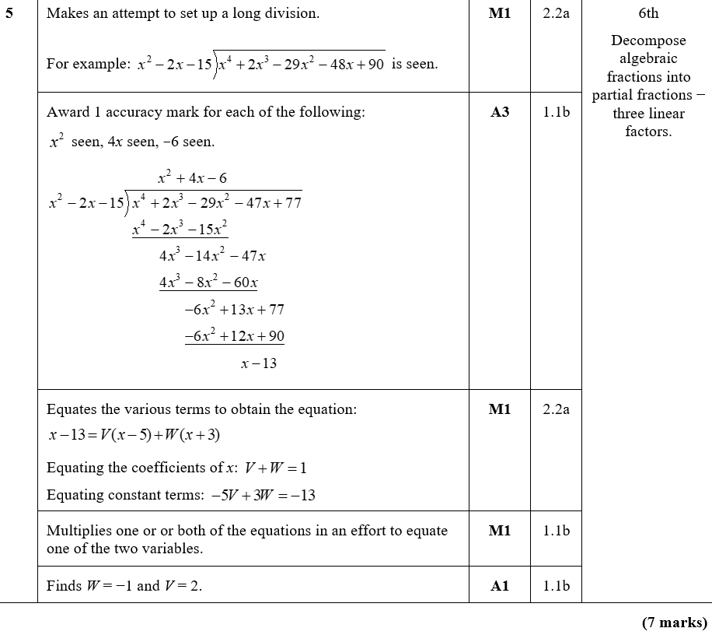
Practice A
A

Slide 4
Practice B

Slide 5
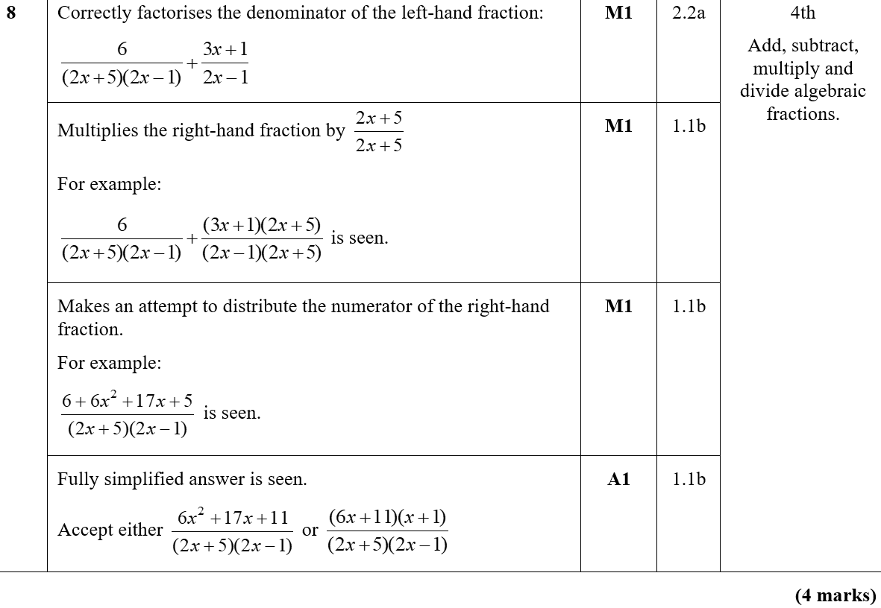
Practice B
A

Slide 6
Practice C

Slide 7
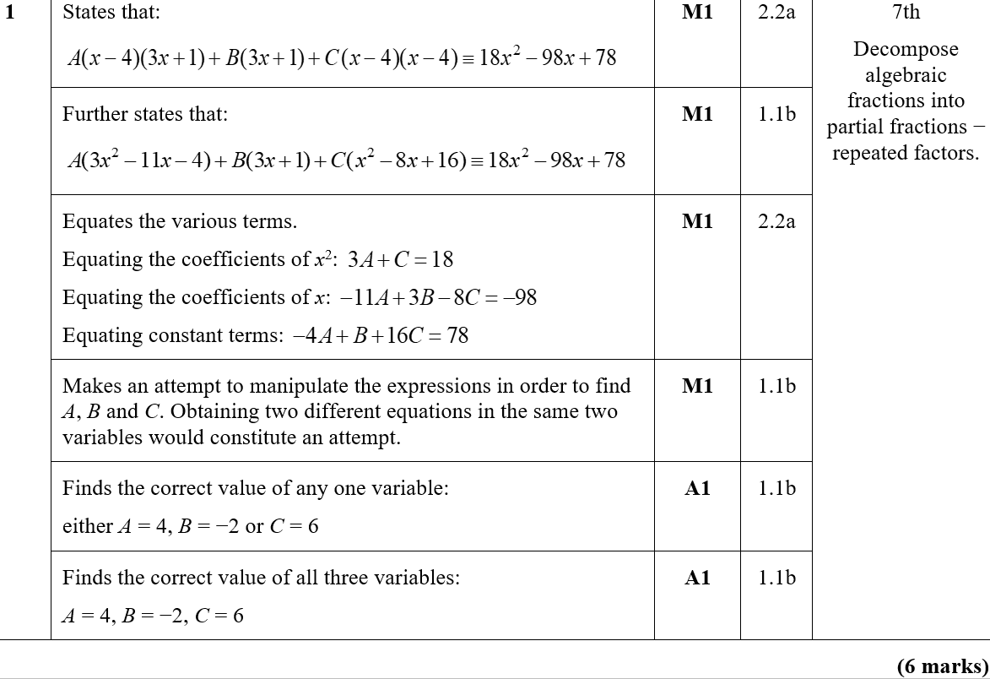
Practice C
A

Slide 8
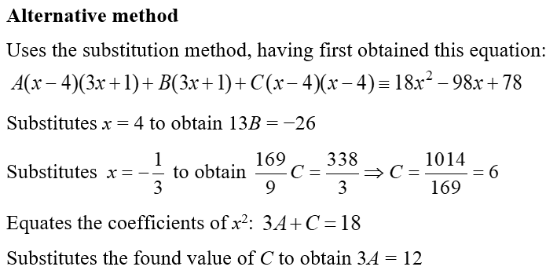
Practice C
Alternative method

Slide 9
Practice C

Slide 10
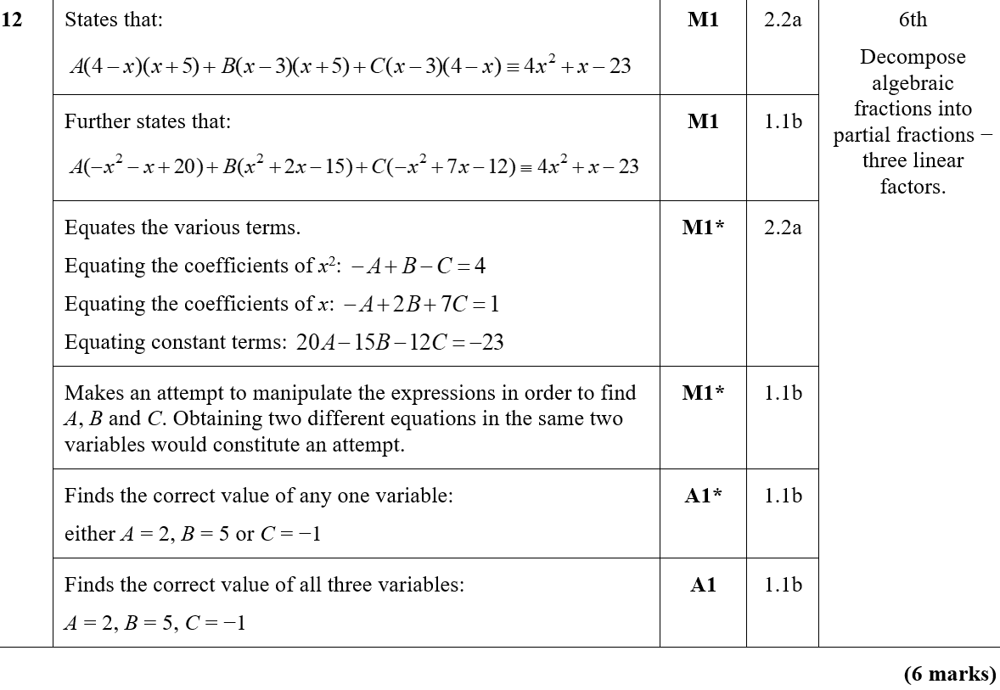
Practice C
A

Slide 11
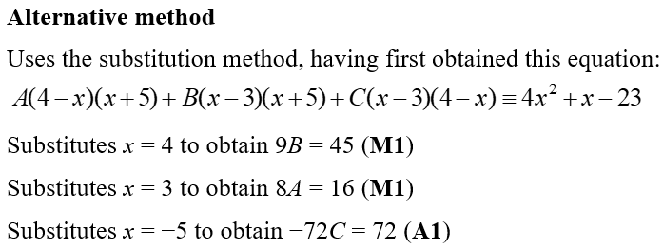
Practice C
Alternative method

Slide 12
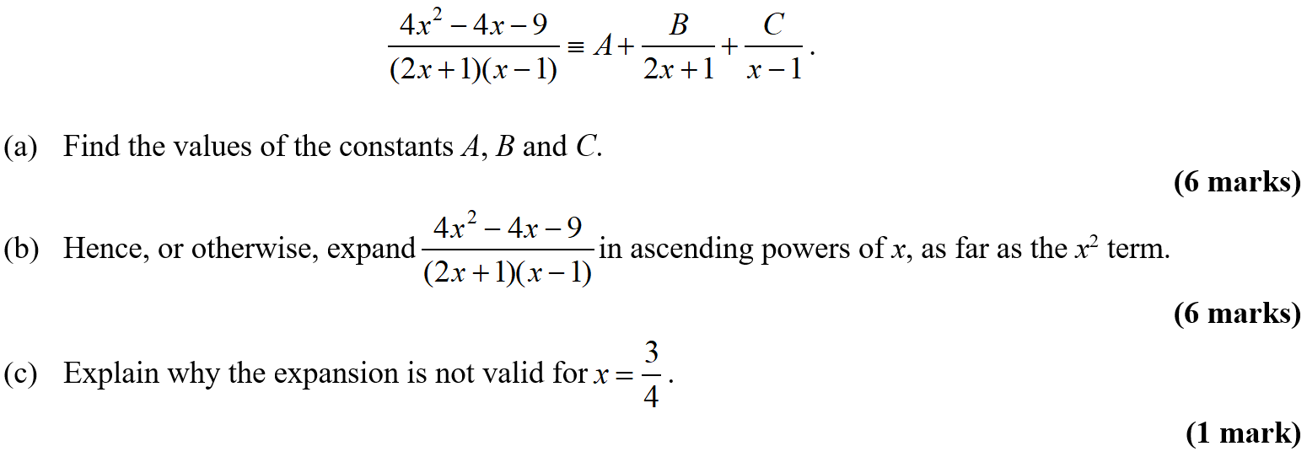
Practice C

Slide 13
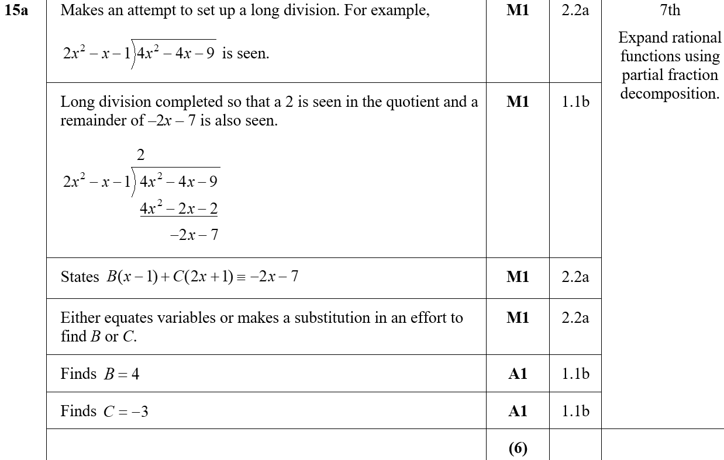
Practice C
A

Slide 14
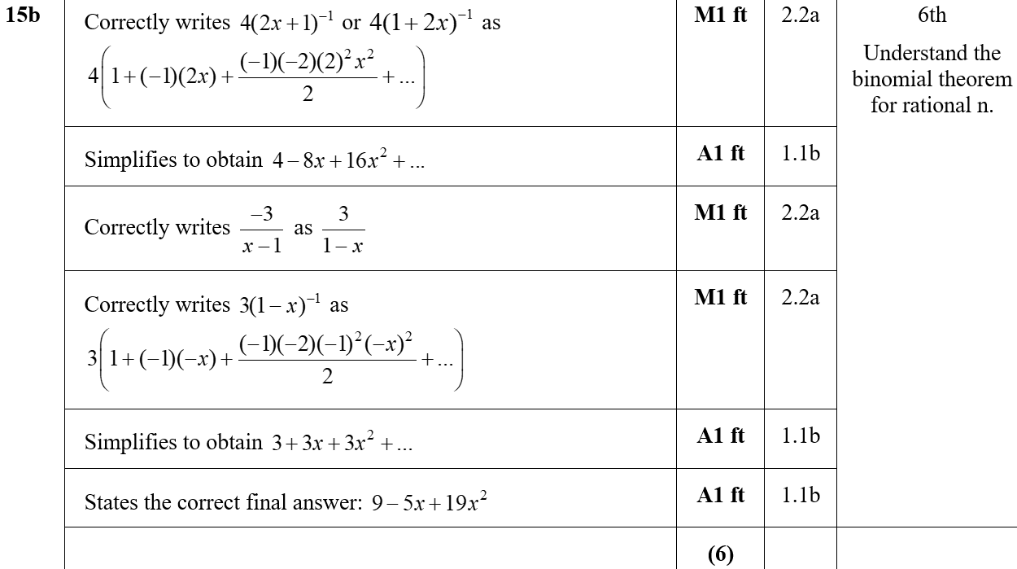
Practice C
B

Slide 15
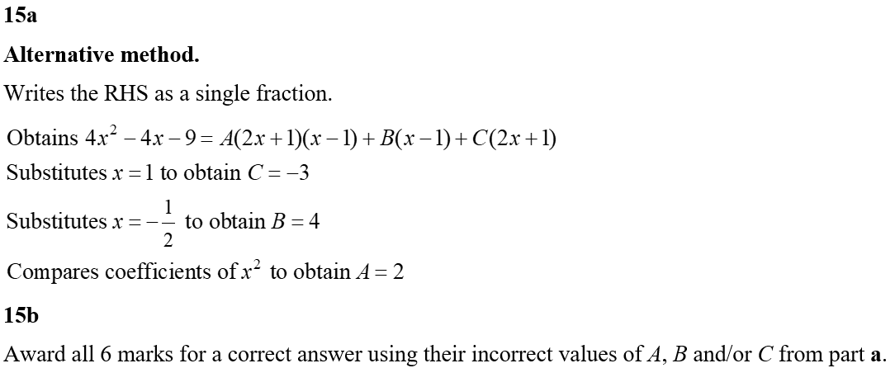
Practice C
C
Alternative A
Alternative B

Slide 16
Practice D

Slide 17
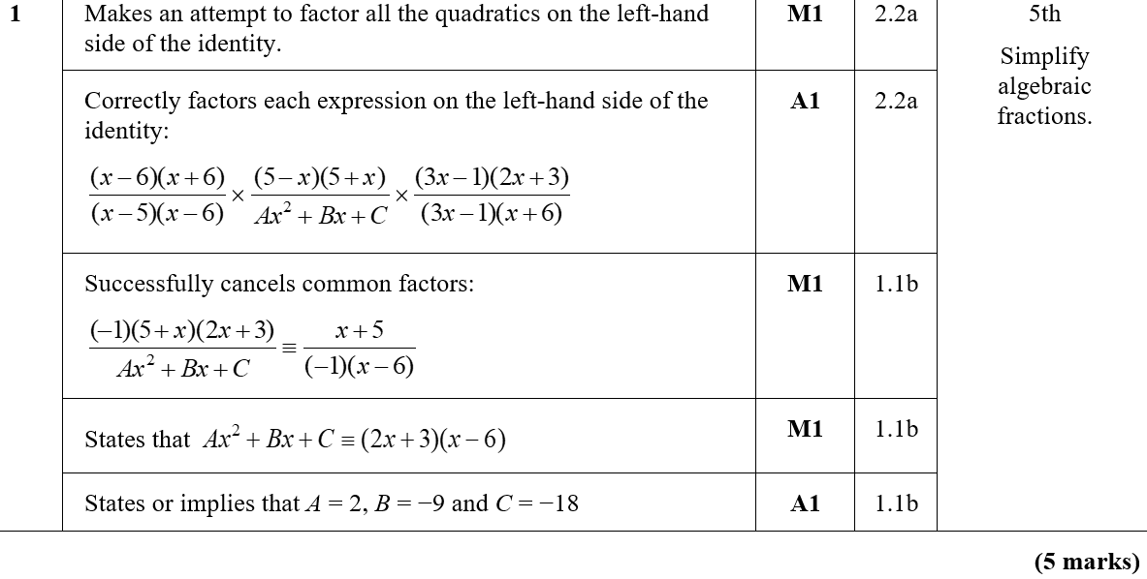
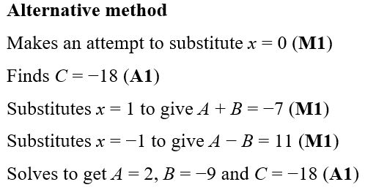
Practice D
A
Alternative method

Slide 18
Practice D

Slide 19
Practice D
A

Slide 20
Practice D

Slide 21
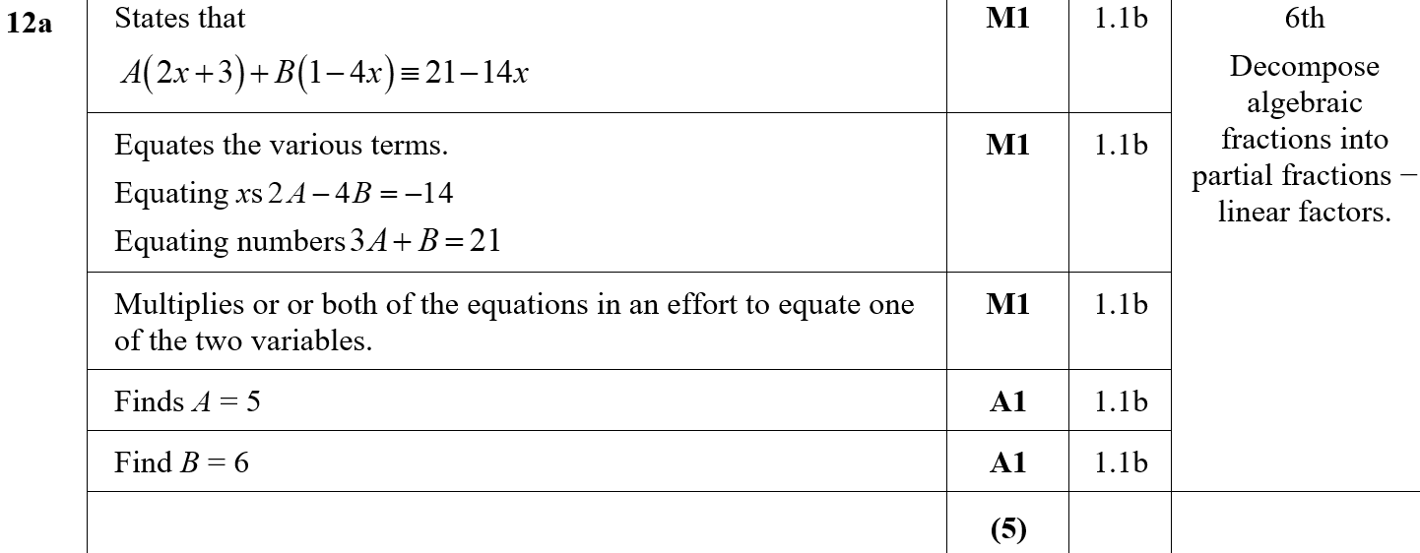
Practice D
A

Slide 22
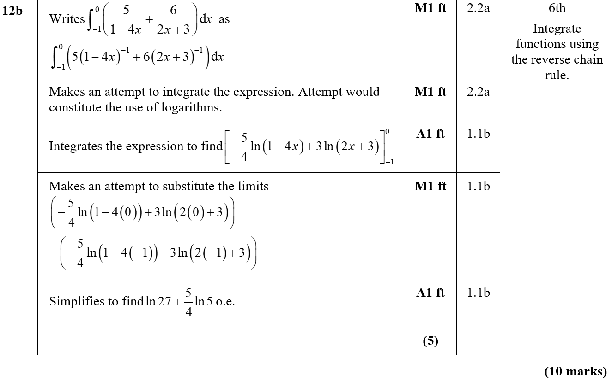
Practice D
B

Slide 23
Practice E

Slide 24
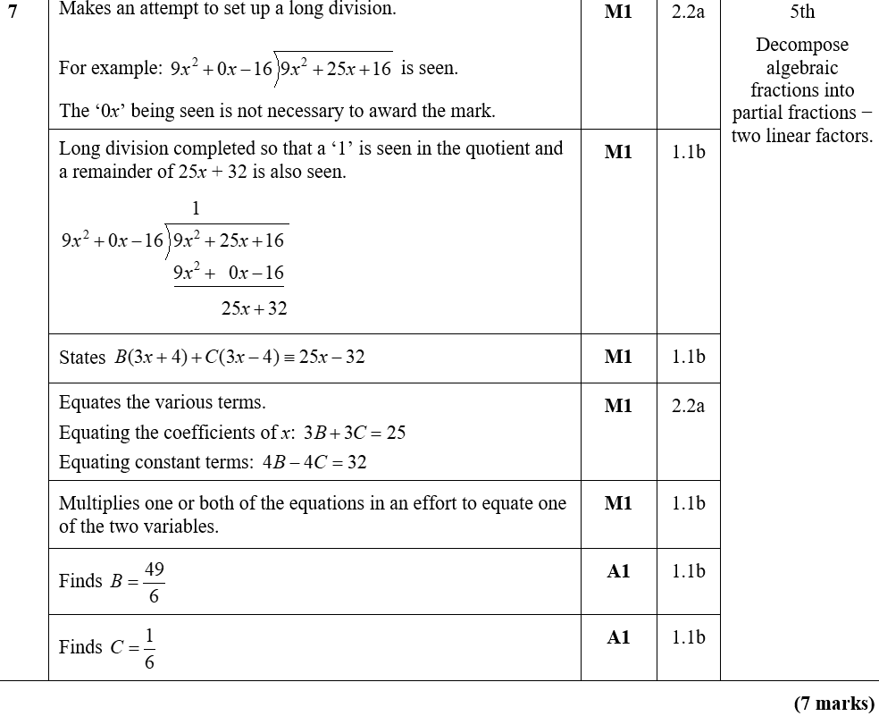
Practice E
A

Slide 25
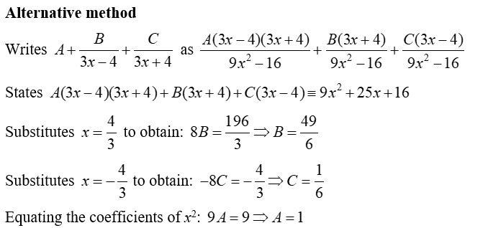
Practice E
Alternative method

Slide 26
Practice F

Slide 27
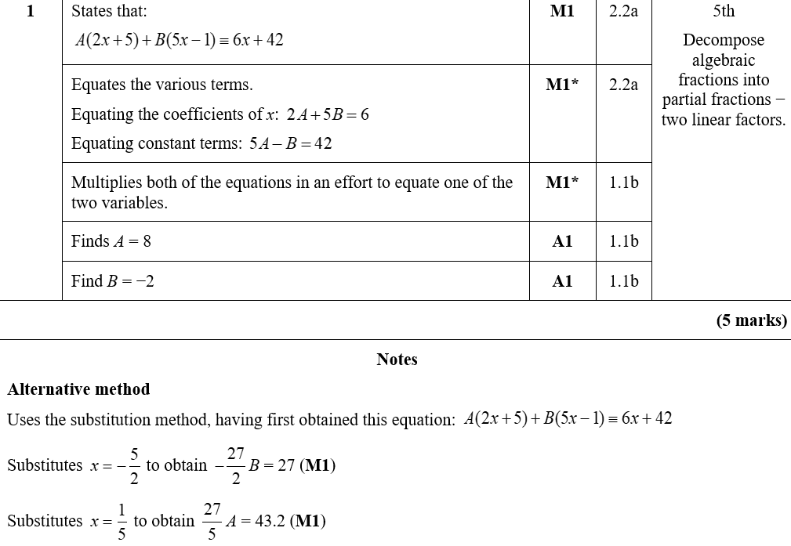
Practice F
A
Alternative Method

Slide 28
Practice F

Slide 29
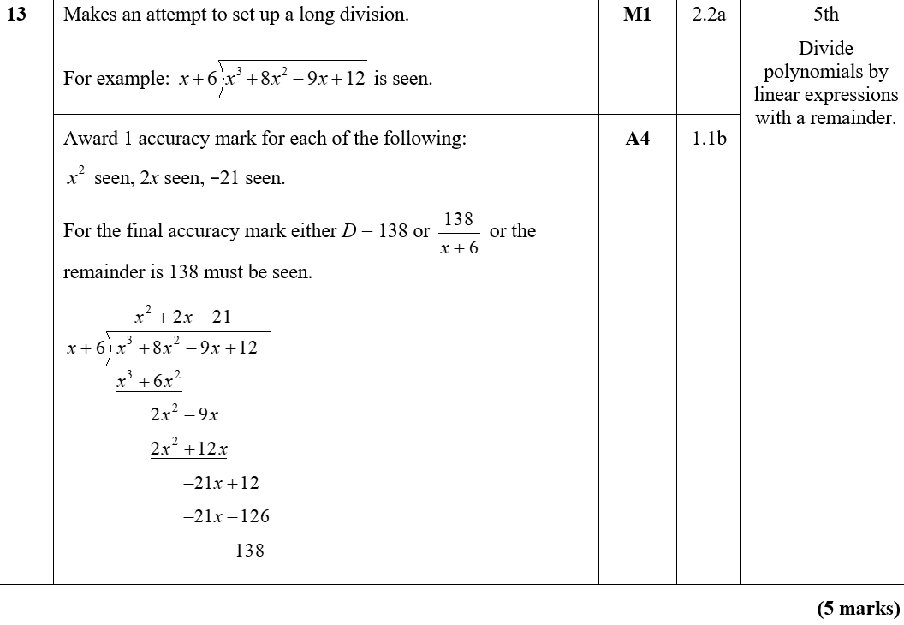
Practice F
A

Slide 30
Practice F
Alternative method

Slide 31
SAM Paper 2

Slide 32
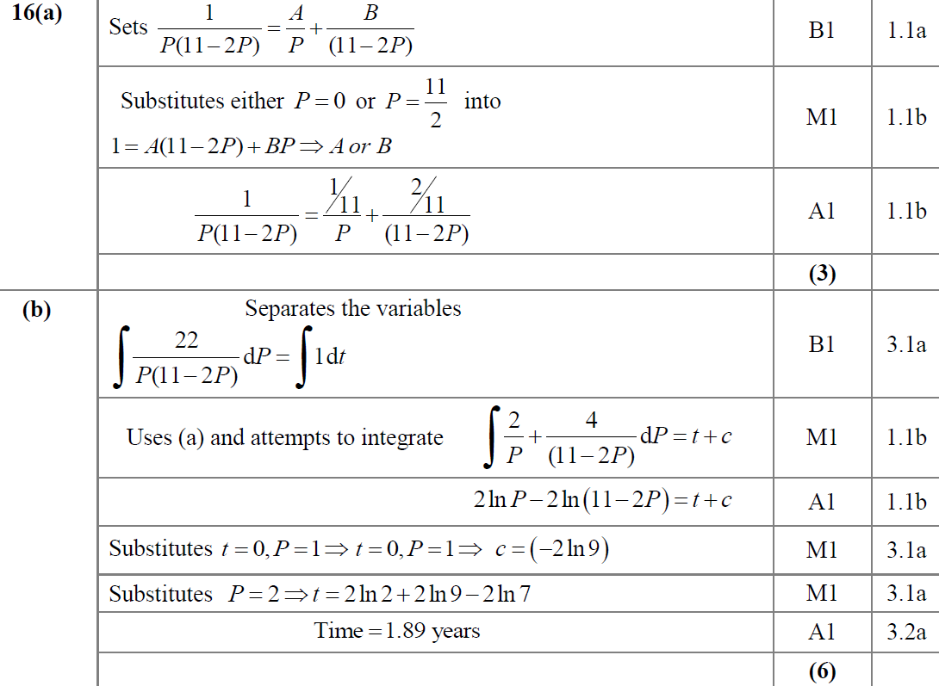
SAM Paper 2
A
B

Slide 33
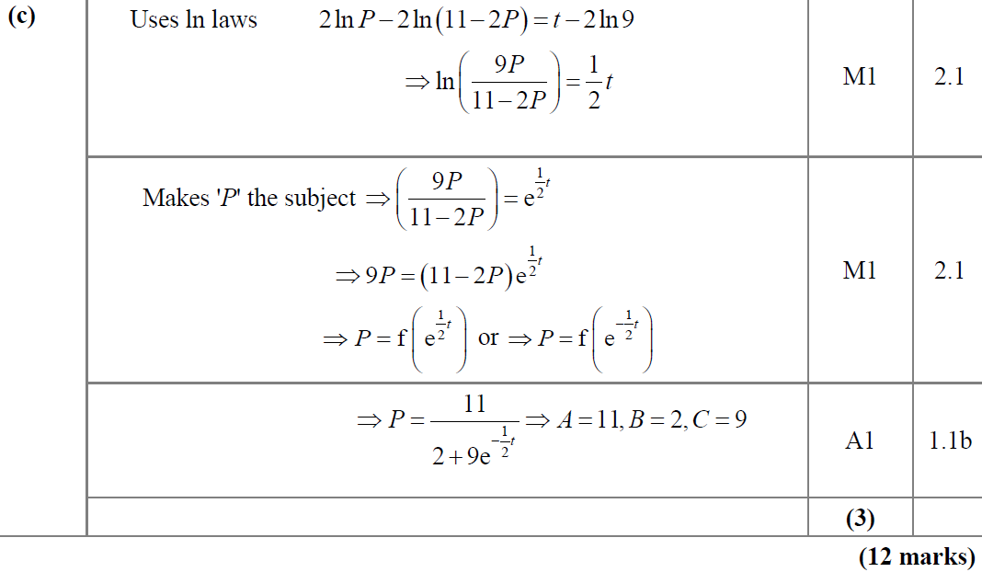
SAM Paper 2
C

Slide 34
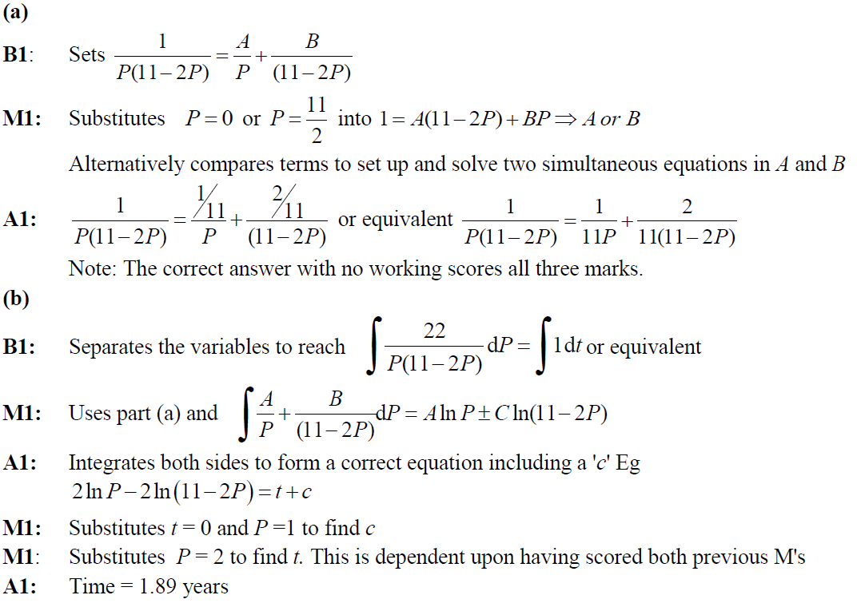
SAM Paper 2
A notes
B notes

Slide 35
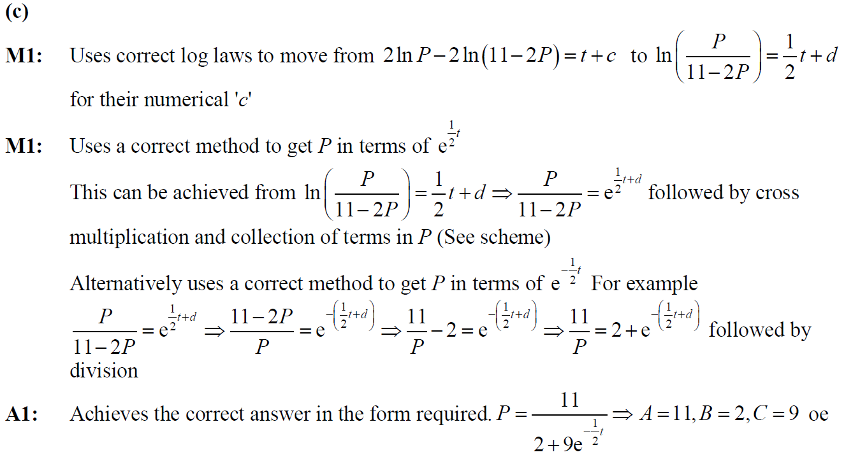
SAM Paper 2
C notes

Slide 36
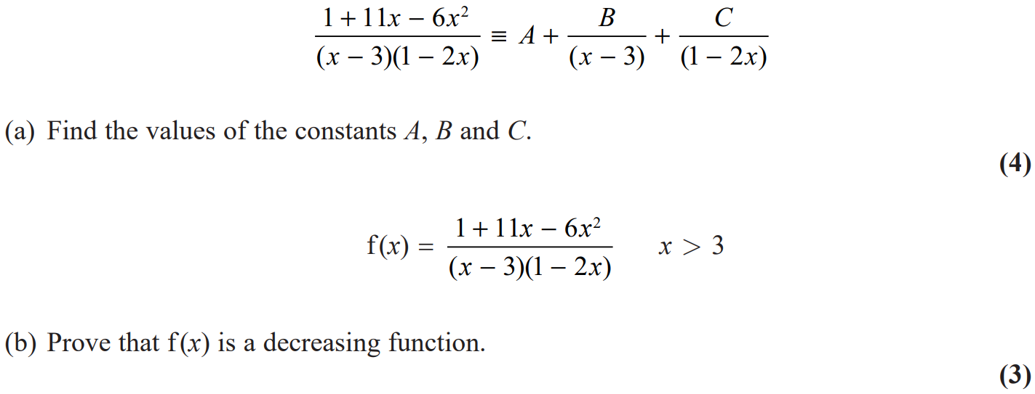
2018 Paper 2

Slide 37
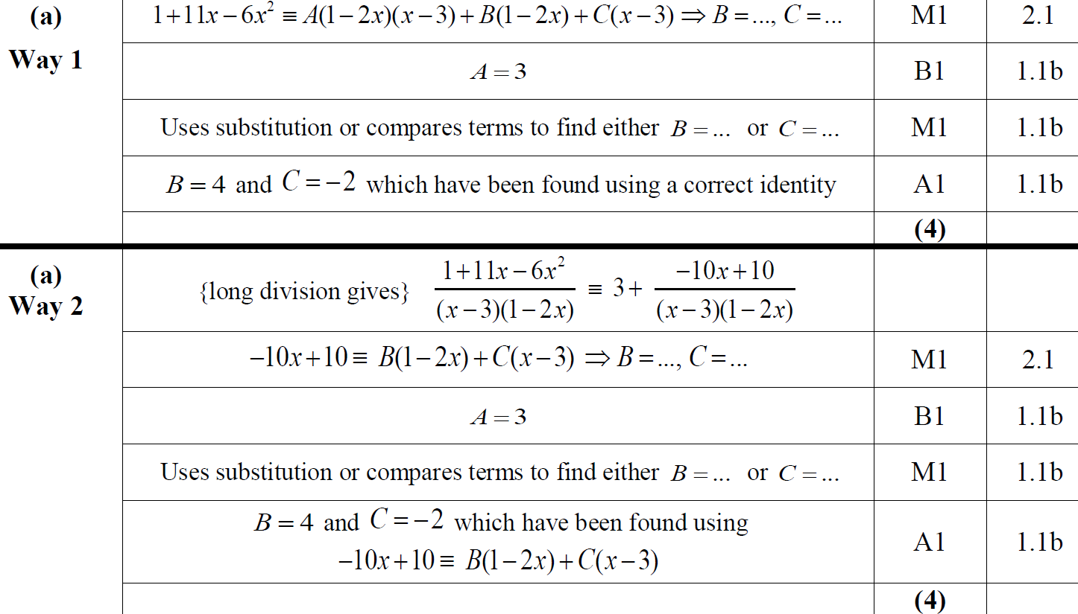
2018 Paper 2
A
A Alternative

Slide 38
2018 Paper 2
B

Slide 39
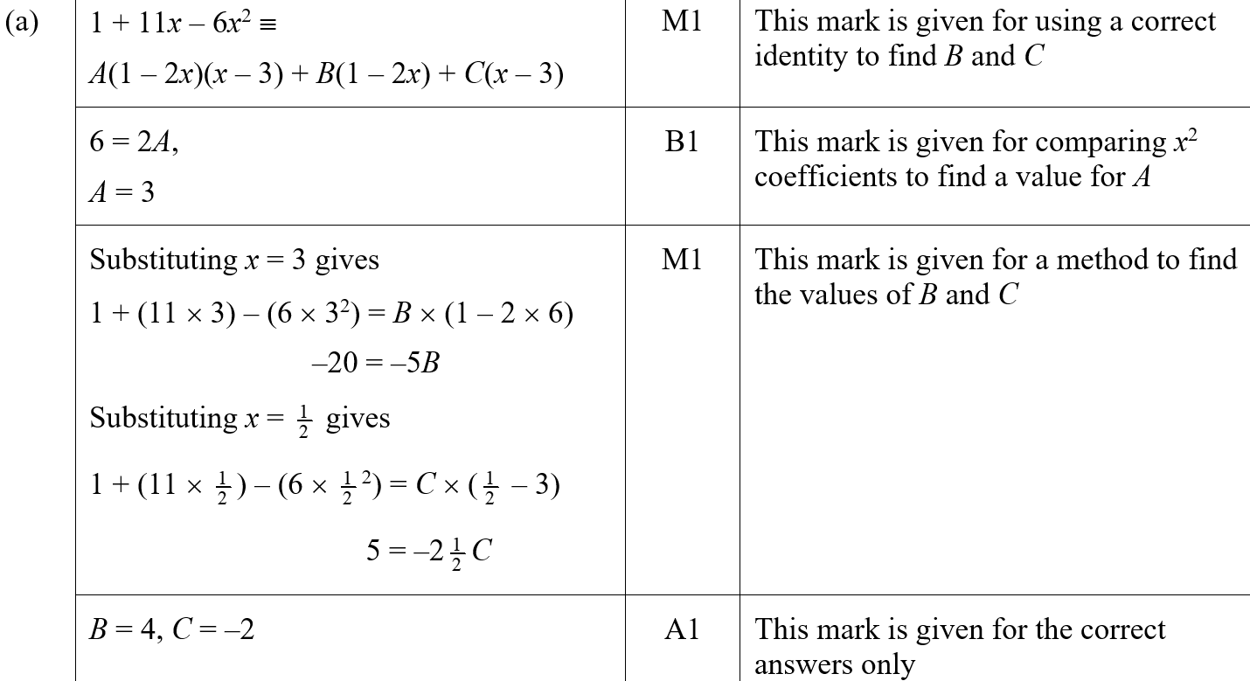
2018 Paper 2
A (SF)

Slide 40
2018 Paper 2
B (SF)

Slide 41
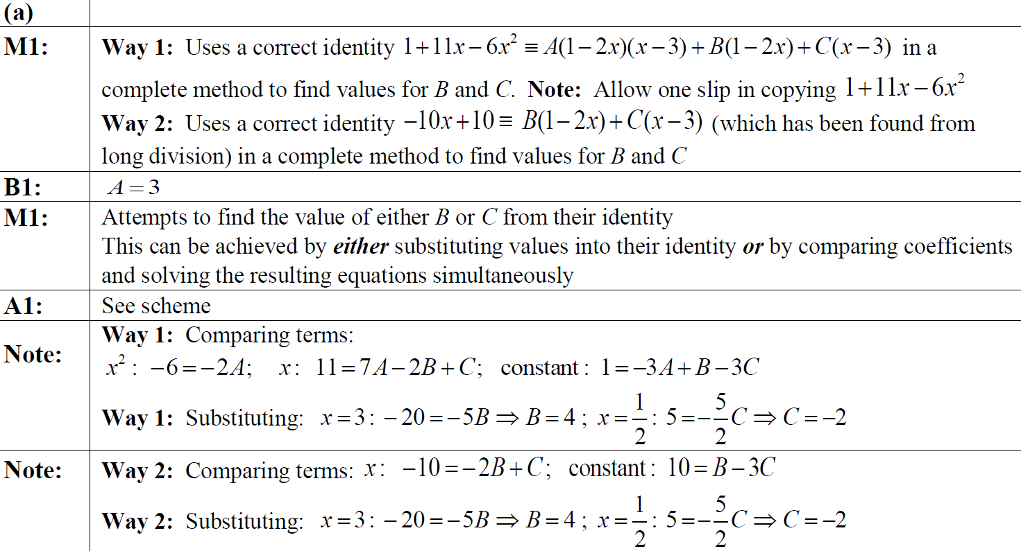
2018 Paper 2
A notes

Slide 42
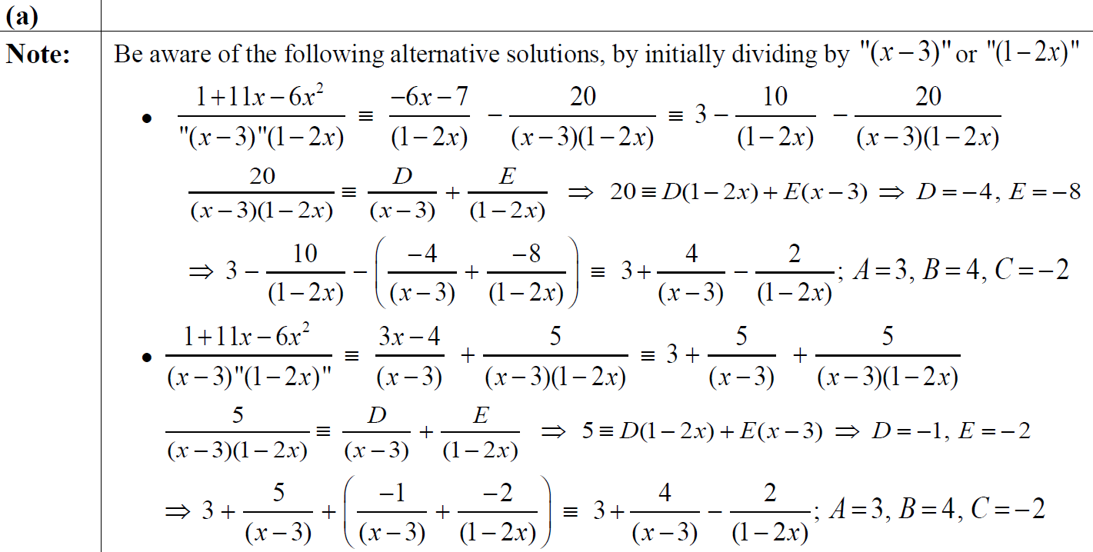
2018 Paper 2
A Alternative notes

Slide 43
2018 Paper 2
B notes

Slide 44
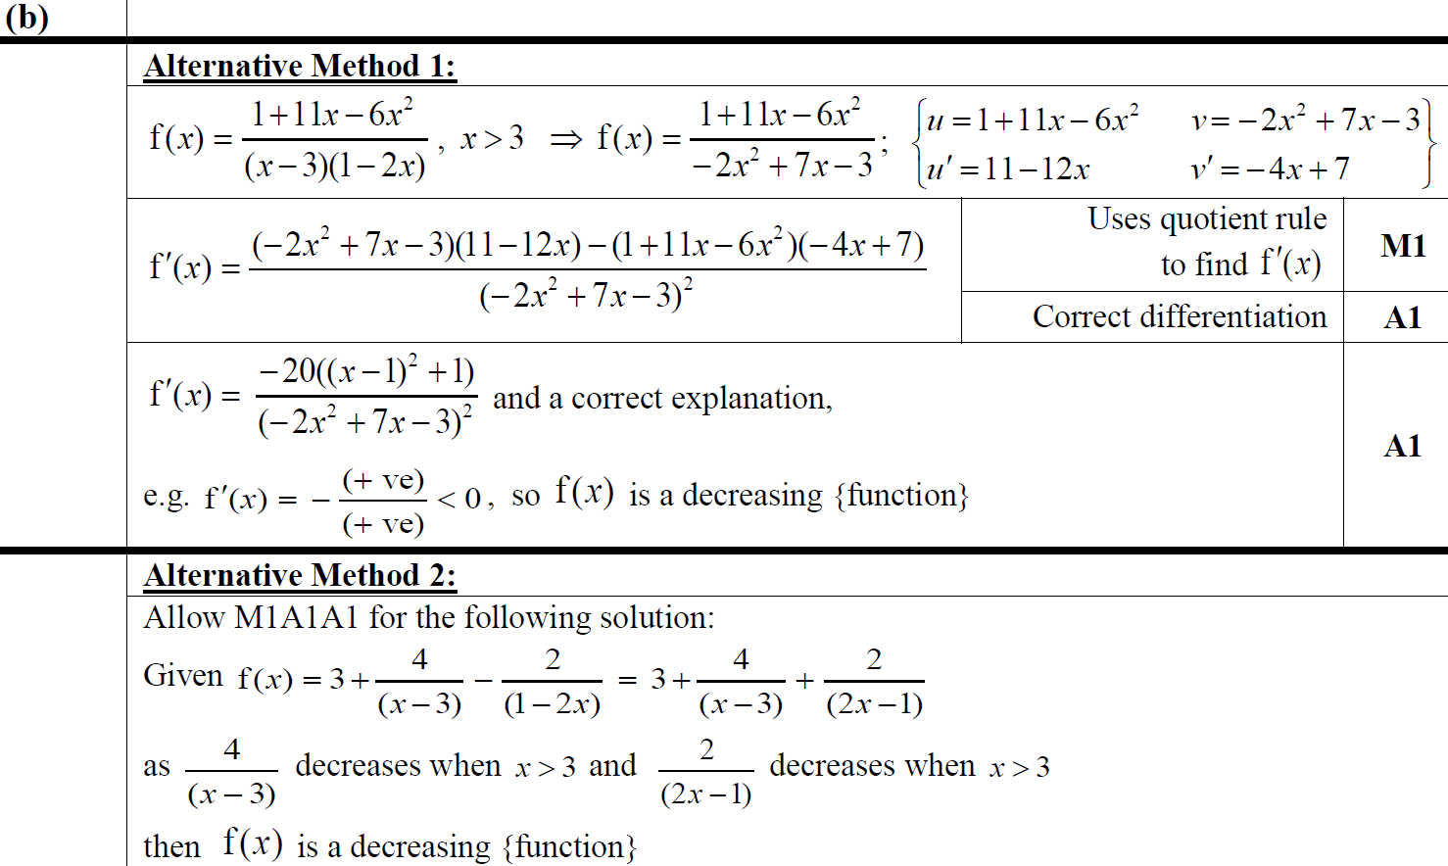
2018 Paper 2
B Alternatives notes

Slide 45
New Spec Q’s
Old Spec Algebraic Fractions
C3 Algebraic Fractions
June 2009
June 2015
C4 Partial Fractions
Jan 2011
Jan 2006
Jan 2010
June 2016
Jan 2006
June 2011
June 2006
June 2010
June 2017
June 2006
Jan 2012
Jan 2007
Jan 2011
June 2018
Jan 2007
June 2012
June 2007 (i)
June 2011
June 2007
Jan 2013
June 2007 (ii)
Jan 2012
Jan 2008
June 2013
Jan 2008 (i)
June 2012
June 2008
June 2015
Jan 2008 (ii)
Jan 2013
Jan 2009
June 2016
June 2008
June 2013
June 2009
June 2018
Jan 2009
June 2014
June 2010

Slide 46
Jan 2006

Slide 47
A
Jan 2006
B

Slide 48
Jan 2006
Alternative B

Slide 49
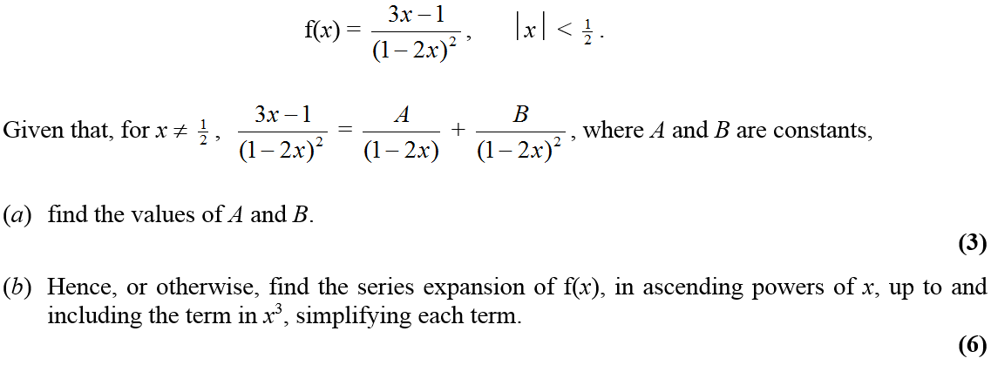
June 2006

Slide 50
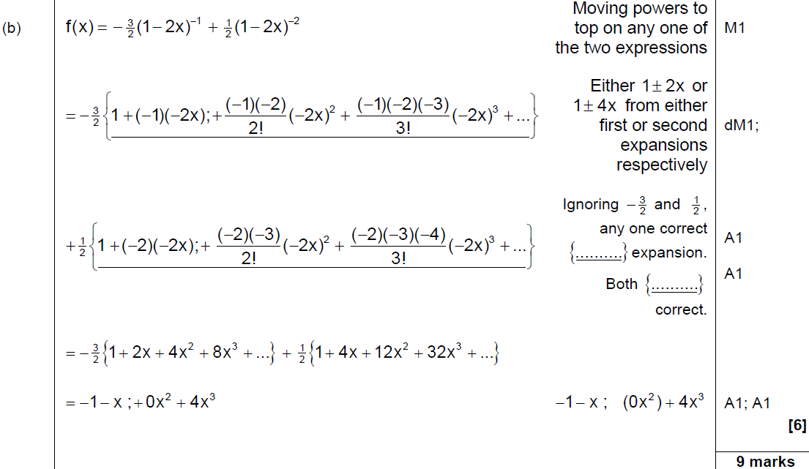
June 2006
A
B

Slide 51
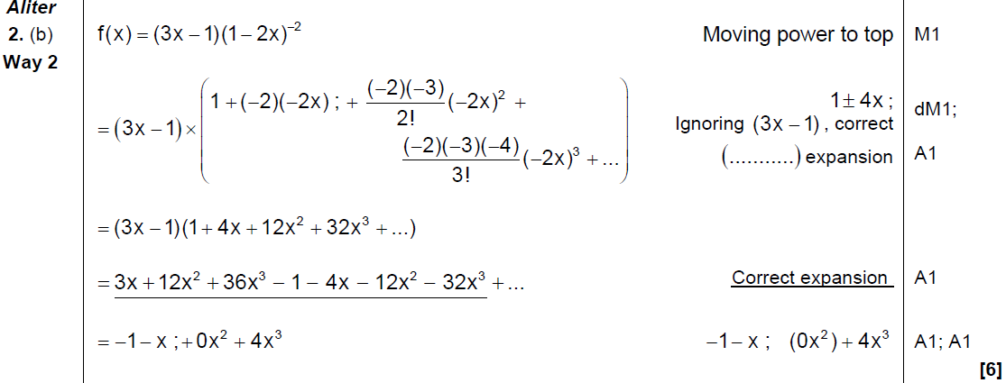
June 2006
Alternative B (i)

Slide 52
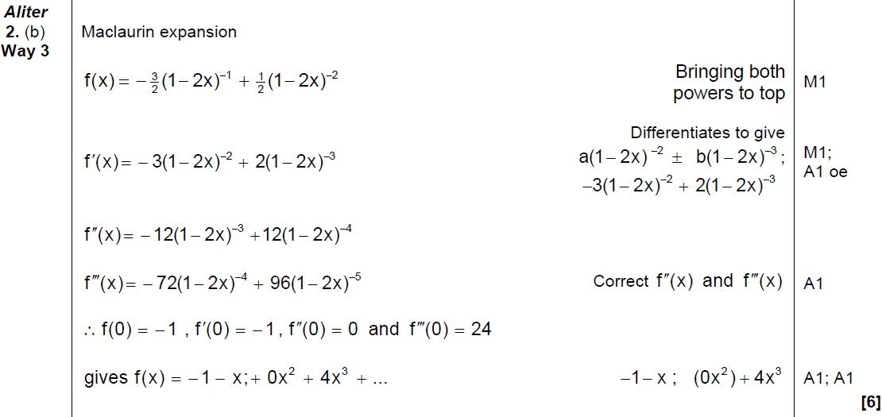
June 2006
Alternative B (ii)

Slide 53
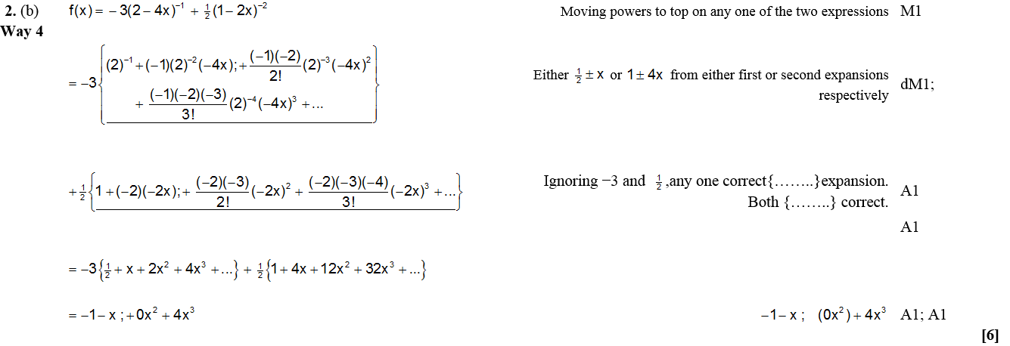
June 2006
Alternative B (iii)

Slide 54
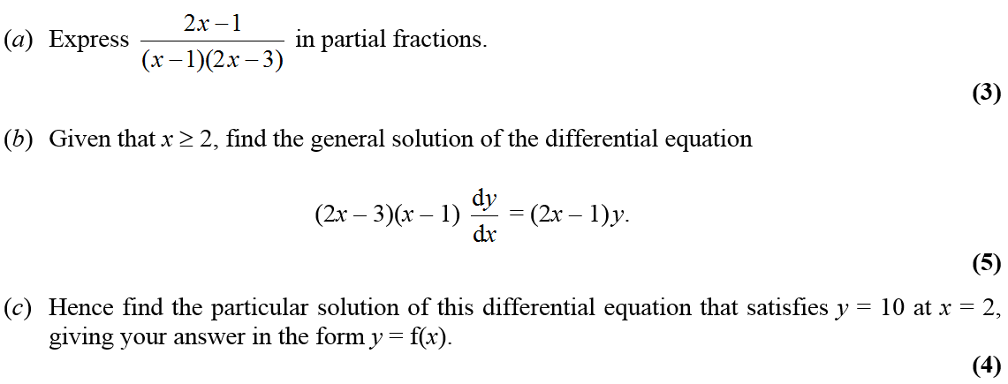
Jan 2007

Slide 55
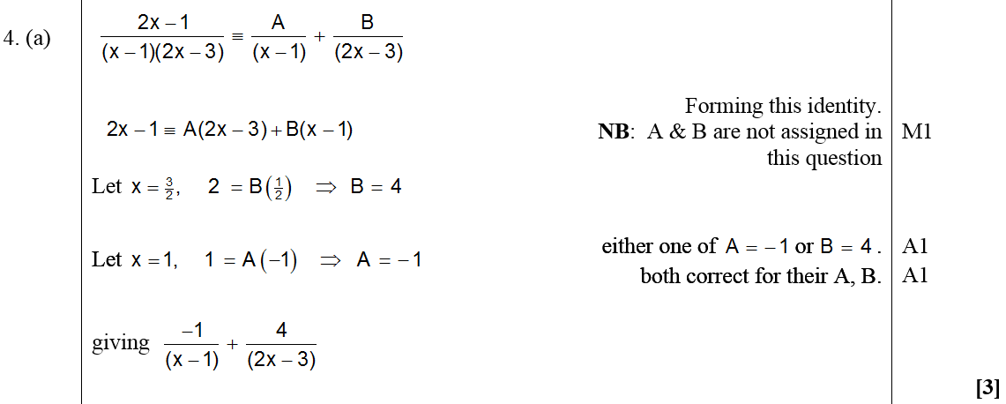
Jan 2007
A
B

Slide 56
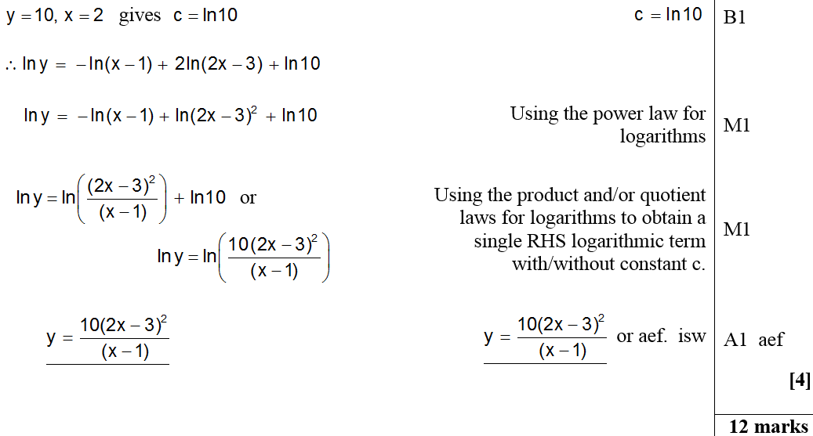
Jan 2007
C

Slide 57
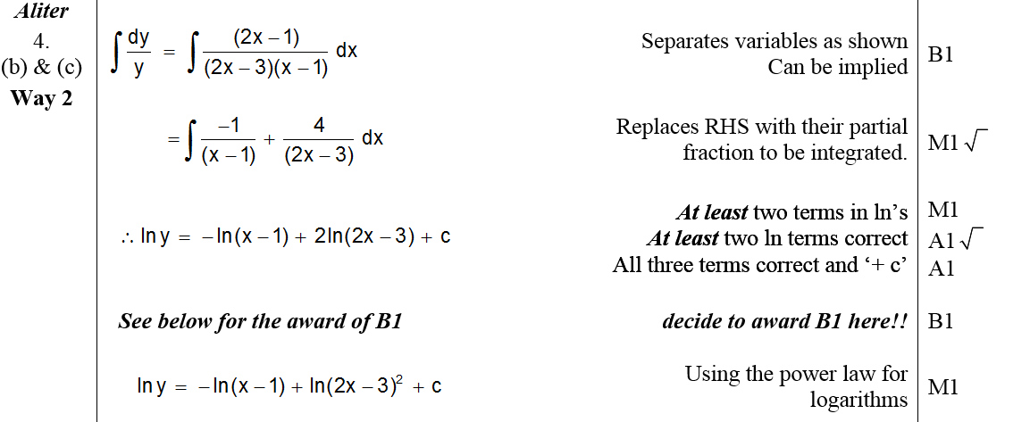
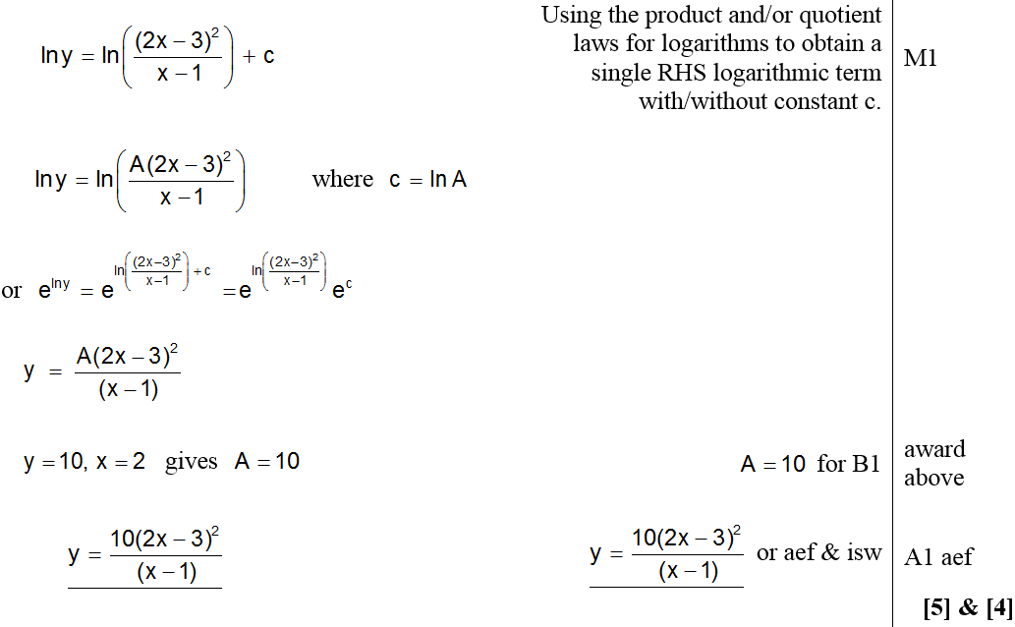
Jan 2007
Alternative B & C (i)

Slide 58
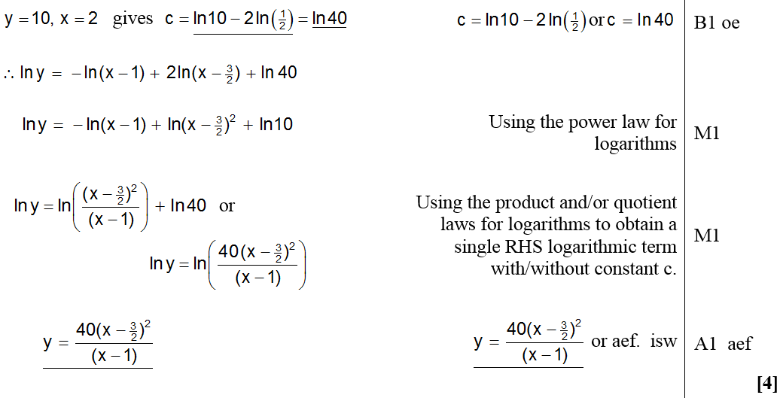
Jan 2007
Alternative B (ii)
Alternative C (ii)

Slide 59
June 2007

Slide 60
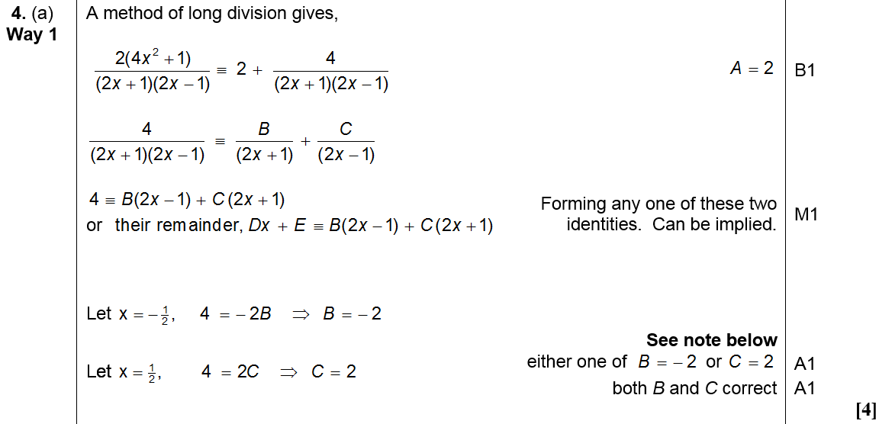
June 2007
A
Note

Slide 61
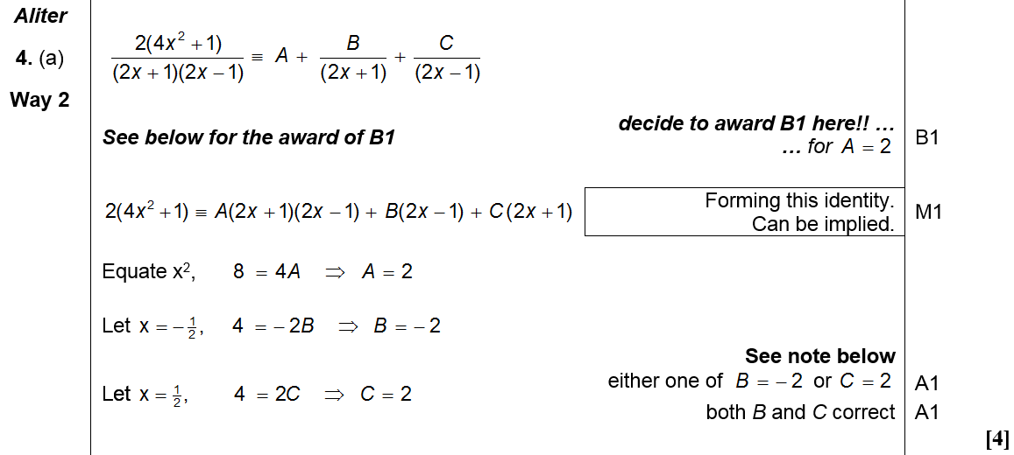
June 2007
Alternative A
Note

Slide 62
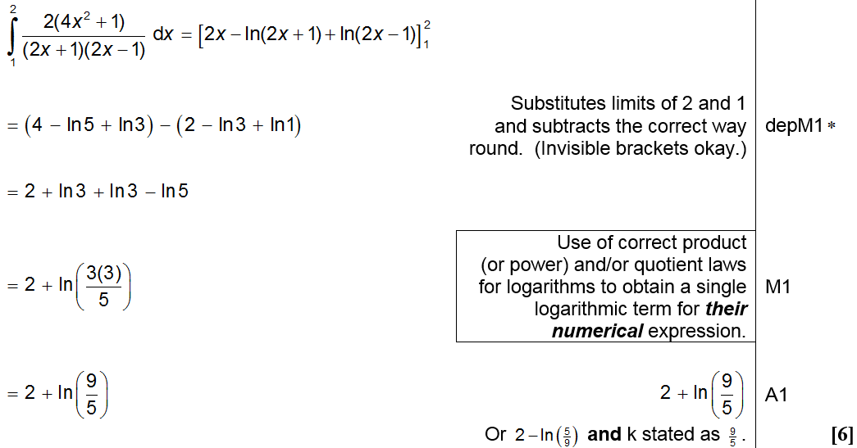
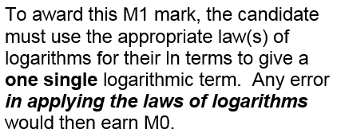
B
June 2007

Slide 63
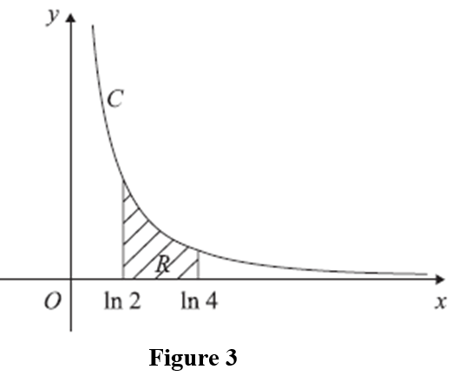
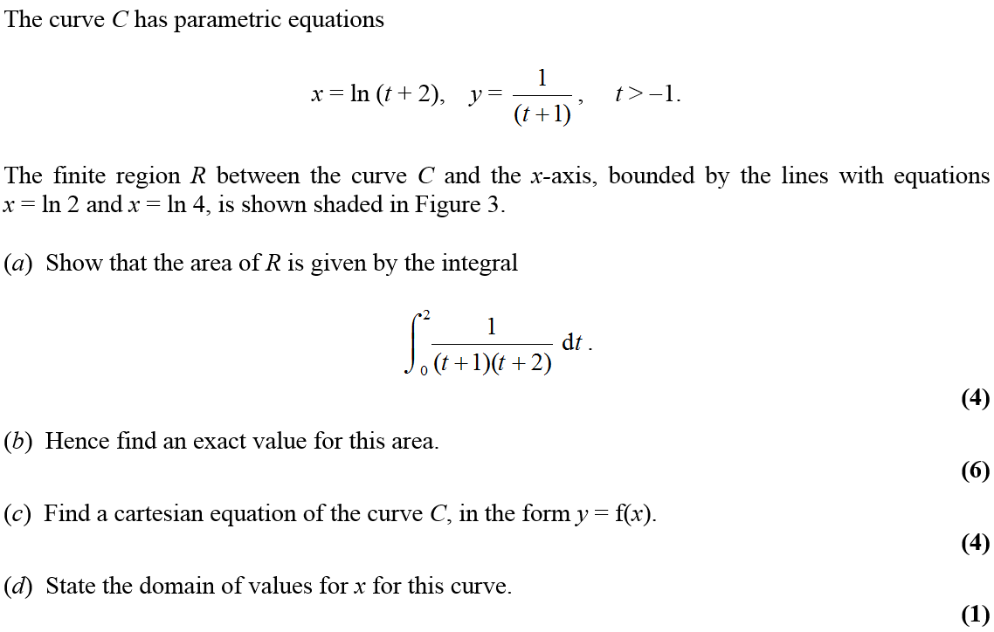
Jan 2008

Slide 64
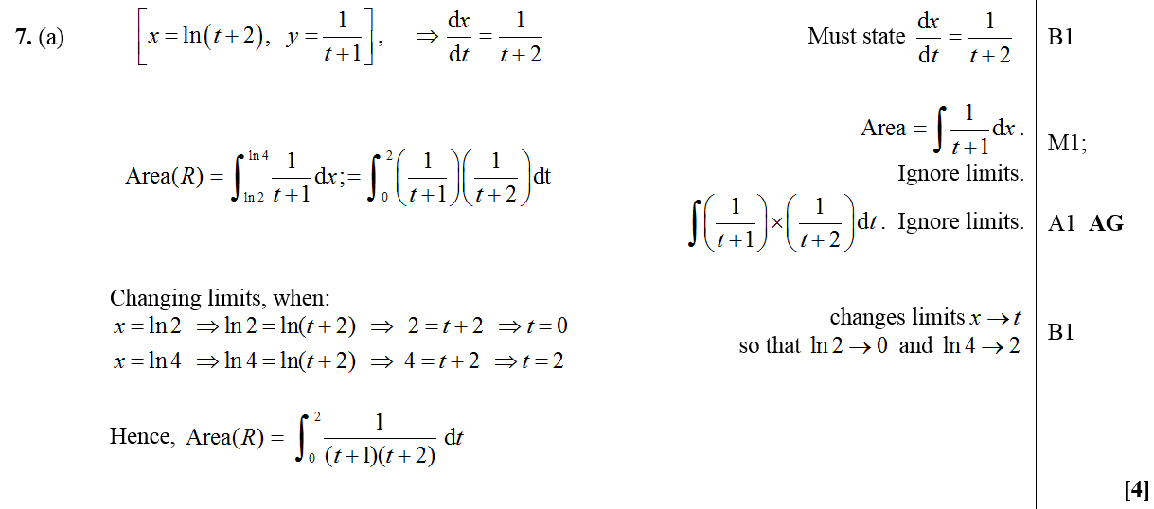
Jan 2008
A

Slide 65
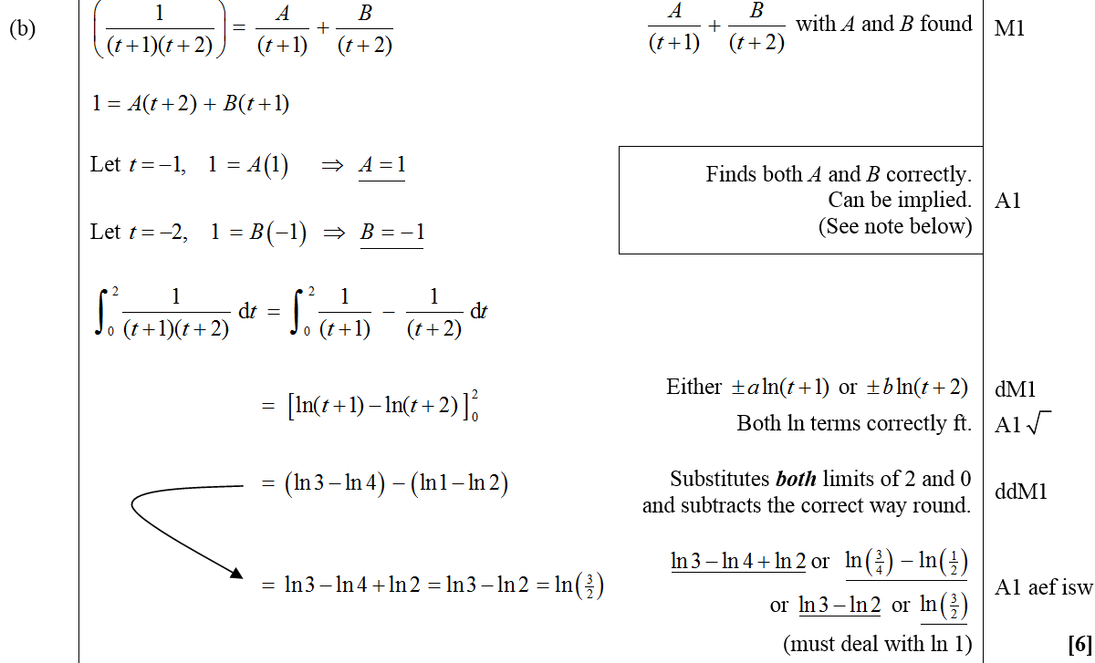
Jan 2008
B

Slide 66
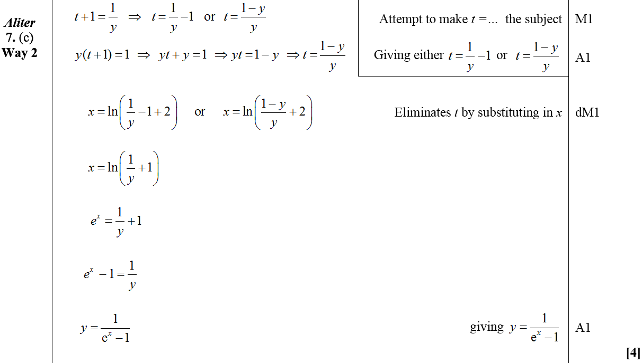
Jan 2008
C
Alternative C (i)

Slide 67
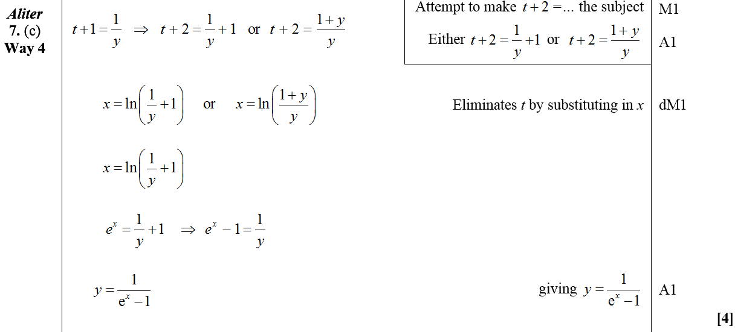
Jan 2008
Alternative C (ii)
Alternative C (iii)

Slide 68
Jan 2008
D

Slide 69
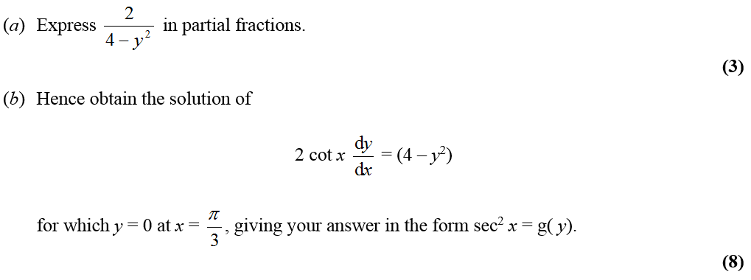
June 2008

Slide 70
June 2008
A

Slide 71
June 2008
B

Slide 72
Jan 2009

Slide 73
Jan 2009
A

Slide 74
Jan 2009
B

Slide 75
Jan 2009
C

Slide 76
June 2009

Slide 77
June 2009
A

Slide 78
June 2009
B (i)
B (ii)

Slide 79
June 2010

Slide 80
June 2010
A
B

Slide 81
Jan 2011

Slide 82
A
Jan 2011
B
C

Slide 83
June 2011

Slide 84
June 2011
A

Slide 85
Jan 2012

Slide 86
Jan 2012
A
B
C

Slide 87
Jan 2012
A Notes

Slide 88
Jan 2012
B Notes

Slide 89
Jan 2012
C Notes
Alternative B

Slide 90
June 2012

Slide 91
June 2012
A

Slide 92
June 2012
B (i)
B (ii)

Slide 93
Jan 2013

Slide 94
Jan 2013
A (method 1)

Slide 95
Jan 2013
A (method 2)

Slide 96
June 2013

Slide 97
June 2013
A

Slide 98
June 2013
B

Slide 99
June 2015

Slide 100
June 2015
A

Slide 101
June 2015
B

Slide 102
June 2015
C
A notes

Slide 103
June 2015
B Alternative

Slide 104
June 2015
B notes

Slide 105
June 2015
C notes

Slide 106
June 2016

Slide 107
June 2016
(i)

Slide 108
June 2016
(ii) A
(ii) B

Slide 109
June 2016
(i) notes

Slide 110
June 2016
(ii) A notes

Slide 111
June 2016
(ii) B notes

Slide 112
June 2016
(i) Alternative 1

Slide 113
June 2016
(i) Alternative 2

Slide 114
June 2016
(i) Alternative 3

Slide 115
June 2016
(ii) A Alternative 1
(ii) A Alternative 2

Slide 116
June 2018

Slide 117
June 2018
(i) A
(i) B

Slide 118
June 2018
(ii)
(iii)

Slide 119
June 2018
(iii) Alternative
(i) A notes

Slide 120
June 2018
(i) B notes

Slide 121
June 2018
(ii) notes
(iii) notes

Slide 122
June 2018
(ii) Alternative 1

Slide 123
June 2018
(ii) Alternative 2

Slide 124
Jan 2006

Slide 125
Jan 2006
A

Slide 126
Jan 2006
Alternative Method

Slide 127
June 2006

Slide 128
June 2006
A
B

Slide 129
Jan 2007

Slide 130
Jan 2007
A
B
C
Alternative B

Slide 131
June 2007

Slide 132
June 2007
A
Alternative A

Slide 133
June 2007
B
A notes
B notes

Slide 134
June 2007

Slide 135
June 2007
A
Alternative A

Slide 136
B
June 2007
C
Alternative C

Slide 137
Jan 2008

Slide 138
Jan 2008
A

Slide 139
Jan 2008

Slide 140
Jan 2008
A
B (i)
B (ii)

Slide 141
June 2008

Slide 142
June 2008
A
B
C
D

Slide 143
Jan 2009

Slide 144
Jan 2009
A
B

Slide 145
Jan 2009
Alternative A
Alternative(s) B

Slide 146
June 2009

Slide 147
June 2009
A

Slide 148
June 2009
B
C

Slide 149
Jan 2010

Slide 150
Jan 2010
A

Slide 151
June 2010

Slide 152
June 2010
A
B

Slide 153
Jan 2011

Slide 154
A
Jan 2011
B

Slide 155
Jan 2011
C

Slide 156
June 2011

Slide 157
June 2011
A

Slide 158
June 2011
B

Slide 159
Jan 2012

Slide 160
Jan 2012
A
B
C
D

Slide 161
Jan 2012
A Notes

Slide 162
Jan 2012
B Notes
C Notes
D Notes

Slide 163
June 2012

Slide 164
June 2012
A

Slide 165
Jan 2013

Slide 166
Jan 2013
A
B
C

Slide 167
June 2013

Slide 168
June 2013
A

Slide 169
June 2013
A Notes

Slide 170
June 2013
A Alternative
A Alternative Notes

Slide 171
June 2014

Slide 172
June 2014
A
B
C

Slide 173
June 2015

Slide 174
June 2015
A
B
C

Slide 175
June 2015
A notes

Slide 176
June 2015
B notes

Slide 177
June 2015
C notes

Slide 178
June 2016

Slide 179
June 2016
A
B

Slide 180
June 2016
A notes

Slide 181
June 2016
B notes

Slide 182
June 2016
A Alternative
B Alternative

Slide 183
June 2017

Slide 184
June 2017
A

Slide 185
June 2017
A notes

Slide 186
June 2018

Slide 187
June 2018
A
B

Slide 188
June 2018
A Alternative 1
A Alternative 2

Slide 189
June 2018
A notes

Slide 190
June 2018
B notes

