Slide 1
Old Spec Q’s
Probability
With data
Practice E
SAM
Practice F
2018
Practice G
Practice H
Practice I
Practice J

Slide 2
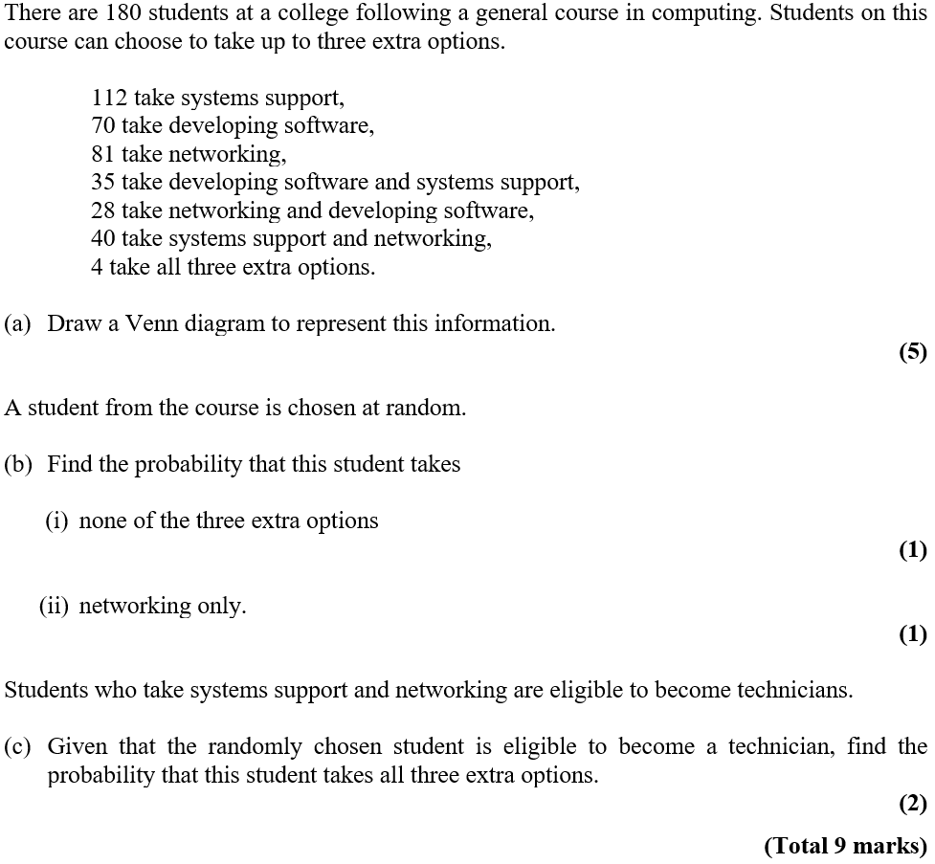
Practice E

Slide 3
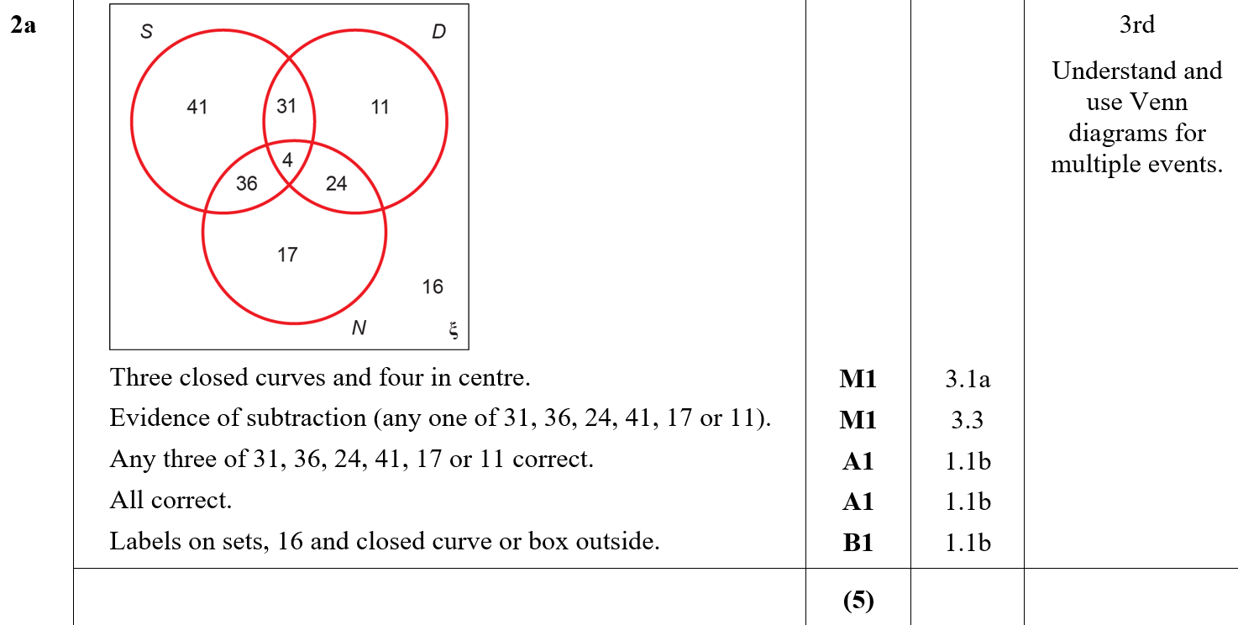
Practice E
A

Slide 4
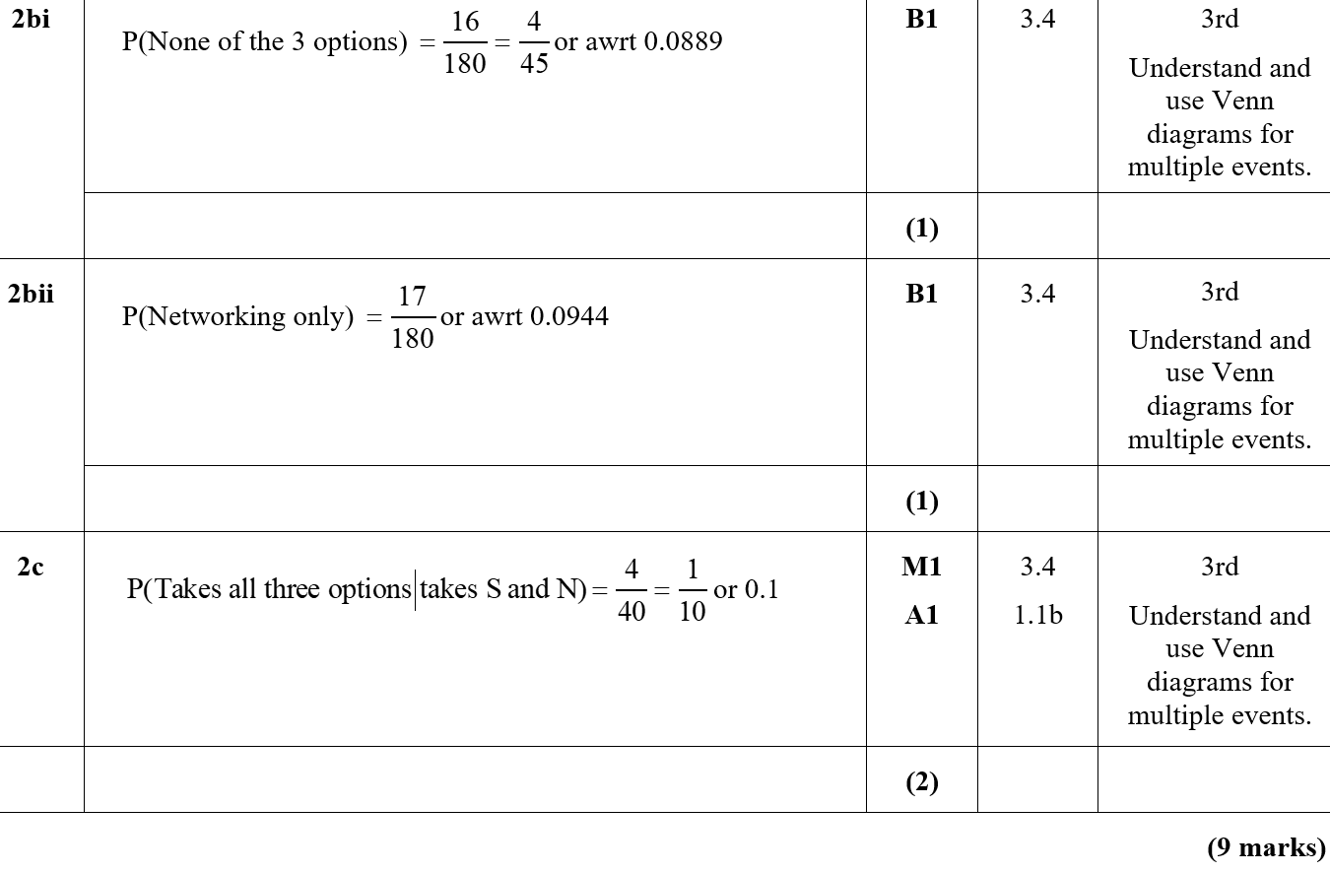
Practice E
B (i)
B (ii)
C

Slide 5
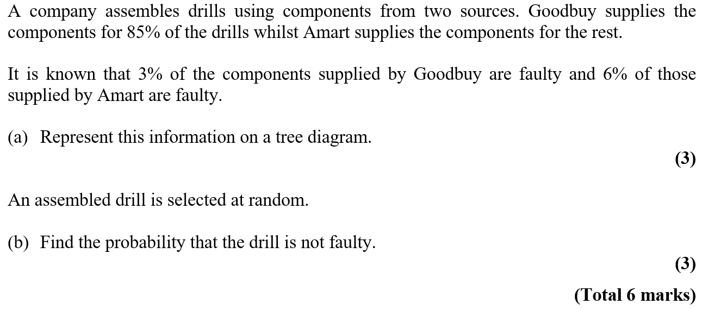
Practice F

Slide 6
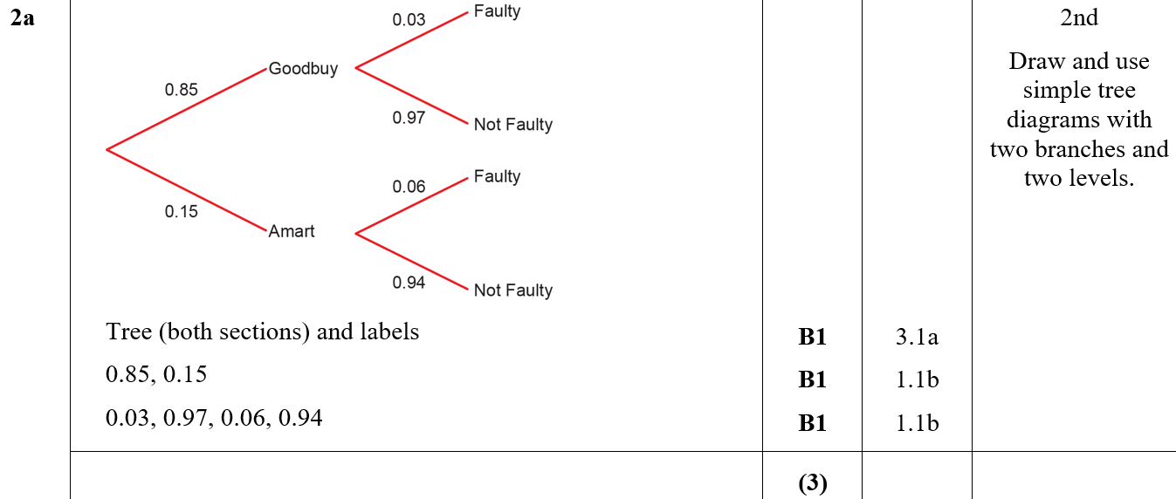
Practice F
A

Slide 7
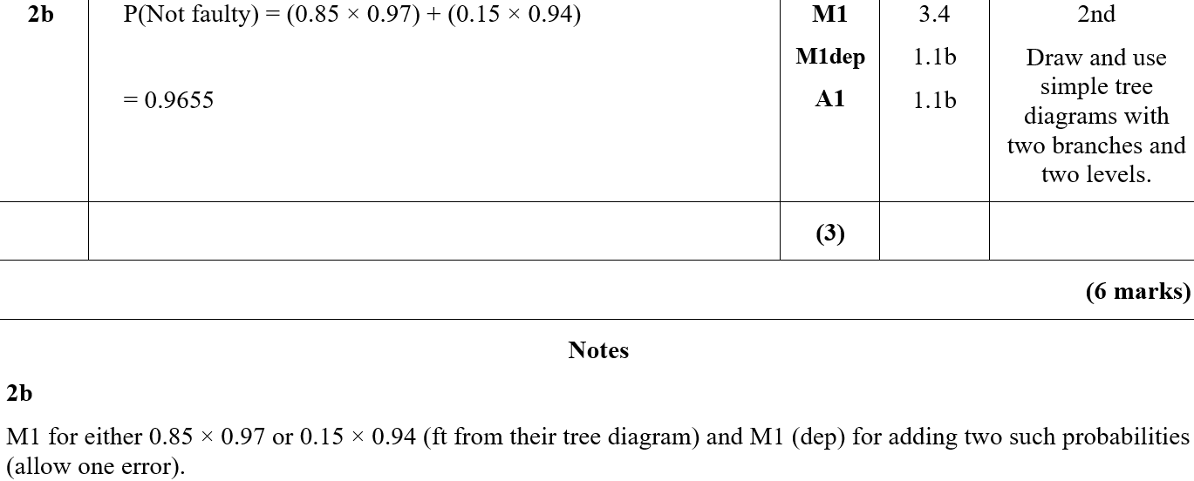
Practice F
B
B notes

Slide 8
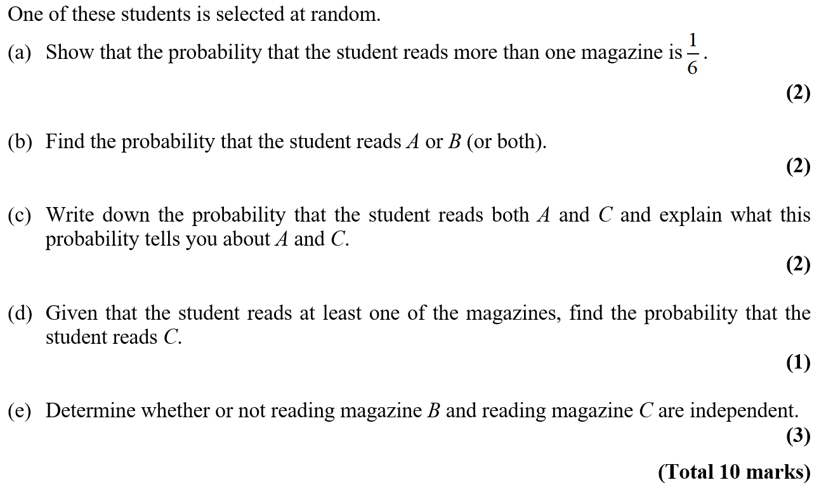
Practice G

Slide 9
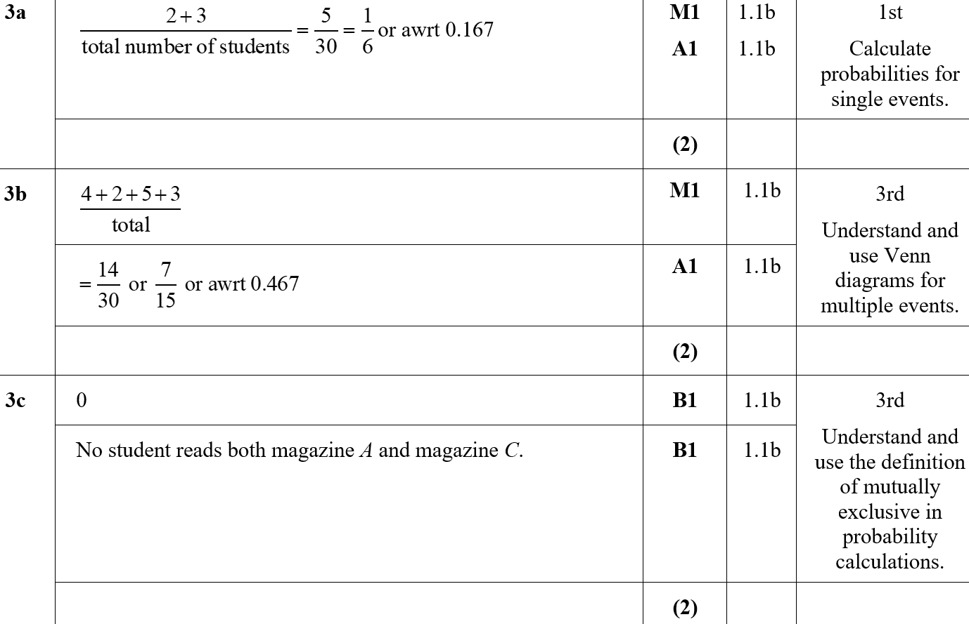
Practice G
A
B
C

Slide 10
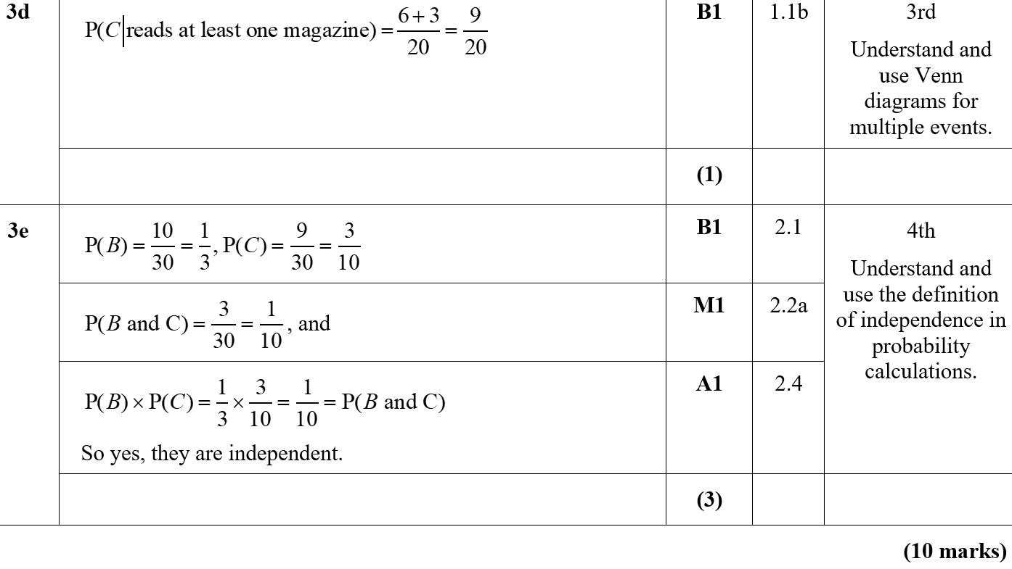
Practice G
D
E
E notes

Slide 11
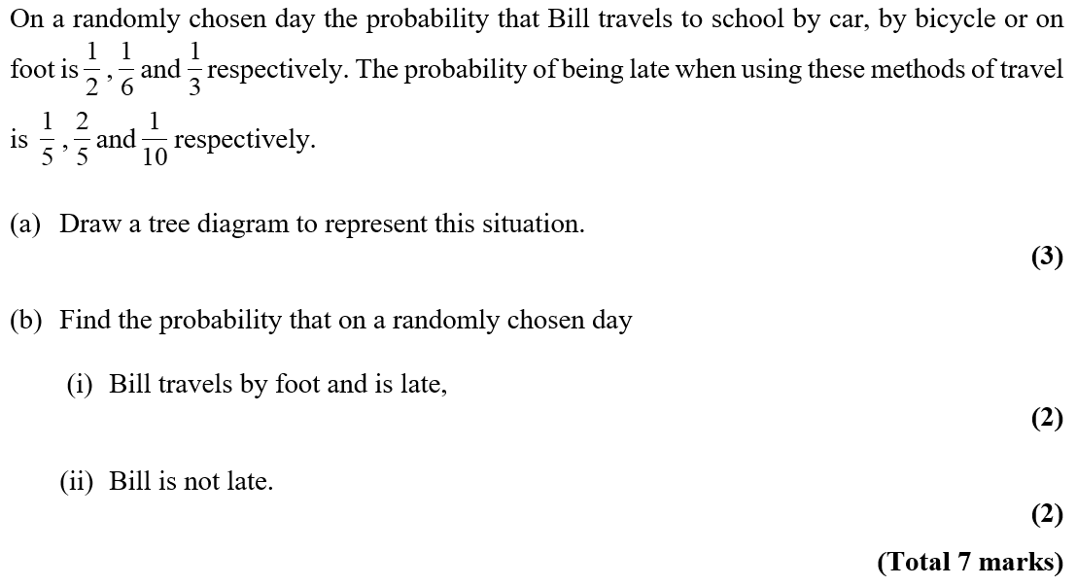
Practice H

Slide 12
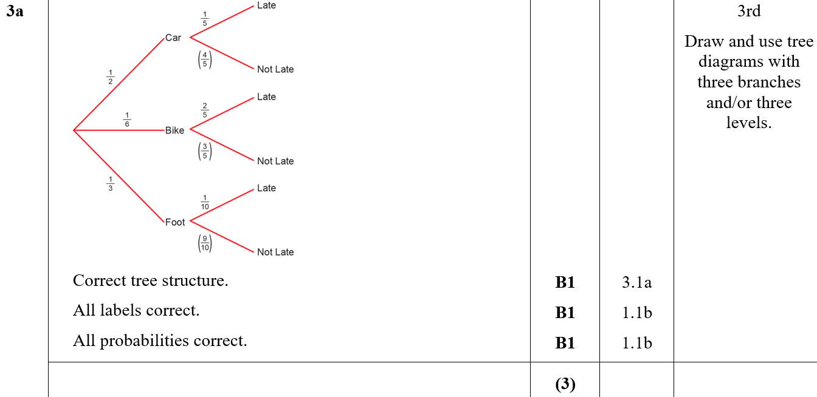
Practice H
A

Slide 13
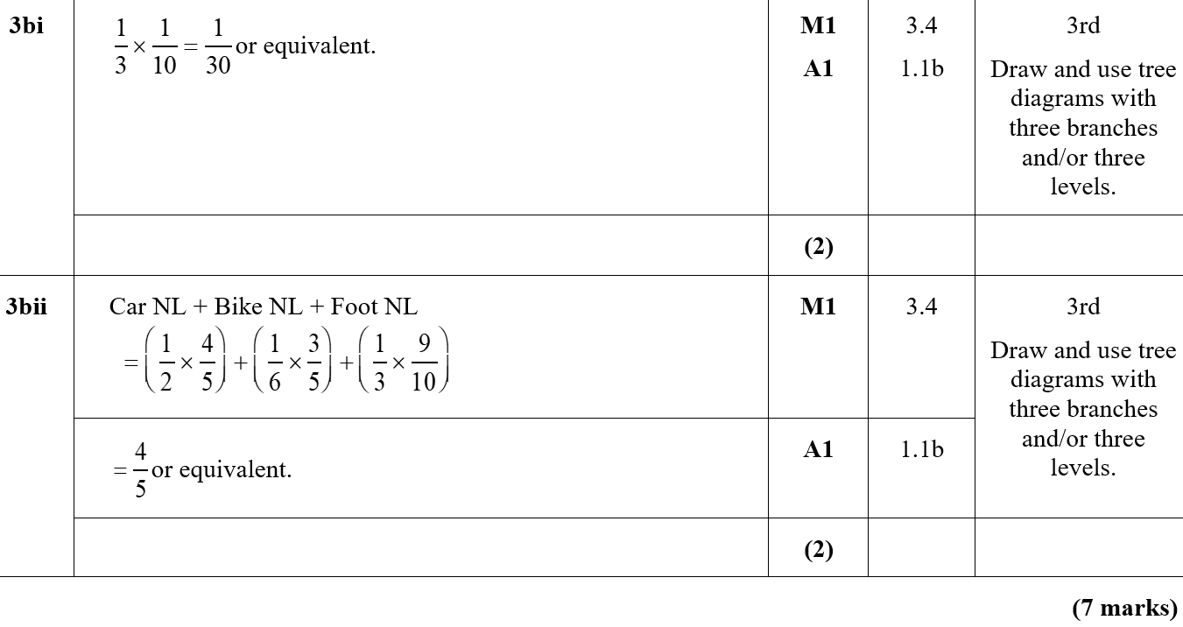
Practice H
B (i)
B (ii)
B (ii) notes

Slide 14
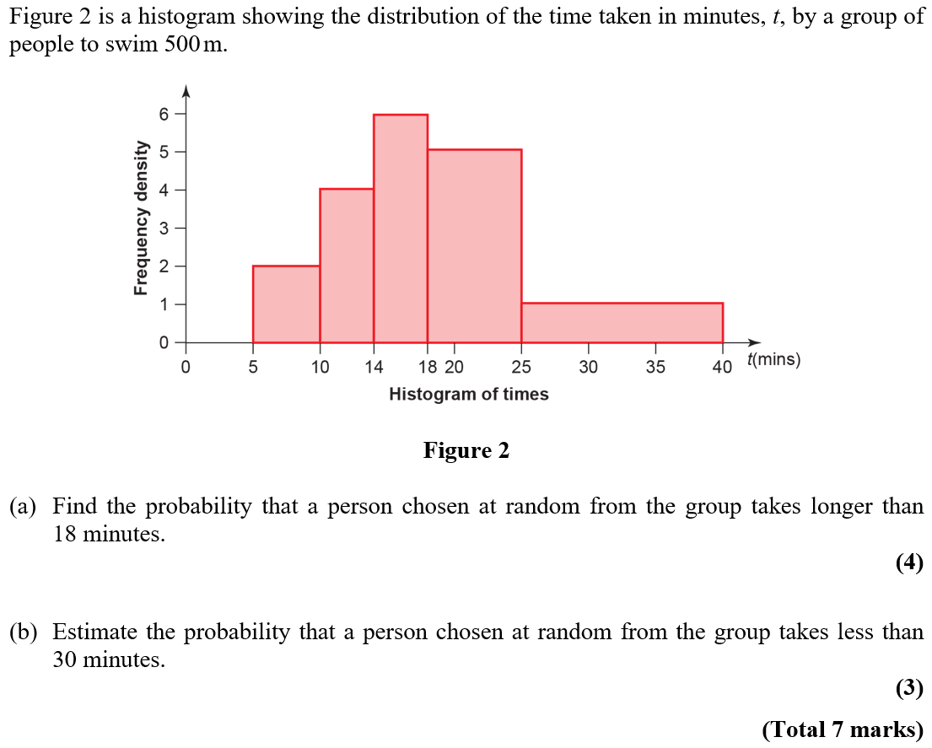
Practice I

Slide 15
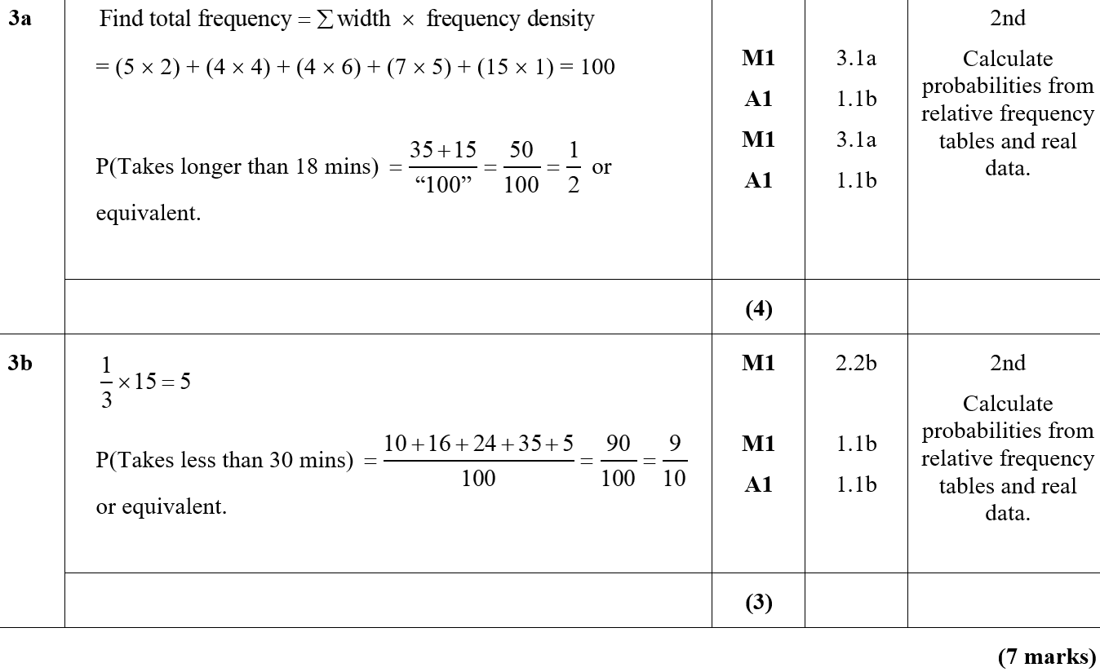
Practice I
A
B

Slide 16
Practice I
A notes

Slide 17
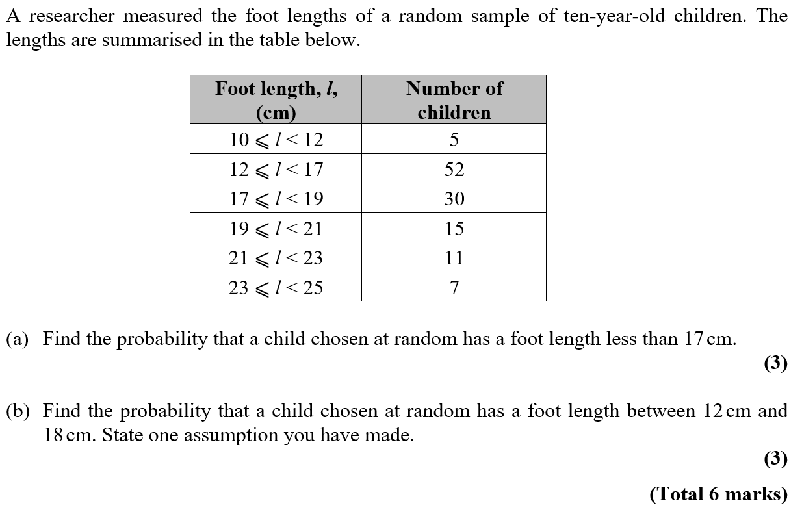
Practice J

Slide 18
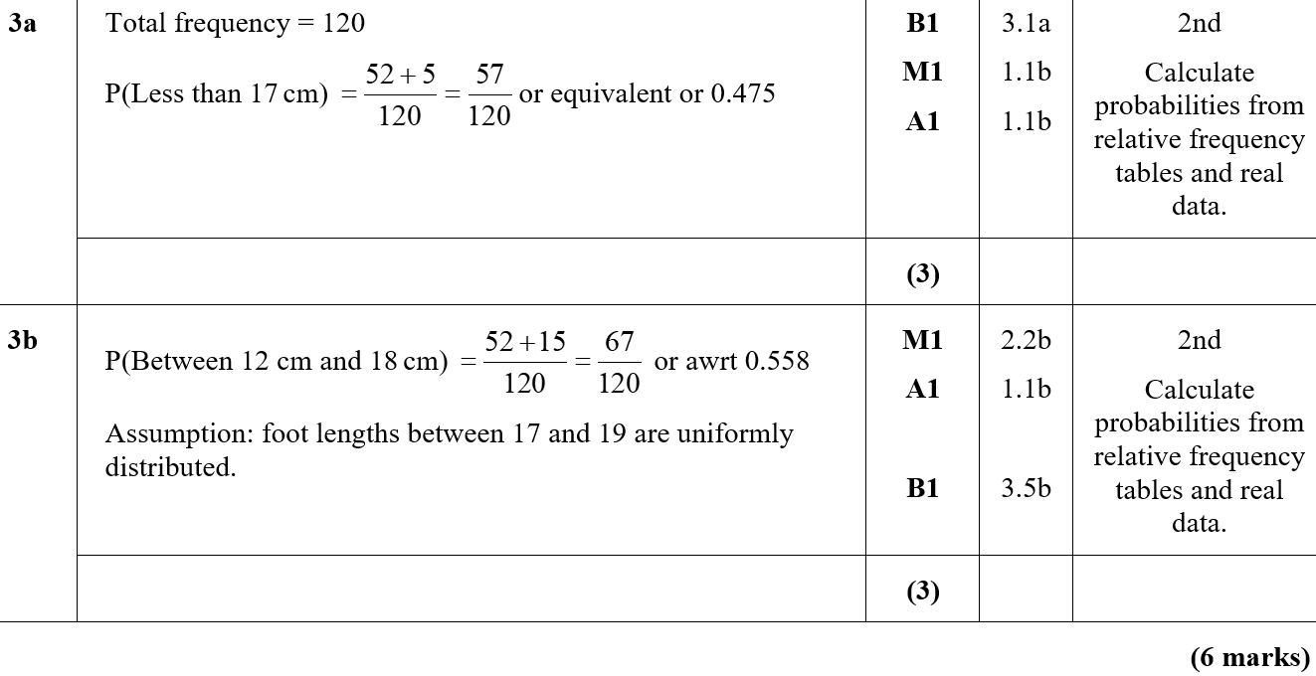
Practice J
A
B

Slide 19
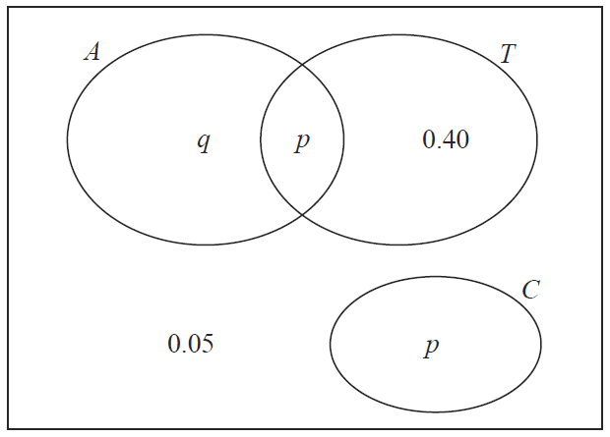
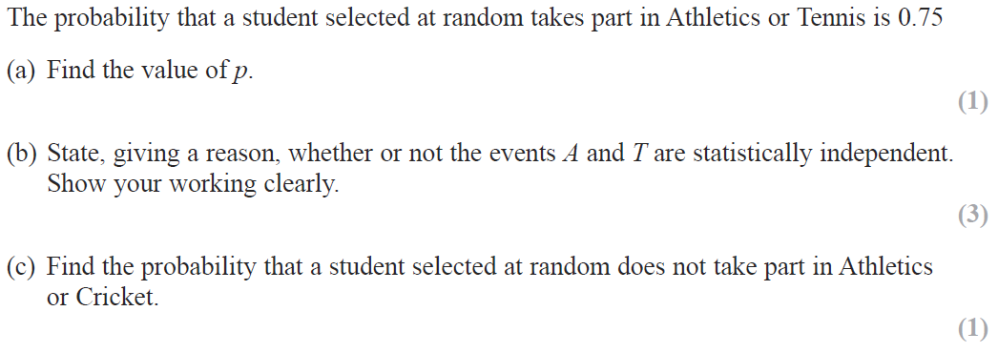
SAM

Slide 20
SAM
A
B
C

Slide 21
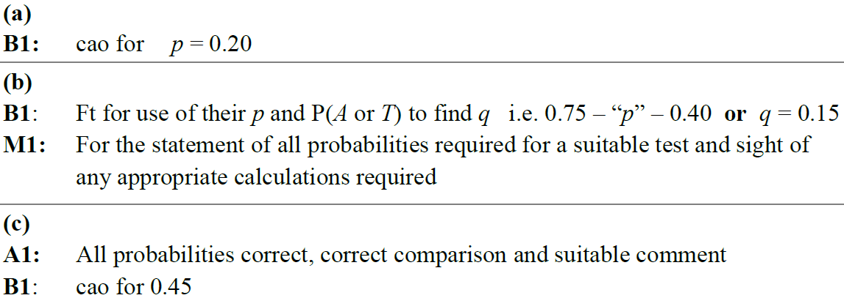
SAM
A notes
B notes
C notes

Slide 22
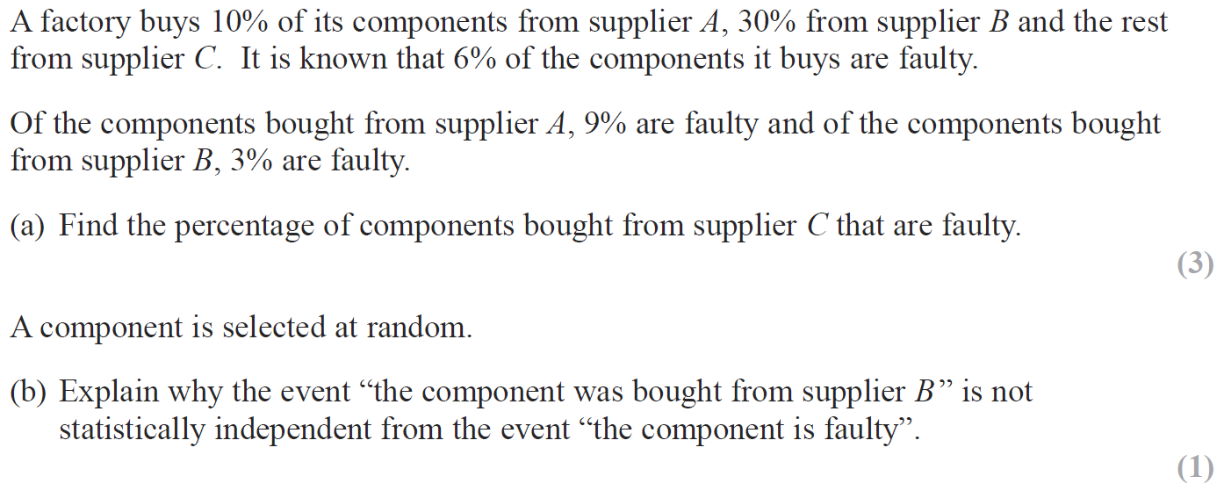
2018

Slide 23
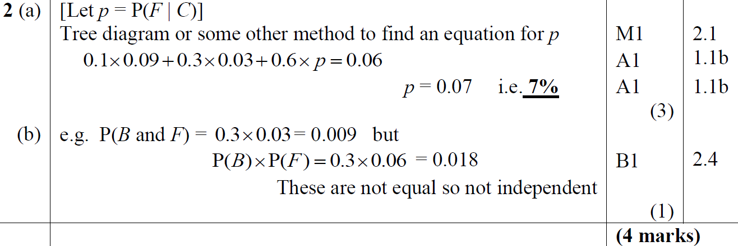
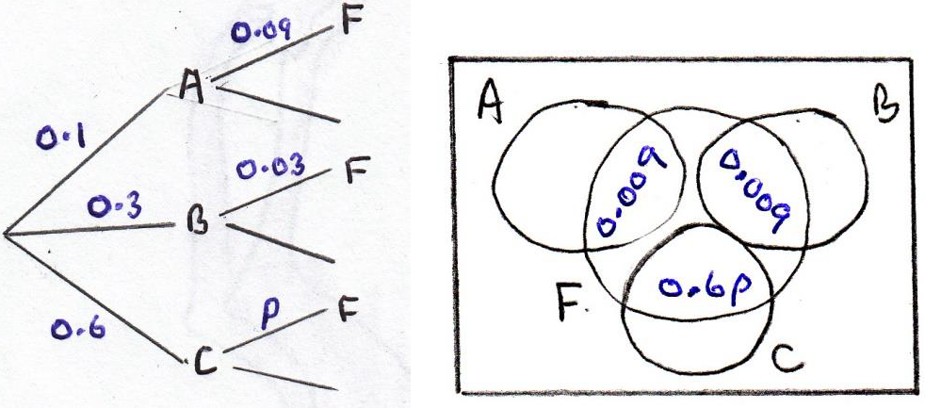
2018
A
B
diagrams

Slide 24
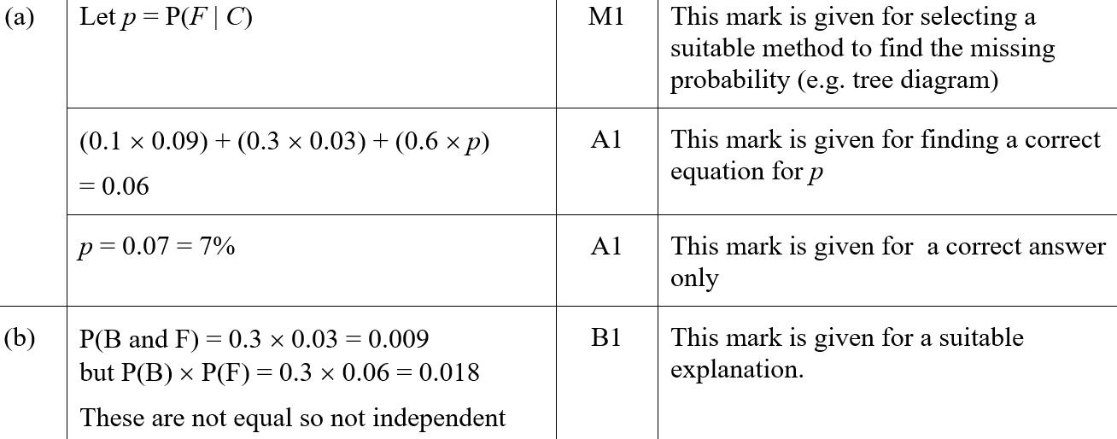
2018
A (SF)
B (SF)

Slide 25
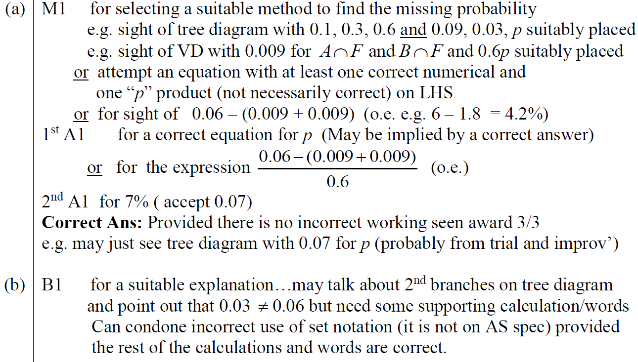
2018
A notes
B notes

Slide 26
New Spec Q’s
Old Spec Probability
Jan 2006 (i)
May 2008 (ii)
Jan 2011
May 2014 (i)
Jan 2006 (ii)*
Jan 2009
May 2011
May 2014 (ii)
Jan 2006 (iii)
May 2009 (i)
Jan 2012 (i)
June 2015
May 2006
May 2009 (ii)
Jan 2012 (ii)
June 2016
Jan 2007
Jan 2010 (i)
May 2012 (i)
June 2017
June 2007
Jan 2010 (ii)
May 2012 (ii)
June 2018
Jan 2008
May 2010 (i)
Jan 2013
May 2008 (i)
May 2010 (ii)
May 2013
*discrete uniform distribution

Slide 27
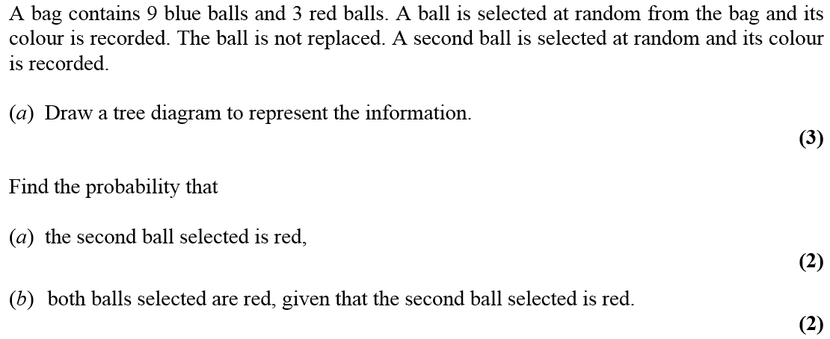
Jan 2006

Slide 28
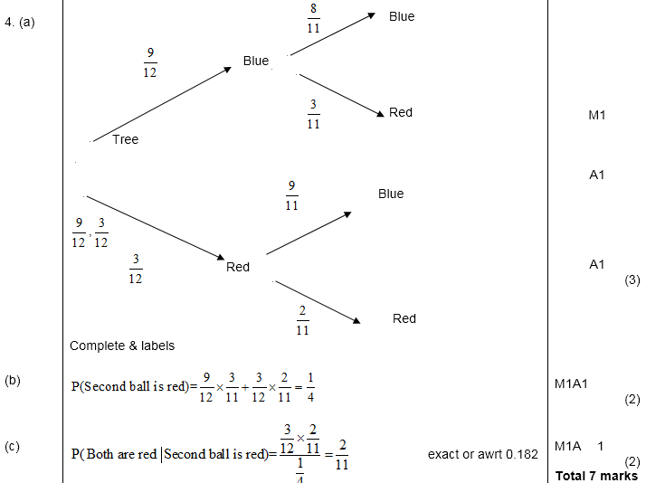
A
Jan 2006
B
C

Slide 29
Jan 2006

Slide 30
Jan 2006
A
B(i)
B(ii)

Slide 31
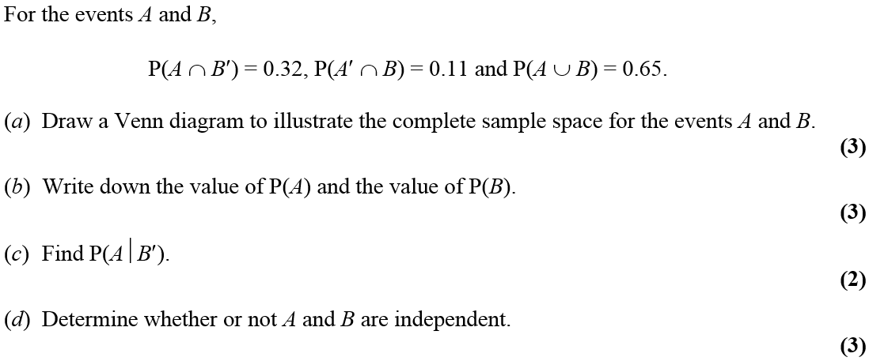
Jan 2006

Slide 32
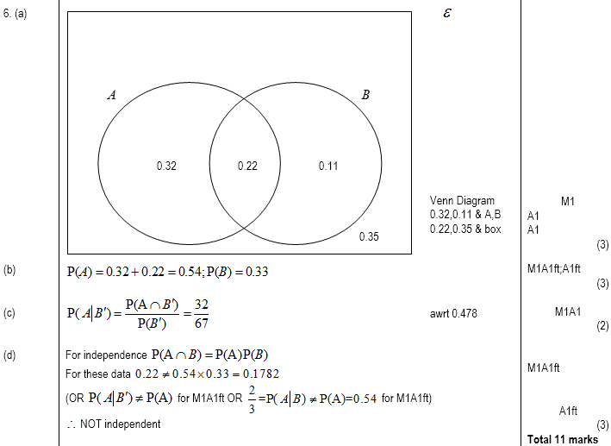
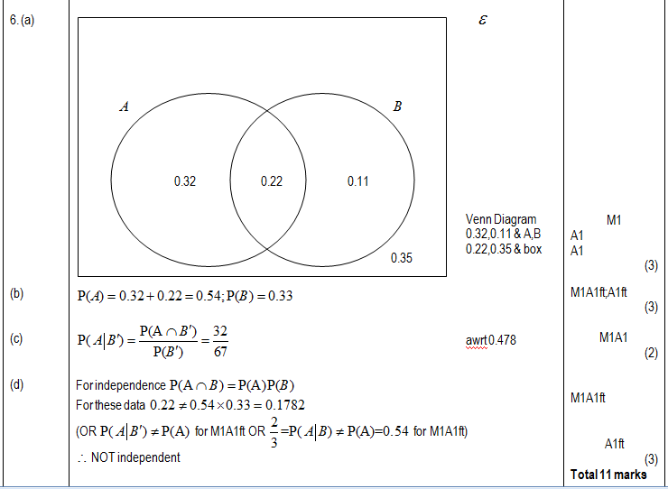
Jan 2006
A
B
C
D

Slide 33
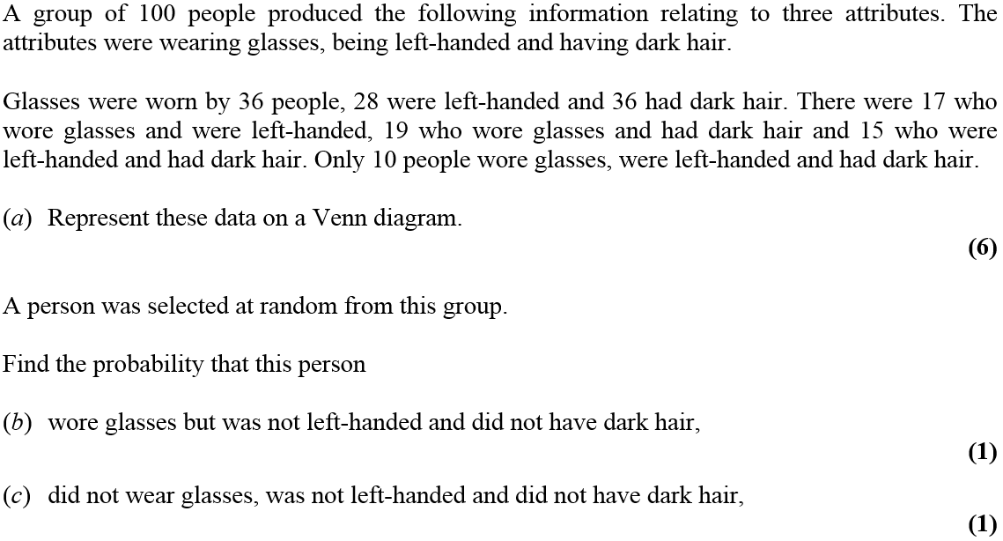
May 2006

Slide 34
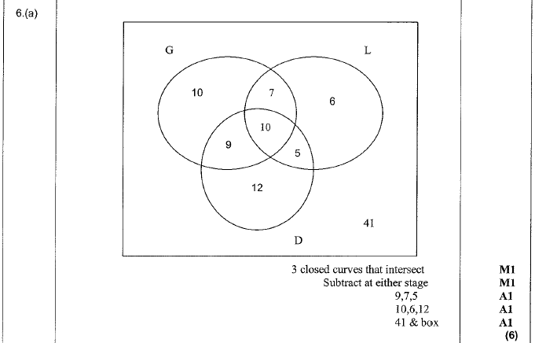
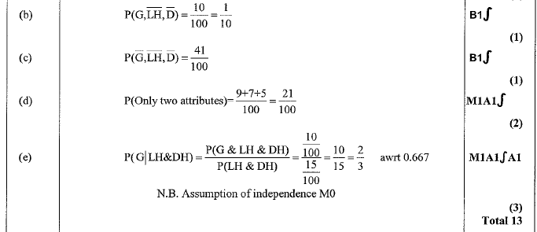
May 2006
A
B
C
D
E

Slide 35
Jan 2007

Slide 36
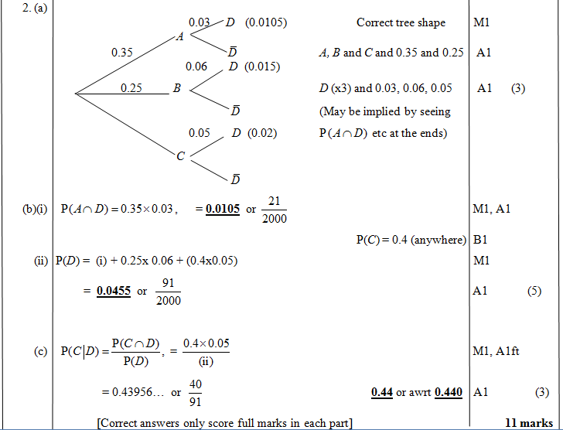
Jan 2007
A
B (i)
B (ii)
C

Slide 37
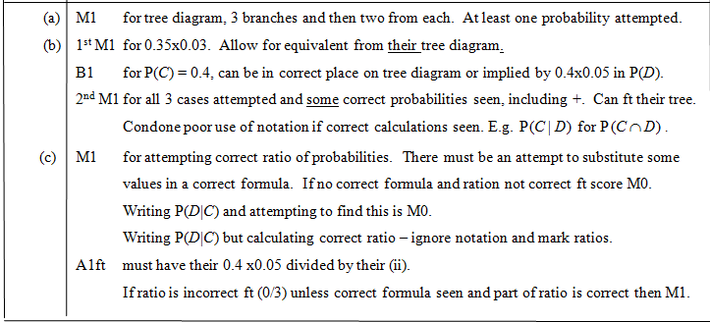
Jan 2007
A
B
C

Slide 38
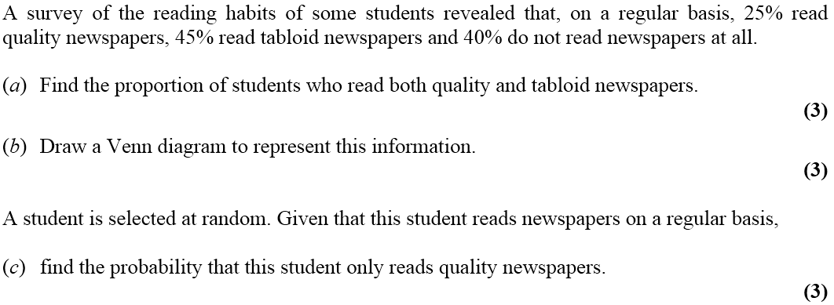
June 2007

Slide 39
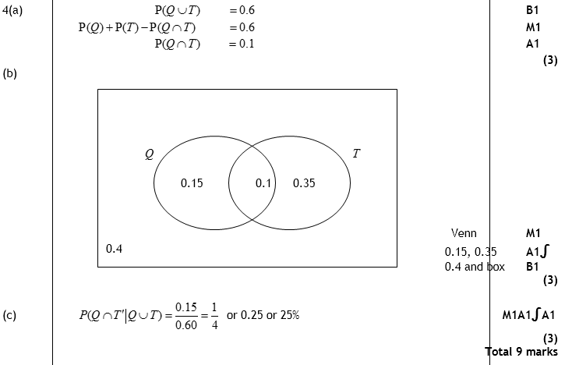
June 2007
A
B
C

Slide 40
June 2007
A
B
C

Slide 41
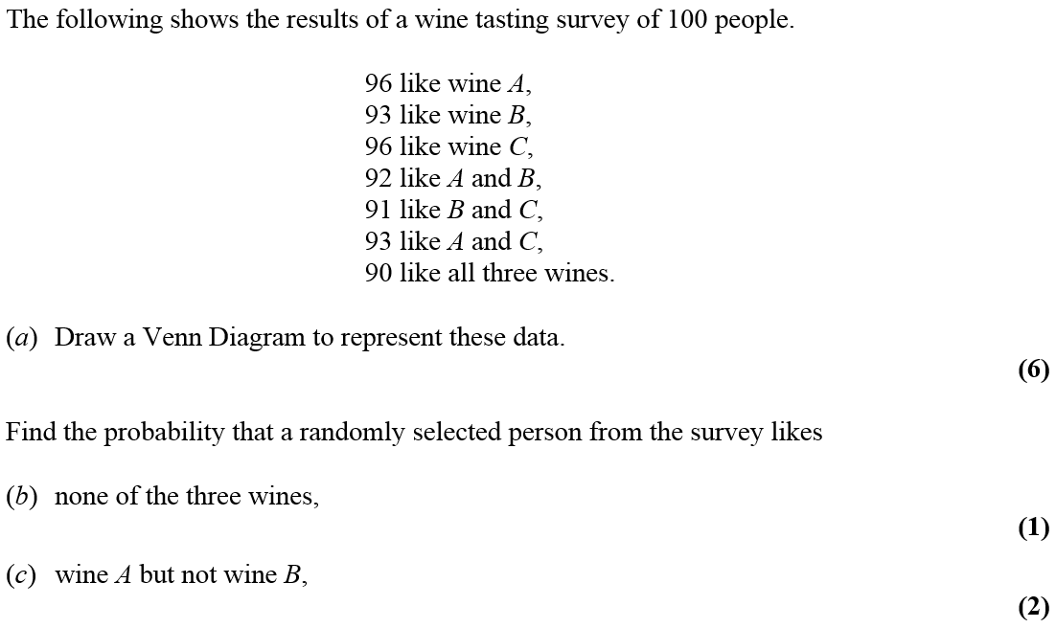
Jan 2008

Slide 42
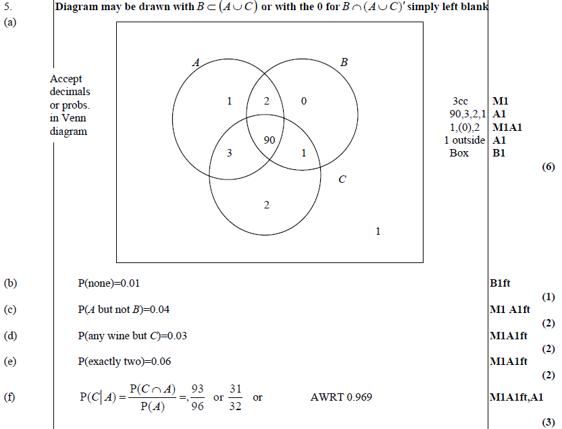
Jan 2008
A
B
C
D
E
F

Slide 43
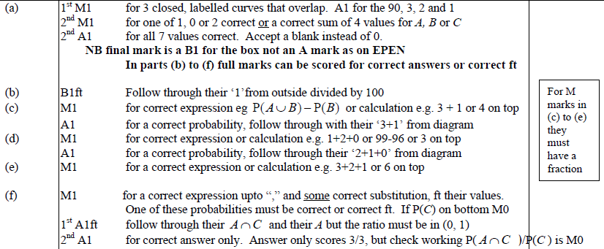
Jan 2008
A
B
C,D,E
C
D
E
F

Slide 44
May 2008

Slide 45
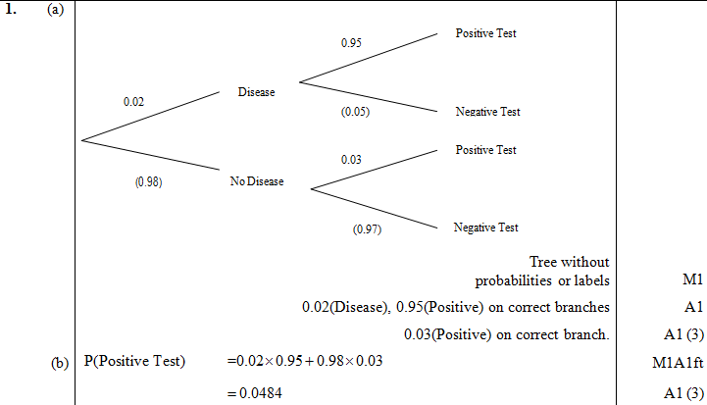
A
May 2008
B
C
D

Slide 46
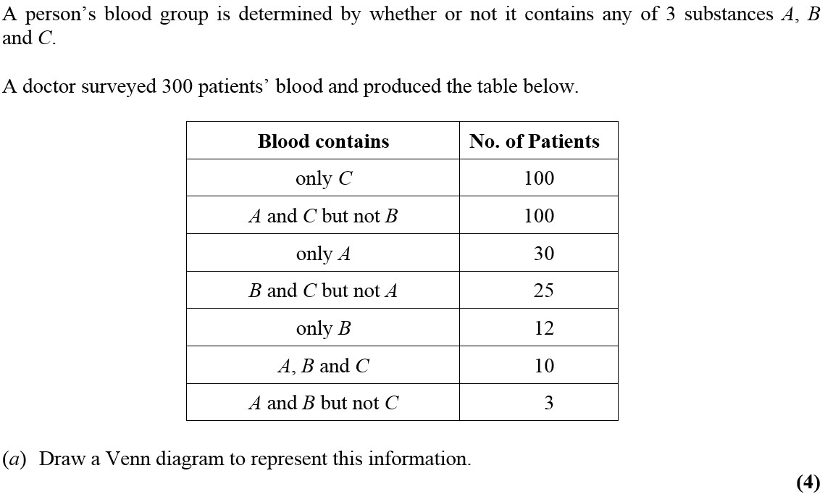
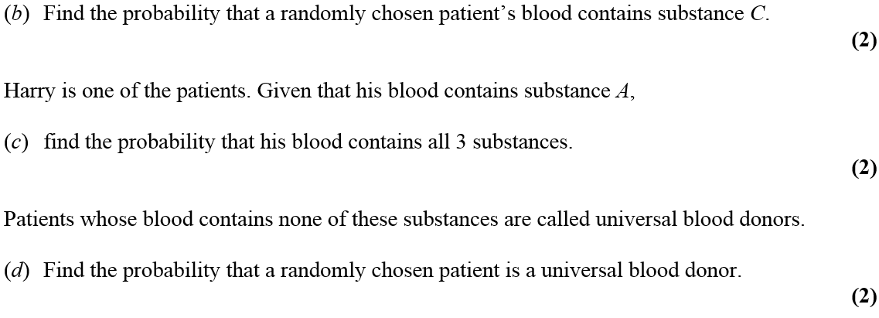
May 2008

Slide 47
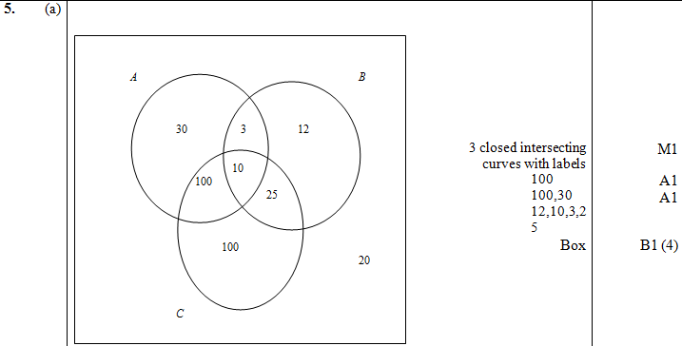
May 2008
A
B
C
D

Slide 48
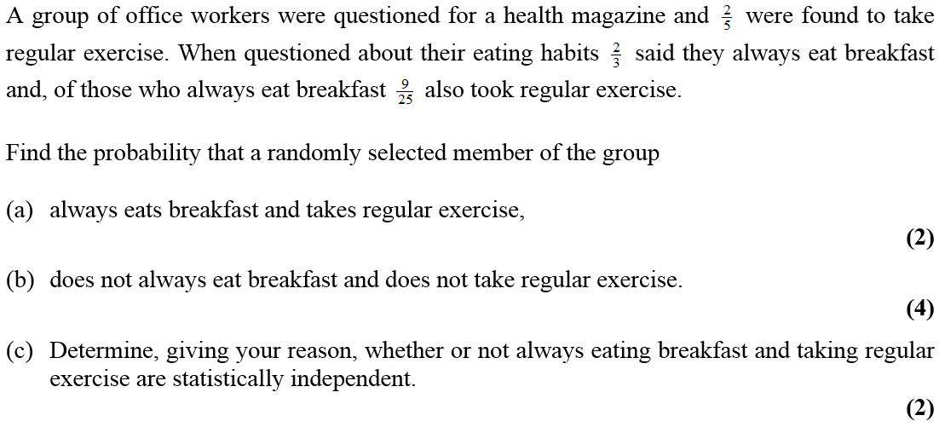
Jan 2009

Slide 49
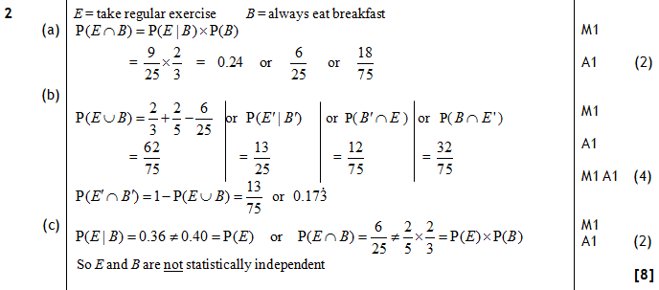
Jan 2009
A
B
C

Slide 50
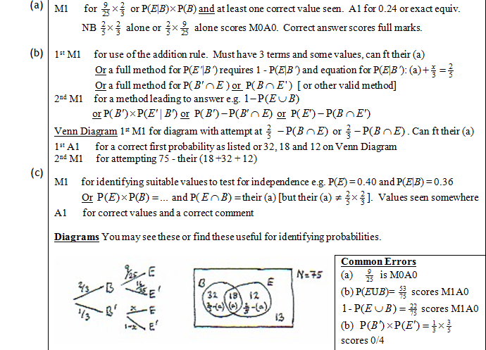
Jan 2009
A
B
C
Diagrams
A errors
B errors

Slide 51
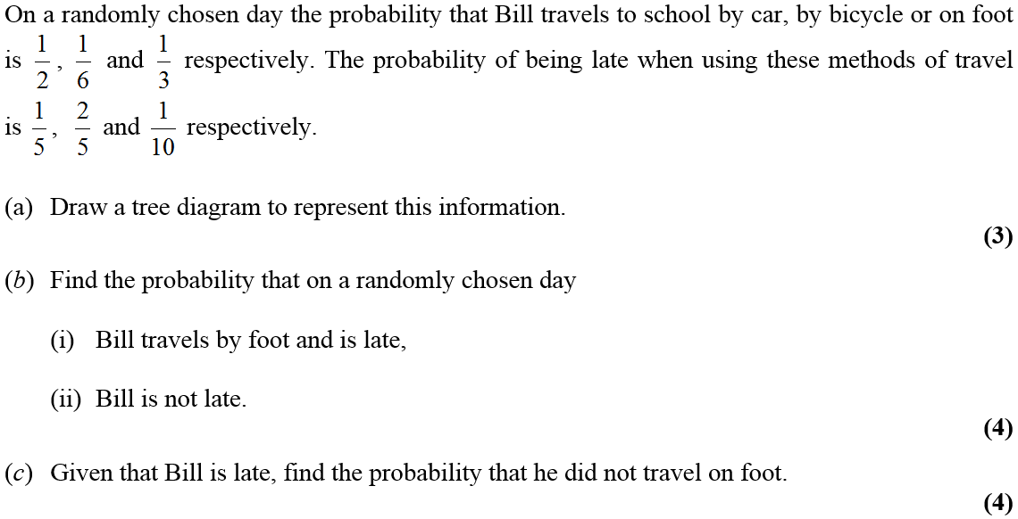
May 2009

Slide 52
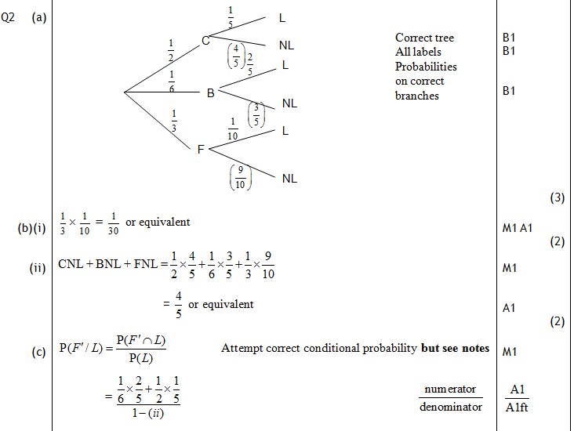
May 2009
A
B (i)
B (ii)
C

Slide 53
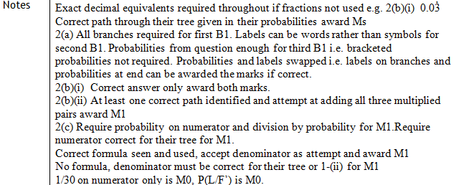
May 2009
A
B (i)
B (ii)
C

Slide 54
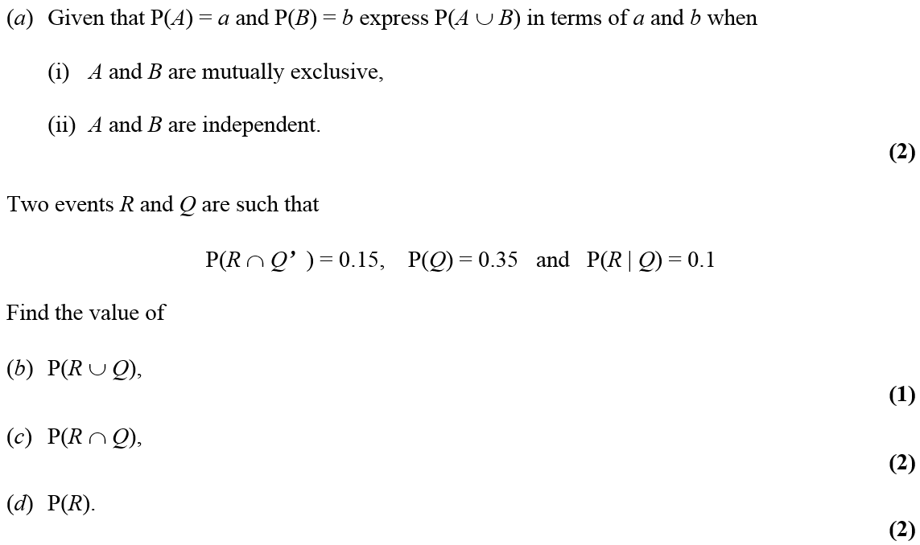
May 2009

Slide 55
A (i)
May 2009
A (ii)
B
C
D
A

Slide 56
Jan 2010

Slide 57
Jan 2010
A
B

Slide 58
Jan 2010
A
B
A
B

Slide 59
Jan 2010

Slide 60
A
Jan 2010
B
C
D

Slide 61
Jan 2010
A
B
C
D

Slide 62
May 2010

Slide 63
May 2010
A
B
C
D

Slide 64
May 2010

Slide 65
May 2010
A
B
C
D
E

Slide 66
Jan 2011

Slide 67
Jan 2011
A

Slide 68
Jan 2011
B
C
D
E
F

Slide 69
Jan 2011
B
C
E
F

Slide 70
May 2011

Slide 71
May 2011
A
B
C
D
E

Slide 72
May 2011
B
C
D
E

Slide 73
Jan 2012

Slide 74
Jan 2012
A
B
C
D

Slide 75
Jan 2012

Slide 76
Jan 2012
A
B
C
D
E

Slide 77
May 2012

Slide 78
May 2012
A
B
C
D
E

Slide 79
May 2012

Slide 80
May 2012
A
B
C
D

Slide 81
Jan 2013

Slide 82
Jan 2013
A
B
C
D
E

Slide 83
May 2013

Slide 84
May 2013
A
B
C
D
E

Slide 85
May 2014

Slide 86
May 2014
A
B
C
D

Slide 87
May 2014

Slide 88
May 2014
A
B
C
D

Slide 89
June 2015

Slide 90
June 2015
A
B
C
D

Slide 91
June 2015
E
A notes
C notes
D notes
E notes

Slide 92
June 2016

Slide 93
June 2016
A
B
C
D (i)
D (ii)
E

Slide 94
June 2016
B notes
C notes
D (i) notes
D (ii) notes
E notes

Slide 95
June 2017

Slide 96
June 2017
A
B
C
D
E

Slide 97
June 2017
A, B & C notes
D notes
E notes

Slide 98
June 2018

Slide 99
June 2018
A
B
C
D

Slide 100
June 2018
A notes
B notes
C notes
D notes

