Slide 1
Which identity?
First of all you need to grab a mini whiteboard.
One fraction will appear on the board at one time and your job is to figure out what the partial fractions look like.
For example, $\frac{2x+3}{(5x−1)(2x+1)}$ will look like $\frac{A}{5x−1}+\frac{B}{2x+1}$

Slide 2
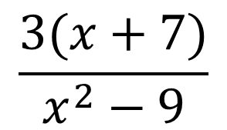
$$\frac{3(x+7)}{x^{2}−9}$$
$$\frac{A}{(x−3)}+\frac{B}{(x+3)}$$

Slide 3
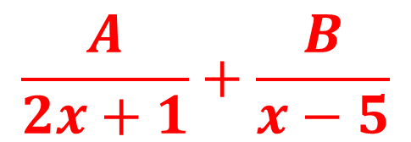
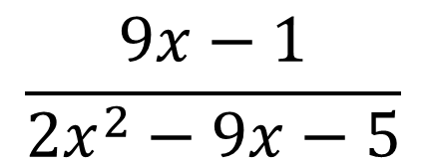
$$\frac{9x−1}{2x^{2}−9x−5}$$
$$\frac{A}{2x+1}+\frac{B}{x−5}$$

Slide 4
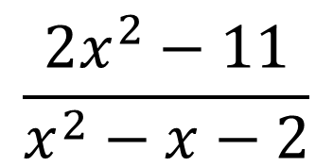
$$\frac{2x^{2}−11}{x^{2}−x−2}$$
$$A+\frac{B}{x+1}+\frac{C}{x−2}$$

Slide 5
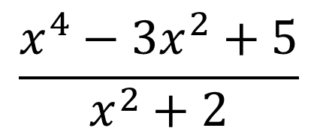
$$\frac{x^{4}−3x^{2}+5}{x^{2}+2}$$
$$Ax^{2}+Bx+C+\frac{Dx+E}{x^{2}+2}$$

Slide 6
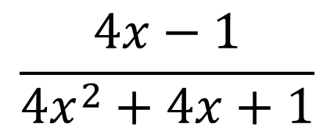
$$\frac{4x−1}{4x^{2}+4x+1}$$
$$\frac{A}{2x+1}+\frac{B}{{\left(2x+1\right)}^{2}}$$

Slide 7
$$\frac{33x−x^{2}−44}{(x−1)(2x^{2}+7x−15)}$$
$$\frac{A}{x−1}+\frac{B}{x+5}+\frac{C}{2x−3}$$

Slide 8
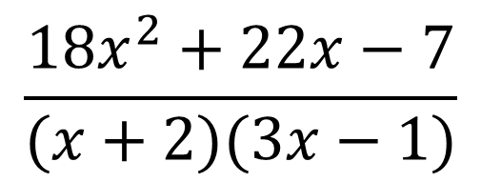
$$\frac{18x^{2}+22x−7}{(x+2)(3x−1)}$$
$$A+\frac{B}{x+2}+\frac{C}{3x−1}$$

Slide 9
$$\frac{x^{2}+7x+32}{(x−2)(x^{2}+6x+9)}$$
$$\frac{A}{x−2}+\frac{B}{x+3}+\frac{C}{{\left(x+3\right)}^{2}}$$

Slide 10
$$\frac{2x^{3}−4x^{2}+5x−1}{x−3}$$
$$Ax^{2}+Bx+C+\frac{D}{x−3}$$

