Slide 1
The Large Data Set
The tension!
Teaching Statistics
Answering exam questions
What’s gone well?
What’s gone wrong?
Notes:
We should be looking at the data set as a teaching tool to make our lessons richer and more interesting rather than just seeing it as an add on to be examined.
Today we’ll be looking at opportunities to integrate it into our teaching.

Slide 2
Barriers
Pupils’ use of IT (shouldn’t be underestimated at all)
Access to computer rooms
Alternatives?
Notes:
What are the issues that you are facing: Discuss points with the audience to see what there issues have been

Slide 3
Introducing the Data Set
When do you start using it?
Notes:
Most schools introduce the data set as they teach the statistics section.
Can we use it as a teaching tool in KS3/4 so students are already familiar with the contexts and layout before we start applying A Level techniques?
Note: this isn’t possible for colleges but if they have a small number of regular feeder schools, can discussions be had to get them using it as a teaching tool?
Can we introduce shorts tasks/lesson starters, before we actually formally introduce the statistics content to get students used to the contexts/terminology?
They don’t need to be formally studying the statistics content to get them comparing data and thinking statistically

Slide 4
Terminology
Trends
Locations
Limits of the data set
Units
What’s so interesting about 1987?
Notes:
Key points that students should become aware of as a consequence of working with the data set rather then key points that we need to shoehorn into our lessons

Slide 5
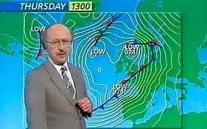
October 1987
What’s so interesting about 1987?
Notes:
Key points that students should become aware of as a consequence of working with the data set rather then key points that we need to shoehorn into our lessons

Slide 6
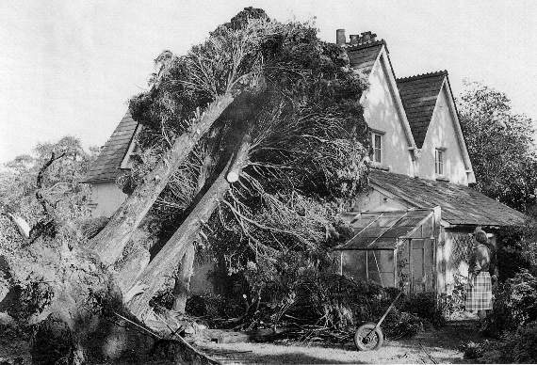
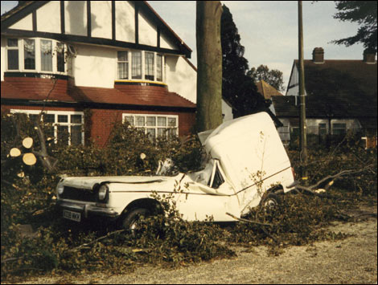
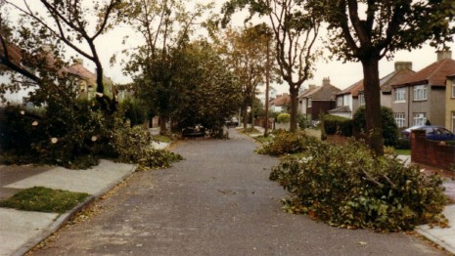
The Great Storm
Notes:
Key points that students should become aware of as a consequence of working with the data set rather then key points that we need to shoehorn into our lessons

Slide 7
Key integration points
How can we look for opportunities to use the data set to introduce topics?
Notes:
See next slide for summaries of the AS and AL content

Slide 8
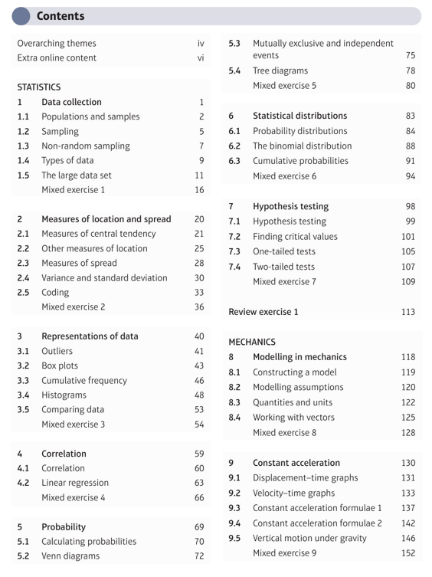
Key integration points

Slide 9
Tasks for Students
Lesson starters
In class
Homework
Notes:
We need to think laterally about how we get students to engage with the data if we are pressed for time.
Short homeworks getting students to compare two graphs with a short conclusion is something that they can operate on independently at this level.
I would recommend a lesson in a computer room on the first task to check their computer skills.
We shouldn’t underestimate how a single student can be fluent on writing formulae in excel but can’t insert an extra column.

Slide 10
When was the best time to go on holiday in 2015?
Choose a location in the UK: Cambourne, Heathrow, Hurn, Leeming, Leuchars
Highlight the date column and the temperature column
Plot a time series graph (use a line graph)
Insert a title and axis labels on your graph
How could we improve the graph?
Copy and paste your graph into Word
What is your conclusion in relation to the question?
Extension:
Is there a common pattern across the UK?
Is there a pattern between 2015 and 1987?
Notes:
Suggested simple task for students. Accessible for KS3
If you’re are creating your own tasks then it’s best to keep them very focussed eg just choosing 1 location and one variable to investigate the task. Otherwise students will try and analyse data from all the locations for a number of different variables and tie themselves in a complete knot trying to reconcile it all for a conclusion.

Slide 11
Resources to make your lives easier
Summary statistics
Summary graphs
Notes:
We’ve created summary statistics of all the data in the LDS for you to either use as the answers to tasks you may set to to give to students as the starting points of discussions

Slide 12
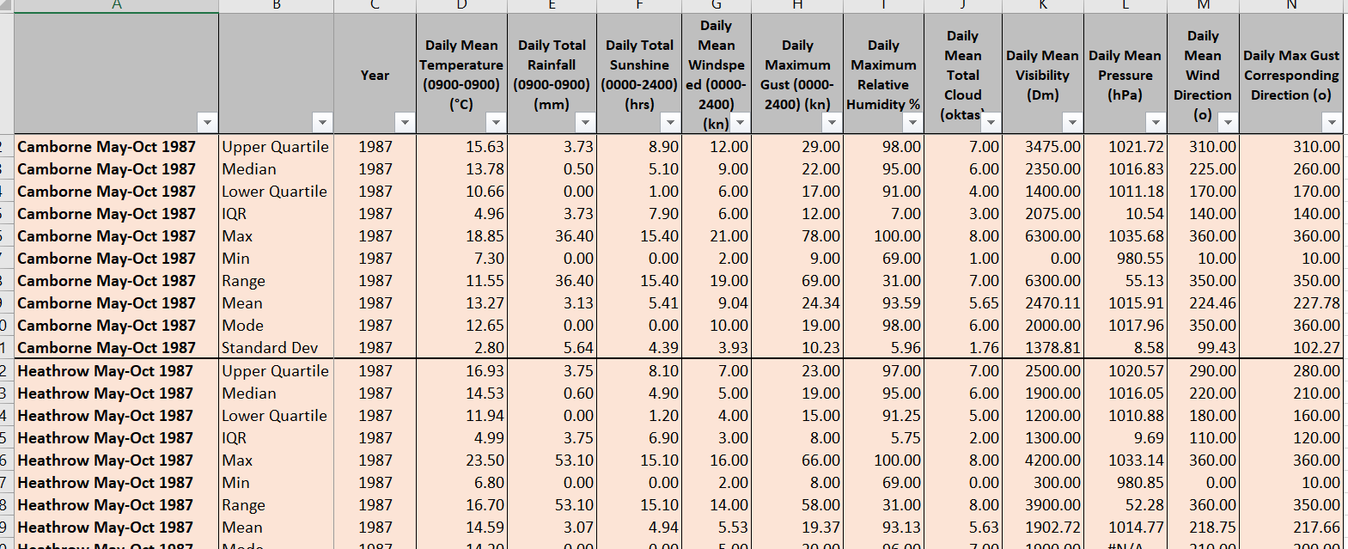
All the Summary Statistics!
Notes:
An example of the summary statistics spreadsheets which covers ALL the locations for both years. Filters have been added so that you can just view a single statistic or location.

Slide 13
All the graphs you could ever want!
Notes:
We’ve created a summary document with graphs of basically everything you could ever want from the LDS.
You can use these as the answers if you are asking your students to investigate something or you can use these graphs as discussion points to give to your students.
There are hyperlinks that take you to the graphs and back to the contents

Slide 14
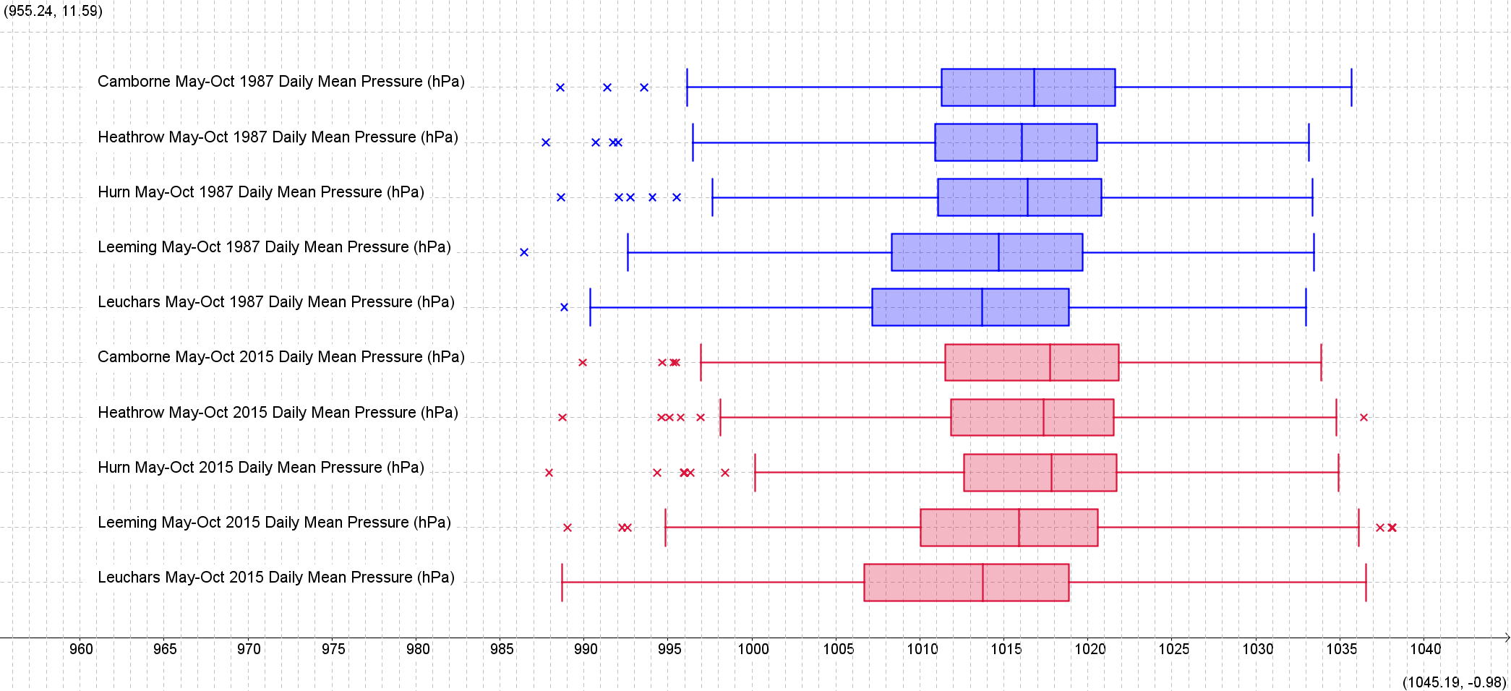
Notes:
Sample graph from the document

Slide 15
Starter for 10
Which is further North: Hurn or Cambourne?
Which location in the UK is highest?
What scales are used for measuring windspeed?
How are snow or hail measured?
Why can’t we test the hypothesis “It’s sunnier in the UK than in Perth” ?
Why is it difficult to compare the temperature in Heathrow and the temperature in Beijing?
Find some discrete data
Find some categorical data
Why might the Daily Mean Wind Direction not be a reliable indicator?
What does a wind direction of 10 mean?
What does “tr” mean?
What is “normal air pressure” (not in the data set)
Notes:
The following slides are examples of tasks that we can use with students.
A simple task that can be either given to students to use in a computer room or as a homework to get them familiar with the contexts of the data
There can be lovely discussions to be had surrounding what is discrete data/categorical data.
It really does get them into the detail of the notes section of the data set.
Most students won’t realise that wind direction of 10 mean that data is blowing from 010⁰ and not towards it!

Slide 16
Starter for 10
Which is further North: Hurn or Cambourne?
Hurn
Which location in the UK is highest?
Cambourne 87m
What scales are used for measuring windspeed?
Beaufort conversion, knots
How are snow or hail measured?
Melted first and then measured as rain
Why can’t we test the hypothesis “It’s sunnier in the UK than in Perth” ?
No sunshine data for overseas stations
Why is it difficult to compare the temperature in Heathrow and the temperature in Beijing? UK:
Heathrow: Highest Daily Temp, Beijing: Daily Average Temp
Notes:
Answers to the previous slide

Slide 17
Starter for 10
Find some discrete data:
Cloud Cover, Wind Direction of 20
Find some categorical data:
Wind Cardinal Direction (NNW)
Why might the Daily Mean Wind Direction not be a reliable indicator?
Doesn’t give an indication of how variable the wind has been.
What does a wind direction of NE mean?
Wind is blowing FROM the North East and not towards the North East
What does “tr” mean?
A trace of rain but not enough to measure
What is “normal air pressure” (not in the data set)
1013 hPa
Notes:
Answers to the previous slide

Slide 18
Daily Mean Temperature (7Pt moving Average) 1987 Which overseas location is the lowest line and why?
Notes:
Perth: it’s in the southern hemisphere and it will be the winter season

Slide 19
Notes:
What questions could we ask students to help get them familiar with the data set?
Describe the trends across the year? Low pressure can occur at any point
What’s the connection between the two graphs?
What graph could we use to check? scatter
What correlation would you expect to see? Negative
Will is be a strong correlation? There are times when pressure is low but the windspeed isn’t high so we would not expect a very strong correlation.

Slide 20
Notes:
Ta Dah
Interpret the gradient in context: for every 1hPa increase in Pressure there is on average a 0.7097 decrease in knots of daily maximum gust.
Why is the y intercept useless: it describes the gust of zero air pressure which is impossible.

Slide 21
Notes:
There are two outliers caused by the 87 storm in the top two graphs. What’s your conclusion about the other two locations? The storm mainly hit the south of the UK

Slide 22
Describe any trends you see
Notes:
What could we ask students?
Describe the trends? Students come to the conclusion that the whole of the uk broadly experiences the same weather.

Slide 23
Notes:
Extension to see if the trends exist for both years

Slide 24
Daily Mean Wind Direction
Notes:
It’s important for students to see data, in line where there are no real trends. See next slide

Slide 25
Daily Mean Wind Direction
Notes:
Odd that the two northern sites have common wind direction across both years!

Slide 26
Find an anomaly!
 | Year |  | Daily Maximum Relative Humidity % | Daily Mean Total Cloud (oktas) | Daily Mean Visibility (Dm) | Daily Mean Pressure (hPa) | Daily Mean Wind Direction (o) | Daily Max Gust Corresponding Direction (o)
Camborne May-Oct 1987 | 1987 | Range | 31.00 | 7.00 | 6300.00 | 55.13 | 350.00 | 350.00
Heathrow May-Oct 1987 | 1987 | Range | 31.00 | 8.00 | 3900.00 | 52.28 | 360.00 | 350.00
Hurn May-Oct 1987 | 1987 | Range | 22.00 | 7.00 | 3400.00 | 52.99 | 989.00 | 350.00
Leeming May-Oct 1987 | 1987 | Range | 21.00 | 7.00 | 6000.00 | 53.43 | 999.00 | 350.00
Leuchars May-Oct 1987 | 1987 | Range | 22.00 | 7.00 | 6000.00 | 57.21 | 350.00 | 350.00
Notes:
It’s the daily mean wind range of 999 which is impossible.
Why is the range a useless measure for this one: it’s a circular scale

Slide 27
Find something that interests you
 | Year |  | Daily Mean Temperature (0900-0900) (°C) | Daily Total Rainfall (0900-0900) (mm) | Daily Total Sunshine (0000-2400) (hrs) | Daily Mean Windspeed (0000-2400) (kn) | Daily Maximum Gust (0000-2400) (kn) | Daily Maximum Relative Humidity % | Daily Mean Total Cloud (oktas) | Daily Mean Visibility (Dm) | Daily Mean Pressure (hPa)
Camborne May-Oct 1987 | 1987 | Max | 18.85 | 36.40 | 15.40 | 21.00 | 78.00 | 100.00 | 8.00 | 6300.00 | 1035.68
Heathrow May-Oct 1987 | 1987 | Max | 23.50 | 53.10 | 15.10 | 16.00 | 66.00 | 100.00 | 8.00 | 4200.00 | 1033.14
Hurn May-Oct 1987 | 1987 | Max | 20.50 | 28.50 | 15.00 | 19.00 | 61.00 | 100.00 | 8.00 | 3700.00 | 1033.38
Leeming May-Oct 1987 | 1987 | Max | 21.45 | 31.70 | 13.60 | 18.00 | 48.00 | 100.00 | 8.00 | 6100.00 | 1033.46
Leuchars May-Oct 1987 | 1987 | Max | 19.05 | 31.80 | 13.30 | 19.00 | 44.00 | 100.00 | 8.00 | 6300.00 | 1033.01
Beijing May-Oct 1987 | 1987 | Max | 30.75 | 62.00 |  | 15.00 |  |  |  |  | 1032.25
Jacksonville May-Oct 1987 | 1987 | Max | 30.86 | 41.00 |  | 17.13 |  |  |  |  | 1026.15
Perth May-Oct 1987 | 1987 | Max | 24.46 | 104.00 |  | 21.83 |  |  |  |  | 1031.37
What else would you want to know?
Notes:
Eg why is the max visibility for heathrow so low since it’s an airport?
Discussion that it must still meet minimum aviation standards so the other locations must also be suitable from a visibility point of view (no pun intended)
Are the other max values outliers?

Slide 28
Existing Large Data Set Questions

Slide 29
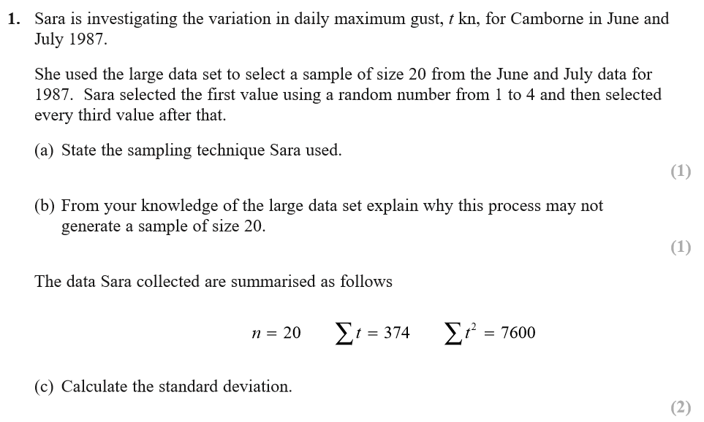
Large Data Set Questions AS SAMs Qu1
Notes:
A summary of all the LDS questions that have been issued so far, with their mark schemes, where available

Slide 30
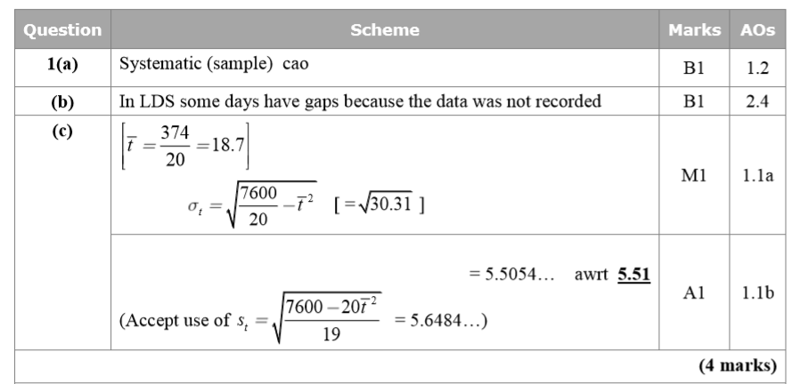

Slide 31
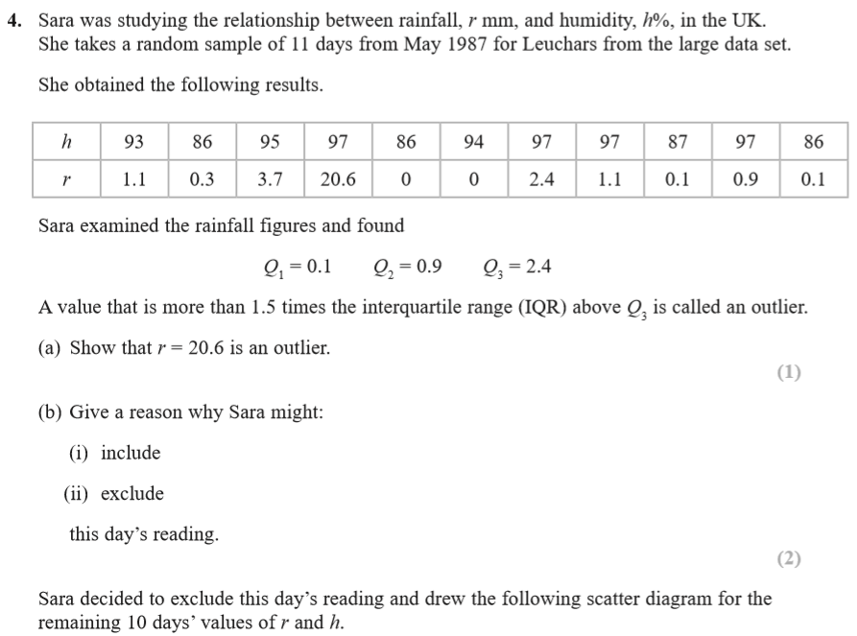
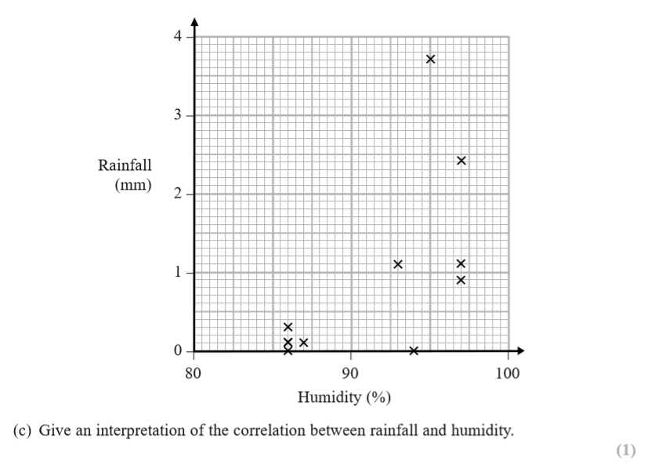
Large Data Set Questions: AS SAMs Qu 4

Slide 32
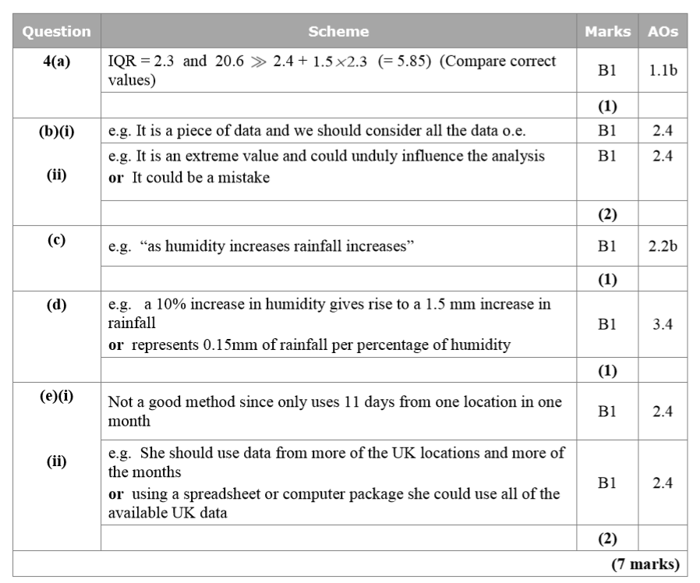

Slide 33
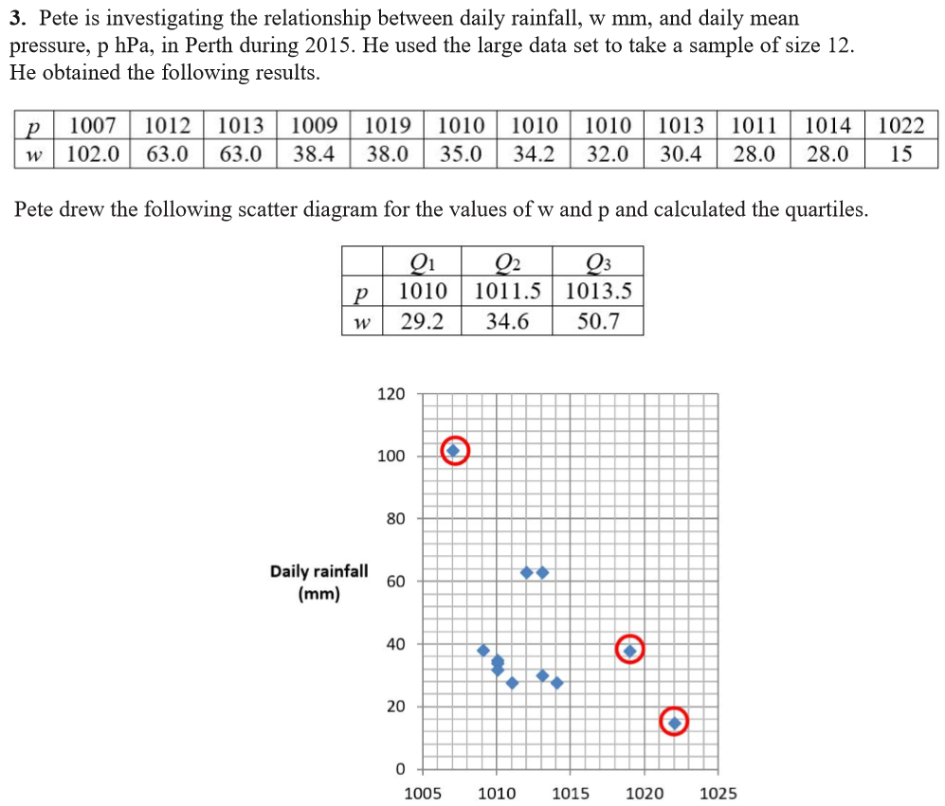
Large Data Set Questions: AS Specimen Qu3

Slide 34
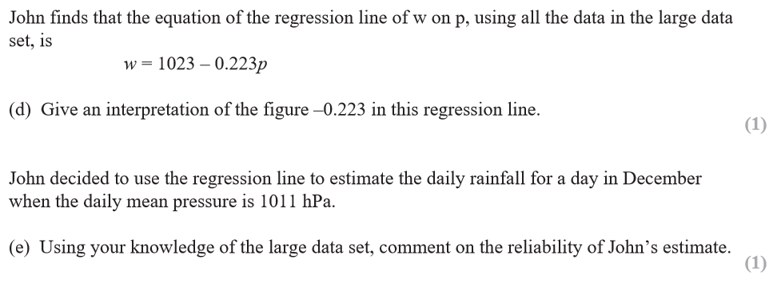

Slide 35
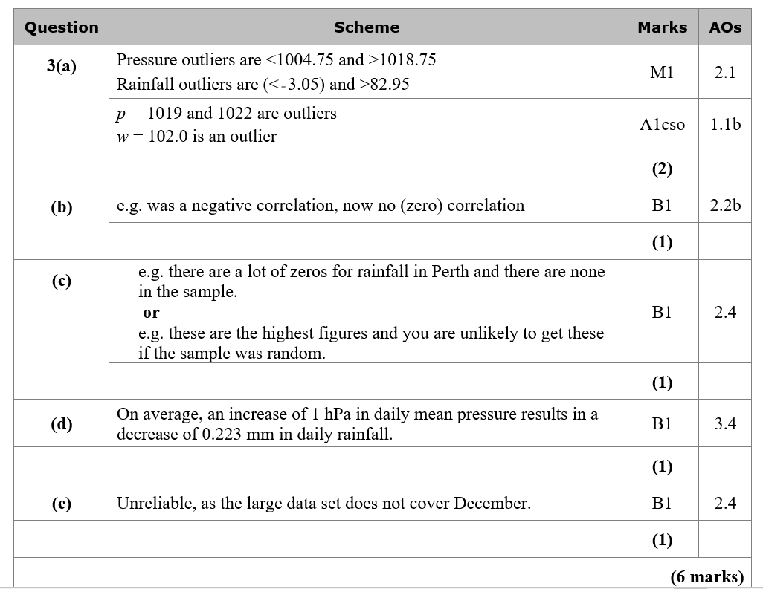

Slide 36
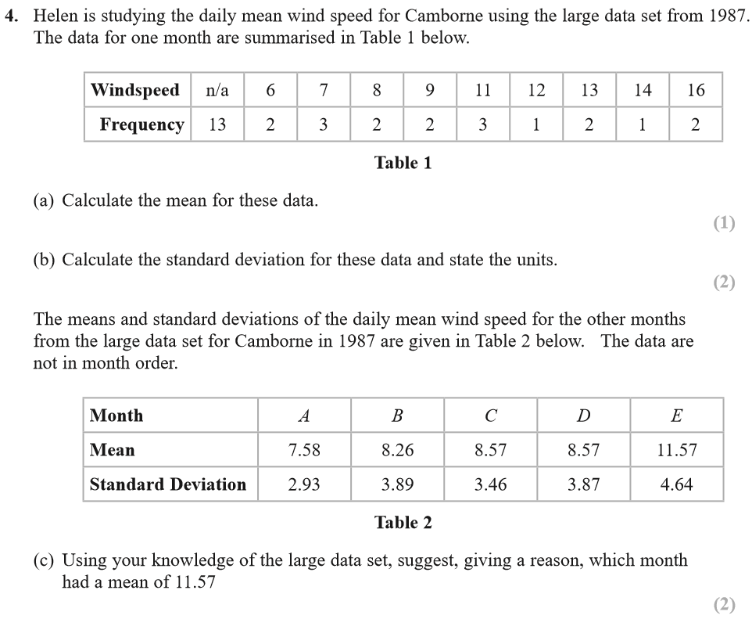
Large Data Set Questions: 2018 AS Paper 2 Qu4

Slide 37
Assumes knowledge of the range of months

Slide 38
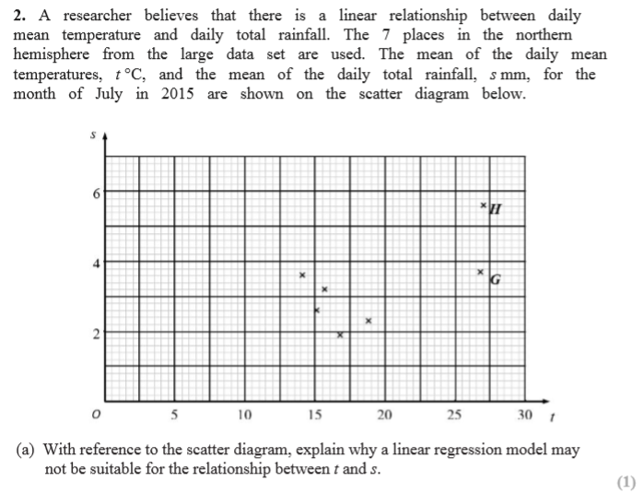
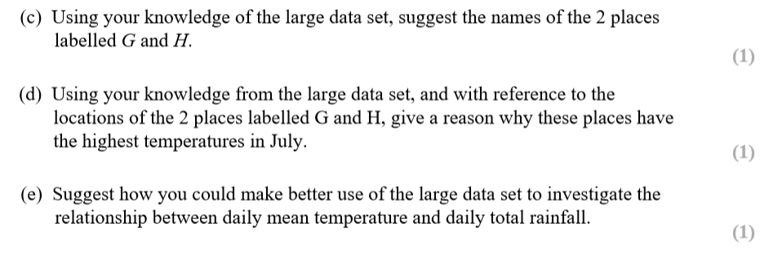
Large Data Set Questions: AL Specimen Qu 2

Slide 39
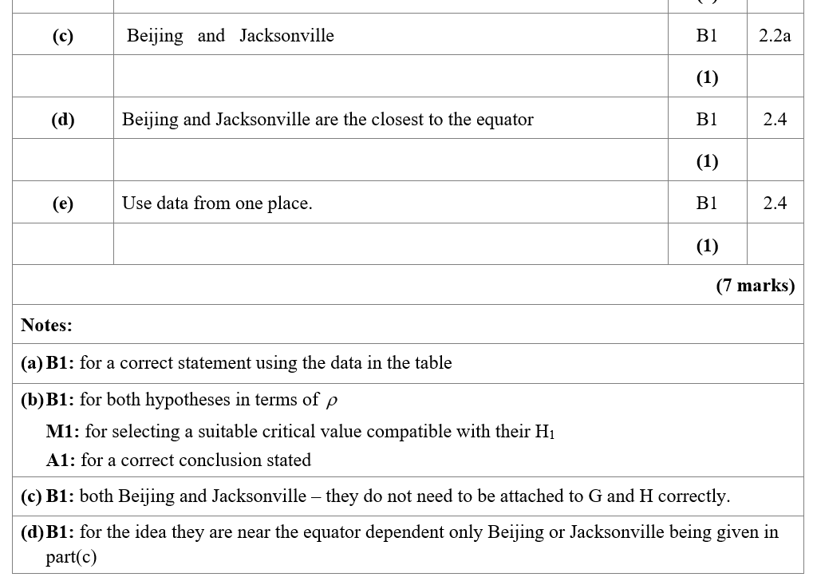

Slide 40
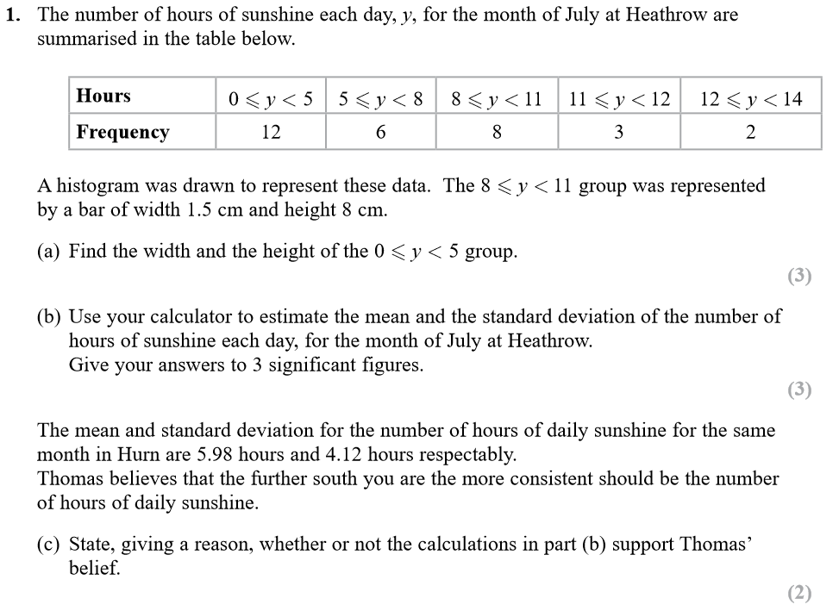
Large Data Set Questions: AL SAMs Qu 1

Slide 41
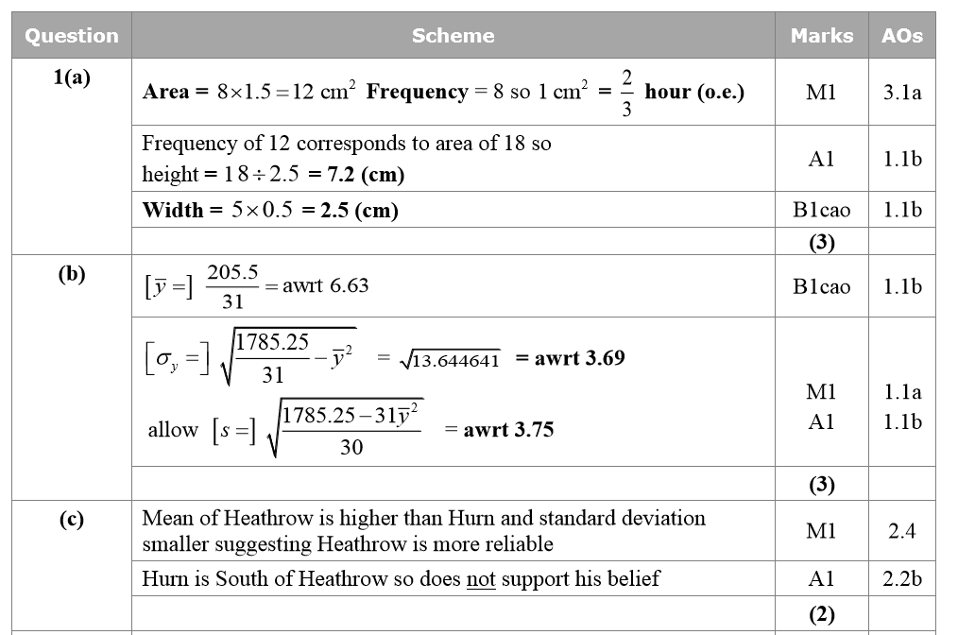

Slide 42
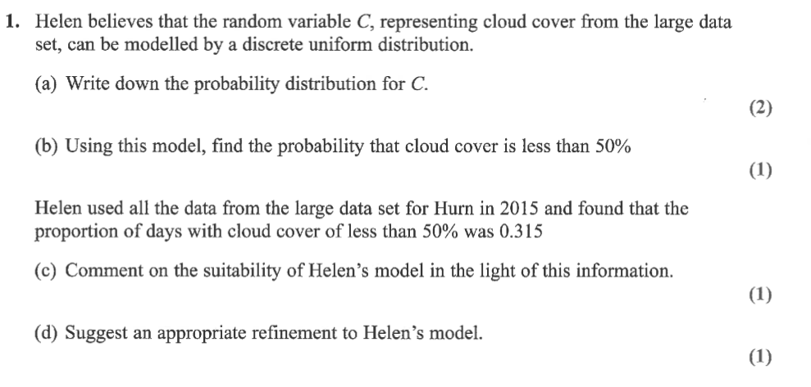
Large Data Set Questions: AL Maths

