Slide 1
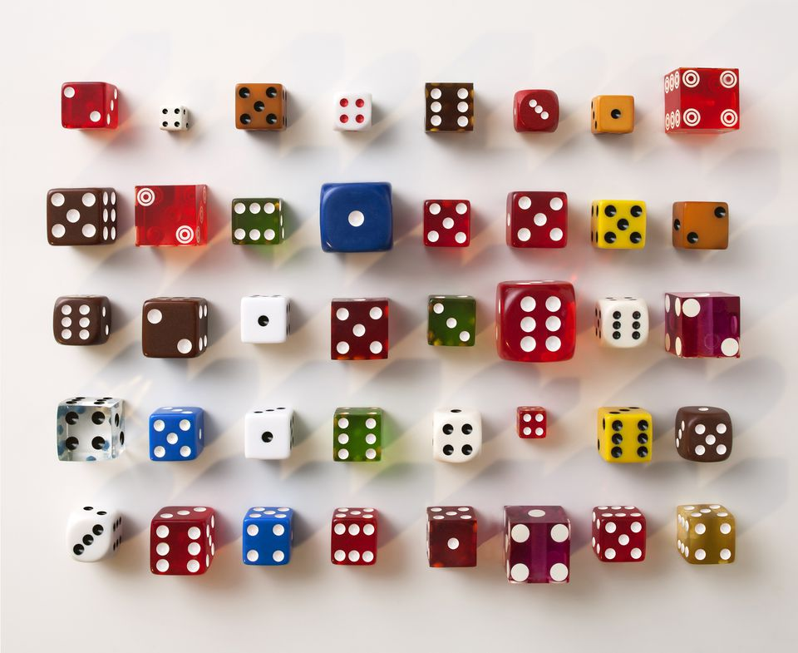
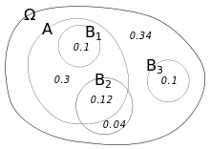
Conditional Probability

Slide 2
Complete the Venn Diagram
In a class of 20, there are
11 boys
5 Pupils with glasses
3 boys that wear glasses
Where should you start?
At the place with most information
Then fill in gaps – be careful as there are already 3 in some groups!
B
G
7
8
3
2

Slide 3
Working with probability
When working with probability, we often use fractions
What is the probability of a randomly selected person from the class being a girl that does not wear glasses?
B
G
7
8
3
2
7 people satisfy the condition
7
Out of
20
20 – the total amount being considered in the question

Slide 4
Some quick questions
Find
P(B∩G)
P(BᴜG)
P(B’∩G)
3
B
G
7
20
13
20
8
3
2
2
20

Slide 5
The ‘given that’ statement
Sometimes a question may ask you to find the probability of an event, given that something has already happened.
This reduces the total amount being considered in the question (the denominator of the fraction)
It can also eliminate some of the amount that would normally satisfy the question (the numerator of the fraction).

Slide 6
The ‘given that’ statement
Question: Given that a boy is selected, what is the probability that they wear glasses?
We are now only considering boys – we can ignore all other values
B
G
7
8
3
2
3 people left still have glasses
3
Out of
11
The amount of boys – the ‘given that’ statement

Slide 7
Notation
We use the ‘|’ symbol to mean ‘given that’
P(G|B) means the probability that G happens, given that B has already happened (the previous question).
Note from the previous question that this was
B
G
7
8
3
2
Probability both happen
P(G∩B)
Out of
P(B)
The ‘given that’ statement

Slide 8
In General you can use the formula
P(A∩B)
= P(A|B)
P(B)
or
P(A∩B) = P(A|B) x P(B)

Slide 9
Similarly
P(A∩B)
= P(A|B)
P(B)
P(A’∩B)
P(A’|B) =
P(B)
P(A∩B’)
P(A|B’) =
P(B’)
And so on…

Slide 10
Let’s have a look at some more examples
In the following slides, the Venn diagrams or tree diagrams will all have been completed for you
In a test, however, this will normally be asked of you first.
You would then use your completed Venn diagrams or tree diagrams to calculate the probabilities
*Note you can always use the formulae to get to an answer quickly, but I like to visualise what is going on in each case – this is more important when dealing with tree diagrams

Slide 11
120 Pupils took a selection of subjects
48 took Geography
50 took History
23 took both History and Geography
H
G
45
Find
a) P(H)
b) P(G|H)
c) P(H’|(HUG))
50
27
23
25
120
23
50
25
75
*note that we could then simplify a) and c)

Slide 12
What if we are already given probabilities?
B
Follow the same approach
Find
P(B|A’)
P(C|A∩B)
P(B∩C’|AUC)
A
0.05
0.2
0.3
0.45
3
=
0.05
0.6
4
0.1
0.15
0.05
1
=
0.25
5
0.1
0.05
0.2
1
C
=
0.6
3

Slide 13

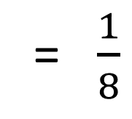


P(A) = $\frac{2}{5}$ P(B) = $\frac{1}{6}$ and P(B|A) = $\frac{1}{8}$ Find P(A’ ∩ B)
We need to start working out some probabilities. Using the given that statement, A has happened – let’s ignore everything else.
Let x be the intersection of A and B, then
P(B|A)
A
B
B
x = $\frac{2}{5}$ x $\frac{1}{8}$
x
$$\frac{1}{20}$$
$$\frac{7}{60}$$
x = $\frac{1}{20}$
x
So P(A’ ∩ B) = $\frac{1}{6} − \frac{1}{20}$
The only part of B left
‘what is the probability of B?’
= $\frac{1}{8}$
Out of
2/5
Remember that now the total probability is out of 2/5 -> P(A)
‘given that A has happened…’
= $\frac{7}{60}$
*Note that we could have found this straight away by using the formula
P(A∩B) = P(A|B) x P(B)

Slide 14
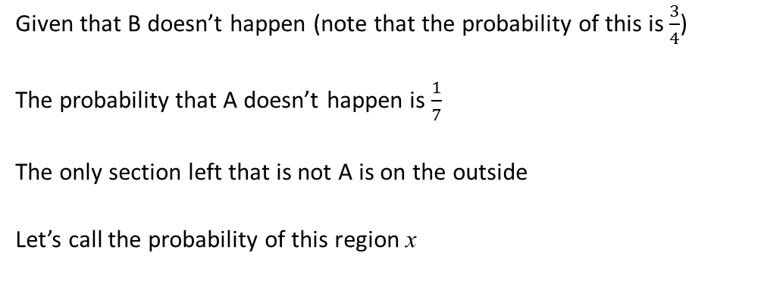
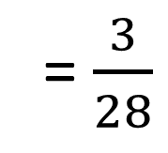
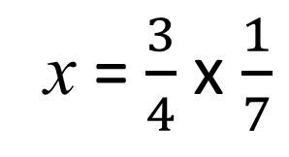
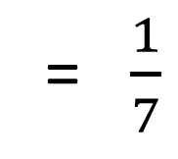
P(B) = $\frac{1}{4}$ and P(A'|B') = $\frac{1}{7}$ Work out P(A' ∩ B')
Given that B doesn’t happen (note that the probability of this is $\frac{3}{4}$)
The probability that A doesn’t happen is $\frac{1}{7}$
The only section left that is not A is on the outside
Let’s call the probability of this region x
A
B
x
= $\frac{1}{7}$
So
3/4
$$\frac{3}{28}$$
x
x = $\frac{3}{4}$ x $\frac{1}{7}$
= $\frac{3}{28}$
*Again we could use the formula, but sometimes it is easier to visualise what is going on. P(A’∩B’) = P(A’|B’) x P(B’)

Slide 15
While you can always use logic to visually decode questions like this, it is often easier to just use the formula (especially for more complex questions).
This is not always the case, however, for tree diagrams.

Slide 16
The performance of a cyclist in a race is affected by whether it rains or not that day. The probability the cyclist crashes is $\frac{7}{12}$ when it's raining and $\frac{1}{12}$ when it's dry. On any given day, the probability of rains is $\frac{1}{5}$. What is the probability it was raining given the cyclist crashes? As there are multiple, dependent events we would need to construct a tree diagram

Slide 17
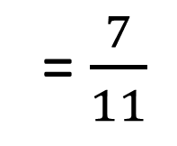





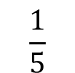



The performance of a cyclist in a race is affected by whether it rains or not that day. The probability the cyclist crashes is $\frac{7}{12}$ when it's raining and $\frac{1}{12}$ when it's dry. On any given day, the probability of rains is $\frac{1}{5}$. What is the probability it was raining given the cyclist crashes?
$$\frac{7}{60}$$
$$\frac{7}{12}$$
Crash
First calculate the probabilities of all outcomes – these are the only values we can use
$$\frac{1}{5}$$
Rains
$$\frac{5}{12}$$
$$\frac{5}{60}$$
Given that the cyclist crashes
No Crash
What is the probability it was raining?
$$\frac{1}{12}$$
$$\frac{4}{60}$$
Crash
$$\frac{4}{5}$$
7/60
Dry
= $\frac{7}{11}$
11/60
$$\frac{11}{12}$$
$$\frac{44}{60}$$
No Crash

Slide 18
Summary
When dealing with given that questions remember to only consider what has already happened.
Fractions are often the best and most accurate way of leaving an answer
Make sure your knowledge of Venn diagrams is spot on so you know which regions the question refers to
Find an approach that works best for you – if that is to simply use the formula then just use the formula (but make sure you check your answers to see if they make sense)

