Slide 1
Teachings for
Exercise 9F

Slide 2




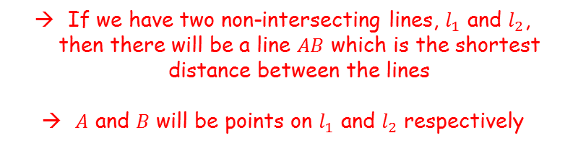


Vectors
You need to be able to find the perpendicular distance between:
Two lines
A point and a line
A point and a plane
The perpendicular distance will be the shortest distance between the lines/planes/points indicated…
$$z$$
$$l_{1}$$
$$A$$
$$B$$
$$l_{2}$$
$$O$$
$$y$$
$$x$$
If we have two non-intersecting lines, $l_{1}$ and $l_{2}$, then there will be a line $AB$ which is the shortest distance between the lines
$A$ and $B$ will be points on $l_{1}$ and $l_{2}$ respectively
9F

Slide 3

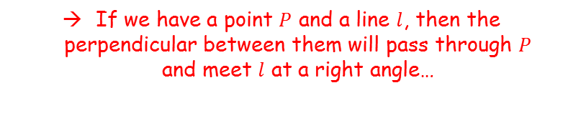
Vectors
You need to be able to find the perpendicular distance between:
Two lines
A point and a line
A point and a plane
The perpendicular distance will be the shortest distance between the lines/planes/points indicated…
$$z$$
$$P$$
$$l$$
$$O$$
$$y$$
$$x$$
If we have a point $P$ and a line $l$, then the perpendicular between them will pass through $P$ and meet $l$ at a right angle…
9F

Slide 4


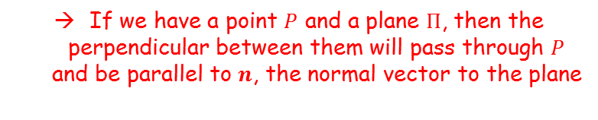
Vectors
$$n$$
You need to be able to find the perpendicular distance between:
Two lines
A point and a line
A point and a plane
The perpendicular distance will be the shortest distance between the lines/planes/points indicated…
$$z$$
$$P$$
$$Π$$
$$O$$
$$y$$
$$x$$
If we have a point $P$ and a plane $Π$, then the perpendicular between them will pass through $P$ and be parallel to $n$, the normal vector to the plane
9F

Slide 5

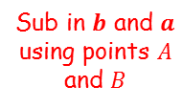

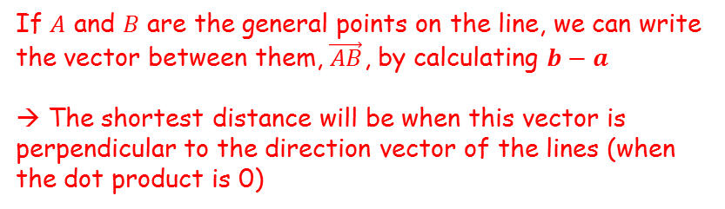
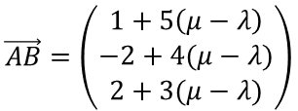
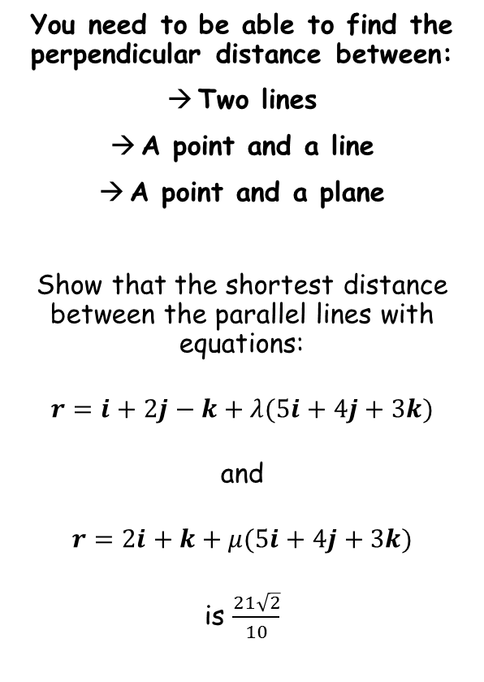

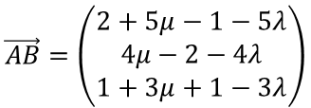


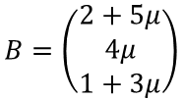
Vectors
$$r=\left(\begin{matrix}1 \\ 2 \\ −1\end{matrix}\right)+λ\left(\begin{matrix}5 \\ 4 \\ 3\end{matrix}\right)$$
$$A$$
You need to be able to find the perpendicular distance between:
Two lines
A point and a line
A point and a plane
Show that the shortest distance between the parallel lines with equations:
$$r=i+2j−k+λ(5i+4j+3k)$$
and
$$r=2i+k+μ(5i+4j+3k)$$
is $\frac{21\sqrt{2}}{10}$
$$r=\left(\begin{matrix}2 \\ 0 \\ 1\end{matrix}\right)+μ\left(\begin{matrix}5 \\ 4 \\ 3\end{matrix}\right)$$
$$B$$
If $A$ and $B$ are the general points on the line, we can write the vector between them, $\vec{AB}$, by calculating $b−a$
→ The shortest distance will be when this vector is perpendicular to the direction vector of the lines (when the dot product is 0)
$$A=\left(\begin{matrix}1+5λ \\ 2+4λ \\ −1+3λ\end{matrix}\right)$$
$$B=\left(\begin{matrix}2+5μ \\ 4μ \\ 1+3μ\end{matrix}\right)$$
Start with A and B, the general points on the lines
$$\vec{AB}=b−a$$
Sub in $b$ and $a$ using points $A$ and $B$
$$\vec{AB}=\left(\begin{matrix}2+5μ−1−5λ \\ 4μ−2−4λ \\ 1+3μ+1−3λ\end{matrix}\right)$$
$$\vec{AB}=\left(\begin{matrix}1+5\left(μ−λ\right) \\ −2+4(μ−λ) \\ 2+3(μ−λ)\end{matrix}\right)$$
Simplify / rewrite
9F

Slide 6

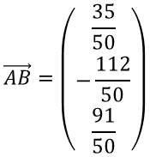
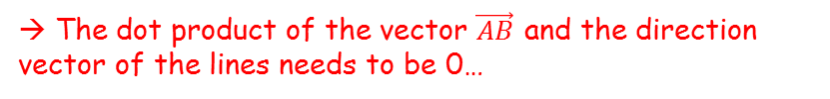





Vectors
$$r=\left(\begin{matrix}1 \\ 2 \\ −1\end{matrix}\right)+λ\left(\begin{matrix}5 \\ 4 \\ 3\end{matrix}\right)$$
$$A$$
You need to be able to find the perpendicular distance between:
Two lines
A point and a line
A point and a plane
Show that the shortest distance between the parallel lines with equations:
$$r=i+2j−k+λ(5i+4j+3k)$$
and
$$r=2i+k+μ(5i+4j+3k)$$
is $\frac{21\sqrt{2}}{10}$
$$\vec{AB}=\left(\begin{matrix}1+5\left(μ−λ\right) \\ −2+4(μ−λ) \\ 2+3(μ−λ)\end{matrix}\right)$$
$$r=\left(\begin{matrix}2 \\ 0 \\ 1\end{matrix}\right)+μ\left(\begin{matrix}5 \\ 4 \\ 3\end{matrix}\right)$$
$$B$$
→ The dot product of the vector $\vec{AB}$ and the direction vector of the lines needs to be 0…
$$\left(\begin{matrix}1+5\left(μ−λ\right) \\ −2+4(μ−λ) \\ 2+3(μ−λ)\end{matrix}\right).\left(\begin{matrix}5 \\ 4 \\ 3\end{matrix}\right)=0$$
Work out dot product
$$\left(5\right)\left(−1+5\left(μ−λ\right)\right)+\left(4\right)\left(2+4\left(μ−λ\right)\right)+\left(3\right)\left(−2+3\left(μ−λ\right)\right)=0$$
Simplify left side
$$3+50(μ−λ)=0$$
Rearrange
$$\vec{AB}=\left(\begin{matrix}1+5\left(μ−λ\right) \\ −2+4(μ−λ) \\ 2+3(μ−λ)\end{matrix}\right)$$
$$μ−λ=−\frac{3}{50}$$
$$\vec{AB}=\left(\begin{matrix}\frac{35}{50} \\ −\frac{112}{50} \\ \frac{91}{50}\end{matrix}\right)$$
Sub in $\left(μ−λ\right)$ and calculate
9F

Slide 7

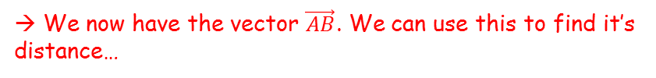



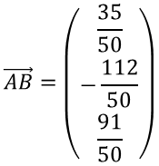

Vectors
$$r=\left(\begin{matrix}1 \\ 2 \\ −1\end{matrix}\right)+λ\left(\begin{matrix}5 \\ 4 \\ 3\end{matrix}\right)$$
$$A$$
You need to be able to find the perpendicular distance between:
Two lines
A point and a line
A point and a plane
Show that the shortest distance between the parallel lines with equations:
$$r=i+2j−k+λ(5i+4j+3k)$$
and
$$r=2i+k+μ(5i+4j+3k)$$
is $\frac{21\sqrt{2}}{10}$
$$\vec{AB}=\left(\begin{matrix}1+5\left(μ−λ\right) \\ −2+4(μ−λ) \\ 2+3(μ−λ)\end{matrix}\right)$$
$$r=\left(\begin{matrix}2 \\ 0 \\ 1\end{matrix}\right)+μ\left(\begin{matrix}5 \\ 4 \\ 3\end{matrix}\right)$$
$$B$$
→ We now have the vector $\vec{AB}$. We can use this to find it’s distance…
$$\vec{AB}=\left(\begin{matrix}\frac{35}{50} \\ −\frac{112}{50} \\ \frac{91}{50}\end{matrix}\right)$$
$$\left|AB\right|=\sqrt{\frac{{\left(35\right)}^{2}+{\left(−112\right)}^{2}+{(91)}^{2}}{{(50)}^{2}}}$$
Calculate numerator and denominator
$$\left|AB\right|=\frac{\sqrt{22050}}{50}$$
Split the numerator
$$\left|AB\right|=\frac{\sqrt{11025}\sqrt{2}}{50}$$
Square root
$$\left|AB\right|=\frac{105\sqrt{2}}{50}$$
$$\left|AB\right|=\frac{21\sqrt{2}}{10}$$
Simplify
9F

Slide 8

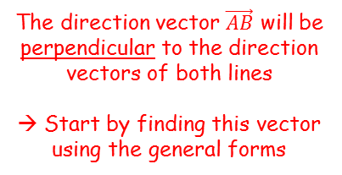


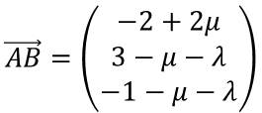
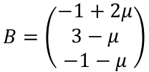
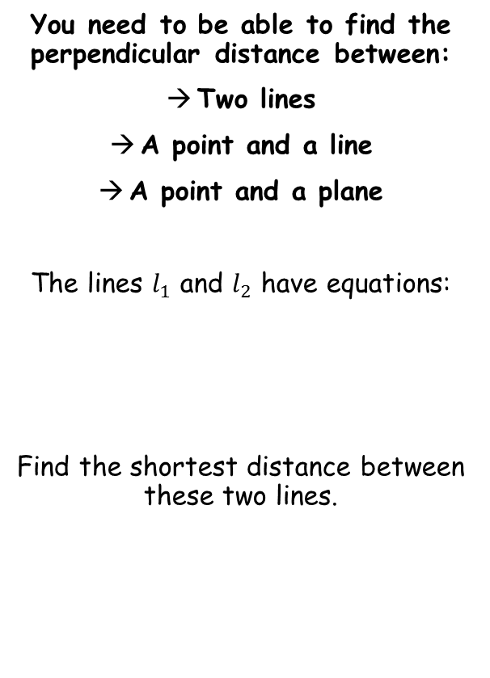



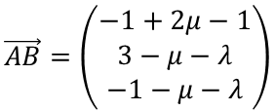


Vectors
$$z$$
$$l_{1}$$
The direction vector $\vec{AB}$ will be perpendicular to the direction vectors of both lines
→ Start by finding this vector using the general forms
$$A$$
You need to be able to find the perpendicular distance between:
Two lines
A point and a line
A point and a plane
The lines $l_{1}$ and $l_{2}$ have equations:
Find the shortest distance between these two lines.
$$B$$
$$l_{2}$$
$$O$$
$$y$$
$$x$$
For $l_{1}$
For $l_{2}$
$$A=\left(\begin{matrix}1 \\ λ \\ λ\end{matrix}\right)$$
$$B=\left(\begin{matrix}−1+2μ \\ 3−μ \\ −1−μ\end{matrix}\right)$$
$$r=\left(\begin{matrix}1 \\ 0 \\ 0\end{matrix}\right)+λ\left(\begin{matrix}0 \\ 1 \\ 1\end{matrix}\right)$$
$$r=\left(\begin{matrix}−1 \\ 3 \\ −1\end{matrix}\right)+μ\left(\begin{matrix}2 \\ −1 \\ −1\end{matrix}\right)$$
$$\vec{AB}=b−a$$
Sub in $b$ and $a$ using points $A$ and $B$
$$\vec{AB}=\left(\begin{matrix}−1+2μ−1 \\ 3−μ−λ \\ −1−μ−λ\end{matrix}\right)$$
Simplify / rewrite
$$\vec{AB}=\left(\begin{matrix}−2+2μ \\ 3−μ−λ \\ −1−μ−λ\end{matrix}\right)$$
9F

Slide 9



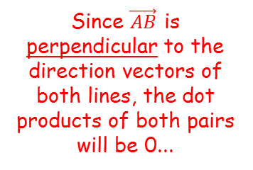


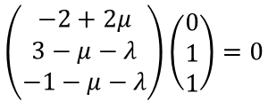
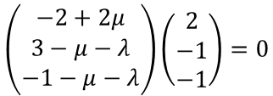

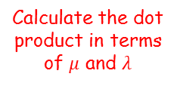
Vectors
$$\vec{AB}=\left(\begin{matrix}−2+2μ \\ 3−μ−λ \\ −1−μ−λ\end{matrix}\right)$$
$$z$$
Since $\vec{AB}$ is perpendicular to the direction vectors of both lines, the dot products of both pairs will be 0...
$$l_{1}$$
$$A$$
You need to be able to find the perpendicular distance between:
Two lines
A point and a line
A point and a plane
The lines $l_{1}$ and $l_{2}$ have equations:
Find the shortest distance between these two lines.
$$B$$
$$l_{2}$$
$$O$$
$$y$$
Dot product of $\vec{AB}$ and $l_{1}$
$$\left(\begin{matrix}−2+2μ \\ 3−μ−λ \\ −1−μ−λ\end{matrix}\right)\left(\begin{matrix}0 \\ 1 \\ 1\end{matrix}\right)=0$$
Calculate the dot product in terms of $μ$ and $λ$
$$r=\left(\begin{matrix}1 \\ 0 \\ 0\end{matrix}\right)+λ\left(\begin{matrix}0 \\ 1 \\ 1\end{matrix}\right)$$
$$r=\left(\begin{matrix}−1 \\ 3 \\ −1\end{matrix}\right)+μ\left(\begin{matrix}2 \\ −1 \\ −1\end{matrix}\right)$$
$$3−μ−λ−1−μ−λ=0$$
Some rearranging later…
$$μ+λ=1$$
Dot product of $\vec{AB}$ and $l_{2}$
$$\left(\begin{matrix}−2+2μ \\ 3−μ−λ \\ −1−μ−λ\end{matrix}\right)\left(\begin{matrix}2 \\ −1 \\ −1\end{matrix}\right)=0$$
Calculate the dot product in terms of $μ$ and $λ$
$$−4+4μ−3+μ+λ+1+μ+λ=0$$
Some rearranging later…
$$3μ+λ=3$$
9F

Slide 10
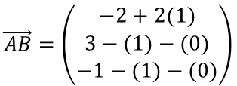
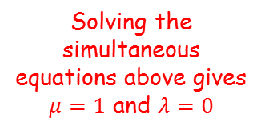
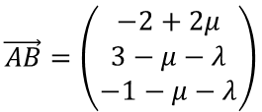
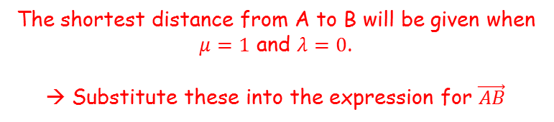


Vectors
$$\vec{AB}=\left(\begin{matrix}−2+2μ \\ 3−μ−λ \\ −1−μ−λ\end{matrix}\right)$$
$$z$$
$$l_{1}$$
$$μ+λ=1$$
$$A$$
You need to be able to find the perpendicular distance between:
Two lines
A point and a line
A point and a plane
The lines $l_{1}$ and $l_{2}$ have equations:
Find the shortest distance between these two lines.
$$3μ+λ=3$$
$$B$$
$$l_{2}$$
Solving the simultaneous equations above gives $μ=1$ and $λ=0$
$$O$$
$$y$$
The shortest distance from A to B will be given when $μ=1$ and $λ=0$.
→ Substitute these into the expression for $\vec{AB}$
$$r=\left(\begin{matrix}1 \\ 0 \\ 0\end{matrix}\right)+λ\left(\begin{matrix}0 \\ 1 \\ 1\end{matrix}\right)$$
$$r=\left(\begin{matrix}−1 \\ 3 \\ −1\end{matrix}\right)+μ\left(\begin{matrix}2 \\ −1 \\ −1\end{matrix}\right)$$
$$\vec{AB}=\left(\begin{matrix}−2+2μ \\ 3−μ−λ \\ −1−μ−λ\end{matrix}\right)$$
Sub in values
$$\vec{AB}=\left(\begin{matrix}−2+2(1) \\ 3−(1)−(0) \\ −1−(1)−(0)\end{matrix}\right)$$
Calculate
$$\vec{AB}=\left(\begin{matrix}0 \\ 2 \\ −2\end{matrix}\right)$$
9F

Slide 11



Vectors
$$\vec{AB}=\left(\begin{matrix}−2+2μ \\ 3−μ−λ \\ −1−μ−λ\end{matrix}\right)$$
$$z$$
$$l_{1}$$
$$μ+λ=1$$
$$A$$
You need to be able to find the perpendicular distance between:
Two lines
A point and a line
A point and a plane
The lines $l_{1}$ and $l_{2}$ have equations:
Find the shortest distance between these two lines.
$$3μ+λ=3$$
$$B$$
$$l_{2}$$
Solving the simultaneous equations above gives $μ=1$ and $λ=0$
$$O$$
$$y$$
$$\vec{AB}=\left(\begin{matrix}0 \\ 2 \\ −2\end{matrix}\right)$$
Find the magnitude of this vector
$$r=\left(\begin{matrix}1 \\ 0 \\ 0\end{matrix}\right)+λ\left(\begin{matrix}0 \\ 1 \\ 1\end{matrix}\right)$$
$$r=\left(\begin{matrix}−1 \\ 3 \\ −1\end{matrix}\right)+μ\left(\begin{matrix}2 \\ −1 \\ −1\end{matrix}\right)$$
$$\left|AB\right|=\sqrt{{(0)}^{2}+{(2)}^{2}+{(−2)}^{2}}$$
Simplify
$$\left|AB\right|=2\sqrt{2}$$
9F

Slide 12



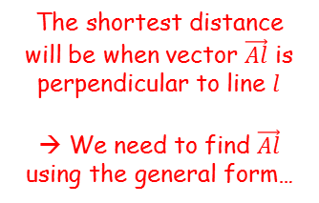

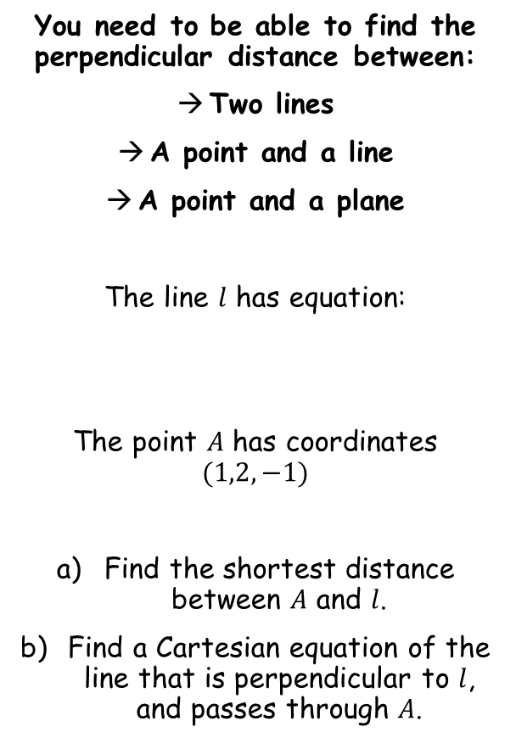








Vectors
$$z$$
$$\left(\begin{matrix}1 \\ 2 \\ −1\end{matrix}\right)$$
The shortest distance will be when vector $\vec{Al}$ is perpendicular to line $l$
→ We need to find $\vec{Al}$ using the general form…
$$A$$
You need to be able to find the perpendicular distance between:
Two lines
A point and a line
A point and a plane
The line $l$ has equation:
The point $A$ has coordinates $(1,2,−1)$
Find the shortest distance between $A$ and $l$.
Find a Cartesian equation of the line that is perpendicular to $l$, and passes through $A$.
$$r=\left(\begin{matrix}1 \\ 1 \\ −3\end{matrix}\right)+λ\left(\begin{matrix}2 \\ −2 \\ −1\end{matrix}\right)$$
$$O$$
$$l$$
$$y$$
$$x$$
$$\vec{Al}=l−a$$
Sub in the general form of $l$, and $A$
$$\vec{Al}=\left(\begin{matrix}1+2λ−1 \\ 1−2λ−2 \\ −3−λ+1\end{matrix}\right)$$
$$\frac{x−1}{2}=\frac{y−1}{−2}=\frac{z+3}{−1}$$
Simplify
$$\vec{Al}=\left(\begin{matrix}2λ \\ −1−2λ \\ −2−λ\end{matrix}\right)$$
The dot product of this vector and the direction of line $l$ will be equal to 1
$$\left(\begin{matrix}2λ \\ −1−2λ \\ −2−λ\end{matrix}\right).\left(\begin{matrix}2 \\ −2 \\ −1\end{matrix}\right)=0$$
Write out the dot product
$$4λ+2+4λ+2+λ=0$$
$$λ=−\frac{4}{9}$$
Calculate
9F

Slide 13


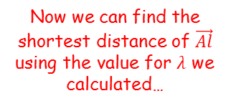
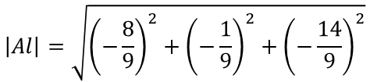
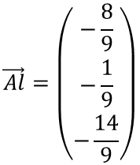




Vectors
$$z$$
$$\left(\begin{matrix}1 \\ 2 \\ −1\end{matrix}\right)$$
$$A$$
You need to be able to find the perpendicular distance between:
Two lines
A point and a line
A point and a plane
The line $l$ has equation:
The point $A$ has coordinates $(1,2,−1)$
Find the shortest distance between $A$ and $l$.
Find a Cartesian equation of the line that is perpendicular to $l$, and passes through $A$.
$$\vec{Al}=\left(\begin{matrix}2λ \\ −1−2λ \\ −2−λ\end{matrix}\right)$$
$$r=\left(\begin{matrix}1 \\ 1 \\ −3\end{matrix}\right)+λ\left(\begin{matrix}2 \\ −2 \\ −1\end{matrix}\right)$$
$$O$$
$$l$$
$$y$$
$$λ=−\frac{4}{9}$$
$$x$$
Now we can find the shortest distance of $\vec{Al}$ using the value for $λ$ we calculated…
$$\vec{Al}=\left(\begin{matrix}2λ \\ −1−2λ \\ −2−λ\end{matrix}\right)$$
$$\frac{x−1}{2}=\frac{y−1}{−2}=\frac{z+3}{−1}$$
$$\vec{Al}=\left(\begin{matrix}−\frac{8}{9} \\ −\frac{1}{9} \\ −\frac{14}{9}\end{matrix}\right)$$
Sub in $λ=−\frac{4}{9}$
Find the magnitude of this vector
$$\left|Al\right|=\sqrt{{\left(−\frac{8}{9}\right)}^{2}+{\left(−\frac{1}{9}\right)}^{2}+{\left(−\frac{14}{9}\right)}^{2}}$$
$$\frac{\sqrt{29}}{3}$$
Calculate
$$\left|Al\right|=\frac{\sqrt{29}}{3}$$
9F

Slide 14

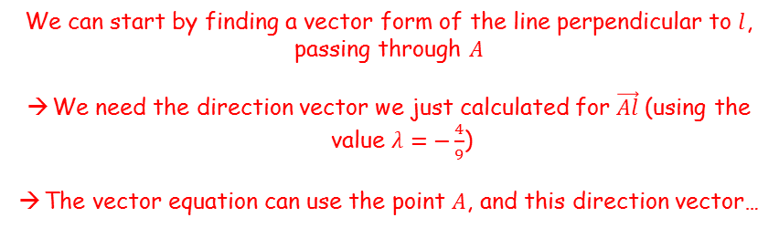
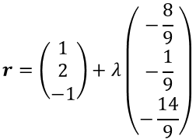


Vectors
$$z$$
$$\left(\begin{matrix}1 \\ 2 \\ −1\end{matrix}\right)$$
$$A$$
$$\vec{Al}=\left(\begin{matrix}−\frac{8}{9} \\ −\frac{1}{9} \\ −\frac{14}{9}\end{matrix}\right)$$
You need to be able to find the perpendicular distance between:
Two lines
A point and a line
A point and a plane
The line $l$ has equation:
The point $A$ has coordinates $(1,2,−1)$
Find the shortest distance between $A$ and $l$.
Find a Cartesian equation of the line that is perpendicular to $l$, and passes through $A$.
$$\vec{Al}=\left(\begin{matrix}2λ \\ −1−2λ \\ −2−λ\end{matrix}\right)$$
$$r=\left(\begin{matrix}1 \\ 1 \\ −3\end{matrix}\right)+λ\left(\begin{matrix}2 \\ −2 \\ −1\end{matrix}\right)$$
$$O$$
$$l$$
$$y$$
$$λ=−\frac{4}{9}$$
$$x$$
We can start by finding a vector form of the line perpendicular to $l$, passing through $A$
We need the direction vector we just calculated for $\vec{Al}$ (using the value $λ=−\frac{4}{9}$)
The vector equation can use the point $A$, and this direction vector…
$$\frac{x−1}{2}=\frac{y−1}{−2}=\frac{z+3}{−1}$$
$$r=\left(\begin{matrix}1 \\ 2 \\ −1\end{matrix}\right)+λ\left(\begin{matrix}−\frac{8}{9} \\ −\frac{1}{9} \\ −\frac{14}{9}\end{matrix}\right)$$
You can multiply the direction vector by -9 to simplify it (it will still be the same direction)
$$\frac{\sqrt{29}}{3}$$
$$r=\left(\begin{matrix}1 \\ 2 \\ −1\end{matrix}\right)+λ\left(\begin{matrix}8 \\ 1 \\ 14\end{matrix}\right)$$
Write in Cartesian form
$$\frac{x−1}{8}=y−2=\frac{z+1}{14}$$
9F

