Slide 1
Vectors
Note: Put the Autograph files in the same folder as this presentation, and the hyperlinks should work!
Twitter: @Owen134866
www.mathsfreeresourcelibrary.com

Slide 2

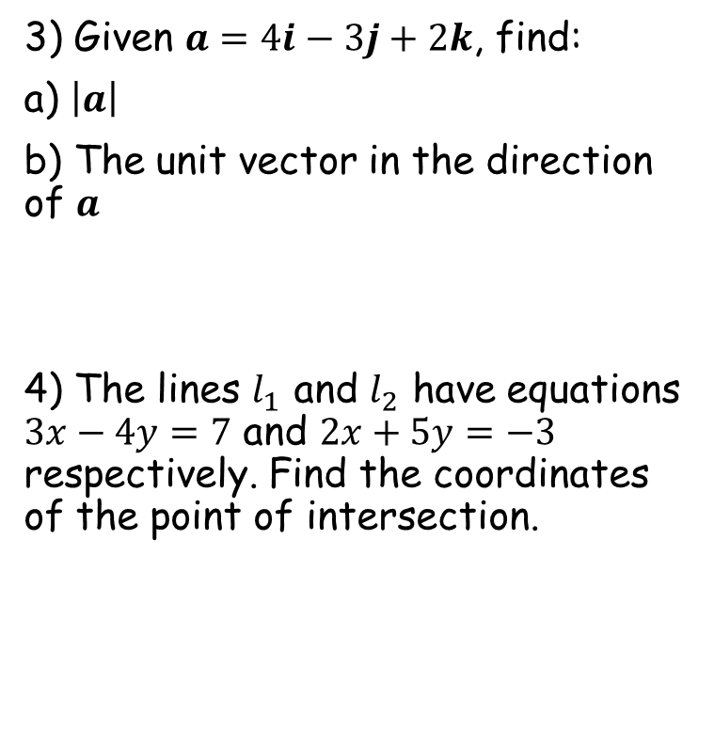

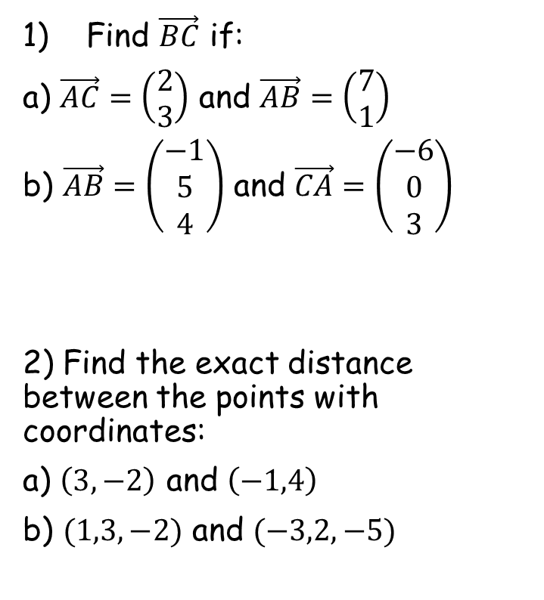

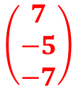



Prior Knowledge Check
Find $\vec{BC}$ if:
a) $\vec{AC}=\left(\begin{matrix}2 \\ 3\end{matrix}\right)$ and $\vec{AB}=\left(\begin{matrix}7 \\ 1\end{matrix}\right)$
b) $\vec{AB}=\left(\begin{matrix}−1 \\ 5 \\ 4\end{matrix}\right)$ and $\vec{CA}=\left(\begin{matrix}−6 \\ 0 \\ 3\end{matrix}\right)$
2) Find the exact distance between the points with coordinates:
a) $\left(3,−2\right)$ and $\left(−1,4\right)$
b) $(1,3,−2)$ and $(−3,2,−5)$
3) Given $a=4i−3j+2k$, find:
a) $\left|a\right|$
b) The unit vector in the direction of $a$
4) The lines $l_{1}$ and $l_{2}$ have equations $3x−4y=7$ and $2x+5y=−3$ respectively. Find the coordinates of the point of intersection.
$$\left(\begin{matrix}−5 \\ 2\end{matrix}\right)$$
$$\sqrt{29}$$
$$\frac{1}{\sqrt{29}}(4i−3j+2k)$$
$$\left(\begin{matrix}7 \\ −5 \\ −7\end{matrix}\right)$$
$$2\sqrt{13}$$
$$(1,−1)$$
$$\sqrt{26}$$

Slide 3
Teachings for
Exercise 9A

Slide 4
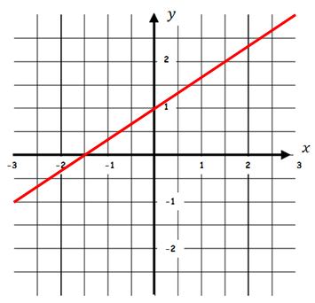
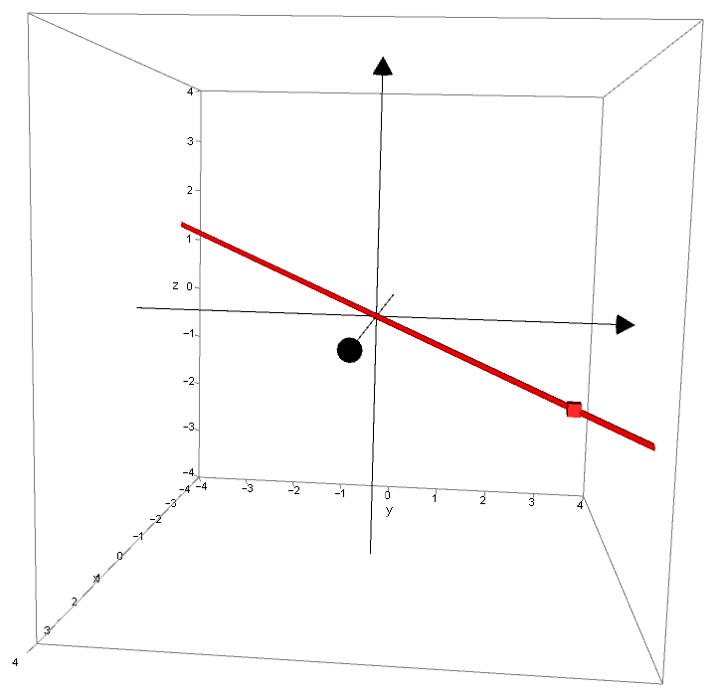






Vectors
You need to be able to write the equation of a straight line in three dimensions in vector form
Direction vector
In 2 dimensions:
Position vector
In 3 dimensions:
$$y=mx+c$$
$$r=a+λb$$
→ The $c$ represents a point on the line
→ The $a$ represents a point on the line (in 3 dimensions)
→ The $m$ represents the direction of the line
→ The $b$ represents the direction of the line
CLICK
9A

Slide 5

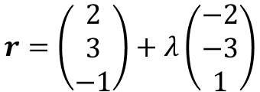
Vectors
You need to be able to write the equation of a straight line in three dimensions in vector form
In 2 dimensions:
In 3 dimensions:
$$y=\frac{2}{3}x+1$$
$$r=\left(\begin{matrix}2 \\ 3 \\ −1\end{matrix}\right)+λ\left(\begin{matrix}−2 \\ −3 \\ 1\end{matrix}\right)$$
9A

Slide 6

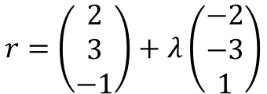



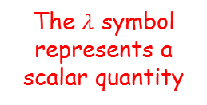
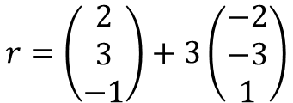
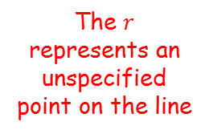

Vectors
You need to be able to write the equation of a straight line in three dimensions in vector form
$$r=\left(\begin{matrix}2 \\ 3 \\ −1\end{matrix}\right)+λ\left(\begin{matrix}−2 \\ −3 \\ 1\end{matrix}\right)$$
The direction vector represents the direction the line is moving
Overall, this tells us that any point on the line is equal to the position vector, plus a multiple of the direction vector…
The $r$ represents an unspecified point on the line
For example, if $λ=3$
For example, if $λ=1$
The $λ$ symbol represents a scalar quantity
This position vector represents a specific point on the line
$$r=\left(\begin{matrix}2 \\ 3 \\ −1\end{matrix}\right)+3\left(\begin{matrix}−2 \\ −3 \\ 1\end{matrix}\right)$$
$$r=\left(\begin{matrix}2 \\ 3 \\ −1\end{matrix}\right)+1\left(\begin{matrix}−2 \\ −3 \\ 1\end{matrix}\right)$$
$$r=\left(\begin{matrix}−4 \\ −6 \\ 2\end{matrix}\right)$$
$$r=\left(\begin{matrix}0 \\ 0 \\ 0\end{matrix}\right)$$
9A

Slide 7
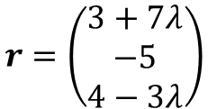


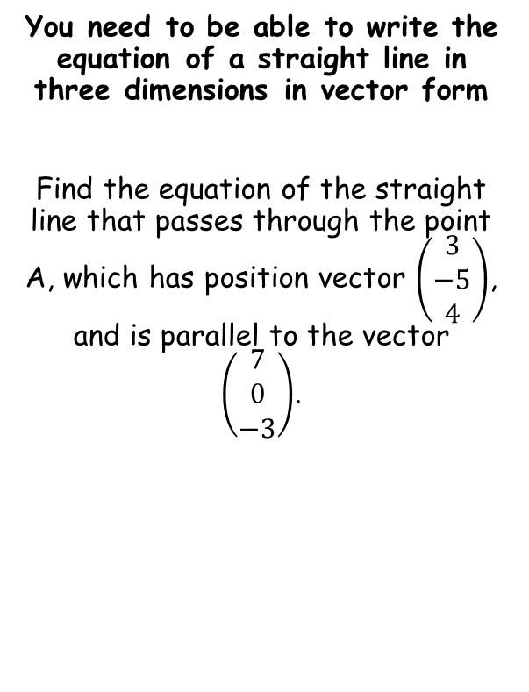

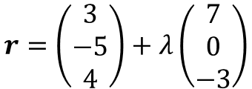

Vectors
$$r=a+λb$$
You need to be able to write the equation of a straight line in three dimensions in vector form
Find the equation of the straight line that passes through the point A, which has position vector $\left(\begin{matrix}3 \\ −5 \\ 4\end{matrix}\right)$, and is parallel to the vector $\left(\begin{matrix}7 \\ 0 \\ −3\end{matrix}\right)$.
$$r=a+λb$$
Replace the position vector and the direction vector
$$r=\left(\begin{matrix}3 \\ −5 \\ 4\end{matrix}\right)+λ\left(\begin{matrix}7 \\ 0 \\ −3\end{matrix}\right)$$
Alternative forms
→ You can also write the vector in these ways…
$$r=(3i−5j+4k)+λ\left(7i−3k\right)$$
$$r=\left(3+7λ\right)i+\left(−5\right)j+\left(4−3λ\right)k$$
$$r=\left(\begin{matrix}3+7λ \\ −5 \\ 4−3λ\end{matrix}\right)$$
9A

Slide 8


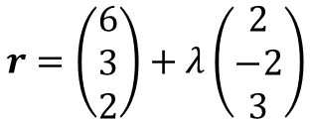

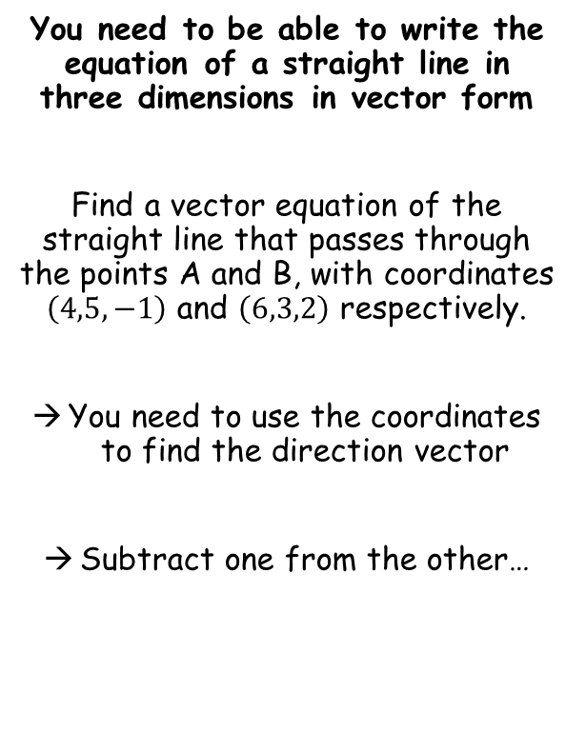


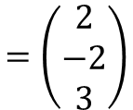

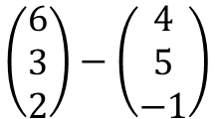
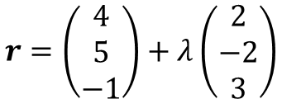
Vectors
$$r=a+λb$$
$$r=c+λ(d−c)$$
$a$ = position vector
$b$ = direction vector
$c$ = position vector 1
$d$ = position vector 2
You need to be able to write the equation of a straight line in three dimensions in vector form
Find a vector equation of the straight line that passes through the points A and B, with coordinates $\left(4,5,−1\right)$ and $\left(6,3,2\right)$ respectively.
You need to use the coordinates to find the direction vector
Subtract one from the other…
$$\left(\begin{matrix}6 \\ 3 \\ 2\end{matrix}\right)−\left(\begin{matrix}4 \\ 5 \\ −1\end{matrix}\right)$$
Calculate
$$=\left(\begin{matrix}2 \\ −2 \\ 3\end{matrix}\right)$$
→ Now we have the direction vector, we can use either of the position vectors to form the equation…
$$r=a+λb$$
$$r=a+λb$$
$$r=\left(\begin{matrix}6 \\ 3 \\ 2\end{matrix}\right)+λ\left(\begin{matrix}2 \\ −2 \\ 3\end{matrix}\right)$$
$$r=\left(\begin{matrix}4 \\ 5 \\ −1\end{matrix}\right)+λ\left(\begin{matrix}2 \\ −2 \\ 3\end{matrix}\right)$$
→ These will both give the same line, but with a different value of $λ$ for each point!
9A

Slide 9
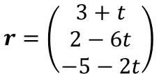


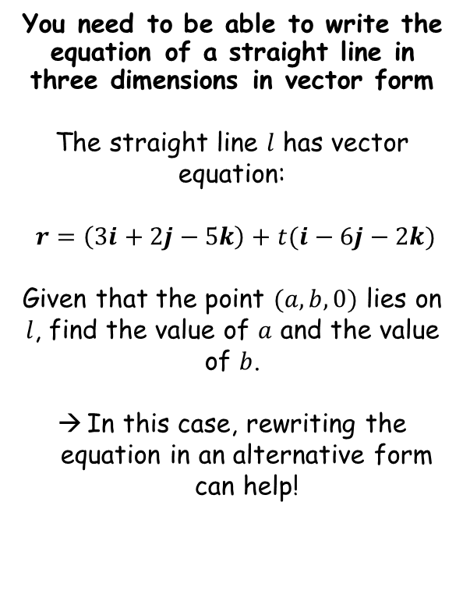






Vectors
$$r=a+λb$$
$$r=c+λ(d−c)$$
$a$ = position vector
$b$ = direction vector
$c$ = position vector 1
$d$ = position vector 2
You need to be able to write the equation of a straight line in three dimensions in vector form
The straight line $l$ has vector equation:
$r=\left(3i+2j−5k\right)+t(i−6j−2k)$
Given that the point $(a,b,0)$ lies on $l$, find the value of $a$ and the value of $b$.
In this case, rewriting the equation in an alternative form can help!
$$r=\left(3i+2j−5k\right)+t(i−6j−2k)$$
$$r=\left(\begin{matrix}3+t \\ 2−6t \\ −5−2t\end{matrix}\right)$$
We know from the question that the final coordinate is 0…
$$−5−2t=0$$
Add 2t
$$−5=2t$$
Divide by 2
$$−2.5=t$$
We can use this to find the values of $a$ and $b$
$$3+t=a$$
$$2−6t=b$$
$$0.5=a$$
$$17=b$$
9A

Slide 10
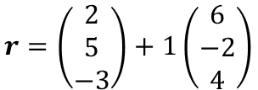
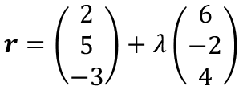

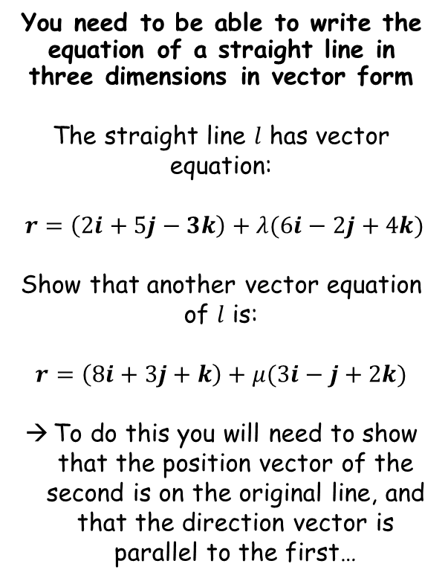



Vectors
$$r=a+λb$$
$$r=c+λ(d−c)$$
$a$ = position vector
$b$ = direction vector
$c$ = position vector 1
$d$ = position vector 2
You need to be able to write the equation of a straight line in three dimensions in vector form
The straight line $l$ has vector equation:
$r=\left(2i+5j−3k\right)+λ(6i−2j+4k)$
Show that another vector equation of $l$ is:
$$r=\left(8i+3j+k\right)+μ(3i−j+2k)$$
To do this you will need to show that the position vector of the second is on the original line, and that the direction vector is parallel to the first…
$$r=\left(\begin{matrix}2 \\ 5 \\ −3\end{matrix}\right)+λ\left(\begin{matrix}6 \\ −2 \\ 4\end{matrix}\right)$$
Check position vector is on the line
Let $λ=1$
$$r=\left(\begin{matrix}2 \\ 5 \\ −3\end{matrix}\right)+1\left(\begin{matrix}6 \\ −2 \\ 4\end{matrix}\right)$$
Calculate
$$r=\left(\begin{matrix}8 \\ 3 \\ 1\end{matrix}\right)$$
So this position vector is on the line!
$$\left(\begin{matrix}6 \\ −2 \\ 4\end{matrix}\right)$$
$$=2\left(\begin{matrix}3 \\ −1 \\ 2\end{matrix}\right)$$
Check direction vector is parallel
As one is a multiple of the other, they are parallel!
9A

