Slide 1
Teachings for
Exercise 7G

Slide 2






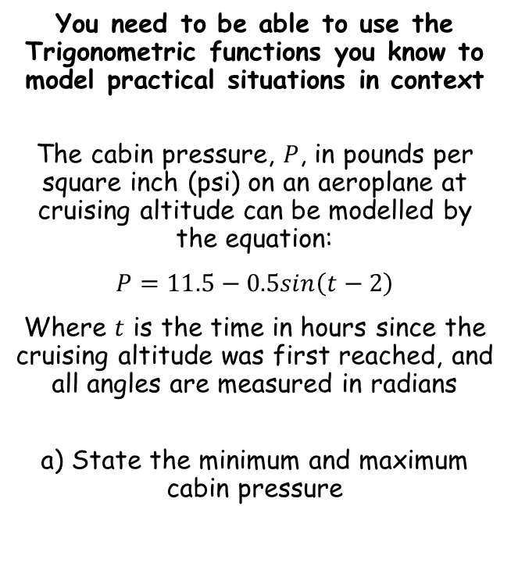









Trigonometry and Modelling
$$sin\left(α+β\right)=sinαcosβ+cosαsinβ$$
$$cos\left(α+β\right)=cosαcosβ−sinαsinβ$$
$$tan\left(A+B\right)=\frac{tanA+tanB}{1−tanAtanB}$$
$$sin\left(α−β\right)=sinαcosβ−cosαsinβ$$
$$cos\left(α−β\right)=cosαcosβ+sinαsinβ$$
$$tan\left(A−B\right)=\frac{tanA−tanB}{1+tanAtanB}$$
You need to be able to use the Trigonometric functions you know to model practical situations in context
The cabin pressure, $P$, in pounds per square inch (psi) on an aeroplane at cruising altitude can be modelled by the equation:
$P=11.5−0.5sin\left(t−2\right)$
Where $t$ is the time in hours since the cruising altitude was first reached, and all angles are measured in radians
a) State the minimum and maximum cabin pressure
The minimum value would be when we subtract as much as possible from 11.5
$$P=11.5−0.5sin\left(t−2\right)$$
The highest value of the $sine$ term is 1
$$P=11.5−0.5(1\text{)}$$
$$Min=11psi$$
Calculate
$$Max=12psi$$
$$P=11 psi$$
The maximum value would be when we add as much as possible to 11.5
$$P=11.5−0.5sin\left(t−2\right)$$
We need this term to be negative, and as low as possible – the value needs to be -1
$$P=11.5−0.5(−1\text{)}$$
Calculate
$$P=12 psi$$
7G

Slide 3



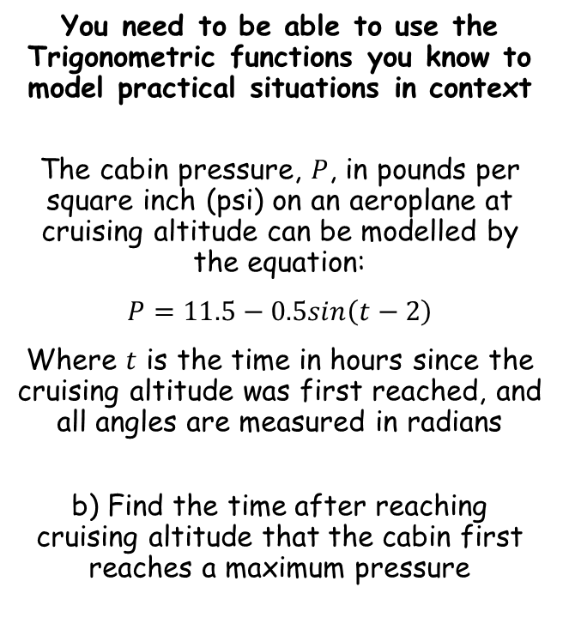




Trigonometry and Modelling
$$sin\left(α+β\right)=sinαcosβ+cosαsinβ$$
$$cos\left(α+β\right)=cosαcosβ−sinαsinβ$$
$$tan\left(A+B\right)=\frac{tanA+tanB}{1−tanAtanB}$$
$$sin\left(α−β\right)=sinαcosβ−cosαsinβ$$
$$cos\left(α−β\right)=cosαcosβ+sinαsinβ$$
$$tan\left(A−B\right)=\frac{tanA−tanB}{1+tanAtanB}$$
You need to be able to use the Trigonometric functions you know to model practical situations in context
The cabin pressure, $P$, in pounds per square inch (psi) on an aeroplane at cruising altitude can be modelled by the equation:
$P=11.5−0.5sin\left(t−2\right)$
Where $t$ is the time in hours since the cruising altitude was first reached, and all angles are measured in radians
b) Find the time after reaching cruising altitude that the cabin first reaches a maximum pressure
$$P=11.5−0.5sin\left(t−2\right)$$
We want the pressure to be at its maximum value
$$12=11.5−0.5sin\left(t−2\right)$$
Subtract 11.5
$$0.5=−0.5sin\left(t−2\right)$$
Divide by -0.5
$$Min=11psi$$
$$−1=sin\left(t−2\right)$$
$$Max=12psi$$
$$−\frac{1}{2}π=t−2$$
Inverse sine
Add 2
$$2−\frac{1}{2}π=t$$
Calculate
$$0.43=t$$
So the time would be 26 minutes (multiply the time in hours by 60)
→ Note that you might need to find more than one possible solution to the trig equation, depending on what you are asked!
7G

Slide 4


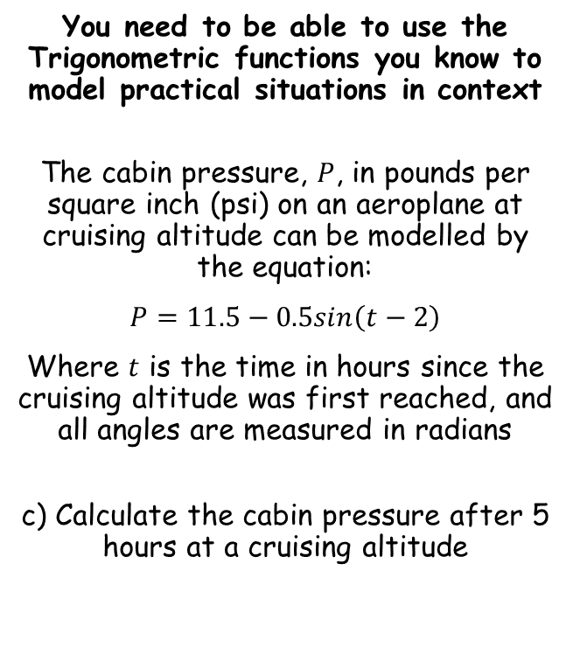


Trigonometry and Modelling
$$sin\left(α+β\right)=sinαcosβ+cosαsinβ$$
$$cos\left(α+β\right)=cosαcosβ−sinαsinβ$$
$$tan\left(A+B\right)=\frac{tanA+tanB}{1−tanAtanB}$$
$$sin\left(α−β\right)=sinαcosβ−cosαsinβ$$
$$cos\left(α−β\right)=cosαcosβ+sinαsinβ$$
$$tan\left(A−B\right)=\frac{tanA−tanB}{1+tanAtanB}$$
You need to be able to use the Trigonometric functions you know to model practical situations in context
The cabin pressure, $P$, in pounds per square inch (psi) on an aeroplane at cruising altitude can be modelled by the equation:
$P=11.5−0.5sin\left(t−2\right)$
Where $t$ is the time in hours since the cruising altitude was first reached, and all angles are measured in radians
c) Calculate the cabin pressure after 5 hours at a cruising altitude
$$P=11.5−0.5sin\left(t−2\right)$$
Sub in $t=5$
$$P=11.5−0.5sin\left(5−2\right)$$
Calculate
$$P=11.43psi$$
7G

Slide 5


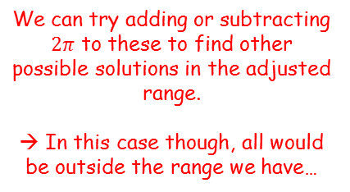



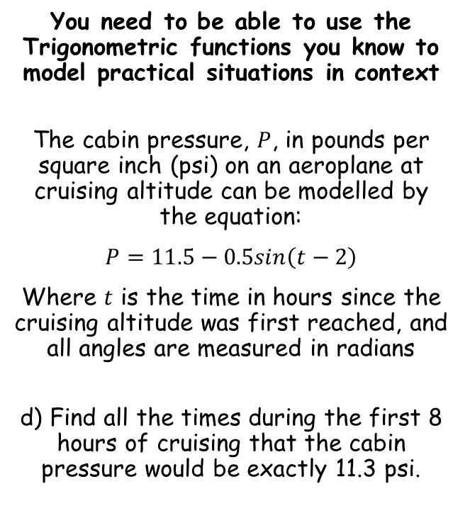









Trigonometry and Modelling
$$sin\left(α+β\right)=sinαcosβ+cosαsinβ$$
$$cos\left(α+β\right)=cosαcosβ−sinαsinβ$$
$$tan\left(A+B\right)=\frac{tanA+tanB}{1−tanAtanB}$$
$$sin\left(α−β\right)=sinαcosβ−cosαsinβ$$
$$cos\left(α−β\right)=cosαcosβ+sinαsinβ$$
$$tan\left(A−B\right)=\frac{tanA−tanB}{1+tanAtanB}$$
You need to be able to use the Trigonometric functions you know to model practical situations in context
The cabin pressure, $P$, in pounds per square inch (psi) on an aeroplane at cruising altitude can be modelled by the equation:
$P=11.5−0.5sin\left(t−2\right)$
Where $t$ is the time in hours since the cruising altitude was first reached, and all angles are measured in radians
d) Find all the times during the first 8 hours of cruising that the cabin pressure would be exactly 11.3 psi.
$$P=11.5−0.5sin\left(t−2\right)$$
We want to know when the psi will be 11.3
$$11.3=11.5−0.5sin\left(t−2\right)$$
Subtract 11.5
$$−0.2=−0.5sin\left(t−2\right)$$
Divide by -0.5
$$0.4=sin\left(t−2\right)$$
Inverse sine
$$0.41=t−2$$
1
0.4
0.41
^{π}/₂
2.73
$$y=sint$$
-1
π
^{3π}/₂
2π
$$t−2=0.41$$
$$, 2.73$$
We can try adding or subtracting $2π$ to these to find other possible solutions in the adjusted range.
→ In this case though, all would be outside the range we have…
$$t=2.41$$
$$, 4.73$$
Ensure you know the range you are working with first!
$$0≤t≤8$$
$$t=2h 25min$$
Calculate
$$t=4h 44min$$
$$−2≤t−2≤6$$
7G

