Slide 1
Modelling with trigonometric functions (7.7)

Slide 2

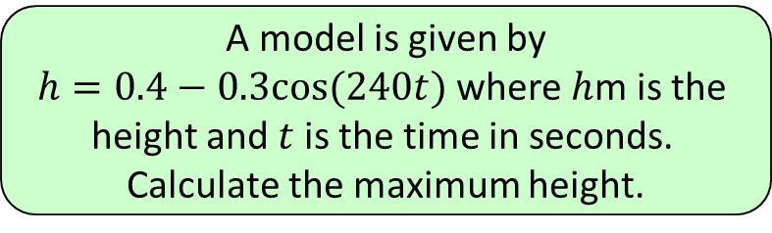




1
A model is given by
$h=0.4−0.3cos⁡(240t)$ where $h$m is the
height and $t$ is the time in seconds.
Calculate the maximum height.
a) $0.1m$
b) $0.1cm$
c) $0.7m$
d) $0.7cm$

Slide 3
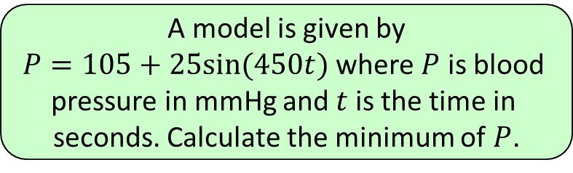




2
A model is given by
$P=105+25sin⁡(450t)$ where $P$ is blood
pressure in mmHg and $t$ is the time in
seconds. Calculate the minimum of $P$.
a) $80mmHg$
b) $105mmHg$
c) $130mmHg$
d) $70mmHg$

Slide 4
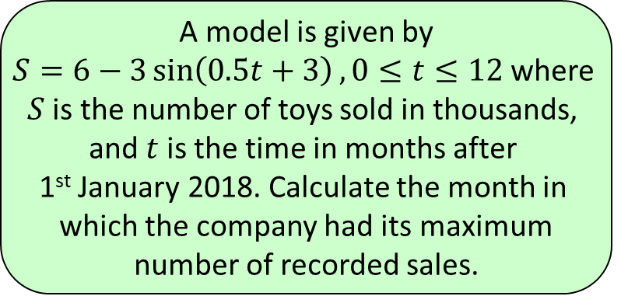
3
A model is given by
$S=6−3\sin\left(0.5t+3\right), 0≤t≤12$ where
$S$ is the number of toys sold in thousands,
and $t$ is the time in months after
1st January 2018. Calculate the month in
which the company had its maximum
number of recorded sales.
a) March
b) April
c) May
d) June

