Slide 1
Teachings for
Exercise 7D

Slide 2
Trigonometry and Modelling
$$sin\left(α+β\right)=sinαcosβ+cosαsinβ$$
$$cos\left(α+β\right)=cosαcosβ−sinαsinβ$$
$$tan\left(A+B\right)=\frac{tanA+tanB}{1−tanAtanB}$$
$$sin\left(α−β\right)=sinαcosβ−cosαsinβ$$
$$cos\left(α−β\right)=cosαcosβ+sinαsinβ$$
$$tan\left(A−B\right)=\frac{tanA−tanB}{1+tanAtanB}$$
You need to be able to use the angle relationships you have seen in equation solving
Solve $4cos\left(θ−30\right)=8\sqrt{2}sinθ$ in the range $0≤θ≤360$. Give answers to 1dp.
$$4cos\left(θ−30\right)=8\sqrt{2}sinθ$$
Use the expansion for $cos\left(α−β\right)$
$$4cosθcos30+4sinθsin30=8\sqrt{2}sinθ$$
Replace exact values where possible
$$4cosθ\left(\frac{\sqrt{3}}{2}\right)+4sinθ\left(\frac{1}{2}\right)=8\sqrt{2}sinθ$$
Simplify left side
$$2\sqrt{3}cosθ+2sinθ=8\sqrt{2}sinθ$$
Divide by 2
$$\sqrt{3}cosθ+sinθ=4\sqrt{2}sinθ$$
Subtract $sinθ$
$$\sqrt{3}cosθ=4\sqrt{2}sinθ−sinθ$$
Factorise right side
$$\sqrt{3}cosθ=sinθ\left(4\sqrt{2}−1\right)$$
Divide by the bracket
$$\frac{\sqrt{3}cosθ}{\left(4\sqrt{2}−1\right)}=sinθ$$
Divide by $cosθ$
$$\frac{\sqrt{3}}{\left(4\sqrt{2}−1\right)}=\frac{sinθ}{cosθ}$$
The right side equals $tanθ$
$$\frac{\sqrt{3}}{\left(4\sqrt{2}−1\right)}=tanθ$$
7D

Slide 3
Trigonometry and Modelling
$$sin\left(α+β\right)=sinαcosβ+cosαsinβ$$
$$cos\left(α+β\right)=cosαcosβ−sinαsinβ$$
$$tan\left(A+B\right)=\frac{tanA+tanB}{1−tanAtanB}$$
$$sin\left(α−β\right)=sinαcosβ−cosαsinβ$$
$$cos\left(α−β\right)=cosαcosβ+sinαsinβ$$
$$tan\left(A−B\right)=\frac{tanA−tanB}{1+tanAtanB}$$
You need to be able to use the angle relationships you have seen in equation solving
Solve $4cos\left(θ−30\right)=8\sqrt{2}sinθ$ in the range $0≤θ≤360$. Give answers to 1dp.
$$tanθ=\frac{\sqrt{3}}{\left(4\sqrt{2}−1\right)}$$
Inverse tan, and then find any alternative solutions…
$$tanθ=20.4^{°}$$
$$, 200.4^{°}$$
7D

Slide 4
Trigonometry and Modelling
$$Sin2A≡2sinAcosA$$
$$Cos2A≡{Cos}^{2}A−{Sin}^{2}A$$
$$Cos2A≡1−2{Sin}^{2}A$$
$$Cos2A≡2{Cos}^{2}A−1$$
$$Tan2A≡\frac{2TanA}{1−{Tan}^{2}A}$$
You need to be able to use the angle relationships you have seen in equation solving
Solve $3cos2x−cosx+2=0$ in the range $0≤x≤360$. Give answers to 1dp where appropriate.
$$3cos2x−cosx+2=0$$
Replace using one of the expressions above
$$3(2\cos^{2}x−1)−cosx+2=0$$
Expand bracket
$$6\cos^{2}x−3−cosx+2=0$$
Simplify
$$6\cos^{2}x−cosx−1=0$$
Factorise
$$\left(3cosx+1\right)\left(2cosx−1\right)=0$$
Write the 2 possible values for $cosx$
$$cosx=−\frac{1}{3}$$
$$cosx=\frac{1}{2}$$
Find the principle value, and then check for any others in the range (remember that $cosθ=cos⁡(360−θ)$
$$x=109.5$$
$$x=60$$
$$, 250.5$$
$$, 300$$
7D

Slide 5

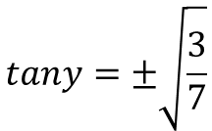
Trigonometry and Modelling
$$Sin2A≡2sinAcosA$$
$$Cos2A≡{Cos}^{2}A−{Sin}^{2}A$$
$$Cos2A≡1−2{Sin}^{2}A$$
$$Cos2A≡2{Cos}^{2}A−1$$
$$Tan2A≡\frac{2TanA}{1−{Tan}^{2}A}$$
You need to be able to use the angle relationships you have seen in equation solving
Solve $2tan2ytany=3$ in the range $0≤y≤2π$. Give answers to 2dp.
$$2tan2ytany=3$$
Replace using a relationship from above
$$2\left(\frac{2tany}{1−\tan^{2}y}\right)tany=3$$
Multiply the bracket by 2
$$\left(\frac{4tany}{1−\tan^{2}y}\right)tany=3$$
Multiply the bracket by $tany$
$$\frac{4tan^{2}y}{1−\tan^{2}y}=3$$
Multiply both sides by $1−\tan^{2}y$
$$4tan^{2}y=3−3\tan^{2}y$$
Add ${3tan}^{2}y$
$$7tan^{2}y=3$$
Divide by 7
$$tan^{2}y=\frac{3}{7}$$
$$tany=±\sqrt{\frac{3}{7}}$$
Square root
7D

Slide 6
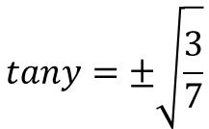
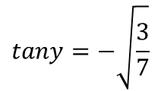
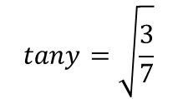
Trigonometry and Modelling
$$Sin2A≡2sinAcosA$$
$$Cos2A≡{Cos}^{2}A−{Sin}^{2}A$$
$$Cos2A≡1−2{Sin}^{2}A$$
$$Cos2A≡2{Cos}^{2}A−1$$
$$Tan2A≡\frac{2TanA}{1−{Tan}^{2}A}$$
You need to be able to use the angle relationships you have seen in equation solving
Solve $2tan2ytany=3$ in the range $0≤y≤2π$. Give answers to 2dp.
$$tany=±\sqrt{\frac{3}{7}}$$
Write the 2 possible values for $tany$
$$tany=\sqrt{\frac{3}{7}}$$
$$tany=−\sqrt{\frac{3}{7}}$$
Find the principle value, and then check for any others in the range (remember that $tanθ=tan⁡(θ+180)$)
$$y=0.58$$
$$, 3.72$$
$$y=2.56$$
$$, 5.70$$
7D

Slide 7
Trigonometry and Modelling
$$Sin2A≡2sinAcosA$$
$$Cos2A≡{Cos}^{2}A−{Sin}^{2}A$$
$$Cos2A≡1−2{Sin}^{2}A$$
$$Cos2A≡2{Cos}^{2}A−1$$
$$Tan2A≡\frac{2TanA}{1−{Tan}^{2}A}$$
You need to be able to use the angle relationships you have seen in equation solving
a) By expanding $sin⁡(2A+A)$, show that:
$$sin3A≡3sinA−{4sin}^{3}A$$
$$sin\left(A+B\right)≡sinAcosB+cosAsinB$$
Replace A and B
$$sin\left(2A+A\right)≡sin2AcosA+cos2AsinA$$
$$sin\left(3A\right)≡$$
$$(2sinAcosA)cosA$$
$$+ (1−2sin^{2}A)sinA$$
$$sin\left(3A\right)≡$$
$$2sinAcos^{2}A$$
$$+ sinA−2sin^{3}A$$
Replace cos²A
$$sin\left(3A\right)≡$$
$$2sinA(1−\sin^{2}A)$$
$$+ sinA−2sin^{3}A$$
Multiply out
$$sin\left(3A\right)≡$$
$$2sinA−{2sin}^{3}A$$
$$+ sinA−2sin^{3}A$$
Group like terms
$$sin\left(3A\right)≡$$
$$3sinA−{4sin}^{3}A$$
7D

Slide 8
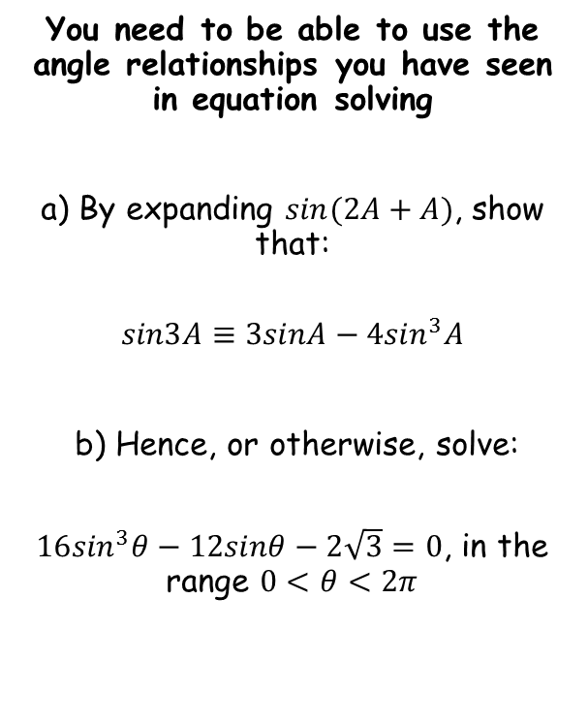
Trigonometry and Modelling
$$Sin2A≡2sinAcosA$$
$$Cos2A≡{Cos}^{2}A−{Sin}^{2}A$$
$$Cos2A≡1−2{Sin}^{2}A$$
$$Cos2A≡2{Cos}^{2}A−1$$
$$Tan2A≡\frac{2TanA}{1−{Tan}^{2}A}$$
You need to be able to use the angle relationships you have seen in equation solving
a) By expanding $sin⁡(2A+A)$, show that:
$$sin3A≡3sinA−{4sin}^{3}A$$
b) Hence, or otherwise, solve:
$16\sin^{3}θ−12sinθ−2\sqrt{3}=0$, in the range $0<θ<2π$
$$sin3A≡3sinA−{4sin}^{3}A$$
Replace $A$ with $θ$ if this helps!
$$sin3θ≡3sinθ−{4sin}^{3}θ$$
Multiply all by 4
$$4sin3θ≡12sinθ−{16sin}^{3}θ$$
Multiply by -1
$$−4sin3θ≡{16sin}^{3}θ−12sinθ$$
Subtract $2\sqrt{3}$
$$−4sin3θ−2\sqrt{3}≡{16sin}^{3}θ−12sinθ−2\sqrt{3}$$
If the right side equals 0, the left side must also equal 0…
$$−4sin3θ−2\sqrt{3}=0$$
Multiply by -1
$$4sin3θ+2\sqrt{3}=0$$
Subtract $2\sqrt{3}$
$$4sin3θ=−2\sqrt{3}$$
→ Try to find a way to change the relationship from a) into the equation you are solving…
$$sin3θ=−\frac{\sqrt{3}}{2}$$
Divide by 4
7D

Slide 9
Trigonometry and Modelling
$$Sin2A≡2sinAcosA$$
$$Cos2A≡{Cos}^{2}A−{Sin}^{2}A$$
$$Cos2A≡1−2{Sin}^{2}A$$
$$Cos2A≡2{Cos}^{2}A−1$$
$$Tan2A≡\frac{2TanA}{1−{Tan}^{2}A}$$
You need to be able to use the angle relationships you have seen in equation solving
a) By expanding $sin⁡(2A+A)$, show that:
$$sin3A≡3sinA−{4sin}^{3}A$$
b) Hence, or otherwise, solve:
$16\sin^{3}θ−12sinθ−2\sqrt{3}=0$, in the range $0<θ<2π$
$$sin3θ=−\frac{\sqrt{3}}{2}$$
Inverse sine
$$3θ=−\frac{1}{3}π$$
Remember that $sinθ=sin\left(π−θ\right)$, so subtract this answer from $π$
$$3θ=\frac{4}{3}π$$
1
$$\frac{4π}{3}$$
$$\frac{3π}{2}$$
$$\frac{5π}{3}$$
$$2π$$
y = Sinθ
$$−\frac{\sqrt{3}}{2}$$
-1
$$\frac{π}{2}$$
$$π$$
Find other values in the initial range, then keep adding $2π$ to them to find more
$$3θ=\frac{4}{3}π$$
$$, \frac{5}{3}π$$
$$, \frac{10}{3}π$$
$$, \frac{11}{3}π$$
$$, \frac{16}{3}π$$
$$, \frac{17}{3}π$$
→ Adjust the range for the equation we are solving…
Divide all by 3
$$θ=\frac{4}{9}π$$
$$, \frac{5}{9}π$$
$$, \frac{10}{9}π$$
$$, \frac{11}{9}π$$
$$, \frac{16}{9}π$$
$$, \frac{17}{9}π$$
$$0<3θ<6π$$
7D

