Slide 1
Trigonometry and
Modelling
Twitter: @Owen134866
www.mathsfreeresourcelibrary.com

Slide 2



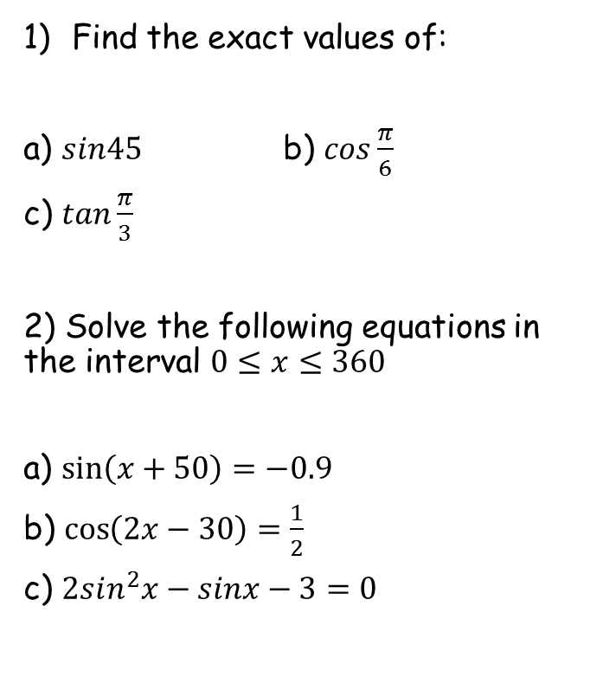




Prior Knowledge Check
Find the exact values of:
a) $sin45$ b) $cos\frac{π}{6}$
c) $tan\frac{π}{3}$
2) Solve the following equations in the interval $0≤x≤360$
a) $\sin\left(x+50\right)=−0.9$
b) $\cos\left(2x−30\right)=\frac{1}{2}$
c) $2sin^{2}x−sinx−3=0$
3) Prove the following:
a) $cosx+sinxtanx≡secx$
b) $cotxsecxsinx≡1$
c) $\frac{\cos^{2}x+\sin^{2}x}{1+\cot^{2}x}≡\sin^{2}x$
$\frac{1}{\sqrt{2}}$ or $\frac{\sqrt{2}}{2}$
$$\frac{\sqrt{3}}{2}$$
$$\sqrt{3}$$
$$194.2, 245.8$$
$$45, 165, 225, 345$$
$$270$$

Slide 3
Teachings for
Exercise 7A

Slide 4






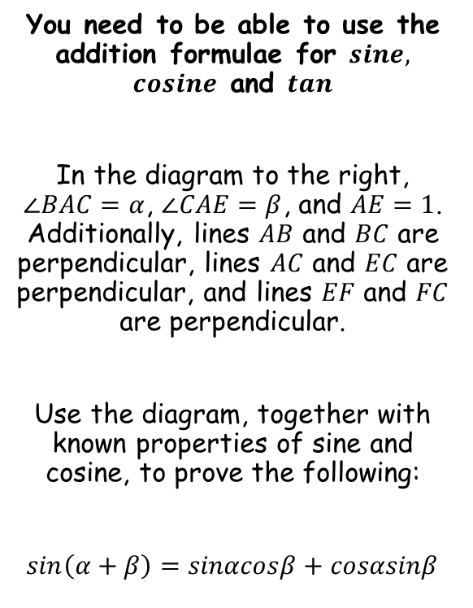









Trigonometry and Modelling
$$G$$
$$E$$
You need to be able to use the addition formulae for $sine,$ $cosine$ and $tan$
In the diagram to the right, $∠BAC=α$, $∠CAE=β$, and $AE=1$. Additionally, lines $AB$ and $BC$ are perpendicular, lines $AC$ and $EC$ are perpendicular, and lines $EF$ and $FC$ are perpendicular.
Use the diagram, together with known properties of sine and cosine, to prove the following:
$sin\left(α+β\right)=sinαcosβ+cosαsinβ$
$$α$$
$$1$$
$$90−α$$
$$F$$
$$α$$
$$C$$
$$β$$
$$α$$
$$A$$
$$D$$
$$B$$
→ Since $FC$ and $AB$ are parallel, $∠ACF=α$
→ This means that $∠ECF=90−α$
→ Which then means that $∠CEF=α$
7A

Slide 5




Trigonometry and Modelling
$$G$$
$$E$$
You need to be able to use the addition formulae for $sine,$ $cosine$ and $tan$
In the diagram to the right, $∠BAC=α$, $∠CAE=β$, and $AE=1$. Additionally, lines $AB$ and $BC$ are perpendicular, lines $AC$ and $EC$ are perpendicular, and lines $EF$ and $FC$ are perpendicular.
Use the diagram, together with known properties of sine and cosine, to prove the following:
$sin\left(α+β\right)=sinαcosβ+cosαsinβ$
$$α$$
$$sinβ$$
$$1$$
$$F$$
$$C$$
$$β$$
$$α$$
$$A$$
$$D$$
$$B$$
In a right-angled triangle: $Opp=Sinθ×Hyp$
→ In triangle $ACE$, the angle is $β$ and the Hypotenuse is 1
$$Opp=Sinβ×1$$
$$Opp=Sinβ$$
7A

Slide 6






Trigonometry and Modelling
$$G$$
$$E$$
You need to be able to use the addition formulae for $sine,$ $cosine$ and $tan$
In the diagram to the right, $∠BAC=α$, $∠CAE=β$, and $AE=1$. Additionally, lines $AB$ and $BC$ are perpendicular, lines $AC$ and $EC$ are perpendicular, and lines $EF$ and $FC$ are perpendicular.
Use the diagram, together with known properties of sine and cosine, to prove the following:
$sin\left(α+β\right)=sinαcosβ+cosαsinβ$
$$α$$
$$cosαsinβ$$
$$sinβ$$
$$1$$
$$F$$
$$C$$
$$β$$
$$α$$
$$A$$
$$D$$
$$B$$
In a right-angled triangle: $Adj=Cosθ×Hyp$
→ In triangle $FEC$, the angle is $α$ and the Hypotenuse is $sinβ$
$$Adj=Cosα×Sinβ$$
$$Adj=CosαSinβ$$
7A

Slide 7




Trigonometry and Modelling
$$G$$
$$E$$
You need to be able to use the addition formulae for $sine,$ $cosine$ and $tan$
In the diagram to the right, $∠BAC=α$, $∠CAE=β$, and $AE=1$. Additionally, lines $AB$ and $BC$ are perpendicular, lines $AC$ and $EC$ are perpendicular, and lines $EF$ and $FC$ are perpendicular.
Use the diagram, together with known properties of sine and cosine, to prove the following:
$sin\left(α+β\right)=sinαcosβ+cosαsinβ$
$$α$$
$$cosαsinβ$$
$$sinβ$$
$$1$$
$$sinαsinβ$$
$$F$$
$$C$$
$$β$$
$$α$$
$$A$$
$$D$$
$$B$$
In a right-angled triangle: $Opp=Sinθ×Hyp$
→ In triangle $FEC$, the angle is $α$ and the Hypotenuse is $sinβ$
$$Adj=Sinα×Sinβ$$
$$Adj=SinαSinβ$$
7A

Slide 8




Trigonometry and Modelling
$$G$$
$$E$$
You need to be able to use the addition formulae for $sine,$ $cosine$ and $tan$
In the diagram to the right, $∠BAC=α$, $∠CAE=β$, and $AE=1$. Additionally, lines $AB$ and $BC$ are perpendicular, lines $AC$ and $EC$ are perpendicular, and lines $EF$ and $FC$ are perpendicular.
Use the diagram, together with known properties of sine and cosine, to prove the following:
$sin\left(α+β\right)=sinαcosβ+cosαsinβ$
$$α$$
$$cosαsinβ$$
$$sinβ$$
$$1$$
$$sinαsinβ$$
$$F$$
$$C$$
$$cosβ$$
$$β$$
$$α$$
$$A$$
$$D$$
$$B$$
In a right-angled triangle: $Adj=Cosθ×Hyp$
→ In triangle $ACE$, the angle is $β$ and the Hypotenuse is 1
$$Adj=Cosβ×1$$
$$Adj=Cosβ$$
7A

Slide 9





Trigonometry and Modelling
$$G$$
$$E$$
You need to be able to use the addition formulae for $sine,$ $cosine$ and $tan$
In the diagram to the right, $∠BAC=α$, $∠CAE=β$, and $AE=1$. Additionally, lines $AB$ and $BC$ are perpendicular, lines $AC$ and $EC$ are perpendicular, and lines $EF$ and $FC$ are perpendicular.
Use the diagram, together with known properties of sine and cosine, to prove the following:
$sin\left(α+β\right)=sinαcosβ+cosαsinβ$
$$α$$
$$cosαsinβ$$
$$sinβ$$
$$1$$
$$sinαsinβ$$
$$F$$
$$C$$
$$cosβ$$
$$sinαcosβ$$
$$β$$
$$α$$
$$A$$
$$D$$
$$B$$
In a right-angled triangle: $Opp=Sinθ×Hyp$
→ In triangle $ACB$, the angle is $α$ and the Hypotenuse is $cosβ$
$$Opp=Sinα×Cosβ$$
$$Opp=SinαCosβ$$
7A

Slide 10






Trigonometry and Modelling
$$G$$
$$E$$
You need to be able to use the addition formulae for $sine,$ $cosine$ and $tan$
In the diagram to the right, $∠BAC=α$, $∠CAE=β$, and $AE=1$. Additionally, lines $AB$ and $BC$ are perpendicular, lines $AC$ and $EC$ are perpendicular, and lines $EF$ and $FC$ are perpendicular.
Use the diagram, together with known properties of sine and cosine, to prove the following:
$sin\left(α+β\right)=sinαcosβ+cosαsinβ$
$$α$$
$$cosαsinβ$$
$$sinβ$$
$$1$$
$$sinαsinβ$$
$$F$$
$$C$$
$$cosβ$$
$$sinαcosβ$$
$$β$$
$$α$$
$$A$$
$$D$$
$$B$$
$$cosαcosβ$$
In a right-angled triangle: $Adj=Cosθ×Hyp$
→ In triangle $ACB$, the angle is $α$ and the Hypotenuse is $cosβ$
$$Adj=Cosα×Cosβ$$
$$Adj=CosαCosβ$$
7A

Slide 11







Trigonometry and Modelling
$$G$$
$$E$$
You need to be able to use the addition formulae for $sine,$ $cosine$ and $tan$
In the diagram to the right, $∠BAC=α$, $∠CAE=β$, and $AE=1$. Additionally, lines $AB$ and $BC$ are perpendicular, lines $AC$ and $EC$ are perpendicular, and lines $EF$ and $FC$ are perpendicular.
Use the diagram, together with known properties of sine and cosine, to prove the following:
$sin\left(α+β\right)=sinαcosβ+cosαsinβ$
$$α$$
$$cosαsinβ$$
$$sinβ$$
$$1$$
$$sinαsinβ$$
$$F$$
$$C$$
$$cosβ$$
$$sinαcosβ$$
$$β$$
$$α$$
$$A$$
$$D$$
$$B$$
$$cosαcosβ$$
In a right-angled triangle: $Opp=Sinθ×Hyp$
→ In triangle $AED$, the angle is $(α+β)$ and the Hypotenuse is $1$
$$Opp=Sin(α+β)×1$$
$$Opp=Sin(α+β)$$
→ However, we also know that the Opposite side is $sinαcosβ+cosαsinβ$…
$$Opp=sinαcosβ+cosαsinβ$$
7A

Slide 12




Trigonometry and Modelling
$$sin\left(α+β\right)=sinαcosβ+cosαsinβ$$
$$G$$
$$E$$
You need to be able to use the addition formulae for $sine,$ $cosine$ and $tan$
In the diagram to the right, $∠BAC=α$, $∠CAE=β$, and $AE=1$. Additionally, lines $AB$ and $BC$ are perpendicular, lines $AC$ and $EC$ are perpendicular, and lines $EF$ and $FC$ are perpendicular.
Use the diagram, together with known properties of sine and cosine, to prove the following:
$sin\left(α+β\right)=sinαcosβ+cosαsinβ$
$$α$$
$$cosαsinβ$$
$$sinβ$$
$$1$$
$$sinαsinβ$$
$$F$$
$$C$$
$$cosβ$$
$$sinαcosβ$$
$$β$$
$$α$$
$$A$$
$$D$$
$$B$$
$$cosαcosβ$$
$$Opp=sin(α+β)$$
$$Opp=sinαcosβ+cosαsinβ$$
Therefore…
$$sin\left(α+β\right)=sinαcosβ+cosαsinβ$$
7A

Slide 13
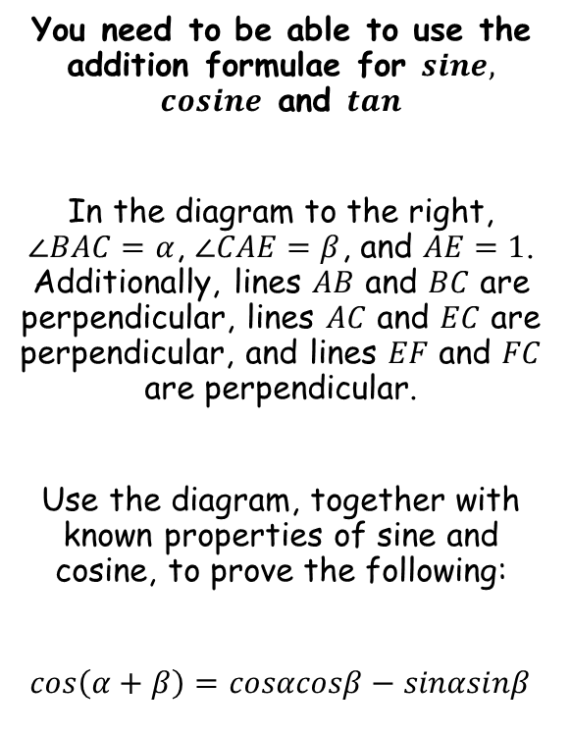





Trigonometry and Modelling
$$sin\left(α+β\right)=sinαcosβ+cosαsinβ$$
$$G$$
$$E$$
You need to be able to use the addition formulae for $sine,$ $cosine$ and $tan$
In the diagram to the right, $∠BAC=α$, $∠CAE=β$, and $AE=1$. Additionally, lines $AB$ and $BC$ are perpendicular, lines $AC$ and $EC$ are perpendicular, and lines $EF$ and $FC$ are perpendicular.
Use the diagram, together with known properties of sine and cosine, to prove the following:
$cos\left(α+β\right)=cosαcosβ−sinαsinβ$
$$α$$
$$cosαsinβ$$
$$sinβ$$
$$1$$
$$sinαsinβ$$
$$F$$
$$C$$
$$cosβ$$
$$sinαcosβ$$
$$β$$
$$α$$
$$A$$
$$D$$
$$B$$
$$cosαcosβ$$
In a right-angled triangle: $Adj=Cosθ×Hyp$
→ In triangle $AED$, the angle is $(α+β)$ and the Hypotenuse is $1$
$$Adj=Cos(α+β)×1$$
$$Adj=Cos(α+β)$$
→ However, we also know that the Adjacent side is $cosαcosβ−sinαsinβ$…
$$Adj=cosαcosβ−sinαsinβ$$
7A

Slide 14




Trigonometry and Modelling
$$sin\left(α+β\right)=sinαcosβ+cosαsinβ$$
$$cos\left(α+β\right)=cosαcosβ−sinαsinβ$$
$$G$$
$$E$$
You need to be able to use the addition formulae for $sine,$ $cosine$ and $tan$
In the diagram to the right, $∠BAC=α$, $∠CAE=β$, and $AE=1$. Additionally, lines $AB$ and $BC$ are perpendicular, lines $AC$ and $EC$ are perpendicular, and lines $EF$ and $FC$ are perpendicular.
Use the diagram, together with known properties of sine and cosine, to prove the following:
$cos\left(α+β\right)=cosαcosβ−sinαsinβ$
$$α$$
$$cosαsinβ$$
$$sinβ$$
$$1$$
$$sinαsinβ$$
$$F$$
$$C$$
$$cosβ$$
$$sinαcosβ$$
$$β$$
$$α$$
$$A$$
$$D$$
$$B$$
$$cosαcosβ$$
$$Adj=cos(α+β)$$
$$Adj=cosαcosβ−sinαsinβ$$
Therefore…
$$cos\left(α+β\right)=cosαcosβ−sinαsinβ$$
7A

Slide 15









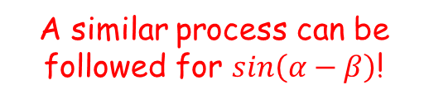






Trigonometry and Modelling
$$sin\left(α+β\right)=sinαcosβ+cosαsinβ$$
$$cos\left(α+β\right)=cosαcosβ−sinαsinβ$$
$$sin\left(α−β\right)=sinαcosβ−cosαsinβ$$
$$cos\left(α−β\right)=cosαcosβ+sinαsinβ$$
You need to be able to use the addition formulae for $sine,$ $cosine$ and $tan$
Use the results above to show that:
$$cos\left(A−B\right)=cosAcosB+sinAsinB$$
$$cos\left(α+β\right)=cosαcosβ−sinαsinβ$$
Replace $α$ and $β$ with $A$ and $B$
$$cos\left(A+B\right)=cosAcosB−sinAsinB$$
Replace $B$ with $(−B)$
$$cos\left(A+(−B)\right)=cosAcos(−B)−sinAsin(−B)$$
You can use some trig relationships
$$cos\left(A−B\right)=$$
$$cosAcosB$$
$$− sinA(−sinB)$$
Simplify
$$cos\left(A−B\right)=$$
$$cosAcosB$$
$$+ sinAsinB$$
$$cosθ=cos⁡(−θ)$$
For example
A similar process can be followed for $sin\left(α−β\right)$!
$$cos20=cos⁡(−20)$$
$$sinθ=−sinθ$$
For example
$$sin40=−sin40$$
7A

Slide 16




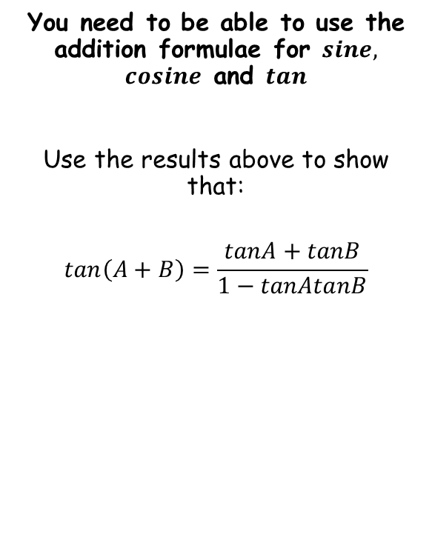


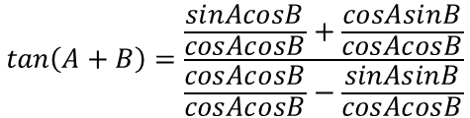
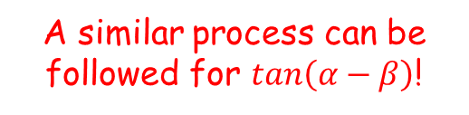
Trigonometry and Modelling
$$sin\left(α+β\right)=sinαcosβ+cosαsinβ$$
$$cos\left(α+β\right)=cosαcosβ−sinαsinβ$$
$$tan\left(A+B\right)=\frac{tanA+tanB}{1−tanAtanB}$$
$$sin\left(α−β\right)=sinαcosβ−cosαsinβ$$
$$cos\left(α−β\right)=cosαcosβ+sinαsinβ$$
$$tan\left(A−B\right)=\frac{tanA−tanB}{1+tanAtanB}$$
You need to be able to use the addition formulae for $sine,$ $cosine$ and $tan$
Use the results above to show that:
$$tan\left(A+B\right)=\frac{tanA+tanB}{1−tanAtanB}$$
$$tan\left(A+B\right)=\frac{sin\left(A+B\right)}{cos\left(A+B\right)}$$
Replace using the relationships above
$$tan\left(A+B\right)=\frac{sinAcosB+cosAsinB}{cosAcosB−sinAsinB}$$
Divide all terms by $cosAcosB$
$$tan\left(A+B\right)=\frac{\frac{sinAcosB}{cosAcosB}+\frac{cosAsinB}{cosAcosB}}{\frac{cosAcosB}{cosAcosB}−\frac{sinAsinB}{cosAcosB}}$$
Simplify each term
$$tan\left(A+B\right)=\frac{tanA+tanB}{1−tanAtanB}$$
A similar process can be followed for $tan\left(α−β\right)$!
7A

Slide 17





Trigonometry and Modelling
$$sin\left(α+β\right)=sinαcosβ+cosαsinβ$$
$$cos\left(α+β\right)=cosαcosβ−sinαsinβ$$
$$tan\left(A+B\right)=\frac{tanA+tanB}{1−tanAtanB}$$
$$sin\left(α−β\right)=sinαcosβ−cosαsinβ$$
$$cos\left(α−β\right)=cosαcosβ+sinαsinβ$$
$$tan\left(A−B\right)=\frac{tanA−tanB}{1+tanAtanB}$$
You need to be able to use the addition formulae for $sine,$ $cosine$ and $tan$
Prove that:
$$\frac{cosA}{sinB}−\frac{sinA}{cosB}≡\frac{cos\left(A+B\right)}{sinBcosB}$$
$$\frac{cosA}{sinB}−\frac{sinA}{cosB}$$
Multiply to make the denominators equal
$$=\frac{cosAcosB}{sinBcosB}−\frac{sinAsinB}{cosBsinB}$$
Group together
$$=\frac{cosAcosB−sinAsinB}{sinBcosB}$$
The top can be replaced using one of the identities above
$$=\frac{cos⁡(A+B)}{sinBcosB}$$
7A

Slide 18



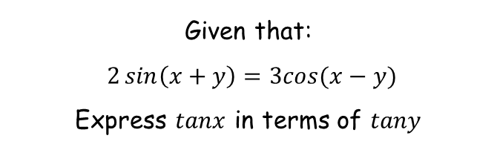

















Trigonometry and Modelling
$$sin\left(α+β\right)=sinαcosβ+cosαsinβ$$
$$cos\left(α+β\right)=cosαcosβ−sinαsinβ$$
$$tan\left(A+B\right)=\frac{tanA+tanB}{1−tanAtanB}$$
$$sin\left(α−β\right)=sinαcosβ−cosαsinβ$$
$$cos\left(α−β\right)=cosαcosβ+sinαsinβ$$
$$tan\left(A−B\right)=\frac{tanA−tanB}{1+tanAtanB}$$
Given that:
$2\sin\left(x+y\right)=3cos⁡(x−y)$
Express $tanx$ in terms of $tany$
$$2\sin\left(x+y\right)=3cos⁡(x−y)$$
Rewrite the sin and cos parts
$$2{(sinxcosy+cosxsiny)}$$
$$= 3{(cosxcosy+sinxsiny)}$$
Multiply out the brackets
$$2{sinxcosy+2cosxsiny}$$
$$= 3{cosxcosy+3sinxsiny}$$
Divide all by cosxcosy
$$2{sinxcosy+2cosxsiny}$$
$$= 3{cosxcosy+3sinxsiny}$$
$$cosxcosy$$
$$cosxcosy$$
$$cosxcosy$$
$$cosxcosy$$
Simplify
$$2{tanx+2tany}$$
$$= 3{+3tanxtany}$$
Subtract 3tanxtany
Subtract 2tany
$$2{tanx−3tanxtany}$$
$$= 3{−2tany}$$
Factorise the left side
$$tanx(2−3tany)$$
$$= 3{−2tany}$$
$$tanx$$
$$= 3{−2tany}$$
Divide by (2 – 3tany)
$$2{−3tany}$$
7A

