Slide 1
Trigonometric Functions
You need to be able to simplify expressions, prove identities and solve equations involving secθ, cosecθ and cotθ
You can solve equations by rearranging them in terms of sin, cos or tan, then using their respective graphs
Rewrite using cos
Rearrange
Work out the fraction
Inverse cos
Work out the first answer. Add 360 if not in the range we want…
Example Question
Subtract from 360 (to find the equivalent value in the range
Solve the equation:
In the range:
1
y = Cosθ
0
-1
90
180
270
360
6C

Slide 2
Trigonometric Functions
You need to be able to simplify expressions, prove identities and solve equations involving secθ, cosecθ and cotθ
You can solve equations by rearranging them in terms of sin, cos or tan, then using their respective graphs
Rewrite using tan
Inverse tan
Work out the first value, and others in the original range (0-360)
You can add 180 to these as the period of tan is 180
Divide all by 2 (answers to 3sf)
Example Question
Solve the equation:
In the range:
y = Tanθ
90
180
270
360
Remember to adjust the acceptable range for 2θ
6C

Slide 3

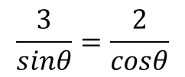

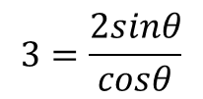
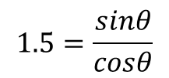




Trigonometric Functions
You need to be able to simplify expressions, prove identities and solve equations involving secθ, cosecθ and cotθ
You can solve equations by rearranging them in terms of sin, cos or tan, then using their respective graphs
Rewrite each side
Cross multiply
Divide by Cosθ
Divide by 2
Example Question
Rewrite the right-hand side
Solve the equation:
In the range:
6C

