Slide 1
Teachings for
Exercise 6B

Slide 2
Trigonometric Functions
You need to know the graphs of secθ, cosecθ and cotθ
At 90°, Sinθ = 1
→ Cosecθ = 1
At 180°, Sinθ = 0
→ Cosecθ = undefined
→ We get an asymptote wherever Sinθ = 0
1
0
y = Sinθ
-1
90
180
270
360
y = Cosecθ
6B

Slide 3
Trigonometric Functions
You need to know the graphs of secθ, cosecθ and cotθ
At 0°, Cosθ = 1
→ Secθ = 1
At 90°, Cosθ = 0
→ Secθ = undefined
→ We get asymptotes wherever Cosθ = 0
1
y = Cosθ
0
-1
90
180
270
360
y = Secθ
6B

Slide 4
Trigonometric Functions
You need to know the graphs of secθ, cosecθ and cotθ
At 45°, tanθ = 1
→ Cotθ = 1
At 90°, tanθ = undefined
→ Cotθ = 0
y = Tanθ
90
180
270
360
y = Cotθ
At 180°, tanθ = 0
→ Cotθ = undefined
6B

Slide 5
Trigonometric Functions
You need to know the graphs of secθ, cosecθ and cotθ
1
0
y = Sinθ
-1
90
180
270
360
Maxima/Minima at (90,1) and (270,-1)
(and every 180 from then)
1
0
-1
90
180
270
360
Asymptotes at 0, 180, 360
(and every 180° from then)
y = Cosecθ
6B

Slide 6
Trigonometric Functions
You need to know the graphs of secθ, cosecθ and cotθ
1
y = Cosθ
0
-1
90
180
270
360
Maxima/Minima at (0,1) (180,-1) and (360,1)
(and every 180 from then)
1
0
-1
90
180
270
360
Asymptotes at 90 and 270
(and every 180° from then)
y = Secθ
6B

Slide 7
Trigonometric Functions
You need to know the graphs of secθ, cosecθ and cotθ
y = Tanθ
90
180
270
360
Asymptotes at 0, 180 and 360
(and every 180° from then)
90
180
270
360
y = Cotθ
6B

Slide 8
Trigonometric Functions
You need to know the graphs of secθ, cosecθ and cotθ
Sketch, in the interval 0 ≤ θ ≤ 360, the graph of:
y = Secθ
1
0
-1
90
180
270
360
y = 1 + Sec2θ
2
Horizontal stretch, scale factor ¹/₂
1
y = Sec2θ
0
Vertical translation, 1 unit up
-1
90
180
270
360
6B

Slide 9











Trigonometric Functions
The graph will be stretched vertically by a factor of 4 (y coordinates are multiplied by 4)
Remember that as this is a sketch, you can use the labelling of the axes to ‘stretch’ it
You need to know the graphs of secθ, cosecθ and cotθ
a) Sketch the graph of:
$y=4cosecx,$ $0≤x≤2π$
4
1
0
$$π$$
$$\frac{π}{2}$$
$$\frac{3π}{2}$$
$$2π$$
0
$$π$$
$$\frac{π}{2}$$
$$\frac{3π}{2}$$
$$2π$$
-4
-1
$$y=4cosecx$$
$$y=cosecx$$
6B

Slide 10

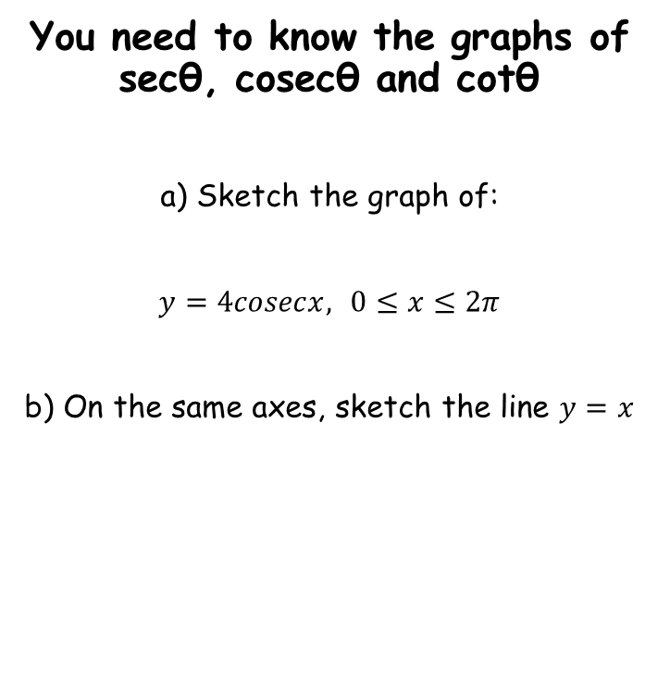






Trigonometric Functions
You need to know the graphs of secθ, cosecθ and cotθ
a) Sketch the graph of:
$y=4cosecx,$ $0≤x≤2π$
b) On the same axes, sketch the line $y=x$
$$y=x$$
4
0
$$π$$
$$\frac{π}{2}$$
$$\frac{3π}{2}$$
$$2π$$
-4
So when $x=\frac{π}{2}$, $y=\frac{π}{2}$ etc…
$$y=4cosecx$$
6B

Slide 11
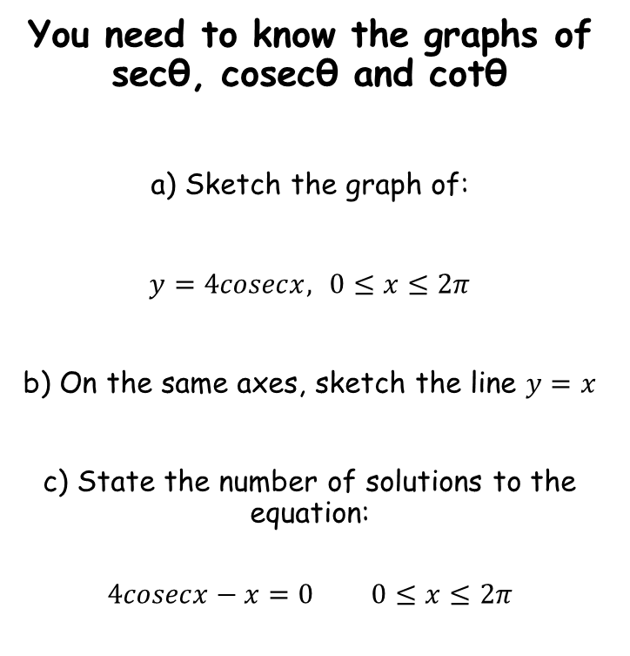

Trigonometric Functions
You need to know the graphs of secθ, cosecθ and cotθ
a) Sketch the graph of:
$y=4cosecx,$ $0≤x≤2π$
b) On the same axes, sketch the line $y=x$
c) State the number of solutions to the equation:
$$4cosecx−x=0 0≤x≤2π$$
$$y=x$$
4
0
$$π$$
$$\frac{π}{2}$$
$$\frac{3π}{2}$$
$$2π$$
-4
$$y=4cosecx$$
Add x
Since the graphs do not intersect in this region, there are no solutions to the equation
$$4cosecx=x$$
6B

