Slide 1
Graphs of sec(x), cosec(x) and cot(x) (6.2)

Slide 2
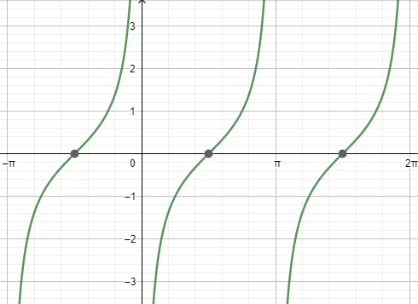
1
What is the graph shown below?
a) $f\left(x\right)=cot⁡(x)$
b) $f\left(x\right)=cot⁡(−x)$
c) $f\left(x\right)=tan(x+\frac{π}{4})$
d) $f\left(x\right)=−cot⁡(−x)$

Slide 3
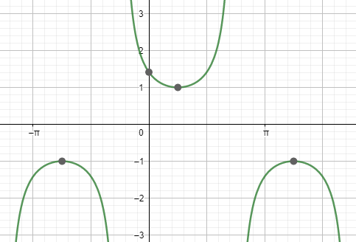
2
What is the graph shown below?
a) $f\left(x\right)=cosec⁡(x)$
b) $f\left(x\right)=cosec⁡(x−\frac{π}{4})$
c) $f\left(x\right)=cosec⁡(x+\frac{π}{4})$
d) $f\left(x\right)=sec⁡(x)$

Slide 4
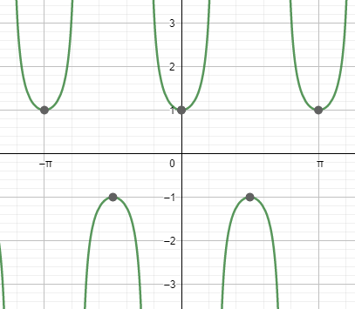
3
What is the graph shown below?
a) $f\left(x\right)=sec⁡(x)$
b) $f\left(x\right)=sec⁡(2x)$
c) $f\left(x\right)=sec⁡(4x)$
d) $f\left(x\right)=cosec⁡(x)$

Slide 5
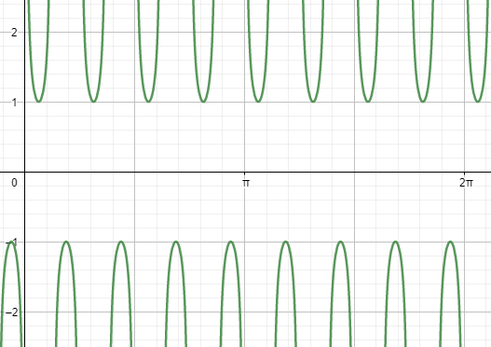
4
What is the graph shown below?
a) $f\left(x\right)=cosec⁡(2x)$
b) $f\left(x\right)=cosec⁡(4x)$
c) $f\left(x\right)=cosec⁡(6x)$
d) $f\left(x\right)=cosec⁡(8x)$

Slide 6
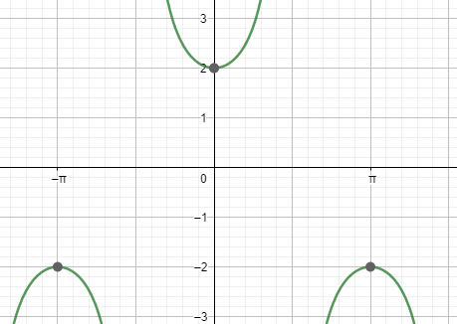
5
What is the graph shown below?
a) $f\left(x\right)=sec⁡(0.5x)$
b) $f\left(x\right)=cosec⁡(0.5x)$
c) $f\left(x\right)=2cosec(x)$
d) $f\left(x\right)=2sec⁡(x)$

