Slide 1
Trigonometric
Functions
Twitter: @Owen134866
www.mathsfreeresourcelibrary.com

Slide 2

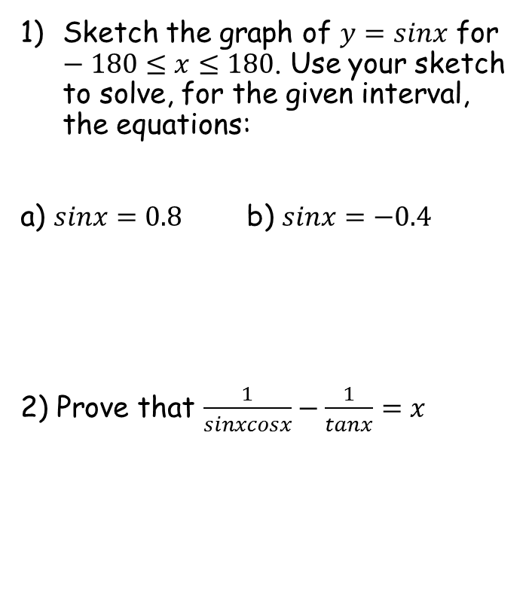
Prior Knowledge Check
Sketch the graph of $y=sinx$ for $−180≤x≤180$. Use your sketch to solve, for the given interval, the equations:
a) $sinx=0.8$ b) $sinx=−0.4$
2) Prove that $\frac{1}{sinxcosx}−\frac{1}{tanx}=x$
3) Find all the solutions in the interval $0≤x≤2π$ to the equation
$$3\sin^{2}\left(2x\right)=1$$
0.308, 1.26, 1.88, 2.83, 3.45, 4.40, 5.02, 5.98
53.1, 126.9
-23.6, -156.4

Slide 3
Teachings for
Exercise 6A

Slide 4
Trigonometric Functions
You need to know the functions secantθ, cosecantθ and cotangentθ
You should remember the index law:
It is NOT written like this in Trigonometry
All 3 are undefined if cosθ, sinθ or tanθ = 0
Something which will be VERY useful later in the chapter…
so
6A

Slide 5
Trigonometric Functions
You need to know the functions secantθ, cosecantθ and cotangentθ
Example Questions
Will cosec200 be positive or negative?
y = Sinθ
90
180
270
360
As sin200 is negative, cosec200 will be as well!
6A

Slide 6
Trigonometric Functions
You need to know the functions secantθ, cosecantθ and cotangentθ
Example Questions
Find the value of:
to 2dp
Just use your calculator!
6A

Slide 7
Trigonometric Functions
You need to know the functions secantθ, cosecantθ and cotangentθ
Example Questions
Find the value of:
to 2dp
Just use your calculator!
6A

Slide 8
Trigonometric Functions
You need to know the functions secantθ, cosecantθ and cotangentθ
30
-60
-60
y = Cosθ
Example Questions
90
180
270
360
210
Work out the exact value of:
By symmetry, we will get the same value for cos210 at cos30 (but with the reversed sign)
(you may need to use surds…)
Cos30 = ^{√3}/₂
Flip the denominator
6A

Slide 9
Trigonometric Functions
You need to know the functions secantθ, cosecantθ and cotangentθ
^{π}/₄
^{3π}/₄
y = Sinθ
^{π}/₂
π
^{3π}/₂
2π
Example Questions
Work out the exact value of:
→ Sin(^{3π}/₄) = Sin(^{π}/₄)
(you may need to use surds…)
Sin(^{π}/₄) = Sin45
→ ¹/_{√2}
Flip the denominator
6B

