Slide 1
Chapter 6- Trigonometric functions

Slide 2
Secant, cosecant and cotangent (6.1)

Slide 3
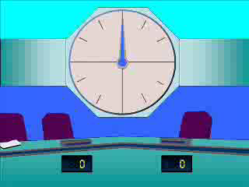
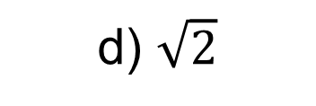
1
What is the exact value of $sec\left(\frac{π}{4}\right)$?
a) $2$
b) $\frac{1}{\sqrt{2}}$
c) $\frac{2}{\sqrt{3}}$
d) $\sqrt{2}$

Slide 4
2
What is the exact value of $cosec\left(\frac{π}{6}\right)$?
a) $2$
b) $\frac{1}{\sqrt{2}}$
c) $\frac{2}{\sqrt{3}}$
d) $\sqrt{2}$

Slide 5
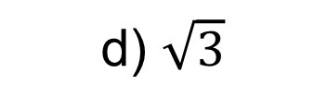
3
What is the exact value of $cot\left(\frac{π}{6}\right)$?
a) $3$
b) $\frac{1}{\sqrt{3}}$
c) $\frac{2}{\sqrt{3}}$
d) $\sqrt{3}$

Slide 6
4
What is the exact value of $cot\left(\frac{π}{3}\right)$?
a) $3$
b) $\frac{1}{\sqrt{3}}$
c) $\frac{2}{\sqrt{3}}$
d) $\sqrt{3}$

