Slide 1
Statistics
Probability
Twitter: @Owen134866
www.mathsfreeresourcelibrary.com

Slide 2















Prior Knowledge Check
1) A bag contains three red balls, four yellow balls and two blue balls. A ball is chosen at random from the bag. Write down the probability that the ball is:
Blue b) Yellow
c) Not red d) Green
2) Three coins are flipped. Write down all the possible outcomes.
3) Poppy rolls a dice. She keeps rolling until she gets a 6. Work out the probability that she rolls the dice:
Exactly three times
Less than 3 times
More than three times
$$\frac{25}{216}$$
$$\frac{2}{9}$$
$$\frac{4}{9}$$
$$\frac{2}{3}$$
$$0$$
$$\frac{11}{36}$$
$$\frac{125}{216}$$
$$HHH$$
$$THH$$
$$HTT$$
$$HHT$$
$$TTT$$
$$THT$$
$$HTH$$
$$TTH$$

Slide 3
Teachings for
Exercise 5A

Slide 4
Probability
Probability is used to predict the chance of events happening
An experiment is a repeatable process that gives rise to a number of outcomes
An event is a collection of one or more outcomes
A sample space is the set of all possible outcomes
5A

Slide 5
Probability
Probability is used to predict the chance of events happening
Two spinners are numbered 1-4. Both are spun and the sum of the numbers (x) is calculated. Find P(x = 5) and P(x > 5)
4
5
6
7
8
Draw a sample space to show the outcomes.
P(x = 5) =
P(x > 5) =
3
4
5
6
7
Spinner 2
4
=
1
2
3
4
5
6
16
4
1
2
3
4
5
1
2
3
4
6
3
=
16
8
Spinner 1
5A

Slide 6

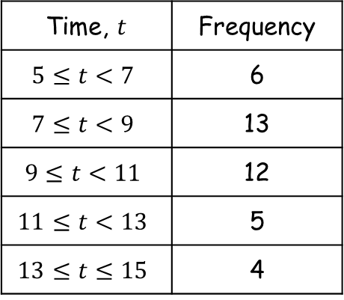


Probability
Probability is used to predict the chance of events happening
a) Estimate the probability that a student completed the puzzle in under 9 minutes
The table shows the time taken, in minutes, for a group of students to complete a number puzzle.
$$=\frac{19}{40}$$
Time, $t$ | Frequency
$$5≤t<7$$ | 6
$$7≤t<9$$ | 13
$$9≤t<11$$ | 12
$$11≤t<13$$ | 5
$$13≤t≤15$$ | 4
b) Estimate the probability that a student completed the puzzle in 10 minutes or more
→ We will need to include half of the 9-11 group…
$$=\frac{15}{40}$$
$$=\frac{3}{8}$$
5A

