Slide 1
Statistics
Correlation
Twitter: @Owen134866
www.mathsfreeresourcelibrary.com

Slide 2
Prior Knowledge Check
1) The table shows the scores out of 10 on a maths test and on a physics test for 7 students.
Show this information on a scatter graph.
2) A straight line has equation $y=0.34−0.21x$.
Write down the gradient and y-intercept of the line.
Maths | 6 | 7 | 7 | 8 | 9 | 9 | 10
Physics | 9 | 7 | 6 | 7 | 5 | 4 | 5
$$Gradient=−0.21$$
$$y−intercept=0.34$$

Slide 3
Teachings for
Exercise 4A

Slide 4
Correlation
Scatter Graphs
Scatter Graphs are a way of representing 2 sets of data (bivariate). It is then possible to see whether they are related.
Positive Correlation
→ As one variable increases, so does the other
Negative Correlation
→ As one variable increases, the other decreases
No Correlation
→ There seems to be no pattern linking the two variables
Positive
Negative
None
4A

Slide 5
Correlation
Scatter Graphs
In the study of a city, the population density, in people/hectare, and the distance from the city centre, in km, was investigated by choosing sample areas. The results are as follows:
Plot a scatter graph and describe the correlation. Interpret what the correlation means.
50
40
Area | A | B | C | D | E
Distance | 0.6 | 3.8 | 2.4 | 3.0 | 2.0
Pop. Density | 50 | 22 | 14 | 20 | 33
30
Pop. Density (people/hectare)
20
10
Area | F | G | H | I | J
Distance | 1.5 | 1.8 | 3.4 | 4.0 | 0.9
Pop. Density | 47 | 25 | 8 | 16 | 38
0
0
1
2
3
4
Distance from centre (km)
The correlation is negative, which means that as we get further from the city centre, the population density decreases.

Slide 6
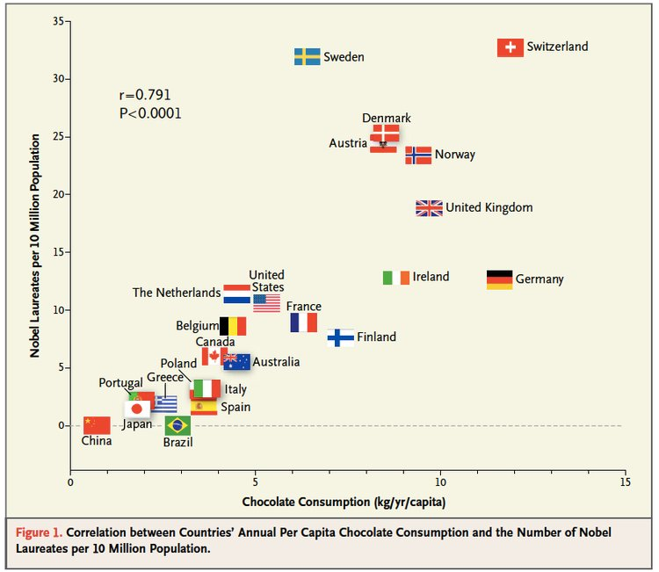
Correlation
Correlation
Scatter graphs are used to represent data linking 2 variables (bivariate data)
Two variables have a causal relationship if a change in one variable causes a change in the other
Note that correlation does not imply causation
Think about context – sometimes data seems like it is linked, but actually it is not!
4A

Slide 7
Correlation
Correlation
Scatter graphs are used to represent data linking 2 variables (bivariate data)
Hideko was interested to see if there was a relationship between what people earn and the age at which they left education or training. She asked 14 friends to fill in an anonymous questionnaire and recorded her results in a scatter diagram.
Describe the type of correlation shown
20
16
12
Hourly pay (£)
8
4
0
14
16
18
20
22
Age at which education/training ended
→ Weak negative correlation
4A

Slide 8
Correlation
Correlation
Scatter graphs are used to represent data linking 2 variables (bivariate data)
Hideko says that her data supports the conclusion that more education causes people to earn a lower hourly rate of pay
b) Give one reason why Hideko’s conclusion might not be valid
20
16
12
Hourly pay (£)
8
4
→ Her data set is very small (and biased as it is her friends only)
0
14
16
18
20
22
→ You could also say that people who left education earlier have had chance to get work experience, increasing their pay
Age at which education/training ended
4A

