Slide 1
Statistics
Correlation
Twitter: @Owen134866
www.mathsfreeresourcelibrary.com

Slide 2
Prior Knowledge Check
1) The table shows the scores out of 10 on a maths test and on a physics test for 7 students.
Show this information on a scatter graph.
2) A straight line has equation $y=0.34−0.21x$.
Write down the gradient and y-intercept of the line.
Maths | 6 | 7 | 7 | 8 | 9 | 9 | 10
Physics | 9 | 7 | 6 | 7 | 5 | 4 | 5
$$Gradient=−0.21$$
$$y−intercept=0.34$$

Slide 3
Teachings for
Exercise 4A

Slide 4
Correlation
Scatter Graphs
Scatter Graphs are a way of representing 2 sets of data (bivariate). It is then possible to see whether they are related.
Positive Correlation
→ As one variable increases, so does the other
Negative Correlation
→ As one variable increases, the other decreases
No Correlation
→ There seems to be no pattern linking the two variables
Positive
Negative
None
4A

Slide 5
Correlation
Scatter Graphs
In the study of a city, the population density, in people/hectare, and the distance from the city centre, in km, was investigated by choosing sample areas. The results are as follows:
Plot a scatter graph and describe the correlation. Interpret what the correlation means.
50
40
Area | A | B | C | D | E
Distance | 0.6 | 3.8 | 2.4 | 3.0 | 2.0
Pop. Density | 50 | 22 | 14 | 20 | 33
30
Pop. Density (people/hectare)
20
10
Area | F | G | H | I | J
Distance | 1.5 | 1.8 | 3.4 | 4.0 | 0.9
Pop. Density | 47 | 25 | 8 | 16 | 38
0
0
1
2
3
4
Distance from centre (km)
The correlation is negative, which means that as we get further from the city centre, the population density decreases.

Slide 6
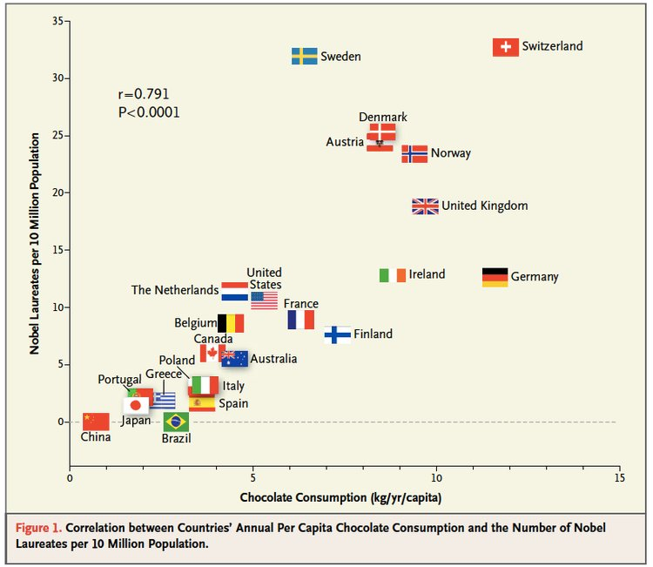
Correlation
Correlation
Scatter graphs are used to represent data linking 2 variables (bivariate data)
Two variables have a causal relationship if a change in one variable causes a change in the other
Note that correlation does not imply causation
Think about context – sometimes data seems like it is linked, but actually it is not!
4A

Slide 7
Correlation
Correlation
Scatter graphs are used to represent data linking 2 variables (bivariate data)
Hideko was interested to see if there was a relationship between what people earn and the age at which they left education or training. She asked 14 friends to fill in an anonymous questionnaire and recorded her results in a scatter diagram.
Describe the type of correlation shown
20
16
12
Hourly pay (£)
8
4
0
14
16
18
20
22
Age at which education/training ended
→ Weak negative correlation
4A

Slide 8
Correlation
Correlation
Scatter graphs are used to represent data linking 2 variables (bivariate data)
Hideko says that her data supports the conclusion that more education causes people to earn a lower hourly rate of pay
b) Give one reason why Hideko’s conclusion might not be valid
20
16
12
Hourly pay (£)
8
4
→ Her data set is very small (and biased as it is her friends only)
0
14
16
18
20
22
→ You could also say that people who left education earlier have had chance to get work experience, increasing their pay
Age at which education/training ended
4A

Slide 9
Teachings for
Exercise 4B

Slide 10
Correlation
y
Linear regression can be used to calculate the equation of the line of best fit of a set of data
One type of line of best fit which is useful is called a ‘’least squares regression line”.
This is the straight line which minimizes the sum of the squares of the distances of each point from the line…
The line will take the form $y=a+bx$ (essentially the same as $y=mx+c)$
d₅
d₃
d₄
d₁
d₂
x
So the line above will ensure that the sum of the distances squared is the smallest possible
At this stage you will not need to calculate the values of $a$ and $b$. The emphasis is on being able to interpret the line in context.
4B

Slide 11
Correlation
Linear regression can be used to calculate the equation of the line of best fit of a set of data
From the large data set, the daily mean windspeed, $w$ knots, and the daily maximum gust, $g$ knots, were recorded for the first 15 days in May in Camborne in 2015.
The data was plotted on a scatter diagram:
a) Describe the correlation between daily mean windspeed and daily maximum gust
w | $$g$$
14 | 33
13 | 37
13 | 29
9 | 23
18 | 43
18 | 38
7 | 17
15 | 30
10 | 28
14 | 29
11 | 29
9 | 23
8 | 21
10 | 28
7 | 20
60
50
Daily maximum gust (knots)
40
30
20
10
0
0
5
10
15
20
25
Daily mean windspeed (knots)
→ There is a strong positive correlation between daily mean windspeed and daily maximum gust
4B

Slide 12
Correlation
Linear regression can be used to calculate the equation of the line of best fit of a set of data
From the large data set, the daily mean windspeed, $w$ knots, and the daily maximum gust, $g$ knots, were recorded for the first 15 days in May in Camborne in 2015.
The equation of the regression line of $g$ on $w$ for this data is:
$$g=7.23+1.82w$$
b) Give an interpretation of the value of the gradient of this regression line
w | $$g$$
14 | 33
13 | 37
13 | 29
9 | 23
18 | 43
18 | 38
7 | 17
15 | 30
10 | 28
14 | 29
11 | 29
9 | 23
8 | 21
10 | 28
7 | 20
60
50
Daily maximum gust (knots)
40
30
20
10
0
0
5
10
15
20
25
Daily mean windspeed (knots)
Remember that gradient represents the change in $y$ per change in $x$
In context, as the daily mean windspeed increases by 1 knot, the daily maximum gust increases by 1.82 knots
4B

Slide 13
Correlation
Linear regression can be used to calculate the equation of the line of best fit of a set of data
From the large data set, the daily mean windspeed, $w$ knots, and the daily maximum gust, $g$ knots, were recorded for the first 15 days in May in Camborne in 2015.
c) Justify the use of a linear regression line in this case.
→ As the graph suggests a linear relationship between $w$ and $g$, it makes sense to use a linear regression line
w | $$g$$
14 | 33
13 | 37
13 | 29
9 | 23
18 | 43
18 | 38
7 | 17
15 | 30
10 | 28
14 | 29
11 | 29
9 | 23
8 | 21
10 | 28
7 | 20
60
50
Daily maximum gust (knots)
40
30
20
10
0
0
5
10
15
20
25
Daily mean windspeed (knots)
It is possible to use regression techniques to find equations to match data which follows different patterns, such as quadratic or exponential!
4B

Slide 14
Correlation
Linear regression can be used to calculate the equation of the line of best fit of a set of data
If you know a value of the independent variable from a bivariate data set, it is possible to use the regression line to make a prediction of the corresponding value of the dependent variable…
→ You should only make predictions which lie within the data range that you already have
4B

Slide 15
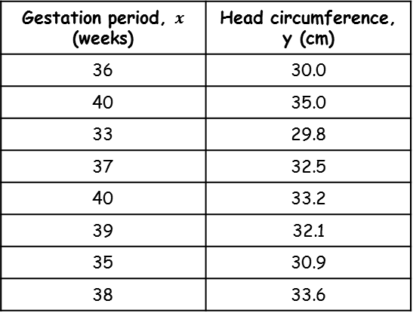
Correlation
38
Linear regression can be used to calculate the equation of the line of best fit of a set of data
The head circumference, $y$ cm, and gestation period, $x$ weeks, for a random sample of newborn babies were recorded, and the scatter graph shows the results.
36
Head circumference (cm)
34
32
30
Gestation period, $x$ (weeks) | Head circumference, y (cm)
36 | 30.0
40 | 35.0
33 | 29.8
37 | 32.5
40 | 33.2
39 | 32.1
35 | 30.9
38 | 33.6
28
30
32
34
36
38
40
42
Gestation period (weeks)
4B

Slide 16
Correlation
38
Linear regression can be used to calculate the equation of the line of best fit of a set of data
The equation of the regression line of $y$ on $x$ is:
$$y=8.91+0.624x$$
a) This equation is used to estimate the head circumference of a baby born after 39 weeks and a baby born after 30 weeks. Comment on the reliability of these estimates.
36
$$y=8.91+0.624x$$
Head circumference (cm)
34
32
30
28
30
32
34
36
38
40
42
Gestation period (weeks)
→ The prediction for 39 weeks falls within the range of data we have, so is more likely to be accurate
INTERPOLATION
→ The prediction for 30 weeks falls outside of the range of data we have, so is less likely to be accurate
EXTRAPOLATION
4B

Slide 17
Correlation
38
Linear regression can be used to calculate the equation of the line of best fit of a set of data
The equation of the regression line of $y$ on $x$ is:
$$y=8.91+0.624x$$
A nurse wants to estimate the gestation period for a baby born with a head circumference of 31.6cm.
b) Explain why the regression equation above is not suitable for this estimate
36
$$y=8.91+0.624x$$
Head circumference (cm)
34
32
30
28
30
32
34
36
38
40
42
Gestation period (weeks)
The head circumference is the dependent variable
Estimation should always be using the independent variable to estimate the dependent variable, not the other way around…
4B

