Slide 1
Old Spec Q’s
3D Lines & Planes
SAM (i)
SAM 1
SAM (ii)
SAM 2
2018
2019 1
2019 (i)
2019 (ii)

Slide 2
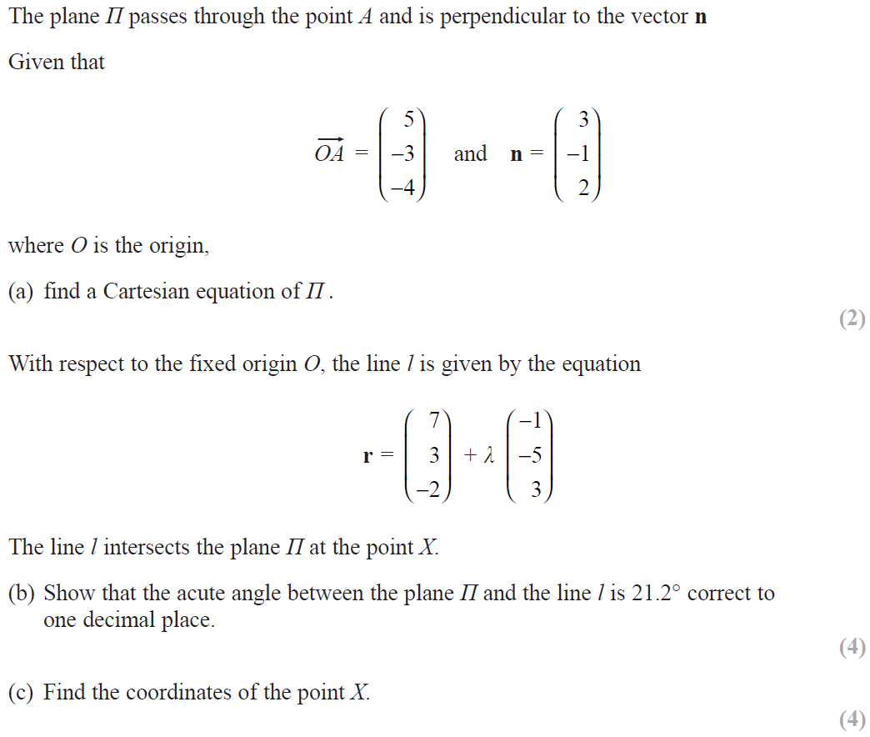
SAM

Slide 3
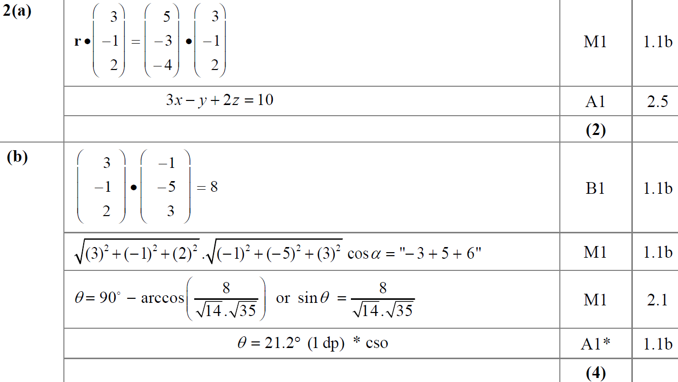
SAM
A
B

Slide 4
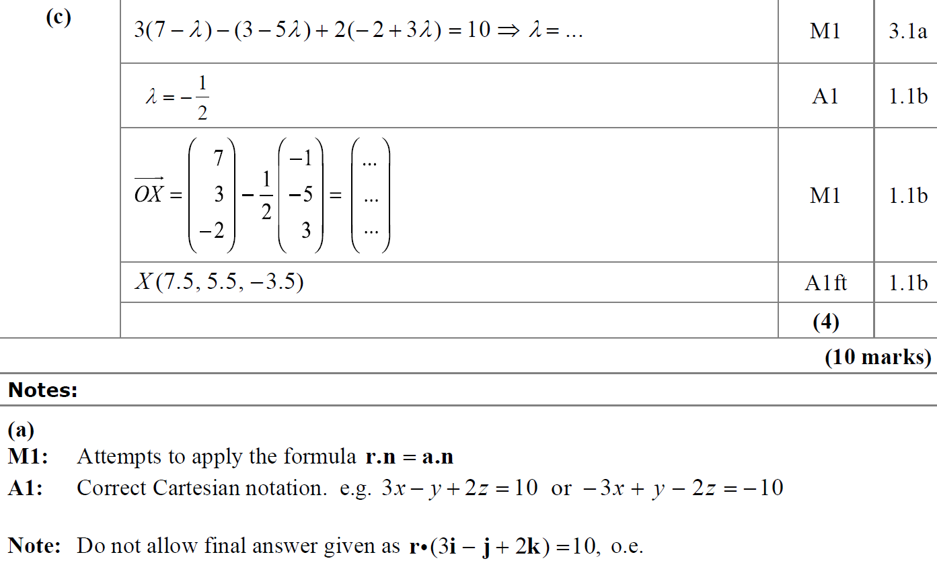
SAM
C
A notes

Slide 5
SAM
B notes
C notes

Slide 6
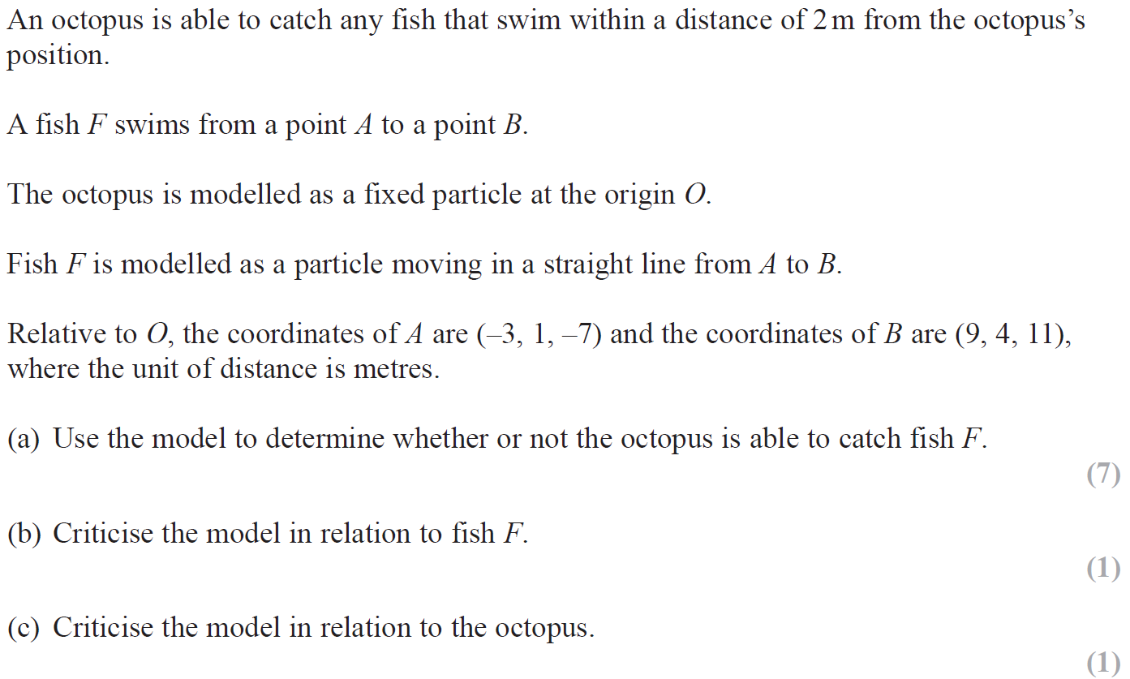
SAM

Slide 7
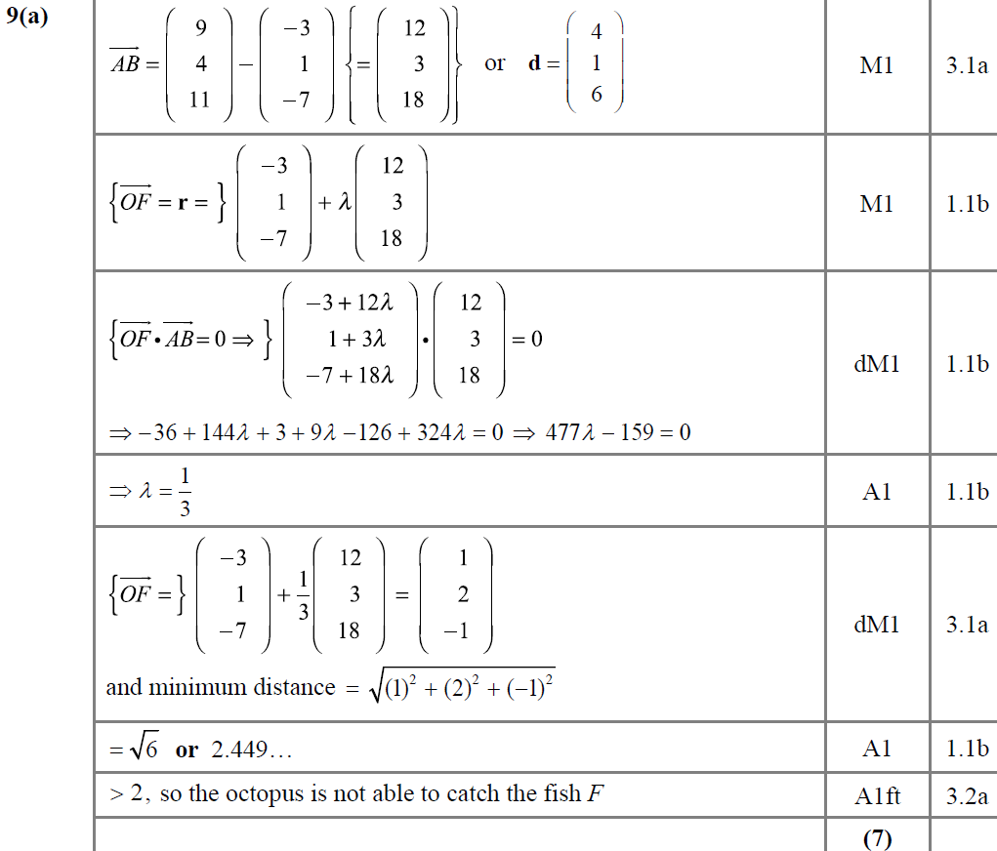
SAM
A

Slide 8
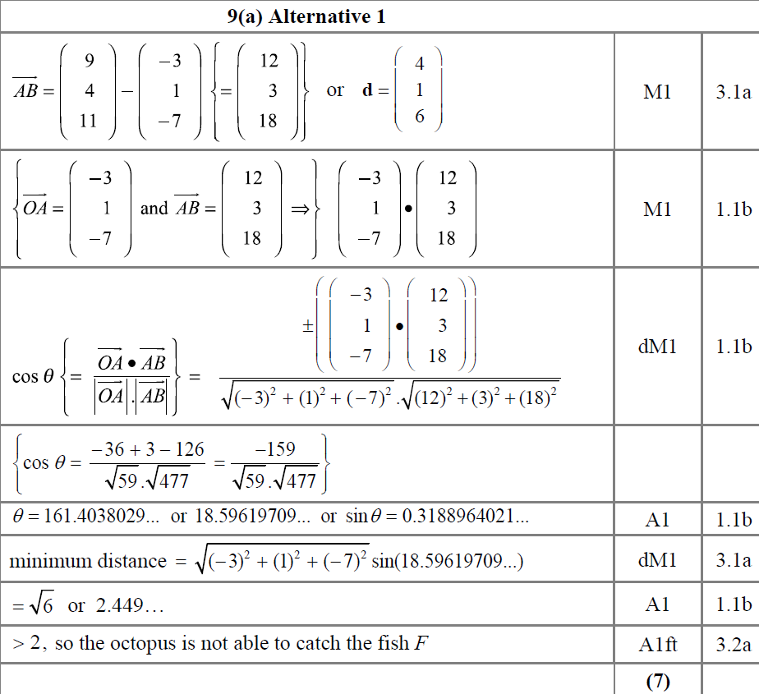
SAM
A Alternative 1

Slide 9
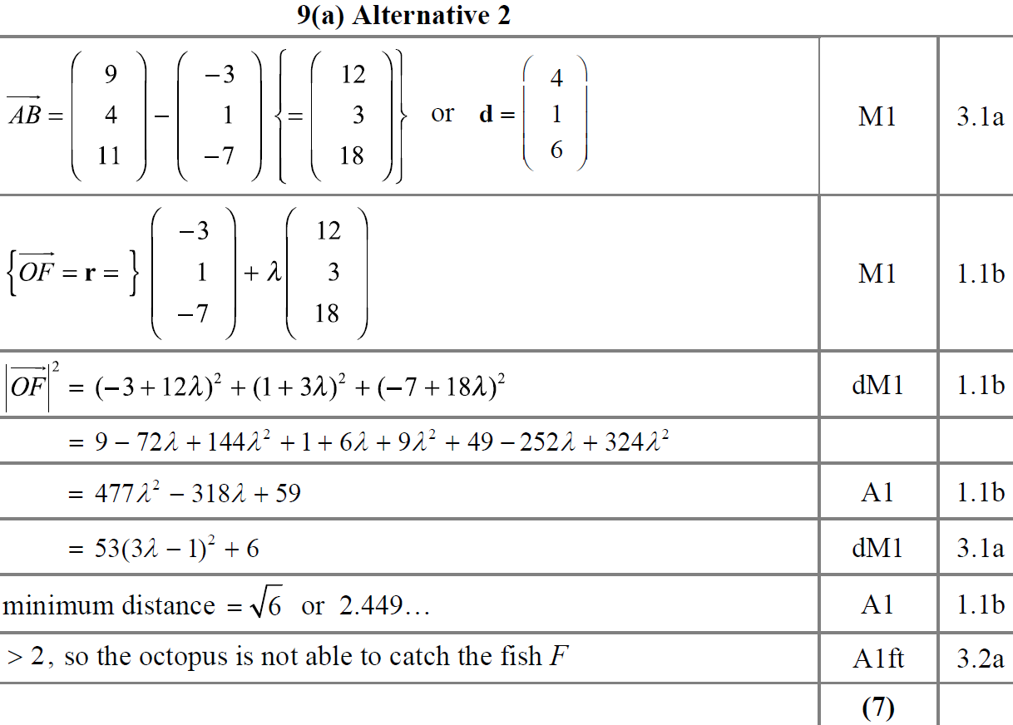
SAM
A Alternative 2

Slide 10
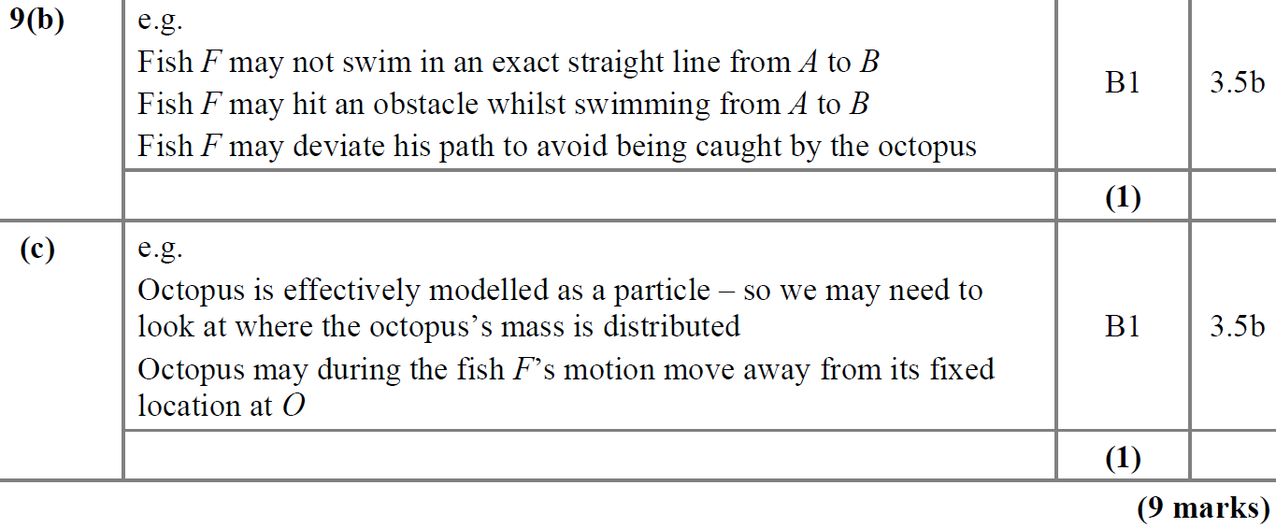
SAM
B
C
B notes
C notes

Slide 11
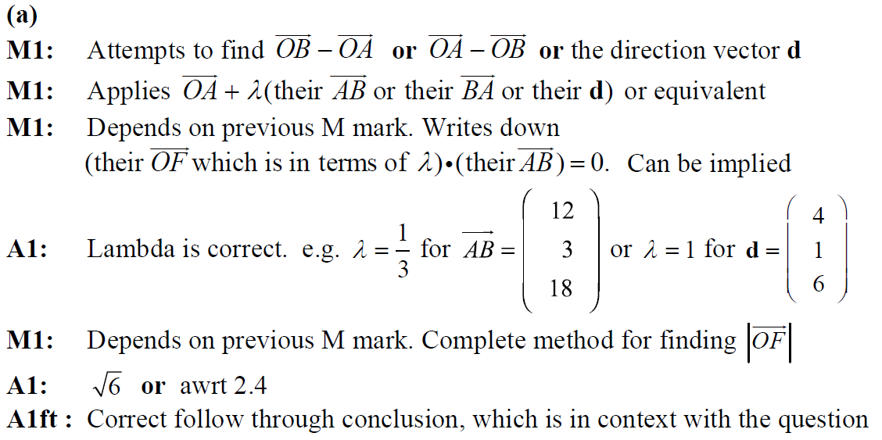
SAM
A notes

Slide 12
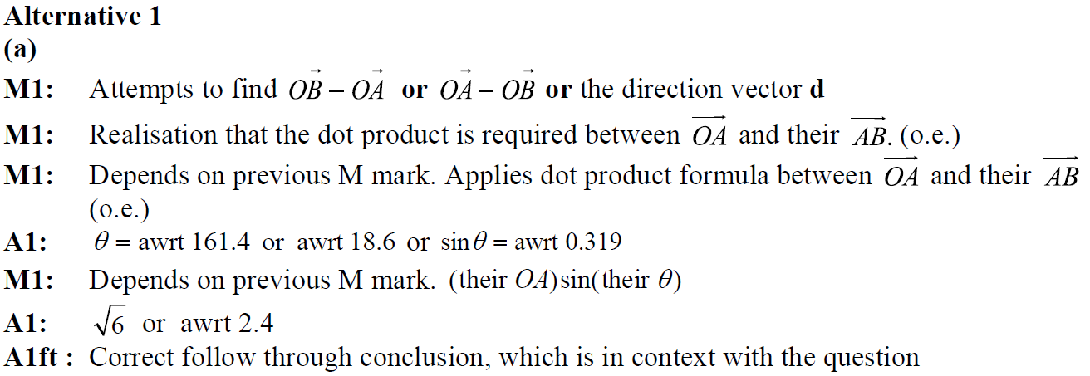
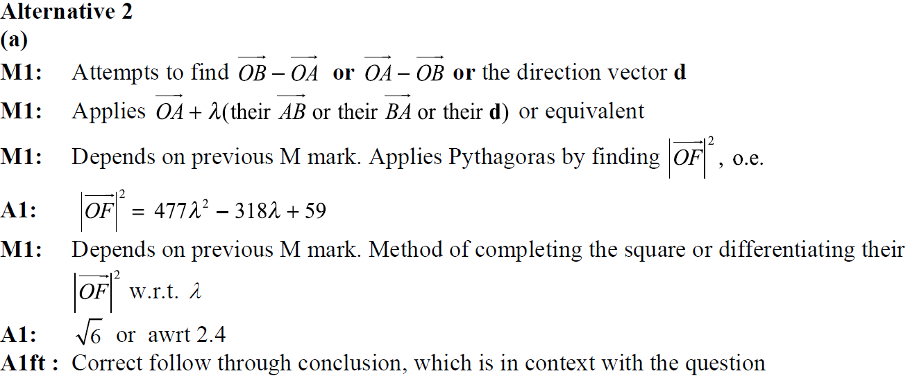
SAM
A Alternative 1 notes
A Alternative 2 notes

Slide 13
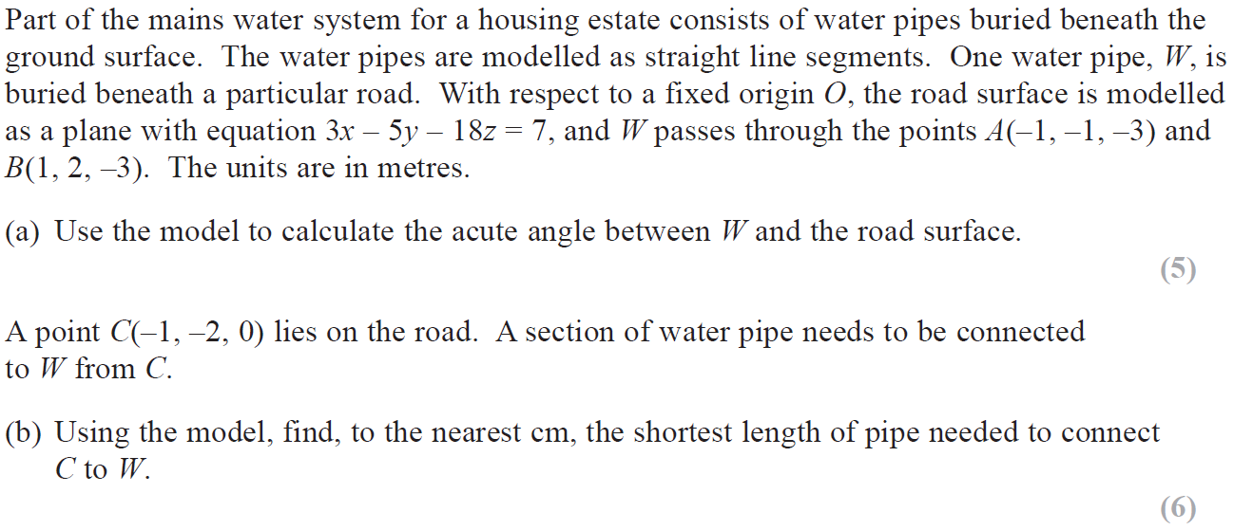
2018

Slide 14
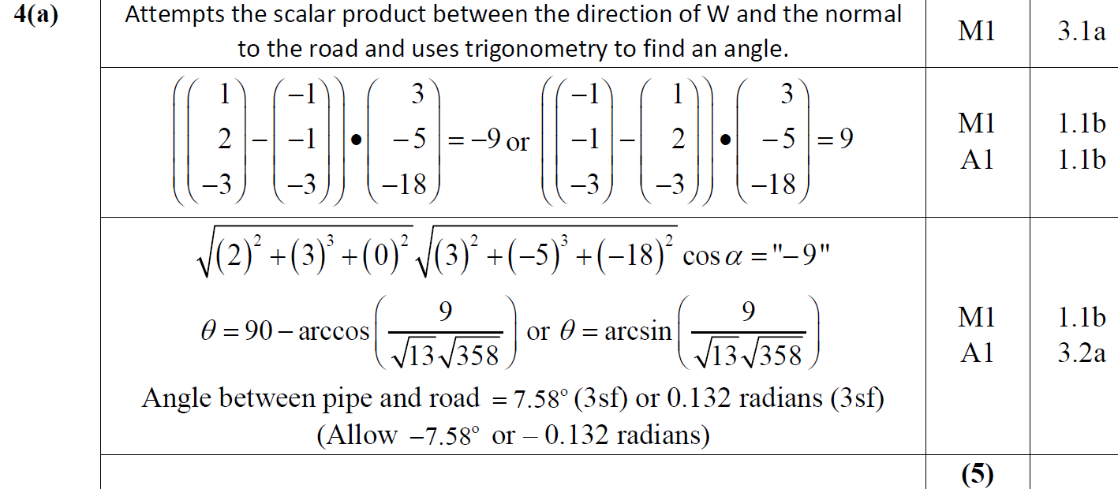
2018
A

Slide 15
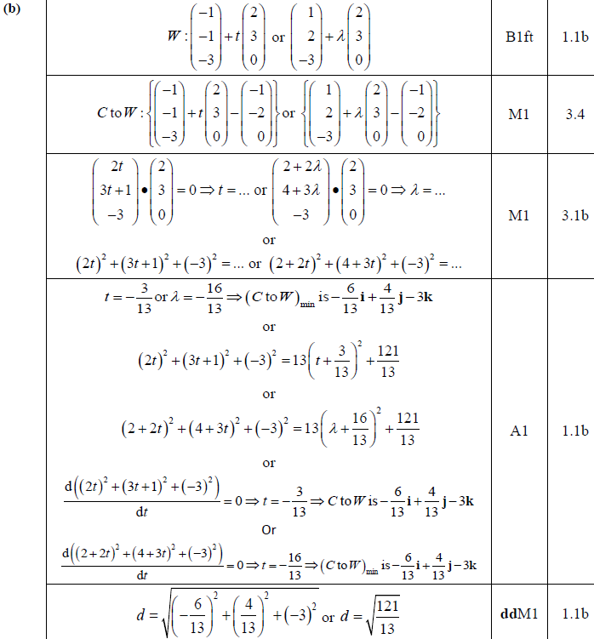
2018
B

Slide 16
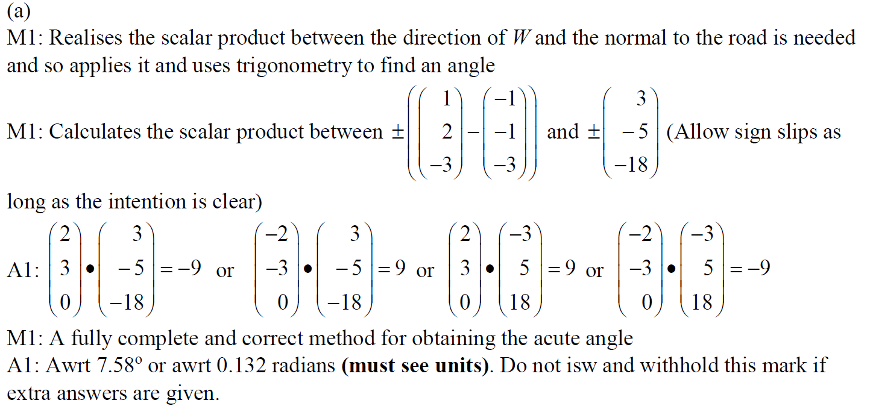
2018
A notes

Slide 17
2018
B notes

Slide 18
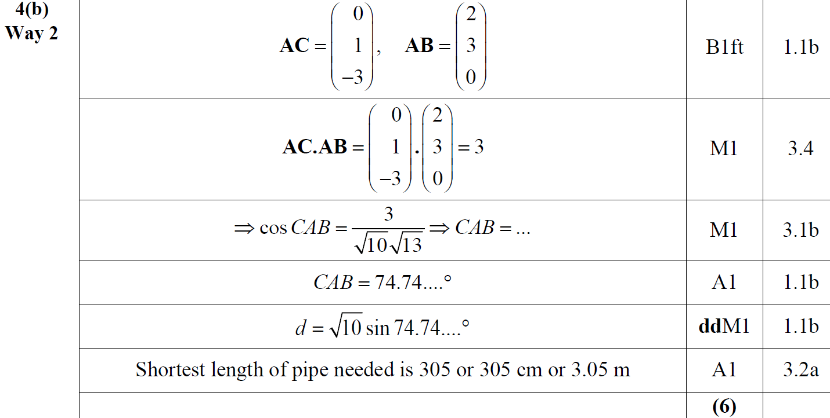
2018
B Alternative 1

Slide 19
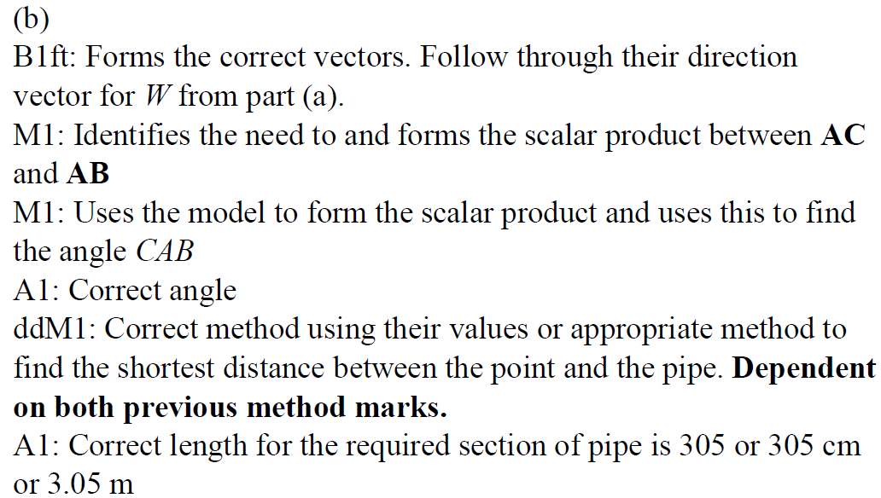
2018
B Alternative 1 notes

Slide 20
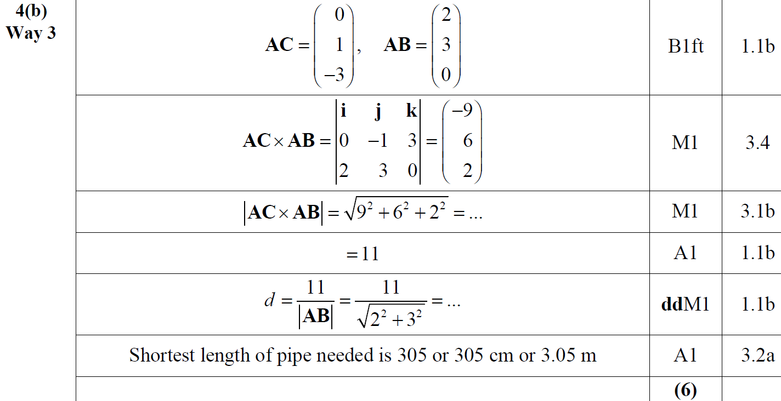
2018
B Alternative 2

Slide 21
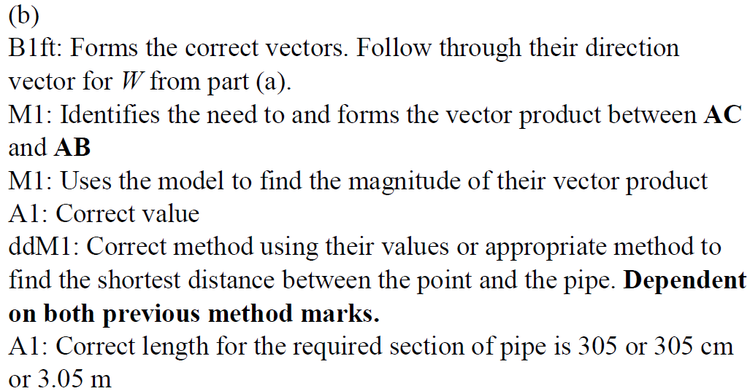
2018
B Alternative 2 notes

Slide 22
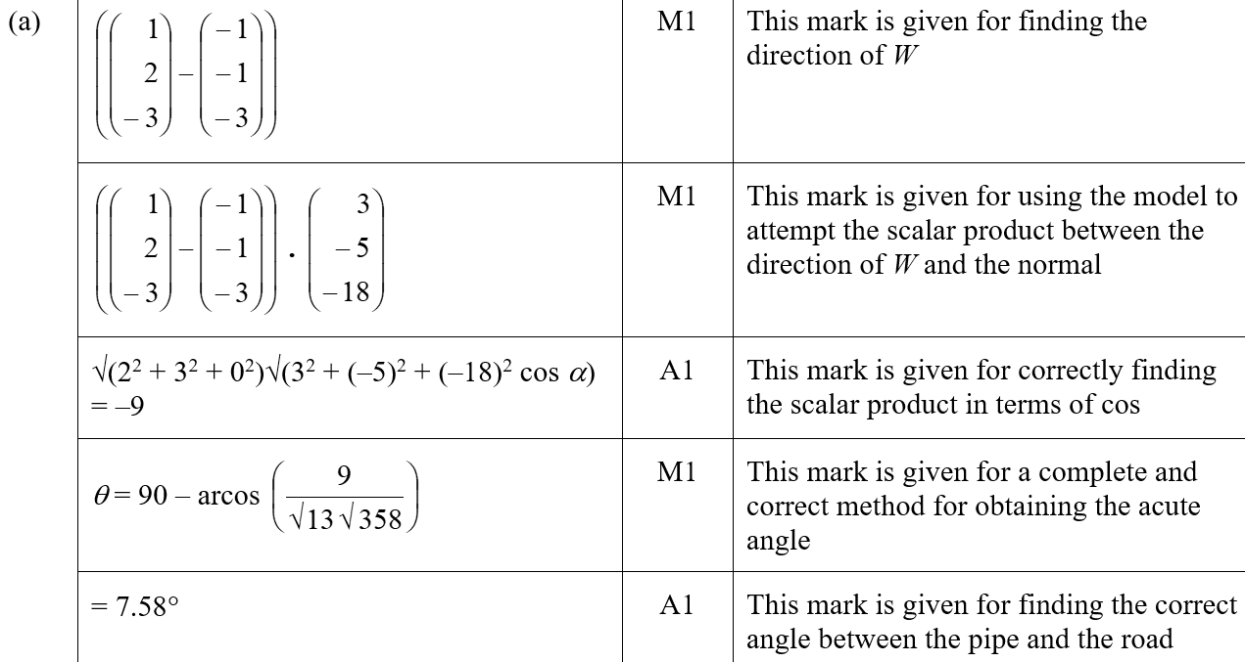
2018
A SF

Slide 23
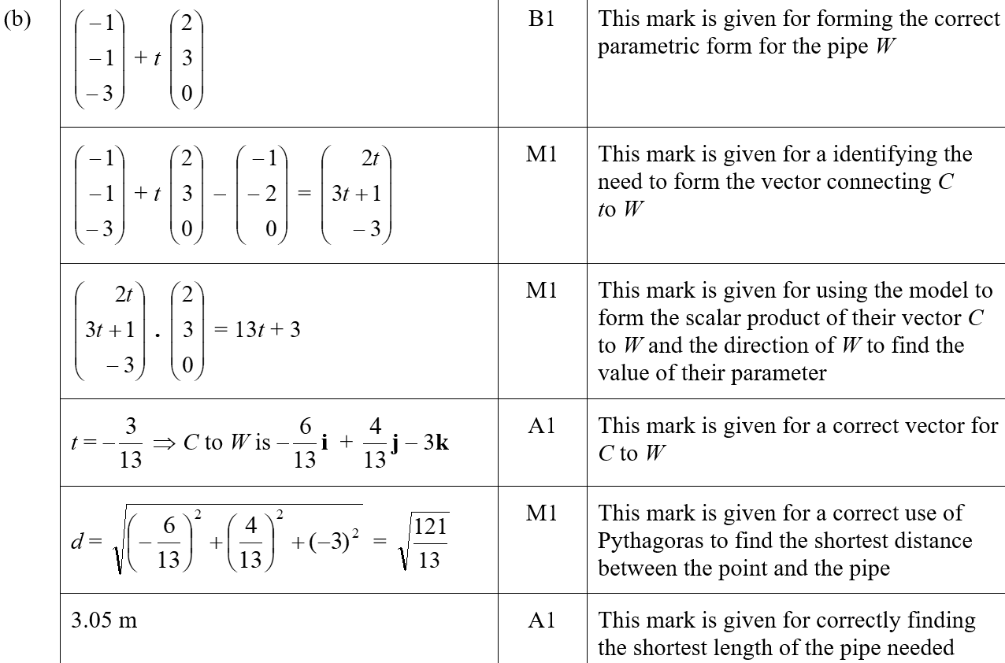
2018
B SF

Slide 24
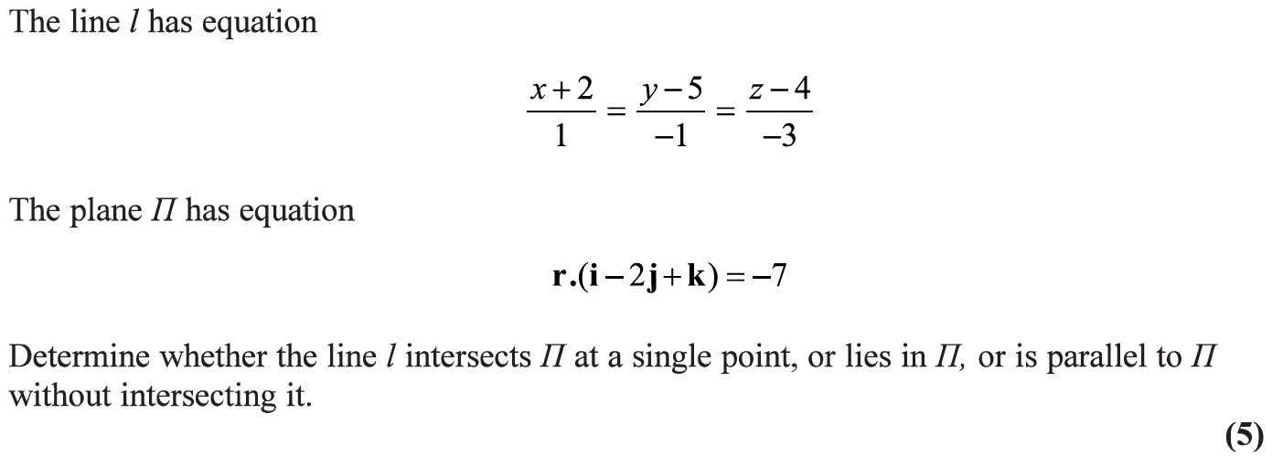
2019

Slide 25
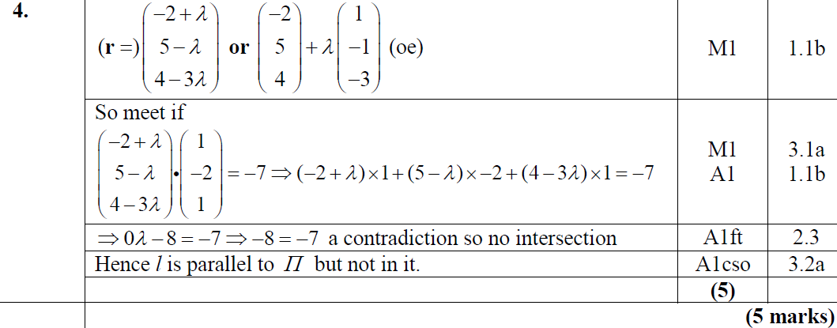
2019
A

Slide 26
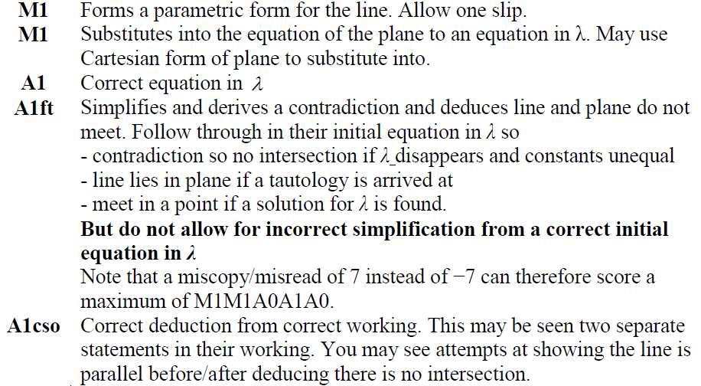
2019
A notes

Slide 27
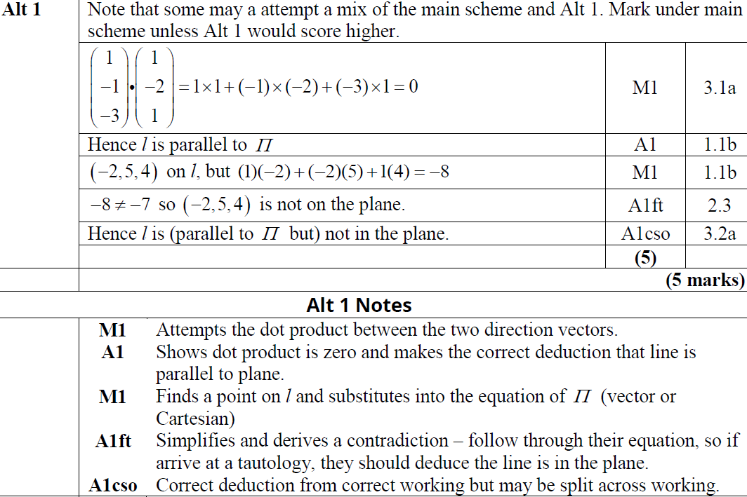
2019
A Alternative 1

Slide 28
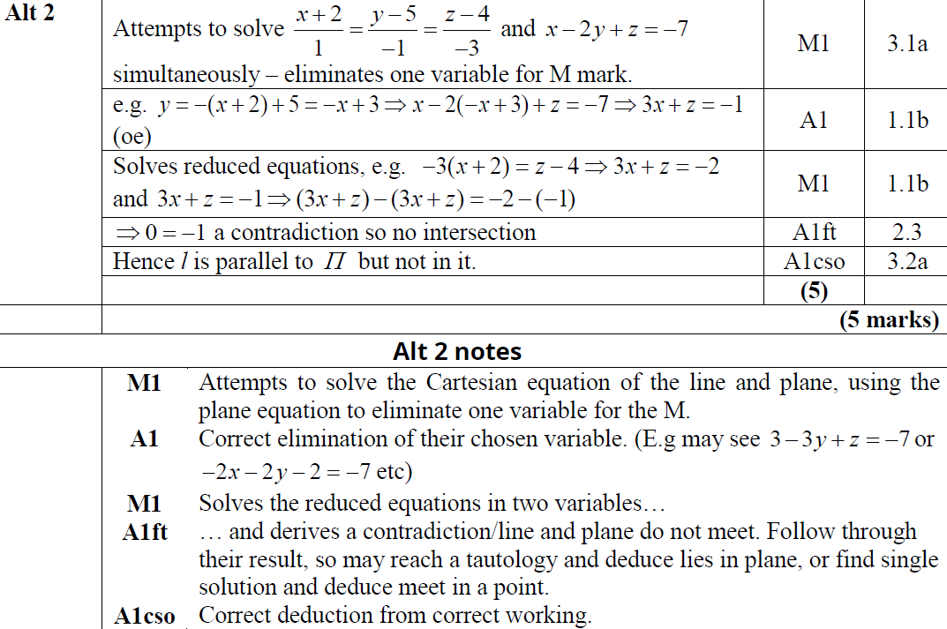
2019
A Alternative 2

Slide 29
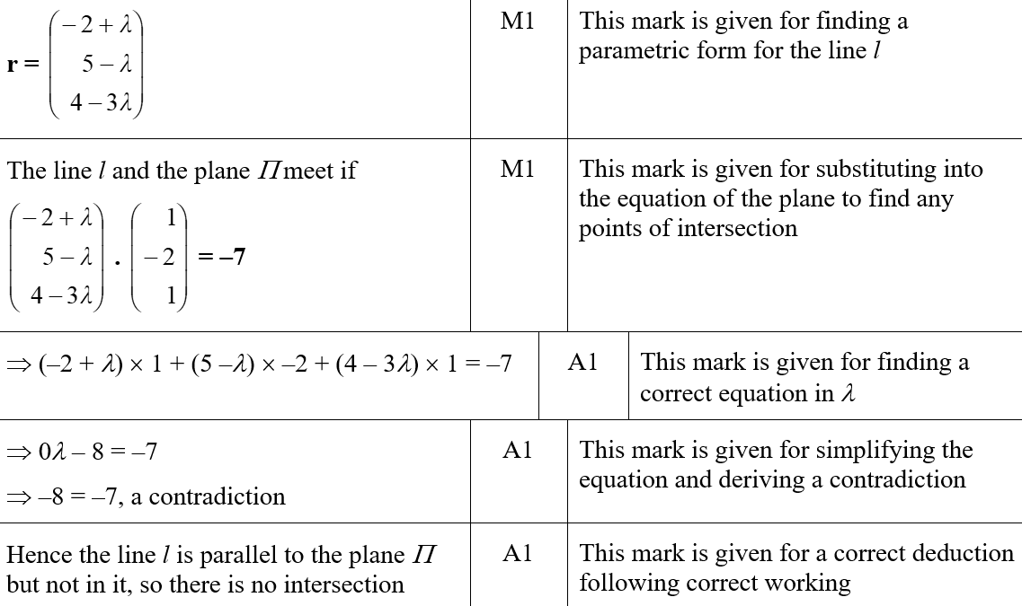
2019
A SF

Slide 30
2019

Slide 31
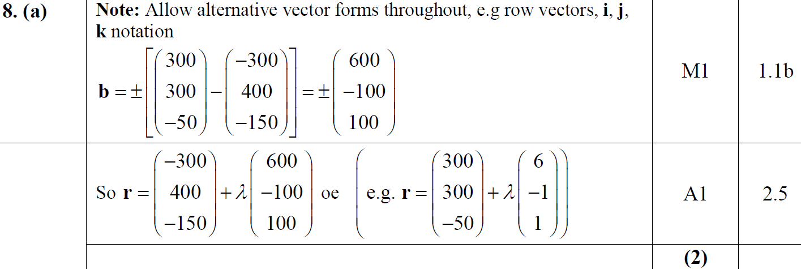
2019
A

Slide 32
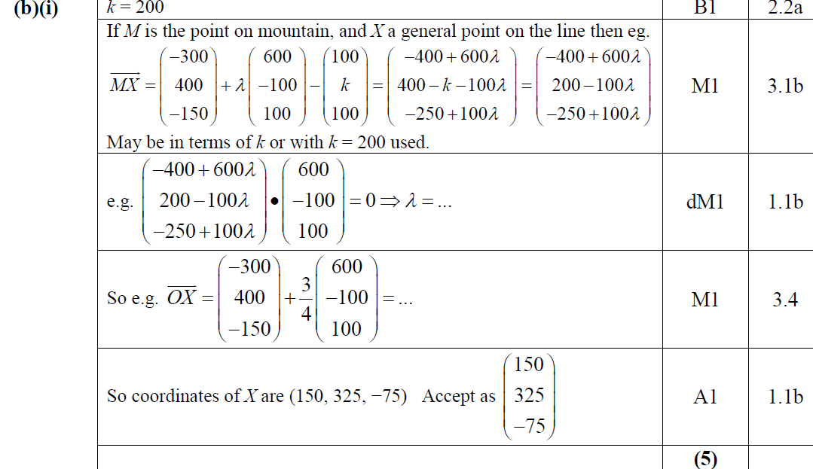
2019
B (i)

Slide 33
2019
B (ii)
C
D

Slide 34
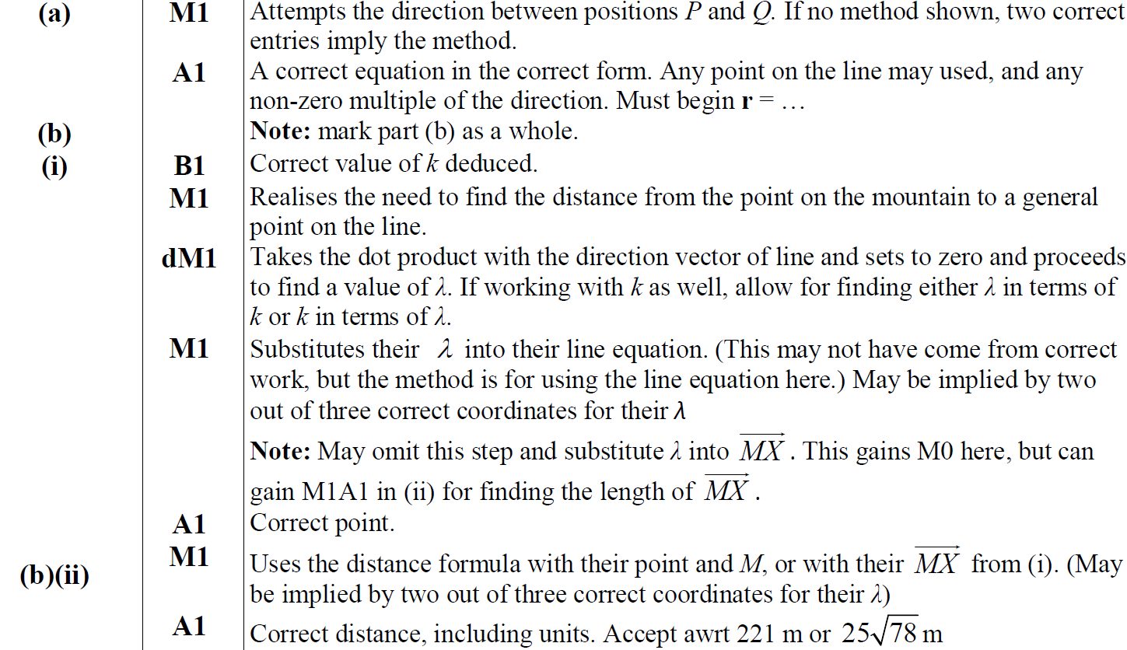
2019
A notes
B (i) notes
B (ii) notes

Slide 35
2019
C notes
D notes

Slide 36
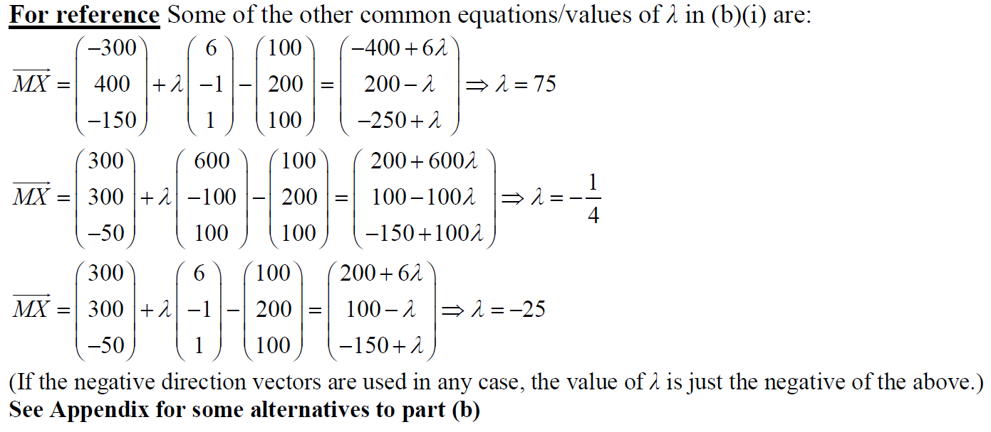
2019
B (i) reference

Slide 37
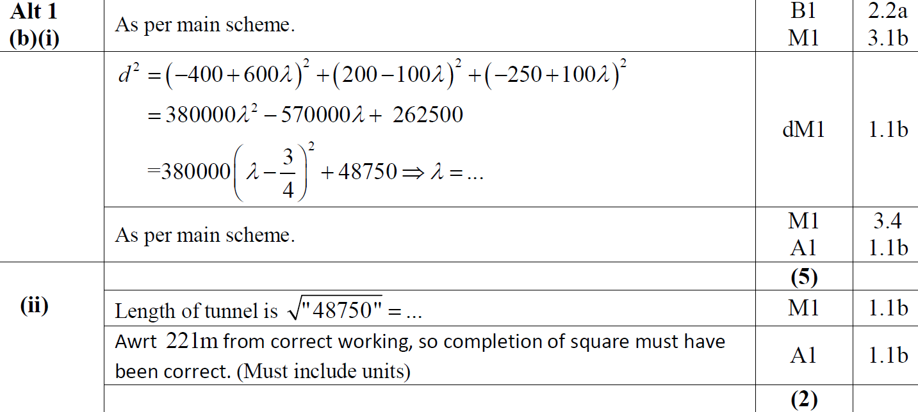
2019
B Alternative 1

Slide 38
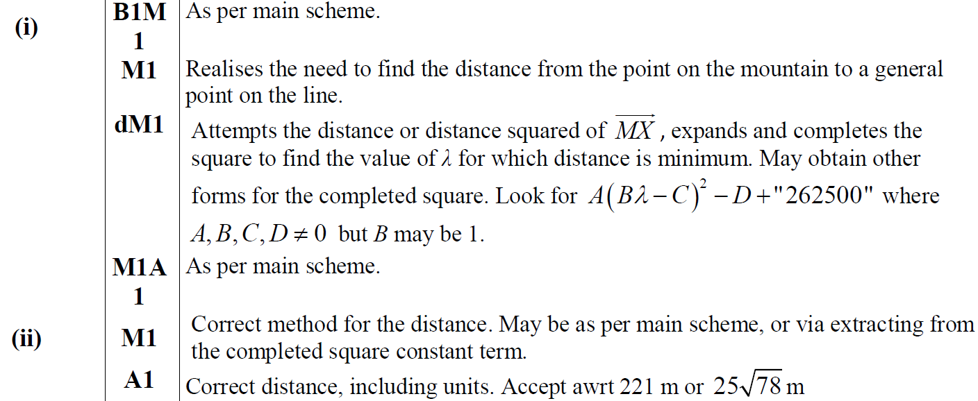
2019
B Alternative 1 notes

Slide 39
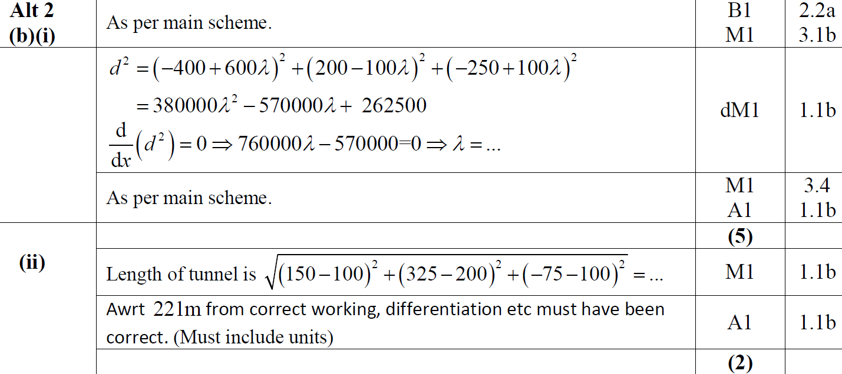
2019
B Alternative 2

Slide 40
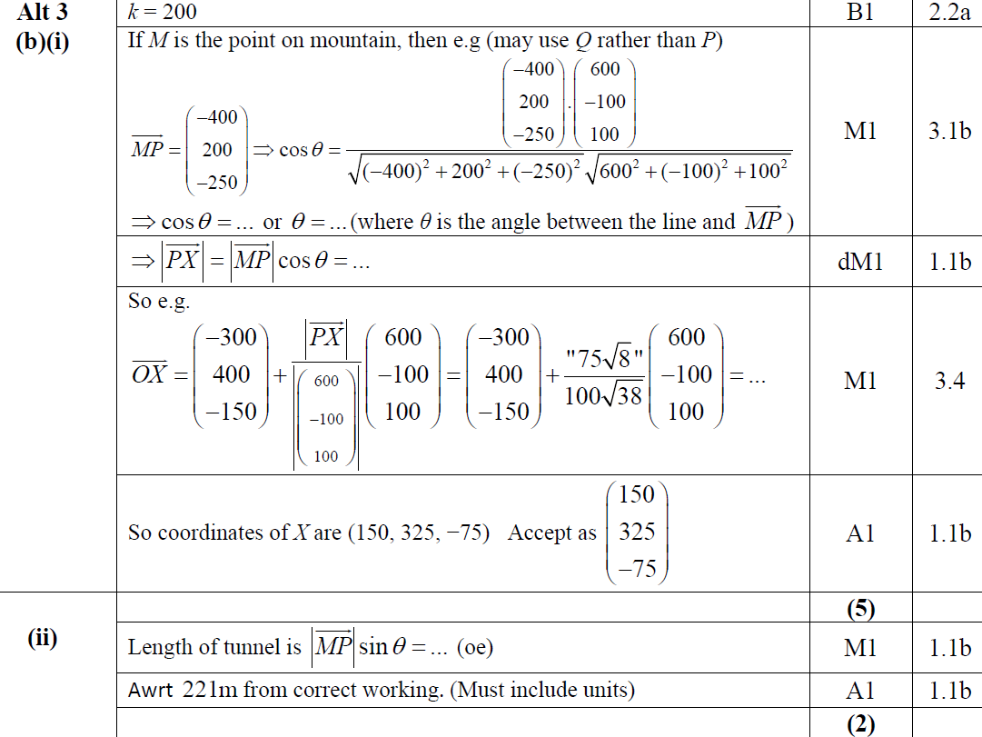
2019
B Alternative 3

Slide 41
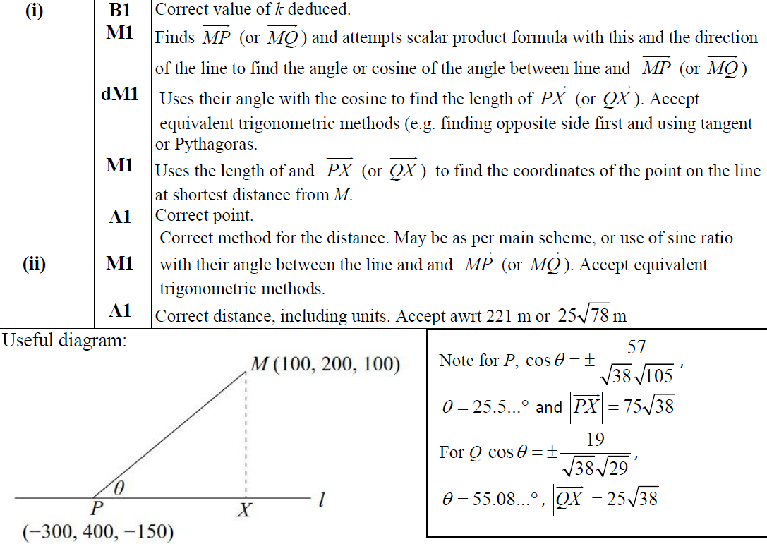
2019
B Alternative 3 notes & useful diagram

Slide 42
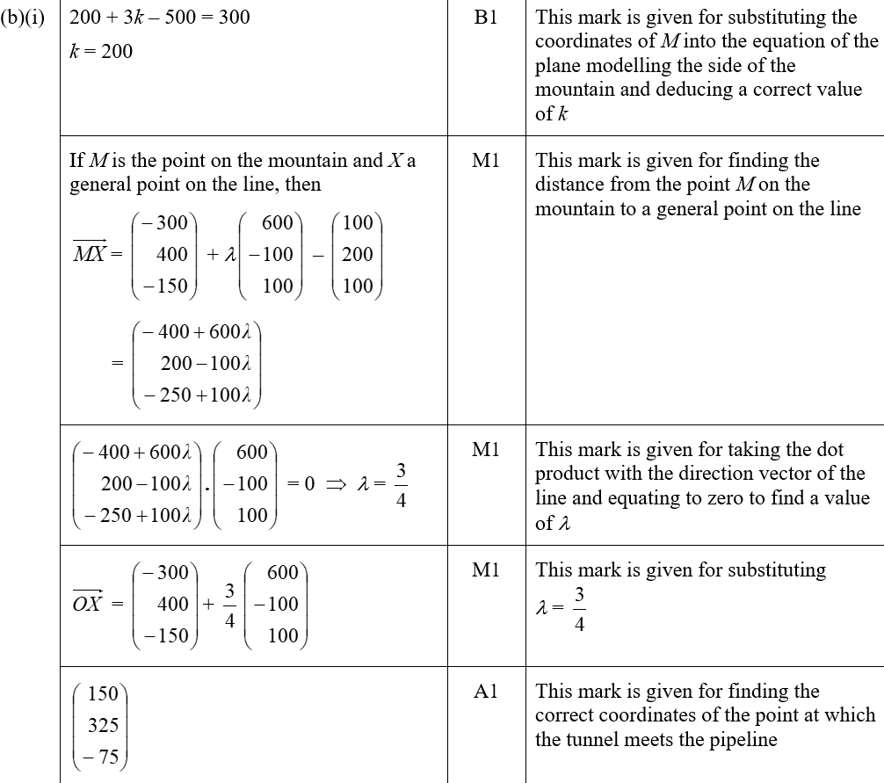
2019
B (i) SF

Slide 43
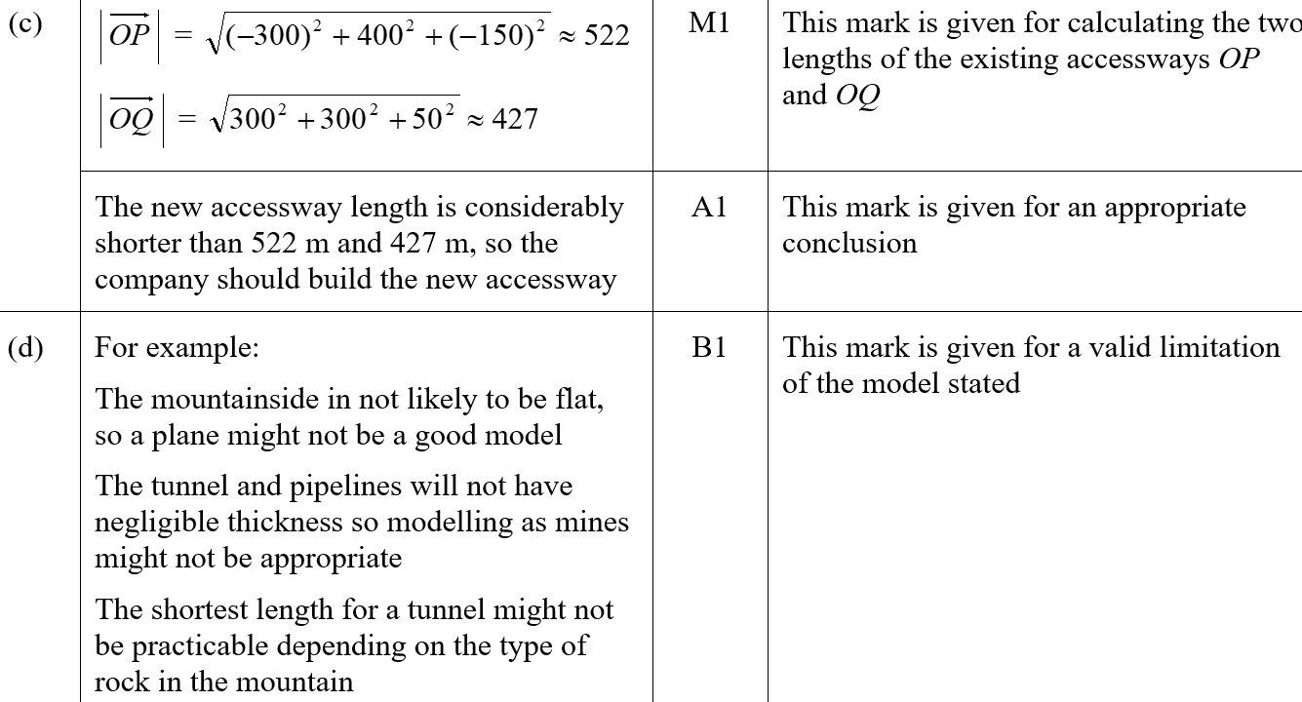
2019
B (ii) SF
C SF
D SF

Slide 44
SAM Paper 1

Slide 45
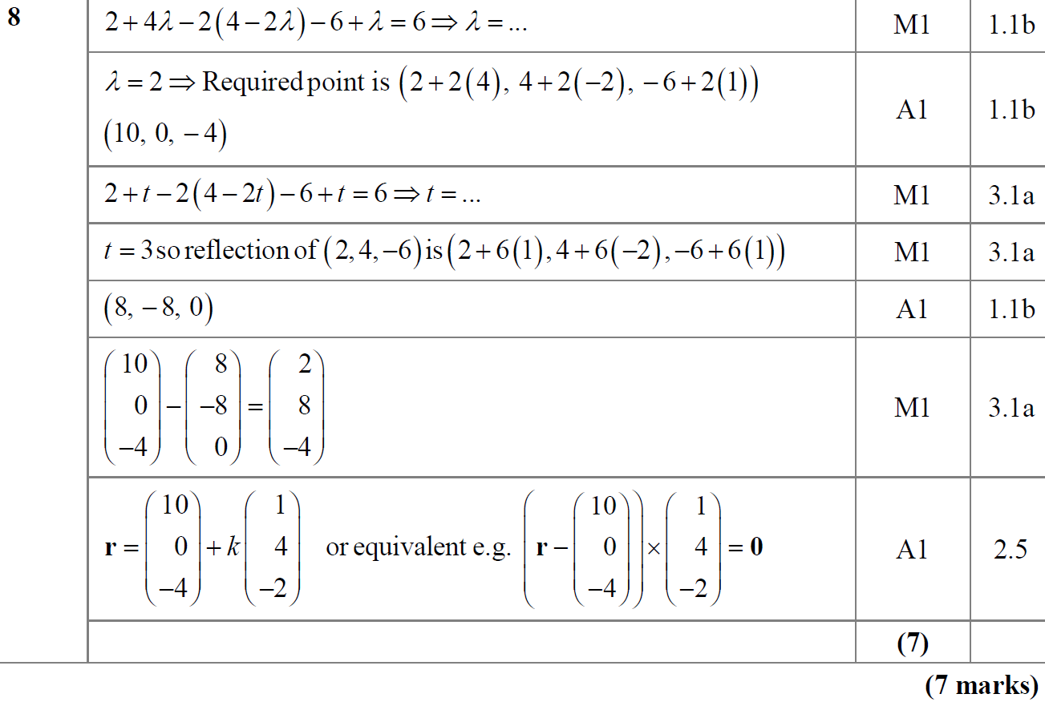
SAM Paper 1
A

Slide 46
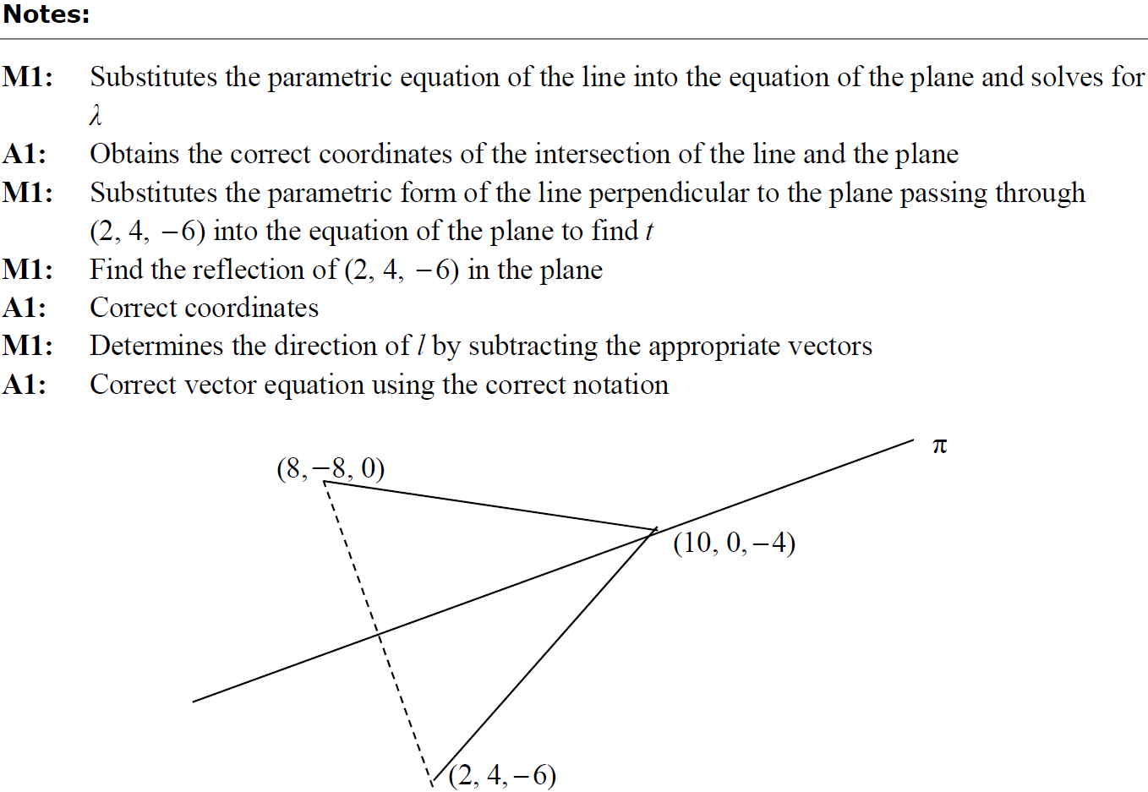
SAM Paper 1
A notes

Slide 47
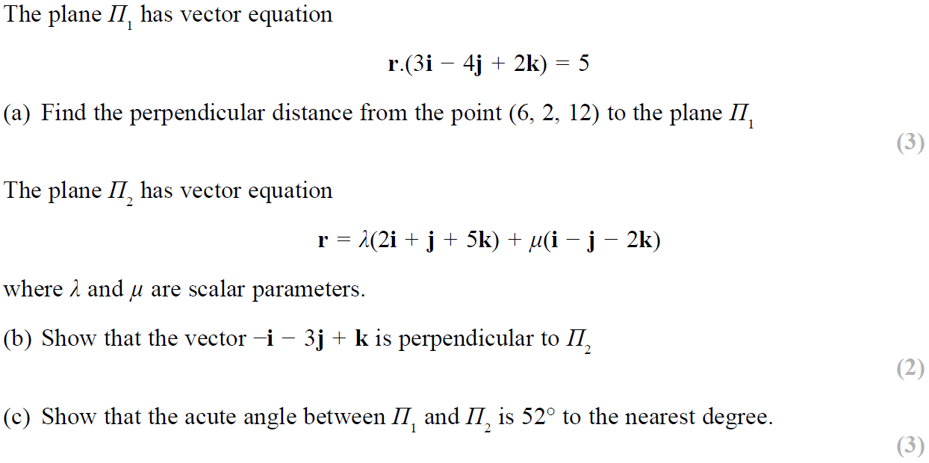
SAM Paper 2

Slide 48
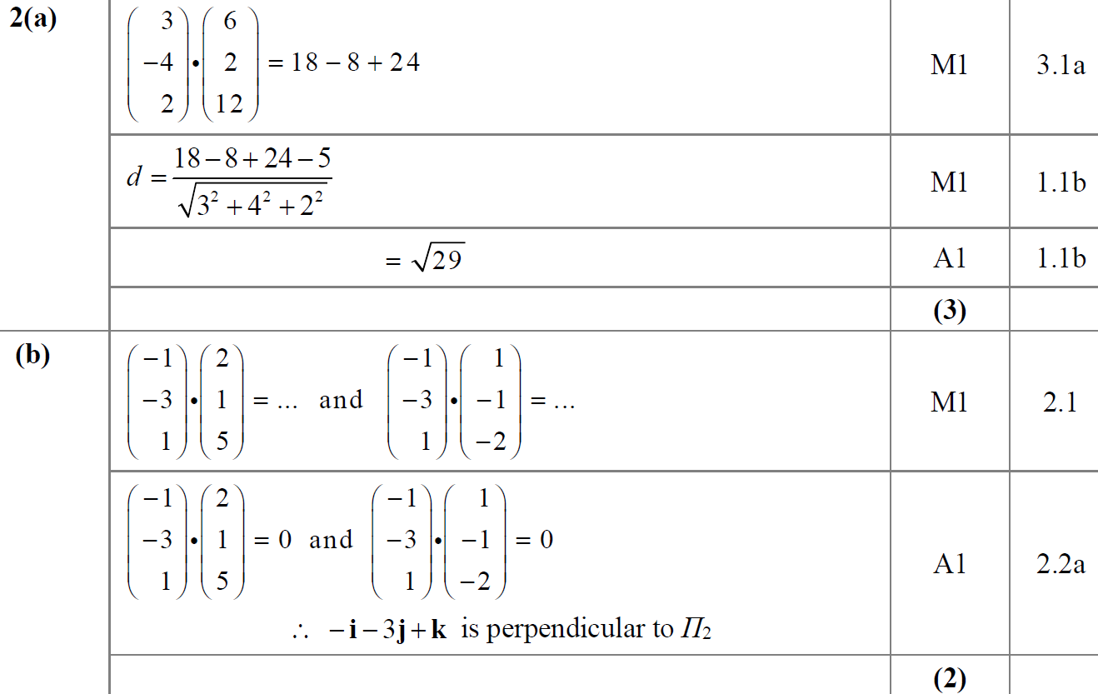
SAM Paper 2
A
B

Slide 49
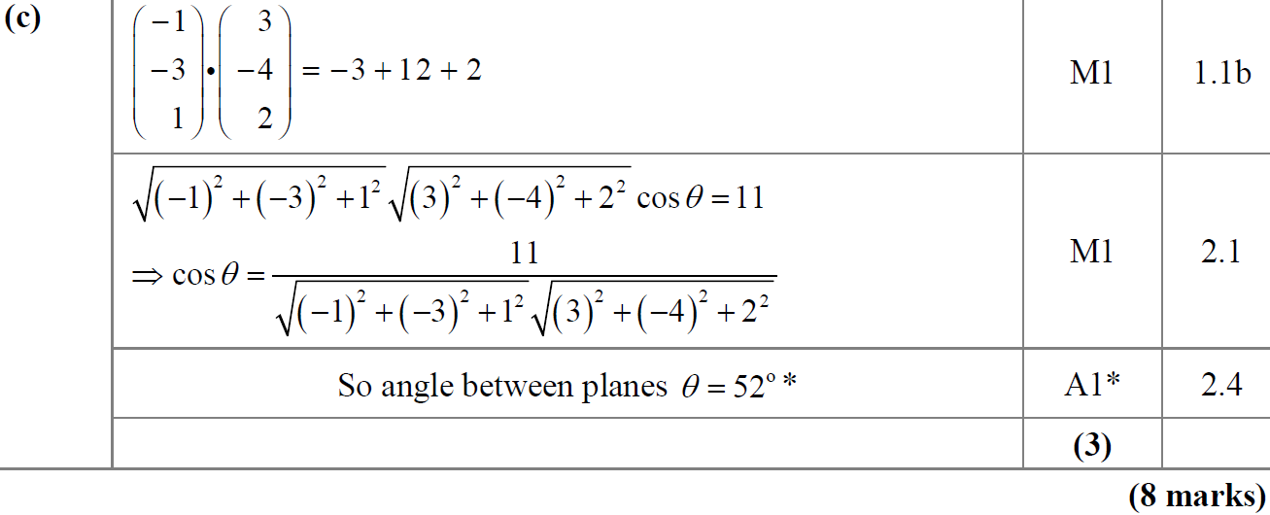
SAM Paper 2
C

Slide 50
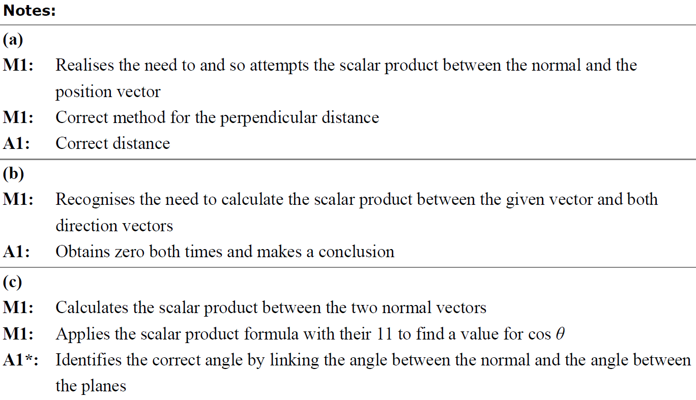
SAM Paper 2
A notes
B notes
C notes

Slide 51
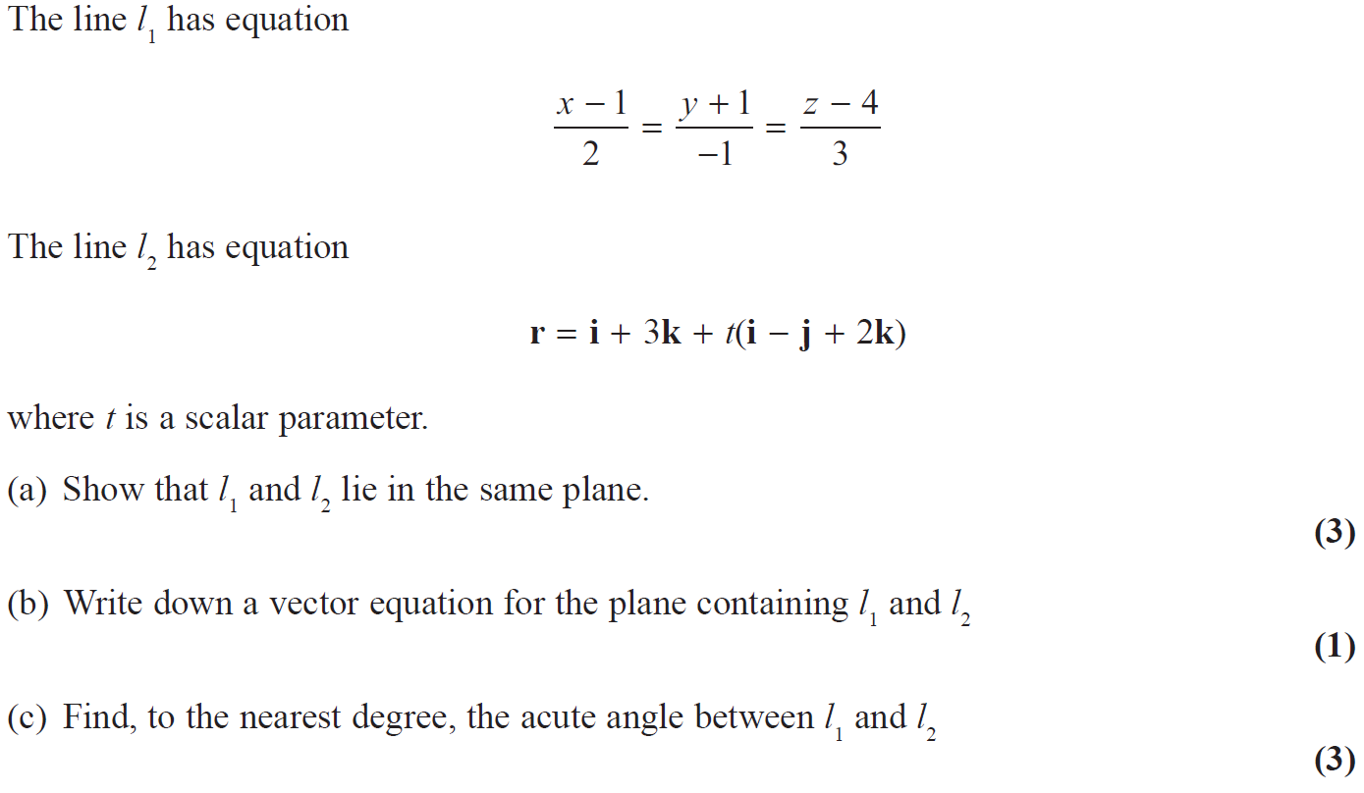
2019 Paper 1

Slide 52
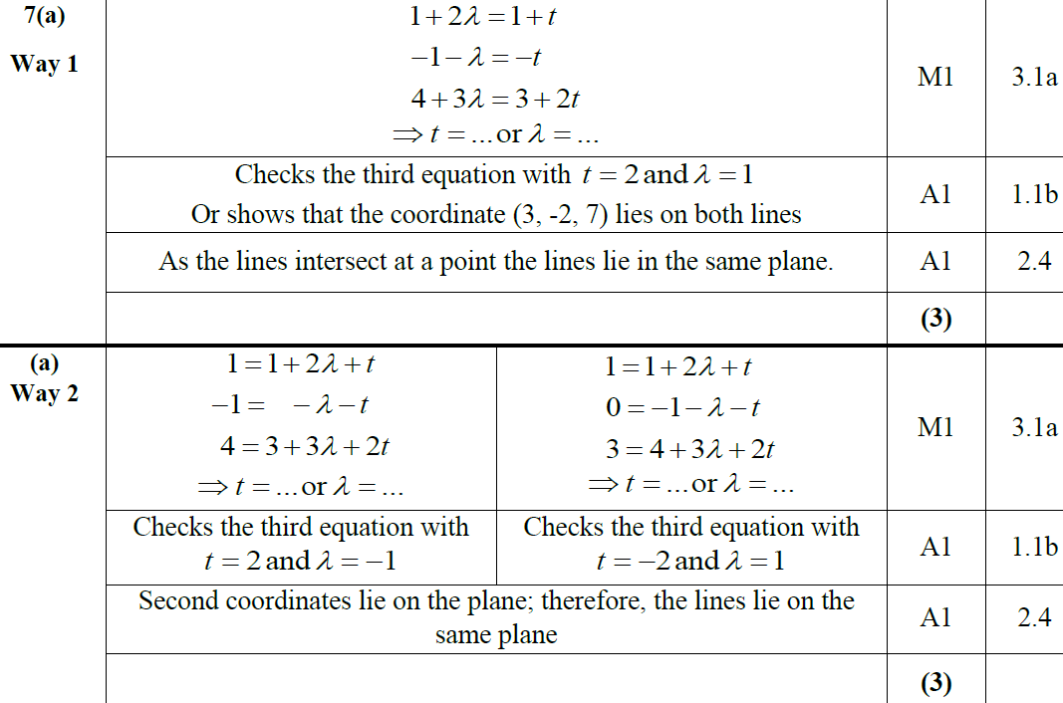
2019 Paper 1
A
A Alternative 1

Slide 53
2019 Paper 1
A Alternative 2

Slide 54
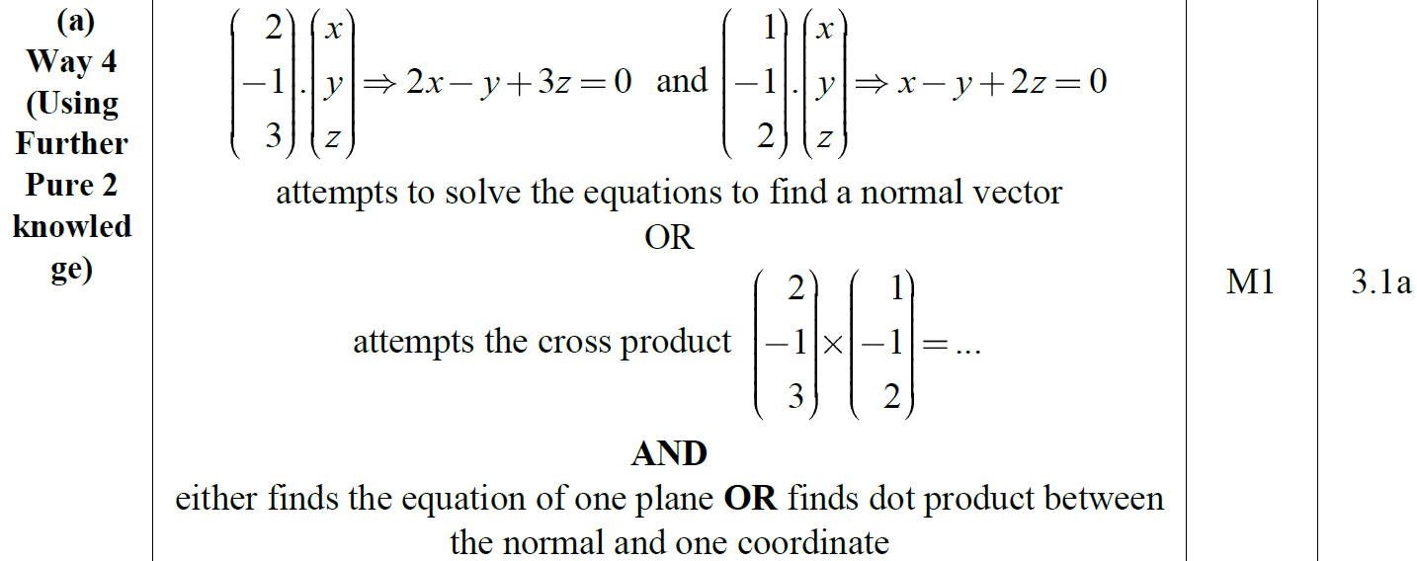
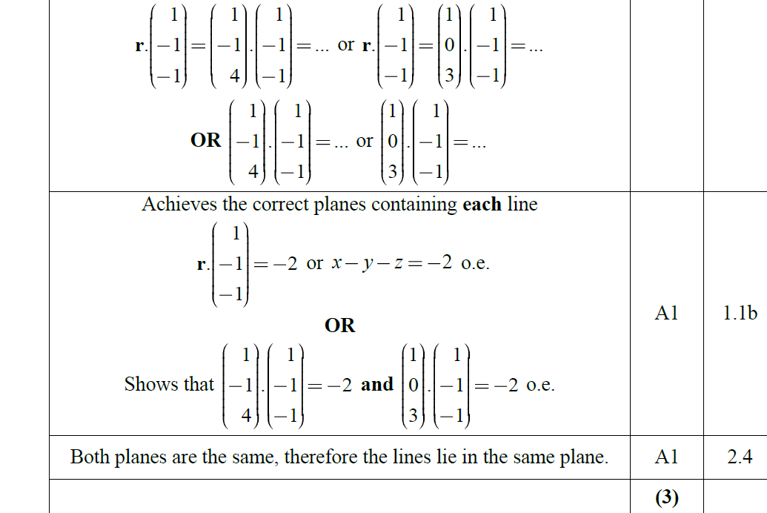
2019 Paper 1
A Alternative 3

Slide 55
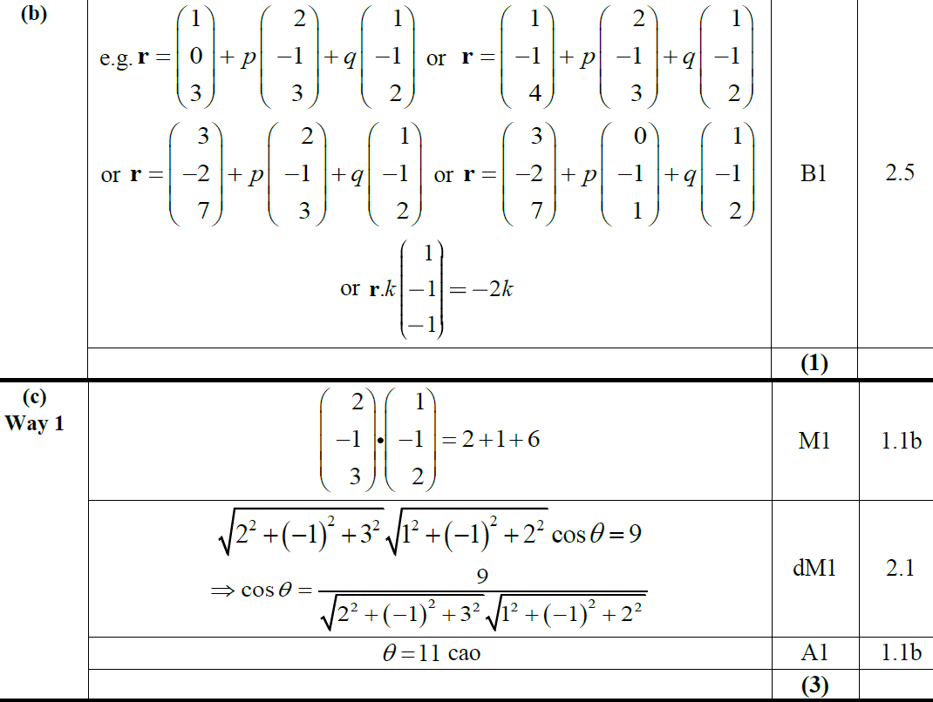
2019 Paper 1
B
C

Slide 56
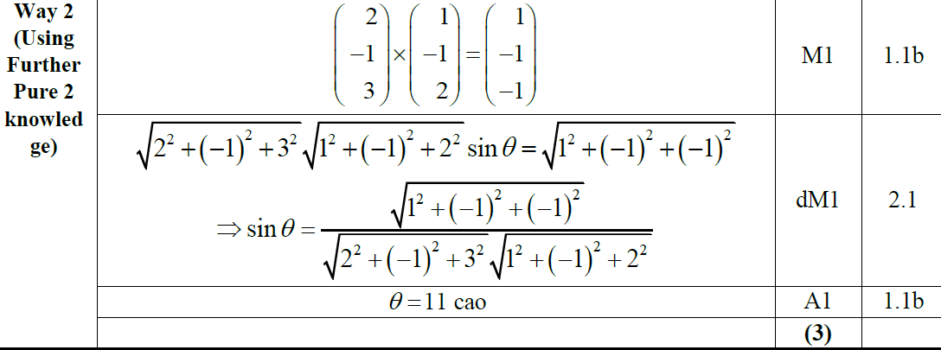
2019 Paper 1
C Alternative

Slide 57
2019 Paper 1
A notes

Slide 58
2019 Paper 1
A Alternative 1 notes
A Alternative 2 notes

Slide 59
2019 Paper 1
A Alternative 3 notes
B notes

Slide 60
2019 Paper 1
C notes
C Alternative notes

Slide 61
New Spec Q’s
Old Spec 3D Lines & Planes
C4
P6/ Old FP3
FP3
Jan 2006
Jan 2010
June 2014
June 2002
June 2009
June 2015
June 2006
June 2010
June 2015
June 2003
June 2010
June 2016
Jan 2007
Jan 2011
June 2016
June 2005
June 2011
June 2017
June 2007
June 2011
June 2017
June 2006
June 2013
June 2018
Jan 2008
Jan 2012
June 2018
June 2009
June 2013 R
June 2019
June 2008
June 2012
June 2014
Jan 2009
Jan 2013
June 2014 R
June 2009
June 2013
cross product part (ignore as not in this spec yet)

Slide 62
Jan 2006

Slide 63
Jan 2006
A
B
C

Slide 64
June 2006

Slide 65
June 2006
A

Slide 66
June 2006
B

Slide 67
June 2006
Alternative B

Slide 68
June 2006
C

Slide 69
June 2006
Alternative C

Slide 70
Jan 2007

Slide 71
Jan 2007
A

Slide 72
B
Jan 2007
C

Slide 73
Jan 2007
D

Slide 74
Jan 2007
D (Alternative 1)

Slide 75
Jan 2007
D (Alternative 2)

Slide 76
Jan 2007
D (Alternative 3)

Slide 77
Jan 2007
D (Alternative 4)

Slide 78
Jan 2007
D (Alternative 5)

Slide 79
June 2007

Slide 80
June 2007
A

Slide 81
June 2007
A (Alternative 1)
A (Alternative 2)

Slide 82
June 2007
A (Alternative 3)

Slide 83
June 2007
B

Slide 84
June 2007
Case 1
Case 2
Case 3
Case 4
Case 5

Slide 85
June 2007
Examples

Slide 86
Jan 2008

Slide 87
Jan 2008
A
B

Slide 88
Jan 2008
C

Slide 89
Jan 2008
D

Slide 90
Jan 2008
Alternative D (i)

Slide 91
Jan 2008
Alternative D (ii)

Slide 92
Jan 2008
Alternative D (ii)

Slide 93
June 2008

Slide 94
June 2008
A

Slide 95
June 2008
B
C

Slide 96
June 2008
D

Slide 97
Jan 2009

Slide 98
Jan 2009
A

Slide 99
Jan 2009
B

Slide 100
Jan 2009
C

Slide 101
Jan 2009
D

Slide 102
June 2009

Slide 103
June 2009
A
B
C

Slide 104
June 2009
D
E

Slide 105
Jan 2010

Slide 106
Jan 2010
A
B
C
D
E

Slide 107
Jan 2010
F

Slide 108
June 2010

Slide 109
June 2010
A
B
C

Slide 110
Jan 2011

Slide 111
Jan 2011
A
B
C
D

Slide 112
June 2011

Slide 113
June 2011
A
B

Slide 114
June 2011
C
D

Slide 115
Jan 2012

Slide 116
Jan 2012
A
B
C

Slide 117
Jan 2012
D
E
F

Slide 118
Jan 2012
A Notes
B Notes
C Notes

Slide 119
Jan 2012
D Notes
E Notes
F Notes

Slide 120
Jan 2012
Alternative C

Slide 121
Jan 2012
Alternative D

Slide 122
June 2012

Slide 123
June 2012
A
B
C

Slide 124
Jan 2013

Slide 125
Jan 2013
A
B

Slide 126
Jan 2013
C

Slide 127
June 2013

Slide 128
June 2013
A

Slide 129
June 2013
B

Slide 130
June 2014

Slide 131
June 2014
A
B
C

Slide 132
June 2014
D
E
F

Slide 133
June 2014
F

Slide 134
June 2015

Slide 135
June 2015
A
B

Slide 136
June 2015
C
D

Slide 137
June 2015
A notes
B notes
B Alternative

Slide 138
June 2015
C notes

Slide 139
June 2015
D Alternatives

Slide 140
June 2015
D notes

Slide 141
June 2016

Slide 142
June 2016
A
B
C

Slide 143
June 2016
D
E

Slide 144
June 2016
F

Slide 145
June 2016
A notes
B notes
C notes

Slide 146
June 2016
D notes

Slide 147
June 2016
E notes
General notes

Slide 148
June 2016
F notes

Slide 149
June 2017

Slide 150
June 2017
A

Slide 151
June 2017
B
C

Slide 152
June 2017
D
E

Slide 153
June 2017
E Alternative 1

Slide 154
June 2017
E Alternative 2

Slide 155
June 2017
E Alternative 3
E Alternative 4

Slide 156
June 2017
E Alternative 5
A notes
B notes

Slide 157
June 2017
B Alternative
C notes
E notes

Slide 158
June 2017
D Alternative 1
D Alternative 2

Slide 159
June 2017
D Alternative 3

Slide 160
June 2018

Slide 161
June 2018
A
B

Slide 162
June 2018
C
D
E

Slide 163
June 2018
B Alternative 1

Slide 164
June 2018
B Alternative 2

Slide 165
June 2018
E Alternative

Slide 166
June 2018
B notes

Slide 167
June 2018
C notes

Slide 168
June 2018
D notes
E notes

Slide 169
June 2018
C Alternative 1
C Alternative 2

Slide 170
June 2002

Slide 171
June 2002
A
B
C

Slide 172
June 2002
D
E
F

Slide 173
June 2003

Slide 174
June 2003
A
B
C

Slide 175
June 2003
D
E
F

Slide 176
June 2005

Slide 177
June 2005
A
B
C

Slide 178
June 2005
D

Slide 179
June 2005
D Alternative

Slide 180
June 2006

Slide 181
June 2006
A
B
C

Slide 182
June 2006
C Equivalents
D

Slide 183
June 2009

Slide 184
June 2009
A
B
C

Slide 185
June 2009

Slide 186
June 2009
A
B

Slide 187
June 2009
C

Slide 188
June 2010

Slide 189
June 2010
A

Slide 190
June 2010
B
C

Slide 191
June 2011

Slide 192
June 2011
A
B

Slide 193
June 2011
C
D

Slide 194
June 2013

Slide 195
June 2013
A

Slide 196
June 2013
B
C

Slide 197
June 2013
C Alternative 1

Slide 198
June 2013
C Alternative 2

Slide 199
June 2013 Reserve

Slide 200
June 2013 Reserve
A

Slide 201
June 2013 Reserve
B

Slide 202
June 2013 Reserve
B Alternative

Slide 203
June 2014

Slide 204
June 2014
A
B

Slide 205
June 2014
C

Slide 206
June 2014 Reserve

Slide 207
June 2014 Reserve
A

Slide 208
June 2014 Reserve
A Alternatives

Slide 209
June 2014 Reserve
B

Slide 210
June 2015

Slide 211
June 2015
A
B

Slide 212
June 2015
C
D

Slide 213
June 2016

Slide 214
June 2016
A

Slide 215
June 2016
B

Slide 216
June 2016
C

Slide 217
June 2017

Slide 218
June 2017
A

Slide 219
June 2017
B

Slide 220
June 2017
C

Slide 221
June 2018

Slide 222
June 2018
A

Slide 223
June 2018
A Alternatives

Slide 224
June 2018
B

Slide 225
June 2018
B without cross prodict

Slide 226
June 2018
B Alternatives

Slide 227
June 2018
C

Slide 228
June 2019

Slide 229
June 2019
A

Slide 230
June 2019
B

Slide 231
June 2019
B
C

Slide 232
June 2019
C Alternative
B
A notes
B notes

