Slide 1
Teachings for
Exercise 3D

Slide 2
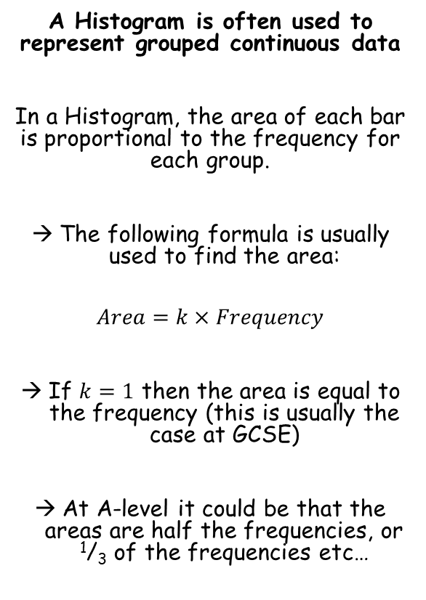
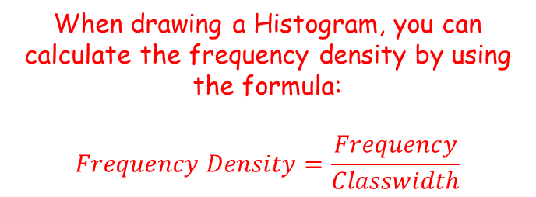
Representations of Data
$$Area=k×Frequency$$
$$Frequency Density=\frac{Frequency}{Classwidth}$$
A Histogram is often used to represent grouped continuous data
In a Histogram, the area of each bar is proportional to the frequency for each group.
The following formula is usually used to find the area:
$$Area=k×Frequency$$
If $k=1$ then the area is equal to the frequency (this is usually the case at GCSE)
At A-level it could be that the areas are half the frequencies, or ¹/₃ of the frequencies etc…
When drawing a Histogram, you can calculate the frequency density by using the formula:
$$Frequency Density=\frac{Frequency}{Classwidth}$$
3D

Slide 3
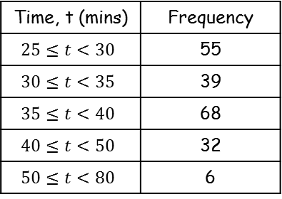
Representations of Data
$$Area=k×Frequency$$
$$Frequency Density=\frac{Frequency}{Classwidth}$$
Freq. Density
A Histogram is often used to represent grouped continuous data
A random sample of 200 students was asked how long it took them to complete their homework the previous night. The time was recorded and summarised in the table to the right.
Draw a Histogram and frequency polygon for this data
Estimate how many students took between 36 and 45 minutes to complete their homework
Time, t (mins) | Frequency
$$25≤t<30$$ | 55
$$30≤t<35$$ | 39
$$35≤t<40$$ | 68
$$40≤t<50$$ | 32
$$50≤t<80$$ | 6
11
7.8
13.6
3.2
0.2
Frequency Density
15
10
5
0
60
20
30
40
50
70
80
Time (mins)
There should be no gaps between bars
The widths will differ depending on the groups
3D

Slide 4
Representations of Data
$$Area=k×Frequency$$
$$Frequency Density=\frac{Frequency}{Classwidth}$$
Freq. Density
A Histogram is often used to represent grouped continuous data
A random sample of 200 students was asked how long it took them to complete their homework the previous night. The time was recorded and summarised in the table to the right.
Draw a Histogram and frequency polygon for this data
Estimate how many students took between 36 and 45 minutes to complete their homework
Time, t (mins) | Frequency
$$25≤t<30$$ | 55
$$30≤t<35$$ | 39
$$35≤t<40$$ | 68
$$40≤t<50$$ | 32
$$50≤t<80$$ | 6
11
7.8
13.6
3.2
0.2
Frequency Density
15
10
5
0
60
20
30
40
50
70
80
Time (mins)
To draw a frequency polygon, join the tops of each bar…
3D

Slide 5
Representations of Data
$$Area=k×Frequency$$
$$Frequency Density=\frac{Frequency}{Classwidth}$$
Freq. Density
A Histogram is often used to represent grouped continuous data
A random sample of 200 students was asked how long it took them to complete their homework the previous night. The time was recorded and summarised in the table to the right.
Draw a Histogram and frequency polygon for this data
Estimate how many students took between 36 and 45 minutes to complete their homework
Time, t (mins) | Frequency
$$25≤t<30$$ | 55
$$30≤t<35$$ | 39
$$35≤t<40$$ | 68
$$40≤t<50$$ | 32
$$50≤t<80$$ | 6
11
7.8
13.6
3.2
0.2
Frequency Density
15
10
5
0
36
45
60
20
30
40
50
70
80
Time (mins)
Calculate the area between 36 and 45 students (2 rectangles)
$$4×13.6$$
$$+ 5×3.2$$
$=70.4 \left(70\right)$ students
3D

Slide 6
Representations of Data
$$Area=k×Frequency$$
$$Frequency Density=\frac{Frequency}{Classwidth}$$
A Histogram is often used to represent grouped continuous data
A random sample of daily mean temperatures $(T,℃)$ was taken from the large data set for Hurn in 2015. The temperatures were summarised in a grouped frequency and represented by a Histogram.
Give a reason to support the use of a Histogram to represent this data
Write down the underlying feature associated with each of the bars in a Histogram
Since temperature is continuous, and the data is already in groups, a Histogram is appropriate
The area of each bar is proportional to the frequency
3D

Slide 7
Representations of Data
$$Area=k×Frequency$$
$$Frequency Density=\frac{Frequency}{Classwidth}$$
A Histogram is often used to represent grouped continuous data
On the Histogram, the rectangle representing the $16≤T<18$ class was 3.2cm high and 2cm wide. The frequency for this class was 8.
c) Show that each day is represented by an area of 0.8
d) Given that the total area of the Histogram was 48cm², find the total number of days in the sample.
$$Area=6.4{cm}^{2}$$
$$3.2cm$$
$$2cm$$
You could write the area and frequency as a ratio (or use the formula to the top-left of the page)
$$8 days=6.4{cm}^{2}$$
Divide by 8
$$1 day=0.8{cm}^{2}$$
3D

Slide 8
Representations of Data
$$Area=k×Frequency$$
$$Frequency Density=\frac{Frequency}{Classwidth}$$
A Histogram is often used to represent grouped continuous data
On the Histogram, the rectangle representing the $16≤T<18$ class was 3.2cm high and 2cm wide. The frequency for this class was 8.
c) Show that each day is represented by an area of 0.8
d) Given that the total area of the Histogram was 48cm², find the total number of days in the sample.
$$1 day=0.8{cm}^{2}$$
Multiply by 60 (you can find this value using your calculator)
$$60 days$$
$$=48{cm}^{2}$$
3D

