Slide 1
Statistics
Representations of Data
Twitter: @Owen134866
www.mathsfreeresourcelibrary.com

Slide 2
Prior Knowledge Check
The table shows the number of siblings for 50 Year 12 students
Draw a bar chart and a pie chart to show the data:
2) Work out the interquartile range for this set of data:
3) Work out the mean and standard deviation for this set of data:
3 | 5 | 8 | 9
9 | 11 | 14 | 15
18 | 20 | 21 | 24
Number of siblings | Frequency
0 | 5
1 | 8
2 | 24
3 | 10
4 | 3
11
17 | 19 | 20 | 25
28 | 31 | 32 | 32
35 | 37 | 38
28.5, 7.02

Slide 3
Teachings for
Exercise 3A

Slide 4


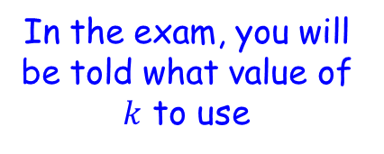
Representations of Data
An outlier is an extreme value which lies outside the overall pattern of data
There are different ways to calculate outliers, but a common definition of an outlier is:
The interquartile range, multiplied by a constant
Upper quartile
Greater than
$$Q_{3}+k(Q_{3}−Q_{1})$$
In the exam, you will be told what value of $k$ to use
OR
Less than
$$Q_{1}−k(Q_{3}−Q_{1})$$
Lower quartile
The interquartile range, multiplied by a constant
3A

Slide 5





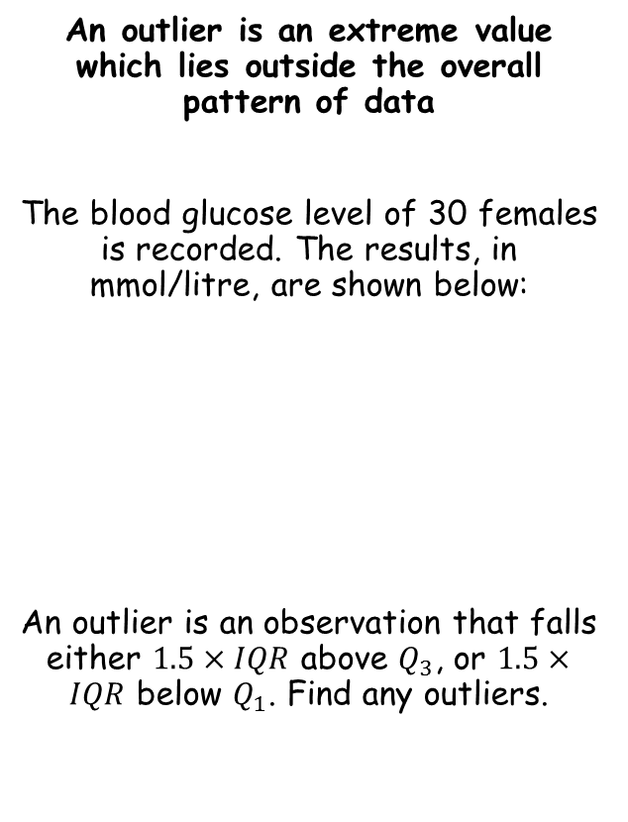









Representations of Data
Greater than $Q_{3}+k(Q_{3}−Q_{1})$
Less than $Q_{1}−k(Q_{3}−Q_{1})$
An outlier is an extreme value which lies outside the overall pattern of data
The blood glucose level of 30 females is recorded. The results, in mmol/litre, are shown below:
An outlier is an observation that falls either $1.5×IQR$ above $Q_{3}$, or $1.5×IQR$ below $Q_{1}$. Find any outliers.
→ The data is discrete
For $Q_{1}$
$$\frac{n}{4}$$
$$\frac{30}{4}$$
$$=7.5$$
→ So take the 8th value
1.7 | 2.2 | 2.3 | 2.3 | 2.5 | 2.7
3.1 | 3.2 | 3.6 | 3.7 | 3.7 | 3.7
3.8 | 3.8 | 3.8 | 3.8 | 3.9 | 3.9
3.9 | 4.0 | 4.0 | 4.0 | 4.0 | 4.4
4.5 | 4.6 | 4.7 | 4.8 | 5.0 | 5.1
$$Q_{1}=3.2$$
For $Q_{3}$
$$\frac{3n}{4}$$
$$\frac{90}{4}$$
$$=22.5$$
→ So take the 23rd value
$$Q_{1}=3.2$$
$$Q_{3}=4.0$$
$$Q_{3}=4.0$$
3A

Slide 6






Representations of Data
Greater than $Q_{3}+k(Q_{3}−Q_{1})$
Less than $Q_{1}−k(Q_{3}−Q_{1})$
An outlier is an extreme value which lies outside the overall pattern of data
The blood glucose level of 30 females is recorded. The results, in mmol/litre, are shown below:
An outlier is an observation that falls either $1.5×IQR$ above $Q_{3}$, or $1.5×IQR$ below $Q_{1}$. Find any outliers.
Greater than $Q_{3}+k(Q_{3}−Q_{1})$
Greater than $4.0+1.5(4.0−3.2)$
Greater than $5.2$
Less than $Q_{1}−k(Q_{3}−Q_{1})$
1.7 | 2.2 | 2.3 | 2.3 | 2.5 | 2.7
3.1 | 3.2 | 3.6 | 3.7 | 3.7 | 3.7
3.8 | 3.8 | 3.8 | 3.8 | 3.9 | 3.9
3.9 | 4.0 | 4.0 | 4.0 | 4.0 | 4.4
4.5 | 4.6 | 4.7 | 4.8 | 5.0 | 5.1
Less than $3.2−1.5(4.0−3.2)$
Less than $2$
So any outliers are less than 2 or greater than 5.2
So there is only one value!
$$Q_{1}=3.2$$
$$Q_{3}=4.0$$
3A

Slide 7



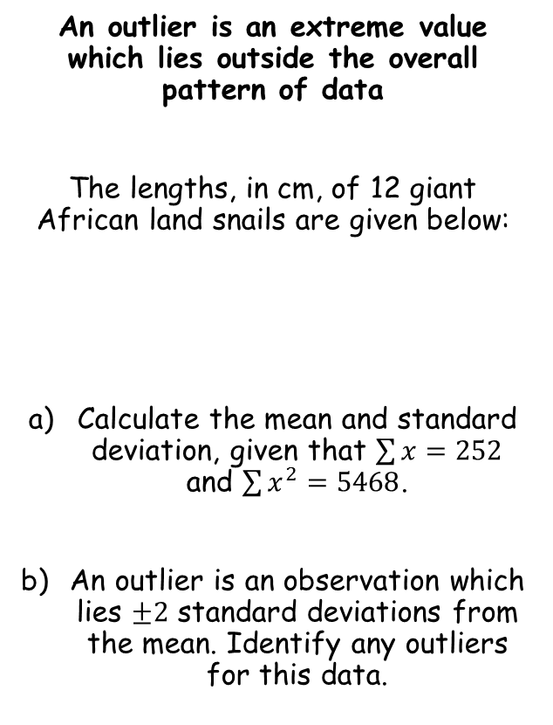



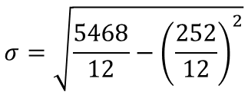
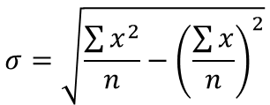
Representations of Data
Greater than $Q_{3}+k(Q_{3}−Q_{1})$
Less than $Q_{1}−k(Q_{3}−Q_{1})$
An outlier is an extreme value which lies outside the overall pattern of data
The lengths, in cm, of 12 giant African land snails are given below:
Calculate the mean and standard deviation, given that $\sum{x}=252$ and $\sum{x^{2}=5468}$.
An outlier is an observation which lies $±2$ standard deviations from the mean. Identify any outliers for this data.
$$\overline{x}=\frac{\sum{x}}{n}$$
Sub in values
$$\overline{x}=\frac{252}{12}$$
Calculate
$$\overline{x}=21cm$$
17 | 18 | 18 | 19 | 20 | 20
20 | 20 | 21 | 23 | 24 | 32
$$σ=\sqrt{\frac{\sum{x^{2}}}{n}−{\left(\frac{\sum{x}}{n}\right)}^{2}}$$
Sub in values
$$σ=\sqrt{\frac{5468}{12}−{\left(\frac{252}{12}\right)}^{2}}$$
$$\overline{x}=21cm$$
$$σ=3.83$$
Calculate
$$σ=3.83$$
3A

Slide 8






Representations of Data
Greater than $Q_{3}+k(Q_{3}−Q_{1})$
Less than $Q_{1}−k(Q_{3}−Q_{1})$
An outlier is an extreme value which lies outside the overall pattern of data
The lengths, in cm, of 12 giant African land snails are given below:
Calculate the mean and standard deviation, given that $\sum{x}=252$ and $\sum{x^{2}=5468}$.
An outlier is an observation which lies $±2$ standard deviations from the mean. Identify any outliers for this data.
Greater than $\overline{x}+2σ$
Greater than $21+2(3.83)$
Greater than $28.66$
17 | 18 | 18 | 19 | 20 | 20
20 | 20 | 21 | 23 | 24 | 32
Less than $\overline{x}−2σ$
Less than $21−2(3.83)$
Less than $13.34$
So there is only one outlier…
The process of finding and removing outliers/anomalies is known as ‘cleaning the data’
Sometimes anomalies are legitimate data, or they could be the result of an experimental error
$$\overline{x}=21cm$$
$$σ=3.83$$
3A

