Slide 1
Statistics
Representations of Data
Twitter: @Owen134866
www.mathsfreeresourcelibrary.com

Slide 2
Prior Knowledge Check
The table shows the number of siblings for 50 Year 12 students
Draw a bar chart and a pie chart to show the data:
2) Work out the interquartile range for this set of data:
3) Work out the mean and standard deviation for this set of data:
3 | 5 | 8 | 9
9 | 11 | 14 | 15
18 | 20 | 21 | 24
Number of siblings | Frequency
0 | 5
1 | 8
2 | 24
3 | 10
4 | 3
11
17 | 19 | 20 | 25
28 | 31 | 32 | 32
35 | 37 | 38
28.5, 7.02

Slide 3
Teachings for
Exercise 3A

Slide 4


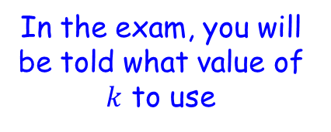
Representations of Data
An outlier is an extreme value which lies outside the overall pattern of data
There are different ways to calculate outliers, but a common definition of an outlier is:
The interquartile range, multiplied by a constant
Upper quartile
Greater than
$$Q_{3}+k(Q_{3}−Q_{1})$$
In the exam, you will be told what value of $k$ to use
OR
Less than
$$Q_{1}−k(Q_{3}−Q_{1})$$
Lower quartile
The interquartile range, multiplied by a constant
3A

Slide 5





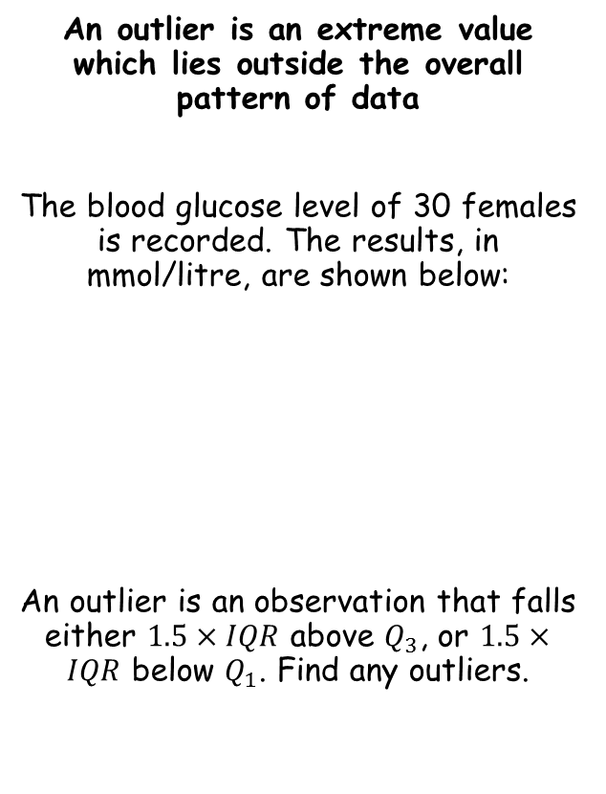









Representations of Data
Greater than $Q_{3}+k(Q_{3}−Q_{1})$
Less than $Q_{1}−k(Q_{3}−Q_{1})$
An outlier is an extreme value which lies outside the overall pattern of data
The blood glucose level of 30 females is recorded. The results, in mmol/litre, are shown below:
An outlier is an observation that falls either $1.5×IQR$ above $Q_{3}$, or $1.5×IQR$ below $Q_{1}$. Find any outliers.
→ The data is discrete
For $Q_{1}$
$$\frac{n}{4}$$
$$\frac{30}{4}$$
$$=7.5$$
→ So take the 8th value
1.7 | 2.2 | 2.3 | 2.3 | 2.5 | 2.7
3.1 | 3.2 | 3.6 | 3.7 | 3.7 | 3.7
3.8 | 3.8 | 3.8 | 3.8 | 3.9 | 3.9
3.9 | 4.0 | 4.0 | 4.0 | 4.0 | 4.4
4.5 | 4.6 | 4.7 | 4.8 | 5.0 | 5.1
$$Q_{1}=3.2$$
For $Q_{3}$
$$\frac{3n}{4}$$
$$\frac{90}{4}$$
$$=22.5$$
→ So take the 23rd value
$$Q_{1}=3.2$$
$$Q_{3}=4.0$$
$$Q_{3}=4.0$$
3A

Slide 6






Representations of Data
Greater than $Q_{3}+k(Q_{3}−Q_{1})$
Less than $Q_{1}−k(Q_{3}−Q_{1})$
An outlier is an extreme value which lies outside the overall pattern of data
The blood glucose level of 30 females is recorded. The results, in mmol/litre, are shown below:
An outlier is an observation that falls either $1.5×IQR$ above $Q_{3}$, or $1.5×IQR$ below $Q_{1}$. Find any outliers.
Greater than $Q_{3}+k(Q_{3}−Q_{1})$
Greater than $4.0+1.5(4.0−3.2)$
Greater than $5.2$
Less than $Q_{1}−k(Q_{3}−Q_{1})$
1.7 | 2.2 | 2.3 | 2.3 | 2.5 | 2.7
3.1 | 3.2 | 3.6 | 3.7 | 3.7 | 3.7
3.8 | 3.8 | 3.8 | 3.8 | 3.9 | 3.9
3.9 | 4.0 | 4.0 | 4.0 | 4.0 | 4.4
4.5 | 4.6 | 4.7 | 4.8 | 5.0 | 5.1
Less than $3.2−1.5(4.0−3.2)$
Less than $2$
So any outliers are less than 2 or greater than 5.2
So there is only one value!
$$Q_{1}=3.2$$
$$Q_{3}=4.0$$
3A

Slide 7



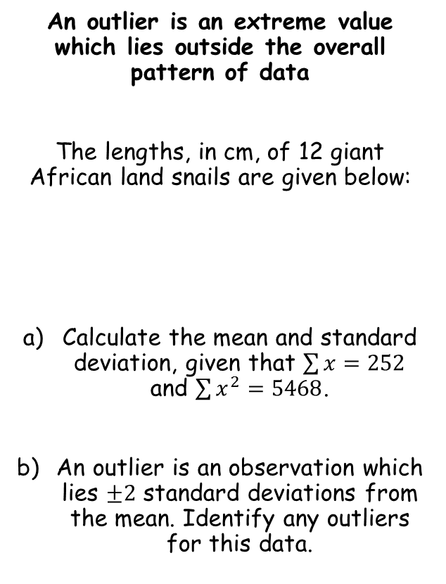



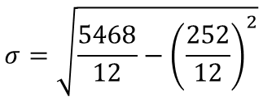
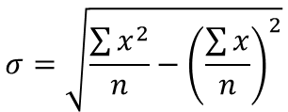
Representations of Data
Greater than $Q_{3}+k(Q_{3}−Q_{1})$
Less than $Q_{1}−k(Q_{3}−Q_{1})$
An outlier is an extreme value which lies outside the overall pattern of data
The lengths, in cm, of 12 giant African land snails are given below:
Calculate the mean and standard deviation, given that $\sum{x}=252$ and $\sum{x^{2}=5468}$.
An outlier is an observation which lies $±2$ standard deviations from the mean. Identify any outliers for this data.
$$\overline{x}=\frac{\sum{x}}{n}$$
Sub in values
$$\overline{x}=\frac{252}{12}$$
Calculate
$$\overline{x}=21cm$$
17 | 18 | 18 | 19 | 20 | 20
20 | 20 | 21 | 23 | 24 | 32
$$σ=\sqrt{\frac{\sum{x^{2}}}{n}−{\left(\frac{\sum{x}}{n}\right)}^{2}}$$
Sub in values
$$σ=\sqrt{\frac{5468}{12}−{\left(\frac{252}{12}\right)}^{2}}$$
$$\overline{x}=21cm$$
$$σ=3.83$$
Calculate
$$σ=3.83$$
3A

Slide 8






Representations of Data
Greater than $Q_{3}+k(Q_{3}−Q_{1})$
Less than $Q_{1}−k(Q_{3}−Q_{1})$
An outlier is an extreme value which lies outside the overall pattern of data
The lengths, in cm, of 12 giant African land snails are given below:
Calculate the mean and standard deviation, given that $\sum{x}=252$ and $\sum{x^{2}=5468}$.
An outlier is an observation which lies $±2$ standard deviations from the mean. Identify any outliers for this data.
Greater than $\overline{x}+2σ$
Greater than $21+2(3.83)$
Greater than $28.66$
17 | 18 | 18 | 19 | 20 | 20
20 | 20 | 21 | 23 | 24 | 32
Less than $\overline{x}−2σ$
Less than $21−2(3.83)$
Less than $13.34$
So there is only one outlier…
The process of finding and removing outliers/anomalies is known as ‘cleaning the data’
Sometimes anomalies are legitimate data, or they could be the result of an experimental error
$$\overline{x}=21cm$$
$$σ=3.83$$
3A

Slide 9
Teachings for
Exercise 3B

Slide 10
Representations of Data
Box plots can be used to represent key features of a data set
Box plots can be drawn summarizing the quartiles, lowest/greatest included values, as well as any outliers
They are especially useful for comparing data sets
3B

Slide 11
Representations of Data
Box plots can be used to represent key features of a data set
→ Any outliers are plotted as crosses outside the main plot
→ Each ‘section’ contains 25% of the observations in the sample
Smallest value
Lower Quartile
Upper Quartile
Largest value
Median
Outlier
25%
25%
25%
25%
10
20
30
40
50
60
70
80
3B

Slide 12
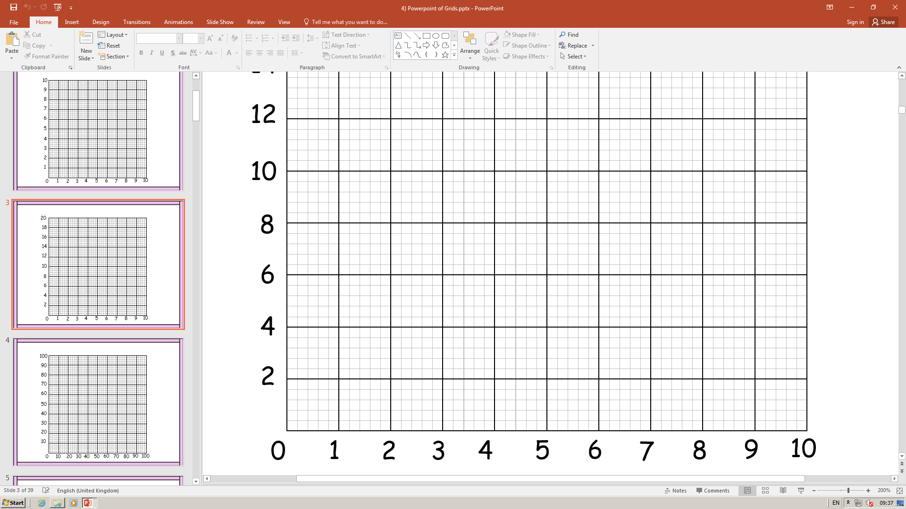



Representations of Data
Box plots can be used to represent key features of a data set
In section A, we saw the following data for blood glucose levels in 30 females:
From that, we calculated the following:
Represent this on a box plot…
0
1
2
3
4
5
6
1.7 | 2.2 | 2.3 | 2.3 | 2.5 | 2.7
3.1 | 3.2 | 3.6 | 3.7 | 3.7 | 3.7
3.8 | 3.8 | 3.8 | 3.8 | 3.9 | 3.9
3.9 | 4.0 | 4.0 | 4.0 | 4.0 | 4.4
4.5 | 4.6 | 4.7 | 4.8 | 5.0 | 5.1
Blood glucose level (mmol/litre)
Plot the smallest and largest values that are not outliers (2.2 and 5.1)
Plot the 3 quartiles, and join to make the box shape
Mark on any outliers…
$$Q_{1}=3.2$$
$$Q_{2}=3.8$$
$$Q_{3}=4.0$$
Outliers are less than 2 or greater than 5.2
3B

Slide 13
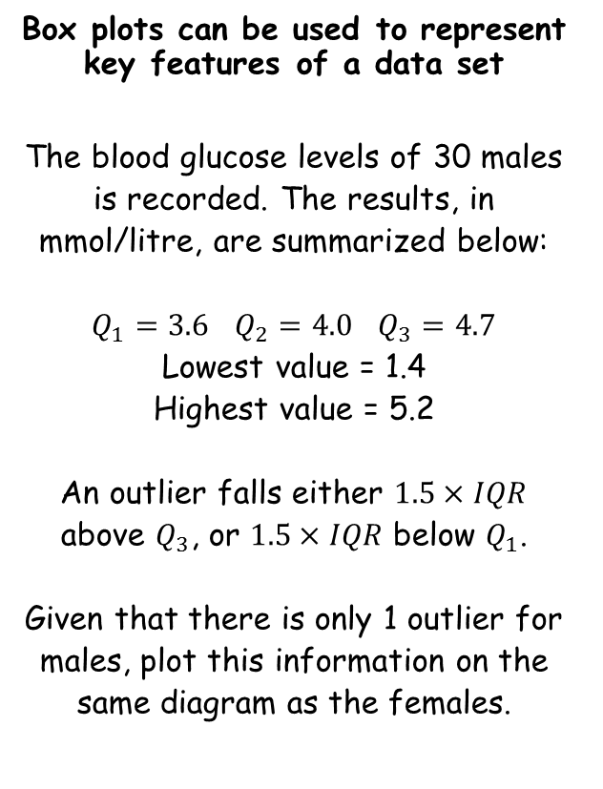
Representations of Data
Box plots can be used to represent key features of a data set
The blood glucose levels of 30 males is recorded. The results, in mmol/litre, are summarized below:
$Q_{1}=3.6$ $Q_{2}=4.0$ $Q_{3}=4.7$
Lowest value = 1.4
Highest value = 5.2
An outlier falls either $1.5×IQR$ above $Q_{3}$, or $1.5×IQR$ below $Q_{1}$.
Given that there is only 1 outlier for males, plot this information on the same diagram as the females.
Males
Females
0
1
2
3
4
5
6
Blood glucose level (mmol/litre)
By using the formulae in the question, outliers will be below 1.95 or above 6.35
So there is one outlier, which is 1.4
The lower and upper boundaries are plotted using the boundaries for the outliers (since we do not have the actual data values)
Plot the rest as before…
3B

Slide 14
Representations of Data
Box plots can be used to represent key features of a data set
Compare the blood glucose levels for males and females.
When comparing data you must always compare a measure of location (average) and a measure of spread (a range)
In this case it makes sense to use the median and interquartile range, as this is the information we have already…
Males
Females
0
1
2
3
4
5
6
Blood glucose level (mmol/litre)
Based on this data, females have a lower median blood glucose level, and a smaller interquartile range. This means the levels are more consistent, and at a lower level than males.
→ Ensure you compare using the context!
3B

Slide 15
Teachings for
Exercise 3C

Slide 16
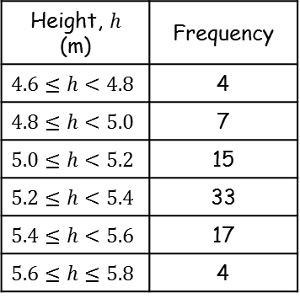
Representations of Data
Cumulative Frequency
80
You can use a cumulative frequency diagram to estimate the median and quartiles for data in groups
The data in the table shows the heights in metres, of 80 giraffes.
Draw a cumulative frequency diagram for the data
Using the cumulative frequency diagram, estimate the median and quartiles
Estimate the 90th percentile
Draw a box plot to represent the diagram
Height, $h$ (m) | Frequency
$$4.6≤h<4.8$$ | 4
$$4.8≤h<5.0$$ | 7
$$5.0≤h<5.2$$ | 15
$$5.2≤h<5.4$$ | 33
$$5.4≤h<5.6$$ | 17
$$5.6≤h≤5.8$$ | 4
CF
70
4
11
26
60
59
76
50
80
40
Start by plotting the lowest possible value at 0 (for the frequency)
Then each CF value is plotted at the upper bound for its group
For example, the 26 will be plotted at 5.2
30
20
10
0
4
4.5
5
5.5
6
Height (m)

Slide 17

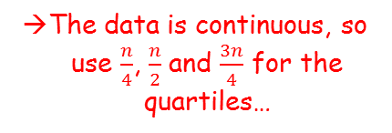





Representations of Data
Cumulative Frequency
80
You can use a cumulative frequency diagram to estimate the median and quartiles for data in groups
The data in the table shows the heights in metres, of 80 giraffes.
Draw a cumulative frequency diagram for the data
Using the cumulative frequency diagram, estimate the median and quartiles
Estimate the 90th percentile
Draw a box plot to represent the diagram
The data is continuous, so use $\frac{n}{4}$, $\frac{n}{2}$ and $\frac{3n}{4}$ for the quartiles…
70
60
$$Q_{3}$$
$$Q_{1}=5.15$$
$$Q_{2}=5.3$$
50
$$Q_{3}=5.4$$
40
$$Q_{2}$$
30
20
$$Q_{1}$$
10
0
4
4.5
5
5.5
6
Height (m)

Slide 18



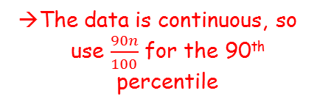




Representations of Data
Cumulative Frequency
80
You can use a cumulative frequency diagram to estimate the median and quartiles for data in groups
The data in the table shows the heights in metres, of 80 giraffes.
Draw a cumulative frequency diagram for the data
Using the cumulative frequency diagram, estimate the median and quartiles
Estimate the 90th percentile
Draw a box plot to represent the diagram
The data is continuous, so use $\frac{90n}{100}$ for the 90th percentile
$$P_{90}$$
70
$$\frac{90(80)}{100}=72nd$$
60
50
$P_{90}=5.$55
40
30
$$Q_{1}=5.15$$
$$Q_{2}=5.3$$
$$Q_{3}=5.4$$
20
$P_{90}=5.$55
10
0
4
4.5
5
5.5
6
Height (m)

Slide 19
Representations of Data
You can use a cumulative frequency diagram to estimate the median and quartiles for data in groups
The data in the table shows the heights in metres, of 80 giraffes.
Draw a cumulative frequency diagram for the data
Using the cumulative frequency diagram, estimate the median and quartiles
Estimate the 90th percentile
Draw a box plot to represent the diagram
Height, $h$ (m) | Frequency
$$4.6≤h<4.8$$ | 4
$$4.8≤h<5.0$$ | 7
$$5.0≤h<5.2$$ | 15
$$5.2≤h<5.4$$ | 33
$$5.4≤h<5.6$$ | 17
$$5.6≤h≤5.8$$ | 4
$$Q_{1}=5.15$$
4
4.5
5
5.5
6
$$Q_{2}=5.3$$
$$Q_{3}=5.4$$
$P_{90}=5.$55
Height (m)
3C

Slide 20
Teachings for
Exercise 3D

Slide 21

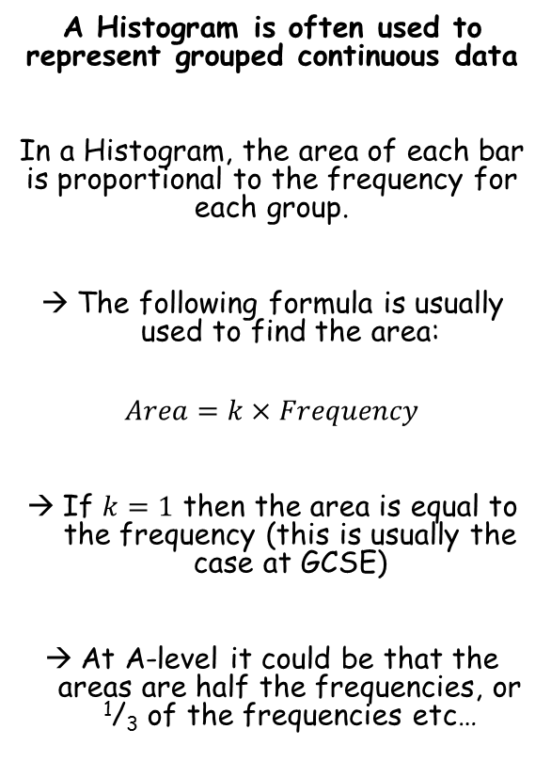
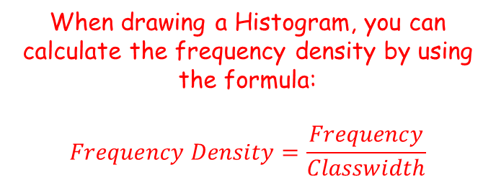

Representations of Data
$$Area=k×Frequency$$
$$Frequency Density=\frac{Frequency}{Classwidth}$$
A Histogram is often used to represent grouped continuous data
In a Histogram, the area of each bar is proportional to the frequency for each group.
The following formula is usually used to find the area:
$$Area=k×Frequency$$
If $k=1$ then the area is equal to the frequency (this is usually the case at GCSE)
At A-level it could be that the areas are half the frequencies, or ¹/₃ of the frequencies etc…
When drawing a Histogram, you can calculate the frequency density by using the formula:
$$Frequency Density=\frac{Frequency}{Classwidth}$$
3D

Slide 22
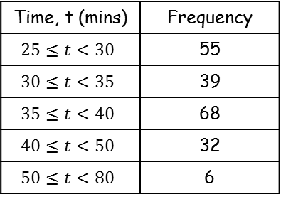
Representations of Data
$$Area=k×Frequency$$
$$Frequency Density=\frac{Frequency}{Classwidth}$$
Freq. Density
A Histogram is often used to represent grouped continuous data
A random sample of 200 students was asked how long it took them to complete their homework the previous night. The time was recorded and summarised in the table to the right.
Draw a Histogram and frequency polygon for this data
Estimate how many students took between 36 and 45 minutes to complete their homework
Time, t (mins) | Frequency
$$25≤t<30$$ | 55
$$30≤t<35$$ | 39
$$35≤t<40$$ | 68
$$40≤t<50$$ | 32
$$50≤t<80$$ | 6
11
7.8
13.6
3.2
0.2
Frequency Density
15
10
5
0
60
20
30
40
50
70
80
Time (mins)
There should be no gaps between bars
The widths will differ depending on the groups
3D

Slide 23
Representations of Data
$$Area=k×Frequency$$
$$Frequency Density=\frac{Frequency}{Classwidth}$$
Freq. Density
A Histogram is often used to represent grouped continuous data
A random sample of 200 students was asked how long it took them to complete their homework the previous night. The time was recorded and summarised in the table to the right.
Draw a Histogram and frequency polygon for this data
Estimate how many students took between 36 and 45 minutes to complete their homework
Time, t (mins) | Frequency
$$25≤t<30$$ | 55
$$30≤t<35$$ | 39
$$35≤t<40$$ | 68
$$40≤t<50$$ | 32
$$50≤t<80$$ | 6
11
7.8
13.6
3.2
0.2
Frequency Density
15
10
5
0
60
20
30
40
50
70
80
Time (mins)
To draw a frequency polygon, join the tops of each bar…
3D

Slide 24



Representations of Data
$$Area=k×Frequency$$
$$Frequency Density=\frac{Frequency}{Classwidth}$$
Freq. Density
A Histogram is often used to represent grouped continuous data
A random sample of 200 students was asked how long it took them to complete their homework the previous night. The time was recorded and summarised in the table to the right.
Draw a Histogram and frequency polygon for this data
Estimate how many students took between 36 and 45 minutes to complete their homework
Time, t (mins) | Frequency
$$25≤t<30$$ | 55
$$30≤t<35$$ | 39
$$35≤t<40$$ | 68
$$40≤t<50$$ | 32
$$50≤t<80$$ | 6
11
7.8
13.6
3.2
0.2
Frequency Density
15
10
5
0
36
45
60
20
30
40
50
70
80
Time (mins)
Calculate the area between 36 and 45 students (2 rectangles)
$$4×13.6$$
$$+ 5×3.2$$
$=70.4 \left(70\right)$ students
3D

Slide 25
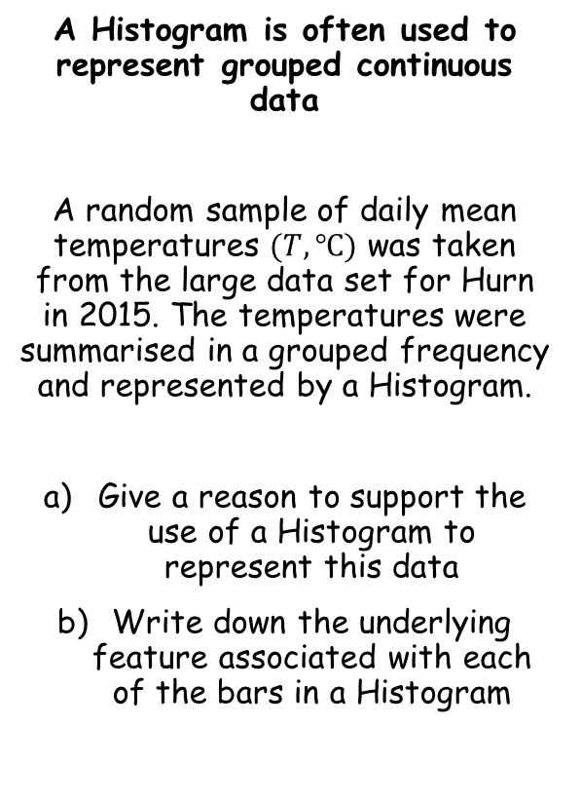
Representations of Data
$$Area=k×Frequency$$
$$Frequency Density=\frac{Frequency}{Classwidth}$$
A Histogram is often used to represent grouped continuous data
A random sample of daily mean temperatures $(T,℃)$ was taken from the large data set for Hurn in 2015. The temperatures were summarised in a grouped frequency and represented by a Histogram.
Give a reason to support the use of a Histogram to represent this data
Write down the underlying feature associated with each of the bars in a Histogram
Since temperature is continuous, and the data is already in groups, a Histogram is appropriate
The area of each bar is proportional to the frequency
3D

Slide 26


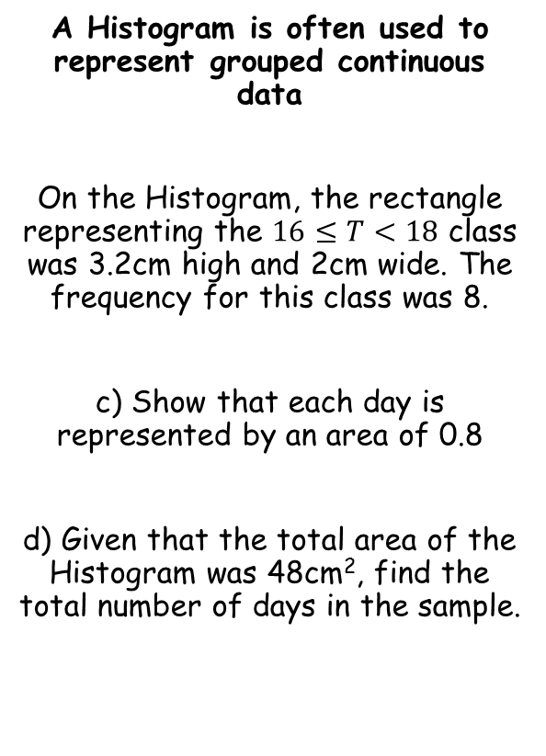



Representations of Data
$$Area=k×Frequency$$
$$Frequency Density=\frac{Frequency}{Classwidth}$$
A Histogram is often used to represent grouped continuous data
On the Histogram, the rectangle representing the $16≤T<18$ class was 3.2cm high and 2cm wide. The frequency for this class was 8.
c) Show that each day is represented by an area of 0.8
d) Given that the total area of the Histogram was 48cm², find the total number of days in the sample.
$$Area=6.4{cm}^{2}$$
$$3.2cm$$
$$2cm$$
You could write the area and frequency as a ratio (or use the formula to the top-left of the page)
$$8 days=6.4{cm}^{2}$$
Divide by 8
$$1 day=0.8{cm}^{2}$$
3D

Slide 27



Representations of Data
$$Area=k×Frequency$$
$$Frequency Density=\frac{Frequency}{Classwidth}$$
A Histogram is often used to represent grouped continuous data
On the Histogram, the rectangle representing the $16≤T<18$ class was 3.2cm high and 2cm wide. The frequency for this class was 8.
c) Show that each day is represented by an area of 0.8
d) Given that the total area of the Histogram was 48cm², find the total number of days in the sample.
$$1 day=0.8{cm}^{2}$$
Multiply by 60 (you can find this value using your calculator)
$$60 days$$
$$=48{cm}^{2}$$
3D

Slide 28
Teachings for
Exercise 3E

Slide 29
Representations of Data
You need to be able to compare multiple data sets by using both measures of location and measures of spread
You should usually use the mean and standard deviation, or the median and interquartile range
If the data set contains extreme values, it is better to use the latter…
3E

Slide 30
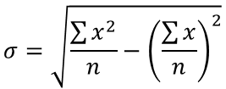


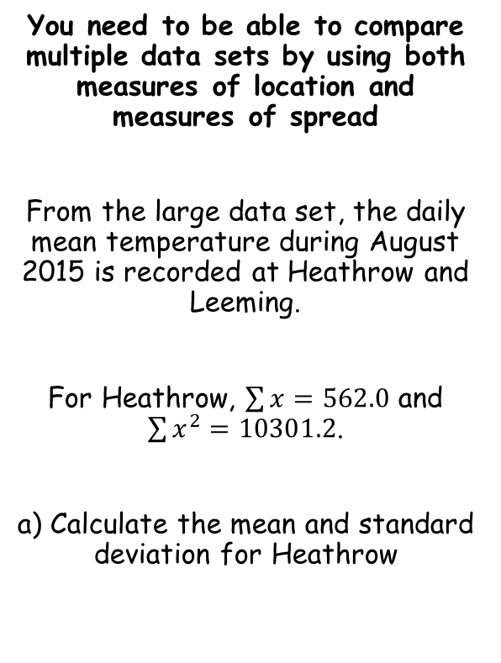




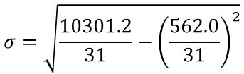
Representations of Data
$$\overline{x}=\frac{\sum{x}}{n}$$
$$σ=\sqrt{\frac{\sum{x^{2}}}{n}−{\left(\frac{\sum{x}}{n}\right)}^{2}}$$
You need to be able to compare multiple data sets by using both measures of location and measures of spread
From the large data set, the daily mean temperature during August 2015 is recorded at Heathrow and Leeming.
For Heathrow, $\sum{x}=562.0$ and $\sum{x^{2}}=10301.2$.
a) Calculate the mean and standard deviation for Heathrow
$$\overline{x}=\frac{\sum{x}}{n}$$
Sub in values – there are 31 days in August
$$\overline{x}=\frac{562.0}{31}$$
Calculate
$$\overline{x}=18.1℃$$
$$σ=\sqrt{\frac{\sum{x^{2}}}{n}−{\left(\frac{\sum{x}}{n}\right)}^{2}}$$
Sub in values
$$σ=\sqrt{\frac{10301.2}{31}−{\left(\frac{562.0}{31}\right)}^{2}}$$
Calculate
$$σ=1.91℃$$
3E

Slide 31


Representations of Data
$$\overline{x}=\frac{\sum{x}}{n}$$
$$σ=\sqrt{\frac{\sum{x^{2}}}{n}−{\left(\frac{\sum{x}}{n}\right)}^{2}}$$
You need to be able to compare multiple data sets by using both measures of location and measures of spread
From the large data set, the daily mean temperature during August 2015 is recorded at Heathrow and Leeming.
For Heathrow:
For Leeming, the mean temperature was 15.6°C with a standard deviation of 2.01°C.
b) Compare the data for the two locations using the information given
The mean daily temperature in Leeming is lower than in Heathrow, but Leeming has a greater spread of temperatures.
(remember you must always compare a measure of location as well as a measure of spread)
$$\overline{x}=18.1℃$$
$$σ=1.91℃$$
3E

