Slide 1
Teachings for
Section 2G

Slide 2



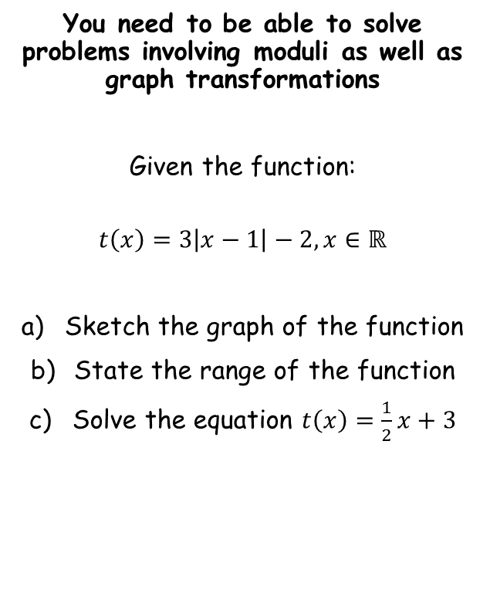




Functions and Graphs
$$y$$
$$y=\left|x\right|$$
$$y$$
$$y=\left|x−1\right|$$
You need to be able to solve problems involving moduli as well as graph transformations
Given the function:
$$t\left(x\right)=3\left|x−1\right|−2, x∈ℝ$$
Sketch the graph of the function
State the range of the function
Solve the equation $t\left(x\right)=\frac{1}{2}x+3$
1
$$x$$
1
$$x$$
Translation $\left(\begin{matrix}1 \\ 0\end{matrix}\right)$
$$y$$
$$y=3\left|x−1\right|$$
$$y$$
$$y=3\left|x−1\right|−2$$
3
1
1
$$x$$
$$x$$
Build up the sketch in stages…
(1,-2)
Vertical stretch factor 3
Translation $\left(\begin{matrix}0 \\ −2\end{matrix}\right)$
2G

Slide 3



Functions and Graphs
$$y$$
$$y=3\left|x−1\right|−2$$
You need to be able to solve problems involving moduli as well as graph transformations
Given the function:
$$t\left(x\right)=3\left|x−1\right|−2, x∈ℝ$$
Sketch the graph of the function
State the range of the function
Solve the equation $t\left(x\right)=\frac{1}{2}x+3$
Range
1
$$x$$
(1,-2)
So the range is any real values greater than or equal to -2
→ Use the correct notation when writing this!
$t\left(x\right)∈ℝ,$ $t\left(x\right)≥−2$
2G

Slide 4






Functions and Graphs
$$y$$
$$y=3\left|x−1\right|−2$$
You need to be able to solve problems involving moduli as well as graph transformations
Given the function:
$$t\left(x\right)=3\left|x−1\right|−2, x∈ℝ$$
Sketch the graph of the function
State the range of the function
Solve the equation $t\left(x\right)=\frac{1}{2}x+3$
$$y=\frac{1}{2}x+3$$
1
$$x$$
(1,-2)
Finding the first solution (on the non-reflected part of the graph)
$$\frac{1}{2}x+3=3\left(x−1\right)−2$$
Expand bracket and simplify
$$\frac{1}{2}x+3=3x−5$$
Add 5, subtract $\frac{1}{2}x$
$$8=2.5x$$
Divide by 2.5
$$3.2=x$$
2G

Slide 5






Functions and Graphs
$$y$$
$$y=3\left|x−1\right|−2$$
You need to be able to solve problems involving moduli as well as graph transformations
Given the function:
$$t\left(x\right)=3\left|x−1\right|−2, x∈ℝ$$
Sketch the graph of the function
State the range of the function
Solve the equation $t\left(x\right)=\frac{1}{2}x+3$
$$y=\frac{1}{2}x+3$$
1
$$x$$
(1,-2)
Finding the second solution (on the reflected part of the graph)
$$\frac{1}{2}x+3=−3\left(x−1\right)−2$$
Expand bracket and simplify
$$x=3.2$$
$$\frac{1}{2}x+3=−3x+1$$
Subtract 1, subtract $\frac{1}{2}x$
$$2=−3.5x$$
Divide by 2.5
$$−\frac{4}{7}=x$$
2G

Slide 6
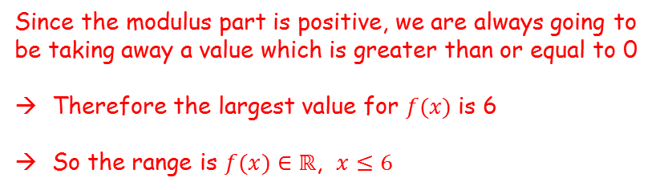

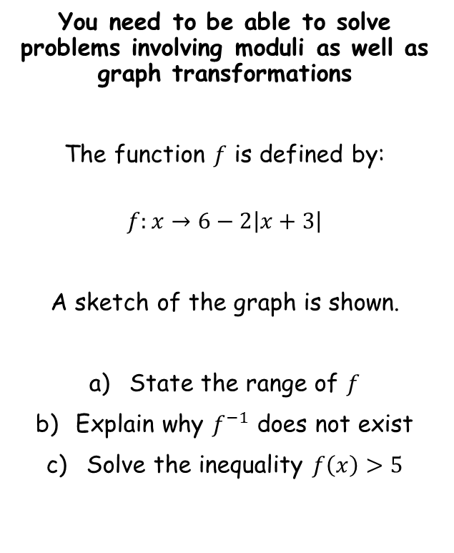


Functions and Graphs
$$y$$
You need to be able to solve problems involving moduli as well as graph transformations
The function $f$ is defined by:
$$f:x→6−2\left|x+3\right|$$
A sketch of the graph is shown.
State the range of $f$
Explain why $f^{−1}$ does not exist
Solve the inequality $f\left(x\right)>5$
$$f\left(x\right)=6−2\left|x+3\right|$$
$$6$$
Range
$$x$$
$$6$$
$$0$$
Since the modulus part is positive, we are always going to be taking away a value which is greater than or equal to 0
Therefore the largest value for $f(x)$ is 6
So the range is $f(x)∈ℝ$, $x≤6$
2G

Slide 7
Functions and Graphs
$$y$$
You need to be able to solve problems involving moduli as well as graph transformations
The function $f$ is defined by:
$$f:x→6−2\left|x+3\right|$$
A sketch of the graph is shown.
State the range of $f$
Explain why $f^{−1}$ does not exist
Solve the inequality $f\left(x\right)>5$
$$f\left(x\right)=6−2\left|x+3\right|$$
$$6$$
$$x$$
$$6$$
$$0$$
This function is many-to-one, as different inputs can give the same output
The inverse would be one-to-many, which is not a function
2G

Slide 8






Functions and Graphs
$$y$$
You need to be able to solve problems involving moduli as well as graph transformations
The function $f$ is defined by:
$$f:x→6−2\left|x+3\right|$$
A sketch of the graph is shown.
State the range of $f$
Explain why $f^{−1}$ does not exist
Solve the inequality $f\left(x\right)>5$
$$f\left(x\right)=6−2\left|x+3\right|$$
$$6$$
$$f\left(x\right)=5$$
$$x$$
$$6$$
$$−2.5$$
$$0$$
Solving for the non-reflected part
$$6−2\left(x+3\right)=5$$
Expand bracket
$$6−2x−6=5$$
Simplify
$$−2x=5$$
Divide by 2
$$x=−2.5$$
2G

Slide 9





Functions and Graphs
$$y$$
You need to be able to solve problems involving moduli as well as graph transformations
The function $f$ is defined by:
$$f:x→6−2\left|x+3\right|$$
A sketch of the graph is shown.
State the range of $f$
Explain why $f^{−1}$ does not exist
Solve the inequality $f\left(x\right)>5$
$$f\left(x\right)=6−2\left|x+3\right|$$
$$6$$
$$f\left(x\right)=5$$
$$x$$
$$6$$
$$−3.5$$
$$−2.5$$
$$0$$
Solving for the reflected part
$$6+2\left(x+3\right)=5$$
Expand bracket
$$6+2x+6=5$$
Rearrange
$$2x=−7$$
Divide by 2
$$x=−3.5$$
2G

Slide 10
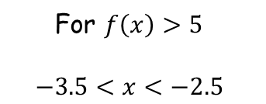
Functions and Graphs
$$y$$
You need to be able to solve problems involving moduli as well as graph transformations
The function $f$ is defined by:
$$f:x→6−2\left|x+3\right|$$
A sketch of the graph is shown.
State the range of $f$
Explain why $f^{−1}$ does not exist
Solve the inequality $f\left(x\right)>5$
$$f\left(x\right)=6−2\left|x+3\right|$$
$$6$$
$$f\left(x\right)=5$$
$$x$$
$$6$$
$$−3.5$$
$$−2.5$$
$$0$$
For $f\left(x\right)>5$
$$−3.5<x<−2.5$$
2G

