Slide 1
Solving modulus problems (2.7)

Slide 2
1
What is the equation of this graph?
a) $y=\left|x−2\right|$
b) $y=\left|2x\right|$
c) $y=\left|x+2\right|$
d) $y=\left|2x+2\right|$

Slide 3
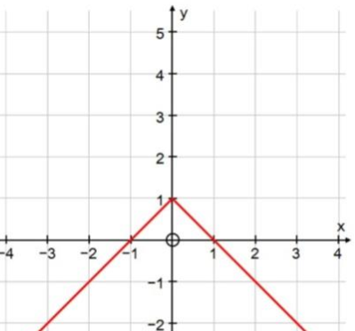
2
What is the equation of this graph?
a) $y=\left|−x+1\right|$
b) $y=−\left|x\right|+1$
c) $y=\left|−x\right|+1$
d) $y=−(\left|x\right|+1)$

Slide 4
3
Solve $\left|4x−3\right|≥2−x$
a) $x≥1$
b) $x≤\frac{1}{3} , x≥1$
c) $x≥\frac{1}{3}$
d) $\frac{1}{3}≤x≤1$

