Slide 1
Teachings for
Section 2F

Slide 2


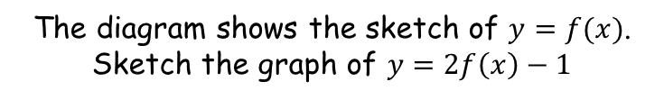


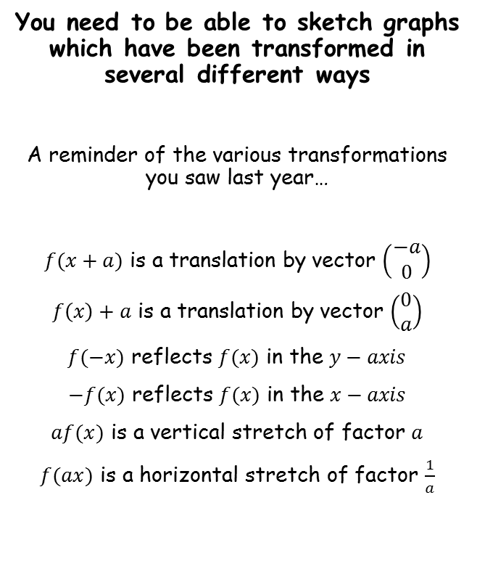









Functions and Graphs
The diagram shows the sketch of $y=f(x)$. Sketch the graph of $y=2f\left(x\right)−1$
You need to be able to sketch graphs which have been transformed in several different ways
A reminder of the various transformations you saw last year…
$f(x+a)$ is a translation by vector $\left(\begin{matrix}−a \\ 0\end{matrix}\right)$
$f\left(x\right)+a$ is a translation by vector $\left(\begin{matrix}0 \\ a\end{matrix}\right)$
$f(−x)$ reflects $f(x)$ in the $y−axis$
$−f(x)$ reflects $f(x)$ in the $x−axis$
$af(x)$ is a vertical stretch of factor $a$
$f(ax)$ is a horizontal stretch of factor $\frac{1}{a}$
$$B′$$
$$(6,7)$$
$$y=f(x)$$
$$y$$
$$(6,4)$$
$$B$$
$$A$$
$$x$$
$$(2,−1)$$
$$(2,−3)$$
$$2f\left(x\right)−1$$
→ Vertical stretch factor 2, then vertical translation 1 unit down
$$A′$$
$$y=2f\left(x\right)−1$$
→ The y-coordinates double, then decrease by 1
2F

Slide 3

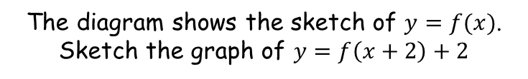







Functions and Graphs
The diagram shows the sketch of $y=f(x)$. Sketch the graph of $y=f\left(x+2\right)+2$
You need to be able to sketch graphs which have been transformed in several different ways
A reminder of the various transformations you saw last year…
$f(x+a)$ is a translation by vector $\left(\begin{matrix}−a \\ 0\end{matrix}\right)$
$f\left(x\right)+a$ is a translation by vector $\left(\begin{matrix}0 \\ a\end{matrix}\right)$
$f(−x)$ reflects $f(x)$ in the $y−axis$
$−f(x)$ reflects $f(x)$ in the $x−axis$
$af(x)$ is a vertical stretch of factor $a$
$f(ax)$ is a horizontal stretch of factor $\frac{1}{a}$
$$y=f\left(x+2\right)+2$$
$$y$$
$$B′$$
$$(4,6)$$
$$B$$
$$(6,4)$$
$$A′$$
$$(0,1)$$
$$A$$
$$x$$
$$(2,−1)$$
$$y=f(x)$$
$$f\left(x+2\right)+2$$
→ Horizontal translation 2 units to the left, then vertical translation 2 units up
You should apply the bracketed parts first!
→ The x-coordinates decrease by 2, and the y-coordinates increase by 2
2F

Slide 4

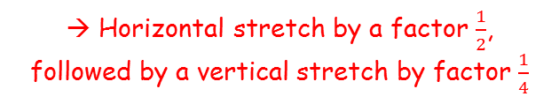

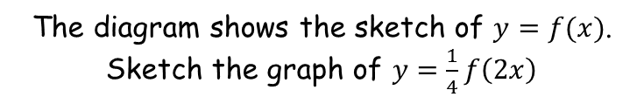



Functions and Graphs
The diagram shows the sketch of $y=f(x)$. Sketch the graph of $y=\frac{1}{4}f\left(2x\right)$
You need to be able to sketch graphs which have been transformed in several different ways
A reminder of the various transformations you saw last year…
$$y$$
$$B$$
$$\frac{1}{4}f\left(2x\right)$$
$$(6,4)$$
$$y=\frac{1}{4}f\left(2x\right)$$
→ Horizontal stretch by a factor $\frac{1}{2}$, followed by a vertical stretch by factor $\frac{1}{4}$
$$\left(1,−\frac{1}{4}\right)$$
$$B′$$
$$(3,1)$$
$$A′$$
$$A$$
$$x$$
→ The x-coordinates get divided by 2, and the y-coordinates get divided by 4
$$(2,−1)$$
$$y=f(x)$$
2F

Slide 5


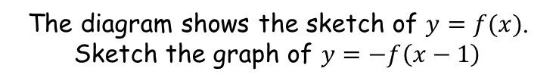



Functions and Graphs
The diagram shows the sketch of $y=f(x)$. Sketch the graph of $y=−f\left(x−1\right)$
You need to be able to sketch graphs which have been transformed in several different ways
A reminder of the various transformations you saw last year…
$$y$$
$$B$$
$$−f\left(x−1\right)$$
$$(6,4)$$
$$\left(3,1\right)$$
$$A′$$
→ Horizontal translation 1 unit to the right, followed by a reflection in the x-axis
$$A$$
$$x$$
→ The x-coordinates get increased by 1, and then the y-coordinates get multiplied by -1
$$(2,−1)$$
$$y=f(x)$$
$$(7,−4)$$
$$B′$$
$$y=−f\left(x−1\right)$$
2F

Slide 6


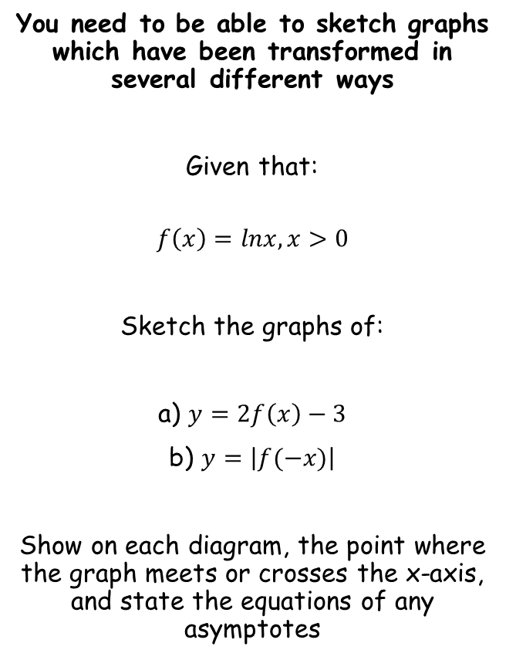




Functions and Graphs
$$y$$
$$y=lnx$$
You need to be able to sketch graphs which have been transformed in several different ways
Given that:
$$f\left(x\right)=lnx, x>0$$
Sketch the graphs of:
a) $y=2f\left(x\right)−3$
b) $y=\left|f(−x)\right|$
Show on each diagram, the point where the graph meets or crosses the x-axis, and state the equations of any asymptotes
Asymptote at $x=0$
1
$$x$$
The graph will be stretched vertically by a factor of 2, and then translated down 3 units
→ A good way of sketching is to do each translation one step at a time (although it is fine to calculate the coordinates at the end)
$$y$$
$$y=2lnx$$
$$y$$
$$y=2lnx−3$$
$$x$$
$$x$$
Asymptote at $x=0$
Asymptote at $x=0$
2F

Slide 7








Functions and Graphs
$$y$$
You need to be able to sketch graphs which have been transformed in several different ways
Given that:
$$f\left(x\right)=lnx, x>0$$
Sketch the graphs of:
a) $y=2f\left(x\right)−3$
b) $y=\left|f(−x)\right|$
Show on each diagram, the point where the graph meets or crosses the x-axis, and state the equations of any asymptotes
$$y=2lnx−3$$
$$4.48$$
$$x$$
Asymptote at $x=0$
To find the x-intercept, set $y=0$
$$2lnx−3=0$$
Add 3
$$2lnx=3$$
Divide by 2
$$lnx=1.5$$
Inverse logarithm
$$x=e^{1.5}$$
Calculate, or use the exact value
$$x=4.48$$
2F

Slide 8



Functions and Graphs
$$y$$
$$y=lnx$$
You need to be able to sketch graphs which have been transformed in several different ways
Given that:
$$f\left(x\right)=lnx, x>0$$
Sketch the graphs of:
a) $y=2f\left(x\right)−3$
b) $y=\left|f(−x)\right|$
Show on each diagram, the point where the graph meets or crosses the x-axis, and state the equations of any asymptotes
Asymptote at $x=0$
1
$$x$$
For the second transformation:
Reflect the graph in the y-axis
Then any values below the x-axis will be reflected above it
$$y=ln⁡(−x)$$
$$y$$
$$y=\left|ln⁡(−x) \right|$$
$$y$$
-1
$$x$$
-1
$$x$$
Asymptote at $x=0$
Asymptote at $x=0$
2F

