Slide 1
Mini whiteboard quiz on transformations!

Slide 2
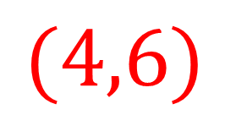
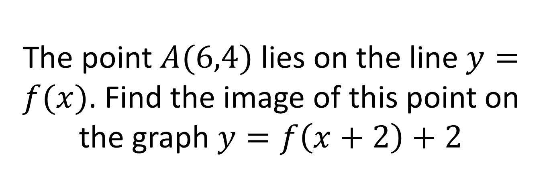
The point $A(6,4)$lies on the line $y=f(x)$. Find the image of this point on the graph $y=f\left(x+2\right)+2$
$$(4,6)$$

Slide 3
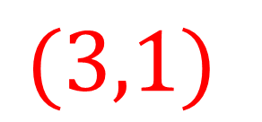
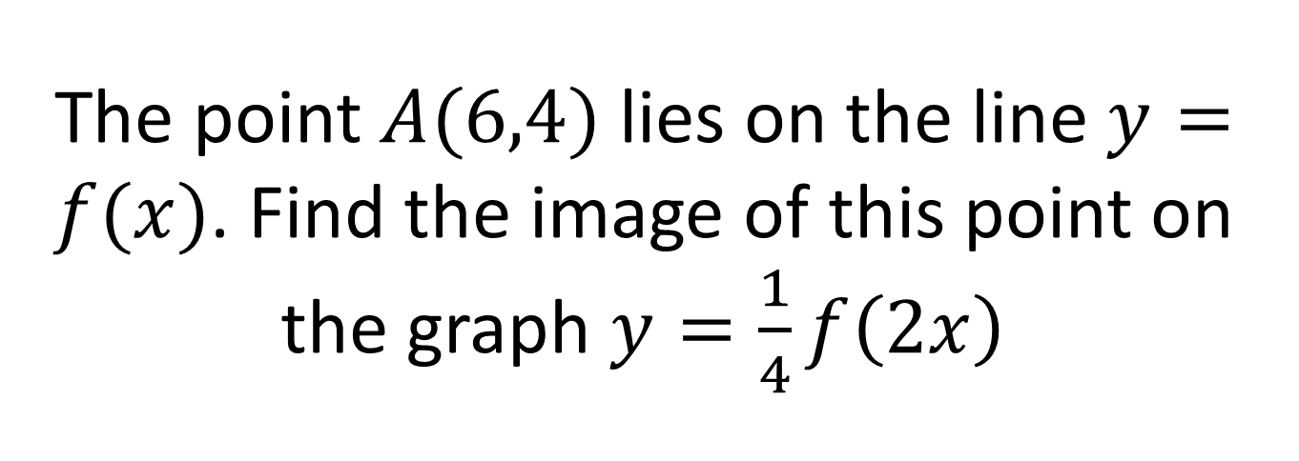
The point $A(6,4)$lies on the line $y=f(x)$. Find the image of this point on the graph $y=\frac{1}{4}f\left(2x\right)$
$$(3,1)$$

Slide 4
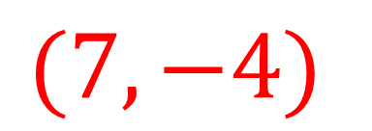
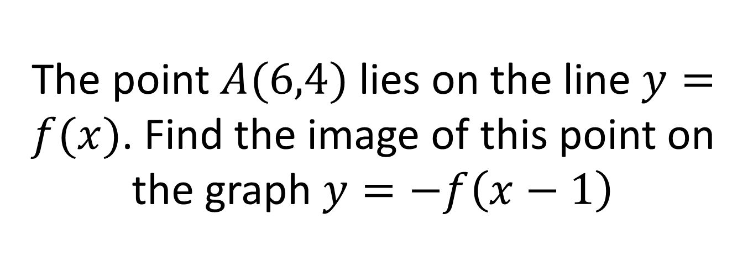
The point $A(6,4)$lies on the line $y=f(x)$. Find the image of this point on the graph $y=−f\left(x−1\right)$
$$(7,−4)$$

Slide 5
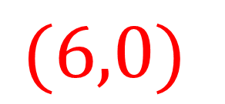
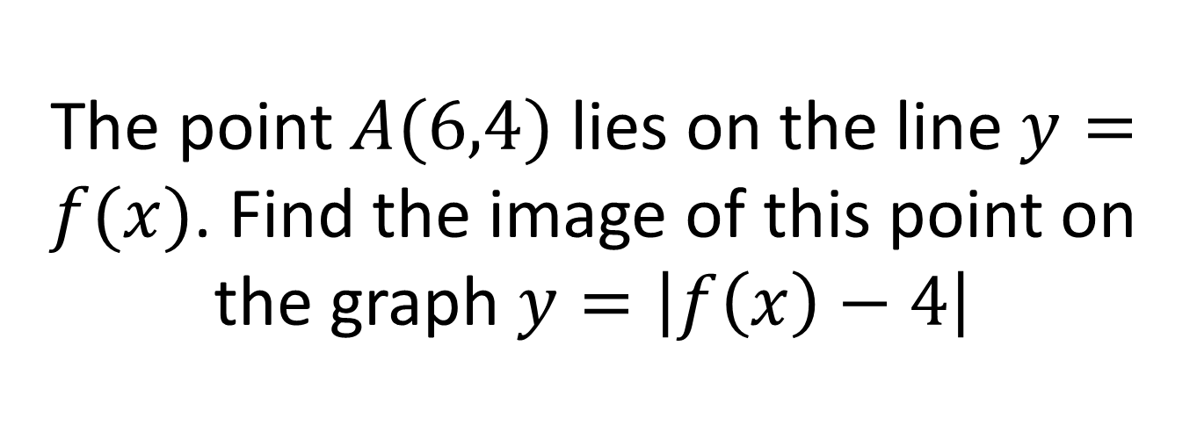
The point $A(6,4)$lies on the line $y=f(x)$. Find the image of this point on the graph $y=\left|f\left(x\right)−4\right|$
$$(6,0)$$

Slide 6
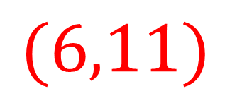
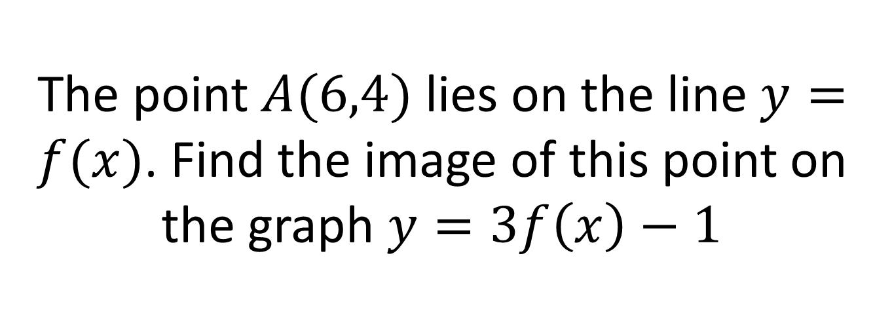
The point $A(6,4)$lies on the line $y=f(x)$. Find the image of this point on the graph $y=3f\left(x\right)−1$
$$(6,11)$$

Slide 7
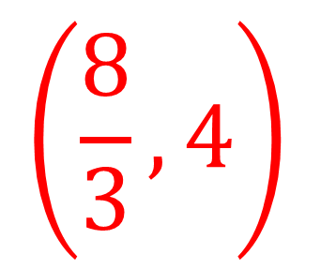
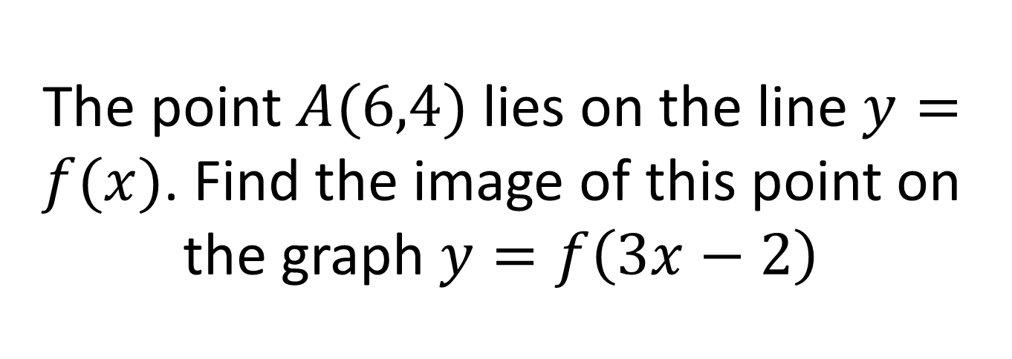
The point $A(6,4)$lies on the line $y=f(x)$. Find the image of this point on the graph $y=f\left(3x−2\right)$
$$\left(\frac{8}{3},4\right)$$

