Slide 1
Teachings for
Exercise 2F

Slide 2




Measures of location and spread
$$σ=\sqrt{\frac{\sum{fx^{2}}}{\sum{f}}−{\left(\frac{\sum{fx}}{\sum{f}}\right)}^{2}}$$
$$σ=\sqrt{\frac{\sum{x^{2}}}{n}−{\left(\frac{\sum{x}}{n}\right)}^{2}}$$
$$\overline{x}=\frac{\sum{x}}{n}$$
$$σ=\sqrt{\frac{S_{xx}}{n}}$$
Imagine we have the following data on people’s heights (cm)
145 170 168 166 151 147 150 172
Coding can be used to make a set of values simpler to work with
If numbers in a data set are particularly large, they can all be altered in the same way to make them smaller
This will however affect the measures of location and dispersion that we have been calculating, and you need to be aware of these effects…
Mean = 158.625
Range = 27
If all the values were multiplied by 2, what would happen to the measures above?
Mean and range would double
If all the values above had 20 added to them, what would happen to the measures above?
Mean would increase by 20, but the range would stay the same
If you change a set of data by adding or subtracting an amount, this will not affect the range, or any other measures of spread, such as the IQR or standard deviation
2F

Slide 3


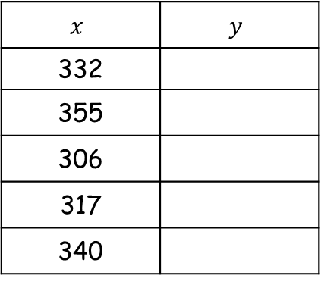


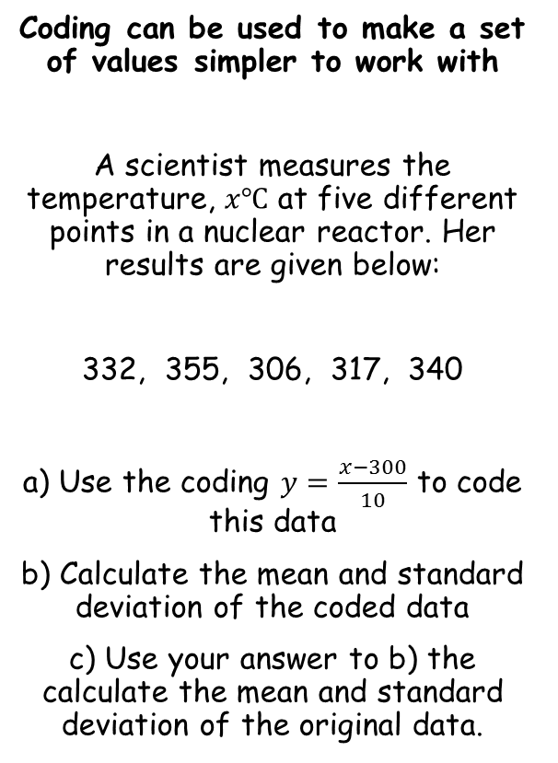










Measures of location and spread
$$σ=\sqrt{\frac{\sum{fx^{2}}}{\sum{f}}−{\left(\frac{\sum{fx}}{\sum{f}}\right)}^{2}}$$
$$σ=\sqrt{\frac{\sum{x^{2}}}{n}−{\left(\frac{\sum{x}}{n}\right)}^{2}}$$
$$\overline{x}=\frac{\sum{x}}{n}$$
$$σ=\sqrt{\frac{S_{xx}}{n}}$$
Coding can be used to make a set of values simpler to work with
A scientist measures the temperature, $x℃$ at five different points in a nuclear reactor. Her results are given below:
332, 355, 306, 317, 340
a) Use the coding $y=\frac{x−300}{10}$ to code this data
b) Calculate the mean and standard deviation of the coded data
c) Use your answer to b) the calculate the mean and standard deviation of the original data.
$$x$$ | $$y$$
332
355
306
317
340
$$y^{2}$$
3.2
$$10.24$$
5.5
$$30.25$$
0.6
$$0.36$$
1.7
$$2.89$$
4
$$16$$
$$\frac{\sum{y=15}}{}$$
$$\frac{\sum{y^{2}=59.74}}{}$$
To code the data. take each starting value, subtract 300 from it, and divide the answer by 10
Now we can calculate the mean and standard deviation of this new information…
$$\overline{y}=\frac{\sum{y}}{n}$$
$$σ_{y}=\sqrt{\frac{\sum{y^{2}}}{n}−{\left(\frac{\sum{y}}{n}\right)}^{2}}$$
Sub in values
Sub in values
$$\overline{y}=\frac{15}{5}$$
$$σ_{y}=\sqrt{\frac{59.74}{5}−{\left(\frac{15}{5}\right)}^{2}}$$
Work out
Work out
$$\overline{y}=3$$
$$σ_{y}=1.72$$
2F

Slide 4






Measures of location and spread
$$σ=\sqrt{\frac{\sum{fx^{2}}}{\sum{f}}−{\left(\frac{\sum{fx}}{\sum{f}}\right)}^{2}}$$
$$σ=\sqrt{\frac{\sum{x^{2}}}{n}−{\left(\frac{\sum{x}}{n}\right)}^{2}}$$
$$\overline{x}=\frac{\sum{x}}{n}$$
$$σ=\sqrt{\frac{S_{xx}}{n}}$$
Coding can be used to make a set of values simpler to work with
A scientist measures the temperature, $x℃$ at five different points in a nuclear reactor. Her results are given below:
332, 355, 306, 317, 340
a) Use the coding $y=\frac{x−300}{10}$ to code this data
b) Calculate the mean and standard deviation of the coded data
c) Use your answer to b) the calculate the mean and standard deviation of the original data.
Original mean
The original data had 300 subtracted, and then was divided by 10
We need to reverse this, so multiply by 10, and then add 300
$$3×10+300$$
$$=330℃$$
Original standard deviation
The original data had 300 subtracted, and then was divided by 10
The subtracting 300 will not have affected the standard deviation, so we only need to multiply by 10
$$\overline{y}=3$$
$$σ_{y}=1.72$$
$$1.72×10$$
$$=17.2℃$$
2F

Slide 5


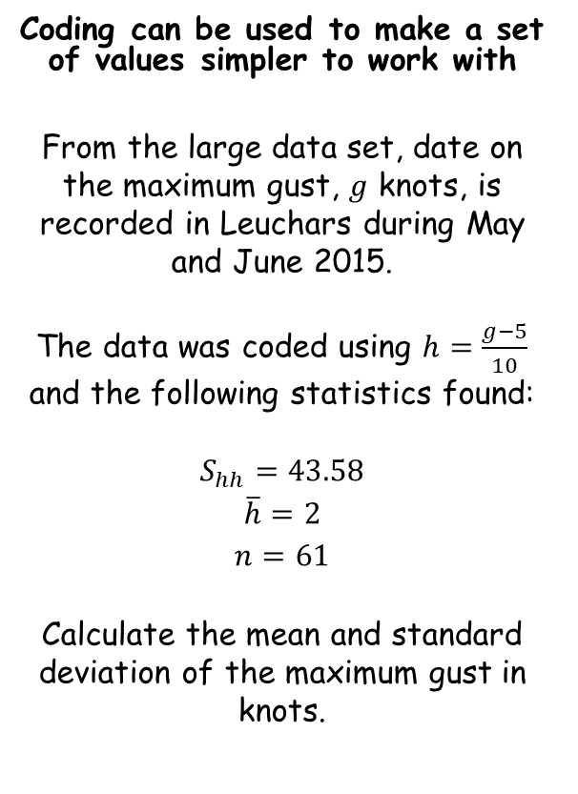



Measures of location and spread
$$σ=\sqrt{\frac{\sum{fx^{2}}}{\sum{f}}−{\left(\frac{\sum{fx}}{\sum{f}}\right)}^{2}}$$
$$σ=\sqrt{\frac{\sum{x^{2}}}{n}−{\left(\frac{\sum{x}}{n}\right)}^{2}}$$
$$\overline{x}=\frac{\sum{x}}{n}$$
$$σ=\sqrt{\frac{S_{xx}}{n}}$$
Coding can be used to make a set of values simpler to work with
From the large data set, date on the maximum gust, $g$ knots, is recorded in Leuchars during May and June 2015.
The data was coded using $h=\frac{g−5}{10}$ and the following statistics found:
$$S_{hh}=43.58$$
$$\overline{h}=2$$
$$n=61$$
Calculate the mean and standard deviation of the maximum gust in knots.
The mean has had 5 subtracted and then been multiplied by 10
→ You can write this as a formula:
$$\overline{h}=\frac{\overline{g}−5}{10}$$
We know the mean of h
$$2=\frac{\overline{g}−5}{10}$$
Multiply by 10
$$20=\overline{g}−5$$
Add 5
$$25=\overline{g}$$
This is a better way to show your workings!
$$\overline{g}=25$$
2F

Slide 6
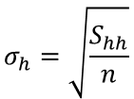




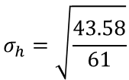

Measures of location and spread
$$σ=\sqrt{\frac{\sum{fx^{2}}}{\sum{f}}−{\left(\frac{\sum{fx}}{\sum{f}}\right)}^{2}}$$
$$σ=\sqrt{\frac{\sum{x^{2}}}{n}−{\left(\frac{\sum{x}}{n}\right)}^{2}}$$
$$\overline{x}=\frac{\sum{x}}{n}$$
$$σ=\sqrt{\frac{S_{xx}}{n}}$$
Coding can be used to make a set of values simpler to work with
From the large data set, date on the maximum gust, $g$ knots, is recorded in Leuchars during May and June 2015.
The data was coded using $h=\frac{g−5}{10}$ and the following statistics found:
$$S_{hh}=43.58$$
$$\overline{h}=2$$
$$n=61$$
Calculate the mean and standard deviation of the maximum gust in knots.
We need to find the standard deviation of h first!
Use the formula above…
$$σ_{h}=\sqrt{\frac{S_{hh}}{n}}$$
Sub in values
$$σ_{h}=\sqrt{\frac{43.58}{61}}$$
Calculate
$$σ_{h}=0.845…$$
As the subtraction has not affected the standard deviation, we only need to undo the division by 10
→ Like with the previous example, we can write this as a formula
$$σ_{h}=\frac{σ_{g}}{10}$$
Sub in values
$$0.845=\frac{σ_{g}}{10}$$
$$\overline{g}=25$$
$$σ_{g}=8.45$$
Multiply by 10
$$8.45=σ_{g}$$
2F

