Slide 1
Teachings for
Exercise 2E

Slide 2
Measures of location and spread
The variance and standard deviation can also be used to analyse a set of data
The variance and standard deviation are both measures of spread, and involve the fact that each data point deviates from the mean by the amount:
$$x−\overline{x}$$
Where $x$ is a data point and $\overline{x}$ is the mean of the data as a whole
2E

Slide 3
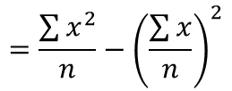
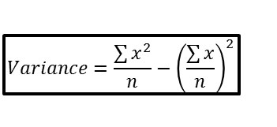
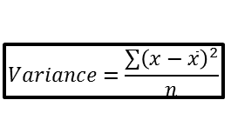
Measures of location and spread
$$Variance=\frac{\sum{{\left(x−\overline{x}\right)}^{2}}}{n}$$
$$Variance=\frac{\sum{x^{2}}}{n}−{\left(\frac{\sum{x}}{n}\right)}^{2}$$
$$Variance=\frac{S_{xx}}{n}$$
The variance and standard deviation can also be used to analyse a set of data
The variance is defined as:
“The average of the squared distances from the mean”
So the distances of each data point from the mean are all squared, and divided by how many there are.
This gives the formula to the right:
$$Variance=\frac{\sum{{\left(x−\overline{x}\right)}^{2}}}{n}$$
This formula is equivalent
“Mean of the squares subtract the square of the mean”
$$=\frac{\sum{x^{2}}}{n}−{\left(\frac{\sum{x}}{n}\right)}^{2}$$
This formula is equivalent
$$=\frac{S_{xx}}{n}$$
The notation $S_{xx}$ is short for $\sum{{\left(x−\overline{x}\right)}^{2}}$ or $\sum{x^{2}}−\frac{{\left(\sum{x}\right)}^{2}}{n}$
2E

Slide 4
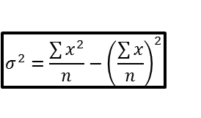
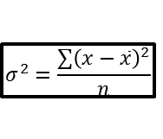
Measures of location and spread
$$Variance=\frac{\sum{{\left(x−\overline{x}\right)}^{2}}}{n}$$
$$σ^{2}=\frac{\sum{{\left(x−\overline{x}\right)}^{2}}}{n}$$
$$σ^{2}=\frac{\sum{x^{2}}}{n}−{\left(\frac{\sum{x}}{n}\right)}^{2}$$
$$Variance=\frac{\sum{x^{2}}}{n}−{\left(\frac{\sum{x}}{n}\right)}^{2}$$
$$σ^{2}=\frac{S_{xx}}{n}$$
$$Variance=\frac{S_{xx}}{n}$$
$$σ=\sqrt{\frac{\sum{{\left(x−\overline{x}\right)}^{2}}}{n}}$$
$$σ=\sqrt{\frac{\sum{x^{2}}}{n}−{\left(\frac{\sum{x}}{n}\right)}^{2}}$$
$$σ=\sqrt{\frac{S_{xx}}{n}}$$
The variance and standard deviation can also be used to analyse a set of data
The standard deviation is the square root of the variance.
The symbol $σ$ (lower case sigma) is used to represent standard deviation
Therefore $σ^{2}$ is usually used to represent the variance
→ The square root of any of these gives the Standard Deviation
This is what it looks like in the formula booklet!
2E

Slide 5
Measures of location and spread
$$σ^{2}=\frac{\sum{{\left(x−\overline{x}\right)}^{2}}}{n}$$
$$σ^{2}=\frac{\sum{x^{2}}}{n}−{\left(\frac{\sum{x}}{n}\right)}^{2}$$
$$σ^{2}=\frac{S_{xx}}{n}$$
$$σ=\sqrt{\frac{\sum{{\left(x−\overline{x}\right)}^{2}}}{n}}$$
$$σ=\sqrt{\frac{\sum{x^{2}}}{n}−{\left(\frac{\sum{x}}{n}\right)}^{2}}$$
$$σ=\sqrt{\frac{S_{xx}}{n}}$$
The variance and standard deviation can also be used to analyse a set of data
→ The Standard Deviation tells you the range from the mean which contains around 68% of the data (if data is normally distributed – you will learn about this at a later date)
For example, if 100 students have a mean height of 150cm and a standard deviation of 10cm.
150
68 of the students are within one Standard Deviation
140
160
95 of the students are within two Standard Deviations
130
170
2E

Slide 6
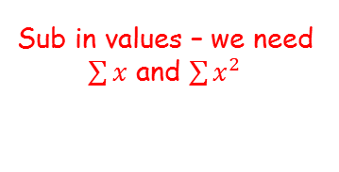
Measures of location and spread
$$σ^{2}=\frac{\sum{{\left(x−\overline{x}\right)}^{2}}}{n}$$
$$σ^{2}=\frac{\sum{x^{2}}}{n}−{\left(\frac{\sum{x}}{n}\right)}^{2}$$
$$σ^{2}=\frac{S_{xx}}{n}$$
$$σ=\sqrt{\frac{\sum{{\left(x−\overline{x}\right)}^{2}}}{n}}$$
$$σ=\sqrt{\frac{\sum{x^{2}}}{n}−{\left(\frac{\sum{x}}{n}\right)}^{2}}$$
$$σ=\sqrt{\frac{S_{xx}}{n}}$$
The variance and standard deviation can also be used to analyse a set of data
The marks gained in a test by seven randomly selected students are:
3 4 6 2 8 8 5
Find the variance and standard deviation of the marks of the seven students.
→ The middle of the 3 formulae above is most commonly used when you have the ‘raw’ data
$$σ^{2}=\frac{\sum{x^{2}}}{n}−{\left(\frac{\sum{x}}{n}\right)}^{2}$$
Sub in values – we need $\sum{x}$ and $\sum{x^{2}}$
$$σ^{2}=\frac{218}{7}−{\left(\frac{36}{7}\right)}^{2}$$
Calculate
$$σ^{2}=4.69$$
$$x$$
$$\frac{\sum{x}=36}{}$$
Square root
$$x^{2}$$
9 16 36 4 64 64 25
$$\frac{\sum{x^{2}}=218}{}$$
$$σ=2.17$$
2E

Slide 7
Measures of location and spread
$$σ^{2}=\frac{\sum{{\left(x−\overline{x}\right)}^{2}}}{n}$$
$$σ^{2}=\frac{\sum{x^{2}}}{n}−{\left(\frac{\sum{x}}{n}\right)}^{2}$$
$$σ^{2}=\frac{S_{xx}}{n}$$
$$σ=\sqrt{\frac{\sum{{\left(x−\overline{x}\right)}^{2}}}{n}}$$
$$σ=\sqrt{\frac{\sum{x^{2}}}{n}−{\left(\frac{\sum{x}}{n}\right)}^{2}}$$
$$σ=\sqrt{\frac{S_{xx}}{n}}$$
The variance and standard deviation can also be used to analyse a set of data
The marks gained in a test by seven randomly selected students are:
3 4 6 2 8 8 5
Find the variance and standard deviation of the marks of the seven students.
→ So this means that 68% of the data is within 2.17 of the mean. Note that 68% is not always a possible percentage though!
2 3 4 5 6 8 8
$$2.97$$
$$5.14$$
$$7.31$$
$$−2.17$$
$$+2.17$$
$$Mean=5.14$$
So out of the original 7 values, 4 are within 1 standard deviation of the mean
→ This is only 57% rather than 68%, because the data size is very small!
$$σ=2.17$$
2E

Slide 8
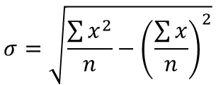
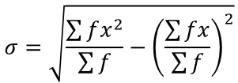
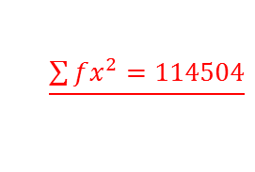
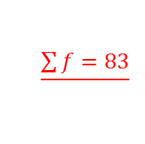
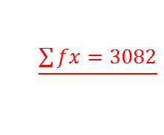
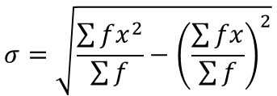
Measures of location and spread
$$σ^{2}=\frac{\sum{{\left(x−\overline{x}\right)}^{2}}}{n}$$
$$σ^{2}=\frac{\sum{x^{2}}}{n}−{\left(\frac{\sum{x}}{n}\right)}^{2}$$
$$σ^{2}=\frac{S_{xx}}{n}$$
$$σ=\sqrt{\frac{\sum{{\left(x−\overline{x}\right)}^{2}}}{n}}$$
$$σ=\sqrt{\frac{\sum{x^{2}}}{n}−{\left(\frac{\sum{x}}{n}\right)}^{2}}$$
$$σ=\sqrt{\frac{S_{xx}}{n}}$$
$$x$$
$$f$$
$$fx$$
$$fx^{2}$$
The variance and standard deviation can also be used to analyse a set of data
Shamsa records the time spent out of school during the lunch hour to the nearest minute, x, of the female students in her year. The results are shown in the table.
Calculate the standard deviation of the time spent out of school.
For tabled data, we need to use a modified formula…
Time (mins) | Frequency
35 | 3
36 | 17
37 | 29
38 | 34
$$105$$
$$3675$$
$$612$$
$$22032$$
$$1073$$
$$39701$$
$$1292$$
$$49096$$
$$\frac{\sum{f=83}}{}$$
$$\frac{\sum{fx=3082}}{}$$
$$\frac{\sum{fx^{2}=114504}}{}$$
$$σ=\sqrt{\frac{\sum{fx^{2}}}{\sum{f}}−{\left(\frac{\sum{fx}}{\sum{f}}\right)}^{2}}$$
Sub in values – we need to use the table to calculate these!
$$σ=\sqrt{\frac{114504}{83}−{\left(\frac{3082}{83}\right)}^{2}}$$
$$σ=\sqrt{\frac{\sum{x^{2}}}{n}−{\left(\frac{\sum{x}}{n}\right)}^{2}}$$
$$σ=\sqrt{\frac{\sum{fx^{2}}}{\sum{f}}−{\left(\frac{\sum{fx}}{\sum{f}}\right)}^{2}}$$
Calculate
$$σ=0.861$$
2E

Slide 9

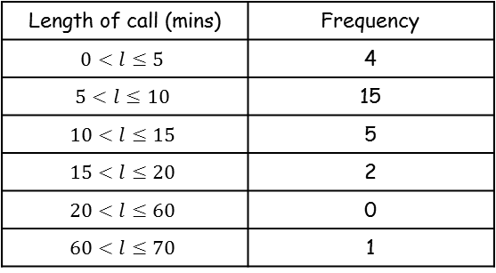
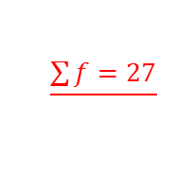
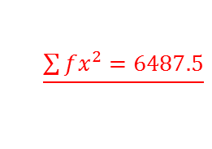
Measures of location and spread
$$σ^{2}=\frac{\sum{{\left(x−\overline{x}\right)}^{2}}}{n}$$
$$σ^{2}=\frac{\sum{x^{2}}}{n}−{\left(\frac{\sum{x}}{n}\right)}^{2}$$
$$σ^{2}=\frac{S_{xx}}{n}$$
$$σ=\sqrt{\frac{\sum{fx^{2}}}{\sum{f}}−{\left(\frac{\sum{fx}}{\sum{f}}\right)}^{2}}$$
$$σ=\sqrt{\frac{\sum{{\left(x−\overline{x}\right)}^{2}}}{n}}$$
$$σ=\sqrt{\frac{\sum{x^{2}}}{n}−{\left(\frac{\sum{x}}{n}\right)}^{2}}$$
$$σ=\sqrt{\frac{S_{xx}}{n}}$$
The variance and standard deviation can also be used to analyse a set of data
Andy recorded the length, in minutes, of each telephone call he made for a month. The data is summarized in the table below.
Calculate an estimate of the standard deviation of the length of the phonecalls
For a grouped table we need to use the midpoints (as in the previous section)
$$x$$
$$f$$
$$fx$$
$$fx^{2}$$
Length of call (mins) | Frequency
$$0<l≤5$$ | 4
$$5<l≤10$$ | 15
$$10<l≤15$$ | 5
$$15<l≤20$$ | 2
$$20<l≤60$$ | 0
$$60<l≤70$$ | 1
2.5
$$10$$
$$25$$
7.5
$$112.5$$
$$843.75$$
12.5
$$62.5$$
$$781.25$$
17.5
$$35$$
$$612.5$$
40
$$0$$
$$0$$
65
$$65$$
$$4225$$
$$\frac{\sum{f=27}}{}$$
$$\frac{\sum{fx=285}}{}$$
$$\frac{\sum{fx^{2}=6487.5}}{}$$
2E

Slide 10
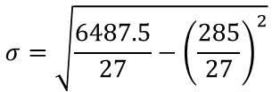
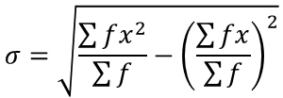
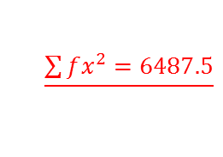
Measures of location and spread
$$σ^{2}=\frac{\sum{{\left(x−\overline{x}\right)}^{2}}}{n}$$
$$σ^{2}=\frac{\sum{x^{2}}}{n}−{\left(\frac{\sum{x}}{n}\right)}^{2}$$
$$σ^{2}=\frac{S_{xx}}{n}$$
$$σ=\sqrt{\frac{\sum{fx^{2}}}{\sum{f}}−{\left(\frac{\sum{fx}}{\sum{f}}\right)}^{2}}$$
$$σ=\sqrt{\frac{\sum{{\left(x−\overline{x}\right)}^{2}}}{n}}$$
$$σ=\sqrt{\frac{\sum{x^{2}}}{n}−{\left(\frac{\sum{x}}{n}\right)}^{2}}$$
$$σ=\sqrt{\frac{S_{xx}}{n}}$$
The variance and standard deviation can also be used to analyse a set of data
Andy recorded the length, in minutes, of each telephone call he made for a month. The data is summarized in the table below.
Calculate an estimate of the standard deviation of the length of the phonecalls
$$σ=\sqrt{\frac{\sum{fx^{2}}}{\sum{f}}−{\left(\frac{\sum{fx}}{\sum{f}}\right)}^{2}}$$
Sub in values – we need to use the table to calculate these!
$$x$$
$$f$$
Length of call (mins) | Frequency
$$0<l≤5$$ | 4
$$5<l≤10$$ | 15
$$10<l≤15$$ | 5
$$15<l≤20$$ | 2
$$20<l≤60$$ | 0
$$60<l≤70$$ | 1
$$σ=\sqrt{\frac{6487.5}{27}−{\left(\frac{285}{27}\right)}^{2}}$$
2.5
7.5
Calculate
12.5
17.5
$$σ=11.35$$
40
65
$$\frac{\sum{f=27}}{}$$
$$\frac{\sum{fx^{2}=6487.5}}{}$$
$$\frac{\sum{fx=285}}{}$$
2E

