Slide 1
Teachings for
Section 2E

Slide 2




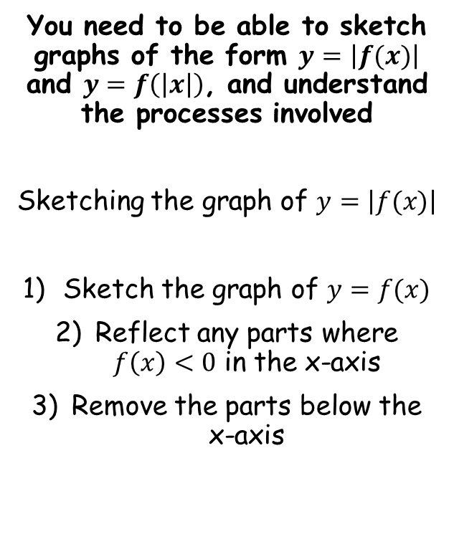





Functions and Graphs
You need to be able to sketch graphs of the form $y=\left|f(x)\right|$ and $y=f\left(\left|x\right|\right)$, and understand the processes involved
Sketching the graph of $y=\left|f(x)\right|$
Sketch the graph of $y=f(x)$
Reflect any parts where $f\left(x\right)<0$ in the x-axis
Remove the parts below the x-axis
$$f\left(x\right)=x^{2}−3x−10$$
Sketch $y=f(x)$ and $y=\left|f(x)\right|$
$$f(x)=x^{2}−3x−10$$
$$f(x)=(x−5)(x+2)$$
Crosses the x-axis at 5 and -2
The y-intercept is at -10
$$y$$
$$f(x)$$
$$y$$
$$\left|f(x) \right|$$
$$f(x)$$
10
-2
5
$$x$$
-2
5
$$x$$
The modulus above is of the whole function
→ This means that any final answers (‘y’) that we get which are negative, they will become positive at the end
-10
-10
2E

Slide 3

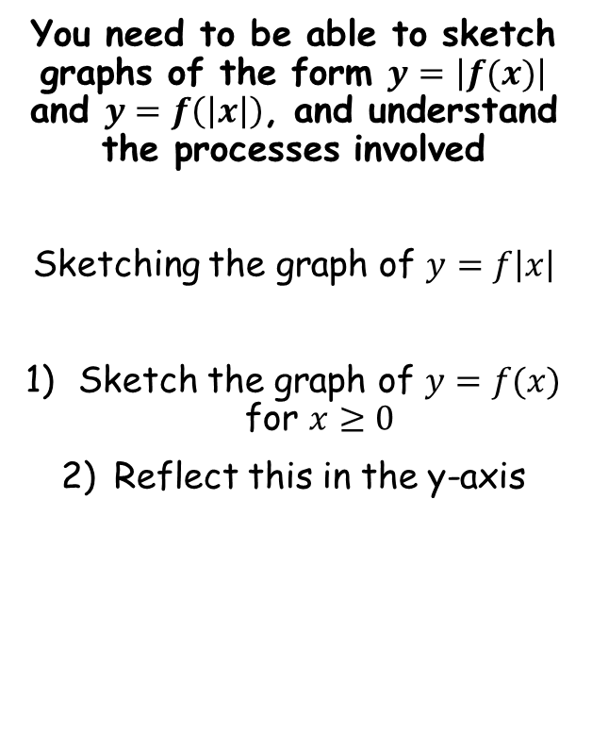


Functions and Graphs
You need to be able to sketch graphs of the form $y=\left|f(x)\right|$ and $y=f\left(\left|x\right|\right)$, and understand the processes involved
Sketching the graph of $y=f\left|x\right|$
Sketch the graph of $y=f(x)$ for $x≥0$
Reflect this in the y-axis
$$f\left(x\right)=x^{2}−3x−10$$
Sketch $y=f(x)$ and $y=f\left(\left|x\right|\right)$
$$f(x)=x^{2}−3x−10$$
$$f(x)=(x−5)(x+2)$$
Crosses the x-axis at 5 and -2
The y-intercept is at -10
$$y$$
$$f(x)$$
$$y$$
$$f\left(\left|x\right|\right)$$
$$f(x)$$
The modulus above is of the inputs (x)
→ This means that when we put in a negative number, we get the same output as for the equivalent positive number
-2
5
$$x$$
-5
5
$$x$$
-10
-10
2E

Slide 4

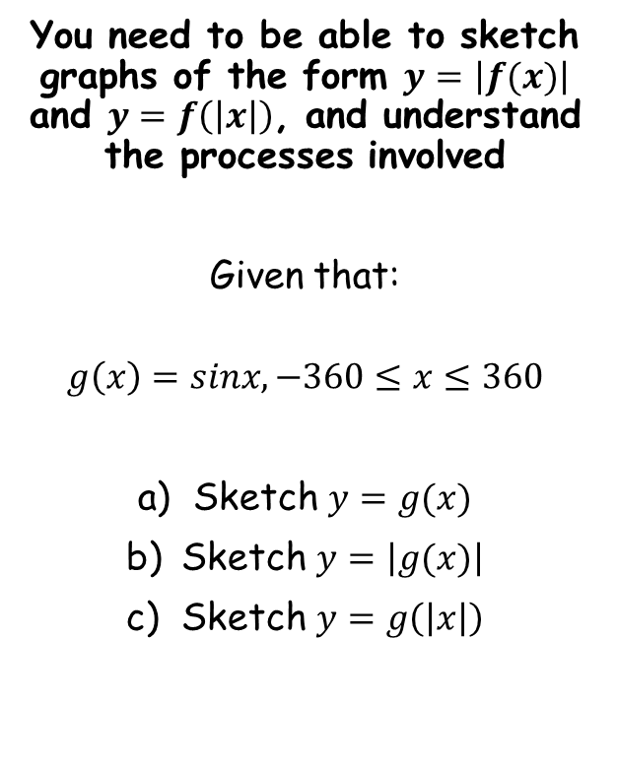




Functions and Graphs
$$y$$
You need to be able to sketch graphs of the form $y=\left|f(x)\right|$ and $y=f\left(\left|x\right|\right)$, and understand the processes involved
Given that:
$$g\left(x\right)=sinx, −360≤x≤360$$
Sketch $y=g(x)$
Sketch $y=\left|g(x)\right|$
Sketch $y=g\left(\left|x\right|\right)$
$$y=g(x)$$
1
$$x$$
-360
-180
180
360
-1
$$y$$
$$y=\left|g(x) \right|$$
$$y=g(x)$$
1
$$x$$
-360
-180
180
360
-1
$$y$$
1
$$y=g(\left|x\right|)$$
$$x$$
-360
-180
180
360
-1
2E

Slide 5









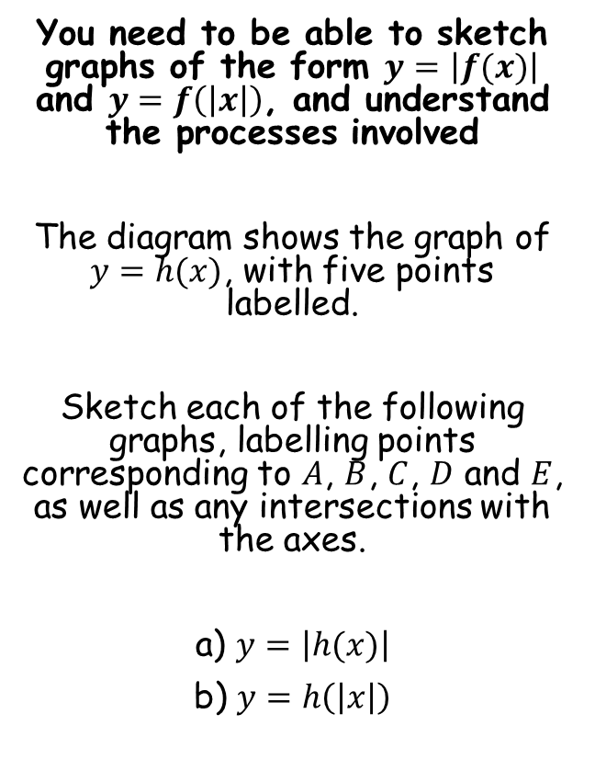
















Functions and Graphs
$$y$$
You need to be able to sketch graphs of the form $y=\left|f(x)\right|$ and $y=f\left(\left|x\right|\right)$, and understand the processes involved
The diagram shows the graph of $y=h(x)$, with five points labelled.
Sketch each of the following graphs, labelling points corresponding to $A$, $B$, $C$, $D$ and $E$, as well as any intersections with the axes.
a) $y=\left|h(x)\right|$
b) $y=h\left(\left|x\right|\right)$
$$(−2.5,15)$$
$$B$$
$$C$$
$$11$$
$$A$$
$$−7$$
$$D$$
$$x$$
$$3$$
$$y=h(x)$$
$$E$$
$$(6,−5)$$
$$y$$
$$(−2.5,15)$$
$$B$$
$$C$$
$$11$$
$$E′$$
$$(6,5)$$
$$y=\left|h(x) \right|$$
$$A$$
$$−7$$
$$D$$
$$x$$
$$3$$
$$y=h(x)$$
$$E$$
$$(6,−5)$$
2E

Slide 6






Functions and Graphs
$$y$$
You need to be able to sketch graphs of the form $y=\left|f(x)\right|$ and $y=f\left(\left|x\right|\right)$, and understand the processes involved
The diagram shows the graph of $y=h(x)$, with five points labelled.
Sketch each of the following graphs, labelling points corresponding to $A$, $B$, $C$, $D$ and $E$, as well as any intersections with the axes.
a) $y=\left|h(x)\right|$
b) $y=h\left(\left|x\right|\right)$
$$(−2.5,15)$$
$$B$$
$$C$$
$$11$$
$$A$$
$$−7$$
$$D$$
$$x$$
$$3$$
$$y=h(x)$$
$$E$$
$$(6,−5)$$
$$y$$
$$C$$
$$11$$
$$D′$$
$$−3$$
$$D$$
$$x$$
$$3$$
$$y=h(x)$$
$$y=h(\left|x\right|)$$
$$E′$$
$$E$$
$$(−6,−5)$$
$$(6,−5)$$
2E

