Slide 1
Teachings for
Exercise 2D

Slide 2
Conditional Probability
$$P\left(A∪B\right)=P\left(A\right)+P\left(B\right)−P(A∩B)$$
You need to be able to use two probability formulae in solving problems (these are both given to you in the formula booklet)
On a Venn diagram, let $P\left(A\right)=a$ and $P\left(B\right)=b$.
Let the intersection $P\left(A∩B\right)=i$
The probability of $A$ or $B$, $P(A∪B)$, will be equal to the sum of the three regions shown
$$A$$
$$B$$
$$a−i$$
$$i$$
$$b−i$$
$$P\left(A∪B\right)=$$
$$a−i$$
$$+ i$$
$$+ b−i$$
Simplify
Replace each term using the information in the question
$$P\left(A∪B\right)=$$
$$a+b−i$$
$$P\left(A∪B\right)=$$
$$P\left(A\right)+P\left(B\right)−P(A∩B)$$
Note that for mutually exclusive events, $P\left(A∩B\right)=0$, so:
$P\left(A∪B\right)=$ $P\left(A\right)+P\left(B\right)$
2D

Slide 3
Conditional Probability
$$P\left(A∪B\right)=P\left(A\right)+P\left(B\right)−P(A∩B)$$
You need to be able to use two probability formulae in solving problems (these are both given to you in the formula booklet)
A and B are two events, such that $P\left(A\right)=0.6$, $P\left(B\right)=0.7$ and $P\left(A∪B\right)=0.9$. Find $P(A∩B)$.
$$P\left(A∪B\right)=P\left(A\right)+P\left(B\right)−P(A∩B)$$
Sub in values from the question
$$0.9=0.6+0.7−P(A∩B)$$
Simplify
$$0.9=1.3−P(A∩B)$$
Calculate
$$P(A∩B)=0.4$$
2D

Slide 4
Conditional Probability
$$P\left(A∪B\right)=P\left(A\right)+P\left(B\right)−P(A∩B)$$
$$P\left(A∩B\right)=P(A)P\left(B | A\right)$$
You need to be able to use two probability formulae in solving problems (these are both given to you in the formula booklet)
On a Venn diagram, let $P\left(A\right)=a$ and $P\left(B\right)=b$.
Let the intersection $P\left(A∩B\right)=i$
The probability of $B$ happening, given that $A$ happens, will mean we only use the ‘$A$’ section.
→ The probability will be the intersection of $A$ and $B$, divided by the whole circle ($A$)
$$A$$
$$B$$
$$a−i$$
$$i$$
$$b−i$$
$$P\left(B | A\right)=$$
$$i$$
$$a−i+i$$
Simplify
$$\frac{i}{a}$$
$$P\left(B | A\right)=$$
Replace using the information in the question
$$\frac{P(A∩B)}{P(A)}$$
$$P\left(B | A\right)=$$
Multiply by P(A)
$$P(A)P\left(B | A\right)=$$
$$P(A∩B)$$
This is the form you are given in the formula booklet
$$P\left(A∩B\right)=P(A)P\left(B | A\right)$$
2D

Slide 5
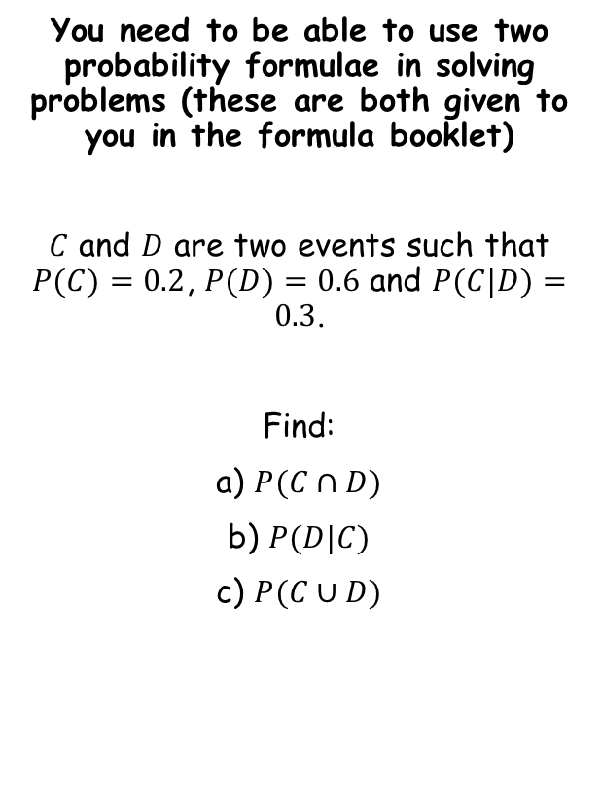
Conditional Probability
$$P\left(A∪B\right)=P\left(A\right)+P\left(B\right)−P(A∩B)$$
$$P\left(A∩B\right)=P(A)P\left(B | A\right)$$
You need to be able to use two probability formulae in solving problems (these are both given to you in the formula booklet)
$C$ and $D$ are two events such that $P(C)=0.2$, $P(D)=0.6$ and $P(C|D)=0.3$.
Find:
a) $P(C∩D)$
b) $P(D|C)$
c) $P(C∪D)$
$$P\left(A∩B\right)=P(A)P\left(B | A\right)$$
Replace $A$ with $C$, and $B$ with $D$
$$P\left(C∩D\right)=P(C)P\left(D | C\right)$$
Note that there is a problem here – we do not know $P(D|C)$ yet…
However, since $P\left(C∩D\right)=P(D∩C)$, we can swap all the $C$s and $D$s around…
$$P\left(C∩D\right)=P(C)P\left(D | C\right)$$
Swap $C$ and $D$s around…
$$=0.18$$
$$P\left(D∩C\right)=P(D)P\left(C | D\right)$$
Sub in values
$$P\left(D∩C\right)=0.6×0.3$$
Calculate
$$P\left(D∩C\right)=0.18$$
2D

Slide 6
Conditional Probability
$$P\left(A∪B\right)=P\left(A\right)+P\left(B\right)−P(A∩B)$$
$$P\left(A∩B\right)=P(A)P\left(B | A\right)$$
You need to be able to use two probability formulae in solving problems (these are both given to you in the formula booklet)
$C$ and $D$ are two events such that $P(C)=0.2$, $P(D)=0.6$ and $P(C|D)=0.3$.
Find:
a) $P(C∩D)$
b) $P(D|C)$
c) $P(C∪D)$
$$P\left(A∩B\right)=P(A)P\left(B | A\right)$$
Replace $A$ with $C$, and $B$ with $D$
$$P\left(C∩D\right)=P(C)P\left(D | C\right)$$
Sub in values (using the answer from a)
$$0.18=0.2×P\left(D | C\right)$$
Divide by 0.2
$$0.9=P\left(D | C\right)$$
$$=0.18$$
$$=0.9$$
2D

Slide 7
Conditional Probability
$$P\left(A∪B\right)=P\left(A\right)+P\left(B\right)−P(A∩B)$$
$$P\left(A∩B\right)=P(A)P\left(B | A\right)$$
You need to be able to use two probability formulae in solving problems (these are both given to you in the formula booklet)
$C$ and $D$ are two events such that $P(C)=0.2$, $P(D)=0.6$ and $P(C|D)=0.3$.
Find:
a) $P(C∩D)$
b) $P(D|C)$
c) $P(C∪D)$
$$P\left(A∪B\right)=P\left(A\right)+P\left(B\right)−P(A∩B)$$
Replace $A$ with $C$, and $B$ with $D$
$$P\left(C∪D\right)=P\left(C\right)+P\left(D\right)−P(C∩D)$$
Sub in values
$$P\left(C∪D\right)=0.2+0.6−0.18$$
Calculate
$$P\left(C∪D\right)=0.62$$
$$=0.18$$
$$=0.9$$
2D

