Slide 1
Teachings for
Section 2D

Slide 2
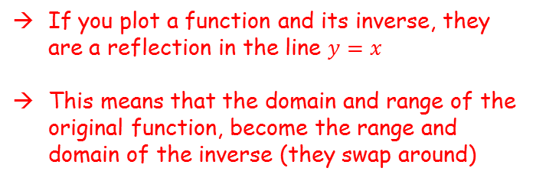


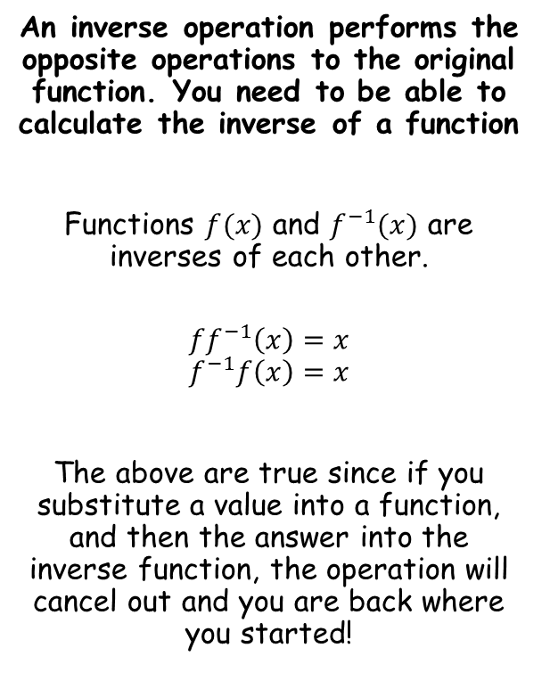


Functions and Graphs
$$y$$
$$f(x)$$
$$y=x$$
An inverse operation performs the opposite operations to the original function. You need to be able to calculate the inverse of a function
Functions $f(x)$ and $f^{−1}(x)$ are inverses of each other.
$$ff^{−1}\left(x\right)=x$$
$$f^{−1}f\left(x\right)=x$$
The above are true since if you substitute a value into a function, and then the answer into the inverse function, the operation will cancel out and you are back where you started!
$$f^{−1}(x)$$
$$x$$
If you plot a function and its inverse, they are a reflection in the line $y=x$
This means that the domain and range of the original function, become the range and domain of the inverse (they swap around)
2D

Slide 3


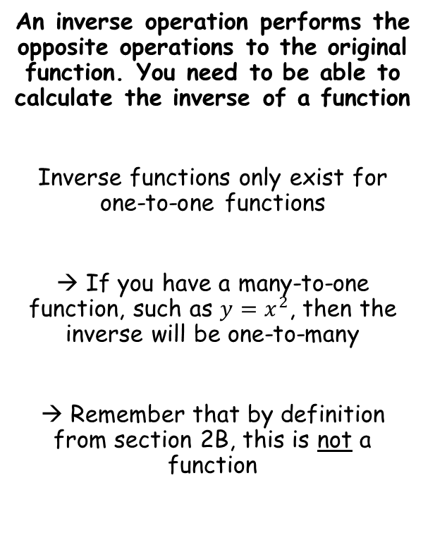


Functions and Graphs
An inverse operation performs the opposite operations to the original function. You need to be able to calculate the inverse of a function
Inverse functions only exist for one-to-one functions
→ If you have a many-to-one function, such as $y=x^{2}$, then the inverse will be one-to-many
→ Remember that by definition from section 2B, this is not a function
$$y=x^{2}$$
$$y$$
$$y=x$$
$$y=\sqrt{x}$$
$$x$$
2D

Slide 4


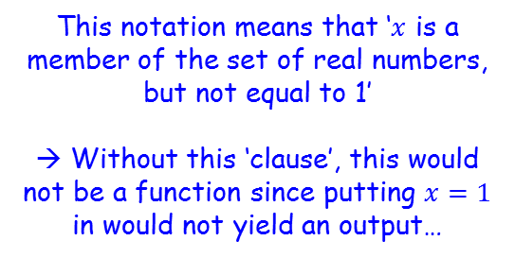


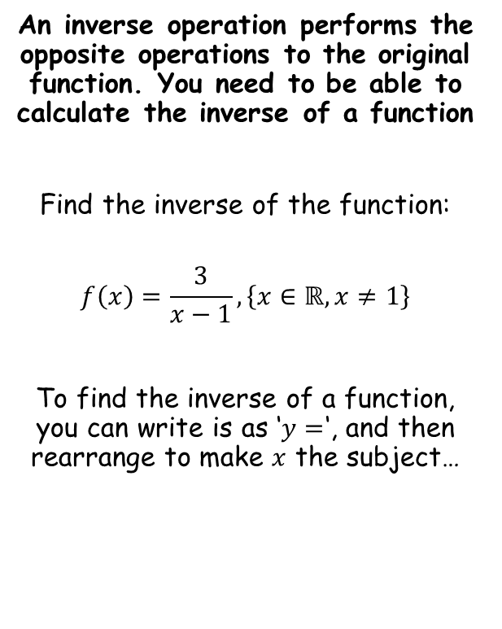






Functions and Graphs
An inverse operation performs the opposite operations to the original function. You need to be able to calculate the inverse of a function
Find the inverse of the function:
$$f\left(x\right)=\frac{3}{x−1}, \left\{x∈ℝ, x≠1\right\}$$
To find the inverse of a function, you can write is as ‘$y=$‘, and then rearrange to make $x$ the subject…
$$y=\frac{3}{x−1}$$
Multiply by $(x−1)$
$$y(x−1)=3$$
Expand bracket
$$xy−y=3$$
Add $y$
$$xy=3+y$$
Divide by $y$
$$x=\frac{3+y }{y}$$
Rewrite using $x$ and the inverse function notation
$$f^{−1}(x)=\frac{3+x }{x}$$
This notation means that ‘$x$ is a member of the set of real numbers, but not equal to 1’
→ Without this ‘clause’, this would not be a function since putting $x=1$ in would not yield an output…
2D

Slide 5
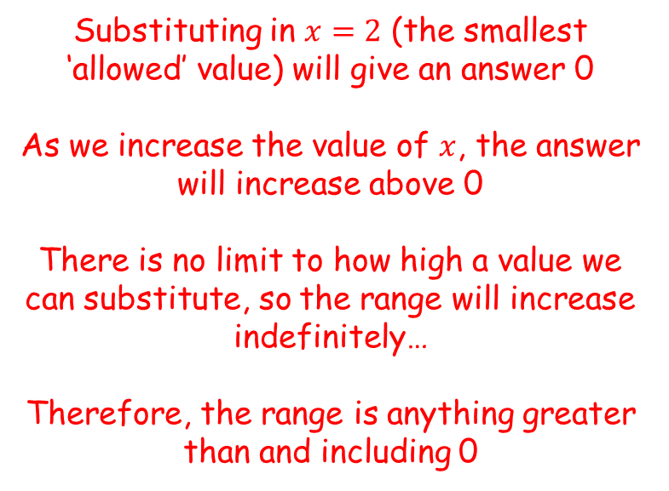
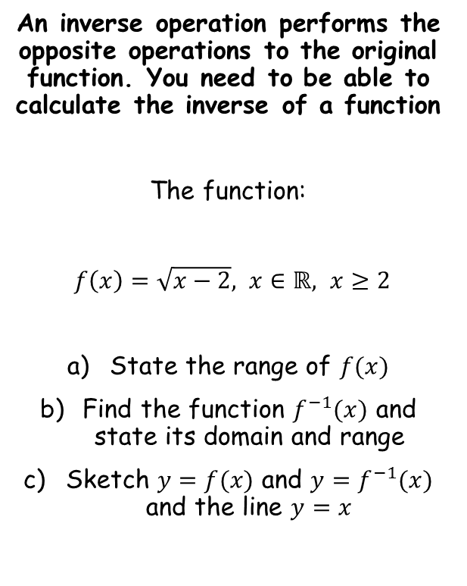

Functions and Graphs
An inverse operation performs the opposite operations to the original function. You need to be able to calculate the inverse of a function
The function:
$f\left(x\right)=\sqrt{x−2}, x∈ℝ, x≥2$
State the range of $f(x)$
Find the function $f^{−1}(x)$ and state its domain and range
Sketch $y=f(x)$ and $y=f^{−1}(x)$ and the line $y=x$
Substituting in $x=2$ (the smallest ‘allowed’ value) will give an answer 0
As we increase the value of $x$, the answer will increase above 0
There is no limit to how high a value we can substitute, so the range will increase indefinitely…
Therefore, the range is anything greater than and including 0
$$f\left(x\right)∈ℝ, f(x)≥0$$
You need to state your answer like the above, using the correct notation
2D

Slide 6

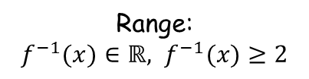




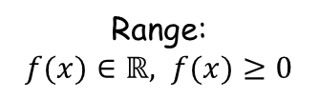




Functions and Graphs
An inverse operation performs the opposite operations to the original function. You need to be able to calculate the inverse of a function
The function:
$f\left(x\right)=\sqrt{x−2}, x∈ℝ, x≥2$
State the range of $f(x)$
Find the function $f^{−1}(x)$ and state its domain and range
Sketch $y=f(x)$ and $y=f^{−1}(x)$ and the line $y=x$
$$y=\sqrt{x−2}$$
Square both sides
$$y^{2}=x−2$$
Add 2
$$y^{2}+2=x$$
Rewrite using the inverse function notation
$$f^{−1}\left(x\right)=x^{2}+2$$
$$f\left(x\right)∈ℝ, f(x)≥0$$
Original function
Inverse function
$$f\left(x\right)=\sqrt{x−2}$$
$$f^{−1}\left(x\right)=x^{2}+2$$
Domain:
$x∈ℝ, x≥2$
Domain:
$x∈ℝ, x≥0$
Consider the domain and range for the original function, and swap them around for the inverse…
Range:
$f(x)∈ℝ, f(x)≥0$
Range:
$f^{−1}(x)∈ℝ, f^{−1}(x)≥2$
2D

Slide 7






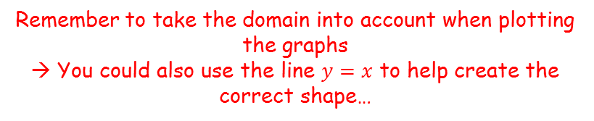
Functions and Graphs
An inverse operation performs the opposite operations to the original function. You need to be able to calculate the inverse of a function
The function:
$f\left(x\right)=\sqrt{x−2}, x∈ℝ, x≥2$
State the range of $f(x)$
Find the function $f^{−1}(x)$ and state its domain and range
Sketch $y=f(x)$ and $y=f^{−1}(x)$ and the line $y=x$
$$f\left(x\right)=\sqrt{x−2}$$
$x∈ℝ, x≥2$
$$f^{−1}\left(x\right)=x^{2}+2$$
$$x∈ℝ, x≥0$$
$$y=f^{−1}(x)$$
$$y$$
$$y=x$$
$$y=f(x)$$
2
$$f\left(x\right)∈ℝ, f(x)≥0$$
$$x$$
2
Remember to take the domain into account when plotting the graphs
→ You could also use the line $y=x$ to help create the correct shape…
2D

Slide 8

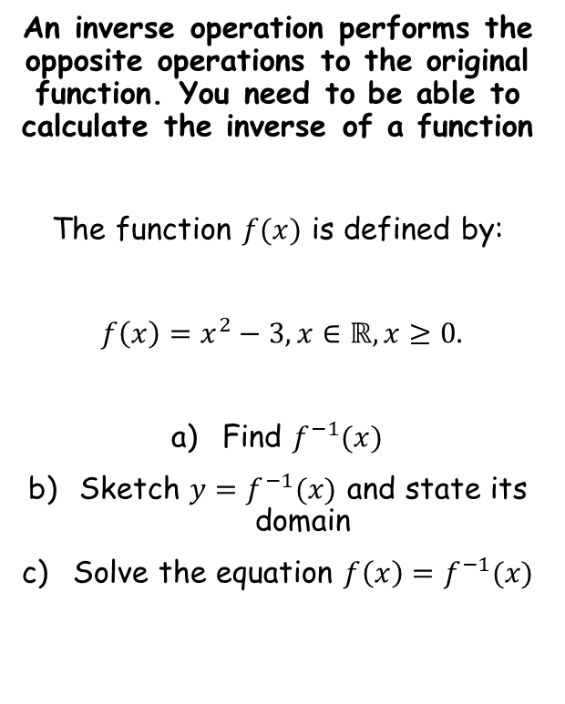



Functions and Graphs
An inverse operation performs the opposite operations to the original function. You need to be able to calculate the inverse of a function
The function $f(x)$ is defined by:
$f\left(x\right)=x^{2}−3, x∈ℝ, x≥0.$
Find $f^{−1}(x)$
Sketch $y=f^{−1}(x)$ and state its domain
Solve the equation $f\left(x\right)=f^{−1}(x)$
$$y=x^{2}−3$$
Add 3
$$y+3=x^{2}$$
Square root
$$\sqrt{y+3}=x$$
Rewrite using $x$ and the inverse function notation
$$f^{−1}(x)=\sqrt{x+3}$$
2D

Slide 9

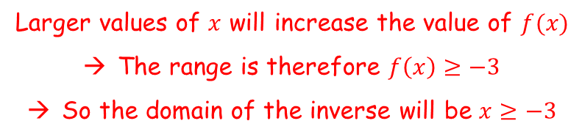


Functions and Graphs
An inverse operation performs the opposite operations to the original function. You need to be able to calculate the inverse of a function
The function $f(x)$ is defined by:
$f\left(x\right)=x^{2}−3, x∈ℝ, x≥0.$
Find $f^{−1}(x)$
Sketch $y=f^{−1}(x)$ and state its domain
Solve the equation $f\left(x\right)=f^{−1}(x)$
We need to know the domain to be able to draw the sketch
→ We can find the domain by finding the range of the original function
$$f\left(x\right)=x^{2}−3$$
Sub in 0
$$f\left(0\right)=−3$$
Larger values of $x$ will increase the value of $f(x)$
The range is therefore $f\left(x\right)≥−3$
So the domain of the inverse will be $x≥−3$
$$f^{−1}(x)=\sqrt{x+3}$$
2D

Slide 10


Functions and Graphs
An inverse operation performs the opposite operations to the original function. You need to be able to calculate the inverse of a function
The function $f(x)$ is defined by:
$f\left(x\right)=x^{2}−3, x∈ℝ, x≥0.$
Find $f^{−1}(x)$
Sketch $y=f^{−1}(x)$ and state its domain
Solve the equation $f\left(x\right)=f^{−1}(x)$
$$f^{−1}\left(x\right)=\sqrt{x+3}, x≥−3$$
$$y$$
$$y=f^{−1}(x)$$
-3
$$x$$
$$f^{−1}(x)=\sqrt{x+3}$$
2D

Slide 11


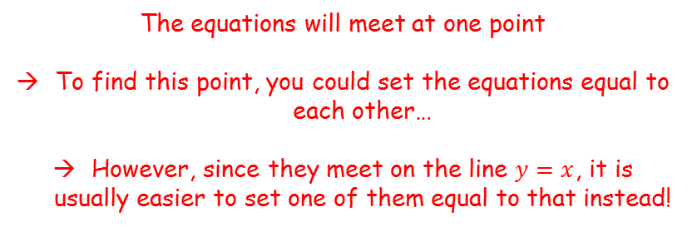
Functions and Graphs
An inverse operation performs the opposite operations to the original function. You need to be able to calculate the inverse of a function
The function $f(x)$ is defined by:
$f\left(x\right)=x^{2}−3, x∈ℝ, x≥0.$
Find $f^{−1}(x)$
Sketch $y=f^{−1}(x)$ and state its domain
Solve the equation $f\left(x\right)=f^{−1}(x)$
$$f^{−1}\left(x\right)=\sqrt{x+3}, x≥−3$$
$$y$$
$$y=f(x)$$
$$y=f^{−1}(x)$$
-3
$$x$$
-3
$$y=x$$
The equations will meet at one point
To find this point, you could set the equations equal to each other…
However, since they meet on the line $y=x$, it is usually easier to set one of them equal to that instead!
$$f^{−1}(x)=\sqrt{x+3}$$
2D

Slide 12




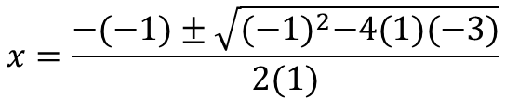




Functions and Graphs
An inverse operation performs the opposite operations to the original function. You need to be able to calculate the inverse of a function
The function $f(x)$ is defined by:
$f\left(x\right)=x^{2}−3, x∈ℝ, x≥0.$
Find $f^{−1}(x)$
Sketch $y=f^{−1}(x)$ and state its domain
Solve the equation $f\left(x\right)=f^{−1}(x)$
$$x^{2}−3=x$$
Subtract $x$
$$x^{2}−x−3=0$$
$$a=1$$
$$b=−1$$
$$c=−3$$
$$x=\frac{−b±\sqrt{b^{2}−4ac}}{2a}$$
Sub in values
$$x=\frac{−(−1)±\sqrt{{(−1)}^{2}−4(1)(−3)}}{2(1)}$$
Calculate (in this case the answer must be positive, based on the graph we sketched)
$$x=\frac{1+\sqrt{13}}{2}$$
$$f^{−1}(x)=\sqrt{x+3}$$
2D

