Slide 1
Inverse functions (2.4)

Slide 2
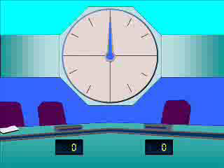
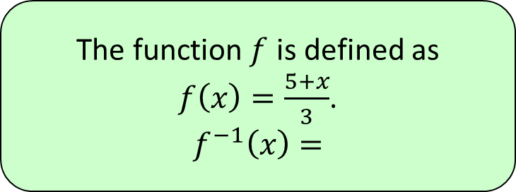




1
The function $f$ is defined as
$f\left(x\right)=\frac{5+x}{3}$.
$$f^{−1}\left(x\right)=$$
a) $3(x−5)$
b) $3x−5$
c) $\frac{3}{5+x}$
d) $\frac{5−x}{3}$

Slide 3
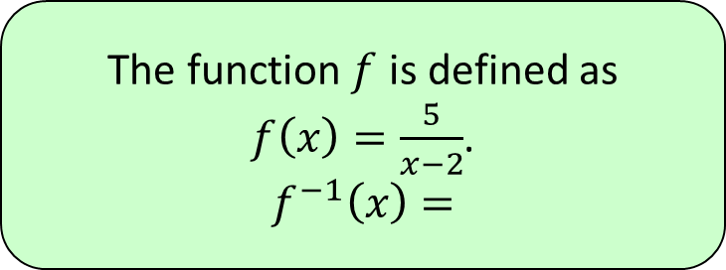




2
The function $f$ is defined as
$f\left(x\right)=\frac{5}{x−2}$.
$$f^{−1}\left(x\right)=$$
a) $2−\frac{5}{x}$
b) $\frac{x−2}{5}$
c) $\frac{5}{2+x}$
d) $2+\frac{5}{x}$

Slide 4
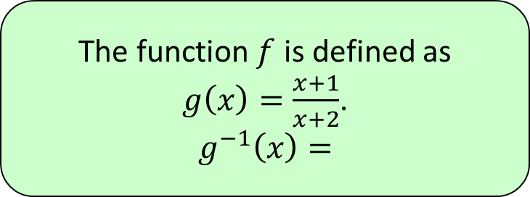




3
The function $f$ is defined as
$g\left(x\right)=\frac{x+1}{x+2}$.
$$g^{−1}\left(x\right)=$$
a) $\frac{x+1}{x+2}$
b) $\frac{1−2x}{x−1}$
c) $\frac{2x−1}{x−1}$
d) $\frac{2x+1}{x−1}$

