Slide 1
Teachings for
Exercise 2D

Slide 2

Measures of location and spread
$$LB+\left(\frac{PL}{GF}×CW\right)$$
A measure of spread is a value which indicated how spread out the data set is. Examples include the range and interquartile range.
The range is the difference between the largest and smallest values, and measures the spread of all the data
The interquartile range is the difference between the upper and lower quartiles, and measures the spread of the middle 50% of the data
→ The interpercentile range is the difference between 2 given percentiles
2D

Slide 3
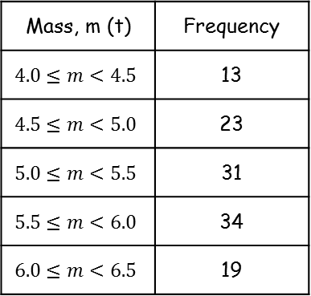
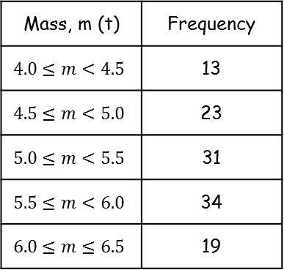

Measures of location and spread
$$LB+\left(\frac{PL}{GF}×CW\right)$$
Mass, m (t) | Frequency
$$4.0≤m<4.5$$ | 13
$$4.5≤m<5.0$$ | 23
$$5.0≤m<5.5$$ | 31
$$5.5≤m<6.0$$ | 34
$$6.0≤m≤6.5$$ | 19
A measure of spread is a value which indicated how spread out the data set is. Examples include the range and interquartile range.
The table to the right shows the masses (tonnes) of 120 African elephants.
Find estimates for:
The range
The interquartile range
The 10th to 90th percentile range
The range is the biggest possible value subtract the smallest possible value
6.5 - 4.0 = 2.5
$$2.5$$
2D

Slide 4








Measures of location and spread
$$LB+\left(\frac{PL}{GF}×CW\right)$$
Mass, m (t) | Frequency
$$4.0≤m<4.5$$ | 13
$$4.5≤m<5.0$$ | 23
$$5.0≤m<5.5$$ | 31
$$5.5≤m<6.0$$ | 34
$$6.0≤m≤6.5$$ | 19
A measure of spread is a value which indicated how spread out the data set is. Examples include the range and interquartile range.
The table to the right shows the masses (tonnes) of 120 African elephants.
Find estimates for:
The range
The interquartile range
The 10th to 90th percentile range
13
36
For $Q_{1}$
67
$$\frac{n}{4}$$
101
120
$$=\frac{120}{4}$$
$=30th$ value
$$2.5$$
Now use linear interpolation
$$LB+\left(\frac{PL}{GF}×CW\right)$$
Sub in values
$$Q_{1}=4.87$$
$$=4.5+\left(\frac{17}{23}×0.5\right)$$
Calculate
$$=4.87$$
2D

Slide 5









Measures of location and spread
$$LB+\left(\frac{PL}{GF}×CW\right)$$
Mass, m (t) | Frequency
$$4.0≤m<4.5$$ | 13
$$4.5≤m<5.0$$ | 23
$$5.0≤m<5.5$$ | 31
$$5.5≤m<6.0$$ | 34
$$6.0≤m≤6.5$$ | 19
A measure of spread is a value which indicated how spread out the data set is. Examples include the range and interquartile range.
The table to the right shows the masses (tonnes) of 120 African elephants.
Find estimates for:
The range
The interquartile range
The 10th to 90th percentile range
13
36
For $Q_{3}$
67
$$\frac{3n}{4}$$
101
120
$$=\frac{360}{4}$$
$=90th$ value
$$2.5$$
Now use linear interpolation
$$0.97$$
$$LB+\left(\frac{PL}{GF}×CW\right)$$
Sub in values
$$Q_{1}=4.87$$
$$Q_{3}=5.84$$
$$=5.5+\left(\frac{23}{34}×0.5\right)$$
$$5.84−4.87=0.97$$
Calculate
$$=5.84$$
2D

Slide 6







Measures of location and spread
$$LB+\left(\frac{PL}{GF}×CW\right)$$
Mass, m (t) | Frequency
$$4.0≤m<4.5$$ | 13
$$4.5≤m<5.0$$ | 23
$$5.0≤m<5.5$$ | 31
$$5.5≤m<6.0$$ | 34
$$6.0≤m≤6.5$$ | 19
A measure of spread is a value which indicated how spread out the data set is. Examples include the range and interquartile range.
The table to the right shows the masses (tonnes) of 120 African elephants.
Find estimates for:
The range
The interquartile range
The 10th to 90th percentile range
13
36
For $P_{10}$
67
$$\frac{10n}{100}$$
101
120
$$=\frac{1200}{100}$$
$=12th$ value
$$2.5$$
Now use linear interpolation
$$0.97$$
$$LB+\left(\frac{PL}{GF}×CW\right)$$
Sub in values
$$P_{10}=4.46$$
$$=4.0+\left(\frac{12}{13}×0.5\right)$$
Calculate
$$=4.46$$
2D

Slide 7








Measures of location and spread
$$LB+\left(\frac{PL}{GF}×CW\right)$$
Mass, m (t) | Frequency
$$4.0≤m<4.5$$ | 13
$$4.5≤m<5.0$$ | 23
$$5.0≤m<5.5$$ | 31
$$5.5≤m<6.0$$ | 34
$$6.0≤m≤6.5$$ | 19
A measure of spread is a value which indicated how spread out the data set is. Examples include the range and interquartile range.
The table to the right shows the masses (tonnes) of 120 African elephants.
Find estimates for:
The range
The interquartile range
The 10th to 90th percentile range
13
36
For $P_{90}$
67
$$\frac{90n}{100}$$
101
120
$$=\frac{10800}{100}$$
$=108th$ value
$$2.5$$
Now use linear interpolation
$$0.97$$
$$LB+\left(\frac{PL}{GF}×CW\right)$$
Sub in values
$$P_{10}=4.46$$
$$P_{90}=6.18$$
$$=6.0+\left(\frac{7}{19}×0.5\right)$$
$$6.18−4.46=1.72$$
Calculate
$$=6.18$$
2D

