Slide 1
Teachings for
Exercise 2C

Slide 2



Measures of location and spread
You need to be able to calculate quartiles and percentiles of a data set
The median describes the middle of a set of data, splitting the data into two halves with 50% in each.
You can also calculate quartiles and percentiles, which are also both measures of location
The median is also known as the second quartile
Lower Quartile
Upper Quartile
Median
Lowest
value
$$Q_{1}$$
$$Q_{2}$$
$$Q_{3}$$
Highest
value
10%
25%
50%
25%
90%
25%
50%
25%
→ When combined with the median, the lower and upper quartiles split the data into 4 equal sections
→ The 10th percentile is the value with 10% of the data lower than it
→ The 90th percentile is the value with 90% of the data lower than it
→ So if your test score was in the 90th percentile, that is a good thing!
2C

Slide 3
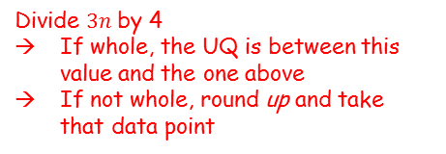
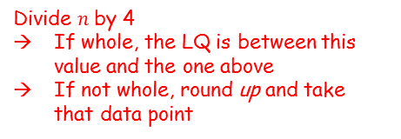


Measures of location and spread
You need to be able to calculate quartiles and percentiles of a data set
The way the quartiles are calculated depends on whether the data is discrete or continuous…
 | Lower Quartile | Upper Quartile
Discrete
Continuous
Divide $n$ by 4
If whole, the LQ is between this value and the one above
If not whole, round up and take that data point
Divide $3n$ by 4
If whole, the UQ is between this value and the one above
If not whole, round up and take that data point
Divide $n$ by 4 and take that data point
Divide $3n$ by 4 and take that data point
2C

Slide 4





Measures of location and spread
You need to be able to calculate quartiles and percentiles of a data set
From the large data set, the daily maximum gust (knots) during the first 20 days of June 2015 is recorded in Hurn. The data is shown below:
Find the median and quartiles for this data.
$Q_{2}=\frac{n+1}{2}th$ value
There are 20 values
$$Q_{2}=\frac{20+1}{2}$$
Calculate
$Q_{2}=10.5th$ value
Find this value
$$Q_{2}=22.5$$
14 | 15 | 17 | 17 | 18
18 | 19 | 19 | 22 | 22
23 | 23 | 23 | 24 | 25
26 | 27 | 28 | 36 | 39
Note that we treat this as discrete data since we have all the actual values!
$$Q_{2}=22.5$$
2C

Slide 5












Measures of location and spread
You need to be able to calculate quartiles and percentiles of a data set
From the large data set, the daily maximum gust (knots) during the first 20 days of June 2015 is recorded in Hurn. The data is shown below:
Find the median and quartiles for this data.
→ The data is discrete
For $Q_{1}$
$$\frac{n}{4}$$
$$\frac{20}{4}$$
$$=5$$
14 | 15 | 17 | 17 | 18
18 | 19 | 19 | 22 | 22
23 | 23 | 23 | 24 | 25
26 | 27 | 28 | 36 | 39
→ So take the 5.5th value
$$Q_{1}=18$$
For $Q_{3}$
$$\frac{3n}{4}$$
$$\frac{60}{4}$$
$$=15$$
→ So take the 15.5th value
$$Q_{1}=18$$
$$Q_{2}=22.5$$
$$Q_{3}=25.5$$
$$Q_{3}=25.5$$
2C

Slide 6



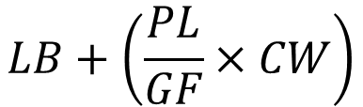

Measures of location and spread
$$LB+\left(\frac{PL}{GF}×CW\right)$$
You need to be able to calculate quartiles and percentiles of a data set
The length of time (to the nearest minute) spent on the internet each evening by a group of students is shown in the table below.
Find an estimate for the upper quartile
Find an estimate for the 10th percentile
→ The data is continuous
$$\frac{3n}{4}$$
$$\frac{210}{4}$$
$=52.5th$ value
→ Find the group that this is in, and use linear interpolation to estimate the median…
Time spent on internet (mins) | Frequency
30-31 | 2
32-33 | 25
34-36 | 30
37-39 | 13
→ You can use this formula:
2
Places into group
27
57
$$LB+\left(\frac{PL}{GF}×CW\right)$$
Lower boundary of the group
Classwidth of the group
Group Frequency
2C

Slide 7


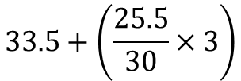

Measures of location and spread
$$LB+\left(\frac{PL}{GF}×CW\right)$$
The value is 25.5 places into the group (it is the 52.5th value, and we have already had 27 before the group started)
You need to be able to calculate quartiles and percentiles of a data set
The length of time (to the nearest minute) spent on the internet each evening by a group of students is shown in the table below.
Find an estimate for the upper quartile
Find an estimate for the 10th percentile
$$LB+\left(\frac{PL}{GF}×CW\right)$$
→ Remember for continuous data, you will need to use 33.5 and 36.5 as the class boundaries
$$33.5+\left(\frac{25.5}{30}×3\right)$$
Calculate
Time spent in internet (mins) | Frequency
30-31 | 2
32-33 | 25
34-36 | 30
37-39 | 13
$$=36.05$$
2
27
57
$=52.5th$ value
2C

Slide 8




Measures of location and spread
$$LB+\left(\frac{PL}{GF}×CW\right)$$
You need to be able to calculate quartiles and percentiles of a data set
The length of time (to the nearest minute) spent on the internet each evening by a group of students is shown in the table below.
Find an estimate for the upper quartile
Find an estimate for the 10th percentile
→ The data is continuous
→ The 10th percentile is calculated as follows
$$\frac{10n}{100}$$
$$\frac{700}{100}$$
$=7th$ value
Time spent in internet (mins) | Frequency
30-31 | 2
32-33 | 25
34-36 | 30
37-39 | 13
→ Find the group that this is in, and use linear interpolation to estimate it…
2
27
$$=36.05$$
2C

Slide 9

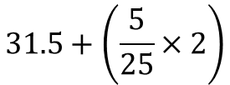
Measures of location and spread
$$LB+\left(\frac{PL}{GF}×CW\right)$$
The value is 5 places into the group (it is the 7th value, and we have already had 2 before the group started)
You need to be able to calculate quartiles and percentiles of a data set
The length of time (to the nearest minute) spent on the internet each evening by a group of students is shown in the table below.
Find an estimate for the upper quartile
Find an estimate for the 10th percentile
$$LB+\left(\frac{PL}{GF}×CW\right)$$
→ Remember for continuous data, you will need to use 31.5 and 33.5 as the class boundaries
$$31.5+\left(\frac{5}{25}×2\right)$$
Calculate
Time spent in internet (mins) | Frequency
30-31 | 2
32-33 | 25
34-36 | 30
37-39 | 13
$$P_{10}=31.9$$
2
27
This notation is usually used for the 10th percentile
$$=36.05$$
2C

