Slide 1
Composite functions (2.3)

Slide 2
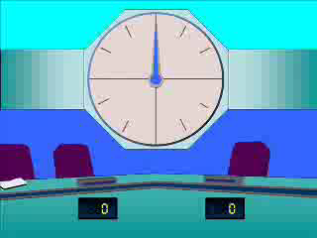
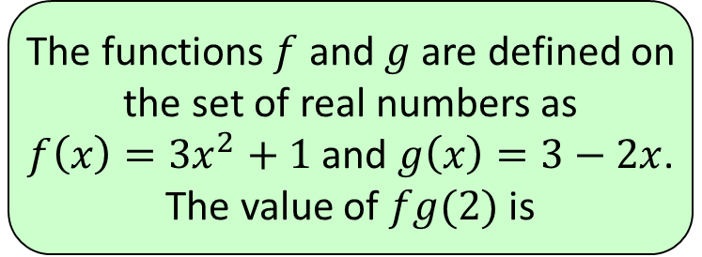
1
The functions $f$ and $g$ are defined on
the set of real numbers as
$f\left(x\right)=3x^{2}+1$ and $g\left(x\right)=3−2x$.
The value of $fg(2)$ is
a) $−2$
b) $−23$
c) $4$
d) $148$

Slide 3
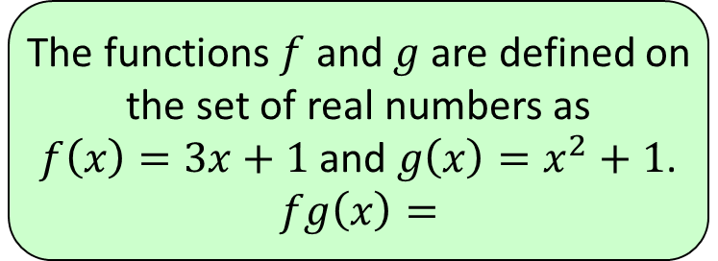
2
The functions $f$ and $g$ are defined on
the set of real numbers as
$f\left(x\right)=3x+1$ and $g\left(x\right)=x^{2}+1$.
$$fg\left(x\right)=$$
a) $3x^{2}+4$
b) $3x^{2}+2$
c) $9x^{2}+6x+2$
d) $3x^{3}+x^{2}+3x+1$

Slide 4
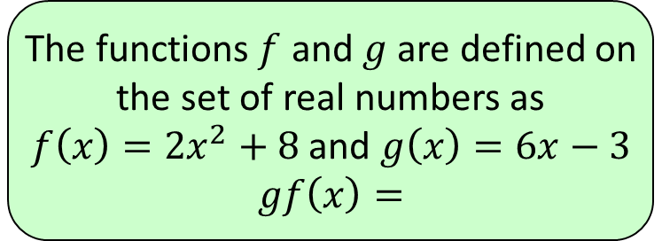
3
The functions $f$ and $g$ are defined on
the set of real numbers as
$f\left(x\right)=2x^{2}+8$ and $g\left(x\right)=6x−3$
$$gf\left(x\right)=$$
a) $12x^{2}+45$
b) $12x^{2}+24$
c) $12x^{2}−24$
d) $72x^{2}−72x+26$

