Slide 1
Functions and mappings (2.2)

Slide 2
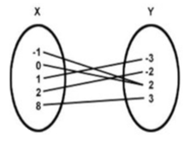
1
The diagram shows what type of
mapping?
a) One to one
b) One to many
c) Many to one
d) Many to many

Slide 3
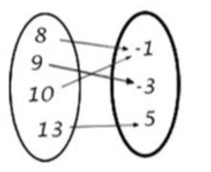
2
The diagram shows what type of
mapping?
a) One to one
b) One to many
c) Many to one
d) Many to many

Slide 4
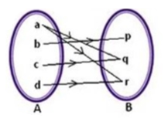
3
The diagram shows what type of
mapping?
a) One to one
b) One to many
c) Many to one
d) Many to many

Slide 5
4
A function $f$ is defined by
$f\left(x\right)=5+2cos⁡(3x)$, where $x∈ℝ$.
What is the range of $f$?
a) $3≤f\left(x\right)≤7$
b) $5≤f\left(x\right)≤7$
c) $5≤f\left(x\right)≤11$
d) $−1≤f\left(x\right)≤11$

Slide 6
5
For which real values of $x$ is the
function $f\left(x\right)=\frac{1}{\sqrt{1−x^{2}}}$ defined on
the set of real numbers?
a) All $x$ except $1$ and $−1$
b) $x<1$ only
c) $x>1, x<−1$ only
d) $−1<x<1$ only

Slide 7
6
A function $f$ is defined by
$f\left(x\right)=\sqrt{9−x^{2}}$. What is a
suitable domain for $f$?
a) $x≥3$
b) $−3≤x<3$
c) $x≤3$
d) $−9≤x≤9$

Slide 8
7
For which real values of $x$ is the
function $f\left(x\right)=\frac{6x}{x^{2}+6x−16}$ not defined
on the set of real numbers?
a) $x≠−8$ or $x≠2$
b) $x≠−4$ or $x≠4$
c) $x≠0$
d) $x≠10$ or $x≠16$

Slide 9
8
The greatest value which the function
$f\left(x\right)=(3{\sin^{2}\left(10x+9\right)−7)}^{2}, x∈ℝ$,
takes is equal to
a) $−9$
b) $16$
c) $49$
d) $100$

Slide 10
9
A function $f$ is given by
$f\left(x\right){=\left(x−2\right)}^{2}−3$.
The function $g$ is given by $g\left(x\right)=\frac{1}{f\left(x\right)+10}$
Which of the following statements about
the stationary value of g is true?
a) Min value of $g$ is $7$
b) Max value of $g$ is $7$
c) Min value of $g$ is $\frac{1}{7}$
d) Max value of $g$ is $\frac{1}{7}$

