Slide 1
Teachings for
Exercise 2B

Slide 2
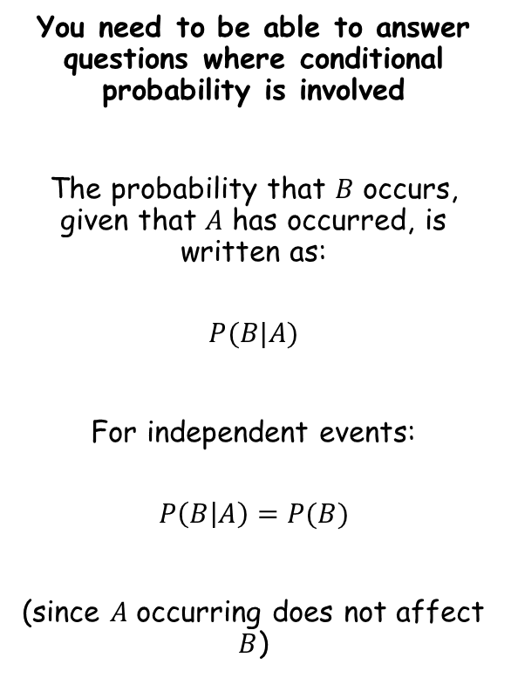
Conditional Probability
You need to be able to answer questions where conditional probability is involved
The probability that $B$ occurs, given that $A$ has occurred, is written as:
$$P(B|A)$$
For independent events:
$$P\left(B | A\right)=P(B)$$
(since $A$ occurring does not affect $B$)
2B

Slide 3
Conditional Probability
You need to be able to answer questions where conditional probability is involved
A school has 75 students in year 12. Of these students, 25 study only humanities subjects (H), and 37 only study science subjects (S). 11 students study both types of subject.
a) Draw a two-way table to show this information
H
H’
Total
S
11
37
48
S’
25
2
27
Total
36
39
75
2B

Slide 4
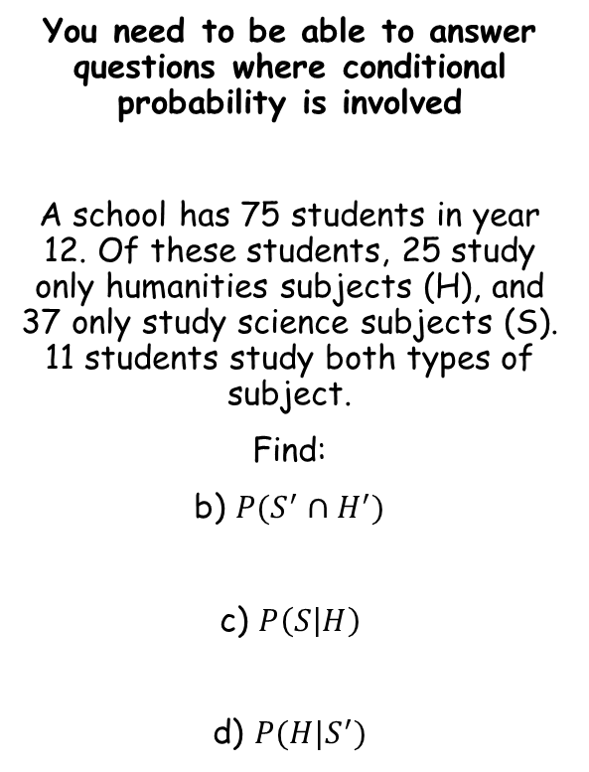
Conditional Probability
You need to be able to answer questions where conditional probability is involved
A school has 75 students in year 12. Of these students, 25 study only humanities subjects (H), and 37 only study science subjects (S). 11 students study both types of subject.
Find:
b) $P(S^{′}∩H^{′})$
c) $P\left(S | H\right)$
d) $P(H|S^{′})$
H
H’
Total
S
11
37
48
S’
25
2
27
Total
36
39
75
The probability of the student studying sciences, given that we know they study humanities
The effect here is that we are not considering all 75 students
Since we know that the student is studying humanities, we are only considering that group
11 students out of these 36 study sciences
So the probability of a student studying sciences, given that they study humanities as well, is $\frac{11}{36}$
$$=\frac{2}{75}$$
2B

Slide 5
Conditional Probability
You need to be able to answer questions where conditional probability is involved
A school has 75 students in year 12. Of these students, 25 study only humanities subjects (H), and 37 only study science subjects (S). 11 students study both types of subject.
Find:
b) $P(S^{′}∩H^{′})$
c) $P\left(S | H\right)$
d) $P(H|S^{′})$
H
H’
Total
S
11
37
48
S’
25
2
27
Total
36
39
75
The probability of the student studying humanities, given that we know they do not study sciences
The effect here is that we are not considering all 75 students
Since we know that the student is not studying sciences, we are only considering that group
25 students out of these 27 study humanities
So the probability of a student studying humanities, given that they do not study sciences, is $\frac{25}{27}$
$$=\frac{2}{75}$$
$$=\frac{11}{36}$$
2B

Slide 6
Conditional Probability
Dice 1
You need to be able to answer questions where conditional probability is involved
Two four sided dice are thrown together, and the sum of the numbers shown is recorded.
Draw a sample space diagram showing the possible outcomes
Given that at least one dice lands on a 3, find the probability that the sum of the two dice is exactly 5
 | 1 | 2 | 3 | 4
1 | 2 | 3 | 4 | 5
2 | 3 | 4 | 5 | 6
3 | 4 | 5 | 6 | 7
4 | 5 | 6 | 7 | 8
Dice 2
We are only considering the pairs where at least one dice is showing a 3
In total, there are 7 combinations (be careful not to count the (3,3) combination twice!
Of these, 2 have a total of exactly 5
Therefore, the probability of the sum being exactly 5, given that at least one of the dice lands on a 3, is $\frac{2}{7}$
2B

Slide 7
Conditional Probability
Dice 1
You need to be able to answer questions where conditional probability is involved
Two four sided dice are thrown together, and the sum of the numbers shown is recorded.
c) State one modelling assumption used in your calculations
That both dice are unbiased which means the outcomes are all equally likely
 | 1 | 2 | 3 | 4
1 | 2 | 3 | 4 | 5
2 | 3 | 4 | 5 | 6
3 | 4 | 5 | 6 | 7
4 | 5 | 6 | 7 | 8
Dice 2
2B

