Slide 1
Statistics
Measures of
location and spread
Twitter: @Owen134866
www.mathsfreeresourcelibrary.com

Slide 2
Prior Knowledge Check
1) State whether each variable is qualitative or quantitative:
Car colour
Miles travelled by a cyclist
Favourite pet
Number of siblings
2) State whether each of these variables is discrete or continuous
Number of pets owned
Distance walked by hikers
Fuel consumption of lorries
Number of peas in a pod
Times taken by a group of athletes to run 1500m.
3) Calculate the 3 averages and range for the data set below:
Qualitative
Quantitative
Peas in a pod | 3 | 4 | 5 | 6 | 7
Frequency | 4 | 7 | 11 | 18 | 6
Qualitative
Quantitative
Mean 5.33
Median 6
Mode 6
Range 4
Discrete
Continuous
Continuous
Discrete
Continuous

Slide 3
Teachings for
Exercise 2A and 2B

Slide 4
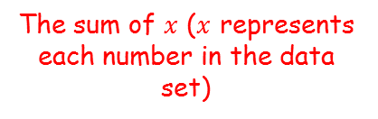

Measures of location and spread
A measure of location is a single value which is used to represent a set of data. Examples include the mean, median and mode
These can also be known as ‘measures of central tendency’
The mode or modal class is the value or class with the highest frequency
The median is the middle value when the data is put into ascending (or descending) order
The mean is calculated using the formula:
The sum of $x$ ($x$ represents each number in the data set)
The mean, ‘x-bar’
$$\overline{x}=\frac{\sum{x}}{n}$$
You need to start using ‘proper’ notation!
The number of ‘bits’ of data
2A/B

Slide 5


Measures of location and spread
$$\overline{x}=\frac{\sum{x}}{n}$$
A measure of location is a single value which is used to represent a set of data. Examples include the mean, median and mode
The mean of a sample of 25 observations is 6.4. The mean of a second sample of 30 observations is 7.2. Calculate the mean of all 55 observations.
$$\frac{6.4+7.2}{2}$$
Why is this calculation wrong?
Each data set has a different quantity
→ The mean will be ‘weighted’ towards the data set with the higher quantity
2A/B

Slide 6









Measures of location and spread
$$\overline{x}=\frac{\sum{x}}{n}$$
Sample 1
Sample 2
A measure of location is a single value which is used to represent a set of data. Examples include the mean, median and mode
The mean of a sample of 25 observations is 6.4. The mean of a second sample of 30 observations of 7.2. Calculate the mean of all 55 observations.
$$6.4=\frac{\sum{x}}{25}$$
$$7.2=\frac{\sum{x}}{30}$$
Multiply by 25
Multiply by 30
$$\frac{\sum{x}}{}$$
$$=160$$
$$\frac{\sum{x}}{}$$
$$=216$$
So the total sum of the data is 376
→ There were 55 ‘bits’ of data in total
$$\overline{x}=\frac{\sum{x}}{n}$$
Sub in values
$$\overline{x}=\frac{376}{55}$$
Sub in values
$$\overline{x}=6.84$$
2A/B

Slide 7
Measures of location and spread
$$\overline{x}=\frac{\sum{x}}{n}$$
A measure of location is a single value which is used to represent a set of data. Examples include the mean, median and mode
You will need to decide which is the best average to use depending on the situation…
Mode
Median
Mean
→ The mode is used for qualitative data, or where the data has a single mode or two modes (bi-modal)
→ This is used for quantitative data, and is usually used when the data has some extreme values (since this will not affect the median too much)
→ The mean is used for quantitative data and uses all data in a set. It therefore gives a true measure, but can be skewed by extreme values
2A/B

Slide 8


Measures of location and spread
$$\overline{x}=\frac{\sum{x}}{n}$$
$$\overline{x}=\frac{\sum{fx}}{\sum{f}}$$
A measure of location is a single value which is used to represent a set of data. Examples include the mean, median and mode
For data given in a frequency table, you can calculate the mean by using the formula below:
The sum of the products of the data values and their frequencies
$$\overline{x}=\frac{\sum{fx}}{\sum{f}}$$
The sum of the frequencies
2A/B

Slide 9










Measures of location and spread
$$\overline{x}=\frac{\sum{x}}{n}$$
$$\overline{x}=\frac{\sum{fx}}{\sum{f}}$$
A measure of location is a single value which is used to represent a set of data. Examples include the mean, median and mode
Rebecca records the shirt collar size, x, of the male students in her year. The results are shown in the table.
For the data, calculate:
The mode
The median
The mean
Explain why a shirt manufacturer might use the mode for setting their production quota
$$x$$
$$f$$
Collar Size | Number of Students
15 | 3
15.5 | 17
16 | 29
16.5 | 34
17 | 12
$$3$$
$$20$$
$$49$$
$$\sum{f}=95$$
$$=16.5$$
$$=16$$
$$\frac{95+1}{2}$$
$$=48th$$
The median is the 48th value
Add the frequencies up until you get beyond this value
So the median must be 16 as it is in that group
2A/B

Slide 10












Measures of location and spread
$$\overline{x}=\frac{\sum{x}}{n}$$
$$\overline{x}=\frac{\sum{fx}}{\sum{f}}$$
A measure of location is a single value which is used to represent a set of data. Examples include the mean, median and mode
Rebecca records the shirt collar size, x, of the male students in her year. The results are shown in the table.
For the data, calculate:
The mode
The median
The mean
Explain why a shirt manufacturer might use the mode for setting their production quota
$$x$$
$$f$$
$$fx$$
Collar Size | Number of Students
15 | 3
15.5 | 17
16 | 29
16.5 | 34
17 | 12
$$45$$
$$263.5$$
$$464$$
$$561$$
$$204$$
$$\sum{f}=95$$
$$\sum{fx}=1537.5$$
$$=16.5$$
$$=16$$
$$\overline{x}=\frac{\sum{fx}}{\sum{f}}$$
$$=16.2$$
Sub in values
$$\overline{x}=\frac{1537.5}{95}$$
Calculate
$$\overline{x}=16.2$$
2A/B

Slide 11
Measures of location and spread
$$\overline{x}=\frac{\sum{x}}{n}$$
$$\overline{x}=\frac{\sum{fx}}{\sum{f}}$$
A measure of location is a single value which is used to represent a set of data. Examples include the mean, median and mode
Rebecca records the shirt collar size, x, of the male students in her year. The results are shown in the table.
For the data, calculate:
The mode
The median
The mean
Explain why a shirt manufacturer might use the mode for setting their production quota
$$x$$
$$f$$
$$fx$$
Collar Size | Number of Students
15 | 3
15.5 | 17
16 | 29
16.5 | 34
17 | 12
$$45$$
$$263.5$$
$$464$$
$$561$$
$$204$$
$$\sum{f}=95$$
$$\sum{fx}=1537.5$$
$$=16.5$$
$$=16$$
$$=16.2$$
The mode is in this case more useful as it tells the manufacturer what size shirt it needs to produce the most of
2A/B

Slide 12




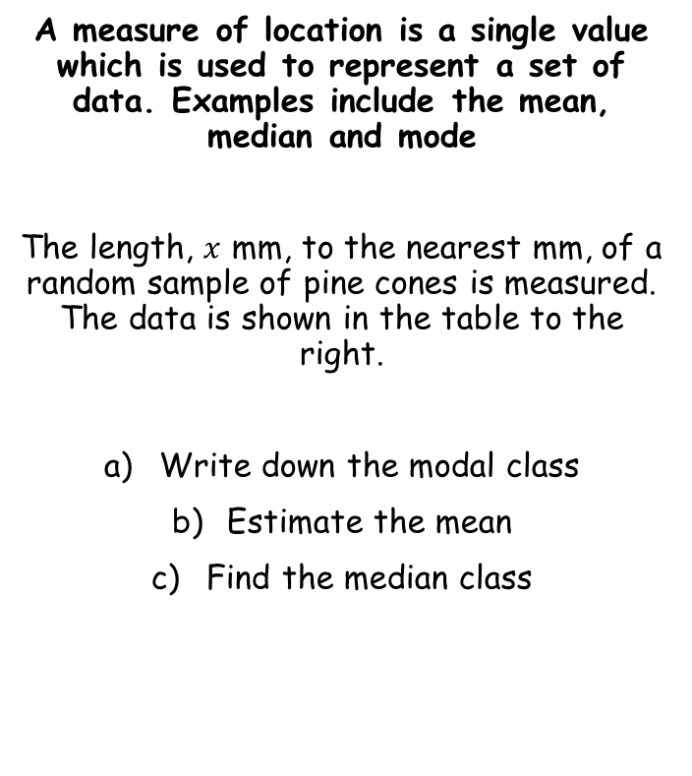








Measures of location and spread
$$\overline{x}=\frac{\sum{x}}{n}$$
$$\overline{x}=\frac{\sum{fx}}{\sum{f}}$$
$$x$$
$$f$$
$$fx$$
A measure of location is a single value which is used to represent a set of data. Examples include the mean, median and mode
The length, $x$ mm, to the nearest mm, of a random sample of pine cones is measured. The data is shown in the table to the right.
Write down the modal class
Estimate the mean
Find the median class
Cone length (mm) | Frequency
30-31 | 2
32-33 | 25
34-36 | 30
37-39 | 13
$$61$$
30.5
32.5
$$812.5$$
35
$$1050$$
38
$$494$$
$$\sum{f}=70$$
$$\sum{fx}=2417.5$$
34-36
To calculate the mean from a grouped table you need to use the midpoint of each group
34.5
$$\overline{x}=\frac{\sum{fx}}{\sum{f}}$$
Sub in values
$$\overline{x}=\frac{2417.5}{70}$$
Calculate
$$\overline{x}=34.5$$
2A/B

Slide 13


Measures of location and spread
$$\overline{x}=\frac{\sum{x}}{n}$$
$$\overline{x}=\frac{\sum{fx}}{\sum{f}}$$
$$x$$
$$f$$
A measure of location is a single value which is used to represent a set of data. Examples include the mean, median and mode
The length, $x$ mm, to the nearest mm, of a random sample of pine cones is measured. The data is shown in the table to the right.
Write down the modal class
Estimate the mean
Find the median class
Cone length (mm) | Frequency
30-31 | 2
32-33 | 25
34-36 | 30
37-39 | 13
2
27
57
$$\sum{f}=70$$
34-36
34.5
$$\frac{70+1}{2}$$
34-36
$$=35.5th$$
The median is the 35.5th value
Add the frequencies up until you get beyond this value
So the median class is 34-36
2A/B

