Slide 1
The modulus function (2.1)

Slide 2
1
What is the equation of this graph?
a) $y=\left|x−1\right|$
b) $y=\left|x\right|−1$
c) $y=\left|x+1\right|$
d) $y=\left|x\right|+1$

Slide 3
2
What is the equation of this graph?
a) $y=\left|x−1\right|$
b) $y=\left|x\right|−1$
c) $y=\left|x+1\right|$
d) $y=\left|x\right|+1$

Slide 4
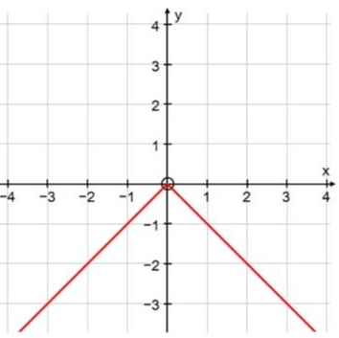
3
What is the equation of this graph?
a) $y=\left|x\right|$
b) $y^{2}=x$
c) $y=−\left|x\right|$
d) $y=\left|−x\right|$

Slide 5
4
Solve $\left|4x−3\right|=2−x$
a) $x=1$
b) $x=\frac{1}{3}$
c) $x=\frac{1}{3}$ , $x=1$
d)$x=\frac{1}{5}$ , $x=\frac{5}{3}$

Slide 6
5
Solve $\left|3x+1\right|<3$
a) $0<x<\frac{2}{3}$
b) $−\frac{4}{3}<x<\frac{2}{3}$
c) $0≤x≤\frac{2}{3}$
d) $−\frac{4}{3}≤x≤\frac{2}{3}$

Slide 7
6
Solve $\left|x−3\right|<−4$
a) $x<−1$
b) No solution
c) $x<−1, x>7$
d) $−1≤x≤7$

Slide 8
7
Solve $\left|4x−3\right|=\left|2−x\right|$
a) $x=1$
b) $x=\frac{1}{3}$
c) $x=\frac{1}{3} , x=1$
d) $x=\frac{1}{5} , x=\frac{5}{3}$

