Slide 1
Statistics
Conditional
Probability
Twitter: @Owen134866
www.mathsfreeresourcelibrary.com

Slide 2
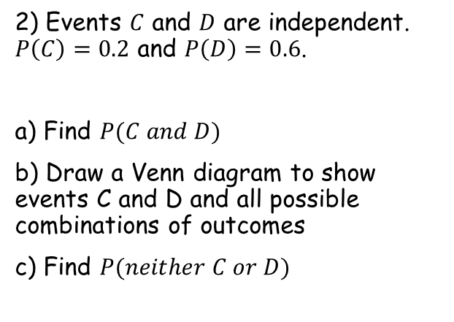
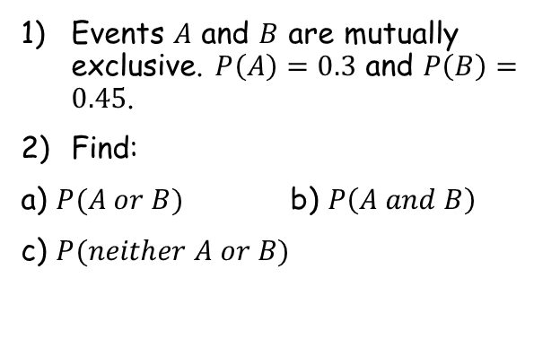


Prior knowledge check
Events $A$ and $B$ are mutually exclusive. $P\left(A\right)=0.3$ and $P\left(B\right)=0.45$.
Find:
a) $P(A or B)$ b) $P\left(A and B\right)$
c) $P(neither A or B)$
3) A bag contains seven counters numbered 1-7. Two counters are selected at random without replacement. Find the probability that:
Both counters are odd-numbered
At least one counter is odd numbered
0.75
0
$$\frac{2}{7}$$
0.25
$$\frac{6}{7}$$
2) Events $C$ and $D$ are independent. $P\left(C\right)=0.2$ and $P\left(D\right)=0.6$.
a) Find $P(C and D)$
b) Draw a Venn diagram to show events C and D and all possible combinations of outcomes
c) Find $P(neither C or D)$
C
D
0.12
0.08
0.12
0.48
0.32
0.32

Slide 3
Teachings for
Exercise 2A

Slide 4



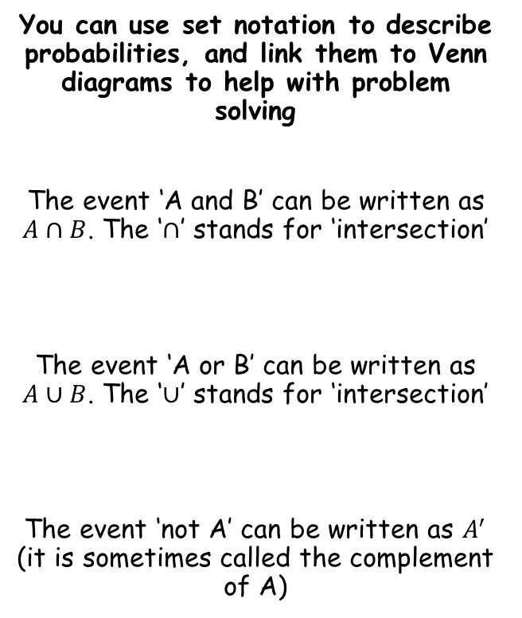






Conditional Probability
You can use set notation to describe probabilities, and link them to Venn diagrams to help with problem solving
The event ‘A and B’ can be written as $A∩B$. The ‘$∩$’ stands for ‘intersection’
The event ‘A or B’ can be written as $A∪B$. The ‘$∪$’ stands for ‘intersection’
The event ‘not A’ can be written as $A^{′}$ (it is sometimes called the complement of A)
$$A$$
$$B$$
$$A∩B$$
$$A$$
$$B$$
$$A∪B$$
$$A$$
$$B$$
$$A′$$
2A

Slide 5


Conditional Probability
You can use set notation to describe probabilities, and link them to Venn diagrams to help with problem solving
A card is selected at random from a standard pack of playing cards. Let A be the event that the card is an Ace, and D be the event that the card is a diamond.
a) Draw a Venn diagram to represent this information.
$$A$$
$$D$$
3
1
12
36
There is one card that is both an ace and a diamond
There are 3 aces that are not diamonds
There are 12 diamonds that are not aces
After this, 36 cards remain that are neither aces or diamonds
2A

Slide 6


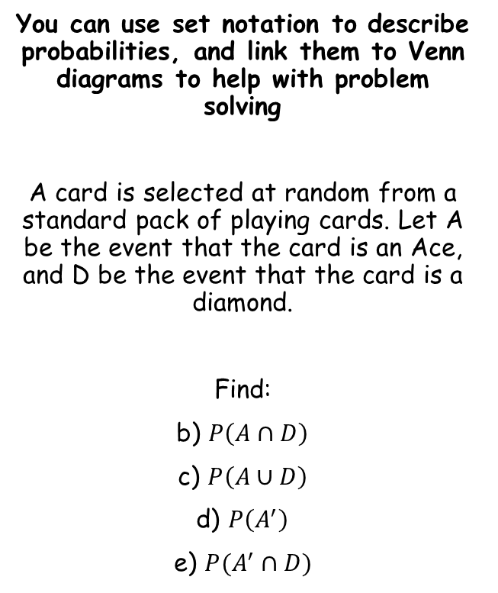





Conditional Probability
You can use set notation to describe probabilities, and link them to Venn diagrams to help with problem solving
A card is selected at random from a standard pack of playing cards. Let A be the event that the card is an Ace, and D be the event that the card is a diamond.
Find:
b) $P\left(A∩D\right)$
c) $P\left(A∪D\right)$
d) $P\left(A^{′}\right)$
e) $P(A^{′}∩D)$
$$A$$
$$D$$
3
1
12
36
‘Probability of the card being an ace and a diamond’
$$=\frac{1}{52}$$
‘Probability of the card being an ace or a diamond’
$$=\frac{16}{52}$$
$$=\frac{4}{13}$$
‘Probability of the card not being an ace’
$$=\frac{48}{52}$$
$$=\frac{12}{13}$$
‘Probability of the card not being an ace, and being a diamond’
$$=\frac{12}{52}$$
$$=\frac{3}{13}$$
2A

Slide 7

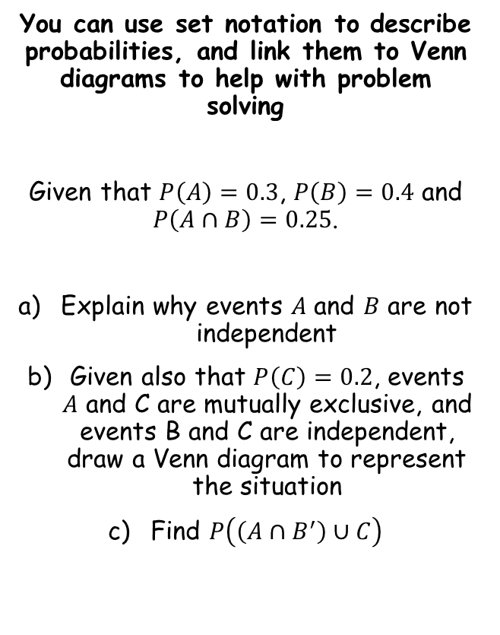
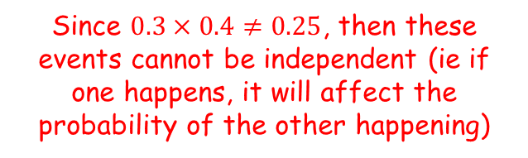
Conditional Probability
You can use set notation to describe probabilities, and link them to Venn diagrams to help with problem solving
Given that $P\left(A\right)=0.3$, $P\left(B\right)=0.4$ and $P\left(A∩B\right)=0.25$.
Explain why events $A$ and $B$ are not independent
Given also that $P\left(C\right)=0.2$, events $A$ and C are mutually exclusive, and events B and C are independent, draw a Venn diagram to represent the situation
Find $P\left(\left(A∩B^{′}\right)∪C\right)$
If the events are independent, then $P\left(A\right)×P\left(B\right)=P(A∩B)$
Since $0.3×0.4≠0.25$, then these events cannot be independent (ie if one happens, it will affect the probability of the other happening)
2A

Slide 8






Conditional Probability
$$B$$
0.43
You can use set notation to describe probabilities, and link them to Venn diagrams to help with problem solving
Given that $P\left(A\right)=0.3$, $P\left(B\right)=0.4$ and $P\left(A∩B\right)=0.25$.
Explain why events $A$ and $B$ are not independent
Given also that $P\left(C\right)=0.2$, events $A$ and C are mutually exclusive, and events B and C are independent, draw a Venn diagram to represent the situation
Find $P\left(\left(A∩B^{′}\right)∪C\right)$
$$A$$
$$C$$
0.05
0.25
0.08
0.12
0.07
→ As $A$ and $C$ are mutually exclusive, they do not overlap
→ $P\left(A∩B\right)=0.25$
Since $P\left(A\right)=0.3$, the probability of only $A$ = 0.05
As $B$ and $C$ are independent, $P\left(B\right)×P\left(C\right)=P(B∩C)$ (0.4x0.2=0.08)
Since $P\left(C\right)=0.2$, the probability of only $C$ = 0.12
Since $P(B)=0.4$, the probability of only $B$ = 0.07
As they must total 1, the probability of none of these must equal 0.43
2A

Slide 9




Conditional Probability
$$B$$
0.43
You can use set notation to describe probabilities, and link them to Venn diagrams to help with problem solving
Given that $P\left(A\right)=0.3$, $P\left(B\right)=0.4$ and $P\left(A∩B\right)=0.25$.
Explain why events $A$ and $B$ are not independent
Given also that $P\left(C\right)=0.2$, events $A$ and C are mutually exclusive, and events B and C are independent, draw a Venn diagram to represent the situation
Find $P\left(\left(A∩B^{′}\right)∪C\right)$
$$A$$
$$C$$
0.05
0.25
0.08
0.12
0.07
$$A∩B^{′}$$
$$C$$
0.05
0.2
$$P\left(\left(A∩B^{′}\right)∪C\right)=0.25$$
The probability of ‘$A$ and not $B$’ or $C$
→ Highlight regions that satisfy each of these parts…
2A

