Slide 1
Teachings for Section 1F

Slide 2


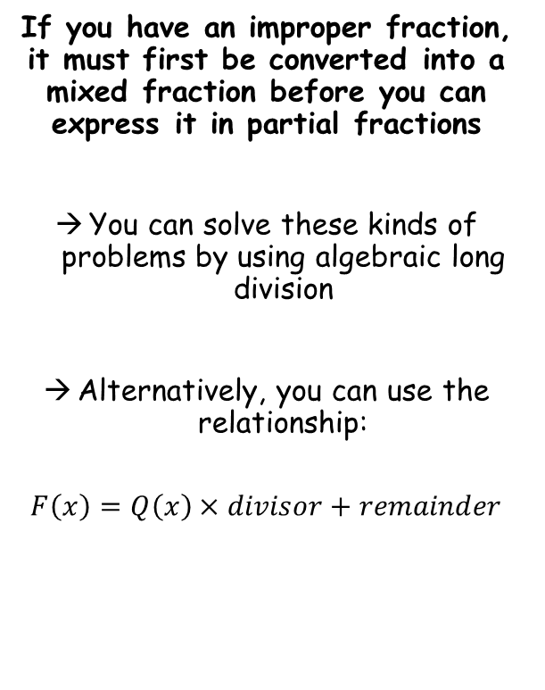







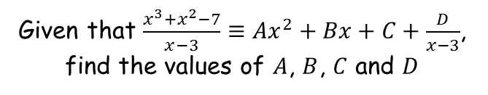





Algebraic Methods
Given that $\frac{x^{3}+x^{2}−7}{x−3}≡{Ax}^{2}+Bx+C+\frac{D}{x−3}$, find the values of $A$, $B$, $C$ and $D$
If you have an improper fraction, it must first be converted into a mixed fraction before you can express it in partial fractions
You can solve these kinds of problems by using algebraic long division
Alternatively, you can use the relationship:
$$F\left(x\right)=Q\left(x\right)×divisor+remainder$$
$$x^{2}$$
$$+ 4x$$
$$+ 12$$
$$x−3$$
$$x^{3}+x^{2}+0x−7$$
Using algebraic long division
$$x^{3}−3x^{2}$$
$${4x}^{2}+0x−7$$
$${4x}^{2}−12x$$
$$12x−7$$
$$12x−36$$
$$29$$
$$\frac{x^{3}+x^{2}−7}{x−3}≡x^{2}+4x+12 remainder 29$$
$$37=12 × 3 + 1$$
Write the remainder over the divisor (as you would if dividing with numbers)
$$\frac{x^{3}+x^{2}−7}{x−3}≡x^{2}+4x+12+\frac{29}{x−3}$$
1F

Slide 3


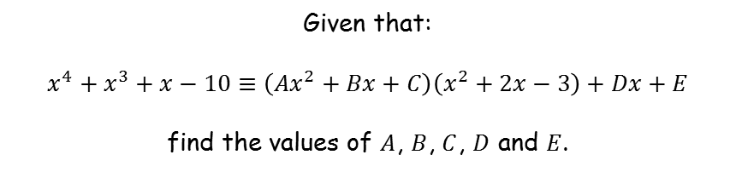












Algebraic Methods
Given that:
$$x^{4}+x^{3}+x−10≡\left({Ax}^{2}+Bx+C\right)\left(x^{2}+2x−3\right)+Dx+E$$
find the values of $A$, $B$, $C$, $D$ and $E$.
If you have an improper fraction, it must first be converted into a mixed fraction before you can express it in partial fractions
You can solve these kinds of problems by using algebraic long division
Alternatively, you can use the relationship:
$$F\left(x\right)=Q\left(x\right)×divisor+remainder$$
Compare $x^{4}$ terms
Compare $x^{3}$ terms
$$x^{4}=Ax^{4}$$
$$x^{3}=2x^{3}+Bx^{3}$$
$$A=1$$
$$B=−1$$
Updated relationship
$$x^{4}+x^{3}+x−10≡\left(x^{2}+Bx+C\right)\left(x^{2}+2x−3\right)+Dx+E$$
$$x^{4}+x^{3}+x−10≡\left(x^{2}−x+5\right)\left(x^{2}+2x−3\right)+Dx+E$$
$$x^{4}+x^{3}+x−10≡\left(x^{2}−x+C\right)\left(x^{2}+2x−3\right)+Dx+E$$
$$x^{4}+x^{3}+x−10≡\left(x^{2}−x+5\right)\left(x^{2}+2x−3\right)−12x+5$$
$$x^{4}+x^{3}+x−10≡\left(x^{2}−x+5\right)\left(x^{2}+2x−3\right)−12x+E$$
Compare $x^{2}$ terms
Compare $x$ terms
$${0x}^{2}=Cx^{2}−3x^{2}−2x^{2}$$
$$x=3x+10x+Dx$$
$$C=5$$
$$D=−12$$
Compare constant
$$−10=−15+E$$
$$E=5$$
1F

Slide 4
Teachings for Section 1G

Slide 5












Algebraic Methods
You can split an improper fraction into Partial Fractions. You will need to divide the numerator by the denominator first to find the ‘whole’ part
A regular fraction being split into 2 ‘components’
$$\frac{22}{35}$$
$$\frac{1}{5}$$
$$\frac{3}{7}$$
$$=$$
$$+$$
$$\frac{57}{20}$$
$$\frac{1}{4}$$
$$\frac{3}{5}$$
$$=$$
$$2$$
$$+$$
$$+$$
A top heavy (improper) fraction will have a ‘whole number part before the fractions
1G

Slide 6




























Algebraic Methods
$$\frac{3x^{2}−3x−2}{(x−1)(x−2)}$$
$$=$$
$$\frac{3x^{2}−3x−2}{x^{2}−3x+2}$$
You can split an improper fraction into Partial Fractions. You will need to divide the numerator by the denominator first to find the ‘whole’ part
Divide the numerator by the denominator to find the ‘whole’ part
$$3$$
$$x^{2}−3x+2$$
$${3x}^{2}−3x−2$$
Split
$${3x}^{2}−9x+6$$
$$\frac{3x^{2}−3x−2}{(x−1)(x−2)}$$
$$6x−8$$
Now rewrite the original fraction with the whole part taken out
$$\frac{3x^{2}−3x−2}{(x−1)(x−2)}$$
$$=$$
$$3 +$$
$$\frac{6x−8}{(x−1)(x−2)}$$
into Partial fractions
Split the fraction into 2 parts (ignore the whole part for now)
Remember, Algebraically an ‘improper’ fraction is one where the degree (power) of the numerator is equal to or exceeds that of the denominator
$$\frac{A}{(x−1)}$$
$$+$$
$$\frac{B}{(x−2)}$$
Make denominators equivalent and group up
$$=\frac{A\left(x−2\right)+B(x−1)}{(x−1)(x−2)}$$
The numerators will be the same
$$6x−8$$
$$=$$
$$A\left(x−2\right)+B(x−1)$$
If x = 2
$$4$$
$$=$$
$$B$$
If x = 1
$$−2$$
$$=$$
$$−A$$
$$2$$
$$=$$
$$A$$
$$= 3 +$$
$$\frac{2}{(x−1)}$$
$$+$$
$$\frac{4}{(x−2)}$$
1G

