Slide 1
Teachings for Exercise 1E

Slide 2
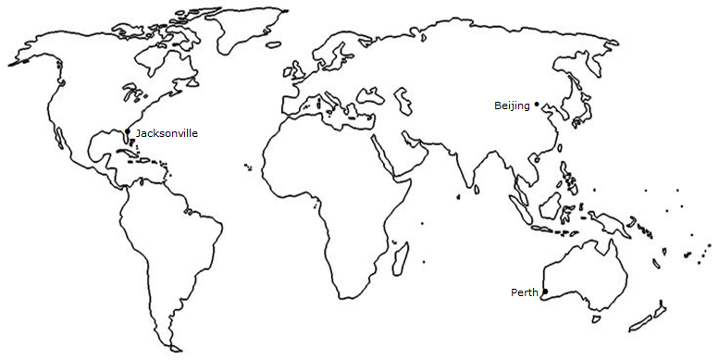
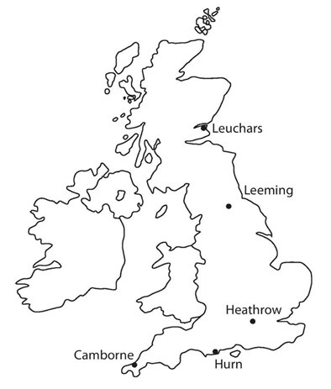
Data Collection
You need to be able to answer exam questions based on large amounts of real data that you will be given
The large data set contains information recorded over a number of years at weather stations around the world (as shown)
The data was recorded in both 1987 and 2015, and you will most likely be asked to draw comparisons between the two
You do not need to memorise the data, but being familiar with it and the locations shown will be useful
1E

Slide 3
Data Collection
Daily mean wind direction and windspeed
You need to be able to answer exam questions based on large amounts of real data that you will be given
The different sets of data recorded are as follows:
Daily mean cloud cover
→ This is measured in knots according to the beaufort scale (more on the next slide)
→ Measured in ‘oktas’, or eighths of the sky covered by cloud
Daily mean temperature
Daily maximum gust
Daily mean visibility
→ The mean temperature on that day
→ The highest instantaneous wind speed recorded, in knots
→ This is measured in decametres (Dm). The greatest distance at which an object can be seen in daylight
Daily total rainfall
The amount of rainfall that day (including snow or hail that has been melted)
Amounts less than 0.05mm are recorded as ‘tr’ (trace)
Daily maximum relative humidity
Daily mean pressure
→ This is a percentage of air saturation with water. Above 95% leads to mist/fog
→ Measured in hectopascals (1hPa = 100 Newtons per square metre)
Daily total sunshine
→ Recorded to the nearest tenth of an hour
1E

Slide 4
Data Collection
You need to be able to answer exam questions based on large amounts of real data that you will be given
Beaufort scale | Descriptive term | Average speed at 10metres above ground
0 | Calm | Less than 1 knot
1-3 | Light | 1-10 knots
4 | Moderate | 11-16 knots
5 | Fresh | 17-21 knots
1 knot is a ‘nautical mile per hour’, and is equivalent to 1.15mph
CLICK
1E

Slide 5
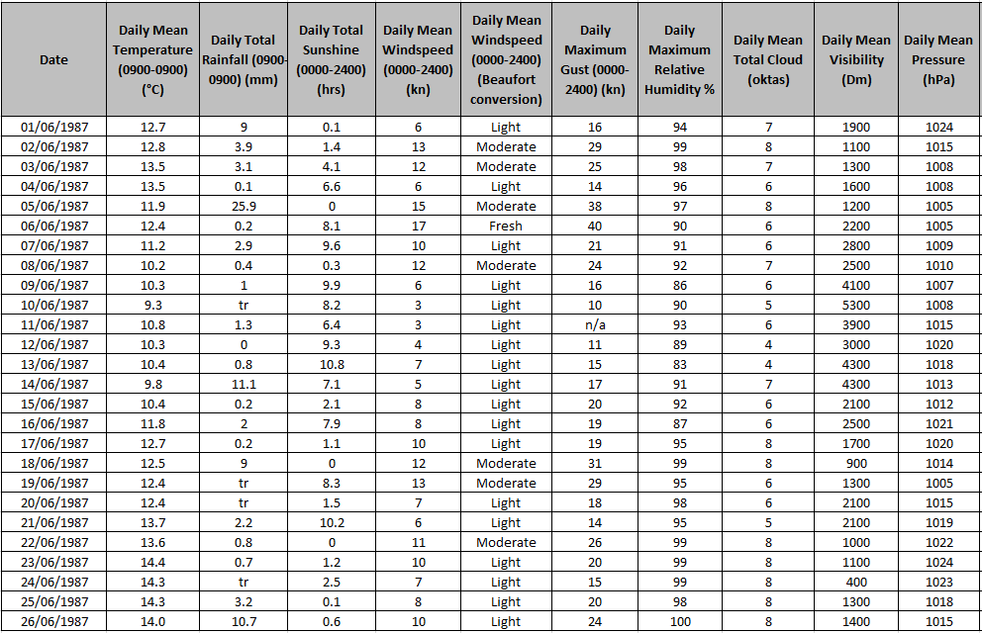
Data Collection
You need to be able to answer exam questions based on large amounts of real data that you will be given
Camborne
1E

Slide 6
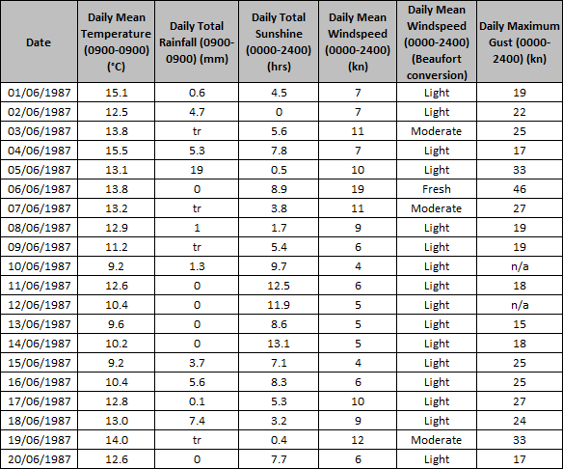
Data Collection
Hurn
You need to be able to answer exam questions based on large amounts of real data that you will be given
Look at the extract given to the right.
Describe the type of data represented by daily total rainfall
→ Continuous Quantitative Data
1E

Slide 7
Data Collection
Hurn
You need to be able to answer exam questions based on large amounts of real data that you will be given
Look at the extract given to the right.
Alison is investigating daily maximum gust. She wants to select a sample size of size 5 from the first 20 days in Hurn in June 1987. She uses the first two digits of the date as the sampling frame and generates 5 random numbers from 1-20
b) State the type of sampling method used
c) Why might the method not generate a sample of size 5?
Simple Random Sampling
Some of the values have n/a, meaning no data was recorded that day
1E

Slide 8
Data Collection
Hurn
You need to be able to answer exam questions based on large amounts of real data that you will be given
Using the extract to the right, calculate:
The mean daily mean temperature for the first 5 days of June in Hurn in 1987
The median daily total rainfall for the week of 14th June to 20th June inclusive
$$\frac{15.1+12.5+13.8+15.5+13.1}{5}$$
The table is to 1dp, so maintain this level of accuracy!
$$=14.0^{°}$$
$$0, 3.7, 5.6, 0.1, 7.4, tr, 0$$
Trace amount are slightly larger than 0
→ Treat them as 0 for any numerical calculations though!
$$0, 0, tr, 0.1, 3.7, 5.6, 7.4$$
$$Median=0.1$$
1E

Slide 9
Data Collection
Hurn
You need to be able to answer exam questions based on large amounts of real data that you will be given
b) The median daily total rainfall for the week of 14th June to 20th June inclusive
The median daily total rainfall for the same week in Perth was 19.0mm. Karl states that more southerly countries experience higher rainfall during June
c) State, with a reason, whether your answer to b) supports this statement
$$Median=0.1mm$$
Perth is in Australia, which is south of the UK, and its median rainfall was higher. However, taking a small sample from a single location is each country means there is not enough data to support the statement.
1E

