Slide 1
Partial fractions (1.3)

Slide 2
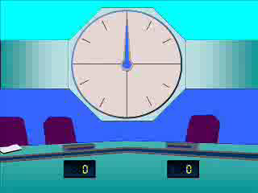
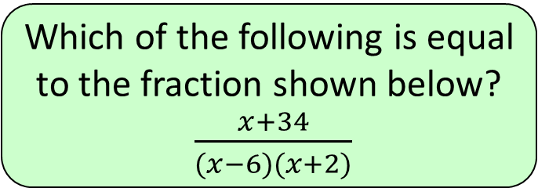
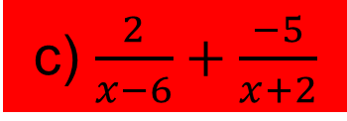

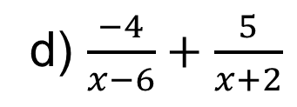
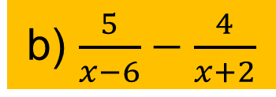
1
Which of the following is equal
to the fraction shown below?
$\frac{x+34}{(x−6)(x+2)}$
a) $\frac{5}{x−6}+\frac{2}{x+2}$
b) $\frac{5}{x−6}−\frac{4}{x+2}$
c) $\frac{2}{x−6}+\frac{−5}{x+2}$
d) $\frac{−4}{x−6}+\frac{5}{x+2}$

Slide 3
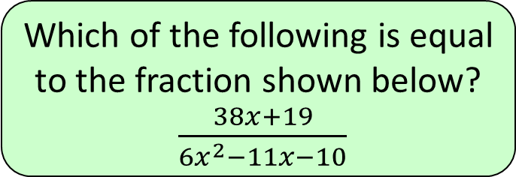
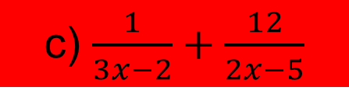
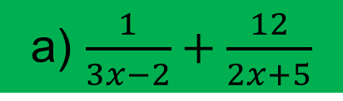
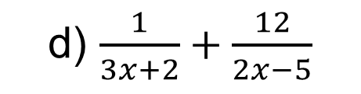
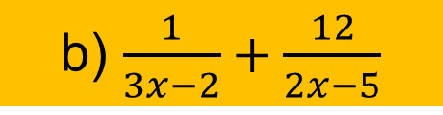
2
Which of the following is equal
to the fraction shown below?
$\frac{38x+19}{6x^{2}−11x−10}$
a) $\frac{1}{3x−2}+\frac{12}{2x+5}$
b) $\frac{1}{3x−2}+\frac{12}{2x−5}$
c) $\frac{1}{3x−2}+\frac{12}{2x−5}$
d) $\frac{1}{3x+2}+\frac{12}{2x−5}$

Slide 4
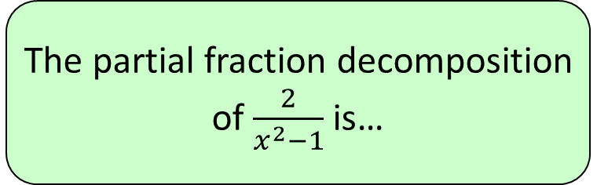
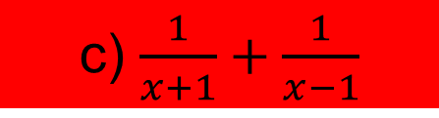
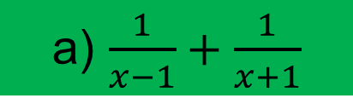
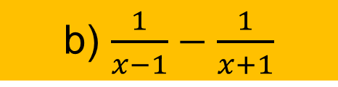
3
The partial fraction decomposition
of $\frac{2}{x^{2}−1}$ is…
a) $\frac{1}{x−1}+\frac{1}{x+1}$
b) $\frac{1}{x−1}−\frac{1}{x+1}$
c) $\frac{1}{x+1}+\frac{1}{x−1}$
d) ?

